Slide 1
A/B testing and personalization service (Adobe Target)
Principal Publisher

Slide 2
Overview
Principal Publisher Analytics Services team offers an A/B testing and personalization service
With the end of fiscal being near, it is time to confirm which institutions want to use the service in 2023-24
Institutions are asked to confirm interest by March 10
Email will be sent by end of week to all institutions formally asking for confirmation

Slide 3
Purpose of today's presentation
Existing client institutions
Reminder to renew for the 2023-24 fiscal year
Our current service agreement with you is ending on March 10
New client institutions
Introduce you to our service
Answer any questions you might have
Invite you to take advantage of the service

Slide 4
Outline
What is A/B testing and personalization?
Why should this matter to you?
About Adobe Target
Getting access to Adobe Target

Slide 5
What is A/B testing and personalization?

Slide 6
What is A/B testing?
A/B testing is a method where two or more variations of content are randomly shown to visitors in order to determine which variation performs best
What can you test?
Anything on a page! Design, layout, titles/headings, images, text, calls to action, buttons, links, etc.

Slide 7
How A/B testing works
Web traffic is randomly allocated between the variations during the same time period to avoid the influence of external factors (e.g. media/news).
A
50%
50%
B

Slide 8
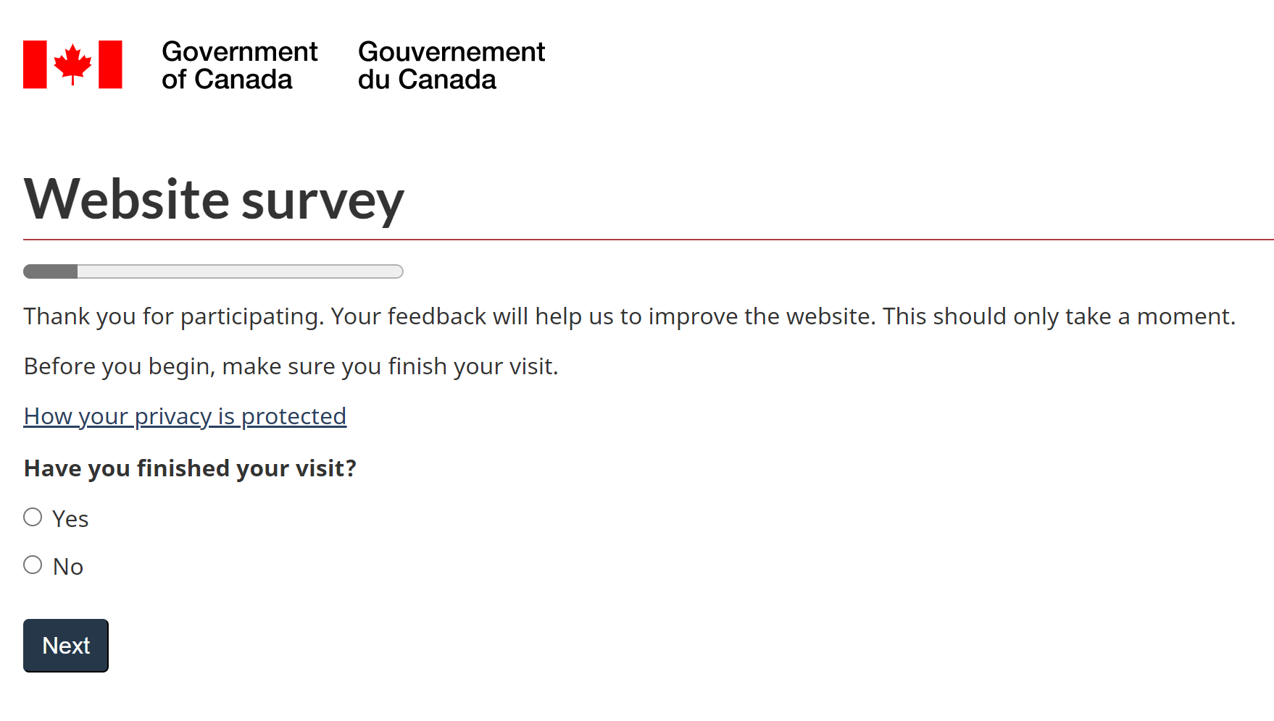
A/B testing example: GC Task Success Survey
Ran 7 tests (some with several iterations) to improve the design of the survey
Experimented with the invite, wording of questions, a progress bar, etc.
Some tests resulted in changes to the survey design, some didn't; in all tests, knowledge was gained
Large increase in participation and completion rate, increase in visitor comments
Similar experimentation can be explored for online processes / funnels across the GC

Slide 9
What is personalization?
Displaying customized web content to groups of visitors based on pre-defined audience criteria
Examples of audience criteria:
Geographic location​
Mobile vs. desktop
GC vs. public traffic
New vs. returning visitors​
Previous page or landing page​

Slide 10
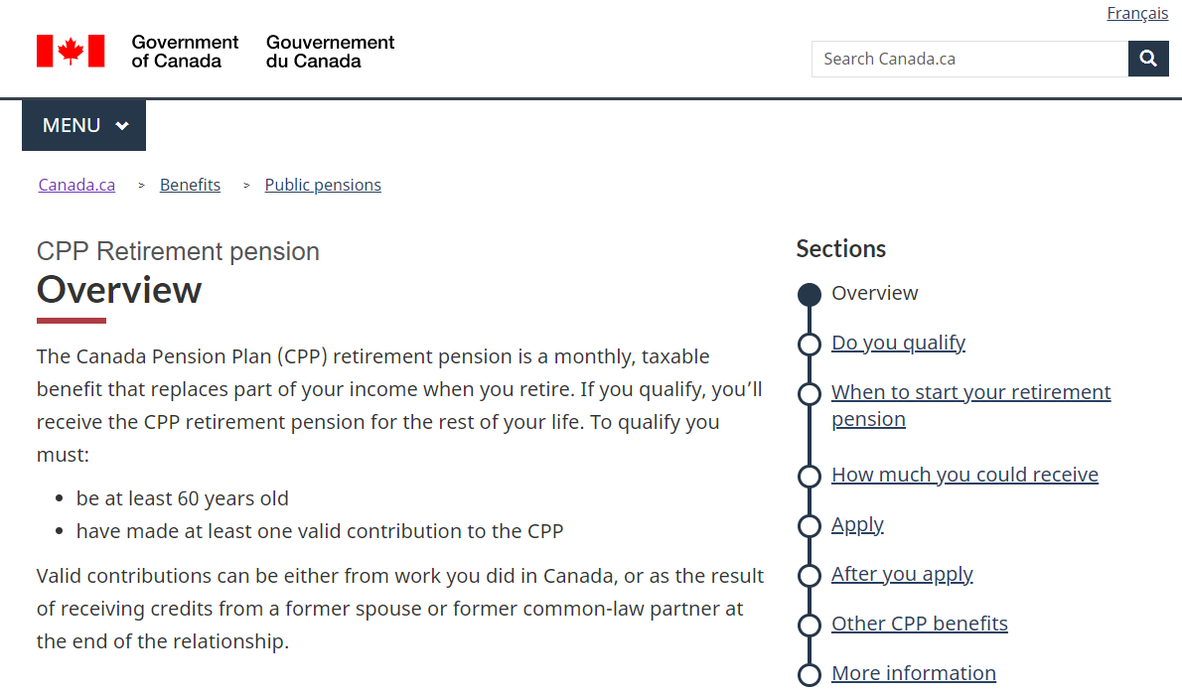
Personalization example: Hurricane Fiona
Without alert
With alert
Providing important information, to impacted people, when they need it
Notes:
Should we include this example or the francophone immigration one? Just wondering cause the floods alert is similar to the COVID alert

Slide 11
Other examples
A/B Test and Personalization use case library
Library provides a summary of A/B tests and personalizations undertaken with Adobe Target within the GC, including:
The use case's research question or problem
The success metrics used
How the use case was designed and implemented
The results of the use case

Slide 12
Why should this matter to you?

Slide 13
Supporting digital government
Digital Standards
Policy on Service and Digital
Canada's Digital Ambition 2022

Slide 14
Canada's Digital Ambition 2022
Digital government is about...
putting the needs of the people we serve at the heart of the government policies, programs and services we deliver, through the use of modern technology and effective use of data.
modernizing and adapting the way we work so that we can compete in a fast‑changing world and ensure that government remains responsive, resilient, and most importantly, relevant.
Strategic theme 2: data-enabled digital services and programs
...unlocking the potential of data will help us improve services and support evidence-based decisions.
Priority 4.1: support fully digital delivery by managing a government-wide culture shift
...adopting a responsible experimentation approach, where the objective is to learn fast in a safe manner in order to de-risk our efforts early.

Slide 15
Policy on Service and Digital
The Policy on Service and Digital...
advances the delivery of services and the effectiveness of government operations
through the strategic management of government information and data and leveraging of information technology,
supporting the mandate of the Minister for Digital Government in leading the Government of Canada’s digital transition.
Innovation and experimentation
4.1.2.6 The Chief Information Officer (CIO) of Canada is responsible for facilitating innovation and experimentation in service design and delivery, information, data, IT and cyber security.
4.1.3.8 Deputy heads are responsible for providing support for innovation and experimentation in service design and delivery, information, data, IT and cyber security.

Slide 16
Digital standards
Design with users
Conduct ongoing testing with users to guide design and development.
Iterate and improve frequently​
Develop services using agile, iterative and user centered methods. Continuously improve in response to user needs. Try new things, start small and scale up.
Empower staff to deliver better services
Make sure that staff have access to the tools, training and technologies they need. Empower the team to make decisions throughout the design, build and operation of the service.

Slide 17
A tool in your web optimization toolbox
A/B testing is one of many tools in your web optimization toolbox.
When you use all of the tools available to you, you can build a better house.
A/B testing can be used alongside your web analytics reporting, your survey data, and usability testing, to help you better understand and optimize the experience of your visitor.

Slide 18
An opportunity for web and communications professionals
Among other examples, you can use Adobe Target when:
You want to display customized web experiences to specific groups of visitors.
You are looking to improve the current online client experience and have identified priority content to work on
You are working on a web request to make a change to a page and want to make sure that change will not negatively impact things​
You are working on new content and, during the process of developing the new content, there was a difference in opinion or possible ways to go about things. You can test the options to see which performs best.​

Slide 19
Make sure you are in fact improving things
"After running tests on websites for nearly 14 years, it would be very easy for me to go around telling people that I know what will work on their website. I have hundreds of examples of tests that seem totally obvious, no-brainers or follow the best of all best practices, and yet they have a very detrimental effect on the site. Everything you do to your website carries a risk. #testeverything"
Jonny Longden
A top experimentation expert
to follow on LinkedIn

Slide 20
About Adobe Target

Slide 21
Adobe Target: the GC's tool for A/B testing and personalization
Procured and ready for use
Assessed for compliance
Enterprise solution
Managed service

Slide 22
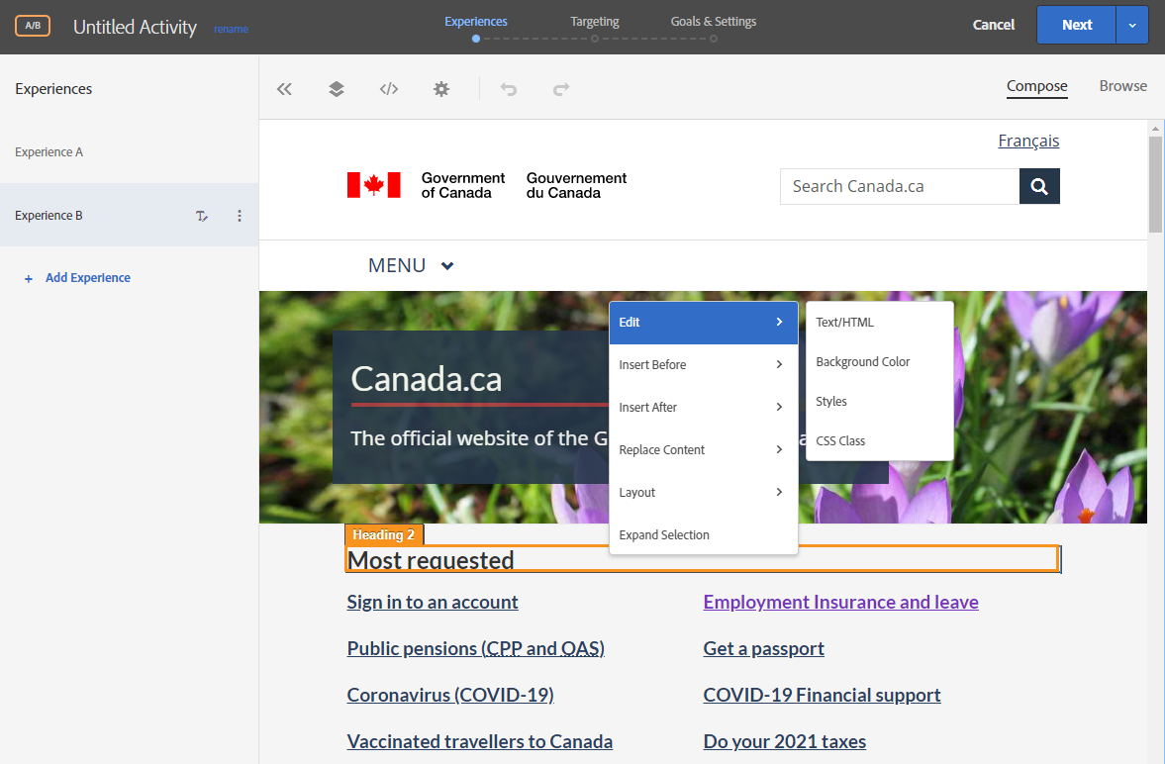
Editing content in Adobe Target
Easy-to-use interface
Does not modify original page
Preview links for reviewing before launch
Can test & personalize any part of content or entire user journeys
Notes:
3 step workflow
Just want you to see how it feels to set this up

Slide 23
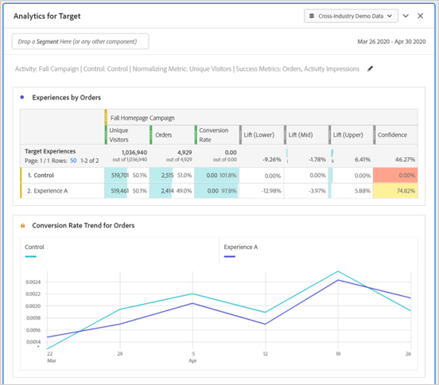
Reporting
Data integrates with Adobe Analytics
Analyze data in Workspace
Can make use of any dimension, metric or segment to analyze results

Slide 24
Getting access to Adobe Target

Slide 25
About the service
Cost-recovered service
Institutions will have access to Adobe Target to create and manage your own tests and personalizations
Unlimited tests and personalizations
Training, support and resources from Principal Publisher
A/B Testing and Personalization Working Group
Note: It is strongly recommended that your institution have Adobe Analytics implemented.
Learn more about the service via Adobe Target GCpedia page

Slide 26
Key dates
Mar
Mar 10: Confirmation of interest of institutions received
Institutions sign service agreements
Feb
Email to institutions for 2023-24 fiscal year
Apr
Onboarding (access to Adobe Target, training)

Slide 27
Contact us!
If you’d like to learn more or if you are interested in getting access to Target, email us at:
gc.analytique-analytics.gc@servicecanada.gc.ca
Betty Geraldes | Director | betty.geraldes@servicecanada.gc.ca
Nicolas Pjontek | Manager | nicolas.pjontek@servicecanada.gc.ca
Celena Bedford | Team Lead | celena.bedford@servicecanada.gc.ca
Emily Gagnon | Coordinator | emily.gagnon@servicecanada.gc.ca

