Slide 1
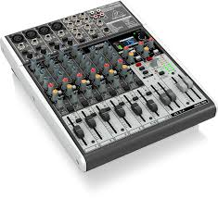
Grandes réunion avec interprétation et salles de sous-commission
Large meetings with Interpretation and Breakout rooms
WebEx Flux vidéo seulement
YouTube Feed for WebEx
Pont des interprètes / Interpreters’ Bridge
Flux audio traduit Français
Translated Audio Stream English
WebEx Video Stream Only
Bilingual / Bilingue
Primary Feed (Audio + Video)
WebEx Video & Audio Stream
Bilingual / Bilingue
Bilingual / Bilingue
Telephone Line téléphonique
Flux vidéo et audio (écouteurs recommandé) / Video & Audio Stream (Headphones Recommended)
Présentateurs / Presenters
Hosts
Traducteurs / Translators
Participants
Notes:
With this design, the following is needed:
1 Zoom account
1 YouTube Live streaming account
3 WebEx accounts (1 for French, 1 for English, and 1 Bilingual/Original Audio)
Advantages...
Easily accommodates Interpretation services
Participants who need to listen via an interpreter will do so connecting to their computer audio
Breakout rooms will occur in the language of their choice
It is the simplest design for the participants, including the executives/presenters
The YouTube Live does a great job about the active speaker/panel view
Disadvantages...​
The executive team or Presenters don't get to participate in breakout rooms, unless they connect to the WebEx using a second device
Needs a large team to cover the hosts roles

