Slide 1
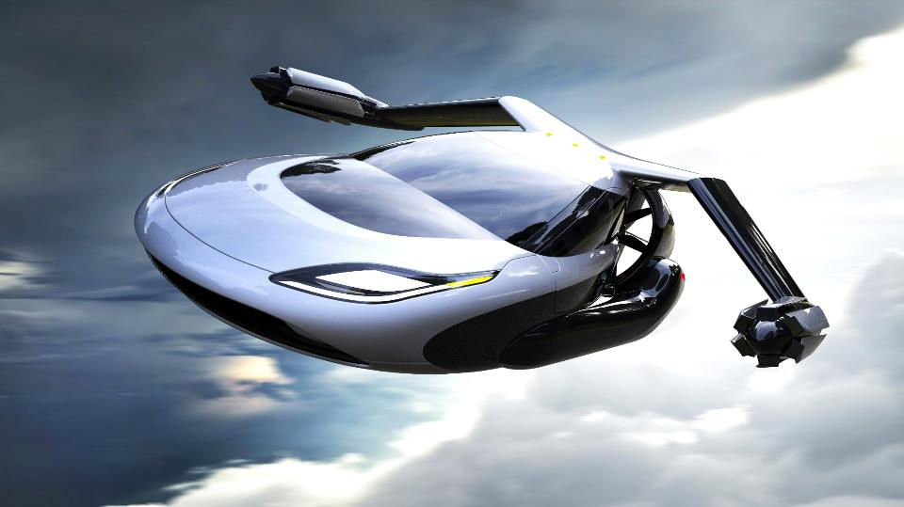
Digital Disruption
Canada School of Public Service
Armughan Ahmad
President & Managing Partner, Digital, KPMG
Notes:
15 mins + Panel Discussion
Armughan Ahmad, thank you for having me here today.
I know you’re probably all familiar with KPMG as a Tax and Audit firm, we certainly hire a lot of accountants
But I’m here to talk to you about the other side of our business, Digital Transformation
…About the rapid shifts taking place, on digital disruption and future of work
Many of the these trends that were in place before the pandemic, we’ve now seen accelerate
I was hired by KPMG to help us disrupt our own thinking on Digital, and to help grow our capacity to deliver end-to-end Digital Transformation with our clients
I came from the Tech industry, and now driving change at KPMG as we help clients with their own transformation journeys
So a lot of what I want to share with you today is taken from that lens

Slide 2
“The pace of change has never been this fast, yet it will never be this slow again”.
JUSTIN TRUDEAU
Prime Minister of Canada
Notes:
Worldwide our client engagements are changing
I can’t imagine a more exciting time to be in the public sector, or serve the public sector
P.M. sums it up nicely

Slide 3
TIMES ARE CHANGING
Notes:
One of the key drivers of this rapid change is people. Technology is the enabler, while people are the Transformers.
The generations that are coming behind us have only known Digital Experiences
This generation will grow up having started life having access to Alexa and VR/3D video games
The pace of change is increasing faster than our ability to adapt.
93% of CEOs see technology disruption as an opportunity, rather than a threat
69% of CEOs say they are actively disrupting rather than waiting to be disrupted
86% of CEOs say they are now personally leading the technology strategy of their firm

Slide 4
The age of personalized experience (Citizen / Resident / Business)
1900
1960
1990
2020
Age of manufacturing
Age of distribution
Age of information
Age of the personalized experience (CX)
Beyond
?
Source: Forrester Research Inc.
Notes:
We’ve moved beyond the Information Age, to the age of personalized experience.
This experience is demanded by consumers and made possible by exponential technologies. This also applies to city services that can be enabled by tech.
Citizen, business and resident experience = Age of customer experience
What is cities seamless experience across all divisions ??
Signing-up for swim classes or yoga at the local community centre
Applying for a Marriage License or short term rental
A young family seeking affordable child care support in their community
A person who seeking skills training after losing their job during COVID

Slide 5
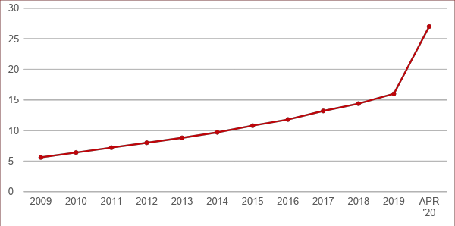
The pandemic has accelerated trends that were in already in place
US E-commerce retail penetration
8 weeks
Source: Bank of America U.S. Department of Commerce, ShawSpring Research, 2020
Notes:
I’m sure you’ve heard the saying that digital trends that were in place before the pandemic have now accelerated.
Even Microsoft’s Satya Nadella who said we’ve seen 2 years of Digital Transformation in 2 months.
Well this is what it looks like. 10 Years of Growth in 8 weeks.
Next big trend will be Algorithmic Commerce – where AI predicts what you want

Slide 6
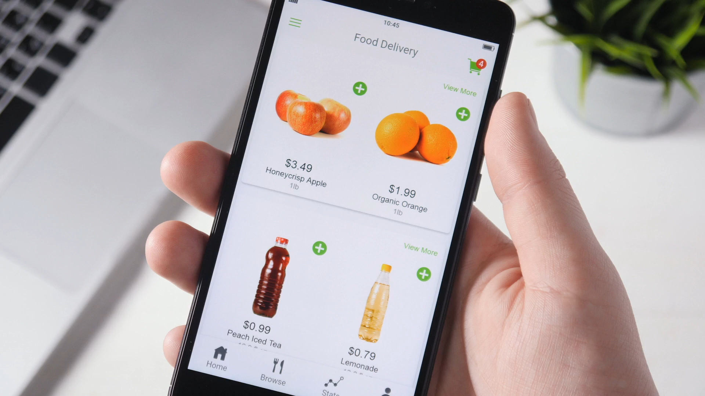
EXPERIENCES DEFINE US
Notes:
We’re starting to experience life in different ways. App loyalty is the new brand loyalty.
How many of you have downloaded an app and deleted it after one use?
Each generation is moving the dial in terms of the expectations they have in how we experience things as a consumer.
We now order our food online
Order our taxis and ubers, expecting instant access
Think of the impact that Airbnb is having on the travel industry, by creating a more personal, connected experience
Payment methods are changing
Even our healthcare experiences are changing – with care closer to and in the home
The new generations are key in driving this - 78% of millennials prefer to spend on experiences over assets

Slide 7
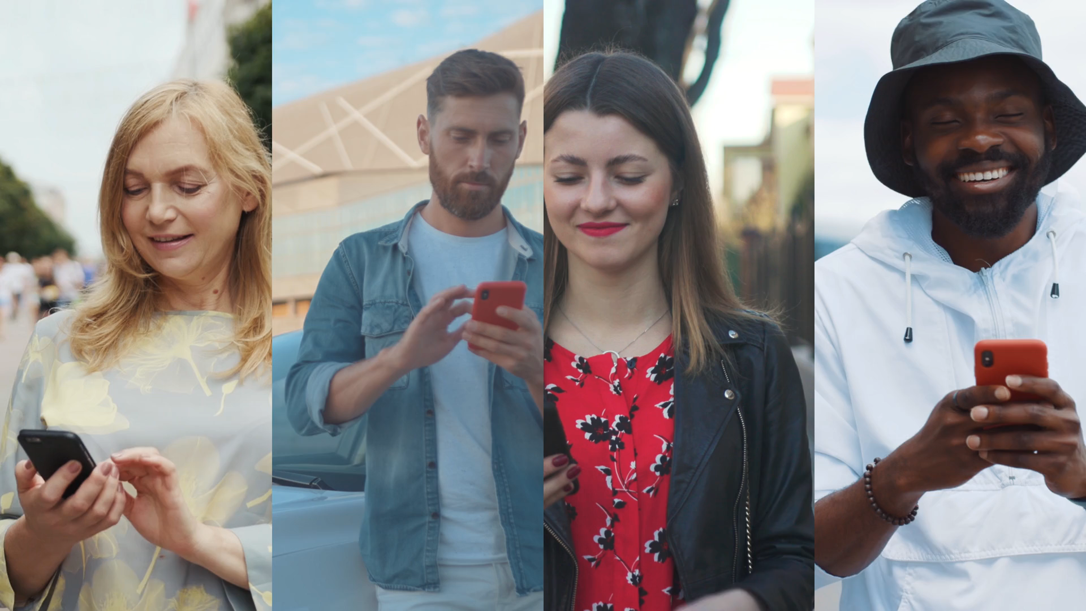
AGE OF PERSONALIZATION
Notes:
People now want all experiences to be personalized for them
Our best experience anywhere, becomes our expectation everywhere

Slide 8
Age of Personalized Experience
2.5bn
Millennials Globally = 50%
78% of Millennials prefer to spend on experience over assets
80% of the global population will own a smartphone in
2020
52%
Of tasks will be performed by machines
by 2025
87% Of people use between 2 and 3 devices
There are more people, living longer and becoming wealthier
People are spending more, but they are also spending differently
Best experiences
are now the norm for expectations
Technology
is changing people’s
behaviour
1bn People aged over 60 globally
50% will be contingent + Gig Workers
90% Customers say buying decisions are influenced by online reviews
61%
Are willing to borrow or share products rather than buy new ones
Seniors have the
highest disposable income
8 Seconds
The attention span of a human is now less than a that of a goldfish
Source: KPMG International, Global Customer Insights Programme
Notes:
KPMG Global Research on Consumer Behavior and expectations
46% millennial workforce by 2020
50% of workforce will be Gig + Contingent workers by 2025
Technology is changing people’s behavior
65% of children entering education today will end up in careers that don’t yet exist

Slide 9
We always overestimate the change that will occur in the next two years and underestimate the change that will occur in the next ten.
— Bill Gates

Slide 10
INNOVATION
DISRUPTION
Doing new things, that make the old things obsolete.
Doing the same
things, better

Slide 11
Notes:
This was the pinnacle of Nokia’s success.

Slide 12
Chaos & Amazement
iPhone Moment
Disappointment
Source: Pascal Finette
Notes:
When a new technology comes out, there’s lots of buzz and excitement, but then this quickly turns to disappointment. How many people wave Alexa or Siri in their home?
Then comes a point when someone has used that technology in a disruptive way. The iPhone Moment as Pascal Finette calls it.
The comes Chaos and Amazement.

Slide 13
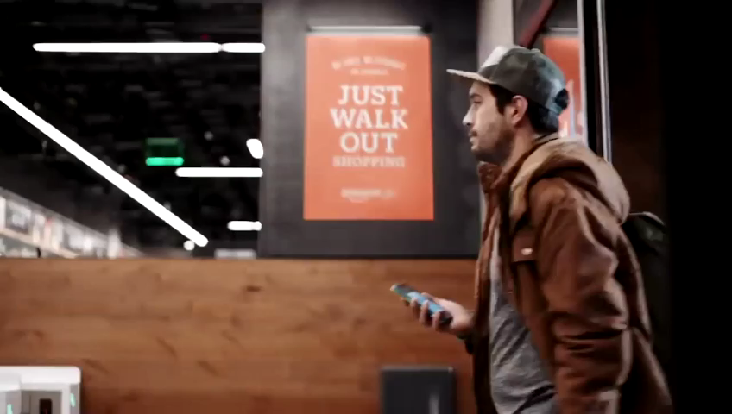
NEW SHOPPING EXPERIENCES
Notes:
Imagine a world where you never wait in line, or even open your wallet.
No cashier, cash register, or self-service checkout stand.
Amazon bills your credit card on your way out.
An app in your phone provides a receipt
Amazon has plans to open 3,000 Amazon Go locations across the United States by 2021

Slide 14
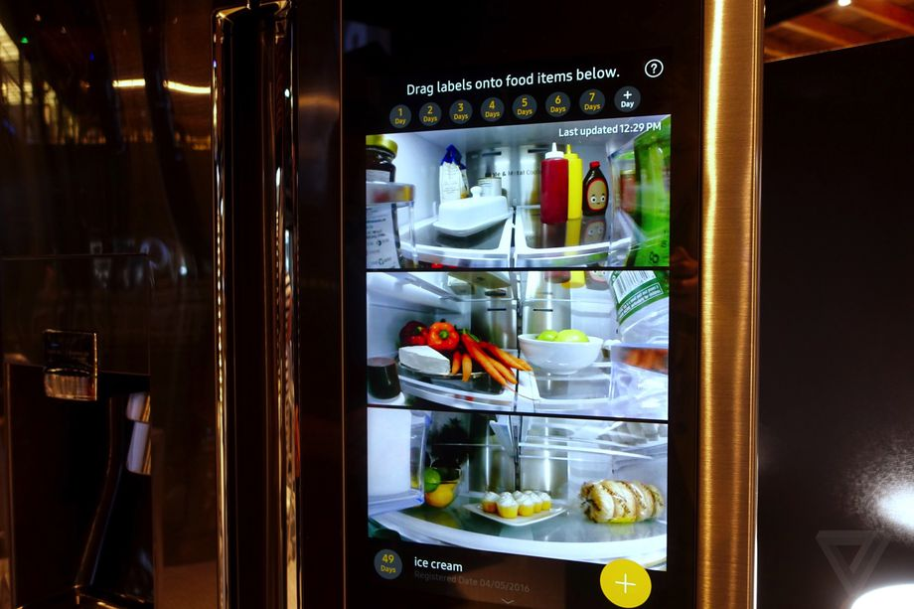
PREDICTIVE PURCHASING
Notes:
ONE COMPANY IS THINKING ONE STEP AHEAD OF YOU WHEN IT COMES TO YOUR SHOPPING HABITS…
Fridge self-replenishing will be more common with product deliveries by drones.
Samsung now has "Groceries by Mastercard," which lets people shop from Fresh Direct or Shop Rite directly from the door, so they can deliver those groceries to you.
Smart refrigerators also reduce waste by letting you know when the carrots in your fridge are about to go bad, and offer up several recipes.

Slide 15
INTERFACE IS CHANGING
Notes:
By the end of this year 50% of all searches will be voice activated
20% of search is now through voice / Alexa / Google Home
How many people have a voice assistant at home?
Event my 80 year old parents have learnt to order groceries online and speak to Google home
Two years ago almost nobody would have raised their hands.
The increasing use of AI does not necessarily mean job losses.

Slide 16
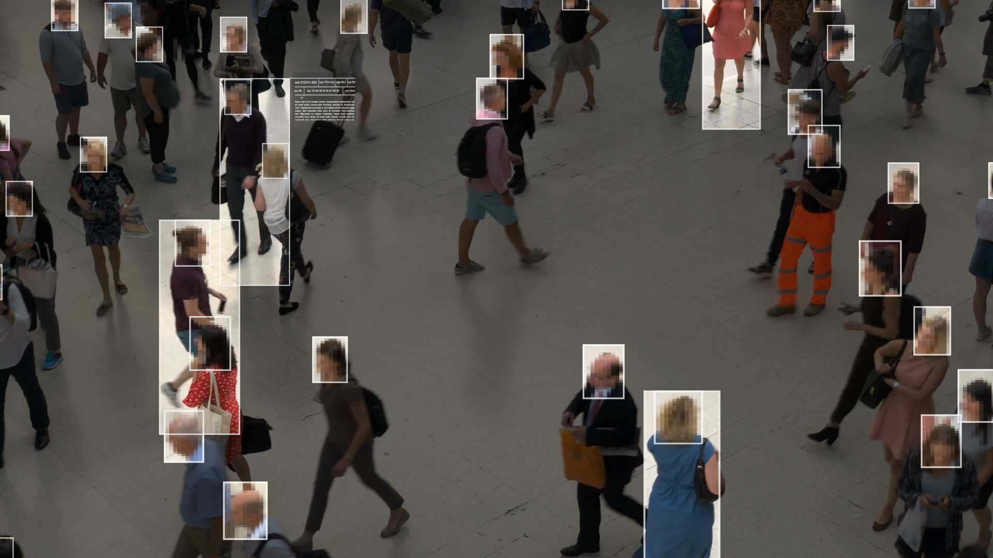
PRIVACY IS CHANGING
Notes:
Risk and privacy is also changing
Bill C-11, Digital Charter Implementation Act, 2020
We expect significant change based on three major themes:
greater consumer choice, control and respect for Canadians’ personal data;
responsible data innovation which involves industry-led standards; and
stronger enforceable protections.

Slide 17
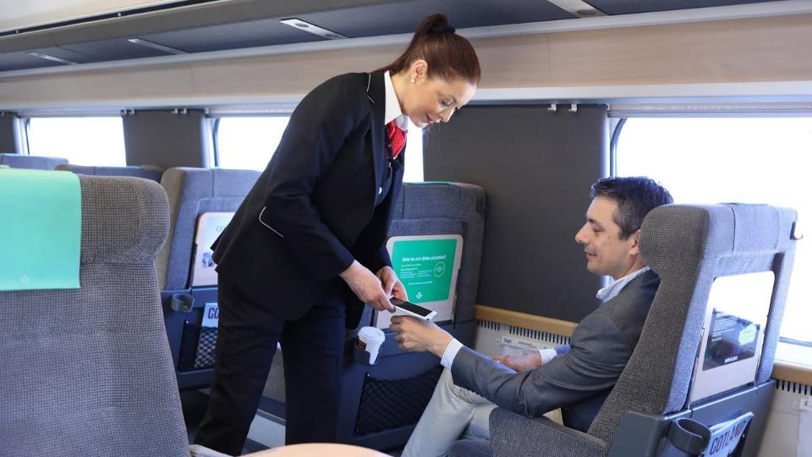
CONVENIENCE IS CHANGING
Notes:
Swedish rail company
Offering passengers a biometric chip implanted into their hand in lieu of a paper train ticket
2,000 Swedes have had the implant in 2017 - most from the tech industry.
We’ve seen Amazon take over retail, now targeting financial services with healthcare and transportation next?

Slide 18
image
WHY IS DIGITAL TRANSFORMATION SO HARD?
Notes:
At KPMG, we’ve built the capability to support our clients through their end-to-end Digital Transformation.
We see many clients who only focus on the front end, such as their websites, or back end like their HR system, but it’s really the front, middle and back office that need to be connected to create seamless customer and employee experiences.

Slide 19
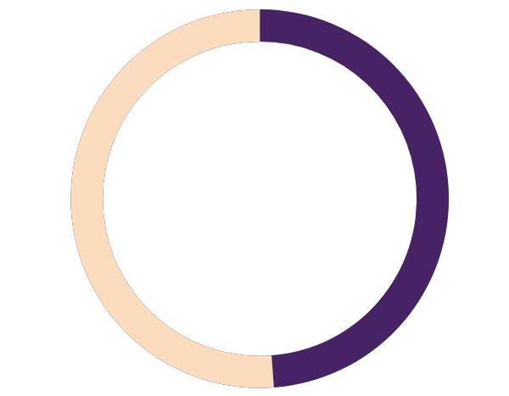
A customer’s best experience anywhere becomes their expectation everywhere
Who is getting it right?
Banking
Wealth Management
Healthcare
Retail
Insurance
43%
17%
35%
27%
23%
Government
Technology
Media
Telecom
Advertising
16%
27%
23%
21%
11%
Notes:
Source: 2019 KPMG Me, My Life, My Wallet Survey.
When it comes to customer experience, companies / Government must look beyond their industry when developing benchmarks and looking to innovate.
According to youngandthrifty.ca the following are best from a Digital banking perspective in Canada:
Tangerine (bought by Scotiabank several years ago) – BEST OVERALL
Equitable Bank (new digital entrant) – BEST FOR SAVERS
Motus Bank (new digital bank owned by Meridian) – BEST FOR MULTI PRODUCTS
Scotia OnLine – BEST FOR DIGITAL INTERFACE

Slide 20
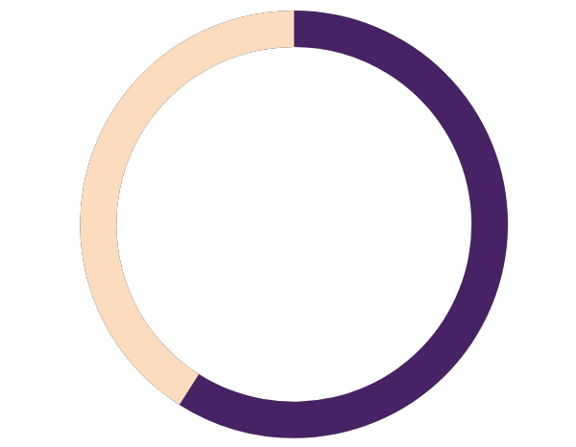
Citizens don’t trust Government with their data
Banking
Wealth Management
Healthcare
Retail
Insurance
60%
33%
62%
46%
38%
Government
Technology
Media
Telecom
Advertising
27%
39%
33%
31%
15%
Notes:
Canadian Consumers level of trust with their data. Source: 2019 KPMG Me, My Life, My Wallet Survey.

Slide 21
The citizen as your customer
Canadians are hesitant to share their data with the government.
Canadians trust the government with their:
Demographic Data
70.4%
Purchase Data (e.g., store loyalty cards)
14.7%
Payments Data
22.0%
Mobile Data (e.g., location, call history)
13.6%
Health Data
31.7%
Work "Social" Data (e.g., LinkedIn)
17.1%
Social Media Data
0.0%
Streaming/Media Data
10.7%
Search/Browsing Data (e.g., cookies)
11.2%
Behaviorally Tracked Ads
9.9%
Income Data (i.e., how much I make)
46.8%
Financial Data (e.g., bank balances,…
21.0%
Wealth Data (i.e., investments)
18.5%
*All statistics quoted are from 2019 Me, my life, my wallet survey results.

Slide 22
Entire “D”-Suite has a role in transformation
CEO
CMO
CRO
COO
CSCO
CIO
CHRO
CFO
FRONT
MIDDLE
BACK OFFICE
© 2019 KPMG LLP, a Canadian limited liability partnership and a member firm of the KPMG network of independent member firms affiliated with KPMG International Cooperative (“KPMG International”), a Swiss entity. All rights reserved. The KPMG name and logo are registered trademarks or trademarks of KPMG International.
Notes:
The entire C-Suite has a role to play in digital transformation

Slide 23
Connecting the Enterprise: Front, middle & back office
Front office
Middle office
Back office
Interfacing with the customer
Core business operations of making, processing, or delivering
Administrative and support functions
Sales
Marketing
Customer service
Customer delivery
Operations
Supply
chain
Procurement
IT
HR
Finance
Notes:
Connected Enterprise is our digital transformation framework that helps clients connect the front, middle and back office to enable a focus on the customer.

Slide 24
To excel in the digital economy, focus on 8 key capabilities
Innovative services
Empowered workforce
Customer centric
Seamless interactions
Responsive operations
Digitally-enabled
Insight-driven
Integrated ecosystem
Notes:
Our research has shown companies that focus on 8 key capabilities, are those that excel in today’s business environment and twice as profitable:

Slide 25
The citizen at the centre
Traditional government service experience
Citizen centric service experience
Labour
Education
Justice
Social
Services
Health
Labour
Education
Justice
Social
Services
Health

Slide 26
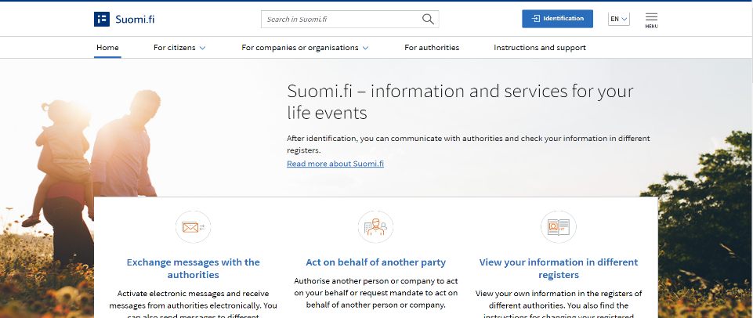
Finland has Transformed the Citizen experience for 62 Life Events
Notes:
Provided this example, because it is one that most of us can identify with on a personal level, but it also demonstrates the value for both the Citizen and Government.
For the GTHA, Bridgeable has been working on a prototype called Skipp, that allows users to find the cheapest, fastest, or healthiest routes. It also integrates Uber and other CarRiding apps into one platform, and provides up-to-date route notifications and alternate route suggestions for delays.
The aim is to provide a seamless experience for Citizens, to help them find solutions that integrate transit where possible, and provide solutions that handle the first and last mile of a users journey. The apps often have varying payment plans that allow users to subscribe to an integrated monthly plan, a pay-as-you-go plan.
The additional value for both Citizens and Government is that you also develop a rich aggregate dataset that allows you to analyse user demand and develop a range of transit options (e.g., micro transit) and to adjust routes as necessary to fill in as much of transportation demand as possible with public transit options. The cited aim of these programs is to help respond to the integrated transportation needs of citizens, enabling journeys through transit where possible, and reducing the necessity of car ownership.

Slide 27
INNOVATION IS NOT EASY

Slide 28
IQ
EQ
AQ
DQ
WORK IS CHANGING
Notes:
Skills we need for work are changing.
WEF: creativity quickly becoming one of the top three skills workers need to succeed in the workforce (2020)
EQ now is more a determinant of success than IQ alone.
AQ important to build resilience – keep learning and adapt to new opportunities
Leaders must also demonstrate high DQ - It implies that a person not only has empathy for employees and colleagues, but also the genuine desire to care for them.

Slide 29
Impact of AI on professions
Compassion Needed
Wedding Planner
Elderly Companion
CEO
Concierge
Crisis Hotline Volunteer
Teacher
Tour Guide
Social Worker
M&A Expert
Elderly Caretaker
Home-school teacher
PR/Marketing Director
Beauty Consultant
Remote Tutor
Optimization
Creativity or Strategy
Customer Support
Radiologist
Columnist
Economist
Hematologist
Security Guards
Scientist
Tele-sales
Research Analyst
Artist
Truck driver
Compassion not Needed
Source: AI Superpowers Kai-Fu Lee
© 2019 KPMG LLP, a Canadian limited liability partnership and a member firm of the KPMG network of independent member firms affiliated with KPMG International Cooperative (“KPMG International”), a Swiss entity. All rights reserved. The KPMG name and logo are registered trademarks or trademarks of KPMG International.
Notes:
So lets break down how AI and humans will need to work together by job function

Slide 30
Impact of AI on professions
Compassion Needed
Wedding Planner
Elderly Companion
CEO
Concierge
Crisis Hotline Volunteer
Teacher
Tour Guide
Social Worker
M&A Expert
Elderly Caretaker
Home-school teacher
PR/Marketing Director
Beauty Consultant
Remote Tutor
Optimization
Creativity or Strategy
AI
Columnist
Economist
Scientist
Research Analyst
Artist
Compassion not Needed
Source: AI Superpowers Kai-Fu Lee
© 2019 KPMG LLP, a Canadian limited liability partnership and a member firm of the KPMG network of independent member firms affiliated with KPMG International Cooperative (“KPMG International”), a Swiss entity. All rights reserved. The KPMG name and logo are registered trademarks or trademarks of KPMG International.
Notes:
So lets break down how AI and humans will need to work together by job function

Slide 31
Impact of AI on professions
Compassion Needed
Wedding Planner
Elderly Companion
CEO
Concierge
Crisis Hotline Volunteer
Teacher
Tour Guide
Social Worker
M&A Expert
Elderly Caretaker
Home-school teacher
PR/Marketing Director
Beauty Consultant
Remote Tutor
Optimization
Creativity or Strategy
AI
AI
HUMAN +AI
Compassion not Needed
Source: AI Superpowers Kai-Fu Lee
© 2019 KPMG LLP, a Canadian limited liability partnership and a member firm of the KPMG network of independent member firms affiliated with KPMG International Cooperative (“KPMG International”), a Swiss entity. All rights reserved. The KPMG name and logo are registered trademarks or trademarks of KPMG International.
Notes:
So lets break down how AI and humans will need to work together by job function

Slide 32
Impact of AI on professions
Compassion Needed
AI
CEO
Concierge
Social Worker
M&A Expert
HUMAN
PR/Marketing Director
Optimization
Creativity or Strategy
AI
AI
HUMAN +AI
Compassion not Needed
Source: AI Superpowers Kai-Fu Lee
© 2019 KPMG LLP, a Canadian limited liability partnership and a member firm of the KPMG network of independent member firms affiliated with KPMG International Cooperative (“KPMG International”), a Swiss entity. All rights reserved. The KPMG name and logo are registered trademarks or trademarks of KPMG International.
Notes:
So lets break down how AI and humans will need to work together by job function

Slide 33
Impact of AI on professions
Compassion Needed
HUMAN +AI
AI
HUMAN
Optimization
Creativity or Strategy
AI
AI
HUMAN +AI
Compassion not Needed
Source: AI Superpowers Kai-Fu Lee
© 2019 KPMG LLP, a Canadian limited liability partnership and a member firm of the KPMG network of independent member firms affiliated with KPMG International Cooperative (“KPMG International”), a Swiss entity. All rights reserved. The KPMG name and logo are registered trademarks or trademarks of KPMG International.
Notes:
So lets break down how AI and humans will need to work together by job function

Slide 34
AI will displace 75 million jobs…
AI & MACHINE LEARNING SPECIALIST
NURSE
BIG DATA SPECIALIST
Jobs of the Future
HOME CARE PROVIDER
ROBOTICS ENGINEERS
…and create 133 million new jobs
TEACHER
Notes:
With 75 million lost – this will cause significant disruption
But Net 58 million new job will be created.
Many new jobs are related to STEM fields
Many of the “caring” and high EQ related jobs will see fewer job losses

Slide 35
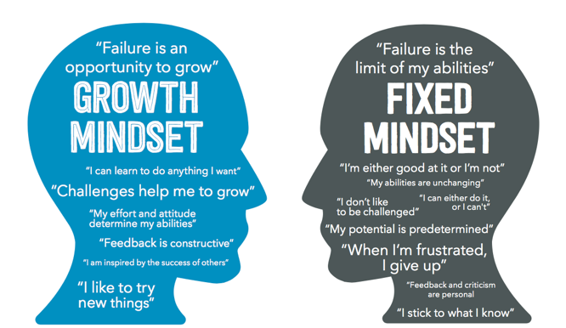
Mindsets = For building back better
Notes:
Carol Dweck

Slide 36
The best way to predict the future is to invent it
Alan Kay
Notes:
If you are not working on the future, it will happen to you.

Slide 37
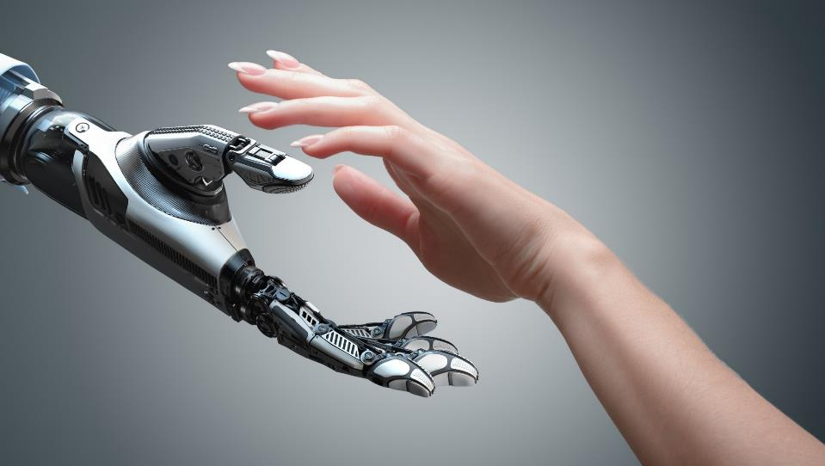
Thank You
@ArmughanAA

