Slide 1
Introducing the Regulators’ Experimentation Toolkit
Autumn 2021

Slide 2
Why have you joined today’s webinar? Maybe you...
...ran a regulatory experiment in the past?
...are running a regulatory experiment now?
...might run a regulatory experiment?
...want to learn about regulatory experimentation and sandboxes?
...want to learn about CRI?
...want to learn about the Regulators’ Experimentation Toolkit?
Something else?

Slide 3
Objectives for this webinar
By the end of this webinar, participants will know more about the CRI, the Regulators’ Experimentation toolkit (including what it is and where to access it) and next steps for teams interested in exploring how their team might use experimentation.
Specifically, the webinar will cover:
An introduction to the CRI and Nesta, including CRI’s role in promoting regulatory experimentation
Reasons regulators use experimentation and examples of regulators using experimentation
An introduction to the Regulators’ Experimentation Toolkit
Next steps - how the CRI and Nesta can help interested regulators

Slide 4
Centre for Regulatory Innovation (CRI)
The CRI, located within TBS Regulatory Affairs sector, helps regulators respond to technological advances and leverage novel regulatory approaches. Services the Centre provides include:
Promotion of innovative regulatory approaches throughout the GoC
Support for regulators to conduct activities such as regulatory experimentation and sandboxes. This includes:
Supplementary funding
Advisory services
Tools (including the Regulators’ Experimentation Toolkit)

Slide 5
Nesta and Nesta’s role with the CRI
Work in partnership with CRI to…
Share learning from our work in regulatory innovation
Including insights to help design the Regulatory Experimentation Expense Fund (REEF) application process
Provide guidance and support to regulators implementing, overseeing and evaluating regulatory experiments
Including guidance to develop / refine proposals submitted to the REEF
Build the Regulators’ Experimentation Toolkit based on learning from CRI’s initial work, including input from regulators and international examples

Slide 6
Why regulatory experimentation?
Regulators constantly need to make decisions in contexts of uncertainty - both about the environment they’re operating in and the impact of their decisions
Innovation can be a particularly challenging source of uncertainty
New product or service innovations
Effects of changes of regulatory frameworks, policies or mechanisms on innovation
Often these uncertainties cannot be resolved through traditional approaches such as information gathering and consultations
Experimentation provides a way for regulators to reduce uncertainty and to inform regulatory decision-making in these circumstances.
Notes:
From toolkit:
A constant challenge for regulators of all kinds is the need to make decisions in contexts of uncertainty. This includes uncertainty about the environment within which the regulator is operating, and about the impact that its decisions will have on the environment. Innovation can be a particularly challenging source of uncertainty for regulators. New product or service innovations – or even entirely new categories of product or service1 – can push at the frontiers of existing regulation and have the potential for significant but unknown impacts, and the effects of changes to regulatory frameworks, policies, or mechanisms on innovation can be deeply uncertain. Often, these uncertainties cannot be satisfactorily resolved through traditional approaches such as information gathering and consultations. For example, information about innovations can be particularly sparse, fragmented and contested or missing entirely relative to that available for more established technologies or practices. In other situations, it may be impossible to know which approach to a regulatory challenge is best if none of the most promising options under consideration have been tried in a similar context before, or indeed if the context is genuinely new and precedents offer little guidance. Experimentation provides a way for regulators to reduce uncertainty and to inform regulatory decision-making in these circumstances. Experimentation can be a powerful approach to reducing uncertainty in a wide range of areas, but it is particularly relevant in relation to innovation where alternative courses of action, such as research and speaking with stakeholders, may be unavailable or unable to sufficiently satisfy a regulator’s information needs. Being experimental is one principle regulators can adopt to become more ‘anticipatory’ in their approach to innovation.2 While experimentation is of course well established as a method in scientific research, and is also routinely used by many businesses to inform business decisions,3 adoption of experimentation by the regulatory community is still at an early stage. While regulatory sandboxes have become widely used (in particular among financial services regulators) to facilitate a particular category of experiment, regulatory experimentation has much broader potential applicability and utility to regulators than is currently being exploited. This Toolkit therefore starts with regulatory experimentation before turning to regulatory sandboxes as a special but important case

Slide 7
Poll: Have you run a regulatory experiment or sandbox before? Why or why not?
[Select as many as applicable]
Yes
No - unclear why I would experiment
No - unclear when to experiment
No - unclear how to experiment
No - lack of support for experimentation in my organization or team
No - considered a high risk activity
No - too resource intensive (time, money, people)
No - something else
Notes:
Collect this data

Slide 8
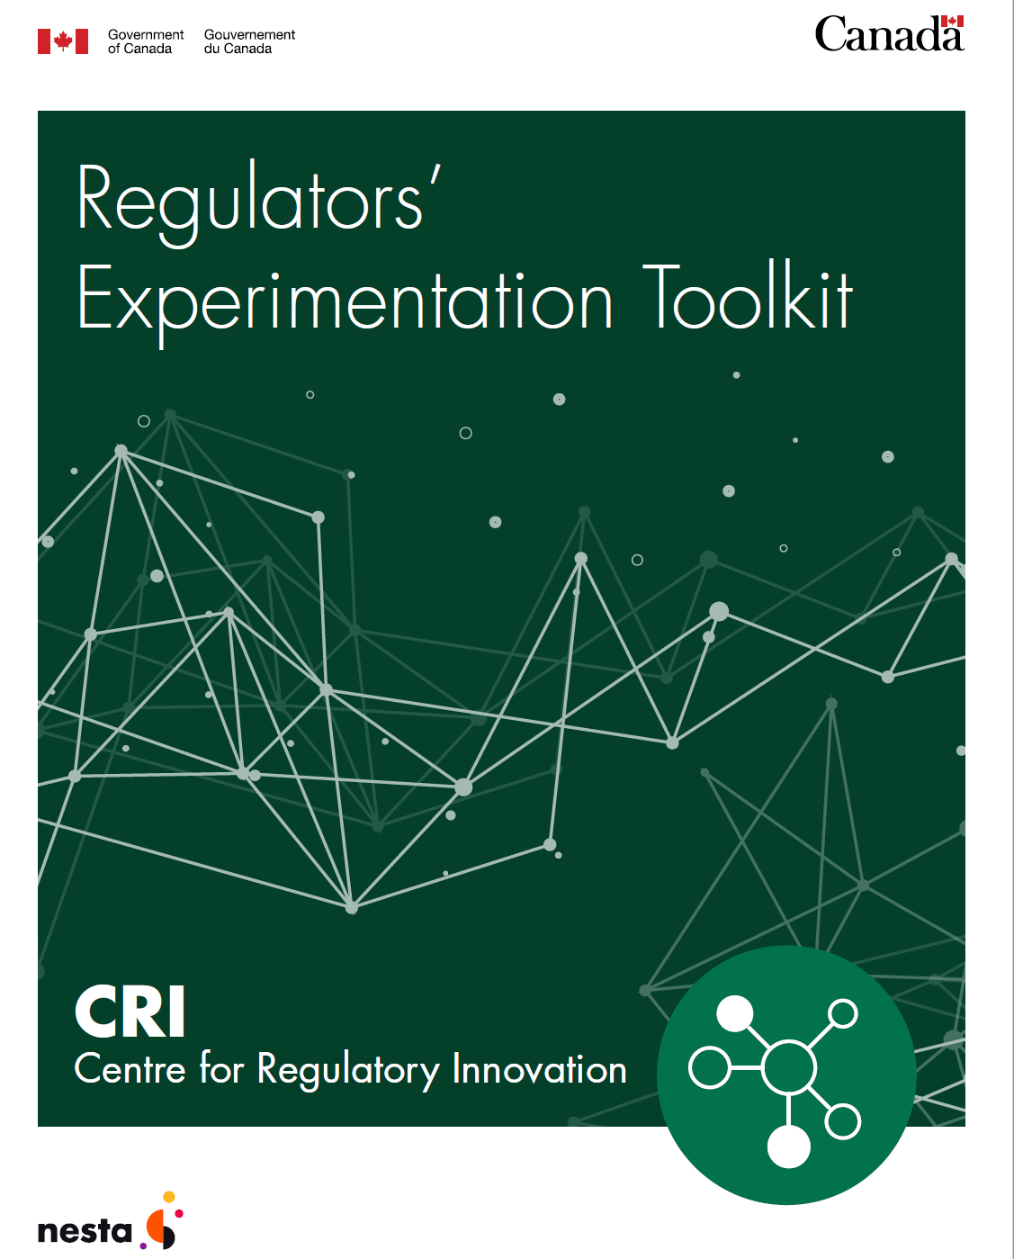
Why develop a regulatory experimentation toolkit?
Codify best practice for running regulatory experiments and regulatory sandboxes
Help integrate experimentation into regulatory culture
Provide examples to spark imagination
Support applications to CRI’s Regulatory Experimentation Expense Fund
Notes:
(Toolkit should help address these questions from poll)

Slide 9
What is the toolkit?
Who is it for?
→ set of tools including guidance, examples, worksheets and links to useful resources that can support departments to:
better understand what regulatory experiments and regulatory sandboxes are
identify when and why these tools can be useful (especially to support innovation)
understand how to use these tools generally (and links to advanced information)
→ any Canadian regulator interested in designing, carrying out or facilitating, and learning from experiments. This includes regulators interested in:
Exploring new ways of regulating to develop a more proactive and anticipatory regulatory practice
Discovering, evidencing and de-risking potential responses to regulatory challenges
Enabling, stimulating or guiding industry or other stakeholders to advance innovation safely within new or existing regulatory framework

Slide 10
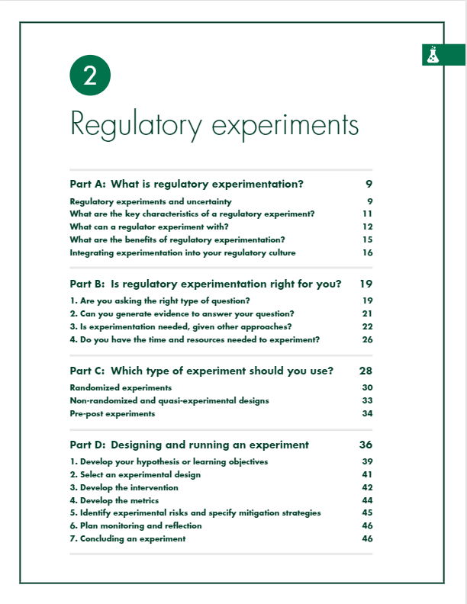
What is in the chapter on regulatory experiments?
A
Defines and includes examples of regulatory experiments
B
Presented as checklist, includes comparisons to other approaches to support decision-making
C
Includes notes on types of experiments and associated ethical considerations
D
Presented as step-by-step guide to design, helpful in completing CRI’s Regulatory Experimentation Expense Fund application
Notes:
First of two main sections is about regulatory experiments

Slide 11
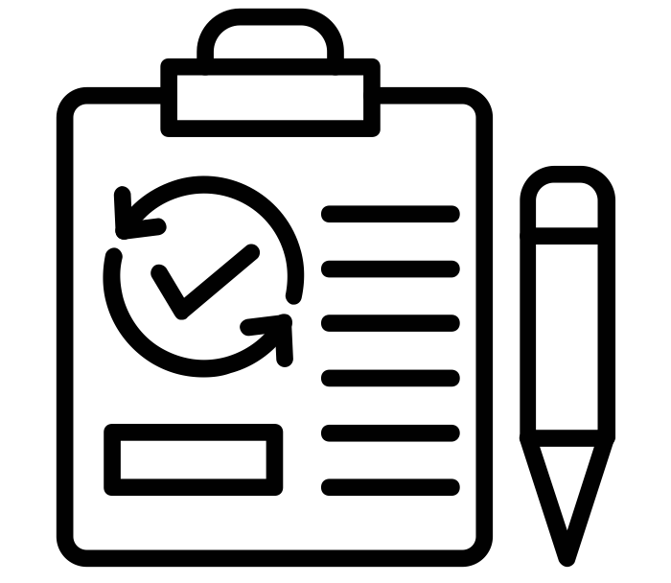
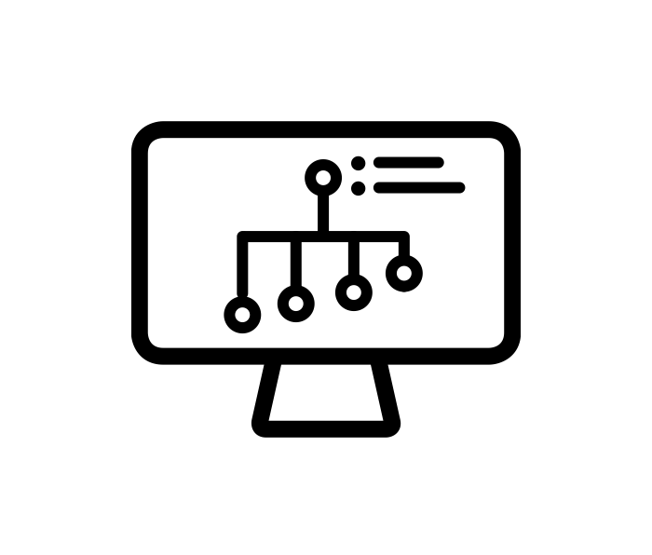
What is a regulatory experiment?
A regulatory experiment is a trial or test of a new product, service, approach, or process, designed to generate evidence or information that can inform the design or administration of a regulatory regime.
Trial or test - where something is tried out under time-limited conditions - with a clear beginning and end
The product, service, approach or process that is tried has an angle that is new
The primary goal is to generate evidence or information - to learn something
The purpose for seeking evidence is to inform the design or administration of a regulatory regime
Regulatory experiments can happen inside or outside a regulatory sandbox, depending on what a regulator needs to experiment with.
Notes:
Note from Brennen: an experiment is not a data-gathering exercise to provide evidence in favour of a pre-determined decision, it is a test of a hypothesis.
In this box here we have the definition of an experiment being used for CRI’s experimentation fund. So I’ll read that out - A regulatory experiment is a trial or test of a new product, service, approach, or process, designed to generate evidence or information that can inform the design or administration of a regulatory regime.
There’s a few key pieces in there, so to break it down a bit:
First - When we’re talking about a trial or test, we’re talking about something being tried out under time limited conditions - so under conditions with a clear beginning and end
Second - in this definition we’re talking about trailing or testing products, services, approaches or processes that are new or have a new angle to them - so even if the product, service, approach or process isn’t new, perhaps it’s being used in a new way, for a new purpose or in a new environment
Third - this definition focuses on experimentation where the primary goal is to generate evidence or information - or in it’s simplest form, the primary goal is to learn something
And fourth - this definition is focusing on evidence to help inform the design or administration of a regulatory regime. This means informing either
The administration of acts or regulations
The design of new acts or regulations
Or the design of revised acts or regulations
A well-designed experiment has these characteristics:
Prioritizes learning: generates information and evidence by systematically testing ideas.
Tests or trials a defined learning objective or hypothesis.
Clarifies the potential outcomes of the experiment and how these would be interpreted and acted on.
Structure: a systematic process that allows learning to happen.
Timelines: there are limits or checkpoints set from the start at which results are assessed and decisions made.
All icons from the Noun Project
testing by Vectors Market from the Noun Project
knowledge idea by Vectors Point from the Noun Project
data chart by Ivan Colic from the Noun Project
regulation by Nithinan Tatah from the Noun Project

Slide 12
Example of a regulatory experiment (Internationally)
Singapore Licensing Experimentation and Adaptation Programme
Telemedicine innovation led to services either not regulated or prohibited - both benefits and risks
Needed to better understand to develop new framework for regulation
Experiment, supported by sandbox, trialled services in a safe and controlled environment to obtain information
Led to development of a new framework for regulating telemedicine
Notes:
From toolkit:
Innovation in Singapore’s telemedicine sector led to the creation of services that were either not regulated or prohibited. These new services seemed to have benefits as well as risks, though neither were well understood. There was a need to better understand innovative telemedicine services to develop a new framework for regulating this service category. In response, the Singapore Ministry of Health launched a regulatory experiment. The experiment was supported by a sandbox, which removed the prohibitions otherwise preventing the experiment. The experiment was designed to trial new and innovative services in a safe and controlled environment to obtain information about the services benefits and risks while ensuring patient safety. Safety measures taken as part of the experiment included providing training for physicians in the safe use of telemedicine. Comparing the telemedicine services trialed during the experiment to traditional services provided through the healthcare system has helped the Ministry of Health better understand the benefits and risks associated with telemedicine and to develop a new framework for regulating telemedicine.

Slide 13
Examples of Canadian regulatory experiments
Examples from the 2020-2021 Regulatory Experimentation Expense Fund
ISED – testing educational approaches to increase regulators’ proficiencies and knowledge of digital credentials and obtain information on how the training affects buy-in of this technology
ECCC – using a policy lab approach to pilot national stakeholder engagement strategies with the aim of enhancing supply chain transparency for chemicals in products in Canada
Competition Bureau - testing whether a created IT tool can help leverage various sources of publicly available information to more efficiently and effectively identify anticompetitive mergers that may be avoiding antitrust scrutiny in Canada because they are not caught by the current regulatory regime for mandatory pre-merger notification

Slide 14
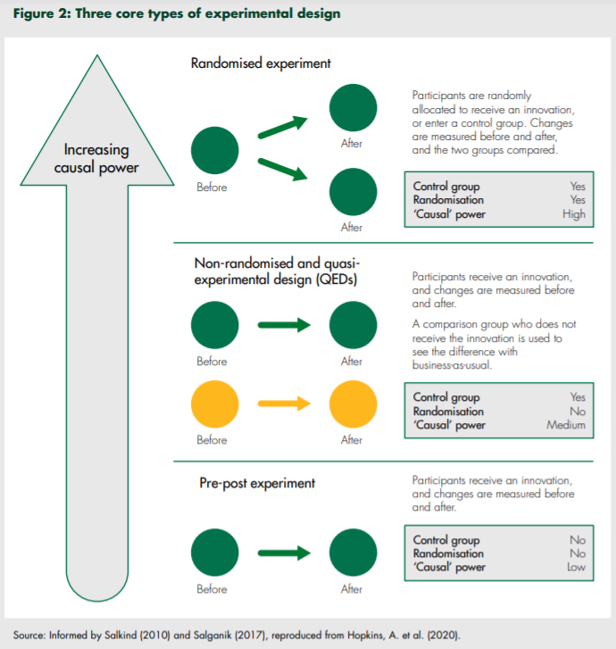
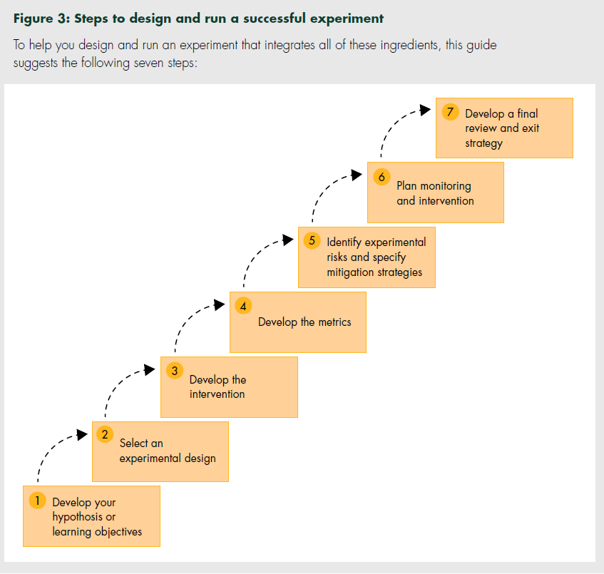

Slide 15
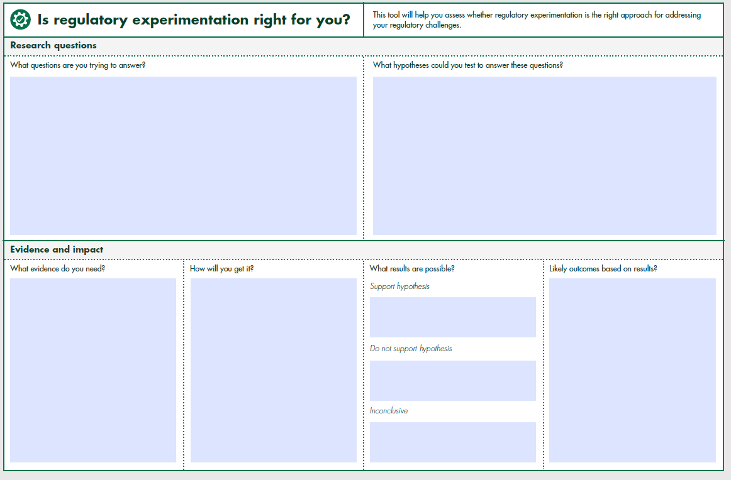

Slide 16
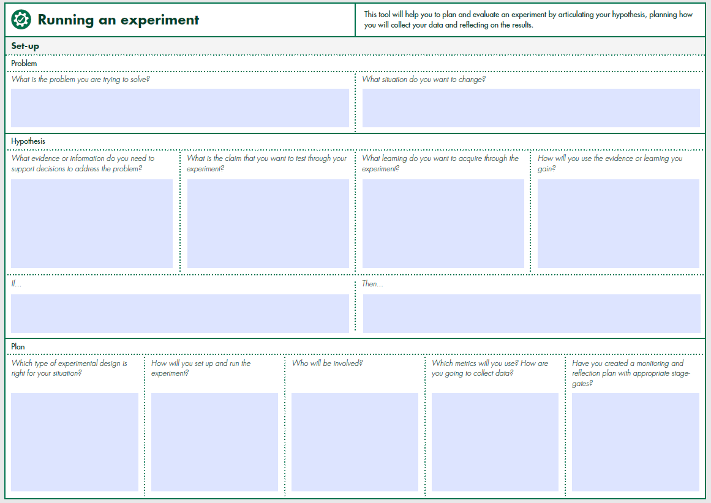

Slide 17
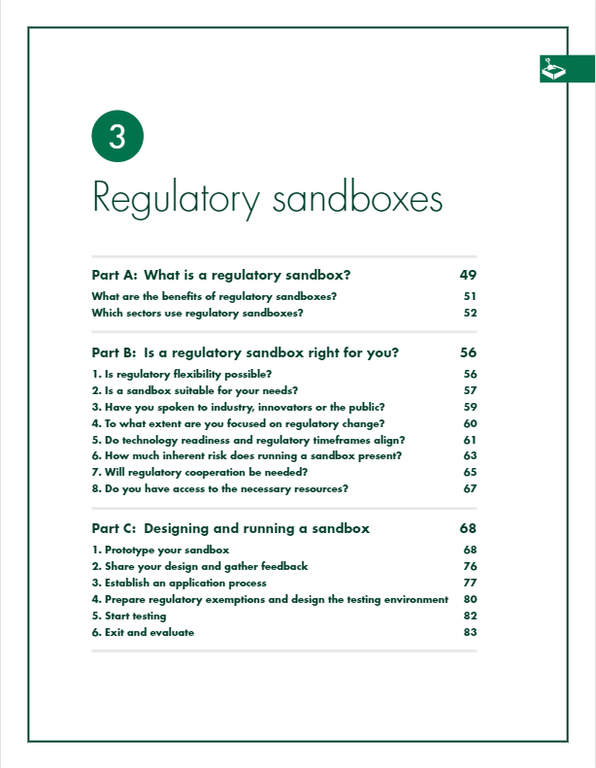
What is in the chapter on regulatory sandboxes?
A
Defines and includes examples of regulatory sandboxes
B
Checklist questions to help you decide if this is the right tool for you
C
Helpful in completing CRI’s Regulatory Experimentation Expense Fund application if submission includes a sandbox
Notes:
Second of two main sections is about regulatory sandboxes

Slide 18
What is a regulatory sandbox?
A regulatory sandbox is a facility, created and controlled by a regulator, design to allow the conduct of testing or experiments with novel products or processes prior to their fully entry into the marketplace.
‘Sandboxes’ are widely used, but meaning can vary widely
Key to CRI’s definition is the role played by industry and that the initiative for particular experiments comes from outside regulators
Benefits for regulators:
Pathway for innovators to propose and safely run experiments
Reduce barriers to marketplace entry for innovators
Provide learning opportunities for regulators
Regulatory experiments underlie and are often ‘prior to’ regulatory sandboxes
Notes:
From toolkit:
Over the past decade many regulators across the world have established
regulatory sandboxes.4 Though this name is used widely, the purpose, design
and implementation of regulatory sandboxes varies significantly across regulatory
jurisdictions. For this Toolkit, we define a regulatory sandbox as a facility,
created and controlled by a regulator, designed to allow the conduct of testing
or experiments with novel products or processes prior to their full entry into the
marketplace.
Key to this definition of a regulatory sandbox is the role played by industry, and
specifically that the initiative for particular regulatory experiments comes from outside
the regulator. By establishing a regulatory sandbox the regulator makes it easier and
less costly for industry to propose and execute experiments, and provides a degree
of certainty that experiments of a certain kind will be allowed.
Regulatory sandboxes involve partnership between regulators and industry and
provide benefits to both that they may not otherwise be able to achieve. For industry,
they offer a pathway for innovators to propose and safely run experiments with novel
technologies subject to a regulator’s approval and oversight. Often the purpose of
a regulatory sandbox is described as being about reducing barriers to marketplace
entry for innovative products and services. But they also provide valuable learning
opportunities for regulators, notably about innovations falling within their regulatory
remit and about the interplay between their regulation and innovator activity.
It follows from these definitions that regulatory experiments underlie, and are
therefore in a significant sense ‘prior’ to, regulatory sandboxes. Regulators
considering whether to establish a sandbox may therefore wish to first explore the
principles and practice of regulatory experimentation more generally in order to
inform specific sandbox design decisions.

Slide 19
Examples of regulatory sandboxes
UK Financial Conduct Authority Regulatory Sandbox (International)
Businesses test innovations with real consumers in a controlled environment
For each cohort, identifies problems interested in addressing
Most recently supported innovations to improve financial resilience:
Willow Money - helps consumers save money and pay off debt faster by refinancing costly credit
Bayfikr - mobile platform empowering UK-based immigrants to pay bill providers in their home country instantly & securely using UK bank accounts
Estimates participation reduces time for innovations to reach the market by 33%
Remotely Piloted Aircraft Systems (RPAS) (Transport Canada)
Absence of regulatory framework for drones is limiting innovation; need to better understand the technology, its capabilities, and its potential applications
Created regulatory sandbox for implementing drone pilot projects
Sandbox has allowed regulator to make timely and iterative amendments to the Canadian Aviation Regulations
Notes:
From toolkit:
Problem
One of the central aims of the UK’s Financial Conduct Authority (FCA) is to protect consumers. It is also interested in encouraging innovation, as long as this is to the benefit of consumers.
Solution
To balance these interests, in 2016 the FCA established the world’s first regulatory sandbox for the financial sector. The FCA’s regulatory sandbox allows businesses to test innovations with real consumers in a controlled environment. Innovations must either be regulated activities or support regulated activities in the UK financial services market, must be genuine innovations with a clear need for testing in the sandbox, and present a benefit for consumers.
How it works
The sandbox accepts applications on a cohort basis. Firms can propose any innovation they think would benefit from access to the sandbox, as long as it meets the eligibility criteria (see Eligibility criteria for the Financial Conduct Authority’s sandbox (UK)). When the FCA opens calls for a sandbox cohort, it often identifies problems it is particularly interested in addressing through innovation. For example, when seeking applications for Cohort 7 in late 2020, although this was not an entry requirement the FCA expressed interest in business, product, and service innovations to “detect and prevent fraud and scams, support the financial resilience of vulnerable consumers”, and “improve access to finance for small and medium sized enterprises.” It also mentioned an interest in proposals for innovations to help address consequences of coronavirus. Once accepted to the sandbox, innovators gain access to regulatory expertise from the FCA, and access to regulatory flexibility. This includes restricted authorization to test specified ideas, informal advice related to regulatory implications of an innovation, waivers and modifications to FCA rules (within the FCA’s regulatory jurisdiction) or “no enforcement action” letters to facilitate testing, and individual guidance to interpret requirements to facilitate responsible testing.
Impact
As of early 2021, the FCA has accepted six cohorts of approximately 20 innovations each for testing through the sandbox, with applications for a seventh having recently closed. The FCA estimates that participation in the regulatory sandbox reduces the time it takes for innovations to reach the market by 33 per cent, and of innovators that participated in the first sandbox cohort, 30 per cent succeeded in attracting investment

Slide 20
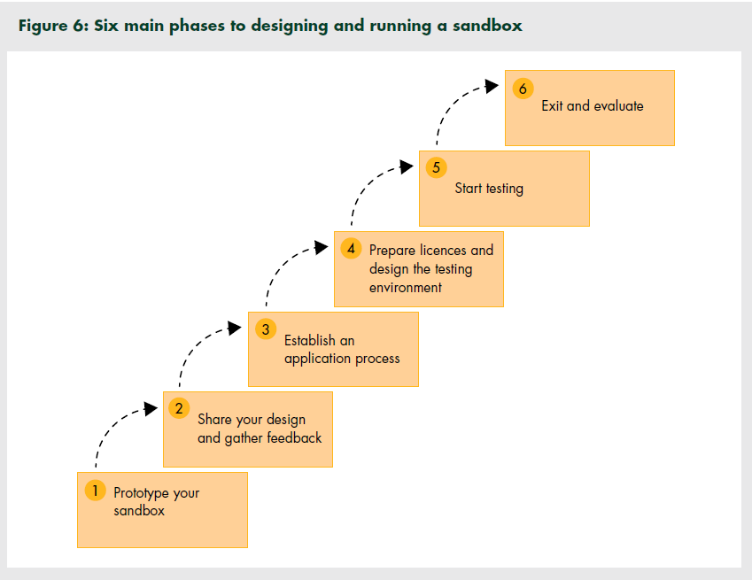

Slide 21
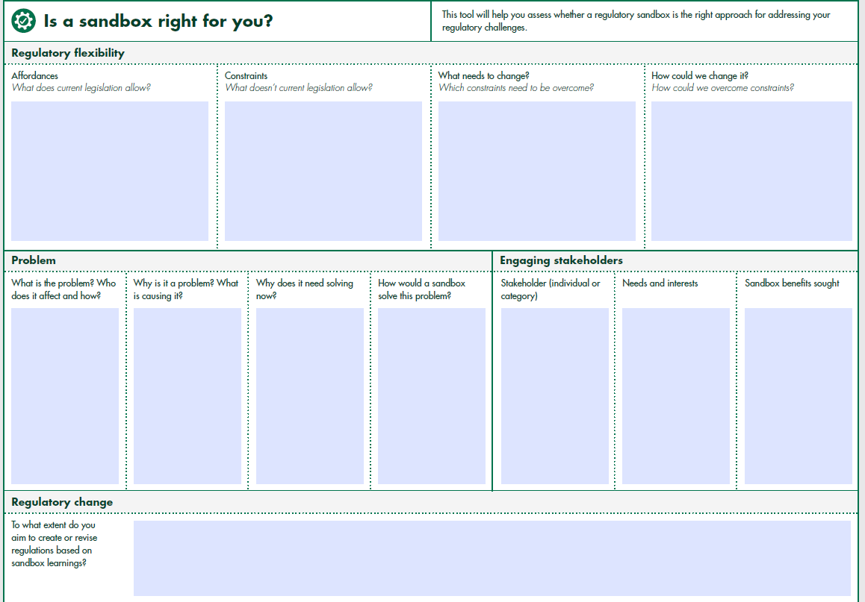

Slide 22
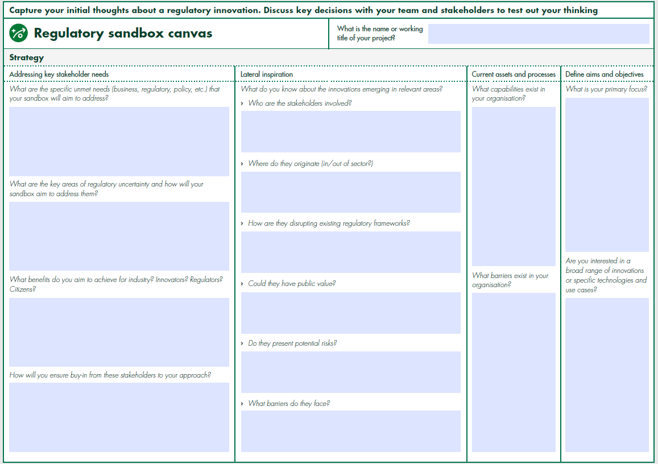

Slide 23
Summary: When to use each chapter?
Regulatory Experiments
→ Best for: testing existing regulations to validate their appropriateness, obtaining information to inform the revision of these regulations or the development of new ones, or trying out potential processes to improve the administration of a regulatory regime.
Regulatory Sandboxes
→ Best for: facilitating market-led innovation, engaging in industry-regulator dialogue, or building an understanding of an immature and emerging sector or innovation space.

Slide 24
Where to access the Toolkit?
CRI GCpedia page
By request from CRI: cri-cir@tbs-sct.gc.ca
On the Nesta website

Slide 25
Next steps:
How the CRI can support your efforts

Slide 26
Focus Sessions
For regulators that wish to further explore how to address regulatory issues using experimentation or sandboxes, we are here to help in a variety of ways:
Testing the Waters
Guided session for teams that wish to ideate on regulatory issues/challenges and explore if the approaches in the Toolkit would be helpful.
Guided discussion of issues or problems the group wishes to address through experimentation
Work through the questions and complete the following worksheets from the toolkit:
“Is regulatory experimentation right for you” or
“Is a sandbox right for you”

Slide 27
Focus Sessions (Continued)
Diving in
Guided sessions for teams that are ready to undertake a regulatory experiment or sandbox. Using the Toolkit as a key reference, CRI/Nesta will provide advisory services throughout the process. Sessions could include:
Session 1 (as required): Exploring opportunities for experimentation
Session 2: Clarifying problem, identifying learning objectives, developing hypothesis to be tested
Session 3: Developing the intervention: planning the experiment, selecting a design, identifying stakeholders
Session 4: Developing the metrics: identifying metrics and planning data collections
Session 5: Completing planning & moving to implementation: risks & mitigation planning, planning for monitoring & reflection
Optional sessions: Reflection/check-in points at identified milestones or at experiment conclusion

Slide 28
Poll: Would you be interested in a focus workshop to help you use the toolkit to develop your own experiment?
Yes - I’d be interested in a session to explore opportunities for experimentation
Yes - I’d be interested in a session to develop an experiment I’m already thinking about/working on
No - not now, but maybe later
No - this isn’t of interest to me

Slide 29
If you are interested in a focus workshop to help you use the toolkit to develop your own experiment…
Reach out to the CRI for additional information regarding eligibility.
CRI GCpedia page: https://www.gcpedia.gc.ca/wiki/Centre_for_Regulatory_Innovation
Email: cri-cir@tbs-sct.gc.ca

Slide 30
Thank you!
Any questions?

