Slide 1
Page analytics tool
Principal Publisher Analytics Services

Slide 2
What is the Page analytics tool?
A web-based solution on Canada.ca that allows anyone (no prior analytics expertise required) to look up analytics data for any page tracked by Adobe Analytics
Ideal for digital communicators, program content creators, etc.
Created in collaboration between Principal Publisher, Digital Transformation Office and Canada Revenue Agency

Slide 3
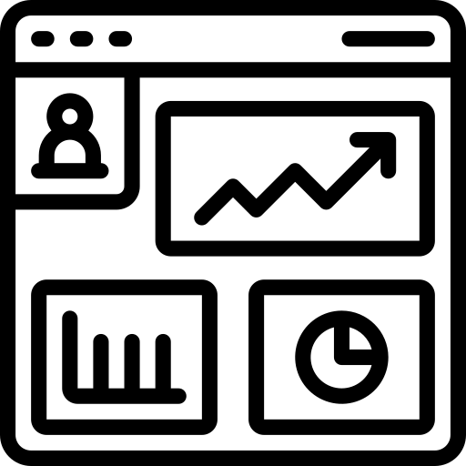
New features
Customizable date ranges
Web analytics data for non-Canada.ca sites
Improvements to the tool’s interface

Slide 4
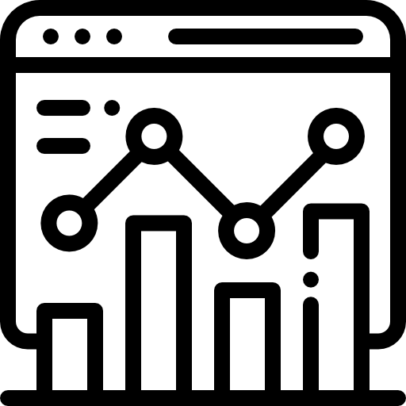
Benefits of the Page analytics tool
Growing our online data presence and increasing data transparency
Similar to other governments: USA, UK, Australia
Supports the Directive on Open Government, Canada’s National Action Plan on Open Government, and the GC Digital Standards
Making Web analytics data easily available
Access to analytics at the click of a button
Democratization of data: Anyone can view and share analytics data
Reduces basic analytics requests, allowing analysts more time to do deeper analysis

