Slide 1
Designing guidance
Simple and user-friendly
without sacrificing accuracy
Draft for discussion

Slide 2
Purpose
To support the design of online GC COVID-related guidance that is clear, understandable and easy to use in order to set Canadians up for task success.
This deck will:
Define guidance
Identify design challenges and considerations for web
Provide recommendations for collaborative guidance development
Highlight ready-to-use tools and examples

Slide 3
What is guidance?
For the purpose of web and this deck, “Guidance” is referring to any form of:
rules or instructions/measures
Regulations
legal requirements
Goal: to help people comply with the rules

Slide 4
Challenges and considerations

Slide 5
Challenges and considerations identified
How can we ensure that people are able to understand and properly adhere to our guidance?
Guidance that is not clear can lead to confusion and frustration and risks not being understood or acted on appropriately.
Plain language can help communicate complex concepts which experts and scientists also prefer and benefit from.
How do we translate policy into an online service or transaction?
What Government wishes to communicate is not always the same as what audiences are coming to learn or accomplish.
Changing the design approach to putting the audience needs first can help.

Slide 6
People just want clear instructions and answers
Excerpts from usability study undertaken May 26, 2020. See findings

Slide 7
Recommendations

Slide 8
Recommendations
Aim to set audiences up for success in order to reduce calls/emails and increase correct application of guidance by Canadians.
Involve colleagues from across disciplines at the outset
Know your audience and their specific tasks before your start designing
Understand and leverage the web channel effectively
Content is words and design

Slide 9
Involve colleagues:
Content is a shared responsibility
Program / Policy:
Subject matter expertise
Guidance creation
Content accuracy
Content complete
Accessibility text
BUILT TOGETHER,
DIGITAL PRODUCTS ARE:
Succinct
Scannable
Easily understood
Usable
Relevant
Accessible
This reduces calls/email to seek help or clarification, and increases the accurate application of guidance.
Digital Comms:
UX/usability
Evidence-based design
Plain language
Prototyping
Dissemination
Promotion
Multidisciplinary teams working in close collaboration develop better products.
Notes:
What we are suggesting here is that it is more than just sending drafts back and forth for feedback, rather actually teaming up to co-develop guidance
Multidisciplinary teams in close collaboration = leads to better products
This is more than sending a draft for feedback
Don’t just write your content —write it in context, i.e. design it
So:
Embed your web/design colleagues in your team from the beginning
Practice pair writing (aka co-writing)
This is a big change. Start with specific projects!

Slide 10
Working together
A point about it being more than just passing drafts back and forth for feedback

Slide 11
2. Know your audience and their tasks
Not all guidance should be developed in the same way, but should always be:
relevant to the audience(s) needs
follow standards, specifications and best practices on usability
Ask:
Who are my audiences (are there several or just one)?
How does my guidance apply to each audience?
What does my audience(s) need to know?
What specific tasks do I require my audience(s) to do with the guidance?

Slide 12
Understanding your audience
Between Policy and Communications, information on audiences can be gathered from:
Internet and social media (social listening)
Google tools
Web and search analytics
Call centres
Subject matter experts
Prior research
New research or experiments
Seek support from Digital Communications to help with research and data collection on your audience behaviours online in order to structure your content.

Slide 13
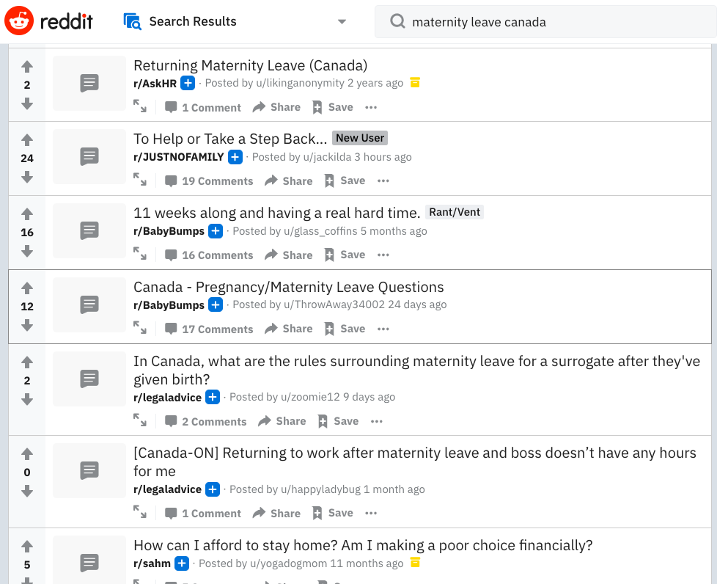
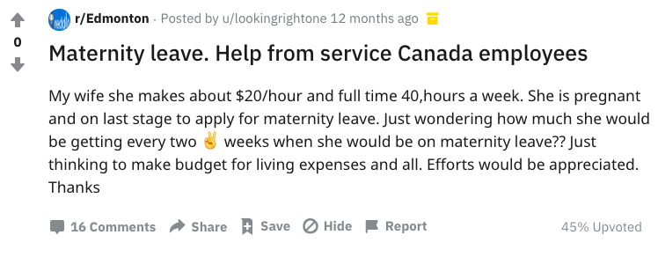

Slide 14
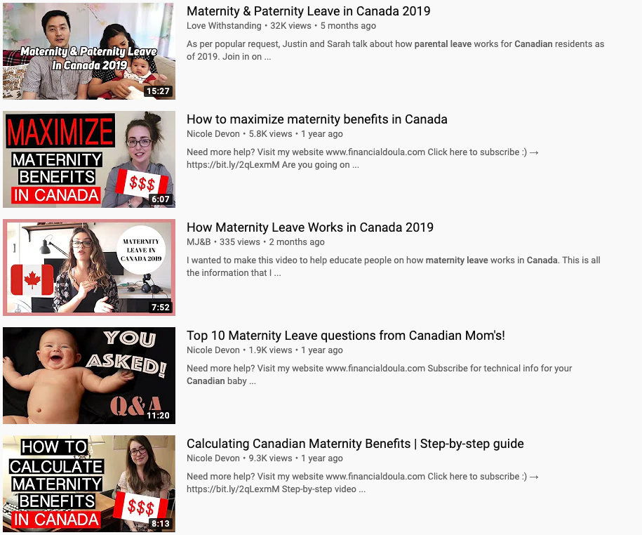
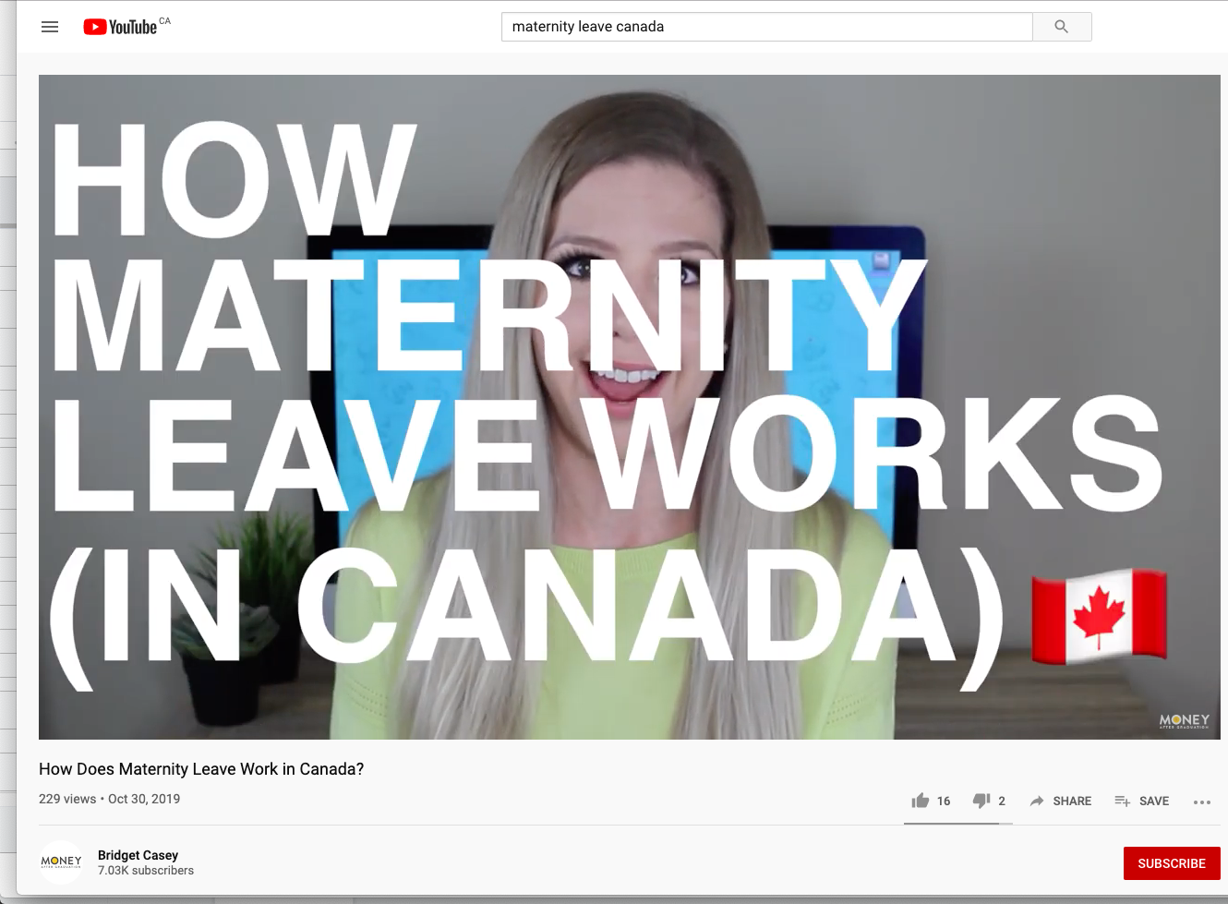

Slide 15
Understanding tasks
Tasks break down into parts, often in the form of steps to complete something.
Renewing your passport:
Understand eligibility
Get a new photo
Gather background docs
Figure out where to go
etc.
To learn how people perform tasks similar to yours, reach out to Digital Communications for support on research and knowledge found through usability testing.

Slide 16
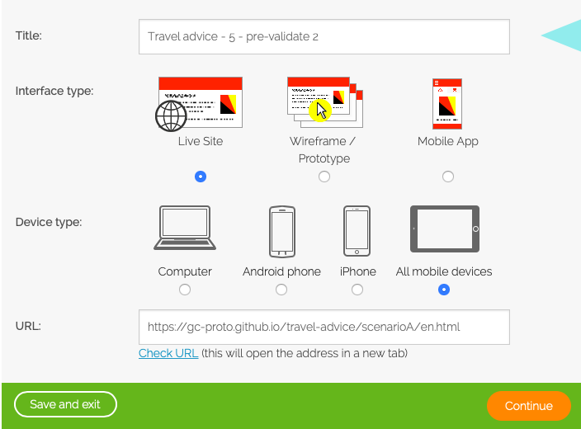
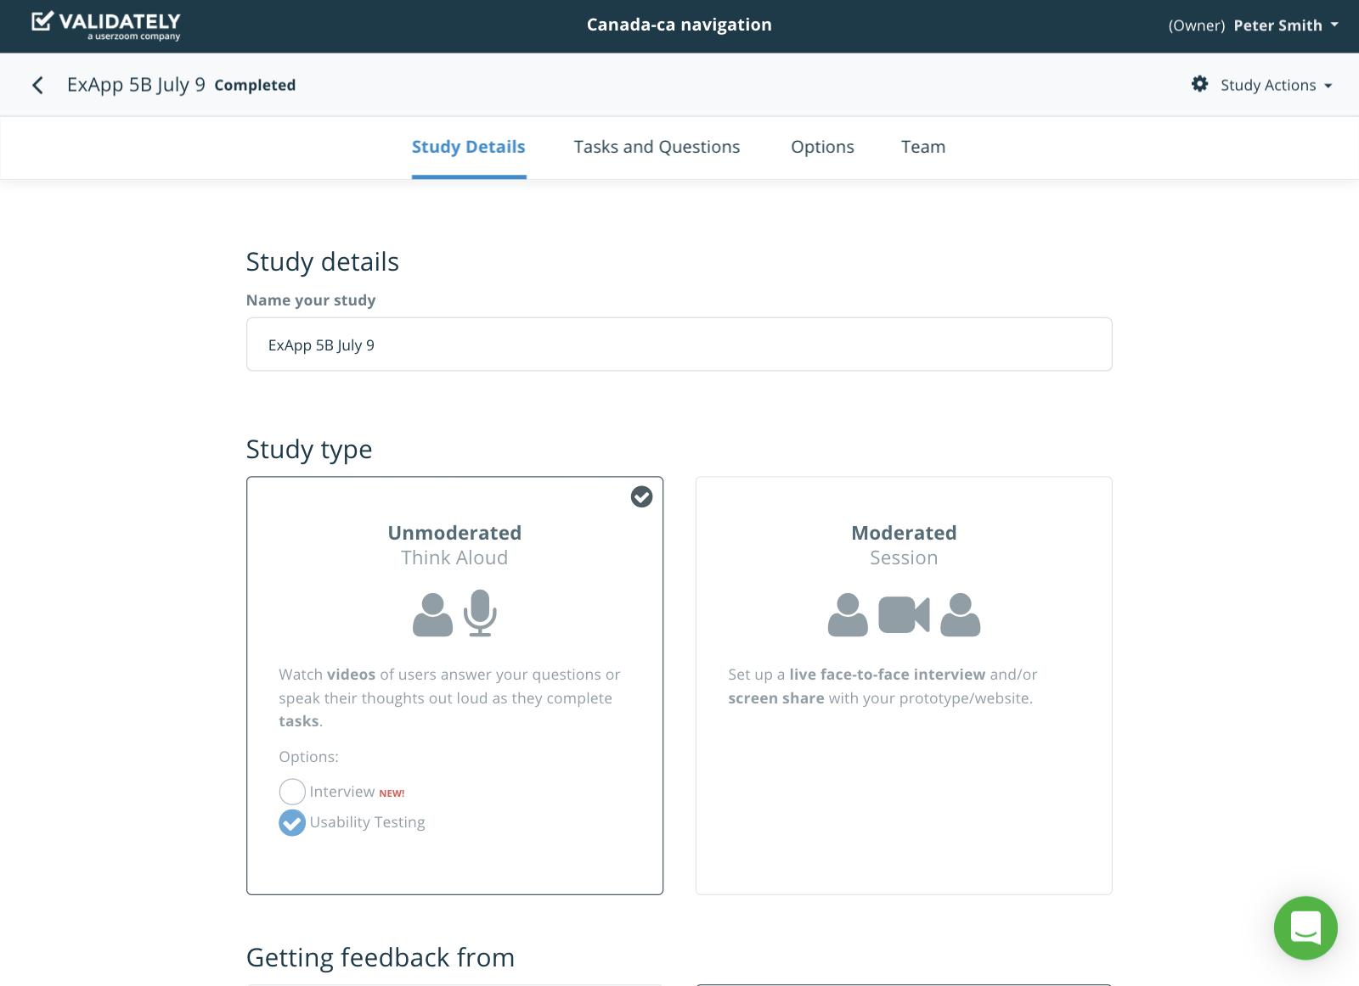
Unmoderated usability testing
Unmoderated testing: Online tools/services, < 9 participants, qualitative

Slide 17
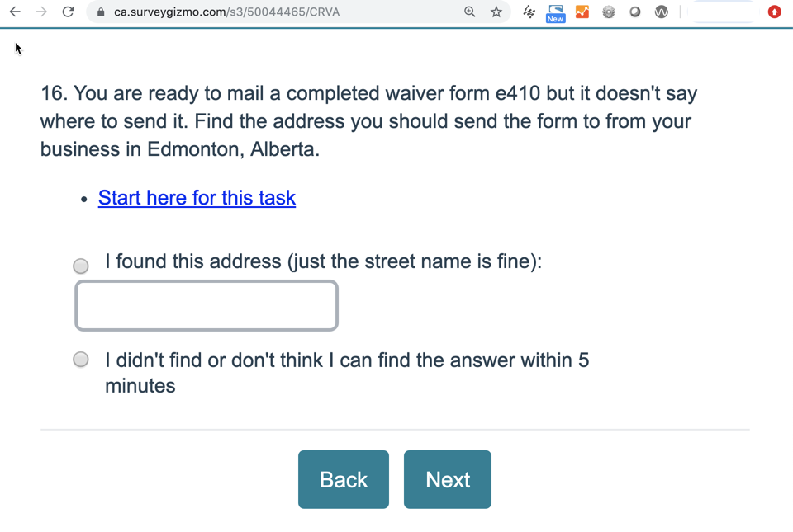
Moderated usability testing
Canada.ca task performance testing: moderated usability tests, 18+ participants, mostly remote

Slide 18
3. Understanding the web channel to leverage its abilities
The digital space comes with different audience behaviours compared to traditional communications.
To make it work for your content, remember:
Web is a ‘doing’ place for most (focus on tasks)
People don't read, they scan (keep short meaningful section headers)
People look for easy to follow directions or steps, or they give up/call/email
Small screens need less content (mobile traffic > 50%)
Don’t duplicate content (GC web space is integrated - collaborate with others or link to existing content)
Adhere to GC standards for web (design.canada.ca)

Slide 19
Consider making prototypes rather than writing documents
Develop guidance for how people experience guidance.
Some common tools:
InVision
Axure
Adobe XD
PowerPoint/Keynote
Github pages
alpha.canada.ca
Other web hosts/CMSs
Local versions on shared drives
Real web pages might be best!
Your web colleagues can help you with working HTML prototypes.

Slide 20
Prototyping process: iteration leads to better products
Engage Digital Communications to support this effort, or to share knowledge from similar prototyping exercises.
Design
Engage Program and Policy to ensure accuracy and completeness of content.
Integrate learning into prototypes
Test
Learn
Evaluate prototypes with users
Analyze user testing results

Slide 21
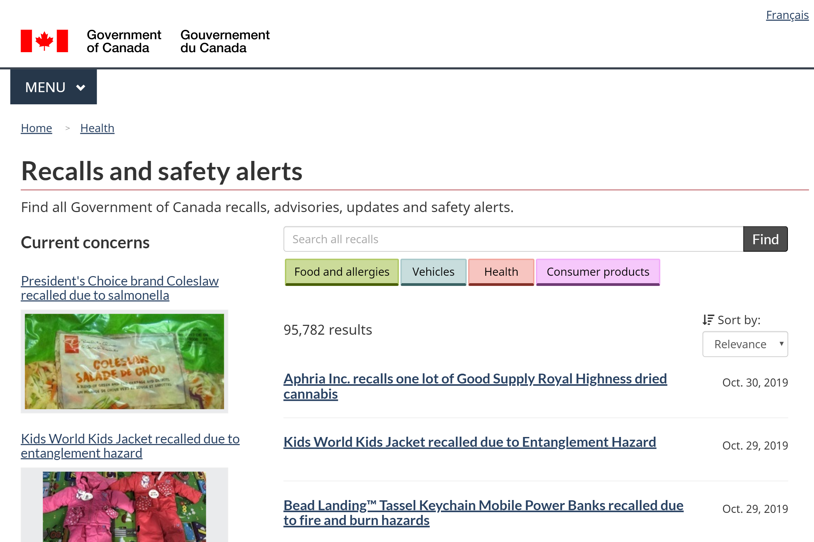
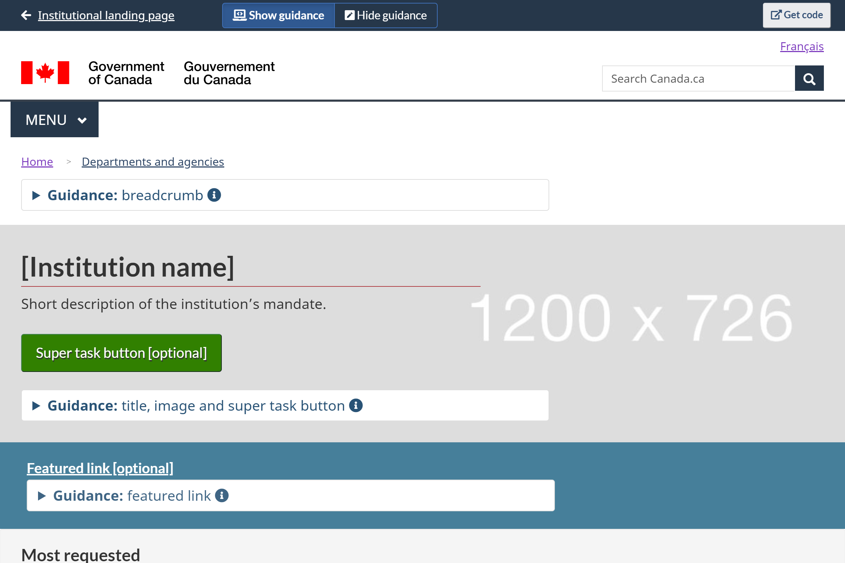
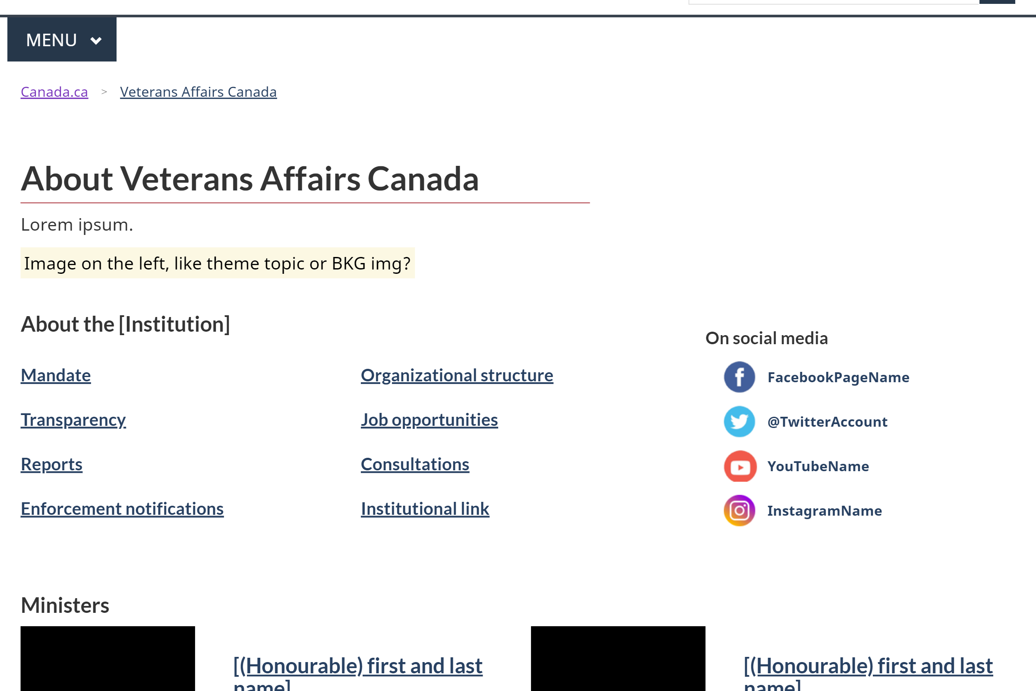
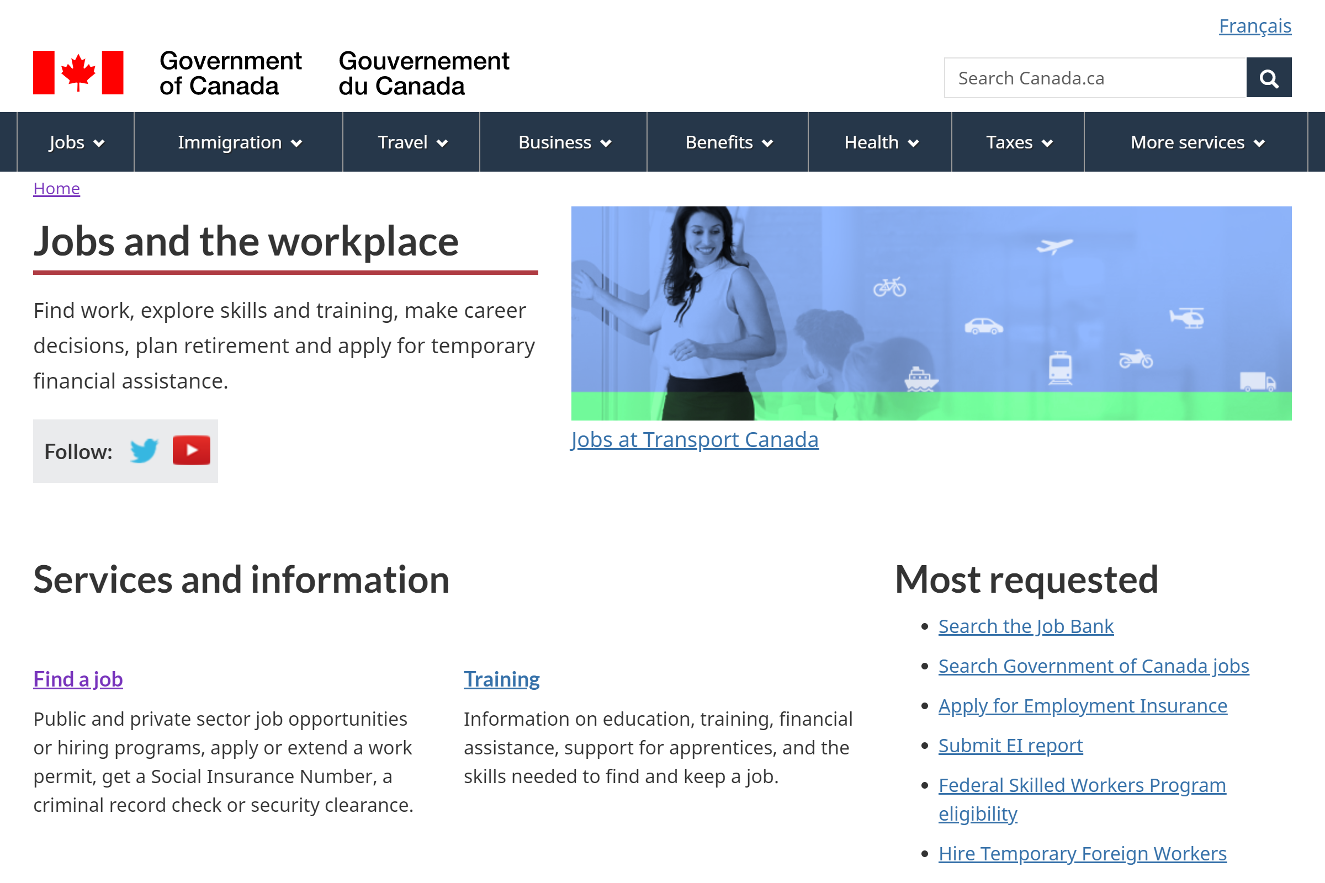
Recommended deliverables for approvals: working HTML prototypes

Slide 22
4. Content is words and design
Guidance content needs to be understandable and usable in context for audience type (health professionals, scientists, general population).
Apply proven methods and design patterns to match the type of guidance you are building:
Plain language principles / summaries (TBS Directive)
Navigation design patterns (e.g. subway, on this page)
Checklists
Expand/collapse (e.g. provide main summary points, expand for details)
Tables and charts
Wizards and drop-downs: personalized answers
Web-first content style (e.g. Canada.ca style guide)
Find these and more at: design.canada.ca

Slide 23
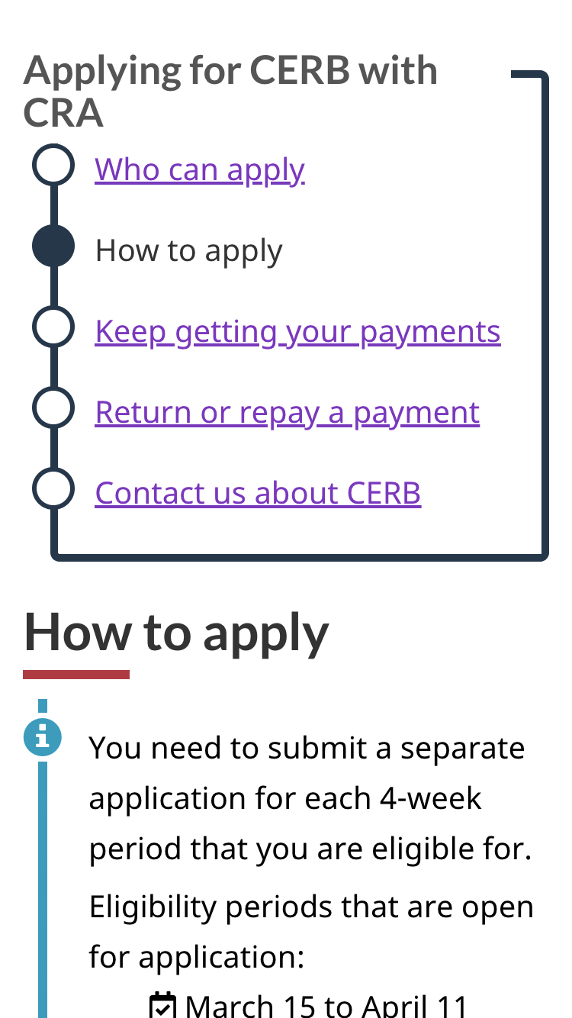
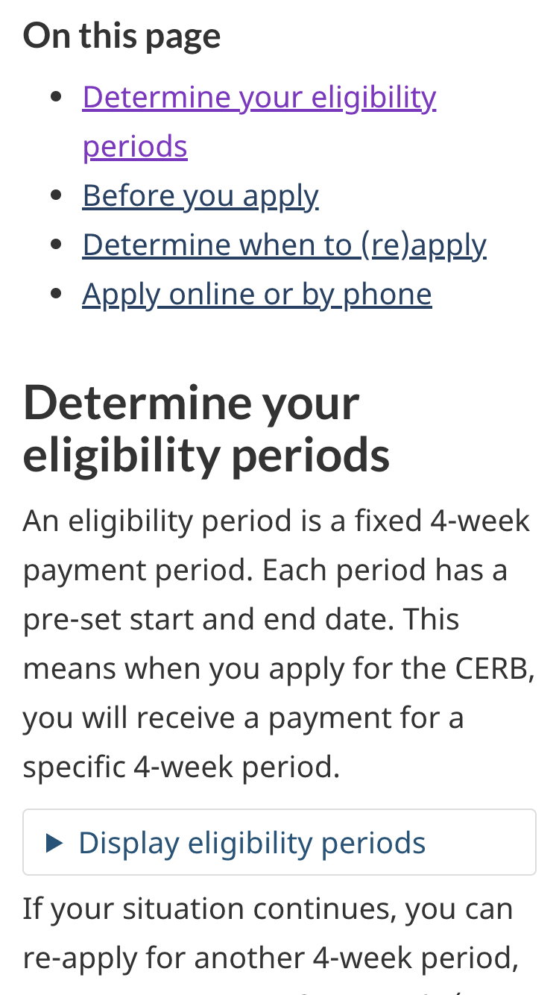
Navigation: help people find what they need
People hunt links online. Good navigation helps them use links to find what they need. Breaking content into chunks makes it easier for people to:
Follow along step by step (“subway” pattern)
Decide which part of a page they want to use (“On this page” links)

Slide 24
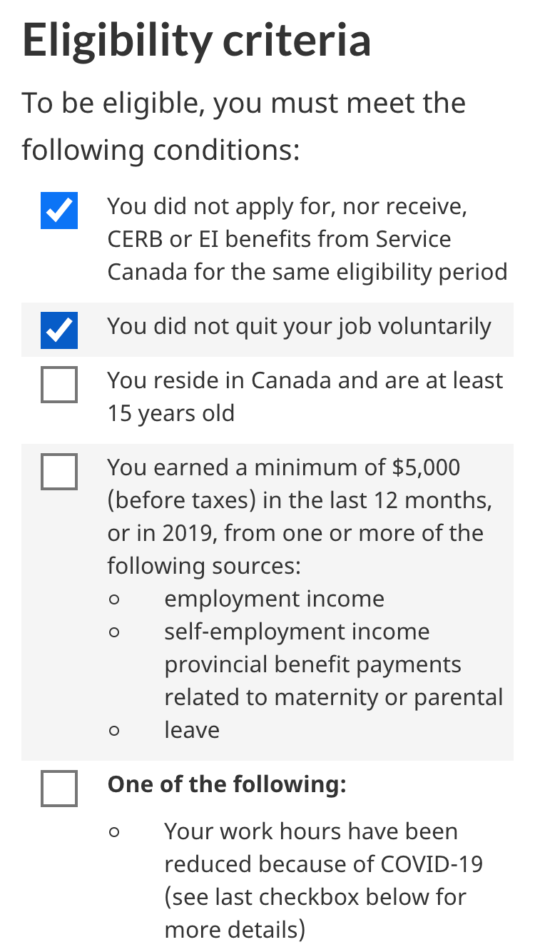
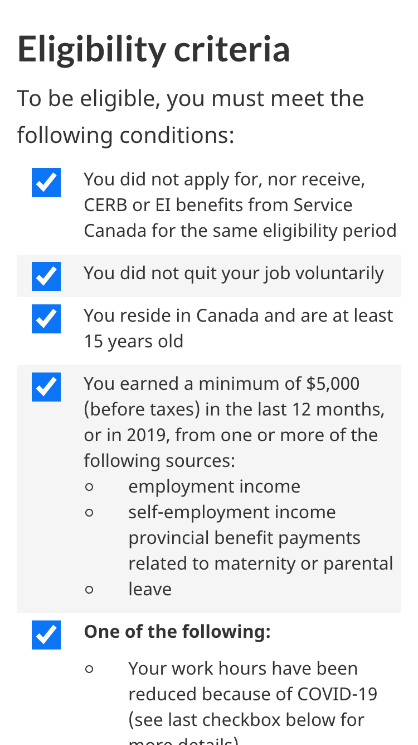
Interactive checklists: instructions you can use
Providing interaction on a list of instructions focuses people’s attention & facilitates greater understanding
Confirming success reinforces and reassures

Slide 25
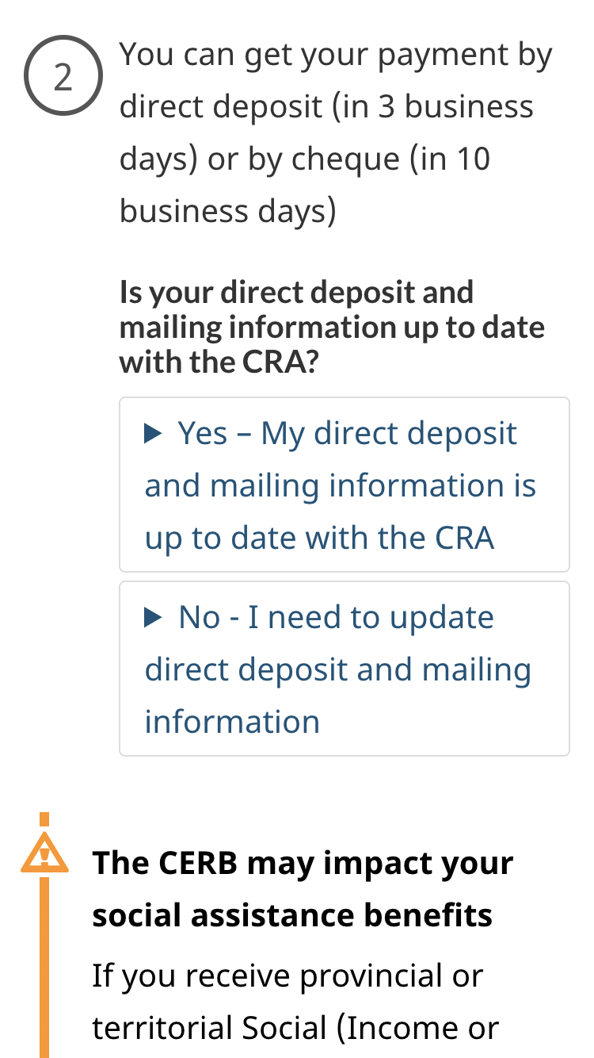
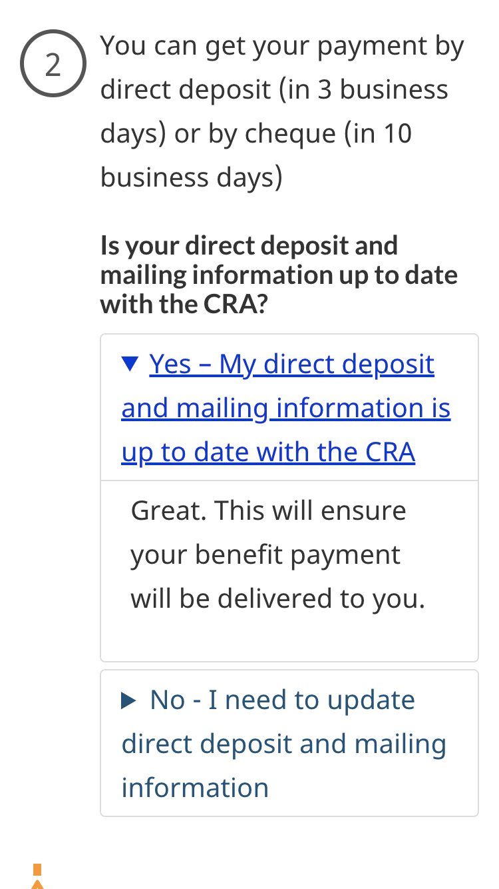
Expand/collapse: making choices
Expand/collapse interaction is excellent for when people need to make mutually exclusive choices
Expanding content improves people’s confidence that they have made the correct choice

Slide 26
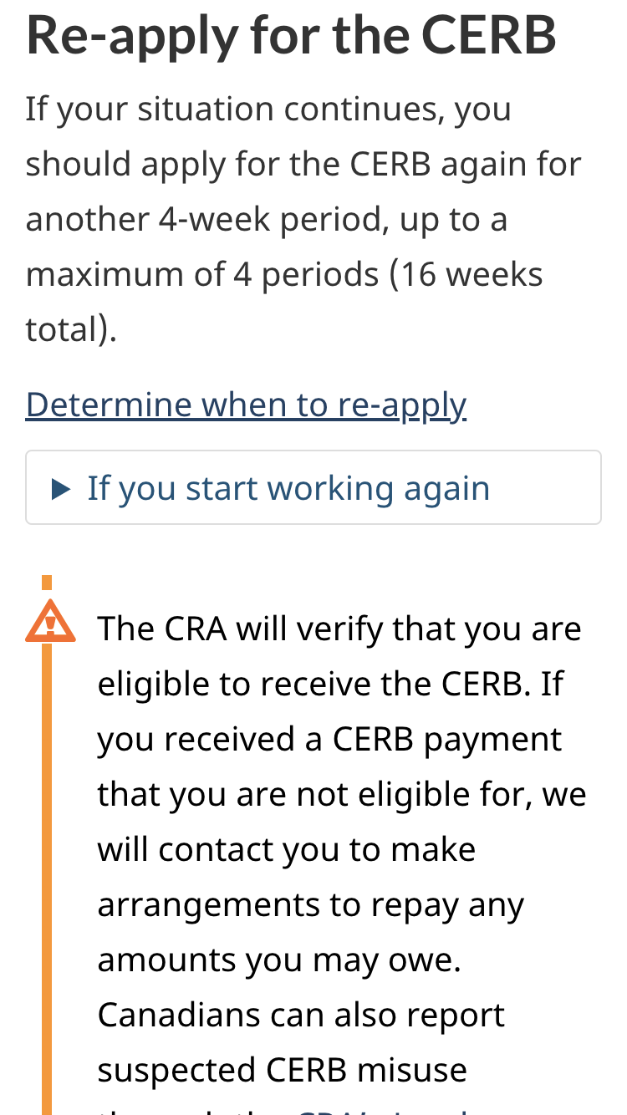
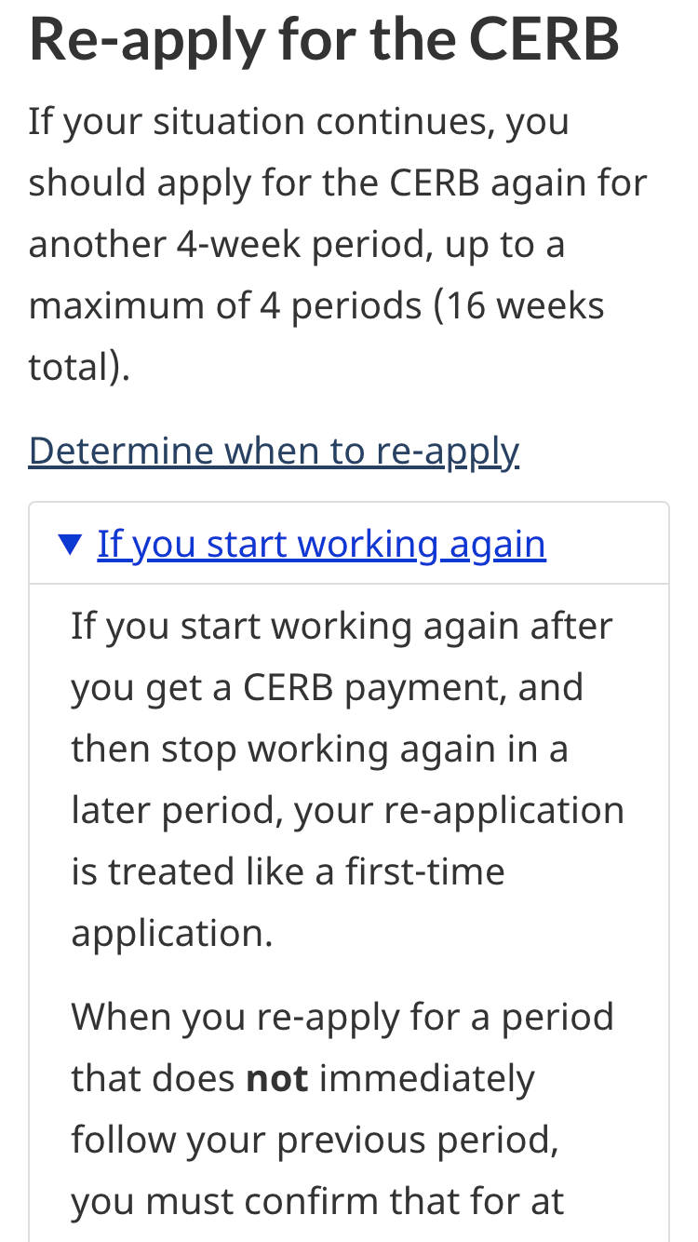
Expand/collapse: Presenting secondary info
Use to prevent secondary content from interfering with the main task.
Only use for content that applies to a minority of people or a rare situation
Labelling is key - provide info scent for the hidden content

Slide 27
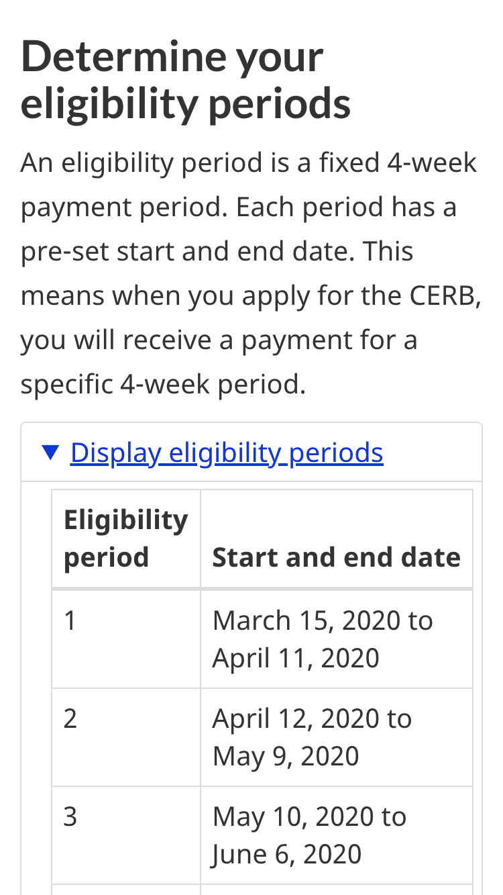
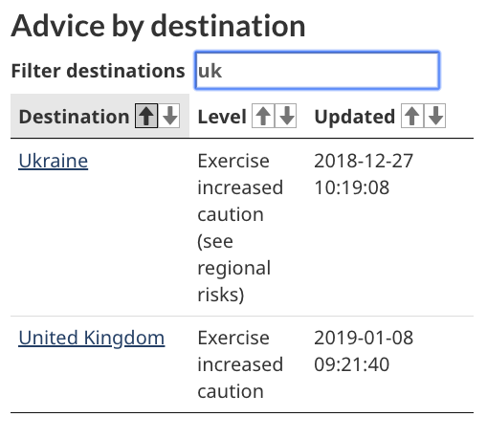
Tables and charts
Tables are great for communicating data
Make tables interactive by including filtering and sorting tools
Ensure they are coded to meet accessibility standards

Slide 28
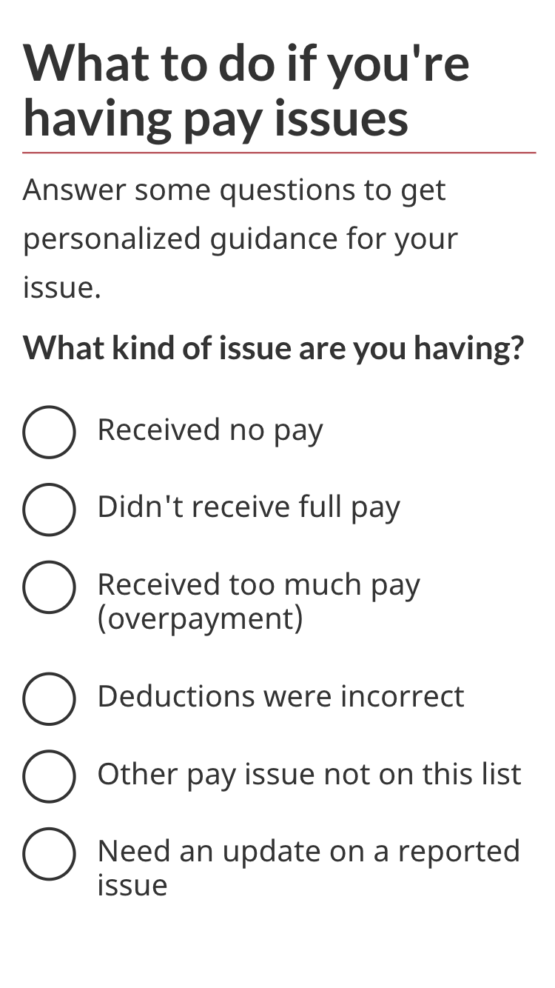
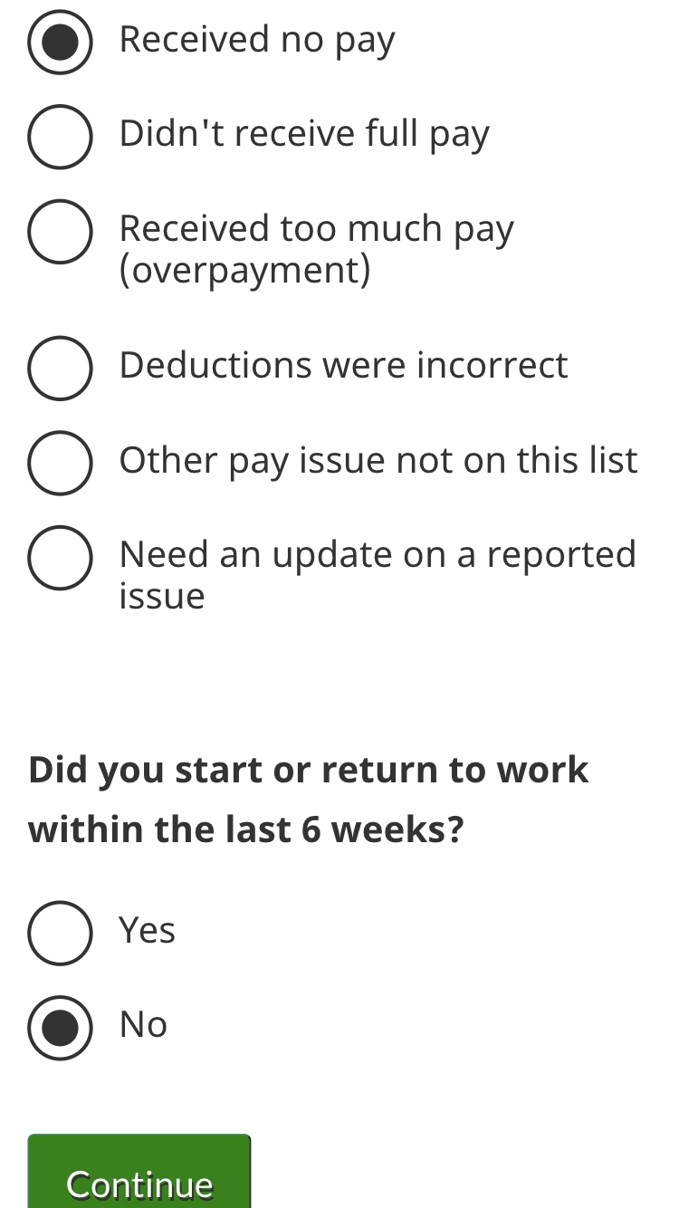
Wizards: guided answers
Structuring your content as answers to interactive questions helps personalize it to people's situations
Personalized answers helps limit people’s cognitive load to what is relevant for them

Slide 29
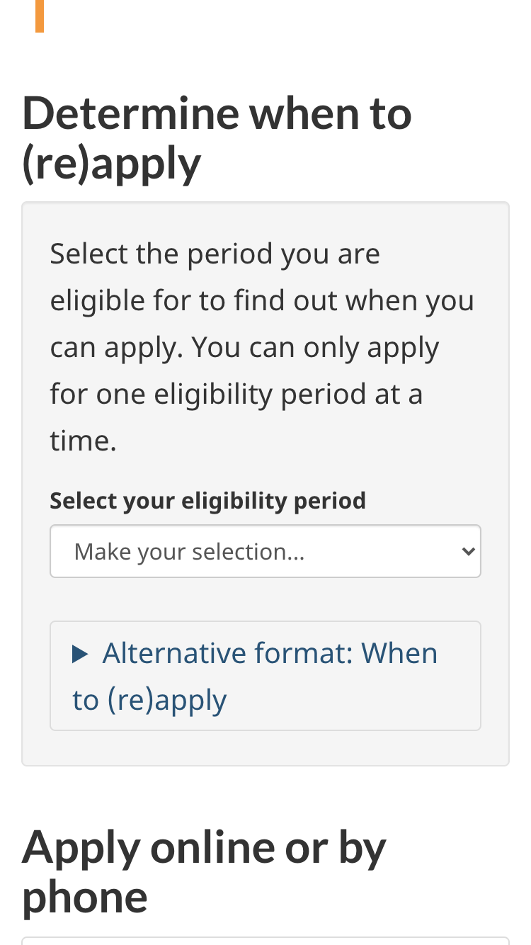
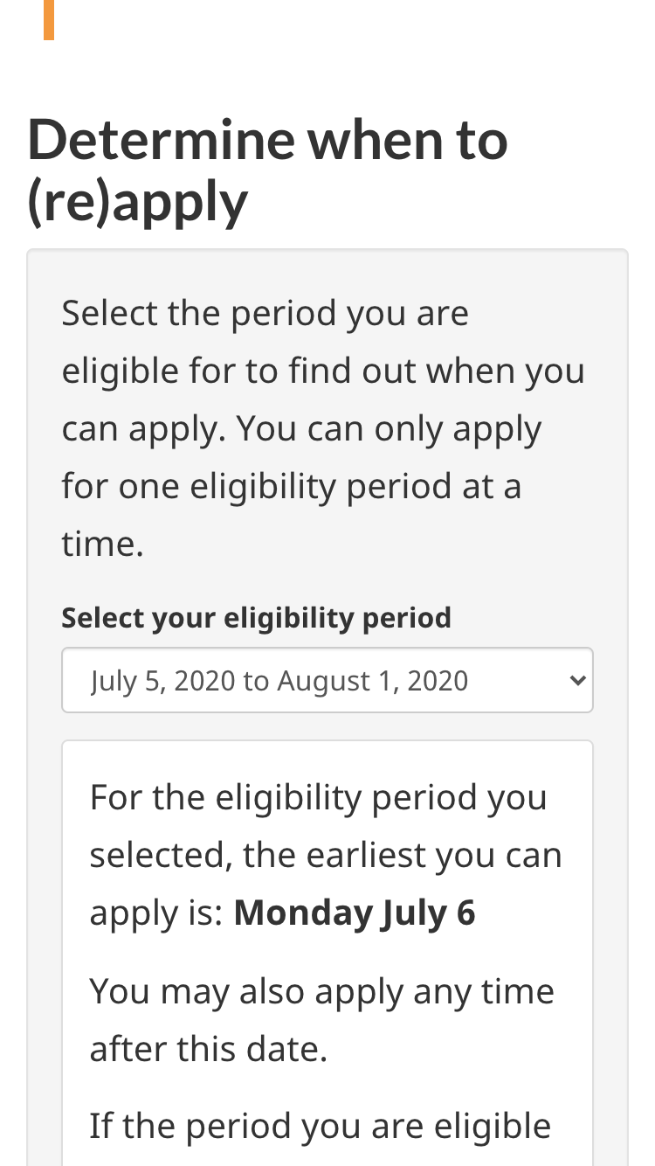
Drop-down selection: choose the option that applies to you
Similar to wizards, but for a single question rather than a series
Returns appropriate answer based on your situation
Limits cognitive load - you don’t have to evaluate answers not relevant to you

Slide 30
Plain language
There is growing evidence that a well-executed plain language approach can:
Improve understanding of scientific and complex information
Save time and money
Improve customer satisfaction
Writing in plain language is not ‘dumbing down information’ but rather simply enables Canadians (no matter their background) to:
Find what they need
Understand what they find
Use what they find to meet their needs

Slide 31
Plain language version alongside technical guidance
When you need to publish full guidance quickly, it is important to at least:
Create a page that summarizes the guidance with plain language, checklists, etc. that can be used to fulfill the user need
Place this summary more prominently in the IA than the detailed guidance itself
Link the summary to detailed guidance for those who want the full details
Make a plan for iterating content
[visual examples on next 2 slides]
Notes:
In a pandemic situation we can’t afford to wait for web/digital and policy/program to work through their differences. People need the answers buried in guidance now.
Related deck: Have a plan for iterating content (such as found in this guide on how to move from announcements to web content…) https://docs.google.com/presentation/d/1uO3FKJN8YsFl5a3FWA0H1ae8c6BkB0bCj0c3Ble-UJQ/edit#slide=id.p

Slide 32
Technical guidance and plain-language summary
Technical guidance with extensive background
Plain-language summary with short introduction

Slide 33
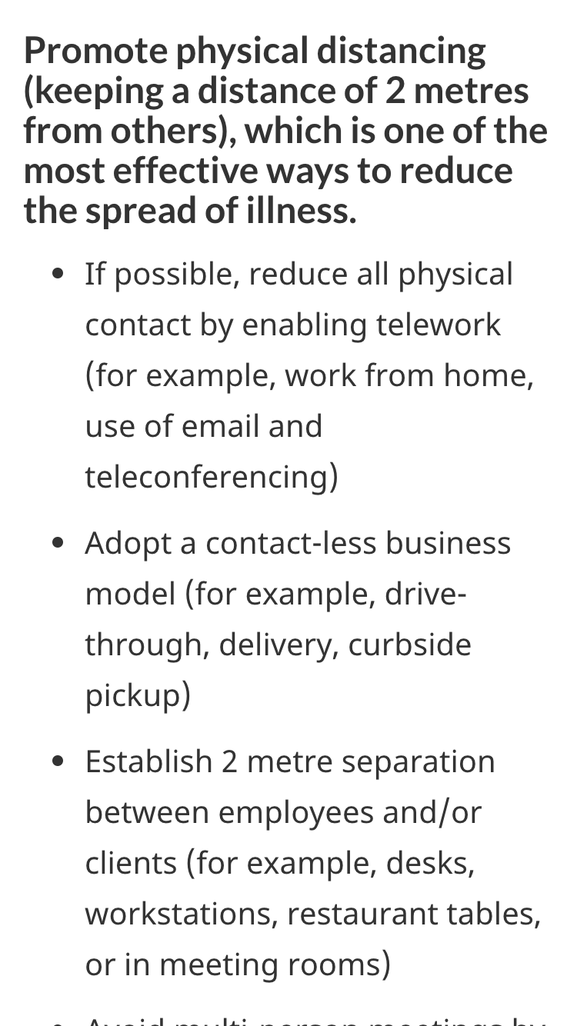
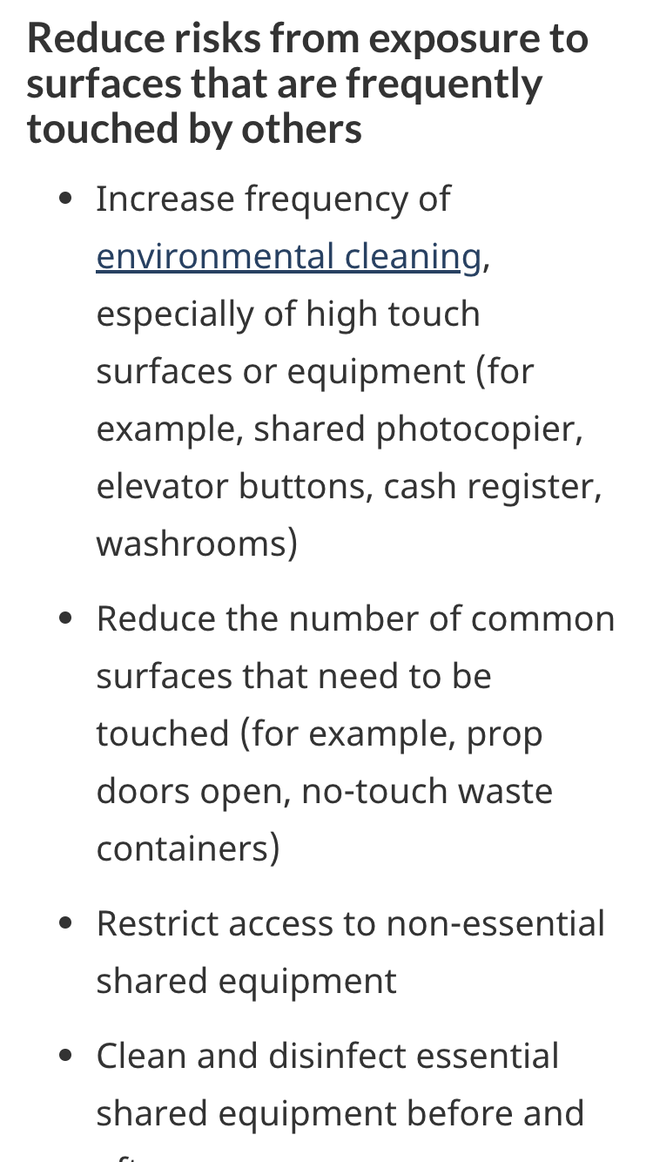
Guidance in point form, as instructions
Answers not information - people’s attention is limited, so limit content accordingly
Use verbs in the imperative for instructions

Slide 34
Content style: Answers not information
Inverted pyramid — most actionable or important first
Use plain language — Even experts can benefit as they are extremely busy people
Clear and simple headings — Avoid words like “tools” “resources” ...
Don’t use third person (they/them) — Speak directly to the user (you)
Drop the intro/background info — Get to the substantive content which provides answers
Pull links out of paragraphs — They should sit on their own
Avoid footnotes — If it’s worth mentioning, mention in main text
Avoid FAQs - read Avoiding FAQs, with one exception
Follow the Canada.ca style guide! It covers these and other points, gained from experience researching, designing and testing effective content: Canada.ca content style guide

Slide 35
Tools and resources

Slide 36
Tools to reference and use
Crisis communications content design checklist
Using web-page alerts during a crisis
Avoiding FAQs, with one exception
Canada.ca content style guide
Template and pattern library for Canada.ca
Checking content reading level with the Flesch-Kincaid tool in MS Word

Slide 37
Annex

Slide 38
Annex A:

