Slide 1
CBSA Business Architecture Business Architecture Program
February 2021

Slide 2
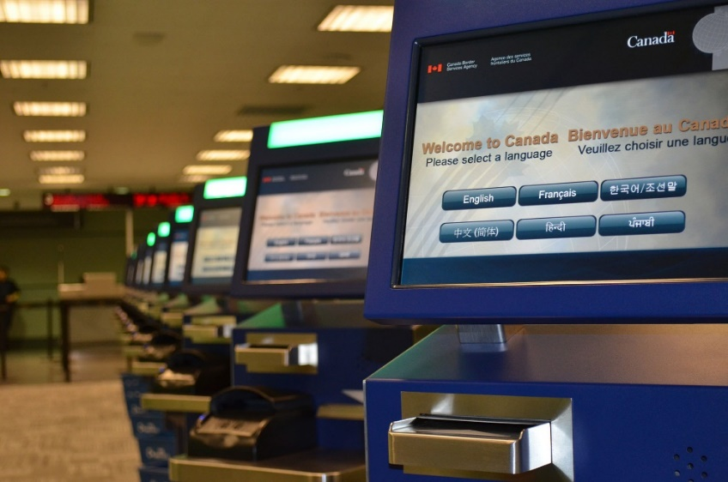
Presentation Objectives
Provide an overview of the CBSA Enterprise Business Architecture Practice (EBA).
Demonstration of the current Business Architecture Content

Slide 3
CBSA Enterprise Architecture
Organized into 5 Architectural Domains (BIATSP)
Business
Information
Application
Technology
Security/Privacy
Fully aligns with TBS direction of a strong Business Led Enterprise Architecture Practice
Widely recognized as one of the most advance EA practices in the GoC

Slide 4
CBSA Business Architecture Team
Fulltime Manager
3 A-base Resources dedicated to Reference Architecture Content and client support
CS-04 Domain Lead
CS-03 Architect
Contractor
6 Client funded resources dedicated to Business Process Management and Modeling exercise
Work with various Program branch resources to fully model the CBSA Business Processes

Slide 5
Accomplished to date
Developed complete baseline reference architecture in the business domain, integrated with Information and Application
CBSA APM repository is maintained within our Agency Collaboration Platform (ACP) and is connected to business at the process level
Maintenance of the Agency Business Service Inventory within the ACP
Support branch business owners in service identification and annual reporting to TB
Adopted Industry Standard Process Categorization Framework for Business Process Management
Developed baseline CBSA Capability model that will be deployed for further use in 2022
Education of Program Clients on what capabilities are and how to use them

Slide 6
Upcoming Work
Further development of Capability model and integration into regular business use
Working with Strategic Planning on integration of Investment Logic Maps and Benefits realization plans with the reference architecture
Align the CBSA Critical Service inventory/report with the CBSA Business Service inventory
Complete BPMN modeling of the CBSA business process catalogue
Multi-year effort to develop and maintain a persistent process repository complete with standardized models

Slide 7
CBSA by the Numbers
17 Programs and 10 Internal Service groupings
327 CBSA, Other Agency and Private Sector Organizational references
197 Business Services
Includes External Services that provide service to the CBSA
450+ Business Processes
96 Acts of Parliament and 581 section specific Legislative References
321 Regulations and other Agreements
976 Policy References
118 Agency and Program Outcomes
251 Performance Measures
301 Business Roles
100+ Business Information Objects
186 National Business Applications
764 models (Excluding BPMN diagrams)

