Slide 1
Northern Housing Innovation Centre
Yukon College
First Nations Managers’ Joint Gathering
June 12, 2019
Stephen Mooney Msc, P.Eng
Director, Northern Housing Innovation

Slide 2
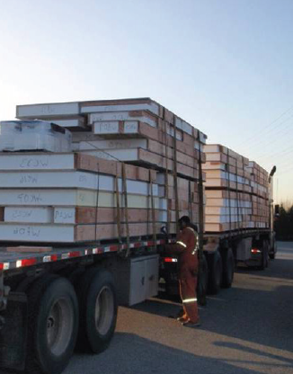

VISION:
To bring together all levels of government, technical experts, the housing construction and development sectors, and Northerners to address housing issues in Canada’s North.

Slide 3
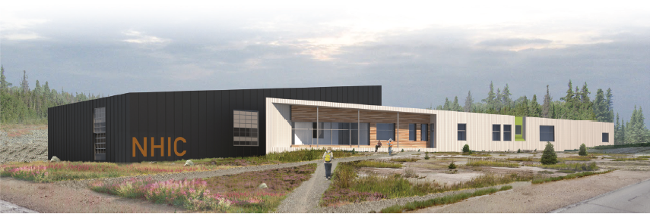
PURPOSE:
To introduce the Northern Housing Innovation Centre (NHIC), a new
housing research facility proposed for the Yukon College Campus in Whitehorse, Yukon. Located in the traditional territory of the Kwanlin Dün First Nation and the
Ta’an Kwäch’än Council.

Slide 4
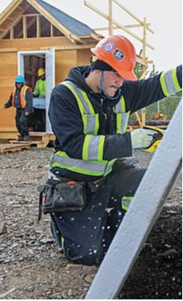
FOCUS:
Building upon the existing assets at Yukon College,
the NHIC will focus on the following areas:
Building Science Research (Indoor air quality, windows)
Policy Research (Standards, funding options/models)
Culturally relevant Housing Designs and Manufacturing
Construction - Installation/Project Management
Housing Support Technologies (Apps, hardware/software)
Construction Technologies (3D Printing, Composite Construction)

Slide 5
BACKGROUND:
Working together, with:
Governments - Yukon Housing Corporation, Yukon Government
  Carcross/Tagish Management Corporation
Industry – Local Architecture firm Kobayashi+Zedda, Ketza Construction
Academia – Yukon College soon to be Yukon University

Slide 6
FOCUS ON APPLIED RESEARCH:
To address many of the current northern housing issues and their
innovative application. Done in partnership with:
Other Universities
Various government
Industry - Housing construction and development / design
NSERC Industrial Research Chair
GOAL - Advance best practices in all areas on the Northern Housing Industry

Slide 7
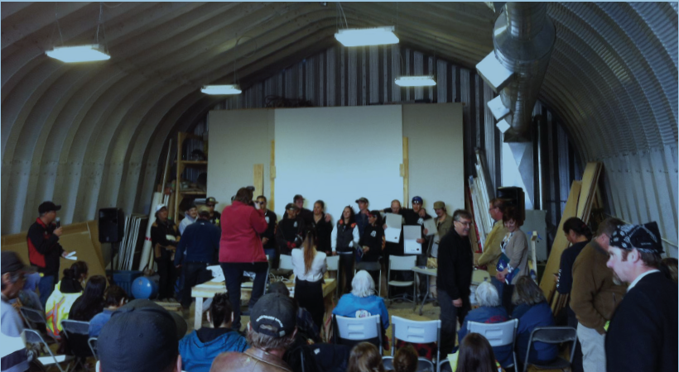
PROVIDE MEANINGFUL CURRICULUM & DESIGNATION:
Work with Yukon College/University to develop a culturally relevant
degree in Northern Housing (Diploma, Degree, Technical Certification
with measurable social and community benefits for individuals and
communities.

Slide 8
SOCIAL + HOUSING INNOVATION:
Combine housing and social goals with a focus on increasing skills and employment for First Nation people who face long term barriers to work. Create new more effective methods of supportive employment in communities across the North: Mentorship and work/like coaching, social issues/challenges faced by workers, training in mental and emotional safety and wellness.

Slide 9
PROVIDE A HANDS ON TESTING LAB & RESOURCES:
Establish a housing Lab component where community members, trades, and
technical experts test, share and/or receive hands-on training regarding the various building systems (wall, floor, electrical, heating, HVAC, etc.) that are necessary to build and maintain a healthy, efficient, and durable northern house.

Slide 10
OPERATE AS A NOT-FOR-PROFIT ORGANIZATION:
Revenues and resources are invested back into the facility to expand its educational programing, research, fabrication, and applied building systems/technology.

Slide 11
COLLABORATIVE, KNOWELDGABLE LEADERSHIP:
Governance by a Board that includes Housing Industry Leaders, multiple levels of government (First Nations, Federal, and Territorial) and Yukon College that will work collaboratively to establish the mandate of NHIC.

Slide 12
Blueprint Ready Drawings

Slide 13
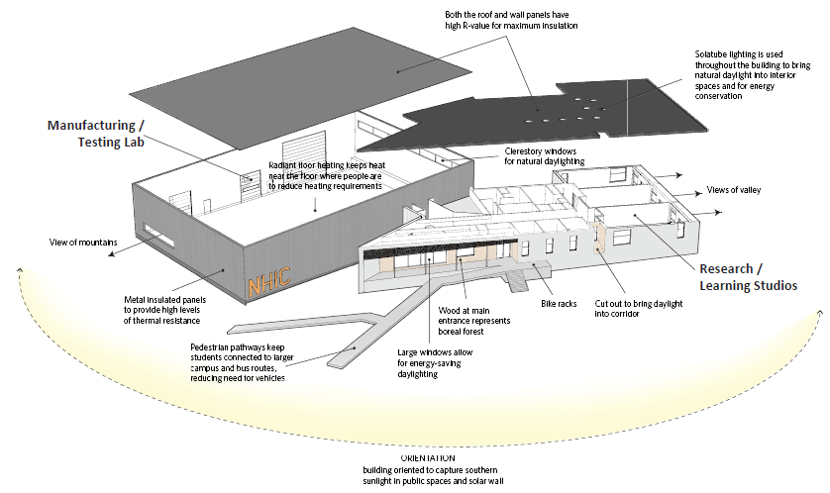

Slide 14
Northern Housing Innovation Centre
Near term opportunities include:
Look at securing an NSERC Industrial Research Chair, Northern Housing Innovation
Pan Territorial approach to Housing issues
Collaboration with First Nations in Yukon to build a housing factory with classrooms that will enable knowledge capacity building.

Slide 15
Northern Housing Innovation Centre (NHIC)
Thank You Màhsi’ choo
http://www.yukoncollege.yk.ca/research
smooney@yukoncollege.yk.ca

