Slide 1
Governance for Digital Solutions
Overview of Concept Cases and GC Enterprise Architecture Review Board
PRESENTER
SECTOR
DATE
TBS
OCIO
April 2019
Updated: APR 3/19
GCDOCS # 32893862

Slide 2
Purpose of Today’s Session …
Highlight the integrated nature of the Digital Project journey
Explain the Concept Case process
Explain when and why to come to GC EARB

Slide 3
What is Enterprise Architecture (EA) ?
An enterprise architecture (EA) is a conceptual blueprint that defines the structure and operation of an organization. The intent of an enterprise architecture is to determine how an organization can most effectively achieve its current and future objectives.
https://searchcio.techtarget.com/definition/enterprise-architecture
Enterprise architecture (EA) is a discipline for proactively and holistically leading enterprise responses to disruptive forces by identifying and analyzing the execution of change toward desired business vision and outcomes.
https://www.techopedia.com/definition/24746/enterprise-architecture-ea
…a discipline for proactively and holistically leading enterprise responses to disruptive forces by identifying and analyzing the execution of change toward desired business vision and outcomes. EA delivers value by presenting business and IT leaders with signature-ready recommendations for adjusting policies and projects to achieve target business outcomes that capitalize on relevant business disruptions.
https://www.gartner.com/it-glossary/enterprise-architecture-ea/

Slide 4
Why Do We Do EA?
Where do we need to be NOW so that we are in the right place then?
What will the world be like in 2025?
What are other government jurisdictions doing… How do we compare?
“A process to determine where an organization is going over a defined period of time and specify how it intends to get there…”
“ Strategic planning is an evolutionary process that should be part of a continuous management lifecycle. The real benefit and value of strategic planning process is the process” ¹
¹ PM Boulevard Article, “The Strategy Lifecycle” by James Picard, Robbins-Giola, LLC. September 2006

Slide 5
Governance for Digital Solutions
EARLY ENGAGEMENT
SOLUTION ALIGNMENT
PROJECT AUTHORITY
ASSURANCE
Budget Proposal & M.C.
Solution Architecture
TB Sub (TB)
Project Execution
Concept Case
Identifies and defines strategic needs by the business
GC EARB
TB Submission
Project Oversight
Mandatory Procedure
Directive
OPMCA Requirements
Ongoing Project Monitoring
Has the problem or opportunity been well defined?
Is there a clear vision of the desired business outcomes and future state?
Is there alignment to using GC Digital Standards?
Have the GC Digital Standards and Architecture Standards been applied?
Is the initiative a candidate to drive out new GC reference architectures?
Does the project comply to TB policies?
Is it aligned with GC Strategies?
Has the project been to GC EARB?
Is the project positioned for success?
Are course corrections needed?

Slide 6

Why Concept Cases?
“Let’s work the problem, people.
Let’s not make things worse by guessing.”
Gene Kranz, Flight Director Apollo 13
Explore and Refine the Business Problem

Ensure a clear understanding of the business problem before discussing solutions.
Early engagement with TBS to ensure alignment prior to proceeding with the investment planning process.
Ensure that investments are conceived in a manner that aligns with the Government of Canada’s Digital Standards.
Don’t Jump Directly to Solutions

Slide 7
What is a Concept Case?
Concept Case
P
Proposed Initiative:
Department:
ADM Business Owner:
Date:
Explain the business problem/opportunity that needs to be solved in one sentence.
Problem/Opportunity
What are your desired business outcomes?
Desired Business Outcome
Explain the current state in which the problem/opportunity exists.
Provide evidence to support the business problem/opportunity.
Future State
Current State/Context
Describe the future state in terms of business capabilities required.
Why does the problem or opportunity exist?
Next Steps
Root Cause
What are the next steps?
Are there any known time constraints moving forward?
Notes:
New Mandatory Procedures for Concept Cases for Digital Projects
Support of the possible initiation of an Digital project to solve a business problem or to take advantage of an opportunity to improve program outcomes.
A concept case is an examination of the problem or opportunity, and a description of the conceptual future state and desired business outcome(s).
Provides an early signal to TBS with respect to prospective Digital projects on the horizon, thereby facilitating earlier engagement prior to significant investments in project definition and before a project course is set.

Slide 8
Problem Solving is an Investment
Value of the Problem
(KPIs, Metrics)
Root Cause
Customer Perspective
Constraints
Environmental Analysis (PESTLE)
Problem Analysis
History of the Problem
Business Owner
“It’s not that I’m so smart, it’s just that I stay with problems longer.” Albert Einstein

Slide 9
Concept Case Process
Identify
  Use criteria (below) to determine which potential investments require concept case
  Engage with TBS Program Sector analyst and the Office of the Chief Information Officer (OCIO)
Develop
  Work directly with TBS OCIO for advice on the development of concept cases
  Submit concept case to TBS Program Sector analyst
Review
  OCIO subject matter experts (e.g. cyber, cloud) analyse concept cases and provide feedback
Respond
GC CIO endorses concept case
Response provided to department with endorsement and guidance
Criteria*
The initiative is at the concept stage prior to either a memorandum to cabinet, a business case, or a Treasury Board submission.
It is likely that the initiative will use digital technology.
The department is willing to spend more than the following to solve the business problem:
  Small Departments and Agencies = $2.5M
  Medium to Large Departments = $5.0M
  Department of National Defence = $15 M
Links for Mandatory Procedures on Concept Cases and the Concept Case Template
English
https://www.tbs-sct.gc.ca/pol/doc-eng.aspx?id=32578
French
https://www.tbs-sct.gc.ca/pol/doc-fra.aspx?id=32578
*Mandatory Procedure on Concept Cases (Policy on Investment Planning – Assets and Acquired Services)

Slide 10

What is the GC EARB?
In order to optimize the business, the Digital Strategy will position the user first in an open, collaborative and accessible way using digital solutions to deliver services.
Digitally, the GC must operate as one to benefit all Canadians.
Mandate:
The Policy on the Management of Information Technology assigns responsibility to the Chief Information Officer of Canada to establish an implement an Enterprise Architecture Review Board that is mandated to define current and target architecture standards for the Government of Canada, and review departmental plans to ensure alignment.
Provide technical recommendations and highlight enterprise-wide directions to the GC CIO for consideration and approval.
TB Policy on the Management of IT (April 1, 2018) https://www.tbs-sct.gc.ca/pol/doc-eng.aspx?id=12755#appA

Slide 11
When to come to GC EARB?
“The Criteria”
Engaging EARB…
Proposals concerned with the design, development, installation and implementation of digital services or solutions, information systems and applications (“digital initiatives”) where the department is willing to invest a minimum of the following amounts in order to address the problem or take advantage of the opportunity:
That involve emerging technologies;
That require an exception to any applicable Directive or Standard under the Policy on the Management of Information Technology;
That are categorized at the protected B level or below‎ using a deployment model other than public cloud for application hosting (including infrastructure), application deployment, or application development; or
As directed by the Chief Information Officer of Canada.
$2.5 million + OPMCA of 0 or 1 $5 million + OPMCA of 2 | $10 million + OPMCA of 3 $15 million Department of National Defence | $25 million + OPMCA of 4
NOTE:
❶ Please ensure that all proposals submitted for review by the Government of Canada Enterprise Architecture Review Board have first been assessed by the departmental architecture review board where one has been established.
❖ Ensure that proposals are submitted to the Government of Canada Enterprise Architecture Review Board following review of concept cases¹ for digital projects and before the development of a Treasury Board Submission or Departmental Business Case.
❸ Ensure all departmental initiatives are assessed against and meet the requirements of Appendix C: Mandatory Procedures for Enterprise Architecture Assessment and Appendix D: Mandatory Procedures for Application Programming Interfaces.
https://www.tbs-sct.gc.ca/pol/doc-eng.aspx?id=15249

Slide 12
Engagement Criteria – What Has Changed
Clearly Defined Criteria
1
Directive on the Management of Information Technology
Mandatory Procedures for Enterprise Architecture
2
Directive on the Management of Information Technology – Appendix C
3
Mandatory Procedures for Application Programming Interfaces
Directive on the Management of Information Technology – Appendix D
Notes:
OLD:
$1 million for Small Depts. /Agencies, $5 million for Large LDAs, and $15 million for DND.
IT plan projects
Public facing services
Enterprise or Enterprise cluster solutions (e.g., can be re-used by other government departments)
Seeking to establish or update an Enterprise Target Architecture or Standard
Seeking an Architectural Exemption
Cloud based or Cloud Services
Conducting Research, Experiment, or Innovation proposal
Preparing a contract renewal(s) for long-standing technology (e.g., solutions intended to have a 5-10 year lifecycle) or values that meet the established financial thresholds
Disruptive/transformational and/or new technology

Slide 13

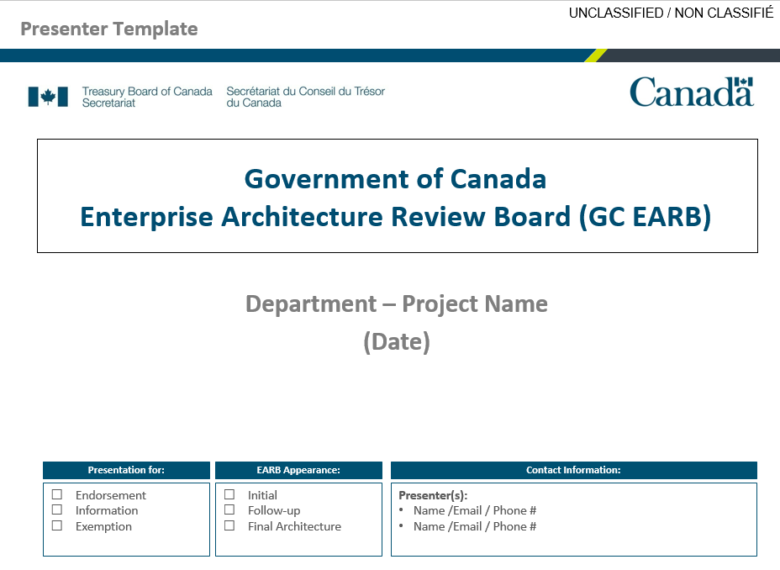
What Do I Do First?
1
2
3
Conduct a self-assessment of your initiative against the “Criteria” to determine if you should be presenting to the GC EARB.
IF so, complete the GC EARB Template
Ensure that all proposals submitted for review to GC EARB have first been assessed by your DARB (Departmental Architecture Review Board) where one has been established.
Ensure your departmental initiatives are assessed against and align to the requirements set out as the GC Architectural Standards.
POLICY:
Criteria
Directive on the Management of Information Technology :
https://www.tbs-sct.gc.ca/pol/doc-eng.aspx?id=15249
Results Enabler
Digial
Stds.
Arch.
Stds.
EARB Template:
https://wiki.gccollab.ca/GC_EARB
IT Supplier

Slide 14

How do you go about getting on the agenda?
1
GC Pedia
https://wiki.gccollab.ca/GC_EARB
Departmental Input
  Go to GC Pedia to attain the most recent GC EARB “Presenter Template”
  Complete the deck
  Email the deck to the generic mailbox:
ZZCIOBDP@tbs-sct.gc.ca
TBS – OCIO (EA Review)
  GC EARB team receives alert of a new submission.
  A tentative date for the presentation is identified.
  A GC EA team conducts a review the input material.
  Comments are provided back to the department for clarification.
  A call/meeting occurs to discuss feedback and refine understanding.
  Updated presentation materials may be requested.
  The EARB meeting date is confirmed.
Prepare Assessment
  An architectural assessment is prepared by the GC EA team.
  Alignment against both the GC Digital and GC Architectural Standards is performed.
  This feedback is provided to the department as well as used to brief the Co-chairs of the GC EARB prior to the meeting.

Slide 15
How it works…what to expect
2
Getting ready for the meeting
TBS-OCIO Secretariat
  2 weeks ahead:
    The Secretariat will extend the calendar invitations to the presenters (typically 1-2 people)
  1 week ahead:
    They will request the presentation materials (both French and English) 1 week prior to the session
    They prepare information packages for the EARB membership to review ahead of the meeting.
GC EARB Meeting
  Time to present (being clear to the Board why you are here…. To seek endorsement to xxx )
  A Record of Discussion (RoD) is prepared after the meeting to capture any highlights that the Board noted, as well as the decision of the Board with any conditions.
  NOTE: The RoD may take several weeks to be officially published, but will be available on the GC EARB GC Pedia site.
Follow Up
  There are times when departments must return to the GC EARB as a result of where the project is in it cycle, or from conditions identified by the Board.
  The GC EA team will capture the need for a future visit and proactively schedule it on the GC EARB Forward Agenda.

Slide 16
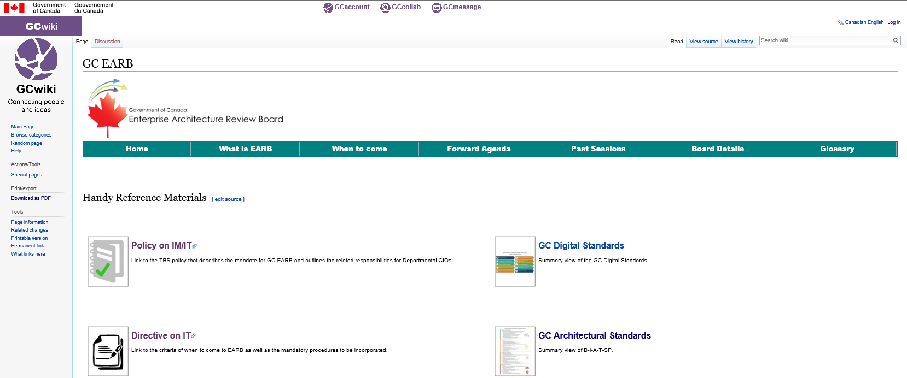
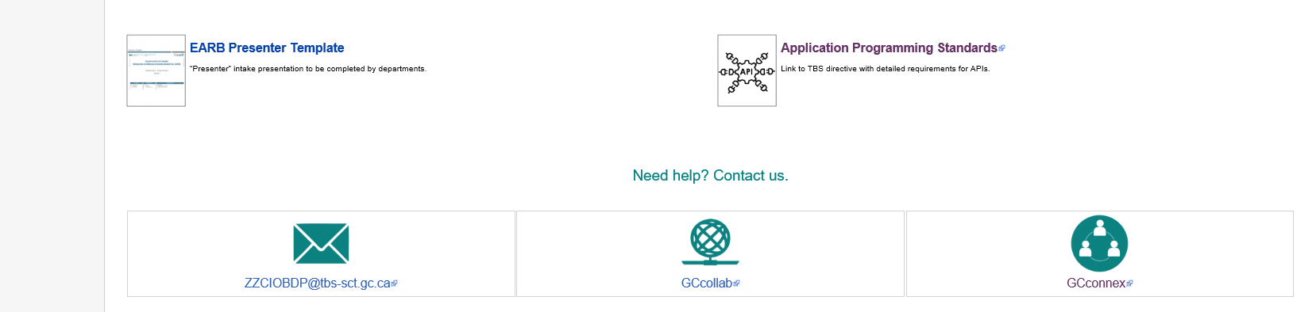
Where to get more information
Today …
https://wiki.gccollab.ca/GC_EARB
GC Wiki
GC Wiki
GC Connex
GC Collaboration
ZZCIOBDP@tbs-sct.gc.ca

Slide 18
APPENDIX:
1 - GC Digital Standards
2 - GC Architectural Standards
3 - High Level Process View
4 - GC EARB Assessment

Slide 19
APPENDIX 1
GC Digital Standards
Design with users
Build in accessibility from the start
Iterate and improve frequently
Empower staff to deliver better services
Work in the open by default
Be good data stewards
Use open standards and solutions
Design ethical services
Address security and privacy risks
Collaborate widely

Slide 20
APPENDIX 2 Mandatory Procedures for Enterprise Architecture Assessment
GC Architectural Standards
 | Business Architecture | Align to the GC Business Capability model Design for Users First and Deliver with Multidisciplinary Teams Design Systems to be Measurable and Accountable
 | Information Architecture | Data Collection Data Management Data Storage Data Sharing
 | Application Architecture | Use open standards and Solutions by Default Maximize Reuse Enable Interoperability
 | Technology Architecture | Use Cloud first Design for Performance, Availability, and Scalability
 | Security & Privacy | Design for Security and Privacy

Slide 21
Business Architecture
Align to the GC Business Capability model
Define program services as business capabilities to establish a common vocabulary between business, development, and operation
Identify capabilities that are common to the GC enterprise and can be shared and reused
Model business processes using Business Process Modelling Notation (BPMN) to identify common enterprise processes
Design for Users First and Deliver with Multidisciplinary Teams
Focus on the needs of users, using agile, iterative, and user-centred methods
Conform to both accessibility and official languages requirements
Include all skillsets required for delivery, including for requirements, design, development, and operations
Work across the entire application lifecycle, from development and testing to deployment and operations
Ensure quality is considered throughout the Software Development Lifecycle
Ensure accountability for privacy is clear
Encourage and adopt Test Driven Development (TDD) to improve the trust between Business and IT
Design Systems to be Measurable and Accountable
Publish performance expectations for each IT service
Make an audit trail available for all transactions to ensure accountability and non-repudiation
Establish business and IT metrics to enable business outcomes
Apply oversight and lifecycle management to digital investments through governance

Slide 22
Information Architecture
Data Collection
Ensure data is collected in a manner that maximizes use and availability of data
Ensure data collected aligns to existing enterprise and international standards
Where enterprise or international standards don’t exist, develop Standards in the open with key subject matter experts
Ensure collection of data yields high quality data as per data quality guidelines
Ensure data is collected through ethical practices supporting appropriate citizen and business-centric use
Data should only be purchased once and should align with international standards
Where necessary, ensure collaboration with department/ agency data stewards/ custodians, other levels of government, and Indigenous people
Data Management
Demonstrate alignment with enterprise and departmental data governance and strategies
Ensure accountability for data roles and responsibilities
Design to maximize data use and availability
Data Storage
Ensure data is stored in a secure manner in accordance with the National Cyber Security Strategy, and the Privacy Act
Follow existing retention and disposition schedules
Ensure data is stored in a way to facilitate easy data discoverability, accessibility, and interoperability
Data Sharing
Data should be shared openly by default as per the Directive on Open Government
Ensure government-held data can be combined with data from other sources enabling interoperability and interpretability through for internal and external use
Reduce the collection of redundant data
Reuse existing data where possible
Encourage data sharing and collaboration

Slide 23
Application Architecture
Use Open Standards and Solutions by Default
Where possible, use open standards and open source software first.
If an open source option is not available or does not meet user needs, favour platform-agnostic COTS over proprietary COTS, avoiding technology dependency, allowing for substitutability and interoperability
If a custom-built application is the appropriate option, by default any source code written by the government must be released in an open format via Government of Canada websites and services designated by the Treasury Board of Canada Secretariat
All source code open must be released under an appropriate open source software license
Expose public data to implement Open Data and Open Information initiatives
Maximize Reuse
Leverage and reuse existing solutions, components, and processes
Select enterprise and cluster solutions over department-specific solutions
Achieve simplification by minimizing duplication of components and adhering to relevant standards
Inform the GC EARB about departmental investments and innovations
Share code publicly when appropriate, and when not, share within the Government of Canada
Enable Interoperability
Expose all functionality as services
Use micro services built around business capabilities. Scope each service to a single purpose
Run each IT service in its own process and have it communicate with other IT services through a well-defined interface, such as an HTTPS-based application programming interface (API) as per Appendix D: Mandatory Procedures for Application Programming Interfaces of the Directive on Information Technology¹
Run applications in containers
Leverage the GC Digital Exchange Platform for components such as the API Store, Messaging, and the GC Service Bus
_______________________________________________________________________________________________
¹ Directive on the Management of Information Technology : https://www.tbs-sct.gc.ca/pol/doc-eng.aspx?id=15249

Slide 24
Technology Architecture
Use Cloud first
Enforce this order of preference: Software as a Service (SaaS) first, then Platform as a Service (PaaS), and lastly Infrastructure as a Service (IaaS)
Enforce this order of preference: Public cloud first, then Hybrid cloud, then Private cloud, and lastly non-cloud (on-premises) solutions
Design for cloud mobility and develop an exit strategy to avoid vendor lock-in
Design for Performance, Availability, and Scalability
Design for resiliency
Ensure response times meet user needs for availability
Support zero-downtime deployments for planned and unplanned maintenance
Use distributed architectures, assume failure will happen, handle errors gracefully, and monitor actively

Slide 25
Security Architecture and Privacy
Design for Security and Privacy
Implement security across all architectural layers
Categorize data properly to determine appropriate safeguards
Perform a privacy impact assessment (PIA) and mitigate all privacy risks when personal information is involved
Balance user and business needs with proportionate security measures and adequate privacy protections.

Slide 26

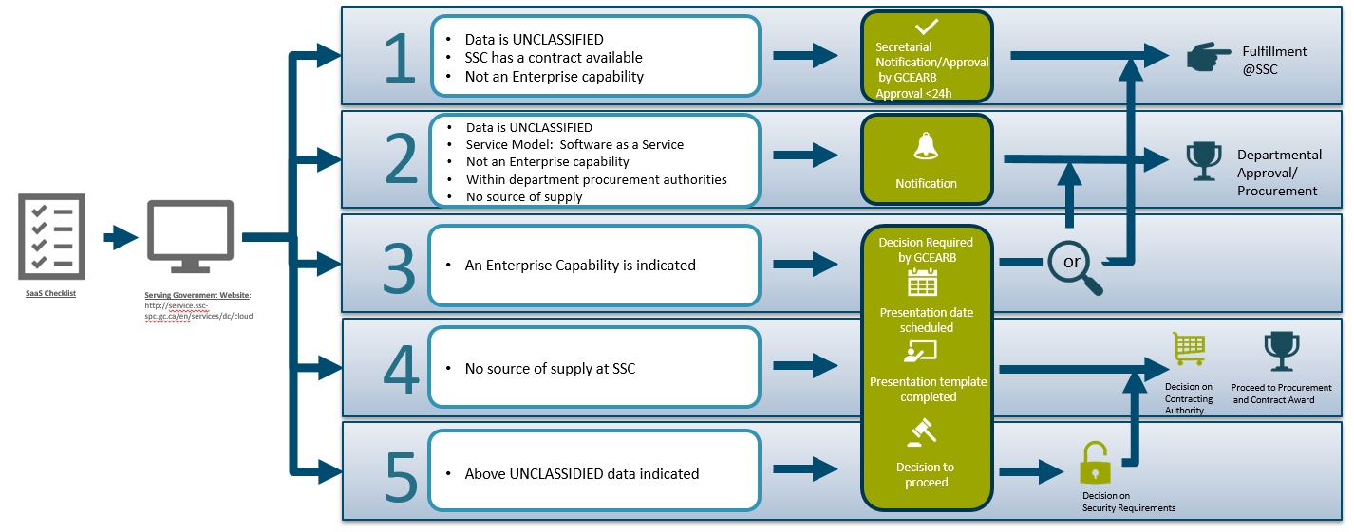
APPENDIX 3 High Level Process View
1
Prepare Concept Case
2
Add project to Departmental IBP and IT PLAN
3
Prepare for GC EARB
4
TB Submission
.or.
Dept. project
5
GC EARB
Detailed Architecture
Submit to OCIO for review
Identified business investment
Prepare ‘Presenter Template’
Project execution (Gating model)
Concept Case defined strategic needs
Identified digital project
EARB Assessment (align to Stds.)
Department
ARB Meeting
GC EARB Meeting
On-going Project Governance & Oversight
*
CLOUD Process :
All Cloud Services must be requested through SSC’s Serving Government website.

Slide 27
From Concept to Execution
Setting the foundation for collaborative IT-enabled results delivery
OCIO provides input on digital standards & suggests paths for alignment
Measure outcomes
Confirm alignment to digital standards against conceptual architecture
Provide direction as needed
Concept Case
Identifies and defines strategic needs by the business
Project Execution
Align Business Capabilities to IT solution
Benefit Realization
(DRF /KPI)
EARB Engagement
Align IT with GC Digital and Architectural Standards
EARB Engagement
Architecture Analysis
Continuous Improvement
Digitalization & automation of business processes that provide measurable outcomes
TB Submission
Fulsome business case
Early indications for digital solution needs
Add/Update new solution(s) in Departmental APM (Application Portfolio Mgt.)
Departmental Planning
Project
Gating
Identified in:
Departmental Integrated Business Plan
IT Plan
During the planning phase of the project - solution architectures presented to the GC EARB
Gate 2/3: Establish solution architecture
Seek Departmental ARB endorsement,
Validate that previous recommendations have been addressed
Monitor selected digital projects

Slide 28
APPENDIX 4
GC EARB Assessment - 3 pages

Slide 29
Dept. – Title
Enterprise Architecture Fitness Assessment Summary
 Endorsement
 Information
Costs : One time: $
On going: $
Overall:
Project Intent |  Proof of Concept |  Experiment |  Pilot |  Implementation | GATE: ____
EARB Review Category |  Public Facing | Enterprise |  Enterprise Cluster | Transformational |  Other
Type of Cloud |  SaaS |  PaaS |  IaaS |  Not Applicable
Data Classification |  Unclassified |  Protected A |  Protected B |  Other
Procurement Vehicle |  SSC | PSPC |  Departmental |  Unknown
Financial Authority | Within Departmental Authority |  |  Outside Departmental Authority
Describe the Investment Proposal
GC EARB Recommendation GC EARB Endorsement Conditions
Comments
EARB Appearance:
 Initial
 Follow-up
Architectural Alignment:
Fully
Partially
Not

Slide 30
Mandatory Procedures for Enterprise Architecture Assessment
GC Architectural Standards
 | Business Architecture | Align to the GC Business Capability model Design for Users First and Deliver with Multidisciplinary Teams Design Systems to be Measurable and Accountable
 | Information Architecture | Data Collection Data Management Data Storage Data Sharing
 | Application Architecture | Use open standards and Solutions by Default Maximize Reuse Enable Interoperability
 | Technology Architecture | Use Cloud first Design for Performance, Availability, and Scalability
 | Security & Privacy | Design for Security and Privacy
Architectural Alignment:
Fully
Partially
Not

Slide 31
Digital Alignment
◆ | Design with users Research with users to understand their needs and the problems we want to solve. Conduct ongoing testing with users to guide design and development. |  | Build in accessibility from the start Services should meet or exceed accessibility standards. Users with distinct needs should be engaged from the outset to ensure what is delivered will work for everyone.
❖ | Iterate and improve frequently Develop services using agile, iterative and user-centred methods. Continuously improve in response to user needs. Try new things, start small and scale up. |  | Empower staff to deliver better services Make sure that staff have access to the tools, training and technologies they need. Empower the team to make decisions throughout the design, build and operation of the service.
⬥ | Work in the open by default Share evidence, research and decision making openly. Make all non-sensitive data, information, and new code developed in delivery of services open to the outside world for sharing and reuse under an open license. |  | Be good data stewards Collect data from users only once and reuse wherever possible. Ensure that data is collected and held in a secure way so that it can easily be reused by others to provide services.
 | Use open standards and solutions Leverage open standards and embrace leading practices, including the use of open source software where appropriate. Design for services and platforms that are seamless for Canadians to use no matter what device or channel they are using. |  | Design ethical services Make sure that everyone receives fair treatment. Comply with ethical guidelines in the design and use of systems which automate decision making (such as the use of artificial intelligence).
 | Address security and privacy risks Take a balanced approach to managing risk by implementing appropriate privacy and security measures. Make security measures frictionless so that they do not place a burden on users. |  | Collaborate widely Create multidisciplinary teams with the range of skills needed to deliver a common goal. Share and collaborate in the open. Identify and create partnerships which help deliver value to users.
Architectural Alignment:
Fully
Partially
Not

