Slide 1
DR. Vlad gheorghiu
QUANTUM SOFTWARE
CSPS/EFPC Moving Quantum Computing from Theory to Practice — June 16, 2021
vlad@softwareq.ca

Slide 2
WHO WE ARE
© COPYRIGHT 2021 SOFTWAREQ INC, ALL RIGHTS RESERVED
Privately-own Canadian company, founded in 2017
Based in Waterloo, ON
Founding member of Quantum Industry Canada
Member of IBM Q network
Our products are part of the key infrastructure in quantum computing (e.g. staq/Quantum++ — targeted by OakRidge’s XACC)

Slide 3
WHO WE ARE
© COPYRIGHT 2021 SOFTWAREQ INC, ALL RIGHTS RESERVED
Dr. Michele Mosca - Co-Founder
Professor, Institute for Quantum Computing, University of Waterloo, Canada
Started the quantum computing effort at the University of Waterloo, is a founder of its world-renowned Institute for Quantum Computing (IQC), from which softwareQ spun off, and is also a founding member of the Perimeter Institute for Theoretical Physics.
Developed and advanced many of the textbook quantum algorithmic tools such quantum eigenvalue estimation, quantum amplitude estimation, quantum state generation, and quantum search with imperfect queries.
Realized several of the first implementations of quantum algorithms including the Deutsch algorithm, quantum searching and approximate quantum cloning.
Co-founded evolutionQ Inc. - spinoff quantum safe cryptography work

Slide 4
WHO WE ARE
© COPYRIGHT 2021 SOFTWAREQ INC, ALL RIGHTS RESERVED
Dr. Matthew Amy - Head of quantum software
Postdoctoral fellow, Dalhousie University
World expert in quantum compiling, quantum circuit synthesis and optimization
Co-developed staq, our quantum processing toolkit

Slide 5
WHO WE ARE
© COPYRIGHT 2021 SOFTWAREQ INC, ALL RIGHTS RESERVED
Dr. Vlad Gheorghiu - Co-Founder, President and CEO
Authored papers in various quantum computing topics, such as fault-tolerance, circuit optimization, entanglement theory, published in top journals and conferences
Co-developed staq, our quantum processing toolkit
Developed our high-performance quantum simulator Quantum++

Slide 6
What we do
© COPYRIGHT 2021 SOFTWAREQ INC, ALL RIGHTS RESERVED
We provide software to run on quantum computers or quantum simulators
We design software tools, and offer support for software tools, to assist organizations who wish to implement their own algorithms
We implement proof-of-concept execution on quantum hardware or simulators
We are platform-agnostic: write the “quantum code” once, we compile for every physical platform

Slide 7
What we do
© COPYRIGHT 2021 SOFTWAREQ INC, ALL RIGHTS RESERVED
We show clients how to:
Translate their problem into a quantum program
Map it to a quantum circuit
Estimate the resources (space/time), optimize them
Estimate the quantum advantage
We help organizations be up and running when the time comes, with real applications in the queue. Meanwhile, they will know what kinds of applications make sense to run, and their potential business advantage.
We offer a full stack platform, ranging from high level algorithm design to optimization to mapping to specific physical architectures

Slide 8
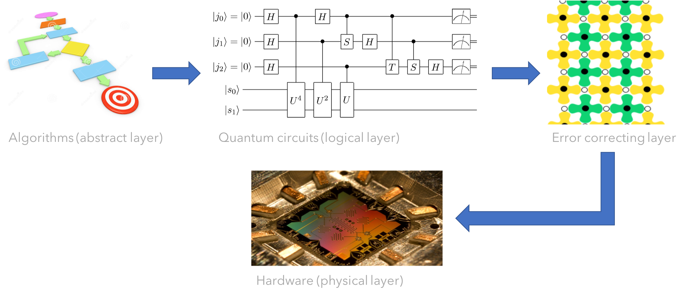
RUNNING A QUANTUM “PROGRAM”
© COPYRIGHT 2021 SOFTWAREQ INC, ALL RIGHTS RESERVED
quantum computing SOFTWARE stack

Slide 9
Our clients
© COPYRIGHT 2021 SOFTWAREQ INC, ALL RIGHTS RESERVED
Material design
Government
Automotive
Financial institutions
…

Slide 10
Our products

Slide 11
staq

Slide 12
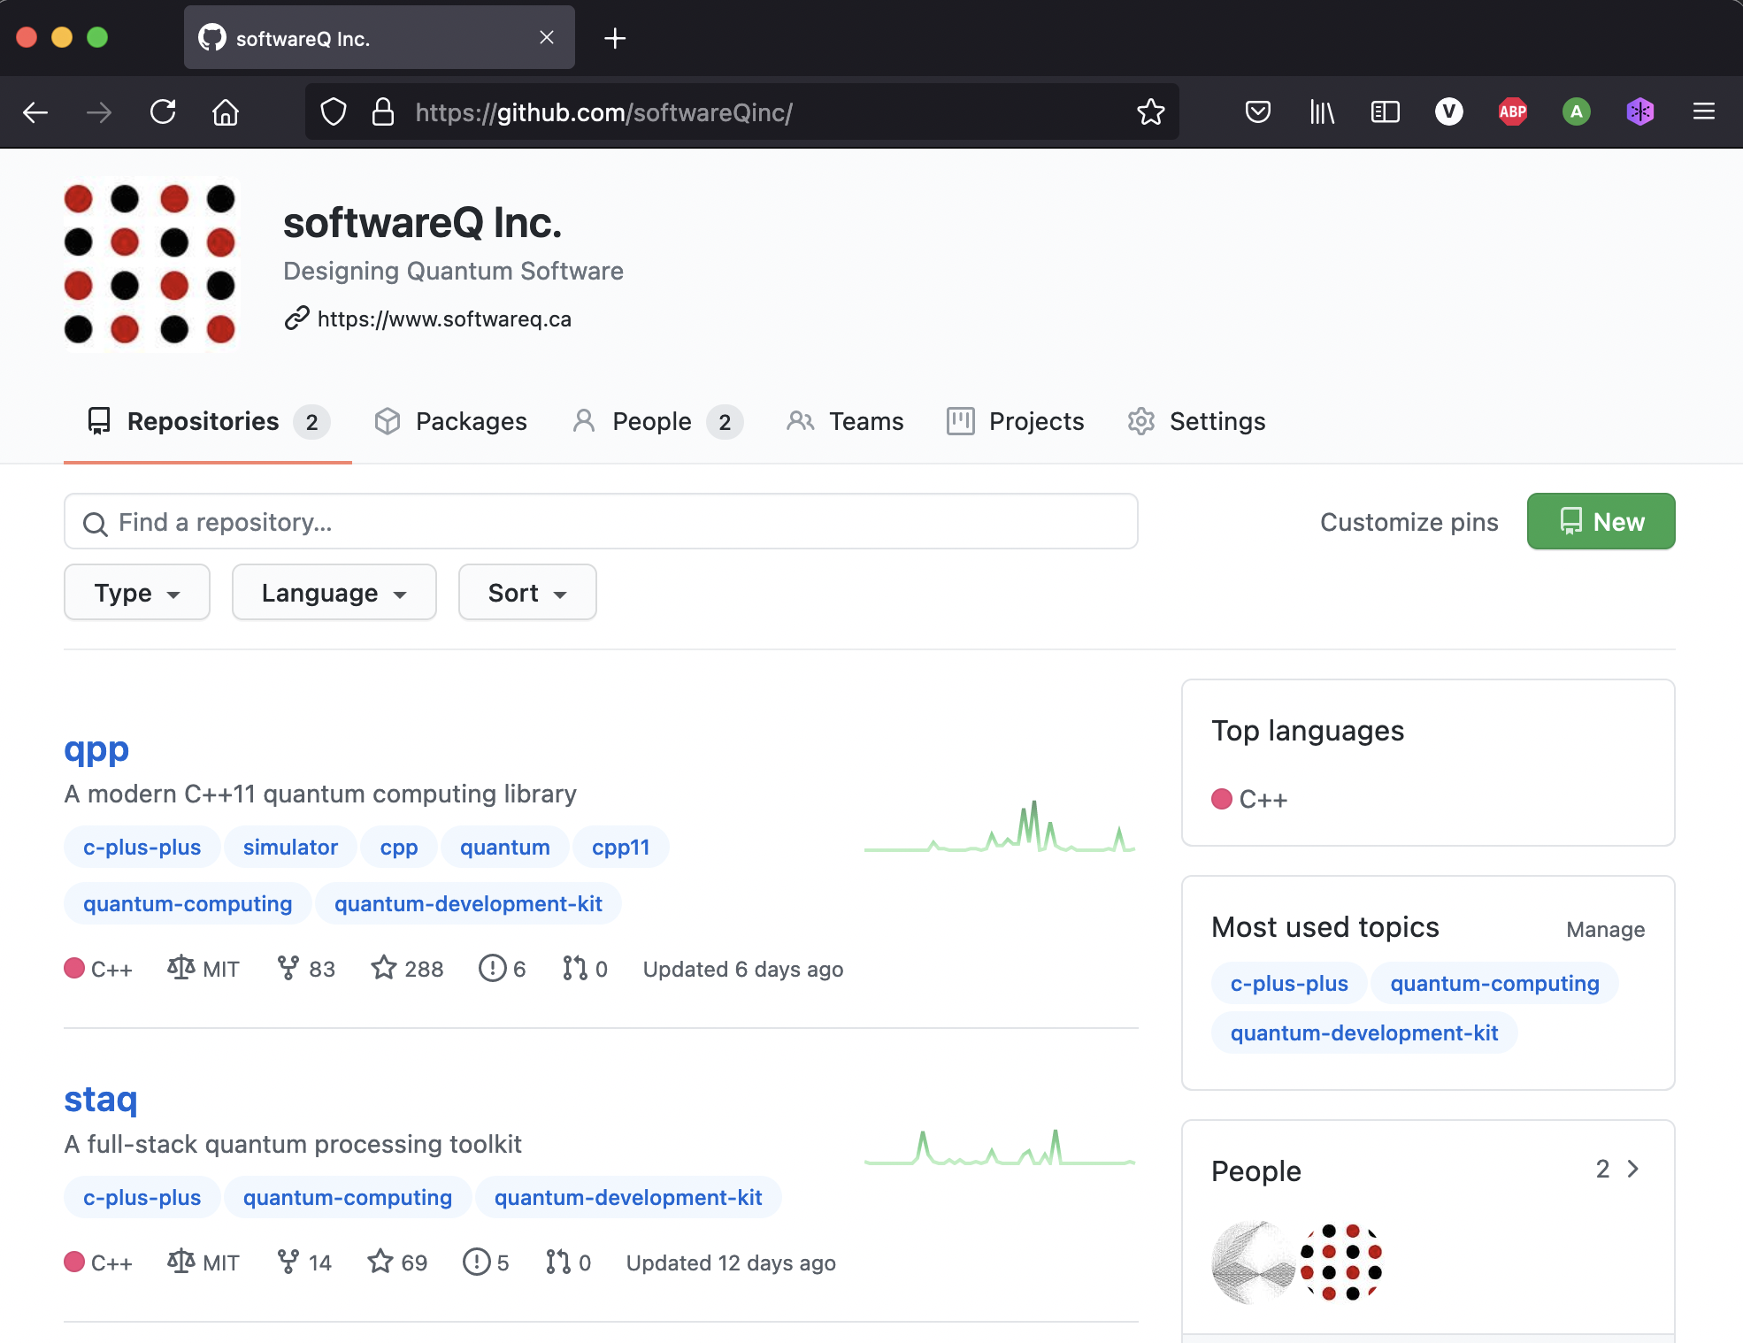
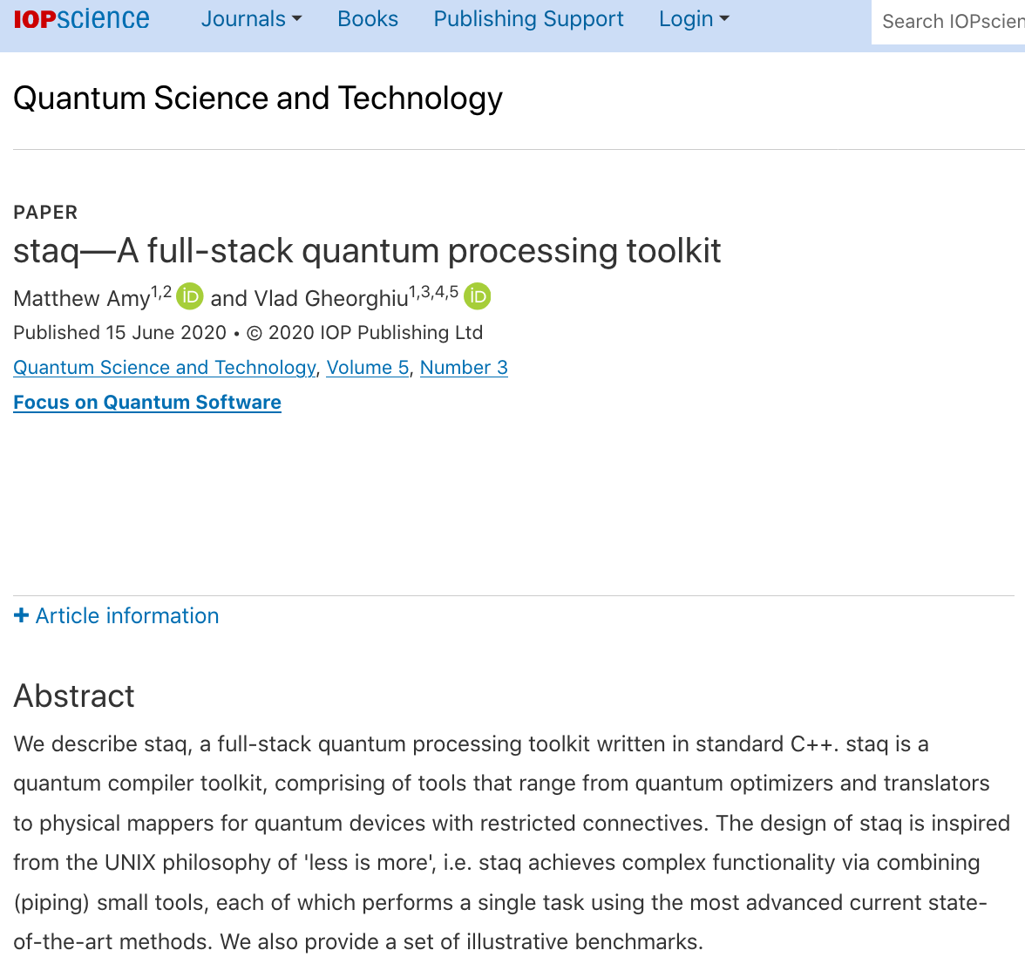
© COPYRIGHT 2021 SOFTWAREQ INC, ALL RIGHTS RESERVED
https://github.com/softwareQinc/staq

Slide 13
Design philosophy
© COPYRIGHT 2021 SOFTWAREQ INC, ALL RIGHTS RESERVED
Open-source quantum compiler toolkit, standard C++17, compiles on all platforms (Windows/UNIX/Linux)
Design inspired from UNIX: combine small tools to achieve combinatorial explosion of functionality
KISS
output $←$ input (OpenQASM) | ${\text{tool}}_{1}$| ${\text{tool}}_{2}$ | … | ${\text{tool}}_{n}$
“no process should affect the original structure of the program more than absolutely necessary”
Each tool performs a single task using the most advanced current state-of-the-art methods
Advantages: very fast and scalable, easy to maintain, not locked to particular APIs

Slide 14
TOOLS
© COPYRIGHT 2021 SOFTWAREQ INC, ALL RIGHTS RESERVED
Ranging from circuit optimizers (both NISQ and full-scale fault-tolerant) and translators to physical mappers for NISQ architectures with restricted connectives
Desugarer
Inliner
Oracle synthesizer
Simplifier
Rotation optimizer (T gates etc.)
Mapper
Resource estimator
Quil compiler
ProjectQ compiler
Q# compiler
Cirq compiler
…
“Transpilers”

Slide 15
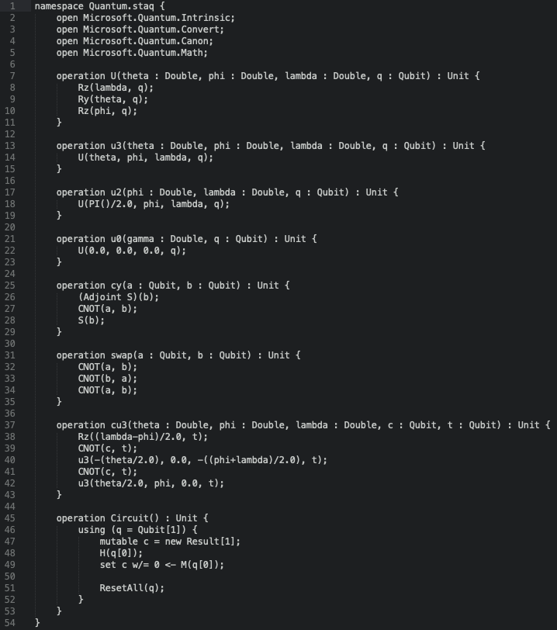
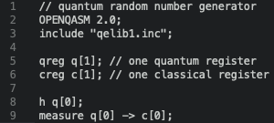
Example tool
© COPYRIGHT 2021 SOFTWAREQ INC, ALL RIGHTS RESERVED
“Transpiler”
$ cat rng.qasm
$ cat rng.qasm | staq_qsharp

Slide 16
QuantuM++

Slide 17
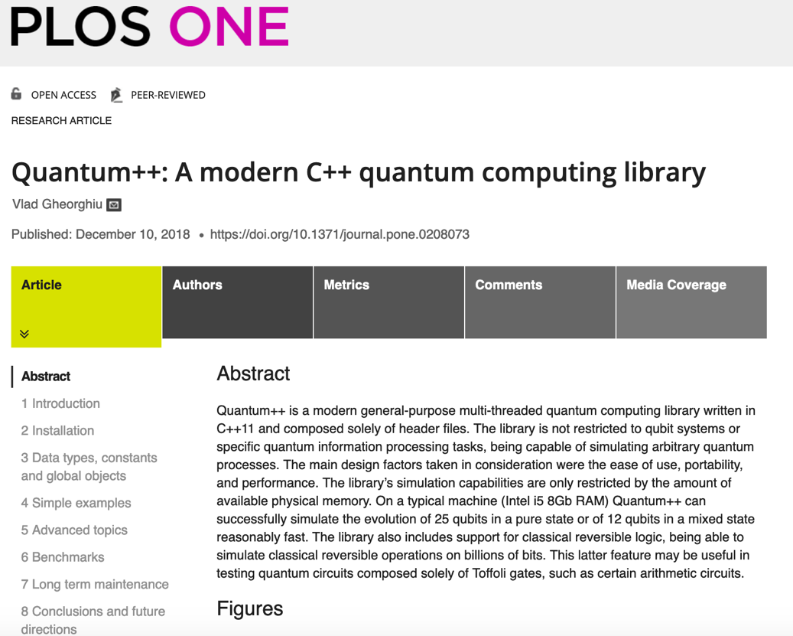
© COPYRIGHT 2021 SOFTWAREQ INC, ALL RIGHTS RESERVED
https://github.com/softwareQinc/qpp

Slide 18
© COPYRIGHT 2021 SOFTWAREQ INC, ALL RIGHTS RESERVED
Open-source high-performance quantum computing simulator
Written in standard C++11, easy to use, very low dependency
Not restricted to qubit systems or specific quantum information processing tasks, being capable of emulating arbitrary quantum processes
Can simulate noisy quantum processors
Interfaces with OpenQASM
Targeted (together with staq) by the XACC quantum accelerator (OakRidge National Lab)

Slide 19
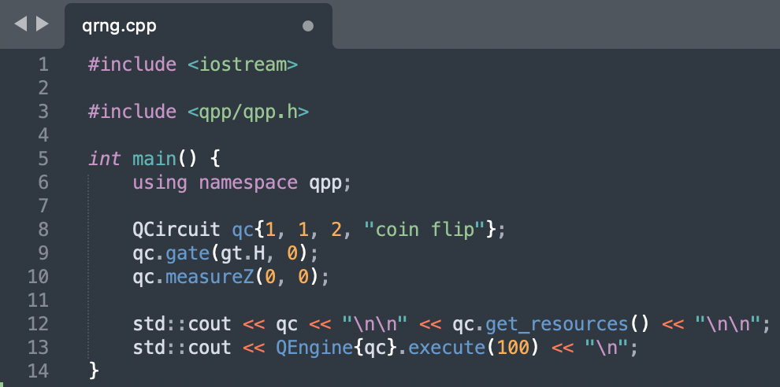
© COPYRIGHT 2021 SOFTWAREQ INC, ALL RIGHTS RESERVED

Slide 20
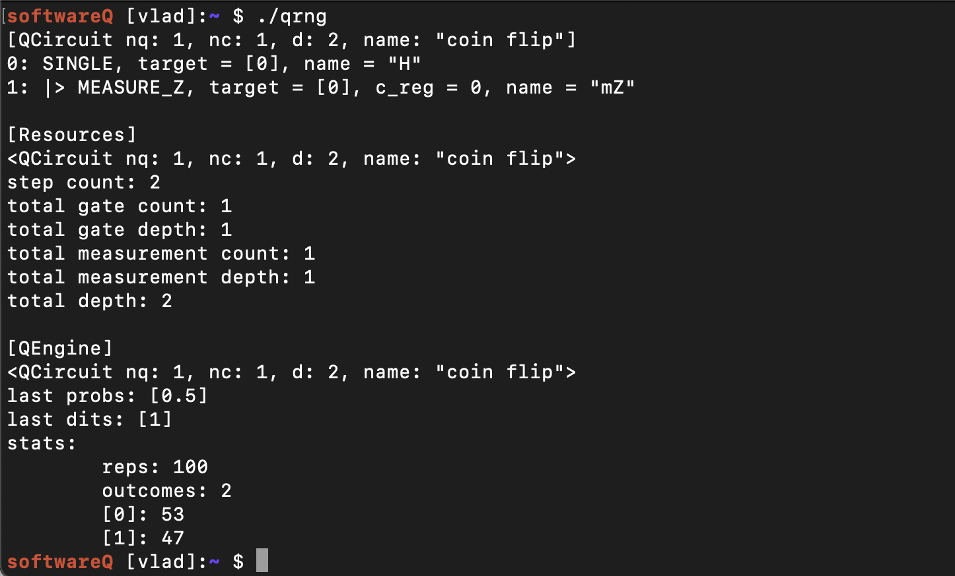
© COPYRIGHT 2021 SOFTWAREQ INC, ALL RIGHTS RESERVED

Slide 21
what needs to be tracked
© Copyright 2021 softwareQ Inc, all rights reserved
Quantum compiler optimizations
Progress in fault-tolerance
State of the art quantum algorithms
New quantum algorithms for NISQ (variational, etc.)
Bleeding-edge research on quantum computing, quantum algorithms, quantum software

Slide 22
THANK YOU
Dr. Vlad Gheorghiu
vlad@softwareq.ca
Co-Founder, President and CEO, softwareQ Inc.
softwareq.ca @softwareQInc

