Slide 1
First Nations Financial Management Board

Slide 2
Agenda
History of First Nations Financial Management Board (FMB)
First Nations Fiscal Management Act (“FMA”)
Overview of FMB
What, Who, How
Challenges for Self-Governing Nations obtaining FMB services and accessing the FMA
How Nations Benefit from Working with FMB

Slide 3
History of the FMB
Where did it come from and why?

Slide 4
What is the First Nations Fiscal Management Act (“FMA”)?
Optional Federal legislation
Outside the Indian Act
274 First Nations participating to date

Slide 5
The Framework… working outside the Indian Act
What is the First Nations Fiscal Management Act (“FMA”)?
First Nations Fiscal Management Act
First Nations Tax Commission
First Nations Financial Management Board
First Nations Finance Authority
Notes:
First Nations Financial Management Board- establishes financial management standards that lead to the principles of sound and transparent practices;
First Nations Tax Commission – ensures the integrity of the First Nations tax system;
First Nations Finance Authority – enables First Nations to borrow against any secure source of revenue at lower rates than traditional financing;

Slide 6
Why Was the FMA Created?
First Nations-led initiative
To support First Nations social and economic development
To provide First Nations with access to borrow through the First Nations Finance Authority
Enables First Nations to leverage their revenues like other levels of government

Slide 7
What is the FMB?
National First Nation Institution created to support First Nations to build strong finance and governance practices
Services provided at no cost
A non-profit organization
Services are optional
Independent of the Crown
Board of Directors appointed by GIC and AFOA

Slide 8
What is the FMB’s Role?
Support First Nations to build strong finance and governance practices.
Set standards for:
Financial Administration Laws (FALs)
Financial Performance (FP) Certification
Financial Management System (FMS) Certification
Financial reporting for the local revenues account
Provide “Certification” of financial management and performance for First Nations.
Support First Nations when working with other governments in areas of governance and finance practices, including accountability and shared fiscal responsibility.
Support First Nations to strengthen their own communities through better relationships with financial institutions, business partners, and other governments.
….for the complete mandate see section 49 of the FMA

Slide 9
What FMB Does
The FMB provides support, tools and guidance that support First Nations to:
Build strong finance and governance practices
Develop necessary capacity to meet expanding financial management requirements
Provide an option to borrow money from the First Nations Finance Authority (FNFA)

Slide 10
What FMB Does
Develops and Maintains Standards
Capacity Development
Option to Borrow Money
STANDARDS to make “best practice” decisions for your community
Financial Administration
Financial Performance
Financial Management Systems
Allows First Nation to have the option to take out a FNFA loan
Supports your community in long-term planning

Slide 11
Many First Nations are already on the journey with the FMB…
As at May 15, 2019
274
181
147
24
First Nations
Scheduled to the
Fiscal Management Act
First Nations
with a
FAL
First Nations
with an
FP Certificate
First Nations
with an
FMS Certificate

Slide 12
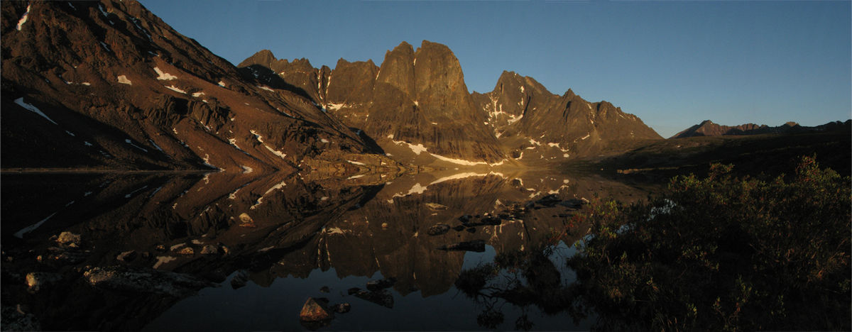
Can Self-Governing Nations Access FMB Services and FMA?

Slide 13
Indian Act Vs Self-Governing Nations
The FMA is Federal legislation that only applies to Indian Act Nations
A Regulation under the FMA can be developed (s.141) to allow Self-Governing Nations to access the FMA and the FMB
Ongoing development is needed in this area to overcome this challenge
Are the Yukon Nations interested in accessing the FMA?

Slide 14
Benefits to Nations of Working with FMB
How Nations Benefit from Working with FMA

Slide 15
How Nations Benefit from Working with FMA
A way to borrow money and an opportunity to create economic development
A framework to establish sound financial systems
A pathway to a long-term financial community plan
Many First Nations have positively improved their community, socially and economically by using the tools and support provided by the FMB.

Slide 16
How Nations Benefit from Working with FMB
Effective and sound financial management that may deliver long term success for the Nation
Increased transparency and accountability to members and future partners
Tools and guidance to improve the management of the Nations’ finances
A framework (when followed) provides financial long-term stability
Continuity through strong administrative governance and finance practices
Improved risk management

Slide 17
Benefits for Council
Council may take advantage of the following:
Obtain financing for important projects
Save money on interest
Make it easier to run the Nation
Improve decision making
Increased accountability and transparency
Manage Risk more effectively
Achieve your Nation goals

Slide 18
Benefits for the Community
Good financial governance and practices build member trust and pride in their Nation. They can also improve long term quality of life for everyone:
Access Affordable Long term Capital
Clear and transparent decision making
Have pride in your First Nation
Address the things that matter most

Slide 19
Benefits for Staff
Staff report the following benefits:
Easier to know how to do their job
Do more for your Nation
Make better decisions
Always have a clear picture

Slide 20
Real Outcomes
The FMB may facilitate access to the FNFA, which lends money to Nations on favorable rates and terms.
Access to financing allows Nations to implement their community development plans.
Nations have also refinanced existing projects that provided interest savings and increased cash flow.
Examples of projects implemented across Canada as a result of going through FMB-FNFA process
Education and Social | Economic development | Infrastructure
Schools | Grocery stores | Road and utility projects
Social programs for Seniors | Fish plants and PPP Projects | Housing developments
Social programs for Youth | Traditional/ Alternative Energy & IPP programs | Building improvements
Drugs and alcohol awareness programs | Machinery and equipment for projects | Clean Water projects

Slide 21
Real Outcomes – Case Study Fisher River Cree (Manitoba)
The Challenge:
Overcrowded school in need of repairs no central space to bring people together.
The Action:
Enacted their FAL, and obtained their FP certificate.
Accessed financing via FNFA and then achieved FMS certification.
The Outcome:
Nation obtained FNFA funding and built a new school grades 7-12 and a community centre is in the works.
Video Link

Slide 22
Real Outcomes – Case Study Nipissing First Nation (Ontario)
The Challenge:
Negotiating a significant land claim settlement - needed to establish a trust to govern the settlement.
The Action:
Enacted their FAL, and obtained their FP certificate.
Accessed financing via FNFA and then achieved FMS certification.
The outcome:
They used the loan to develop their community solar panel project.
Nipissing generates renewable energy and sells any excess to the province of Ontario. They now receive a cheque from Ontario Hydro instead of a bill because of this project. Also refinanced an existing loan used to build their daycare, saving significantly on financing costs.
Video Link

Slide 23
Do the Yukon Self-Governing Nations want to access the FMA?
Let’s talk…
Shayla Point, BA, LLB Director, Market Development, Laws & Stakeholder Relations shayla_point@fnfmb.com
fnfmb.com Toll free: 1.877.925.6665

