Slide 1
GC TSS quarterly results process
Pilots: what we have learned so far
Digital Transformation Office • #CanadaDotCa • December 2022
Notes:
Opening slide

Slide 2
Background
TBS intends to implement a quarterly results process for departments to improve GC TSS scores in 2023-24
TBS and PP are spending rest of 2022-23 piloting the process with departments, to refine before implementing GC-wide
Today, we want to give you an update on how the pilots are going
Notes:
Content example slide #1

Slide 3
Engagement in these pilots is low to date
Currently piloting with 3 departments: DFO, DND, NRC
Understanding what pilot means may have hampered take-up
Need leadership to make time for improvement projects and encourage web advisors to use TSS feedback as part of day-to-day workflows
Notes:
Content example slide #1

Slide 4
How the pilot is going
Step 1. Identifying what to work on together
Before step 1. Improving GC Task Success Survey data quality
1. Identify
Opportunities for improvement
4. Review
Improvement in performance?
2. Plan
Changes to be made
3. Execute
Implement changes
Notes:
Content example slide #1

Slide 5
Improving survey data quality
Incomplete survey implementation
Learned that the survey wasn’t running on enough of DFO’s web presence - missing out on many potential responses
Working together to get it up on key subdomains that account for high volumes of traffic
Notes:
Content example slide #1

Slide 6
Improving survey quality
“Other” is the survey’s top task
Several departments’ top task in the survey is ‘Other’ - particularly in custom surveys where specific tasks are at the second level
Solution: Update tasks lists using insights from TSS feedback
Analyzed “Other” survey responses to:
Clarify task wording to reflect user language
Add missing tasks that users identified as being important
Include keyword exemplars to the first level of tasks
Notes:
Content example slide #1

Slide 7
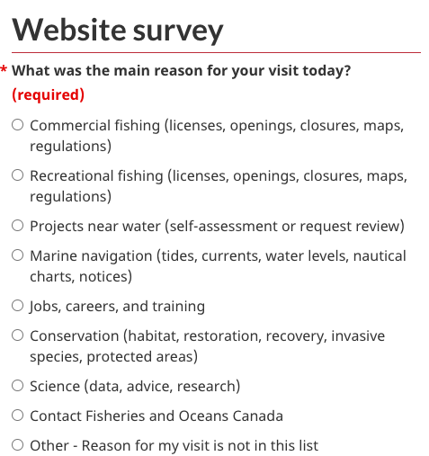
Improving survey quality
The importance of exemplars
People were entering tasks as “other” at the first level when they didn’t see the specific task they came to do.
In information architecture, exemplars describe the contents by including examples of the content. This practice applies to survey design as well.
Solution: Update first level tasks using keyword exemplars
So far - seeing a 50% reduction in ‘other’

Slide 8
Identifying what to work on
Value of combining TSS data with other sources
From the TSS results and comments, we can identify problem areas, but there may not always be enough comments or detail to identify what is the causing the problem.
Solution: Leverage additional data sources to fill in gaps (feedback, analytics, previous research, call centre data)
For DFO, they leveraged the page feedback tool to understand how content design on key pages was impacted task success on licensing as well as web analytics.
Notes:
Content example slide #1

Slide 9
Identifying what to work on
Aligning feedback analysis methods between data sources makes it easier to combine TSS and page feedback data
DFO used the same tags to analyze and group feedback between the TSS and the page feedback tool.
By aligning their methods for analysis open text feedback it:
made it easier (and quicker) to leverage insights between the two data sources
allowed their team to share the task of feedback analysis
Tools
Tagging template
Guidance for choosing page feedback tags (Word doc) - applies to TSS as well
Notes:
Content example slide #1

Slide 10
Identifying what to work on
Considering operational realities & other evidence
In addition to reviewing top tasks identified in the TSS, the team took other factors into account. The team selected what task to improve in this pilot on by prioritizing:
Quick wins Simple fixes that can go live quickly (like broken links / content design)
Feasibility The improvements already align with current priorities
Few dependencies Not too many stakeholders or levels of approval
Low technical complexity Specialized applications may not be the best place to start
Notes:
Content example slide #1

Slide 11
Improving existing processes
Socializing the use of new tools & data beyond the web team
Including feedback examples in dashboards and reports builds empathy beyond the web team.
Include representative feedback quotes on analytics dashboards or when briefing up to help make the numbers and issues experienced by users feel more real.
Notes:
Content example slide #1

Slide 12
Improving existing processes
What this means for the quarterly results process
The TSS can be used as a reliable starting point to begin continuous improvement work
The TSS can inform continuous improvement projects already in progress
Notes:
Content example slide #1

Slide 13
Next steps
Continue pilots with DFO, DND, NRC
Report back in Q4 with next round of learnings
Iterate draft quarterly process
Notes:
Content example slide #2

Slide 14
Does your department want to participate?
There’s still room to get support with:
Analyzing data for insights
Refining tasks to improve data collected in the survey
Identifying tasks to improve
Contact dto.btn@tbs-sct.gc.ca
Notes:
Content example slide #2

