Slide 1
1

Slide 2
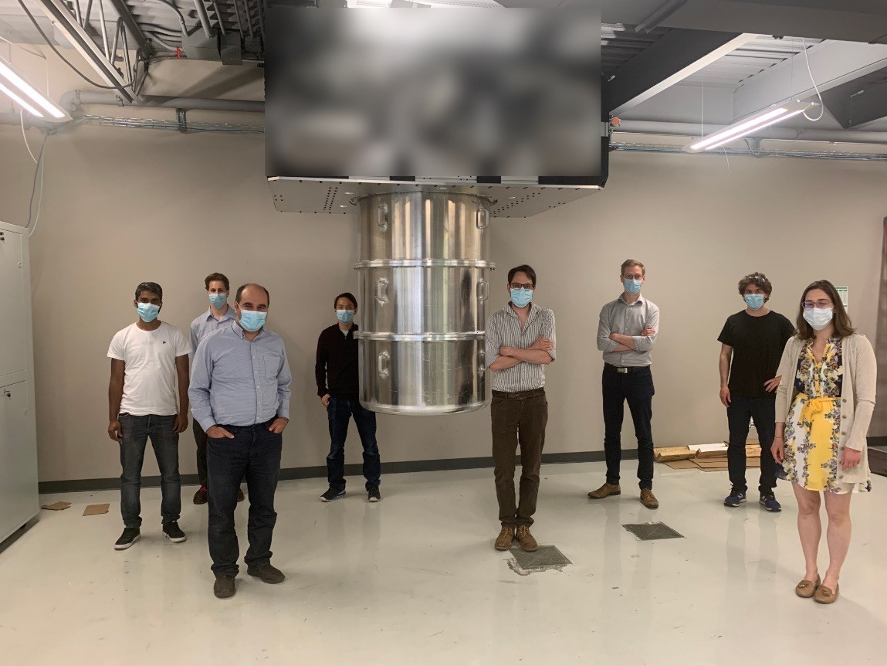
We are Team Anyon
2
Founded in 2014
Team: 23 Scientists
Develop “universal” quantum computers
Superconducting Qubits
Montreal, QC, Waterloo, ON
Began commercialization in 2020
Deliver DRDC’s first quantum computer later this year.

Slide 3
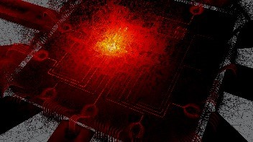
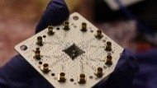
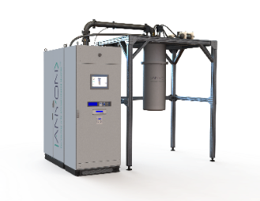
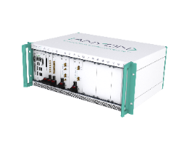
Our Journey
33
2015
2016
2017
2018
2019
2020
2021
Design Toolkit Google Contracts
HW & SW Development
DND Order

Slide 4
Anyon’s Roadmap
4
Ottawa
10000
Winnipeg
2688 qb
1000
Oka
Kamaraska
672 qb
Qubit
Nanaimo
100
168 qb
Nunavut
64 qb
56 qb
Yukon
Yamaska
24 qb
10
12 qb
1
2019
2020
2021
2022 2023
Year
2024
2025
2026

Slide 5
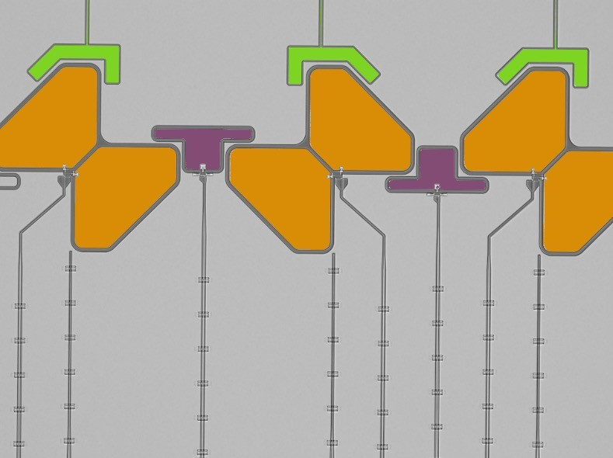
Superconducting QPU
5
Tunable Qubits
Readout
𝐸
|2⟩
|1⟩
Control lines
Tunable Coupler
|0⟩
Φ

Slide 6
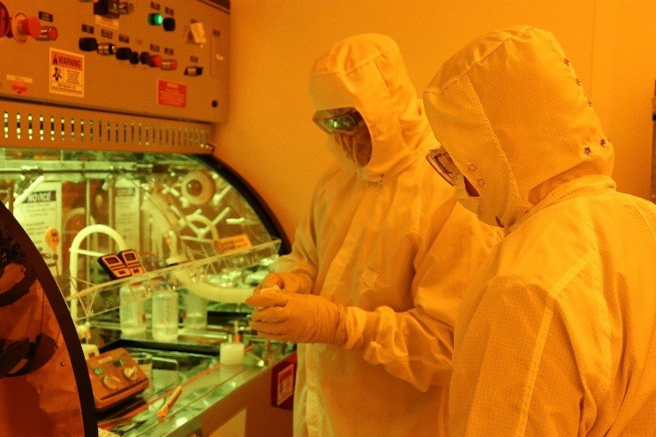
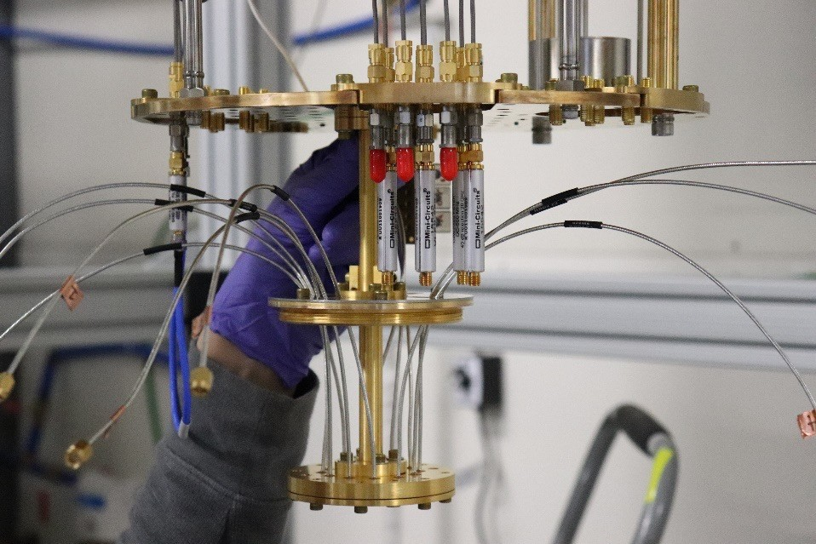
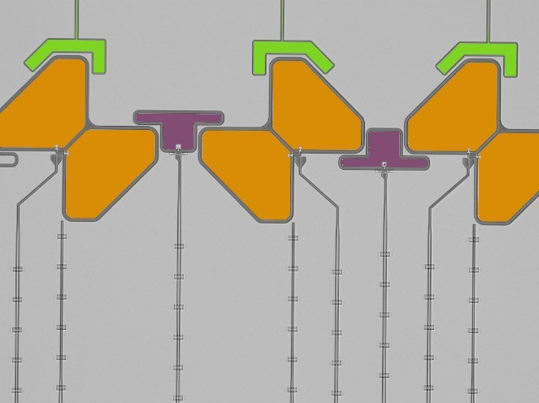
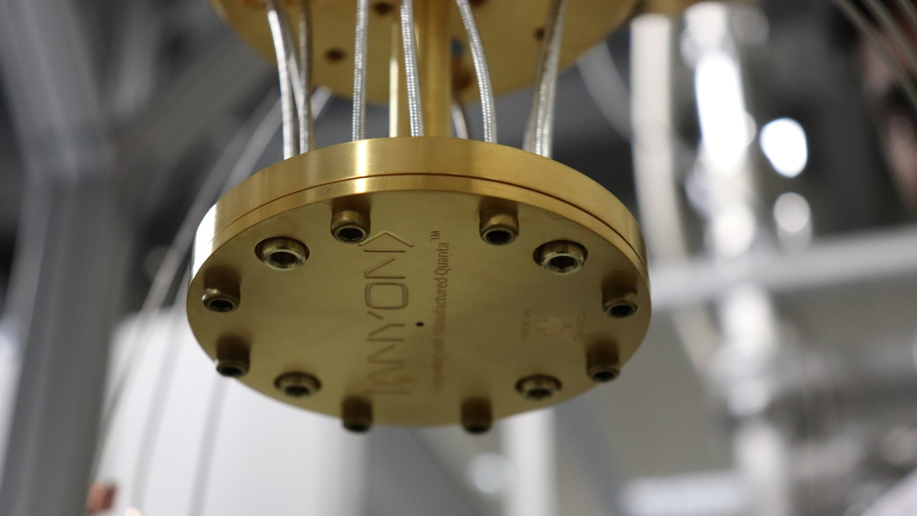
Superconducting QPU
6

Slide 7
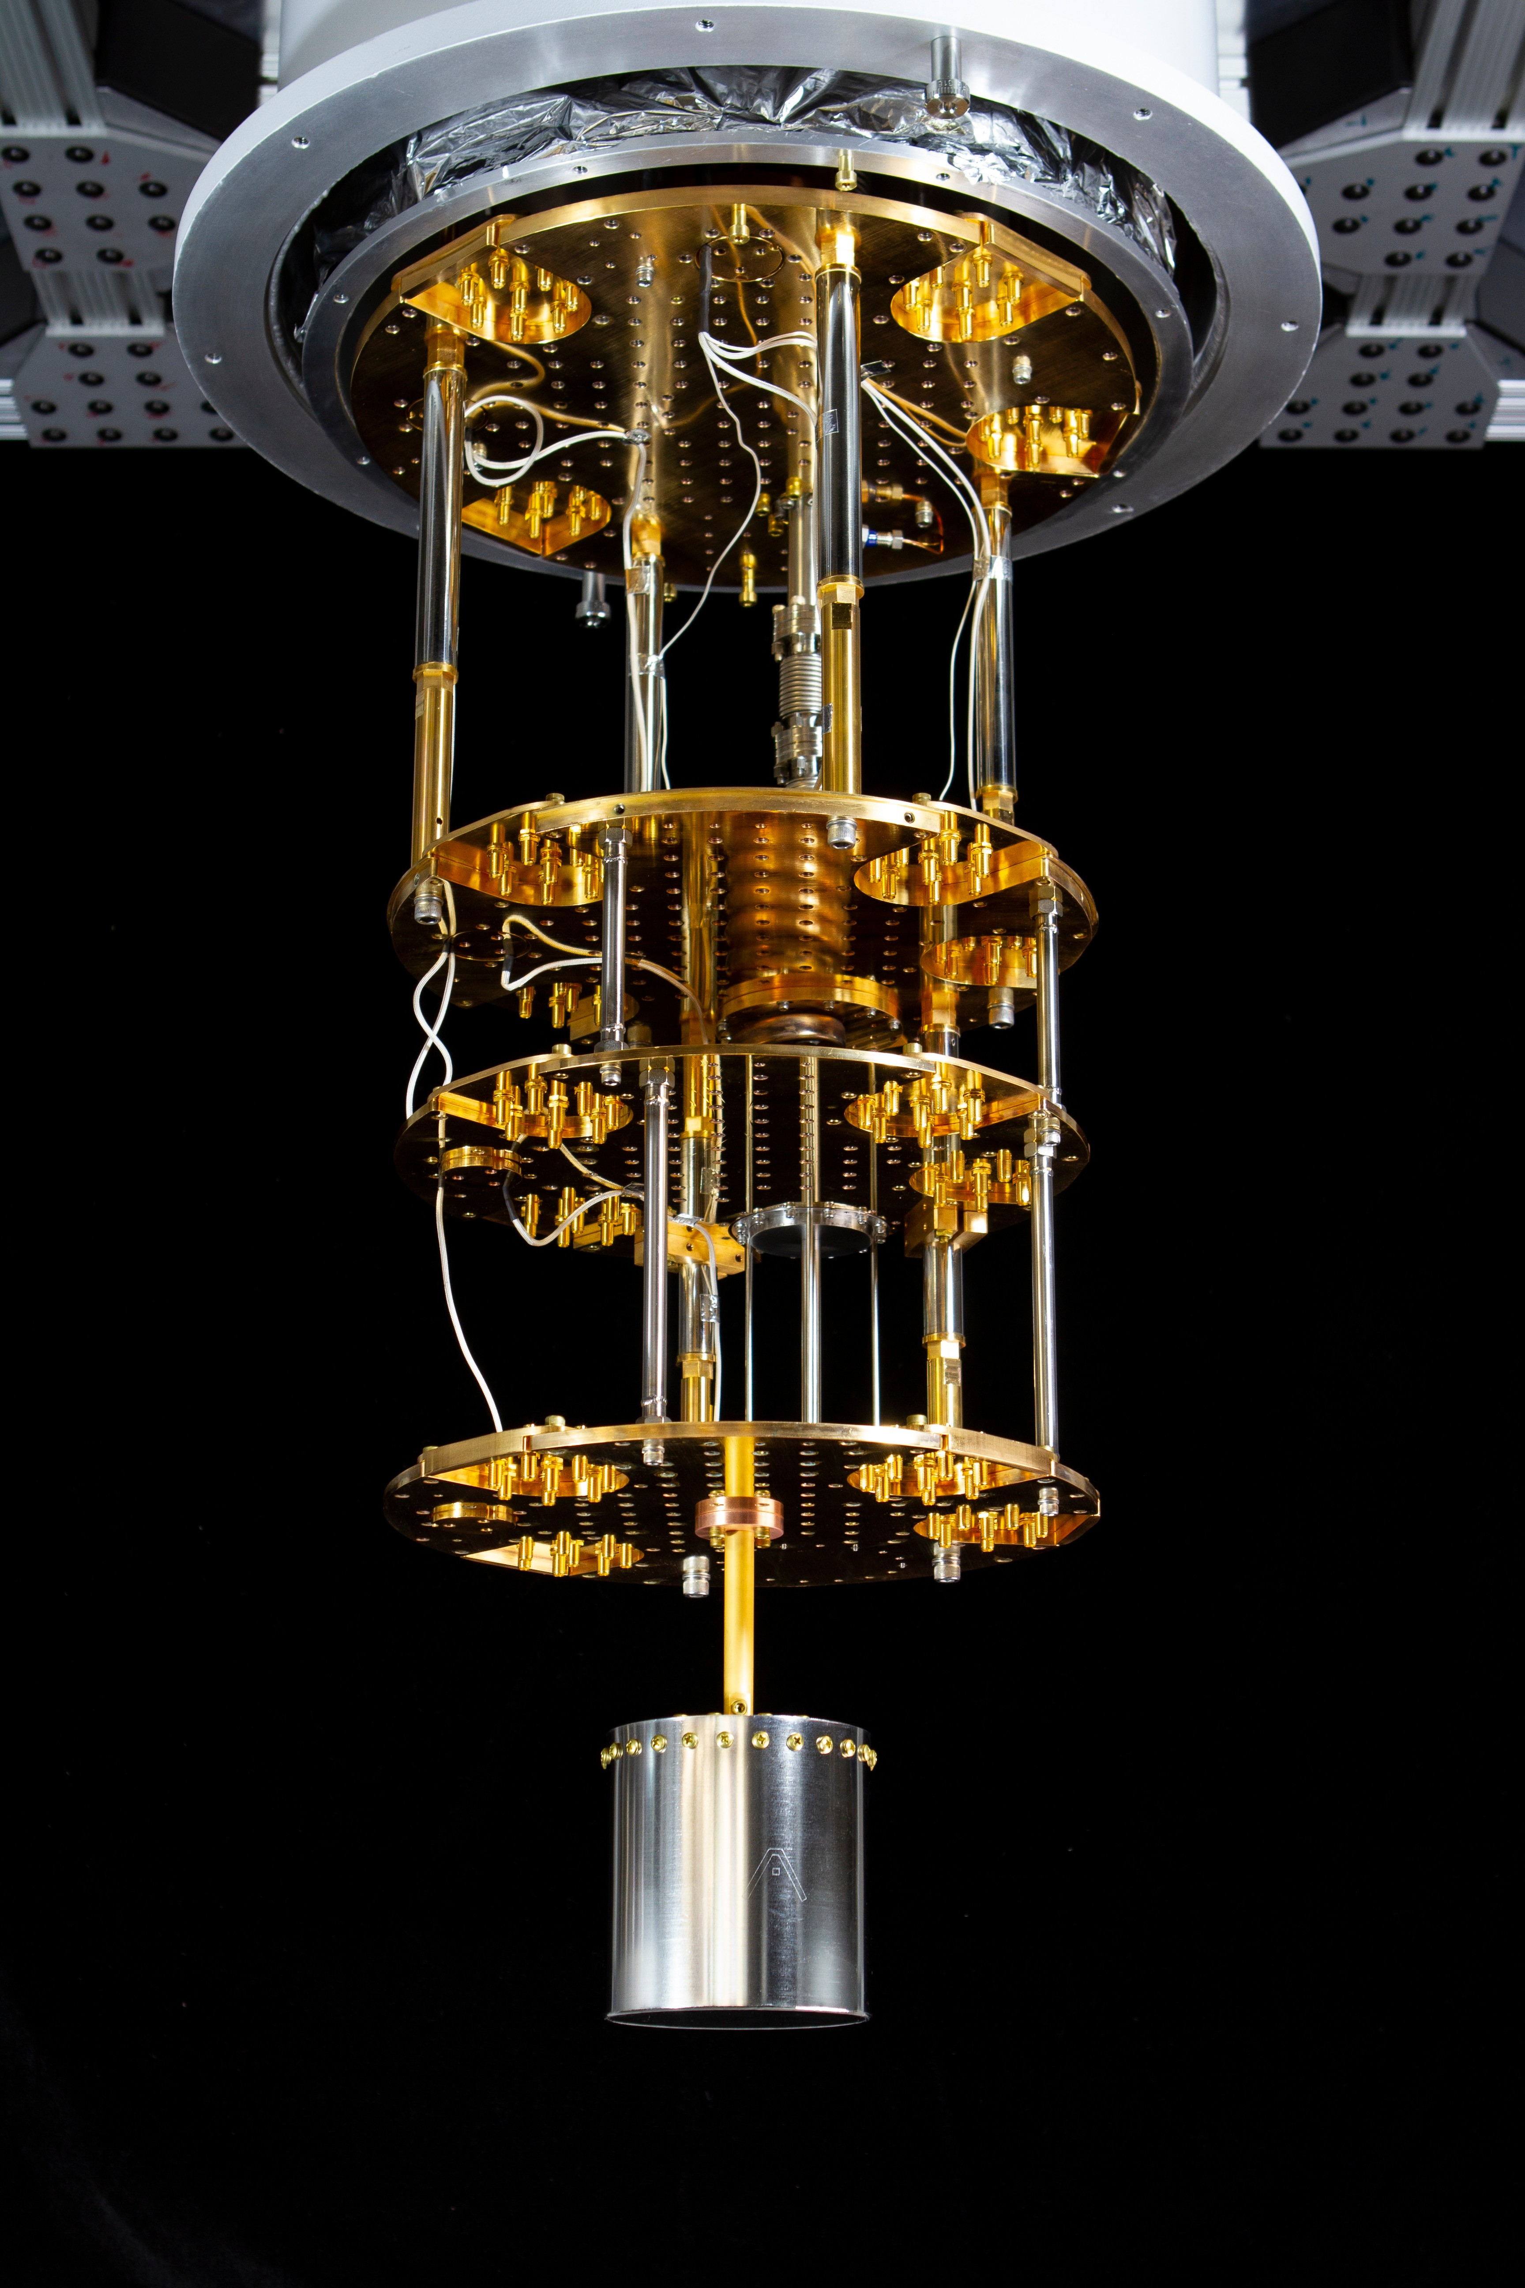
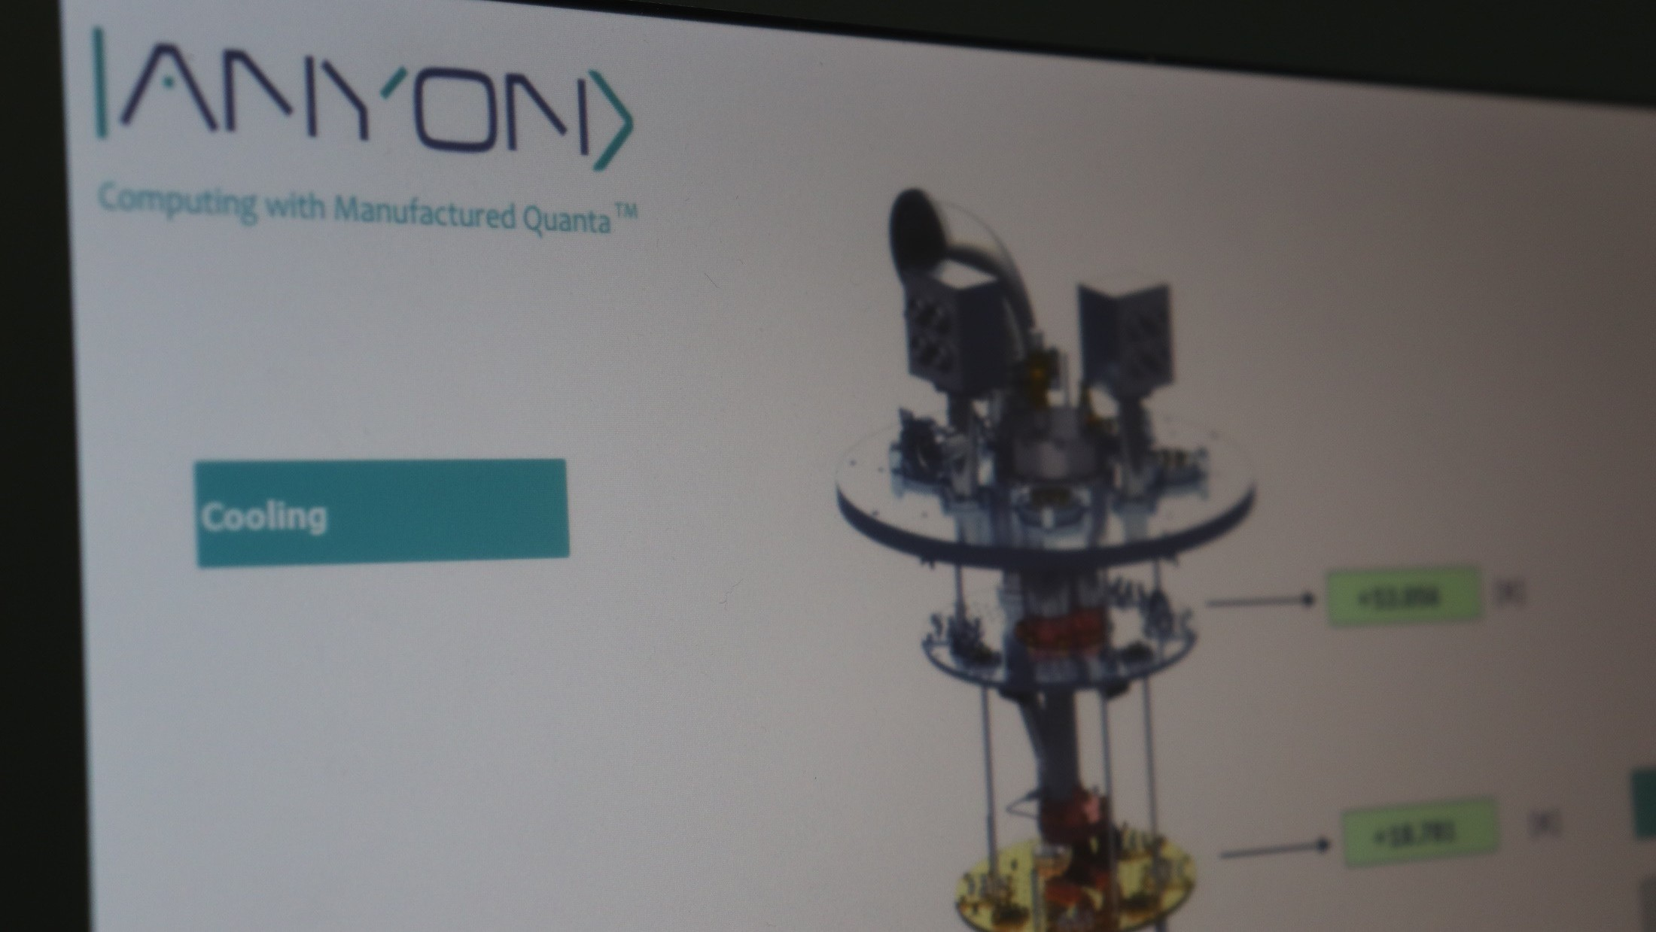
Dilution Fridge Cryogenics
7
Developed & Manufactured in house
<20 mk above absolute zero

Slide 8
Software Stack
8
User App
SDK (Iris)
Q-Compiler
Host Driver Firmware
Quantum Processor

