Slide 1
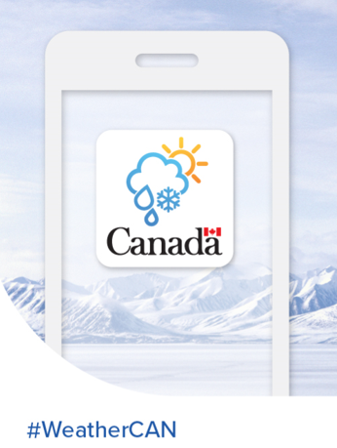
Building the ECCC weather app – a modern love story..
Claire Martin
MSC Manager – Service Delivery Transformation
HR Innovation RH à la carte event
Sep 22, 2021
Notes:
Notice: my title within the MSC has nothing to do with app development, nor it is in my background, nor was I qualified to do this.

Slide 2
Building the ECCC weather app – a modern love story..
Claire Martin
MSC Manager – Service Delivery Transformation
HR Innovation RH à la carte event
Sep 22, 2021
Notes:
Notice: my title within the MSC has nothing to do with app development, nor it is in my background, nor was I qualified to do this.

Slide 3
Please download “WeatherCAN” / “MétéoCAN”
Notes:
If you’re bored already do it now. If not, I’ll give you another chance at the end of the presentation.

Slide 4
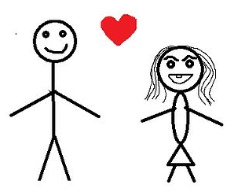
All good GC apps are created by a (loving) partnership between..
Mr. Government
Ms. Agile
Notes:
Ms Agile: Agile software development refers to a group of software development methodologies based on iterative development, where requirements and solutions evolve through collaboration between self-organizing cross-functional teams

Slide 5
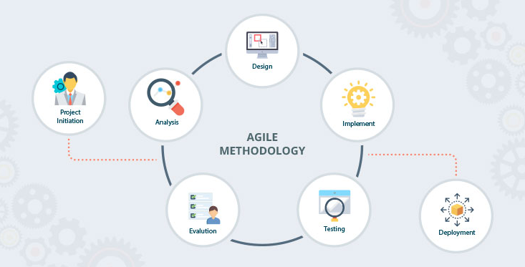
“To improve is to change; to be perfect is to change often” – Sir Winston Churchill
Notes:
Remember these stages: Analyse, Design, Implement, Test, Evaluate (often re-analyse, re-design, re-implement) etc.

Slide 6
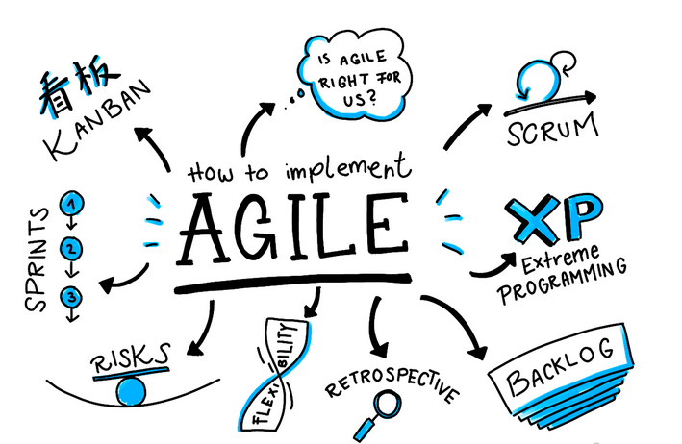
1. Analysis = “am I looking for a mate?”
Do you need an app?
YES?
Do you know what to put in an app?
MAYBE (hint: survey!)
Do you have supportive management?
10000% YES

Slide 7
2. Design = “imagine the ideal mate”
Bring in experts in app design.
UX/UI.
Don’t get hung up on cosmetics (yet).
Beware scope creep.
NEVER let a bunch of meteorologists build a weather app!

Slide 8
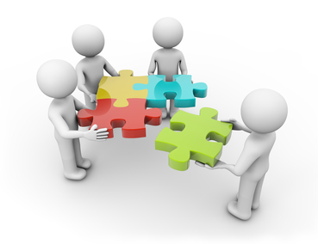
3. Implement = “create the mate”
Hire androgynous looking IT specialists who know how to put massive coloured puzzle pieces together…
Trust your IT team.
Millennials (students) are gold – they’re keen, hard-working and grew up on apps/social media.
Use contractors to fill in talent gaps – and learn from them.

Slide 9
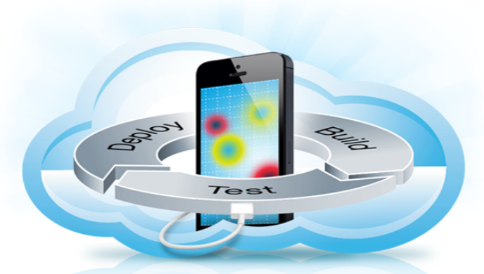
4. Test = to see if what you seek is truly what you are getting!
Test – often, and frequently.
Test – with non subject matter experts
Test – accessibility
Test – regressively
Test – cos you’re bored!
Notes:
Regression testing is re-running functional and non-functional tests to ensure that previously developed and tested software still performs after a change. It has become a crucial part of testing due to the pace of technology advancement

Slide 10
5. Evaluate = “is this a good mate?”
Does the app behave as expected? Does it do what the general public expects it to do?
Is it functionally perfect? Easy to navigate??
Do you need to change or add functionality? Agile development allows for multiple changes along the way.
Are you happy with your decisions/choices?
Notes:
Easy to navigate is essential. 48% Canadians read at Grade 8 level or below. This is why Canada.ca Content Style Guide instructs us to write information at Grade 6-8 levels.

Slide 11
A match made in heaven is..
Public Service is about making a difference, it’s about working together towards a common goal, and it’s about serving the public so that they can make informed decisions relating to their health and safety.
Working agiley helps the Government of Canada achieve it’s goals and achieve them faster.

Slide 12
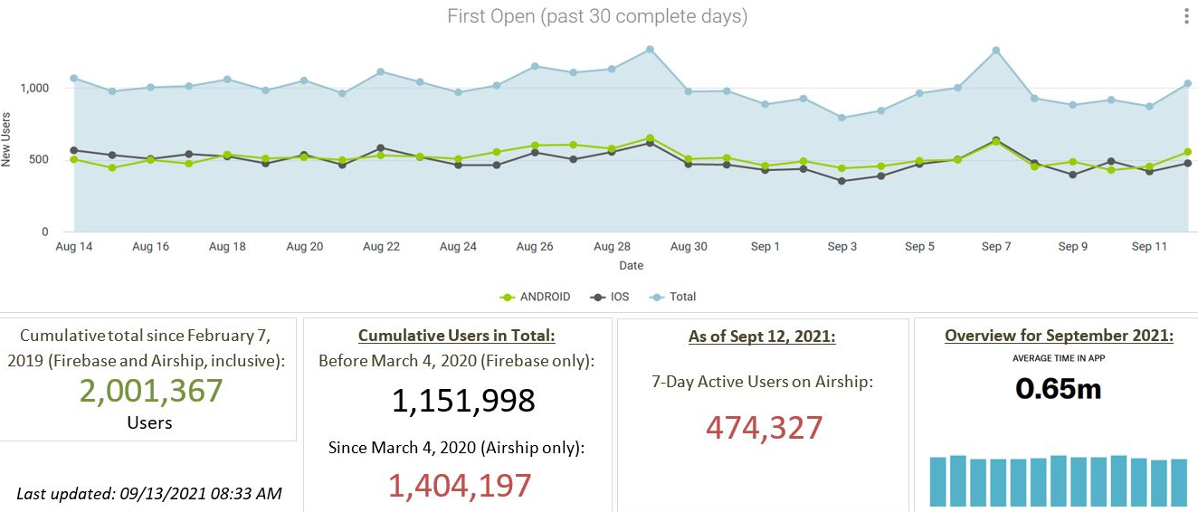
App stats (Sep 13, 2021)..
Stats
0.65 min per day = 39 secs per day x 7 days per week = 273 secs = 4.5 minutes per week
Notes:
Going to try and increase the “session time” by introducing gaming.

Slide 13
App stats (Sep 17, 2021)..
Average number of active users:
1-day (green) = 250K
7-day (purple) = 475K
30-day (blue) = 660K

Slide 14
Hard lessons learned
App was created, developed and delivered at a large development cost to other MSC projects.
Financial cost.
Large amount of resources needed to complete a project quickly.

Slide 15
But on the up-side..
From Treasury Board, the CIO Community Award in the category of “Excellence in User Focused Service Delivery”.
From ECCC the departmental “Citation of Excellence for Teamwork, Partnering and Collaboration”.

Slide 16
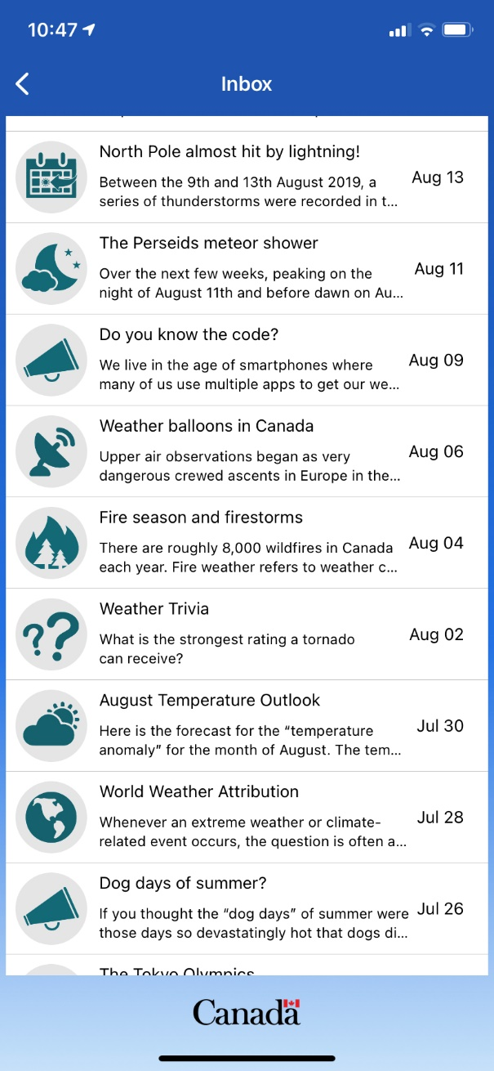
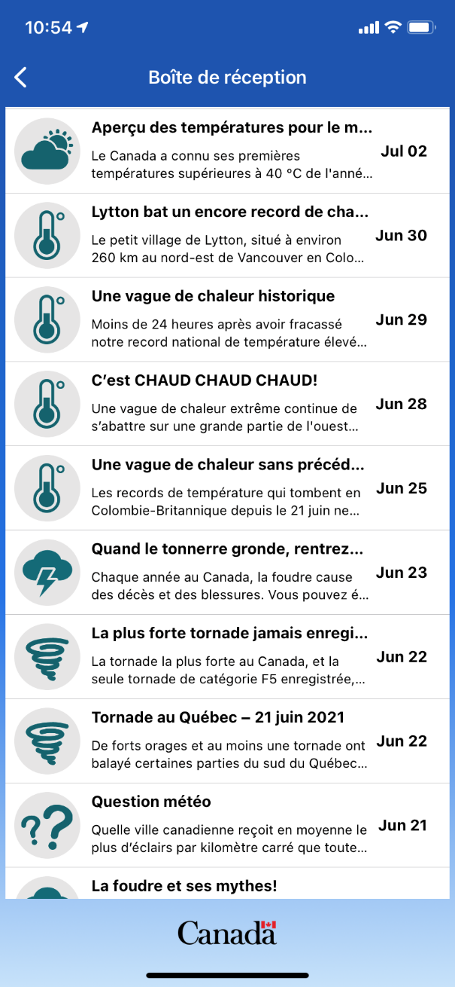
Our in-app message centre

Slide 17
Ok, now please download “WeatherCAN” or “MétéoCAN”

