Slide 1
Government of British Columbia Digital Trust Technology
Presented by:
Charles Macpherson
Senior Product Manager
Nancy Norris
Senior Director of ESG & Digital Trust

Slide 2
Charles Macpherson
Senior Product Manager

Slide 3
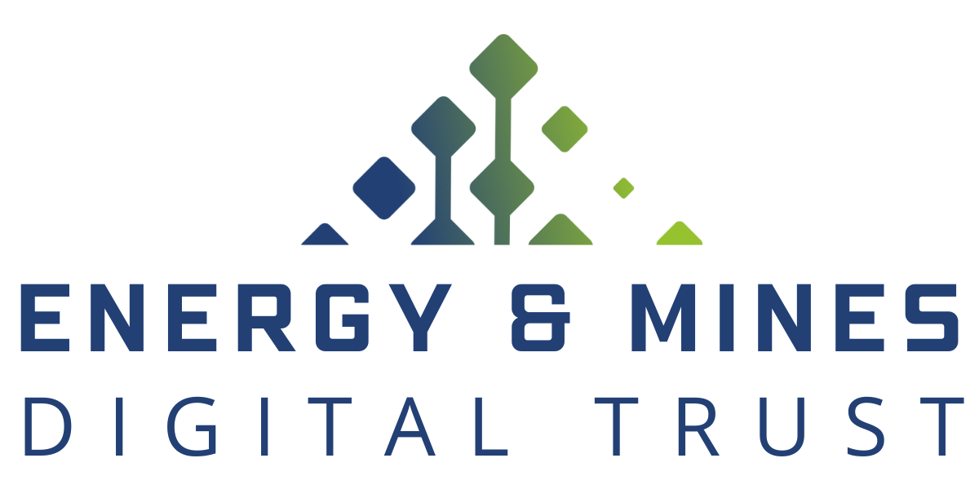
Nancy Norris
Senior Director
ESG & Digital Trust

Slide 4
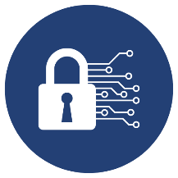
Key Terms and Concepts
Digital Trust
Digital Trust Ecosystem
Digital Wallet
Digital Credentials
Notes:
Digital credentials are the digital equivalent to a physical credential, like business registration or sustainability certifications.
Digital credentials offer a huge improvement over pdf documents shared by email because they:
Can be shared quickly and are tamper-proof
Allow organizations to control their data
Guarantee the integrity of the information
Build digital trust
A digital trust ecosystem is a network of organizations including environmental auditors, government bodies, mining and energy companies, and non-government organizations who share information using digital trust technology.
EMDT's technology, Traction, is open-source software built on Hyperledger Aries ACA-y and Hyperledger Indy. Traction enables the B.C. government to share and receive digital credentials.
EMDT is working with global partners to establish a governance framework including common terminology, policies, and standards for use by the digital trust ecosystem.

Slide 5
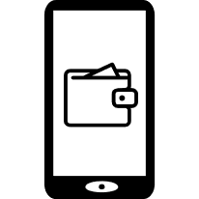
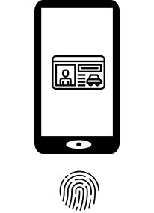
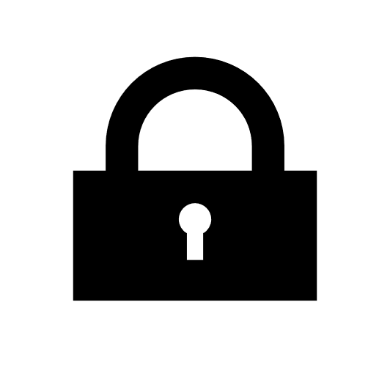
Digital Credentials
Physical
credentials
An organization…
issues a credential…
that is kept in a wallet…
and presented when needed…
to get things done.
Digital
Credentials

Slide 7
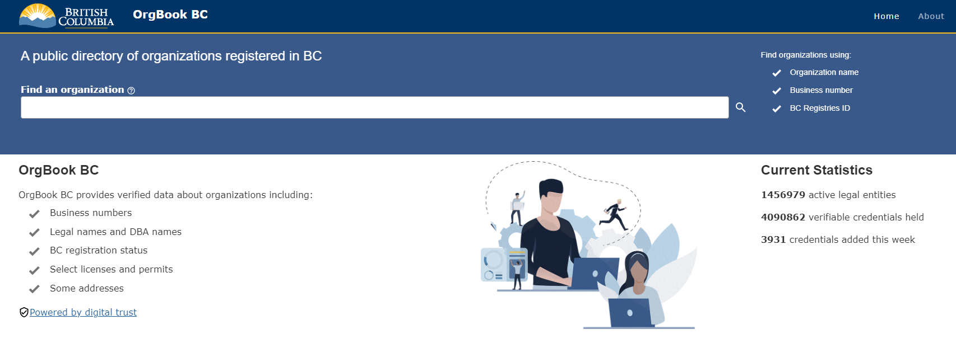
OrgBook BC

Slide 8
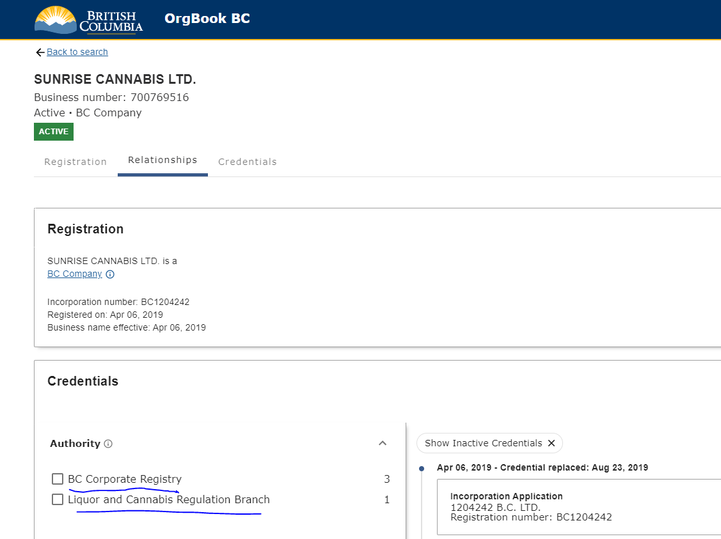

Slide 9
Lawyer Use Case: Access to Court Material
Moving towards…
The Province, and the businesses and people of British Columbia participating, with confidence, in the digital world
Problem
Importance
Solution
Lawyers in BC need fast and secure access to official court audio recordings and materials.
The Supreme Court of Canada requires that bail hearings are heard within 30 days.
Lawyers receive verifiable credentials that proves their identity and good standing. These credentials can be used to efficiently access court material.

Slide 10
User Journey
Logon to BC Services Card app
Receive Person credential
BC Wallet
Access to Court Materials
Logon to Law Society portal
Receive Law Society membership
Prove credentials to logon each time
Set up once

Slide 11
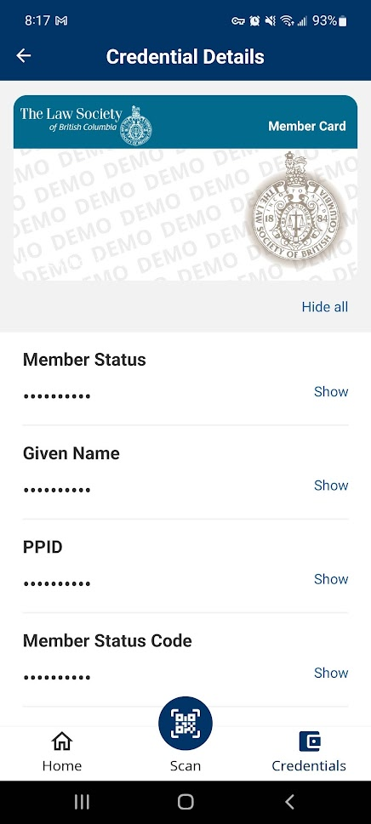
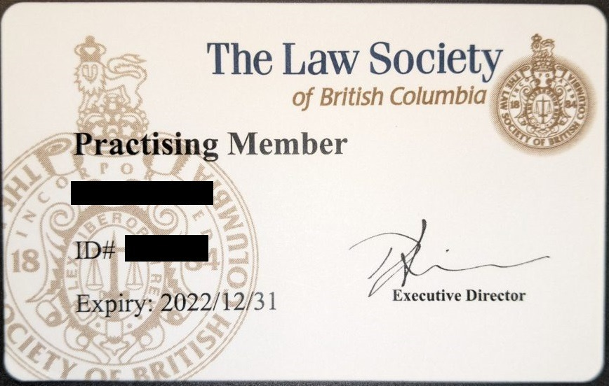
Law Society of BC membership credential
Notes:
A credential such as this Law Society membership, can be represented on a paper or plastic card, or cryptographically in digital wallet

Slide 12
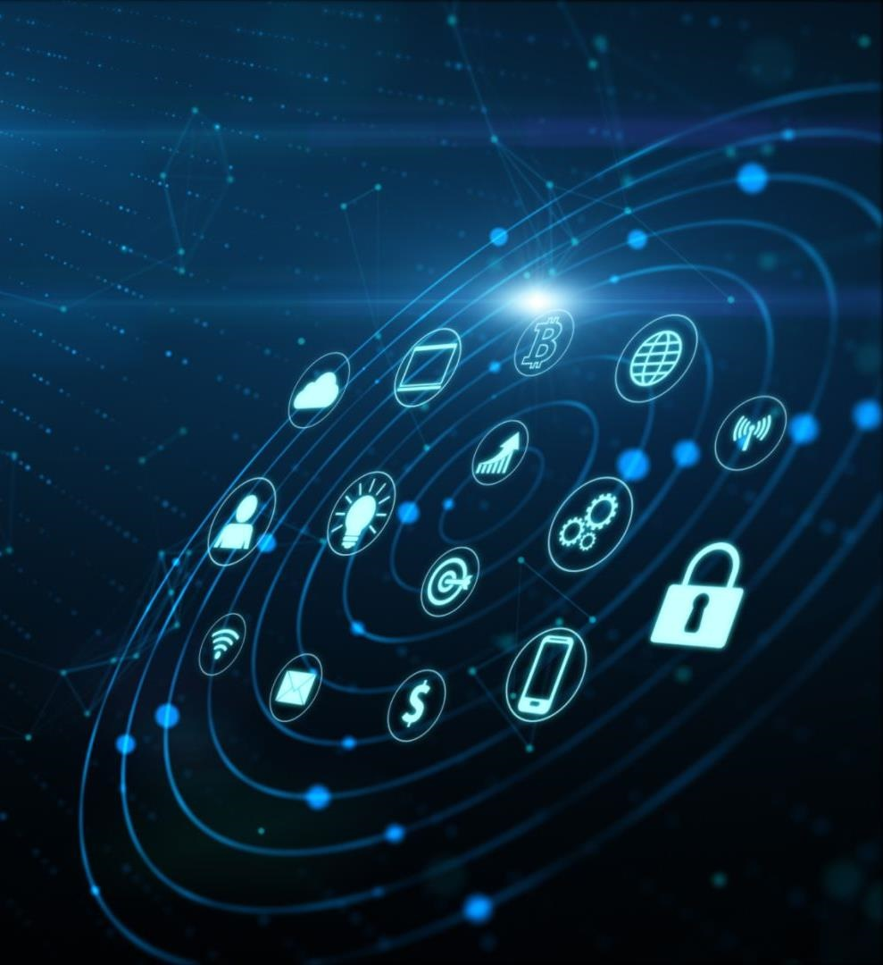
EMDT is enabling and accelerating the B.C. government's entry into a digital trust ecosystem.
This initiative is creating a simple and secure way to share sustainability data, certifications, and credentials.​​​
Notes:
Energy & Mines Digital Trust (or EMDT) is a pilot project that was initiated in November 2020 by the British Columbia Ministry of Energy, Mines and Low Carbon Innovation.
This project is enabling a collaborative digital ecosystem between the B.C. government, natural resource companies, and organizations around the world, making it simple and secure to share sustainability data.
We are working to provide mining and natural gas industry participants with a trusted, verifiable way to share greenhouse gas emissions data.
This initiative actively contributes to B.C. and Canada becoming recognized globally as a desirable, responsible, and competitive jurisdiction for investment.

Slide 13
Opportunities to Improve Sustainability Reporting
More Efficient Processes
Increase trust and security
Allow selective disclosure
Image: Copper Mountain Mining Corporation
Notes:
Globally, an increasing emphasis on responsibly sourced natural resource products is pressuring organizations to prove they are globally competitive, environmentally-leading, and socially responsible.
However, the current process for sustainability reporting relies on emails, spreadsheets and .pdf documents, which isn’t efficient and presents a number of challenges relating to security, privacy and administrative burden
EMDT is working to make improvements in a few different ways:
First, by making the process more efficient by providing digital solutions to organizations to reduce the degree of manual effort and administrative burden required to report sustainability data
Second, EMDT is delivering a way for market participants to trust that sustainability reports are accurate and legitimate, and to share information in a secure manner
And finally, EMDT is providing a way for organizations to share only the data that is necessary; this selective disclosure provides greater privacy.

Slide 15
Charles Macpherson
Senior Product Manager
Nancy Norris
Senior Director
Charles.Macpherson@gov.bc.ca
Digital.gov.bc.ca/digital-trust
Nancy.Norris@gov.bc.ca

