Slide 1
COVID-19 - Using alerts
Developing web content as one government

Slide 2
Updated alert guidance
Latest guidance on alerts for crisis comms:
https://design.canada.ca/crisis/alerts.html

Slide 3
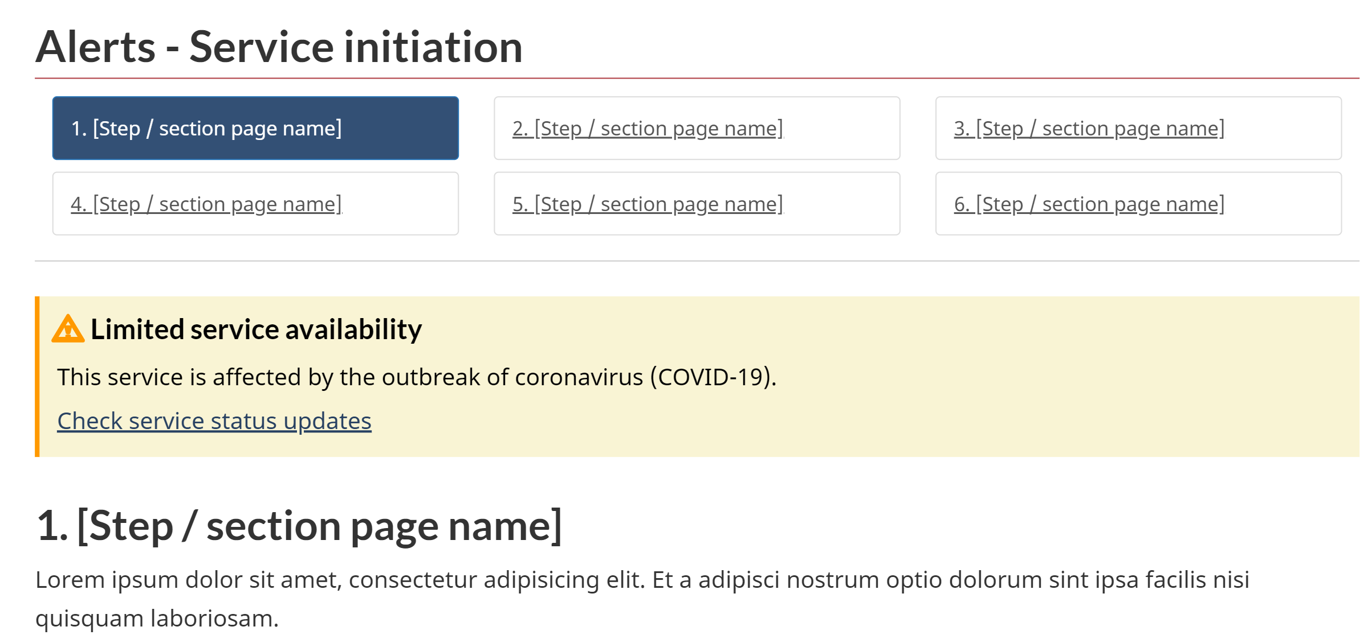
Alerts = content about content
Meant to draw attention to changes in regular content
Examples: service disruptions, upcoming policy or service changes

Slide 4
Where are alerts useful?
A doormat on a topic page to point to new content
Alerts are well suited for “service level” pages to highlight things like:
Service disruptions
Upcoming important changes
Recent important changes
Might have use on nav pages - but in many cases a new doormat would serve the same purpose
Limit use of alerts so that they continue to have impact

Slide 5
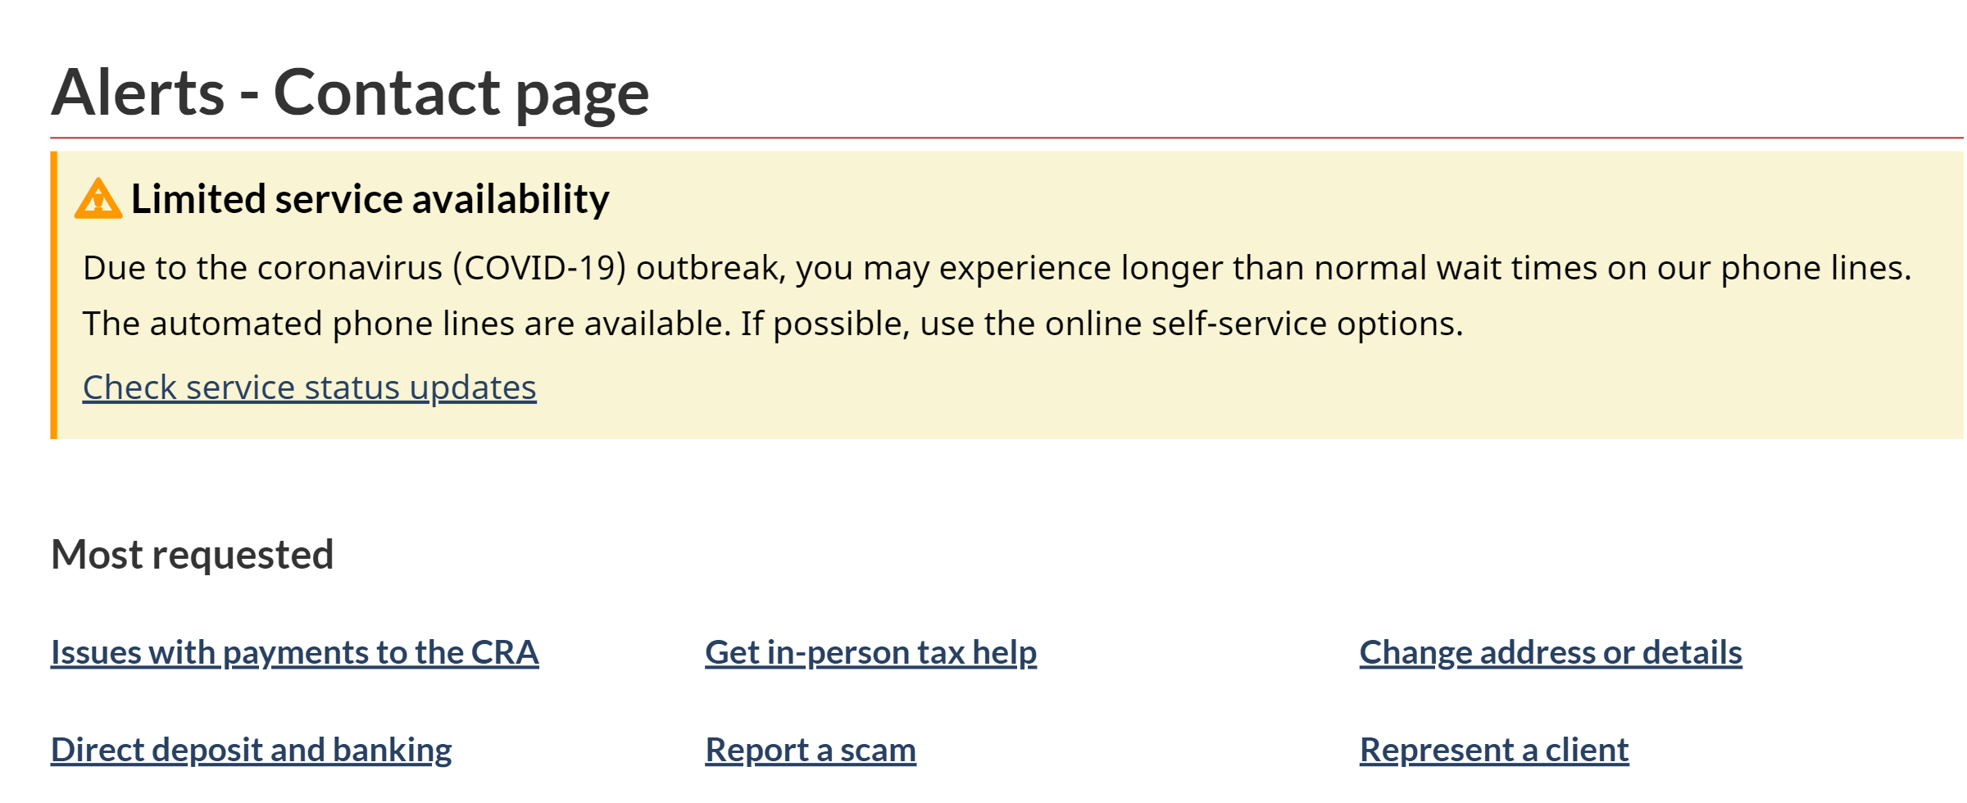
Alerts = short and simple
Describe the impact on the user
If including a link, use only one

Slide 6
When and for how long
This is a note that is being emphasized - not an alert
Use for temporary situations and significant changes
Avoid using alert styles just for emphasis

Slide 7
Minimize the number of alerts on each page
This competes with the alerts

Slide 8
Different types of alerts for different situations
Red and yellow - makes sense for warnings and danger
Blue and green - might make more sense for policy and service changes as part of the government response

Slide 9
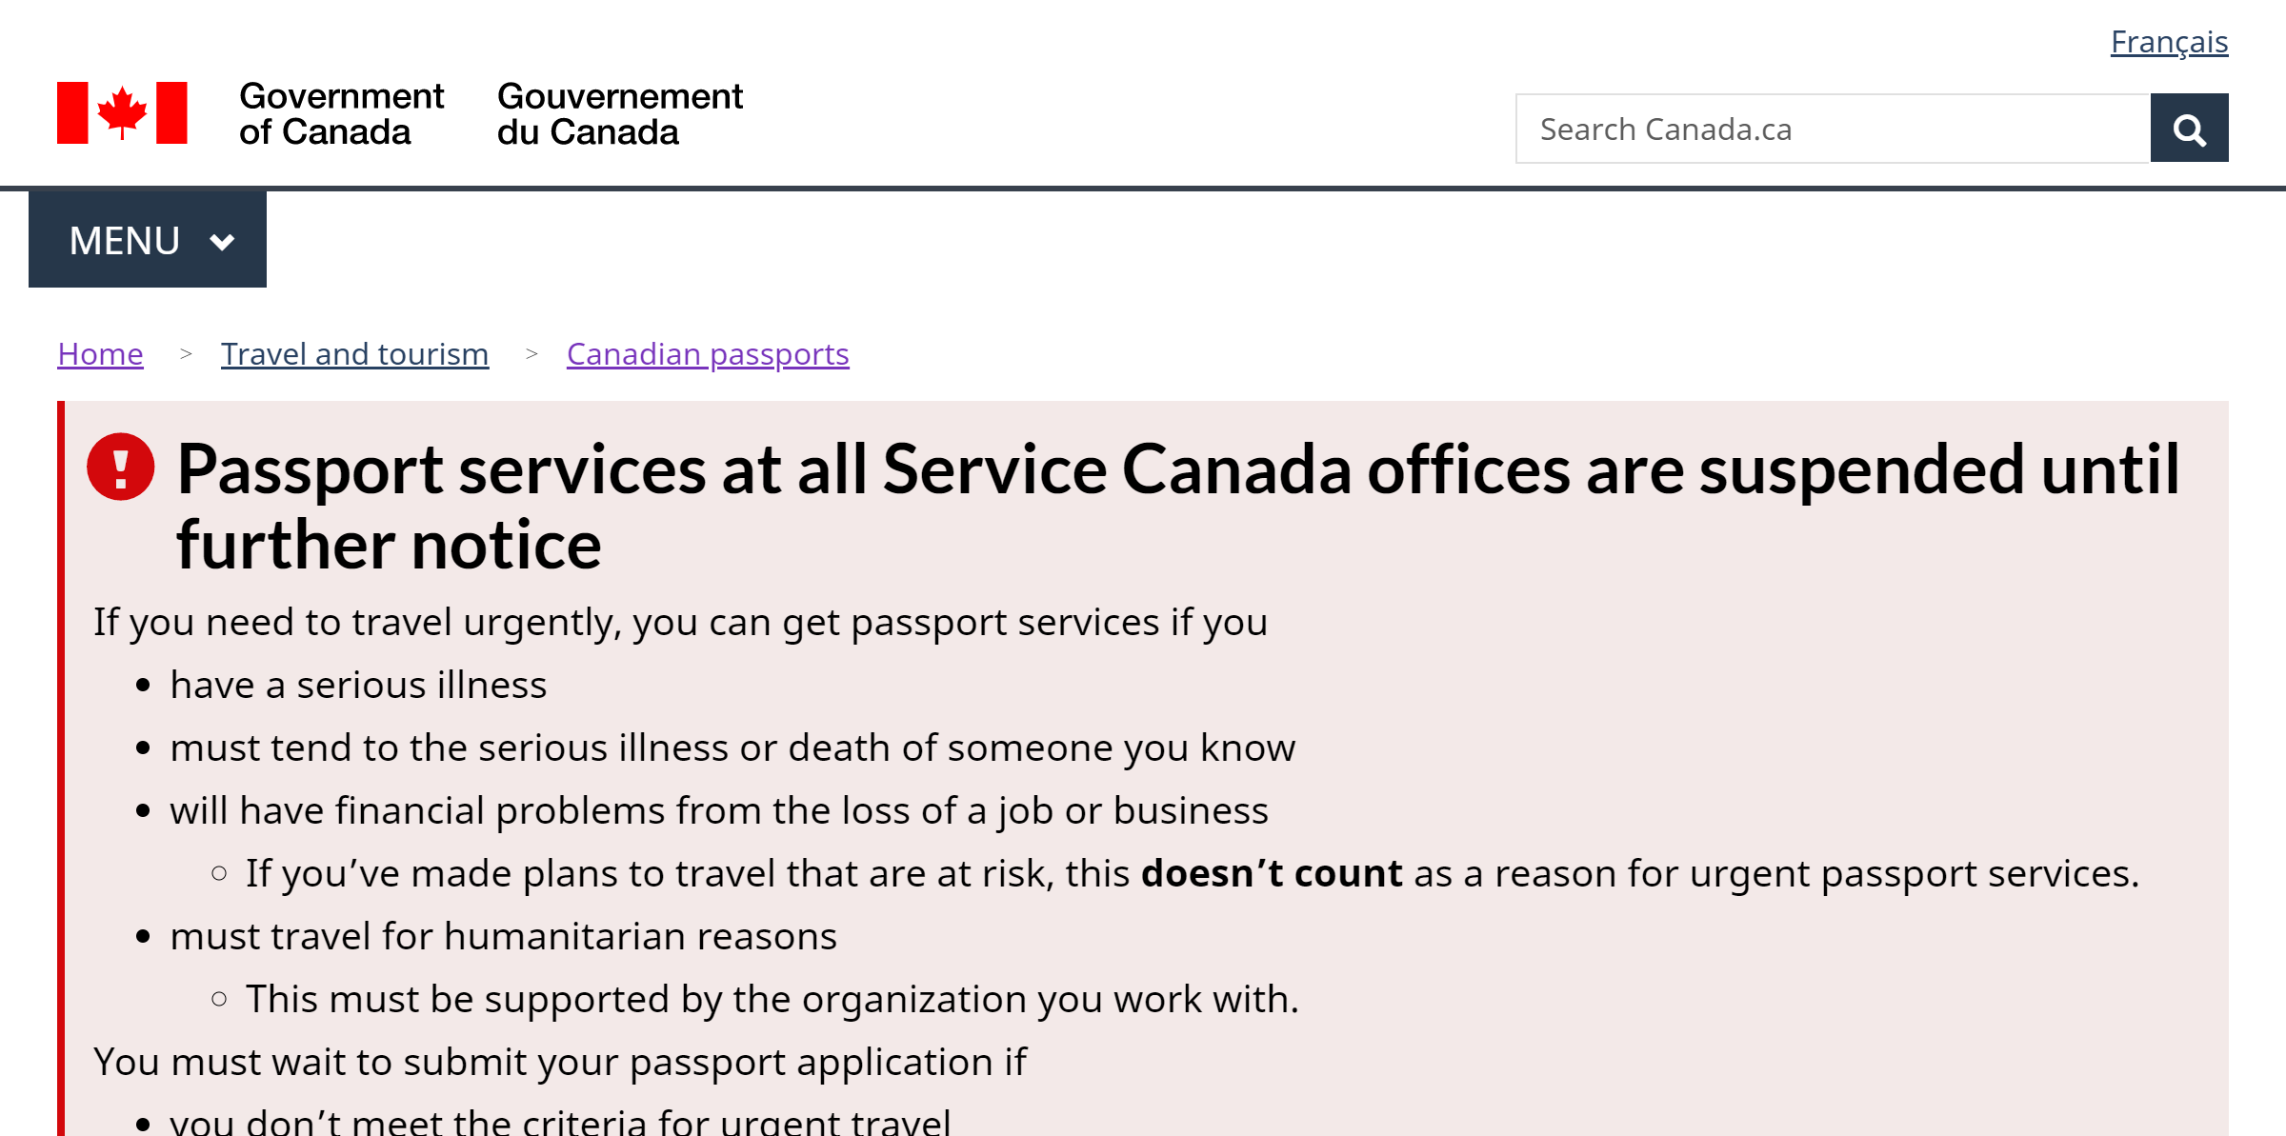
Alerts that repeat on several pages
If the alert is long, it’s no longer an alert
Better to keep alert on each page very short, with a link to a new “Passport services are suspended” page

