Slide 1
Short-term plans for business supports
FOR DISCUSSION

Slide 2
From: Taking Stock: COVID-19 Content for Business

Slide 3
Proposed short-term work plan to address Web Strategy
Initial launch of business landing page with a focus on:
Reopening guidance
Financial supports
Advice for small business
Access to PPE
Page performance feedback implementation
SEO improvements
Iterative content development/redesign and testing
Content inventory for business
Heuristic assessment of priority tasks
Content strategy
Content gaps
Content redesign and optimization requirements
Content development plan
Ongoing performance measurement

Slide 4
Testing business support effectiveness
3 rounds of unmoderated testing (so far) with initial business landing page
Page success widget to track real-time issues
Daily monitoring of analytics
COVID task success survey (with business support tasks included)
Further testing on specific tasks (reopening)

Slide 5
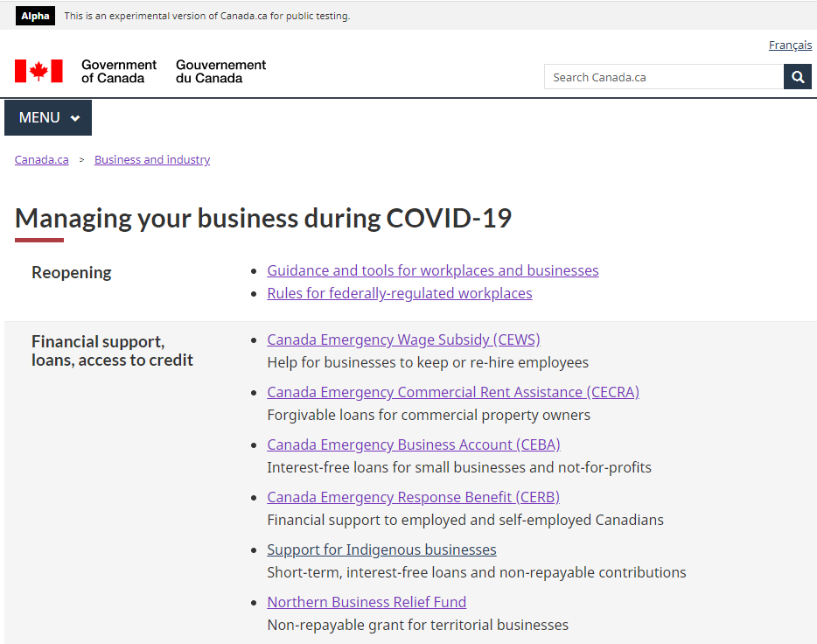
Business landing page

Slide 6
Questions?

