Slide 1
Regulatory Experimentation:
Centre for Regulatory Innovation & Nesta
Harry Armstrong, Chris Gorst, Andrea Richardson, Nicola Tulk
June 18, 2020

Slide 2
Objectives for this webinar
By the end of this webinar participants should know more about the CRI, our partner Nesta and our approach to regulatory innovation and experimentation.
Specifically, the webinar will cover:
The CRI’s role, the support offered and how regulators can access this support
An introduction to Nesta, the innovation foundation
Ways of thinking about regulation and innovation, and different approaches available to regulators to respond to and capitalize on innovation
The role of regulatory experimentation, and what makes a good regulatory experiment
International examples of regulatory innovation and experimentation

Slide 3
Agenda
Introductions - CRI & Nesta | 15 mins
Regulation & innovation: background | 10 mins
Regulation & innovation: framework | 15 mins
Regulation & innovation: principles | 5 mins
Questions & discussion | 10 mins
Break | 10 mins
Regulatory experimentation: what and when | 20 mins
What makes a good regulatory experiment | 15 mins
Next steps | 10 mins
Questions & discussion | 10 mins

Slide 4
Context
Regulations have been identified as one of the reasons why Canada is not reaching its full economic potential
Government has been pursuing an ambitious regulatory modernization agenda to ensure that:
Regulations do not inhibit competition and economic growth
Regulatory inefficiencies and duplicative requirements across borders are reduced
Regulatory frameworks encourage innovation and new technologies can be brought to market
Positive reaction from stakeholders and regulators on this approach suggests the Government of Canada should maintain momentum to modernize regulations

Slide 5
Centre for Regulatory Innovation (CRI)
Announced in 2018 Fall Economic Statement as part of the ongoing regulatory modernization agenda:
“The Centre will work as a convener and focal point that is business-facing, helping businesses connect with relevant regulators and managing a roster of sandboxes … that support innovation and competitiveness, while also ensuring that Canadians’ expectations around the protection of health, safety and the environment continue to be met.”
Mandate:
Support whole-of-government approach to regulatory experimentation;
Help regulators to respond to technological advances; and,
Support industry in bringing applications of new technologies into the Canadian marketplace.
Funding: up to $11.4M over five years (starting in 2019-20) and $3.2M ongoing to enable business and Government to work together on regulatory experimentation approaches.

Slide 6
Goals
SHORT-TERM
LONG-TERM
Create opportunities for regulatory experimentation
Enhance regulators’ capacity to analyze and respond to challenges associated with technological advances
Help embed experimental learnings into regulation, facilitating a regulatory framework conducive to innovation
Maximize opportunities offered by emerging technologies while continuing to protect health, safety, environment and the economy

Slide 7
CRI functions
Support businesses
Engage and collaborate
Help businesses understand and navigate the regulatory system, and connect them with relevant regulators.
Engage with international regulatory community and diverse stakeholders on issues of regulatory policy and innovation.
Facilitate experimentation
Measure and share
Bring parties together to design and implement regulatory experiments.
Measure impacts and share lessons learned from regulatory experiments.
Build regulatory capacity
Tools and guidance
Enhance the capacity of departments to design and implement regulations that support competitiveness
Develop tools and guidance around innovative regulatory approaches.

Slide 8
Nesta introductions
Harry Armstrong
Head of Technology Futures
Chris Gorst
Director at Nesta Challenges
Andrea Richardson
Programme
Manager
Nicola Tulk
Programme
Manager

Slide 9
Nesta’s role with the CRI
Work in partnership with CRI to…
Share learning from our work in regulatory innovation
Provide guidance and support to regulators implementing, overseeing and evaluating regulatory experiments
Including guidance to develop / refine proposals for CRI’s Experimentation Fund
Build a regulator toolkit / practice guide based on learning from CRI’s initial work and international examples

Slide 10
Background
Regulation and Innovation

Slide 11
Poll questions
How innovative do you think the Canadian economy is?
How innovative is the regulatory system in Canada?
How well equipped is your department to understand and respond to marketplace innovation?
Notes:
Icons from thenounproject.com bu Larea

Slide 12
Innovation - a blind spot in regulatory theory?
Current regulatory systems emerged in economies very different from today’s
Dominant neoclassical economic paradigm: homo economicus, equilibrium
Competition → efficiency and innovation → consumer benefit
Correct clear market failures when they occur
Quantify (static) costs and benefits
Regulator can and should be technology neutral

Slide 13
The old dilemma - trading off innovation and risk of harm
Regulate too early and innovation could be stifled
Regulate too late and innovation could lead to lasting harms
Sweet spot?

Slide 14
There is no straightforward tradeoff
“wait and see” approach is not necessarily good for innovation and is inadequate in tackling global challenges
“Regulatory drag” and path dependence- potential regulatory tax on innovation
Missing regulatory frameworks create uncertainty, cedes ground to potentially harmful innovation
Innovation not emerging where needed- critical for global challenges like climate change, COVID, inequality etc

Slide 15
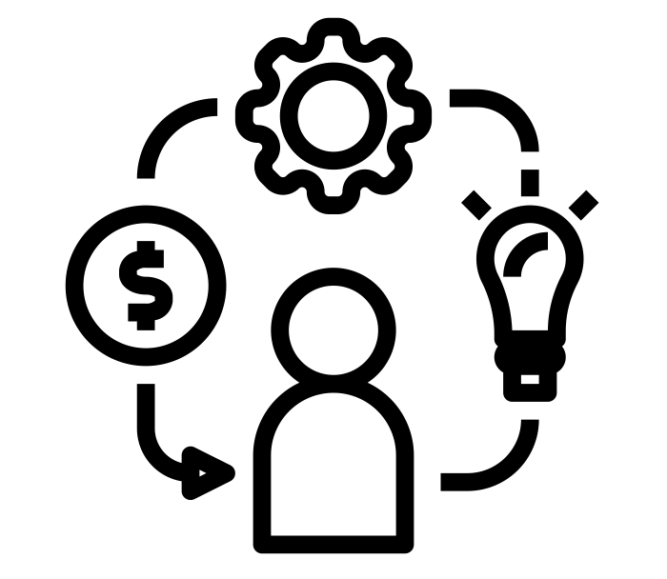
In taking a new approach, regulators have to contend with a number of challenges
Pressure for regulation and regulatory action To support innovation and respond to unchecked digital innovation, new technologies and business models. Uncertainty around what needs to be regulated and how it should be regulated
Radically different environments
Decentred regulation (eg self regulation), changing power dynamics, new types of harms and opportunities, erosion of sectoral boundaries, Uncertainty around how regulators can adopt new ways of working to respond (eg co-design)
Pressure for more innovation
Growing business and political pressure to ease regulation, stagnant productivity growth and international competition as well as the need to respond to global crises. Uncertainty on regulators role in respect to innovation and how to balance innovation along with other elements of their mandate (eg safety)
Internal challenges
Development and adoption basic playbook not effective. Uncertainty around how better processes, ways of working or regulatory frameworks might work
Notes:
Icons from Tippawan Sookruay on The Noun Project

Slide 16
Uncertainty and information asymmetry are important underlying issues regulators have to deal with in responding to innovation
Innovation is inherently uncertain - e.g. which innovations will emerge, gain traction, how they will evolve or what impacts they will have is very difficult to predict
Market players may have more reliable information about innovation than the regulator and some of this might be tacit knowledge
Regulatory action can have significant impacts on the market and innovation but knowing when and how to act under this uncertainty is very difficult
Experimentation, piloting and evaluating different approaches, is an effective way to resolve some of this uncertainty

Slide 17
Poll question answers...

Slide 18
Framework
Regulation and Innovation

Slide 19
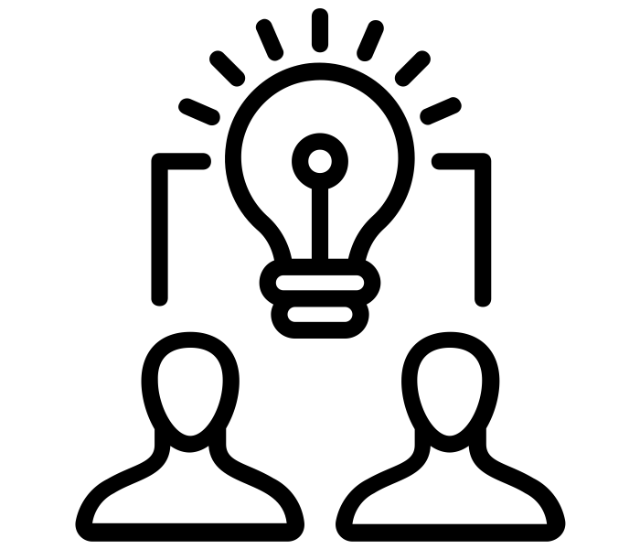
Regulation and innovation: three relationships and regulator roles
Regulatory innovation
Regulation of innovation
Regulation for innovation
Regulator as Innovator
Regulator as Steward
Regulator as Catalyst
New ways of regulating to meet regulatory objectives, improve efficiency etc.
Includes adoption or development of new approaches, tools (eg Regtech) and roles.
Regulatory responses to real or potential impacts of innovation
Focus on business-led innovation and scientific developments
Regulatory action to enable, or stimulate, innovation in support of regulatory goals
Regulators use innovation as a tool to achieve goals
Notes:
All icons from https://thenounproject.com/prosymbols/collection/human-resource-line-icons/ by Pro Symbols

Slide 20
Why distinguish between Innovator/Steward/Catalyst roles?
Different roles have different implications for skills, culture, organisation, tools
Balance of roles needed by a regulator may change over time
Different roles entail regulator grappling with different kinds of risk, uncertainty
What counts as “regulatory innovation” varies between regulators
Based on regulator experience, sector
Steward role may or may not require regulator to adopt Innovator role
Innovator role may be unrelated to marketplace innovation:
Could be about achieving same objectives in same setting at lower cost or risk

Slide 21
When to adopt different roles?
Role: Regulator as…. | Can help to achieve regulatory objectives... | Motivation | Example
Innovator: innovating itself | Better, more efficiently | Identify reforms to/new kinds of regulatory practice that can meet regulatory objectives ‘better’ (at lower cost, with less risk) | Shift from bright-line rules to outcomes-based regulation
Steward: responding, adapting to (marketplace) innovation | In a changing innovation environment | Identifying appropriate regulatory response to specific innovation or innovations | Development of guidance/rules on provision of automated advice in regulated activities (e.g. legal, financial advice)
Catalyst: Catalysing (marketplace) innovation through regulatory action | By changing the innovation environment | Identifying and implementing regulatory action to unlock, facilitate greater innovation in a specific domain | Open standards e.g. for data (Long term) emissions standards

Slide 22
Why might a regulator want or need to be an Innovator?
Pushing for the ‘efficiency frontier’ | New challenges that demand new solutions | Old and persistent challenges that demand new solutions
“Regulator X’s processes impose an excessive and unnecessary burden on business” Can be a response to external pressure - regulatees, political Achieving regulatory goals with lower overhead/costs to business without increasing risks RegTech focusses here Incremental change Example: using machine learning to analyse regulatory returns | “AI is going to make our current approach to regulating Y redundant. What needs to change?” Can be driven by a new technology reaching maturity and achieving user traction Can demand significant change from the regulator and regulatory system e.g. collaboration & reorganisation Example: creation of Digital Markets Unit with new powers to tackle market power of digital platforms (UK) | “Our approach to regulating Z is not working well enough. What needs to change?” Can be enabled by a new technology that creates new possibilities for industry structure, dynamics Aim can be for radical change - paradigm shift Example: tackling consumer exploitation using behavioural science to define new defaults e.g. for product renewals, information provision

Slide 23
Steward and Catalyst: regulator faces different kinds of uncertainty
Steward | Catalyst
Trajectory of an innovation - speed and shape of development, adoption, dissemination How the innovation will be (ab)used New opportunities for creating harms (personal, social, environmental) Public attitudes, values in relation to the innovation Impact of current regulation/regulatory practice on types, trajectories of innovation Effect of different options for regulating on types, trajectories of innovation | Is there ‘enough’, the ‘right kind of’ innovation emerging and gaining traction in the regulated space? How to make these judgements? What are the major drivers of/impediments to innovation in the sector? Which regulatory options are available to address these? How would the marketplace respond over time to these regulatory actions? What could be unintended consequences? What would be key determinants of success for these regulatory actions?

Slide 24
Regulator as Steward: what stances can a regulator adopt towards an emerging innovation?
Do nothing (intentionally or otherwise)
Effect could be restrictive or permissive
Flexibility and forbearance
Case-by-case
No action letters, restricted licences, special charters
Restricted experimentation
Structured context, “safe space” for experimentation
Regulatory development
Reform existing, create new regulation
* Based on Regulating a Revolution, Zetzsche et al (2017)

Slide 25
Principles for Practice
Regulation and Innovation

Slide 26
Principles to guide regulators in their engagement with innovation
One way in which regulators can support innovation without compromising safety in a context of uncertainty is to use processes that can better anticipate issues and opportunities.
We have identified a set of 6 six principles which we believe can help regulators to:
Avoid some of the issues associated with acting early,
Develop intelligence around marketplace innovation and its potential impacts,
Leverage wider stakeholder input through more participatory processes, and
Assess the effectiveness of different interventions.
(These principles build on the concept of anticipatory governance and are part of Nesta’s work on anticipatory regulation. They outline ways in which regulators can build knowledge and capacity in key areas -e.g. foresight, engagement, data collection etc- to help overcome uncertainty, better understand what might happen and how to respond in a resilient way)

Slide 27
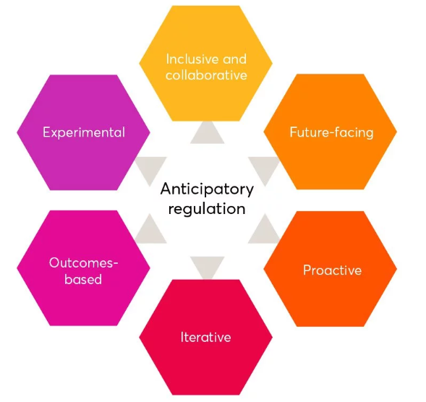
Six principles of practice
Inclusive and collaborative- e.g. co-design, see City of Toronto’s work with public on sharing economy regulation.
Future-facing- e.g. integrating foresight, see Singapore’s approach
Proactive- e.g. acting early and guiding innovation, see FCA’s green fintech challenge (innovator as catalyst).
Iterative- e.g. continually testing alt approaches
Outcomes-based- balanced with risk, rule and principles based regulation.
Experimental- e.g. Sandboxes, regulator as innovator and steward

Slide 28
Poll questions - Innovator, Steward, Catalyst roles
Which role(s) do you think will be most important for you in the next few years?
Which role(s) do you feel most comfortable in?
Which roles do you feel least comfortable in?
Notes:
Icons from thenounproject.com bu Larea

Slide 29
Questions & Discussion

Slide 30
Break
Please return in 10 minutes

Slide 31
What and When
Regulatory Experimentation

Slide 32
The need for experimentation
Dominant underlying issue that regulators have to deal with is uncertainty e.g.
What implications, regulatory or otherwise, might market innovations have? What does good look like?
What role should regulators play in the emergence of new products, services or business models?
Can market led innovation help fulfil regulatory mandates?
What kinds of approaches or methods work?
Experimentation, piloting and evaluating different approaches, is an effective way to resolve some of this uncertainty

Slide 33
What is a regulatory experiment?
Key features:
Clear and significant element of uncertainty that can’t be resolved in other ways (eg desk research)
Involves testing or learning about something innovative (i.e. new and original), such as:
There are clearly articulated outcomes, setting out what the experiment aims to learn and how this learning will influence future practice or policy
Limited in some way e.g. once clarity on outcome is achieved
Facilitating the development of new products, services, processes and business models and their entry to the market and/or
Piloting or development of new types of regulatory processes
Piloting or development of new (components of) regulatory frameworks
1 - New products
2 - New regulatory processes
3 - New regulatory frameworks

Slide 34
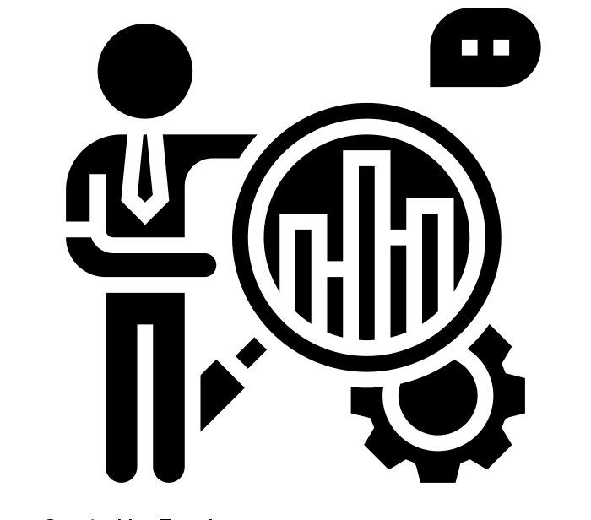
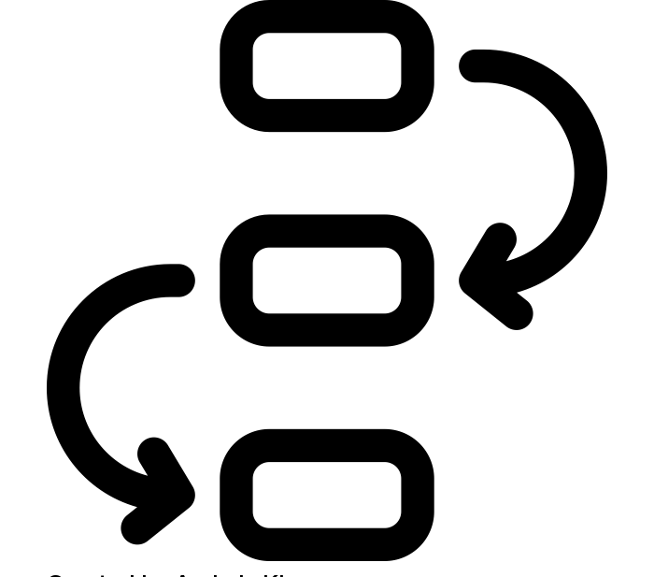
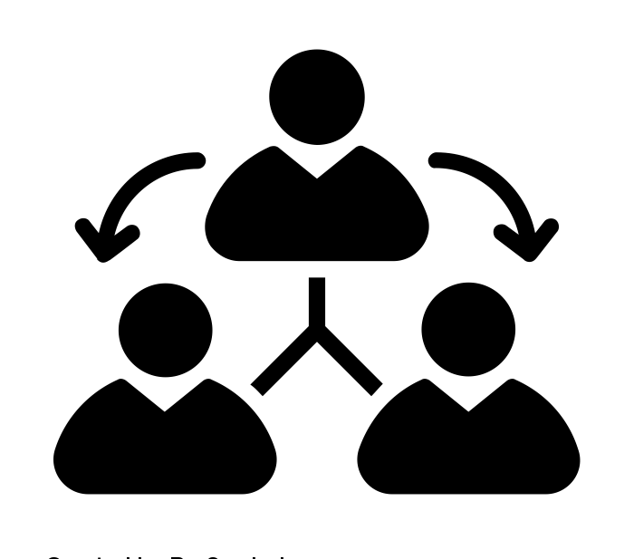
Innovation-enabling approaches to regulation already being employed around the world
Supporting experimentation & testing of innovations
Sandboxes & testbeds
Experimenting with new processes
Challenge prizes - setting regulatory challenges to drive innovation
Advice centres - experimenting with new ways of providing regulatory advice
Fast track pathways - streamlining regulatory approvals
Regulatory collaboration on innovations
Work-sharing
Regulatory harmonisation
Collective experimentation i.e. cross-border testing
Public engagement models
Notes:
All icons from https://thenounproject.com/, by Eucalyp, Andrejs Kirma and ProSymbols

Slide 35
Supporting experimentation & testing of innovations
1 - New products
2 - New regulatory processes
3 - New regulatory frameworks
Testbeds & sandboxes
Description
Situations where useful
Live testing environments such as sandboxes or testbeds enable innovators to trial new products, services or business models safely, to test the viability of an innovation before accessing the market.
New products/ services/ businesses pose a potential risk
Innovation is hindered by inability to test early viability of new ideas
Regulator needs more insight on new types of products/ services/ businesses to inform future regulatory reform
Regulator needs insight to test & develop new regulation / policy / infrastructure
Speed of innovation is reduced when innovation cannot start until new regulation / policy / infrastructure has been fully implemented
Need to prove benefits of new approaches to gain public and industry trust
Examples
FCA Sandbox - first regulatory sandbox established in 2016 for fintech, model has become a blueprint
Singapore Autonomous Vehicle Initiative - addressing challenges of travel demand, land & labour constraints
Singapore Licensing Experimentation & Adaptation Programme - regulatory framework for tele & mobile medicine

Slide 36
Example: Telemedicine Sandbox- Singapore and Malaysia
1 - New products
2 - New regulatory processes
3 - New regulatory frameworks
Context
Need
Objectives
Experiment
Telemedicine and online health services not allowed under existing provisions but new innovations could deliver public value.
A way to develop a new regulatory framework that protects the public but also captures the value of these innovations and enables a new industry
Understand the implications of these innovations and where regulation may be needed
Work closely with the emerging industry
Time limited sandbox to test innovations and co-develop + test a new regulatory framework
Final framework published in 2020
Regulator as Innovator
Regulator as Steward

Slide 37
Example: Remotely Piloted Aircraft Systems (RPAS)- Transport Canada
1 - New products
2 - New regulatory processes
3 - New regulatory frameworks
Context
Need
Objectives
Experiment
Drone technology emerging but absence of a regulatory framework is limiting innovation and economic opportunity
Greater flexibility under current regulation and clarity on future frameworks
Amend Canadian Aviation Regulations
Develop and implement performance- based standards
Expand pilot projects (some currently ongoing with aviation and technology industries) to support the development and adoption of drone technology
Regulator as Innovator
Regulator as Steward
Regulator as Catalyst

Slide 38
Experimenting with new processes to drive innovation
1 - New products
2 - New regulatory processes
3 - New regulatory frameworks
Challenge prizes
Description
Situations where useful
Challenge prizes offer a reward to whoever can first or most effectively solve a problem. They are a tried and tested method of attracting new innovators to change the status quo. At the same time, they also challenge incumbents to redirect their efforts or think about a problem in a new way.
Lack of innovation directed towards a specific challenge or outcome, for example fairer access to services, climate change
The regulator needs more insight on new types of products/ services/ businesses to inform future regulatory reform
The regulator needs insight to test and develop new regulation / policy / infrastructure
Examples
Open Up Challenge - open banking fintech innovations, backed by UK’s Competition & Markets Authority
Legal Access Challenge - lawtech for consumers, run in partnership with the UK’s Solicitors Regulation Authority
Green Fintech Challenge - seeking green solutions, a pilot approach by the UK’s Financial Conduct Authority

Slide 39
Example: Legal Access Challenge
1 - New products
2 - New regulatory processes
3 - New regulatory frameworks
Context
Need
Objectives
Experiment
Lawtech slow to develop, and very little innovation in consumer services
Solicitors Regulation Authority to define its role in relation to innovation and tech
Accelerate development of new consumer services
Understand whether current regulation is a barrier to tech innovation
Challenge prize
Encouraging new services
Direct engagement with innovators to understand barriers
Regulator as Innovator
Regulator as Steward
Regulator as Catalyst

Slide 40
Experimenting with new processes to streamline approvals
1 - New products
2 - New regulatory processes
3 - New regulatory frameworks
Fast track pathways
Description
Situations where useful
Mechanisms to speed up market authorisation of novel products or services, for example through faster alternative approval processes, often with increased resource allocation, post-market monitoring and/or different evidence requirements.
Innovation is hindered by slow approval and authorisation processes - particularly relevant where innovation offers high potential public benefit e.g. health
Examples
Food and Drug Administration’s (FDA) De Novo classification - pathway to classify new medical devices
UK Accelerated Access Collaborative Pathway - health products accelerated path to market + horizon scanning
Hong Kong Insurance Authority Fast-Track Approval system - applicants must partner with established insurer

Slide 41
Experimenting with new ways of providing regulatory advice to innovators
1 - New products
2 - New regulatory processes
3 - New regulatory frameworks
Advice centres
Description
Situations where useful
Dedicated innovation teams or contact points providing innovators with regulatory guidance. Example areas of support include navigating the regulatory system and ensuring alignment of new ideas with existing regulations or regulatory expectations.
The regulatory system is a “soft” barrier to innovation. Regulatory complexity or uncertainty hinders innovation
New products/ services/ businesses are not aligned with existing regulation or regulatory expectation
The regulator needs more insight on new types of products/ services/ businesses to inform future regulatory reform
Examples
UK MHRA Innovation Office - joined up advice for medical & healthcare products covering several authorities
German Federal Institute for Drugs and Medical Devices - varied support for innovators at different stages
Hong Kong Monetary Authority’s Fintech Supervisory Chatroom - support open to fintechs not regulated by HKMA

Slide 42
Regulatory collaboration on innovations
1 - New products
2 - New regulatory processes
3 - New regulatory frameworks
Regulatory collaboration on innovations
Description
Situations where useful
A range of methods to work collaboratively internationally or with the public or industry:
Work-sharing
Regulatory harmonisation
Collective experimentation i.e. cross-border testing
Public engagement models
Differing regulatory approaches across jurisdictions hinder innovation that would benefit multiple locations
Global products / services / businesses may pose risks that are not addressed by individual regulatory approaches
Progress on unsolved challenges requires input from multiple actors e.g. regulators, government, industry, public
Examples
Global Financial Innovation Network - global sandbox facilitating cross-border testing
Australia-Canada-Singapore-Switzerland Consortium - work-sharing on New Chemical Entities & Generic Medicines
Flying High - collaborative engagement to shape the future of urban drone use in the UK

Slide 43
What makes a good regulatory experiment?

Slide 44
Broad considerations for good regulatory experiments
Design
Clarity on the problem, what is known and what isn’t?
Clarity on the desired outcomes, what are you trying to find out or learn? (hypothesis to be tested)
Clarity about how to apply this learning in practice
Mitigation plan for barriers to success: systemic barriers, funding, resource, licence, other
Be explicit about scale and type of risk willing to take on
Broad engagement considering public, industry, other regulators, other jurisdictions

Slide 45
Broad considerations for good regulatory experiments
Implementation
Ensuring right resource - capacity, capability and senior buy-in
Define stage-gates for reflection - know when an experiment has “failed” (not getting desired learning) and be ready to kill it
Define when experiment ends - time limited, outcomes achieved, particular # of tests, etc
Consider who else needs to be involved to achieve objectives - other regulators, parts of government, etc

Slide 46
Broad considerations for good regulatory experiments
Evaluation
Impact evaluation
Clear knowledge of hypothesis being tested and what is to be evaluated, evidence to be used to assess, and how / when evidence will be gathered
Plans for impact evaluation beyond life of experiment
Plan for sharing data / insights
Process evaluation
Defined times for reflection and process evaluation
Plan to codify/ document / share insights from process

Slide 47
Open banking in Canada - how can experimentation inform policy/implementation?
1 - New products
2 - New regulatory processes
3 - New regulatory frameworks
Context
Need
Objectives
Experiment
Lack of effective competition in retail banking leading to lack of choice for consumers and limited innovation in products and services
Reduce consumers’ tie in to their current account provider through enabling easy and secure sharing of data with permissioned third parties
Define and implement a common open banking standard
In UK implementation of open banking, led by newly created body, is the experiment
Will open banking deliver improvements in consumer choice, competition and innovation?
Regulator as Innovator
Regulator as Catalyst

Slide 48
Three important but under-explored areas
Cross sector initiatives:
A few examples exist around the world. Hampered by differing mandates and cultures but critical for issues that cross sectoral boundaries (eg AI or climate change).
Federal, provincial and city level collaboration:
Some experiments and pilots may need to be done in a specific place and initial small scale tests may be valuable in some cases.
Wider stakeholder engagement and public inclusion:
Very few examples except at city level (eg city of Toronto and sharing economy). Innovations and global challenges open up values based questions (i.e. what world do we want to live in) that cannot always be answered by government/parliament.
Notes:
All icons from https://thenounproject.com/, by Wichai Wi, BomSymbols and priyanka

Slide 49
Next Steps

Slide 50
Next steps
Nesta will be conducting interviews with a cross-section of regulators, to inform the CRI Regulators Toolkit.
First round of experimentation proposals are being developed, MOUs with departments to be signed this summer.
20 Regulator Capacity Fund submissions were received and are in the process of being assessed.
If you or a stakeholder have an idea for a regulatory experiment, let us know!
CRI-CIR@tbs-sct.gc.ca
https://www.gcpedia.gc.ca/wiki/Centre_for_Regulatory_Innovation

Slide 51
Questions & Discussion

Slide 52
Some questions to takeaway...
Regulator as Innovator: How could you systematically identify better ways of achieving your regulatory objectives?
Regulator as Steward: What kinds of marketplace innovation present (or could present) deep challenges to how you regulate?
Regulator as Catalyst: What assets/resources/powers can you leverage to stimulate innovation in your space?
Where are coalitions of regulators needed to adequately address challenges presented by innovation (e.g. AI and advice)?

Slide 53
Thank you

Slide 54
Nesta’s Work in this Space

Slide 55
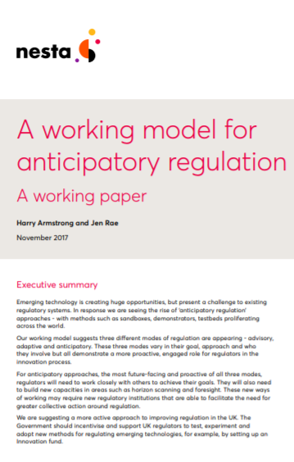
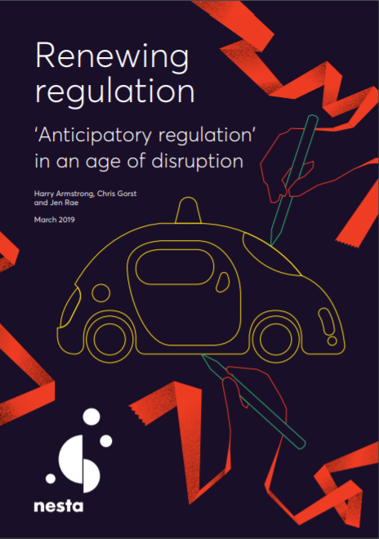
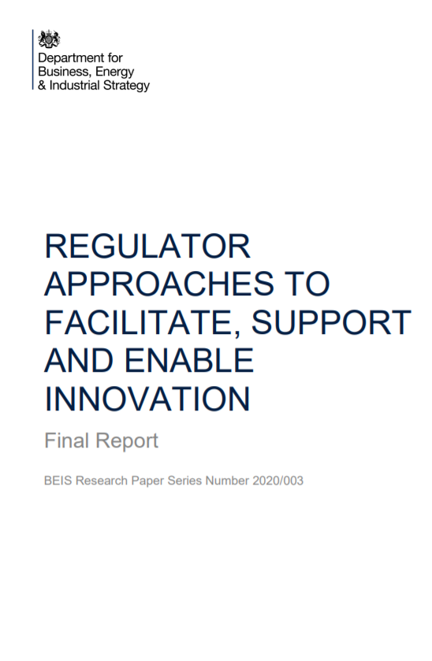
“Anticipatory regulation”: Nesta research
Sources:
https://www.nesta.org.uk/report/renewing-regulation-anticipatory-regulation-in-an-age-of-disruption/
https://www.gov.uk/government/publications/regulator-approaches-to-facilitate-support-and-enable-innovation
https://www.nesta.org.uk/report/flying-high-challenge-future-of-drone-technology-in-uk-cities/

Slide 56
“Anticipatory regulation”: Nesta practice
Open Up 2018 & 2020
Challenges
Legal Access
Challenge
Affordable Credit Challenge
Flying High

Slide 57
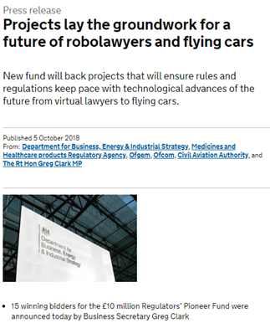
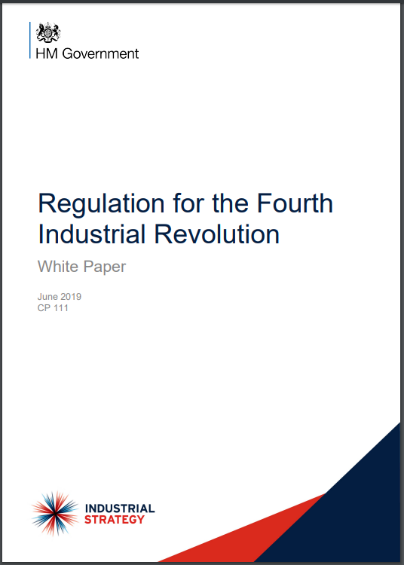
Policy engagement
Regulators Pioneer Fund
UK Government (BRE) strategy and development of the Regulatory Horizons Council
Finnish Government’s innovation friendly regulation framework
German Government’s experimentation strategy
EU’s innovation principle

