Slide 1
Interviews on the Future of Public Service HR
Key Takeaways (2021-03-16 v.1)
By Étienne Laliberté

Slide 2
Background
In early 2020, the Assistant Deputy Minister (ADM) of the ESDC Human Resources Services Branch tasked the Human Resources Innovation (HRI) team with developing a 10-year “aspirational” vision for the Branch, with an emphasis on culture change.
Then…Covid-19 happened, disrupting public service HR in ways that would have been unimaginable only a few months earlier. The disruption also presented a unique opportunity to make fundamental changes and enhance the readiness of the HR function to meet future challenges. But what specifically? How? And where to start?
The HRI team proposed to explore the ways the Covid-19 crisis might change HR's role in the public service and how the HR function must lead the transformation, by surfacing emergent strategies, ongoing initiatives, patterns, trends, and original ideas that might show the path forward.
The approach the HRI team took consisted in interviewing a wide range of HR leaders across the public service: HR executives, subject matter experts and innovators. Using semi-structured interviews carried out virtually and a small set of questions as a starting point, we let the interviewees take the conversation where they wanted, following their expertise, interests, and main preoccupations.
The findings – alongside the products of strategic foresight – will feed into the development of the aspirational vision for the Department.

Slide 3
203 Interviews With 215 People…
550+ people invited to participate:
37% scheduled an interview
8%declined or were unavailable
55% did not respond
15 of the 26 executives of the HRSB were interviewed
8-week interview period (August 3rd – September 25th, 2020)
100+ hours of recorded content going into the analysis (approximately 700 pages of transcription, single-spaced!):
67.2% in English
28.4% in French
4.5% bilingual

Slide 4
…from 42 Organizations

Slide 5
« Imagine the HR function of the future… »
In light of the challenges of the past year and the « reset » forced by the pandemic
In terms of problems, gaps and limitations we need to address, as well as opportunities HR must seize
In terms of mindsets and behaviours that are holding us back and those we must develop in HR
In terms of fundamental changes we must make and next concrete steps we could take
In terms of questions we would like to find answers to…

Slide 6
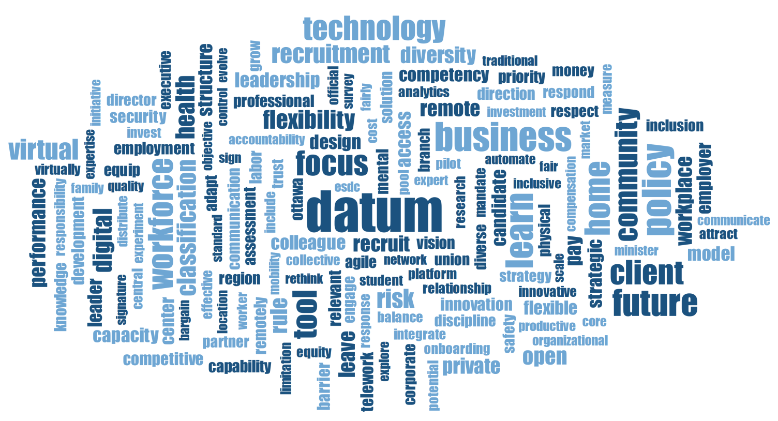
What We Heard in the Interviews

Slide 7
Main Findings from the Interviews

Slide 8
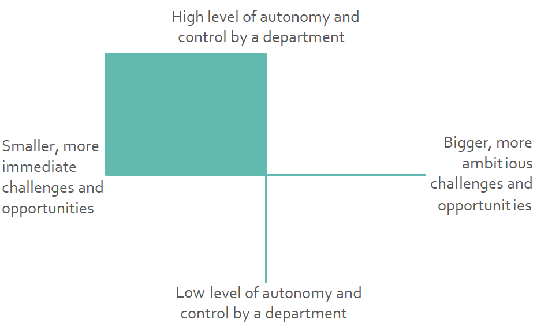
Smaller, more immediate challenges and opportunities for which departments have a high level of autonomy and control:
Work from home, telework, remote work and virtual work are (probably / hopefully) here to stay
The technology and equipment necessary to fully enable and support work from home, telework, remote work and virtual work still require improvement and investment
We have a great opportunity to grow the talent pool and access talent anywhere – both the talent pool that could work in the federal public service, and the talent pool within the public federal public service (in terms of which jobs they may be able to do)

Slide 9
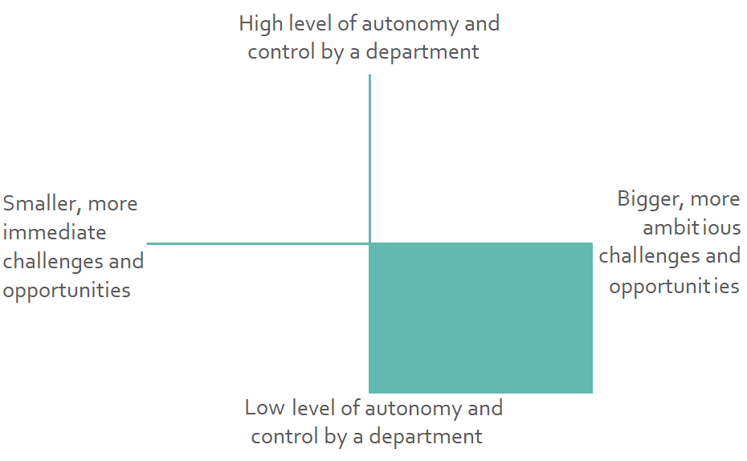
Bigger, more ambitious challenges and opportunities for which departments have a low level of autonomy and control:
The “archaic” classification system was one of the most often mentioned fundamental changes HR must make to remain relevant
An “enterprise approach” must be considered to address some challenges (e.g. data analytics capabilities, shared HR services, etc.)
The HR community must take ownership of its destiny (e.g. need for strong horizontal leadership, professionalization of HR, etc.)
The GoC must rethink the “employment contract” to meet the new reality (e.g. Terms and Conditions, collective agreements, etc.)

Slide 10
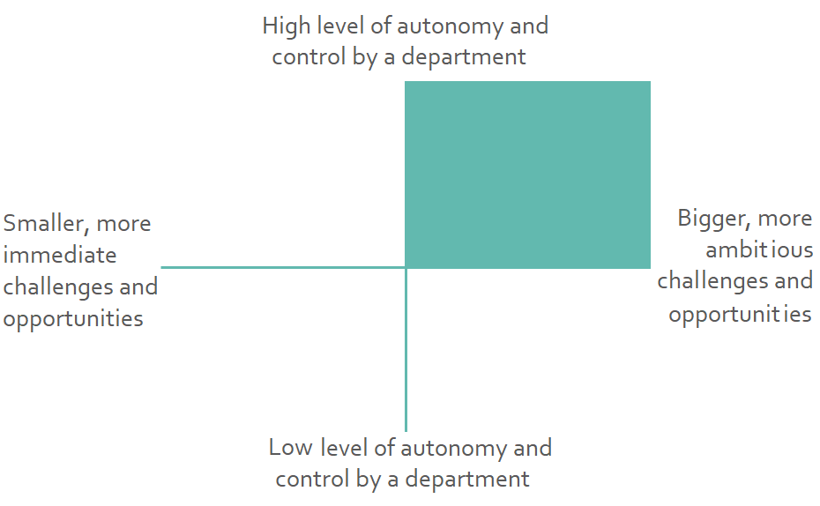
Bigger, more ambitious challenges and opportunities for which departments have a high level of autonomy and control:
Data analytics and evidence-based decision-making: We must leverage HR data for their strategic interventions, and put the evidence at the center the decision-making process
HR digitalization: We must make our HR products and services simple, modern and digitally enabled, available anytime, anywhere, from any device
User-centricity: We must shift the focus of HR from compliance with policies and processes to meeting the needs of the users: managers, employees, candidates, etc.

Slide 11
Key Takeaways
Departments and agencies are already working on the more immediate challenges and opportunities they face, notably adapting to the new reality of working from home, telework, remote work and virtual work – and should sustain the momentum
Departments and agencies can influence bigger challenges and opportunities for which strong horizontal collaboration with other organizations and the leadership of the central agencies will be required
Departments and agencies are still in many regards catching up with the evolution of the HR industry outside the public service and several traditional mindsets, behaviours, tools and practices must make place for radically different ways of doing HR

Slide 12
Appendix 1: Participants Profile
The follow-up survey received 129 responses out of 215 interviewees
(60% response rate)

Slide 13
Functional Communities, Roles

Slide 14
Region, Province or Territory

Slide 15
Diversity

Slide 16
Diversity

Slide 17
Diversity

Slide 18
Appendix 2: Interview Questions
Submitted to the participants ahead of their interview

Slide 19
Interview Questions
How well was the HR function of the public service prepared to handle Covid-19?
What capability gaps, limitations or problems did Covid-19 highlighted in public service HR?
Beyond the short-term return to federal work sites (i.e. this fall) what are the fundamental changes that we need to make in public service HR to stay relevant in the next decade?
What opportunities are all of a sudden knocking at the door of public service HR, when they would have been either unimaginable or merely nice-to-have’s only a few months ago? Which of these opportunities must public service HR seize?
What mindsets and behaviours are holding public service HR back? Which mindsets and behaviours must we develop in HR?
What’s on your radar? What are the things that you think HR must start paying attention to right now otherwise the public service will no longer be competitive as an employer in 5 years from now?
What should be the next concrete steps we take to prepare the future of HR in the public service?
What questions relating to the future of HR in the public service are top-of-mind for you and that you wish your peers would have an answer to?
Before we conclude this interview, is there any question I might have missed that you wish I would have asked you?

Slide 20
Appendix 3: Selected Quotes
From the Interviews on the Future of Public Service HR

Slide 21
Smaller, more immediate challenges and opportunities for which ESDC has a high level of autonomy and control
Main Findings | In a Quote…
Work from home, telework, remote work and virtual work are (probably / hopefully) here to stay | What opportunities should public service HR seize? For me, this is the sudden big culture change - a culture change more specifically related to the changing universe from telecommuting, working from home, working remotely. […] The culture was not ready - half of the people at the management table said yes, the other half said no. But here we end up with a situation where we no longer have the choice to adapt to a new reality. [Translation]
The technology and equipment necessary to fully enable and support work from home, telework, remote work and virtual work still require improvement and investment | One of the most obvious or painful shortcomings that Covid-19 identified early on in the public service was technology. People were not equipped. They were not equipped for a long time. [...] And even today, as an employer, we have not yet plunged. [...] But it is necessary to invest so that people are well equipped at home. [Translation]
We have a great opportunity to grow the talent pool and access talent anywhere – both the talent pool that could work in the federal public service, and the talent pool within the public federal public service (in terms of which jobs they may be able to do) | If you believe the purpose of HR is to get the right people in the right position at the right time, and if you have a more virtual work environment, that massively increases the pool of people you will have access to, because individuals who otherwise would say "I'm not willing to move" or "I have to be able to work from home“. We used to tell them: "You can't do this job from home". […] Why do we need geographic limiters for any of the jobs? Why couldn't you equally be doing a management job or a policy job from Whitehorse as you could do from everywhere else?

Slide 22
Bigger, more ambitious challenges and opportunities for which ESDC has a low level of autonomy and control
Main Findings | In a Quote…
The “archaic” classification system was one of the most often mentioned fundamental changes HR must make to remain relevant | In order for the public sector to remain relevant, we're going to have to revisit our core assumptions on which we built 50 years ago. I mean: classification. Why are we still using boxes in a fluid world? Our world is increasingly fluid, it's increasingly fast-paced. And we have this anchor that we're dragging along, which says that "You know what, in this team, you cannot have this kind of skill set, because you don't have that box in your team”. So those kinds of changes are critical in order to ensure our relevance as a public service organization that’s nimble, that's ready to react to or act in advance of the change that's coming. But right now, how we're managing our talent remains associated a lot - unfortunately - with boxes, classification, bums in seats, as opposed to talent with talent management.
An “enterprise approach” must be considered to address some challenges (e.g. data analytics capabilities, shared HR services, etc.) | This pandemic has created a backdrop where, as the federal government, we recognize that there are some limitations in the data we have at the enterprise level. And that perhaps, we really need to be very, very serious about that transition from the collection of 150 departments and organizations and agencies to an enterprise that is serving Canadians in Canada in a different way. And for me, a big part of that is data. [TBS-OCHRO] needs to start actually mapping some really important data sets. And those include job and work data and, and employee skills data. And this is really around employee identification and mobilization. That's really just the very first fundamental building block, actually enabling a massive overhaul transformation and change of our HR situation.

Slide 23
Bigger, more ambitious challenges and opportunities for which ESDC has a low level of autonomy and control (cont’d)
Main Findings | In a Quote…
The HR community must take ownership of its destiny (e.g. need for strong horizontal leadership, professionalization of HR, etc.) | The people management function for the government has to go through the same process than the financial management community went through (so CFOs) the same process the internal audit community went through (for internal auditors). There has to be a focused investment and attention on the "professionalization" of the people management function. I don't mean like certification or anything like that; I mean, instilling a sense of purpose, pride, and innovative lateral thinking and cohesion to the people management function for the entire government. That community needs to be recognized as a key functional community in the Government of Canada. I think that we should then use that established community to achieve some of the objectives we have, including shifting mindsets or behaviors for the organization or for the community as a whole [and] navigating the fine line between being business enablers, and also being guardians of our system.
The GoC must rethink the “employment contract” to meet the new reality (e.g. Terms and Conditions, collective agreements, etc.) | Fundamentally, we have to look at our employment contract in the broadest sense. We have to think about what we're hiring people for and what we're going to tell them to expect. […] We have to move that yardstick in terms of the employee, and we have to prepare managers to be able to manage in this new world. So this, as we see isn't just a month worth of change. [...] So my biggest fear would be we don't want to go backwards at all, we want to at least hold our ground here and move forwards in terms of changing our employment contract with our people, in terms of how we manage the work, and the people. So these are huge, huge things. And like I say, it's almost too big.

Slide 24
Bigger, more ambitious challenges and opportunities for which ESDC has a high level of autonomy and control
Main Findings | In a Quote…
Data analytics and evidence-based decision-making: We must leverage HR data for their strategic interventions, and put the evidence at the center the decision-making process | For HR to stay relevant in the next decade, one of the fundamental changes we need to make pertains to data and actually being able to support the decision-making. Our role is supporting managers and supporting employees. And we don't have some of those basic enabling infrastructure pieces at where they need to be.
HR digitalization: We must make our HR products and services simple, modern and digitally enabled, available anytime, anywhere, from any device | We need to make sure there’s continuous improvement on the digital side, and I would even say on the information management side because the way we organize our information, the way we manage our information, we are not as good as we should be. And because we’re more digital now, it’s even more important than before. [...] That’s a concrete step that we should take collectively to make sure that as we become more digital and more virtual, that we can manage that information correctly. Get ready for a changing workforce!
User-centricity: We must shift the focus of HR from compliance with policies and processes to meeting the needs of the users managers, employees, candidates, etc. | Talk to the clients, especially at the managerial or employee level, and understand their journeys and what their expectations are, and what they're experiencing, what they're feeling now, and what perhaps they would like to see. I think that is the most tangible, concrete step that the HR function or the branch could implement. But there seems to be a lot of resistance to it. If you implement sort of a client-centric or design-centric thinking, then you'd be much better prepared to implement new functions over the medium term, or be at least be open to them. The branch has to understand the stories that employees and managers are telling amongst ourselves to our colleagues about the HR function.

