Slide 1
HR 2030 – Strategic Foresight Overview
Jennifer O’Rourke

Slide 2
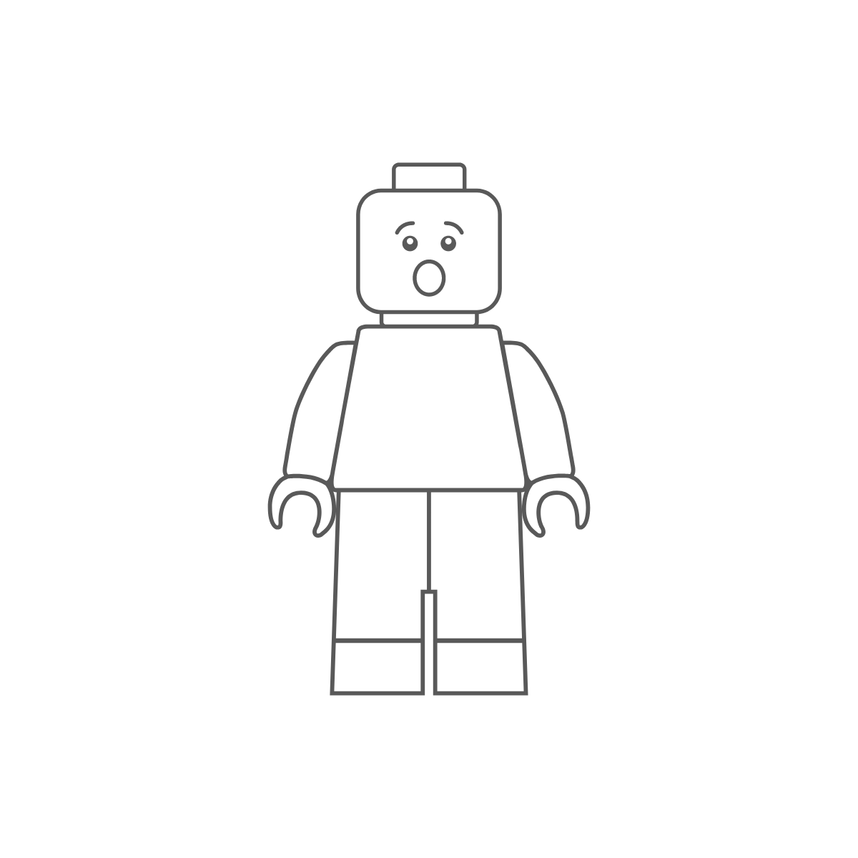
Foresight: What is it and Why do we do it?
The future is not optional
Strategic Foresight:
Explores plausible alternative futures to help us better prepare for uncertainty and surprise.
Is a rigorous and systematic process.
Distinct from forecasting.
The objective of foresight is not to predict the future, but to:
Assist leaders in strategic planning;
Demystify and provide clarity on drivers of change and;
Enhance capacity for smart, prudent, and anticipatory governance.
*Adapted from Policy Horizons Canada
Notes:
that aims to understand how an issue or a system could evolve in the future, and the challenges and opportunities that may arise.
envisioning and assessing multiple plausible futures to build robust policy and programs and guide

Slide 3
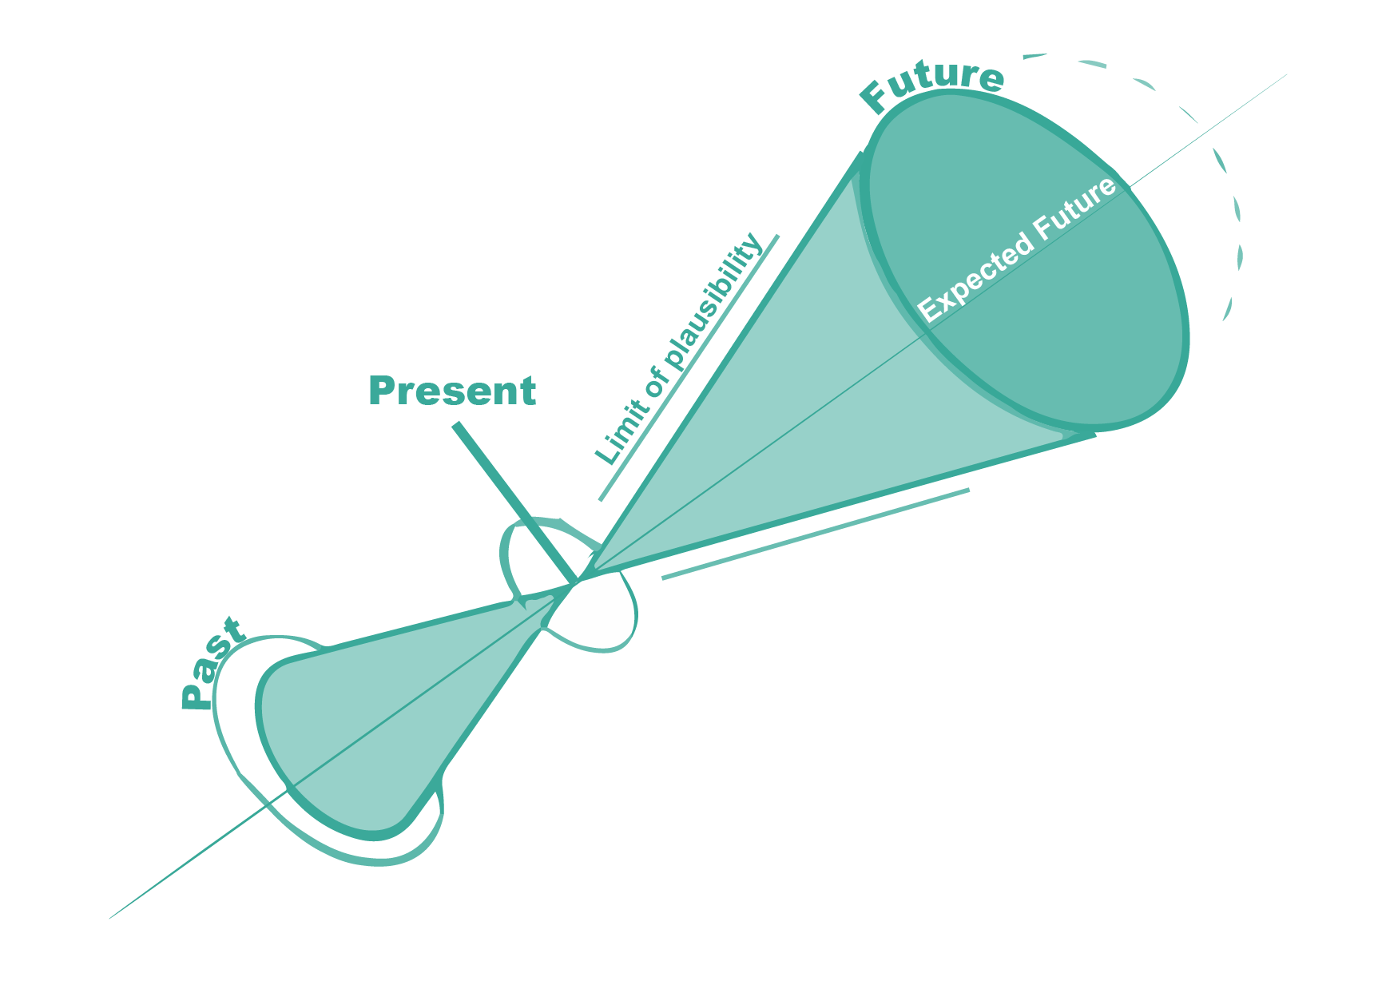
Exploring Alternative Futures
Foresight explores a range of plausible alternative futures
There is no data on the future, it has not happened yet

Slide 4
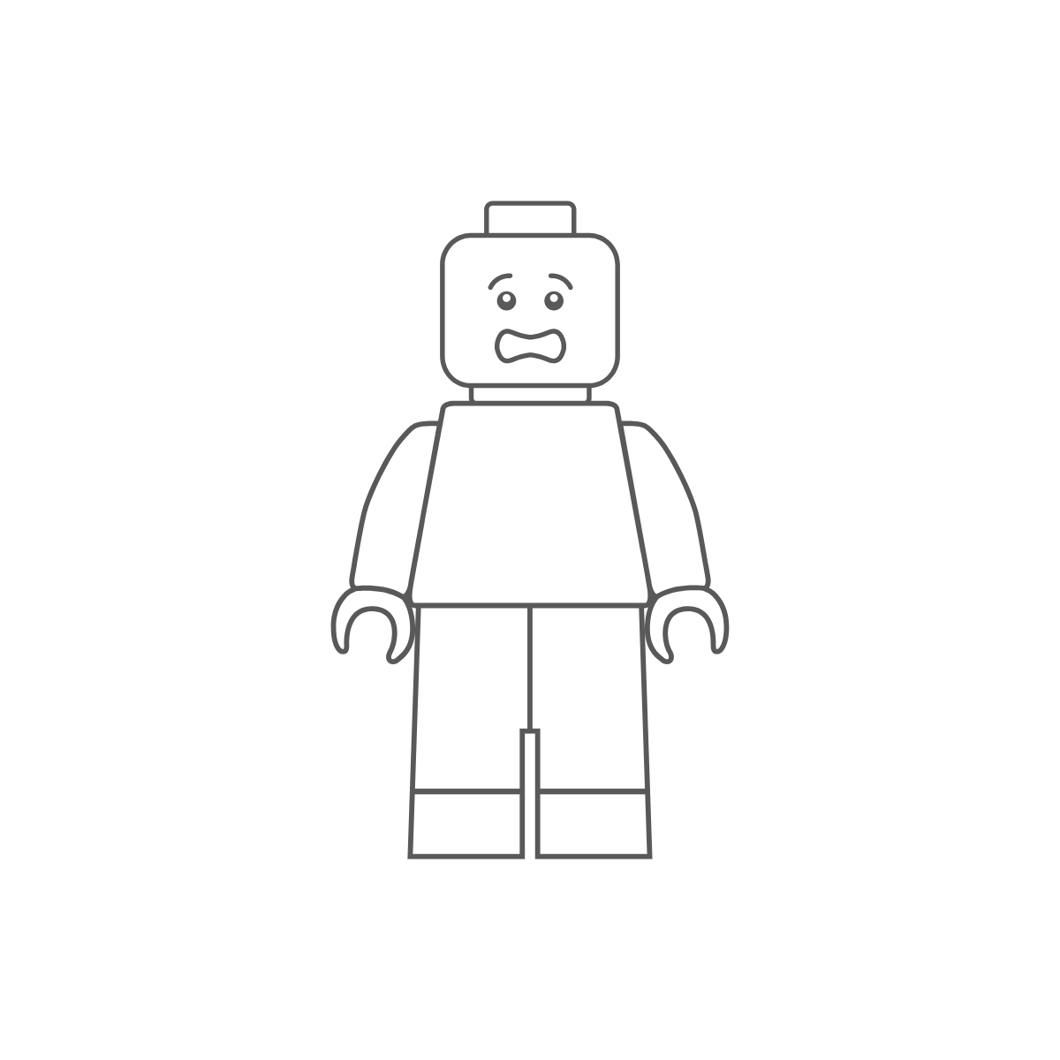
Challenges in Futures Work
Exploring the future can be scary
People feel safe with what is familiar, predictable, and known.
People feel uncomfortable with what is unfamiliar, unpredictable, and unknown.
Constraints
Leaders often have a multitude of urgent “today” matters that take up a significant portion of time.
Futures work and foresight methodologies are not always well understood and can be quickly dismissed or not prioritized.
Resources and subject matter expertise are scarce.
*Adapted from Policy Horizons Canada

Slide 5
Embracing Change
Dealing with change and navigating into the future in a safe space
It is important to recognize that it is OK to be concerned about change. Understanding that change is coming and embracing it is a process.
To feel more in control of the future, people need to become familiar with the underlying changes coming.
Once we understand the changes coming, we are empowered to have control of how they will play out and our own preparedness for them.
This leads us to feel confident in our ability to build robust policies and programs that are future-proof.
“It is not good enough, as the cliché goes, to be preparing for the last war. That means, on so many fronts, that we need to try to think ahead.”
Michael Wernick, Remarks at the Defence Leadership Symposium, October 17, 2017

Slide 6
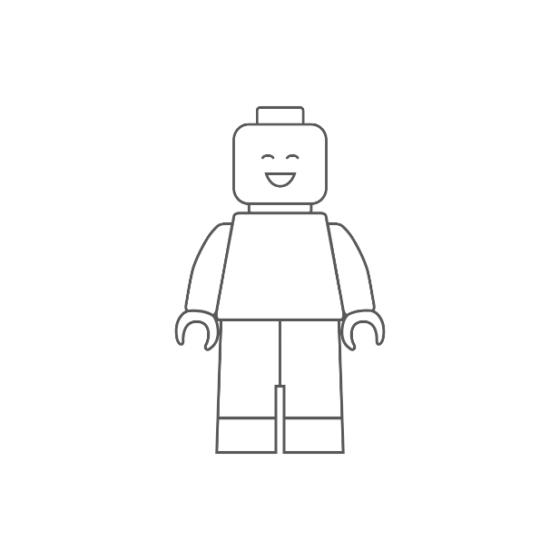
Keys to Success in Strategic Futures Work
How we can overcome constraints
Commitment – futures work requires commitment across all levels to see projects through.
Executive champions – like most change management and transformation processes, futures work requires buy-in at the top levels.
Co-creation - co-creation is critical in ensuring we understand how plausible futures could directly impact certain areas and departments, like HR at ESDC.
Resources – successful foresight projects require a resource commitment.
Expertise – Experts in strategic foresight are critical to develop and guide projects and help usher people into the future safely.
Trust and open-mindedness – as foresight is a less understood field and we cannot possibly have data from the future (data by nature represents past occurrences), people can feel uncomfortable and skeptical of the work.
Clear planning and project management – having clear project plans and methodologies helps ensure foresight projects stay on track and provide outputs.

Slide 7
The Strategic Foresight Process
Framing
Foresight study: The Future of Work and HR
Scanning & Literature Review
Examination of existing literature: forecasts, major trends, expected futures, foresight, historical analysis
Scanning for signals of change
Change Drivers
Scenarios
Preferred Future and Visioning
Building the vision and preparing for next steps
Identifying, researching, and analysing major change drivers from Economic and HR systems, and COVID19 (ongoing)
White Papers: COVID 19 and a return to work
Developing scenarios on plausible futures for HR
Identifying a preferred future and future states to avoid for HR and work
Solidify long-term vision
Prepare for implementation phase – another process (applied foresight)
SWOT
Building a vision of the preferred future

Slide 8
Key Change Drivers From the Future of Work

Slide 9
Key Change Drivers
Digital labour platforms and automation are driving job unbundling, leading to temporary and task-based work.
AI and robotics combined with human workers to increase capabilities in knowledge-based and physical work.
Combined digital technologies, such as augmented reality, virtual reality, and mixed reality, as well as relocation incentives are facilitating a rise in remote work.
Advancements in digital technologies (the Internet of Things) are leading to a rise in smart cities and smart workspaces.
Declining trust in government and changing information landscape are driving increased demands for transparency, a reluctance to share data with government, ever-expanding access to information of all types (false, opinion, factual etc.), and a need for digital and media literacy skills. We are further seeing non-government entities taking on traditional government services (cartels, corporations, non-profits etc).
Societal expectations of the employer are changing. A shockwave from COVID 19 that has driven remote work combined with infinite information flows are driving a change to the employee/employer relationship
*see appendix 1 for definitions

Slide 10
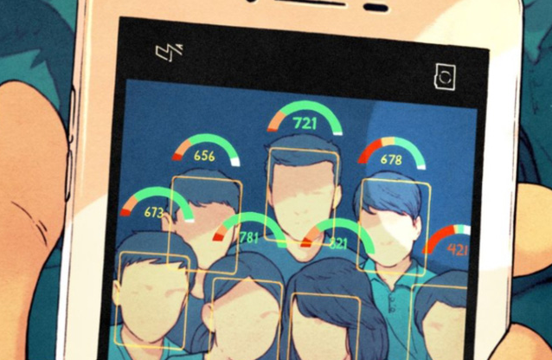
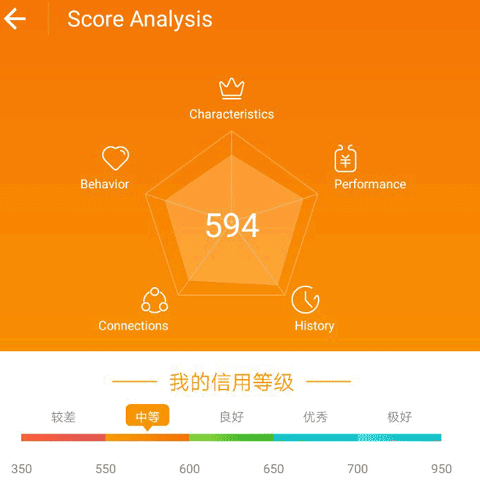
What the foresight points to for HR
We cannot ignore the future coming at us – in fact, it is already here! So, what does this future look like for HR?
Predictive analytics, data centricity, and biometrics
IoT integrated into personal and professional lives – mass data gathering and hyper-personalization
Reputation and monitoring systems
Automation and AI
Combine with analytics to produce performance evaluation, learning and career plans, redistribution of resources and talent
Recruitment and staffing – screening and matching candidates to positions/tasks available
Job unbundling and a borderless virtual workforce
Task-based work, hyper-individualized to match with employee skill sets
Global talent pool and virtual workspaces
Notes:
Analyze behaviours and traits to identify core job competencies
Identify employees at risk of leaving or violating terms of employment

Slide 11
Building Scenarios and a Preferred Future

Slide 12
Scenario Building – Four Archetypes Approach
Embracing change
Things may improve in an incremental fashion
Incremental Decline
Current systems and arrangements hard to sustain
Transformation
Muddling Through
Reacting to and coping with change as it arises without improving things
Could see too much “caution to the wind”
Incremental Progress
Often a response to an opportunity or crisis
Significant departure from the present
Putting out fires
Things are getting incrementally worse
Head in the sand approach + actively resisting change
Transformative shift based on lessons learned

Slide 13
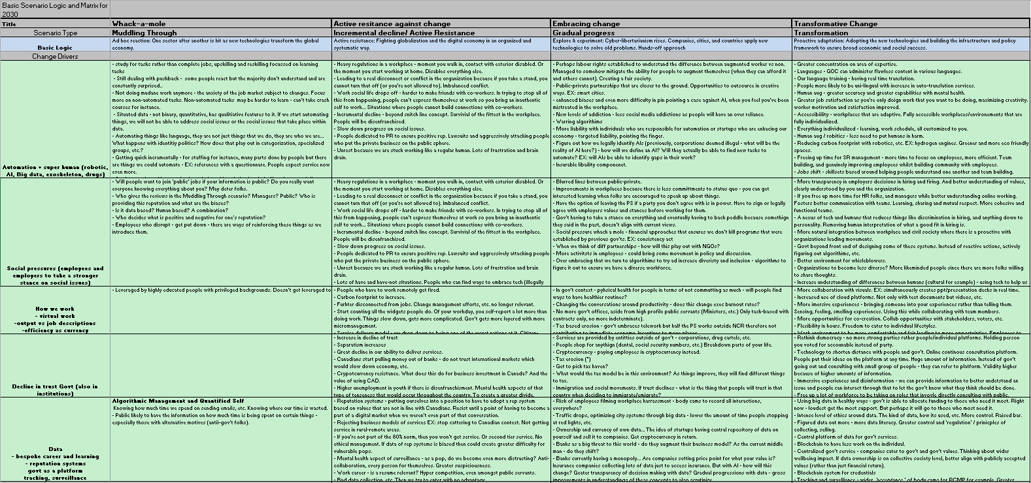
Scenario Building – HR Futures (snapshot)
*Intent of this slide is to show the rigorous process behind scenario development (you don’t need to read it)

Slide 14
Building the Preferred Future
Human experience and lifestyle
Increased focus on individual health (mental and physical) and wellbeing of the person
Trust and Transparency
Increased transparency between employee / employer, agile responses
Diversity and Inclusion
Public service more representative
Global talent pool –increased inclusion of diverse views, globally and domestically
Integrated lifelong learning and career planning, driven by smart data, AI, and humans
Seamless employee mobility (in and out of government)
Service Delivery
Bespoke, efficient, and agile service delivery to citizens
Borderless virtual work
Increased use of talent, refined understanding of existing workforce skills and experience
Increased flexible work arrangements giving agency to employees to manage lifestyle and career
Nuanced, holistic compensation values (move from traditional thinking of hours/outcome based)
Increased fairness in hiring, promotions, opportunities, and representation at the top
More refined understanding among employees of different backgrounds (cultural, educational, personality based, etc.)
Increased representation within teams, units, working groups
Increased emphasis and capabilities for a psychologically safe workspace
Shift towards global accreditation and recognition of talent and experience
Inclusion of more languages within PS and services (all indigenous languages in OL, minority languages)
Using technology to suit individual needs and competencies – no one seize fits all application
Transparent, secure storage and sharing of data – user control and agency
Optimized, fluid, responsive HR practices enables by nexus of tech and humans
Proactive responses vs. reactive responses
Increased non-financial incentivization and compensation
Technology enabled shift from compliance regime to human centric design
Access to human augmentation technology, the future of ability and accessibility
Language translation technology to break barriers and increase compassionate, human centered service delivery
Shift from meritocracy to wholesome take on value and contributions to work
Increased trust in government and institutions
Broken down hierarchies better integration and distribution of subject expertise and leadership expertise
Increased collaboration in and out of departments
Decreased space between policy makers and clients
Work becomes much more open and accessible among departments
Defragmentation of data, blockchain enabled sharing and transparency across departments

Slide 15
Appendix 1: Definitions and Resources
From the foresight team

Slide 16
Definitions from foresight slides
Digital labour platforms: Online platforms where individuals and companies can buy and sell work, often in the form of specific tasks. Employers can post specific work they would like done and what they offer as pay and individuals can bid on these jobs. Concurrently, individuals can list their skills as well as how much they charge (hourly/by the task etc.). Examples: Fiverr and Upwork.
Virtual Reality: Complete immersion into a digital space using a head-mounted display. Example: Leap Motion’s Cat Explorer
Augmented Reality: Overlay of digital information onto real-world elements. Examples: Pokemon Go and medmovie
Mixed Reality: Combined AR and VR interactive experience – users interact with virtual and physical elements simultaneously. Example: Spatial
Remote work: Working from a location outside of the physical working space of the office (on the road, from a difference location etc.)
Virtual work: Working via modern technology – can be from the physical office or another location
Internet of Things (IoT): A network comprised of multiple things that allow for connectivity (sensors, software, surveillance, etc.) which can exchange data between all units and other systems over the internet. More information
Notes:
Potential discussion questions for contemplation:
Who owns the “employee experience”? Is it HR? Is it explicitly noted anywhere?
What HRSB priorities are likely to change or emerge over the next 2-3 years?
Are there plans to co-develop with IITB, or bring them onboard of various governance tables?
What opportunities do you see for the future of the Branch?
Data on the users?
Big gaps:
Data
Users
The Branch
Takeaways
Need to make more use of data/better understanding of the user
Future-oriented, first steps
Look differently at how we do HR
Tech big enabler

Slide 17
Example from today (actually yesterday)
New York Times: How China is Changing your Internet

