Slide 1
Strategic Data Management System
Findings
William Taylor Business Analyst

Slide 2
Findings
The top level of findings during this assessment are these:
System Maturity Issue is a barrier to needed improvements and to new systems
CCDIC systems are at a Capability Maturity Model level 3. At least one CS grade resource is required to break the development paralysis and significantly improve the existing systems and put those systems in place that are clearly needed and those that CCDIC would like to run as experiments to gain knowledge.
Poor UX contributes to the negative spreadsheet culture and a bad attitude about any new spreadsheets.
Good User Experience in the form of well laid out, attractive transaction forms capable of adding new rows of data and editing existing rows is desperately needed in order to change the negative perception of spreadsheet usage.
Database / Data Management practices and capability are not good enough for the next maturity level.
Currently unable to leverage on opportunities in local data models, not well equipped to see the opportunities that lie in multiple sources of data, not able to effectively add data to a collection in a useful manner, not able to make choices today that fit with emerging tools in the future.
Requirements Management is not at a level which will ensure the systems will meet the needs in CCDIC. There are current examples of prototypes which were built without requirements, there are examples of reports designed without requirements, of services delivered without requirements. Without requirements one cannot measure the system with accuracy. Without those metrics one does not know what to improve nor if any improvements made achieved their goals. But, with out requirements one cannot seriously negotiate with partners nor can they get credible performance measurements of CCDIC deliveries to its clients or know when actions have resulted in improvements recognized by their partners.
These four barriers are responsible for symptoms of anti-proactivity, resistance, demotivation, helplessness and feelings of a lack of control especially in the planning function.

Slide 3
Capability Maturity Model (CMM) Levels
Level 1 - Initial
- undocumented processes in a state of dynamic change,
- driven in an ad hoc, uncontrolled and reactive manner by users or events.
- a chaotic or unstable environment for the processes.
- the levels of negative outcome are not known.
Level 2 - Repeatable
- some processes are repeatable, possibly with consistent results.
- process discipline is unlikely to be rigorous,
- but good enough to ensure that existing processes are maintained during times of stress.
Level 3 - Defined
- sets of defined and documented standard processes established
- some degree of improvement over time.
- these standard processes may not have been systematically or repeatedly used
This could be considered a developmental stage - with use in a wider range of conditions and user competence development the process can develop to next level of maturity.
Level 4 - Managed (Capable)
- at this level, using process metrics, effective achievement of the process objectives can be evidenced across a range of operational conditions.
- the suitability of the process in multiple environments has been tested and the process refined and adapted.
- process users have experienced the process in multiple and varied conditions, and are able to demonstrate competence.
- the process maturity enables adaptions to particular projects without measurable losses of quality or deviations from specifications.
Level 5 - Optimizing (Efficient)
- the focus is on continually improving process performance through both incremental and innovative technological changes/improvements.
- processes are concerned with addressing statistical ”common causes” of process variation and changing the process (for example, to shift the mean of the process performance) to improve process performance. This would be done at the same time as maintaining the likelihood of achieving the established quantitative process-improvement objectives.
Between 2008 and 2019, about 12% of appraisals given were at maturity levels 4 and 5.
In my chart, I show three levels of maturation. Level 3 shown in the chart is made up of the Levels 3-5 above.
Capability Maturity Model (CMM) Levels
Level 1 - Initial
- undocumented processes in a state of dynamic change,
- driven in an ad hoc, uncontrolled and reactive manner by users or events.
- a chaotic or unstable environment for the processes.
- the levels of negative outcome are not known.
Level 2 - Repeatable
- some processes are repeatable, possibly with consistent results.
- process discipline is unlikely to be rigorous,
- but good enough to ensure that existing processes are maintained during times of stress.
Level 3 - Defined
- sets of defined and documented standard processes established
- some degree of improvement over time.
- these standard processes may not have been systematically or repeatedly used
This could be considered a developmental stage - with use in a wider range of conditions and user competence development the process can develop to next level of maturity.
Level 4 - Managed (Capable)
- at this level, using process metrics, effective achievement of the process objectives can be evidenced across a range of operational conditions.
- the suitability of the process in multiple environments has been tested and the process refined and adapted.
- process users have experienced the process in multiple and varied conditions, and are able to demonstrate competence.
- the process maturity enables adaptions to particular projects without measurable losses of quality or deviations from specifications.
Level 5 - Optimizing (Efficient)
- the focus is on continually improving process performance through both incremental and innovative technological changes/improvements.
- processes are concerned with addressing statistical ”common causes” of process variation and changing the process (for example, to shift the mean of the process performance) to improve process performance. This would be done at the same time as maintaining the likelihood of achieving the established quantitative process-improvement objectives.
Between 2008 and 2019, about 12% of appraisals given were at maturity levels 4 and 5.
In my chart, I show three levels of maturation. Critical (Global Impact) shown in the chart is made up of the Levels 4-5 above, Supportive (Regional Impact) represents Level 3 above an finally, Basic (Local Impact) represents Levels 1 & 2 above.

Slide 4
Path to Systems Maturity
The Systems
Conform to PHAC
Critical
Global Impact
Staff working within Job Descriptions again
Development is done by a layer of CS across PHAC
Low productivity but high value deliveries as PHAC critical assets are enabled to expedite the delivery of PHAC information: ie, lower the “time to Public” metric
CMM Level 5
Open Data, Systems Harmonization / Integration
CMM Level 4
Fitting Systems and Apps to the Agency
Supportive
Regional Impact
Some staff, from time to time, are working outside Job Descriptions
Some Visual Basic code is now required
Low productivity: Staff cannot continue to meet the increasing demand for improvements with “out of the box” solutions.
Staff is only able to deliver “tweaked solutions” (requiring very little code) in a slow and halting manner.
The symptomatic “hitting the Wall” development paralysis is a clear indicator of the requirement for CS roles to be embedded in the workforce
UX / Data Gathering & Management / Reporting
System Maturity
Minor customization: Application Tweaking
CMM Level 3
Slow or Stalled Development (GAP)
Local Impact
CMM Level 2
Local Tools
“The Wall”
All development above this level requires coding / programming
Out of the box – little customization
Staff working within Job Descriptions
No Visual Basic code required
High productivity: Many systems emerge, some will mature into critical Agency assets
Paralysis
CMM Level 1
PHAC Conforms to the Systems
Basic
Time
Today
A Maturity Model is a tool that helps people assess the current effectiveness of a person or group and supports figuring out what capabilities they need to acquire next in order to improve their performance

Slide 5
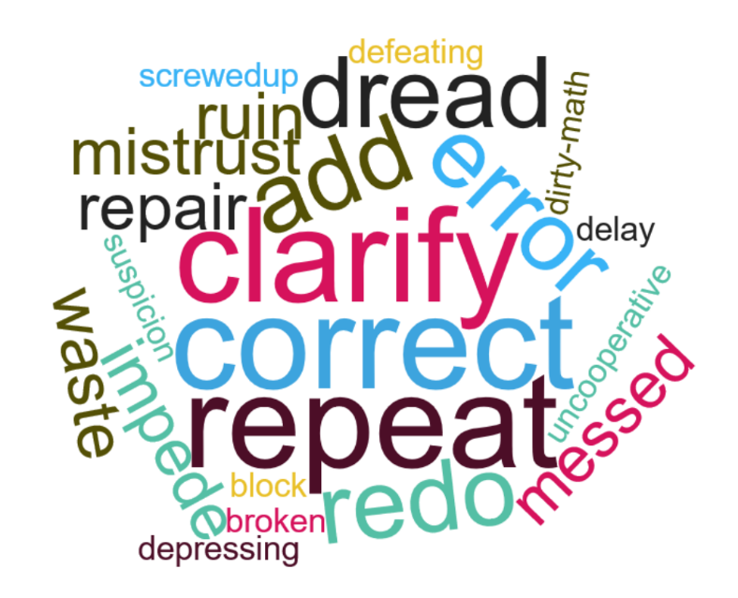
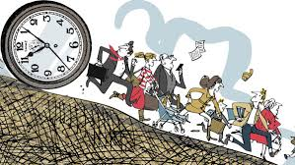
Initial Assessment Issues:
Planning: Contiguous data required, data model improvements required
Action Requests: Unable to handle proactively
Data Gathering System Issues: CRAC, not prepared, data model issues
Culture: Pressure to improve has become toxic from all directions.
Process: missing, unreactive, out dated, no clear path to improvement
Software/System Improvement Process: none
Data Storage: integrity is at risk, new facilities required
Data Handling: reasonable, but, too many steps
Data Quality: will improve due to other improvements
Partnerships: Require expansion, sharing, Communities of Practice, new collaborations, yearly requirements reviews and reviews of deliveries to CCDIC with respect to requirements
Too much work because too much CRAC (correct, repeat, add and clarify) About 15% of our work.

Slide 6
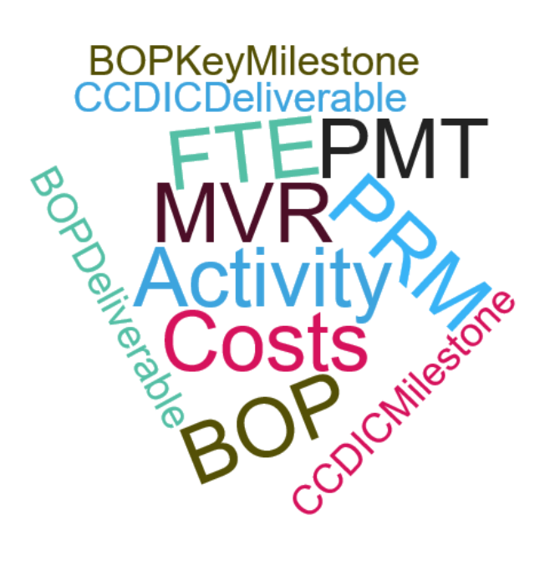
Planning Issues:
Workload Planning: Current Workload Planning does not create the foundation for CCDIC planning information.
Data Model: The CCDIC data model is fuzzy at the deliverables/milestones/FTE/costs layer
Missing Data: In order to be useful assessing aggregated variance data returned to cost centers, PPMG must preserve data inputs to the financial system.
Traceability of Data: Traceability breaks down between the MVR and the costs gathered in the local data collection.
Data Reuse and Repurposing: Until the data model is defined and missing data added to the local set, the potential for local data reuse and repurposing will not be realized.
Relationships with Partners:
Those who provide data: yearly requirements reviews including previous year’s assessment of compliance with the requirements are required.
Those to who we provide data: yearly requirements reviews including the data receiver’s previous year’s experience of our compliance with the requirements are required.
Those with whom we should partner to share our data collection and system development experiences
Those who are not in our Community of Practice for Performance Measurement to whom we should be telling our story in order that they can benefit from our experience.

Slide 7
Repository
Solutions
BOP, PMR, PMT as a demonstration of the integration possibilities. Experimental reports, demonstrations of data gathering for more than one or data gathering in phases. Hybrid forms gathering data for more than one at a time. Users transact with the collection not with the various report authorities.
Demonstration of how MRAP commitments can be gathered and included In the PMR reports.
How an employee base can be integrated with all the other planning data reducing more of the resource planning to drop down menus.
How this could be the place for all of CCDIC indicators and results to feed the PIP. It would be the target of a automated sub-system capable of transparently receiving and importing indicator information.
CCDIC HR dbs is included. This employee location, position, email and phone tracking information is used for continuity planning. The data should be higher quality, timely in this more mature tool.
CCDIC Privacy queries should be kept here. A collection of all of the questions about protected “B” data, it’s usage, transmission and storage would serve as a useful tirage of all of these questions creating a useful, comprehensive summary for the ATIP team. We all must document our thoughts with respect to privacy issues anyway. If we help the ATIP team we help ourselves.
A demonstration of the various ways and scope of resource data captured against milestones in an effort to address MVR and other activities.
An exploration of how Professional Service (Contracts) data tracking and scope could be managed and reported.
An example database for attachments.

Slide 8
Strategic
Tactical
Operational Analysis
Solution Design
Build
UA Testing
Analysis
Analysis
Scrum Master runs Sprint planning meeting with the Agile – Scrum team
Evaluations
Inventories
Business Goals
Needs Assessments
Opportunity Assessments
Business Requirements
Past Studies
Executive level directives Pain Points
Backlog
Daily Scrum
Final solution methods can now be designed as “As-Is” -> “To-Be” change scenarios:
New or modified Excel commands with the intended location references defined
Process maps detailing the process changes
Data maps of the location changes
Data Path changes
Increment selected for this Sprint
5 Day Sprint
Growing Testable prototype
Solution Description
Changes Committed
The stakeholders of the requirements or user stories witness the operation of the new spreadsheet elements in order to valid their own requirements / user stories (it did produce the change I wanted)
The prototype spreadsheet construction continues by using the Solution Design enabling
information to guide the developers as they add the newly designed elements from the Sprint Increment to the growing prototype.

Slide 9
Process Issues
Missing Processes:
An initiative to add new functionalities and to address the current deficits in our surveys, spreadsheets and processes in order to continuously improve the system is required. An Agile / Scrum software development methodology is recommended.

Slide 10
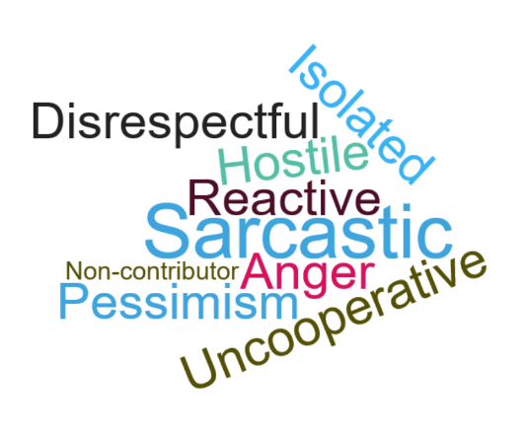
Cultural Solutions:
Sources of Toxicity:
Design processes and methods carefully. Ensure that the future states of the positions in the process will not be transformed into positions which will be expected to “control” the data input behaviour of data contributing individuals if the system’s performance, data content or update timeliness falls below expectations.
Crac (correction, re-do, add and clarify):
Ensure Input guidelines and instructions are tested. Use pop-down lists to help folks populate fields with the correct value.
Use validation to ensure the expected format, length or type of data has been entered or display an error message.
User Disinvestment:
By focussing on the “User Experience”, the continuous improvement plan can incrementally remove the sources of erosion of user faith and hope (investment) in the system. Until this change is achieved it is very difficult for the User to abandon their reactive, “refuse to be involved” attitude and re-adopt a proactive stance.

Slide 11
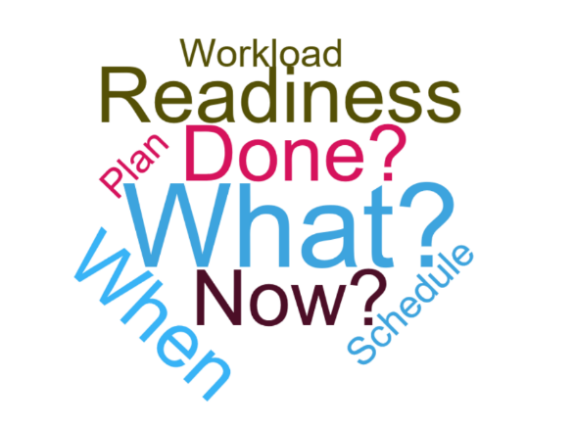
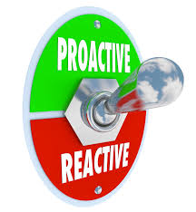
Action Request Issues:
Action Request Performance:
Our performance is unknown
Action Request Tracking:
There is no comprehensive Tracking and Reporting system
Action Request Metrics:
Our “rate of Proactive handling vs. rate of Reactive Handling” is critically unknown
The number of “overdue” and “processed on time” Action Requests are not known
Action Request Service Level Agreement:
There is no service level agreement, formal or otherwise, to use a metric.

Slide 12
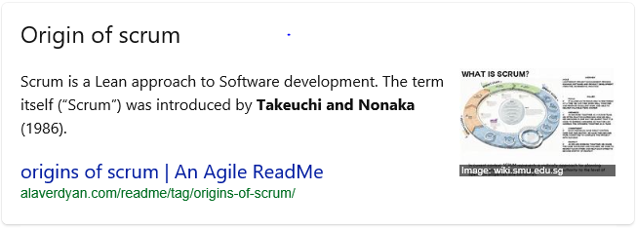
Scrum
is a framework for getting things done.
Agile
is a mindset. Lean
is a mindset which it’s developers have expanded with the
Balanced Score Card
which is a strategic management performance metric.

Slide 13
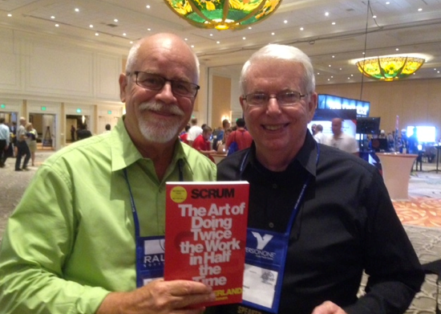
“Grandfather” of Scrum’s initial concept
Hirotaka Takeuchi
is a Professor of Management Practice in the Strategy Unit at Harvard Business School. [2]
He co-authored The New New Product Development Game which influenced the development of the Scrum framework.[3]
In the “New New Product Development Game”, Takeuchi and Nonaka proposed this new approach to innovation by comparing it to rugby. This is where the term 'scrum' was first used outside the context of the beloved English team sport.
In rugby, this term denotes the huddle of players (8 from each team) as they compete to win the possession of the ball. In the article, the metaphor showcased how companies such as Fuji-Xerox, Canon, and Honda displayed a superior production performance by using a team-based technique.
They argued the importance of self-organized, cross-functional teams over the linear process, all in favor of reaching the set goal for the project - which is represented as a ball in this allegory.
Enter “the Father” of Scrum and the “Framework”
However, it took some time before the first complete implementation of SCRUM at the Easel Corporation,
a popular software development company during the first half of the 1990s. (The company was subsequently
acquired by VMARK.)
Enter: Scrum Father
Jeff Sutherland, John Scumniotales and Jeff McKenna, all of the Easel Corp, happened upon the “New New Product Development Game” and found its content to be positively revelatory.
Along with Ken Schwaber in 1995, he formally developed SCRUM as a framework for agile, iterative product development. They jointly presented "The SCRUM Development Process" to the OOPSLA (Object-Oriented Programming, Systems, Languages & Applications) conference in Austin, Texas on that same year, which was SCRUM's first public appearance
Jeff Sutherland

