Slide 1
Continuous Integration and Continuous Delivery in a Hybrid Cloud Environment
Erik Vollebekk
Application Architect
Immigration, Refugees and Citizenship Canada
June 20, 2019

Slide 2
Background
A modernized software architecture is adopted by IRCC’s eServices team for the development of online web applications. Benefits to be realized include;
Team autonomy
Flexibility in deployment
Stability
Scalability
Cloud readiness
Initial development following this architecture is done on-premise
Updated CI/CD process is put into place
AWS Cloud is selected as the desired environment for new eServices intake web applications
2

Slide 3
eServices CI / CD Process
Plan
Code
Build
Package
Deploy
Test
3

Slide 4
Plan
Code
Build
Package
Deploy
Test
Microsoft Team Foundation Server (TFS) is the application lifecycle management tool used by IRCC
Core to all IM/IT system development and support. Provides key functionality such as;
Workload Management - Intake Process / Release Planning, Reporting
Creation / Tracking of change requests, tasks, and bugs
Version control
Automated build and release tasks
Waterfall model has traditionally been followed
Major production release dates and migrations to non-production environments are pre-established on a three year plan
A more agile approach is being taken for new online application
4

Slide 5
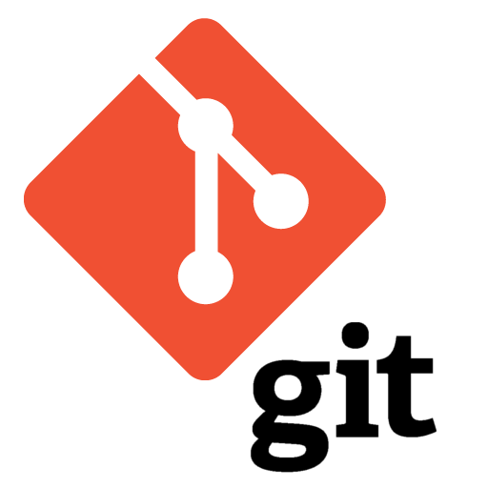
Code
Build
Package
Deploy
Plan
Test
Code is version-controlled through TFS managed git repositories
Linkage is created between code changes and assigned TFS work items
Branch policies are used to promote / enforce code review and ensure changes are tracked against a work item
Code review duties can be assigned to specific team members based on path
5

Slide 6
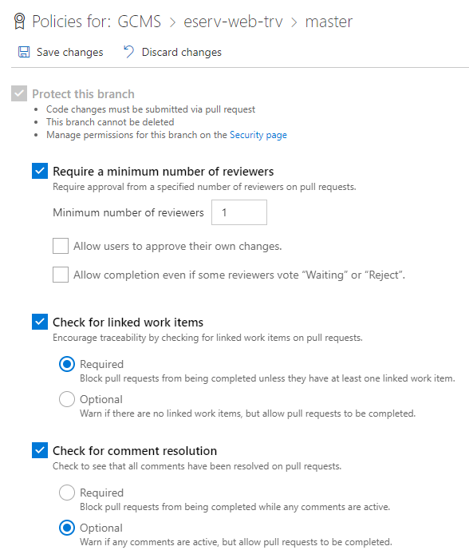
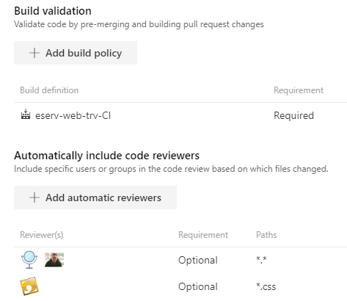
Code
Build
Package
Deploy
Plan
Test
6

Slide 7
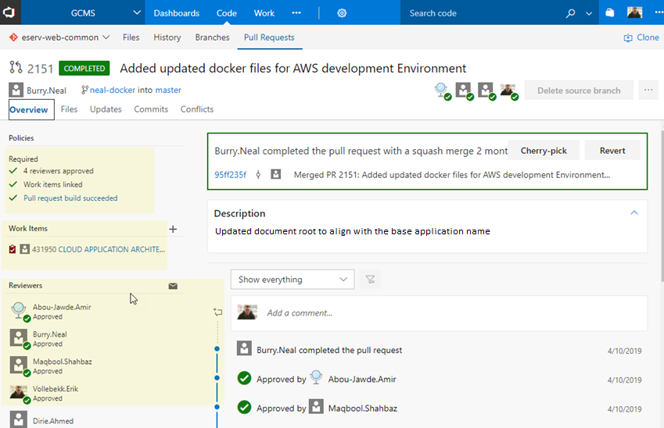
Code
Build
Package
Deploy
Plan
Test
7

Slide 8
Plan
Code
Build
Package
Deploy
Test
Builds are defined using TFS build definitions
Builds can be triggered automatically by a pull request, on a set schedule or manually
A unique build id is generated for each build that is executed
NPM is used for dependency management
Artifactory is configured as a NPM remote repository cache
Artifactory manages IRCC created dependencies and artifacts
8

Slide 9
Plan
Code
Build
Package
Deploy
Test
>_
CLI
9

Slide 10
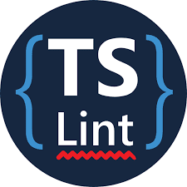
Plan
Code
Build
Package
Deploy
Test
TSLint is used to perform static code analysis
Code is scanned for potential functional errors and style
Jasmine is used to develop easy to understand unit tests
Tests are executed as part of the TFS CI process using Karma
Test results are published
Code coverage results are published
10

Slide 11
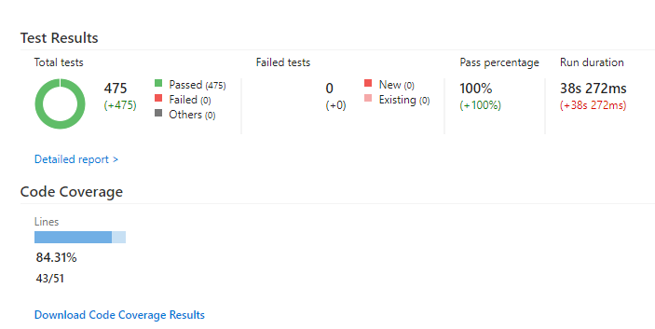
Plan
Code
Build
Package
Deploy
Test
Example of TFS test results and code coverage results
11

Slide 12
Plan
Code
Build
Package
Deploy
Test
Application is packaged into a TAR file for server deployment
TFS archive task is leveraged
Filename is created using a mix of predefined build variables and user defined variables
Major
release
Project name
Hot Fix
E.g. eserv-web-trv-18.00.00.19352.tgz
Minor
release
BuildId
Package is uploaded to Artifactory and build information is published
12

Slide 13
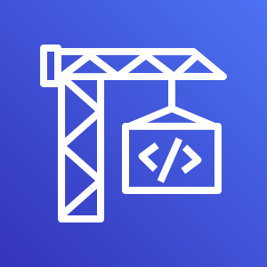
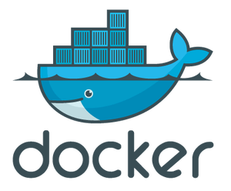
Plan
Code
Build
Package
Deploy
Test
AWS CodeBuild is used to build Docker containers
Build instructions are defined in a buildspec YAML file
CodeBuild buildspec YAML file and application Dockerfile are zipped with the application TAR file and stored in Artifactory
Zipped application package is provided to CodeBuild using a TFS S3 bucket task
AWS CodeBuild process is triggered by TFS using AWS CLI
Build variables are passed to CodeBuild
Docker containers are tagged and stored in the project specific Amazon EC2 Container Registry
AWS CodeBuild
Amazon EC2 Container Registry
13

Slide 14
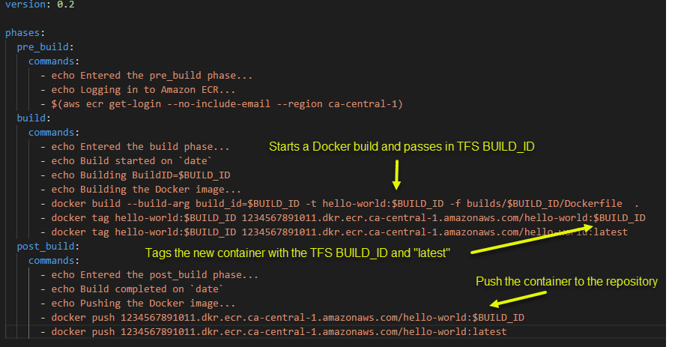
Plan
Code
Build
Package
Deploy
Test
Example CodeDeploy buildspec YAML file
14

Slide 15
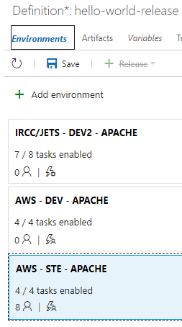
Plan
Code
Build
Package
Deploy
Test
Release definitions and associated tasks are created in TFS
Development and System Test target environments are definition
Target environments can be on-premise or cloud-based
Releases can be triggered manually, automatically on build completion or scheduled
Release content is pulled from Artifactory
Pre and post deployment approvers can be defined for each environment
15

Slide 16
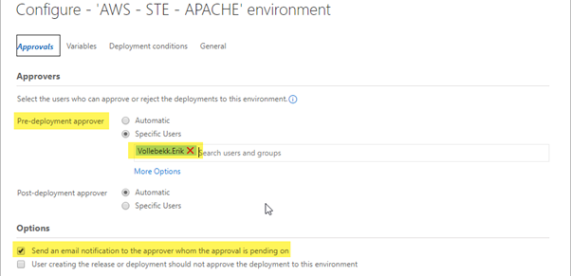
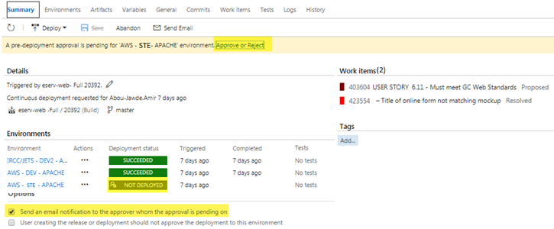
Plan
Code
Build
Package
Deploy
Test
16

Slide 17
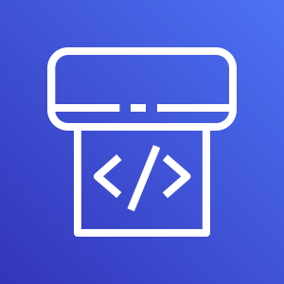
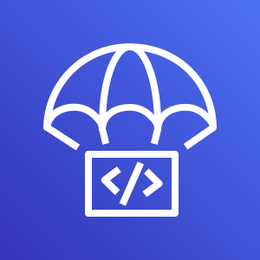
Plan
Code
Build
Package
Deploy
Test
AWS CodeDeploy is used in conjunction with AWS CodePipeline to automate deployments to AWS compute services
Deployments are triggered by the TFS release process using the AWS CLI task
TFS variables are passed to AWS CodePipeline
Containers are pulled from the project’s ECR
AWS CodePipeline
AWS CodeDeploy
17

Slide 18
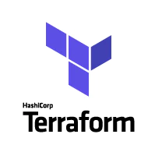
Next Steps….
Begin developing infrastructure as code using Terraform
Terraform is used to define/configure the infrastructure that should be provisioned
Revisions and changes to infrastructure are tracked and managed by committing Terraform scripts to a git repository
TFS git repository is used to perform peer review of infrastructure changes
TFS CI/CD process is used to build and deploy infrastructure
18

Slide 19
Questions?
19

Slide 20
Thank you
Erik Vollebekk
Email: erik.vollebekk@cic.gc.ca

