Slide 1
Being mobile: Best practices
ADOPTING NEW WAYS OF WORKING AND WORKPLACES THAT ARE EFFICIENT
Date: 2019-08-20

Slide 2
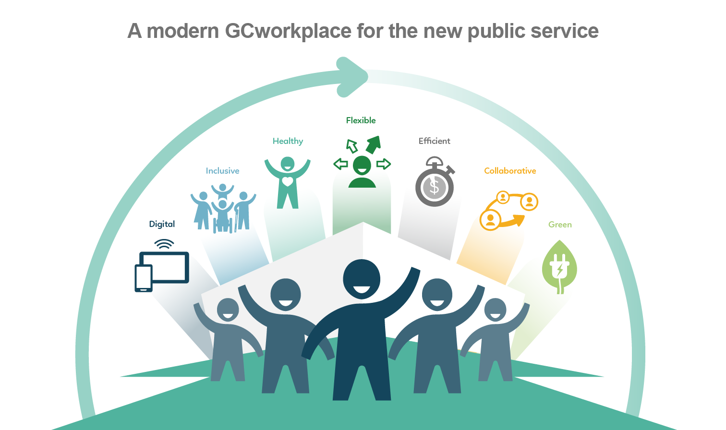
Workplace vision
The link to Blueprint 2020
An open, networked modern workplace and a confident and high-performing public service
The link to Beyond2020
Changing mindsets and behaviors for an agile, inclusive and equipped workforce.
We surveyed 1,300 employees from across Canada…
They ranked “flexibility" as the most important workplace dimension.

Slide 3
And the survey says…
Data from pre-occupancy survey only
Source: Workplace Performance Survey: Results of inaugural phase (September 2017-August 2019)

Slide 4
New ways of working
What is telework?
According to the Treasury Board Secretariat’s Telework Policy, telework is defined as a flexible work arrangement, approved by the manager, through which employees can carry out some or all of their work duties from an alternative location that is not the employer’s.
Benefits
Managers can structure their team based on function, rather than work location
Employees are better supported and they have an increased sense of control over their work
Greater flexibility for both organization and employees
Encourages trust and management based on results
Increases productivity
Improves access to talent
Reduces stress
Reduces carbon footprint and commute time
Supports work-life harmony
Provides an improved use of resources and office space
Challenges
Less in-person, face-to-face dialogues
Limited opportunity for social interaction
Difficulty developing a working relationship and team spirit based on trust
Extra efforts required to gain engagement and sense of belonging
Notes:
http://globalworkplaceanalytics.com/resources/costs-benefits
20-25 percent more productive than their office colleagues. And American Express employees who worked from home were 43 percent more productive than workers in the office.

Slide 5
New ways of managing
The concepts of managing a team by presentism or virtually are based on the same foundation which is managing performance by results. The system currently in place in the public service helps to create clear and SMART objectives with clear deliverables, outcomes and standards. The manager’s involvement with the team and the quality of his or her presence greatly contribute to the team's success and inspire its members.
Even though already-identified leadership skills are necessary in a mobile team setting, it is also required that a manager have specific methods and additional communication skills in order to effectively manage a virtual team.
Give yourself and your team some time to try new ways of working and develop the new skills that are required. Readjust if necessary!

Slide 6
Different levels of mobility
A telework agreement should always be in place
Set schedule of teleworking
Mobile within the workplace and teleworking
Highly mobile
Employees have a set schedule of teleworking
Employees can be mobile within the workplace and use various workpoints or areas
Employees have a set schedule of teleworking
Location of work depends on agenda
Working from various locations and workpoints
Avid users of technological tools
Employees have a paperless office

Slide 7
EXAMPLE: Shared Services Canada–highly mobile workforce
Example
Toolkit
Understanding virtual management
Organizing remote management
Mobilizing and supporting teams
Managing, supervising and following-up
Telework guide
Managing virtually–Four ways to overcome the challenges of long-distance leadership
GCconnex working group
Virtual web meeting tips, tricks and best practices
Faculty of Management and Administration–Virtual management
Occupational Health and Safety considerations for managing and/or supervising mobile workers and virtual team
Telework–Occupational Health and Safety Inspection Checklist
What is a virtual management toolkit?
Compilation of tools for managers
Determines what best suits your situation
Toolkit needs to be adjusted based on:
team's maturity
knowledge of telecommunications and email etiquette
personal qualities of team members
management style and personality
Toolkit inspired by Shared Services Canada Virtual Management: Managers' guide and tools.

Slide 8
EXAMPLE: Public Services and Procurement Canada, Science Portfolio Team– highly mobile workforce
Example, see annex A
Team charter
A team charter is the outcome of the team's agreement rather than a set of strictly established policies and rules. This agreement lays the ground work for the team's development, allowing the charter to evolve in parallel with the team, responding to its members' concerns, needs and expectations. For this reason, the charter needs to be updated periodically.
Team of 20 (1 DG, 2 support admin. staff, 17 analysts)
Went fully mobile in December 2018
Team developed a team charter
Workshop provided before going mobile

Slide 9
The recipe for effective mobile working
Set goals and objectives | Develop effective patterns of communication | Ensure you and your team have the skills and abilities to be mobile | Meet regularly
Build trust | Provide the necessary tools | Create a charter | Celebrate!

Slide 10
New ways of managing–best practices
Establish clear performance objectives and indicators for each employee. Schedule regular meetings and check-ins to share updates.
Ensure all employees can be easily reached and that they are able to communicate with managers just as easy.
Share team calendars to keep team members informed of where others are.
Utilize instant messaging tools to keep team members informed of where others are.
As a team, develop a team charter to foster team spirit and morale.
Take advantage of WebEx and other available tools to encourage virtual socialization and facilitate interaction within your team.
Make sure your team members have the ability to use the available technological tools. Otherwise, provide training.
Organize bilateral meetings and team meetings with all employees to discuss the advancement of their files, set objectives and provide regular feedback.
Identify potential conflicts and address them immediately.
Encourage employees to develop project plans (weekly/biweekly) and share with the team
Set aside time to build team spirit.
Mobile employees must have access to the right technological tools needed to be effective (mobile phone, laptop, WebEx account (or other videoconference application), etc.

Slide 11
Annex A–Team charter
WHY
It rallies team members around its objectives by encouraging their involvement and participation
Promotes team spirit
Fosters positive team dynamics and cohesion by:
involving team members in the development of team plans, strategies and achievable priorities;
fostering acceptance of and general enthusiasm about team objectives;
allowing virtual team members to collectively define the shared values and procedures that they adhere to;
providing a concrete set of benchmarks for operating a virtual workplace.
HOW
Have the team establish its charter
Brainstorm with your team about the elements they would like to have included in the charter such as “ground rules”, roles and responsibilities, communication styles and frequency of communications, mechanisms, language of work commitments, and measurable objectives.

Slide 12
Annex A–Framework of a team charter
TEAM CHARTER
Team vision and mission
Information about services offered by team members
Team values
Operating rules adopted by team members for a mobile office
Meetings (goals, frequency, conduct, rules, length, nature [in person or conference call], etc.)
Communications operating procedures (email, call management, voicemail etiquette, official languages, etc.)
Substitutes for absent members, task prioritization (important vs. urgent tasks), etc.
Creation and management of work tools (automated file system, database, etc.)
Clear information sharing processes within the team and with others
Special operating instructions for the entire team
Establishment of roles and responsibilities among team members
Other relevant information
Signatures and dates
Example

Slide 13
Tools and references
Ask around! Many organizations have created their own telework guide or directives
Service Canada
Shared Services Canada
Public Services and Procurement Canada
And many more…
The CSPS offers online courses for managers that might be helpful:
G140 Performance management in the Government of Canada
G014 Creating a plan for performance management
X027 Leading teams and managing virtual teams
Interesting links
https://docs.google.com/document/d/1wKTU1kp64DD9dAh5qxIZrxrSuBBdYwvUMoKG6_4iC8U/edit–this is a good one from the Free Agents program
https://www.linkedin.com/pulse/transformation-real-kathleen-fehr
https://www.predictivesuccess.com/blog/your-team-can-work-from-home-you-just-have-to-understand-them/
https://www.forbes.com/sites/dedehenley/2019/07/27/how-to-inspire-and-motivate-your-team-that-works-from-home/#61243ecc5bca
https://www.forbes.com/sites/forbescommunicationscouncil/2019/07/24/improve-your-team-leadership-by-working-from-home-for-a-week/#12f4b232552b–like most of our teams’ leadership do (lead by example)
https://marcuswermuth.com/remote-leader-working-routine/
https://www.workplaceless.com/partners-appearin
https://www.bbc.com/worklife/article/20190807-why-finland-leads-the-world-in-flexible-work

Slide 14
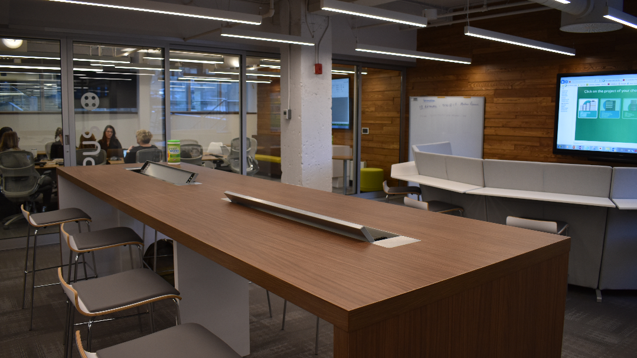
Thank you

