Slide 1
ATSSC Overview
Notes:
This PowerPoint presentation provides an overview of the ATSSC with suggested speaking notes. It is designed to ensure consistent information is communicated about the ATSSC.
When preparing PowerPoint presentations, please consult this ATSSC Overview and add applicable slides to your presentation.
Questions: communications@tribunal.gc.ca

Slide 2
Objectives of the ATSSC
Build capacity to meet the needs of administrative tribunals
Find efficiencies through economies of scale
Improve access to justice
Notes:
The Administrative Tribunals Support Service of Canada – the ATSSC – was established on November 1, 2014 through the ATSSC Act.
Its creation sought to achieve three main objectives :
Building capacity to meet the needs of administrative tribunals;
Finding efficiencies through economies of scale; and
Improving access to justice for Canadians.
In essence, the goal was to pool together the resources of several smaller tribunals into a larger organization, the ATSSC. This would allow the ATSSC to better leverage the resources at its disposal to help meet the needs that had long been identified by tribunals, but that they did not have the capacity to address within their own limited budgets and staff complement.

Slide 3
Plans and Priorities
2020-21 Departmental Plan Highlights:
Service Excellence
Implementing New and Modernizing Existing Case Management Solutions
Building and Sustaining a Healthy and Respectful Workplace
Planning for the Future
Notes:
Each year, the ATSSC must account for its activities and the results it expects to achieve with the funding it receives from Parliament.
Copies of the ATSSC’s Departmental Plan, Departmental Results Report, Corporate Risks and other information are available on the ATSSC’s website.

Slide 4
ATSSC Mandate
Responsible for providing support services and facilities to 12 federal administrative tribunals by way of a single, integrated organization.
Services include:
Specialized support services required by each tribunal (e.g. registry, research and analysis, legal and other mandate or case activities specific to each tribunal);
Internal services (e.g. human resources, financial services, information management and technology, accommodations, security, planning and communications).
Notes:
The ATSSC provides the specialized expert services required by each tribunal, as well as centralized internal services common to all tribunals.
By providing these services, the ATSSC enables the tribunals to exercise their individual powers and perform their unique duties and functions according to their respective legislation, rules and regulations.
The ATSSC reports to Parliament through the Minister of Justice and Attorney General, but it operates at arms’ length from the Department of Justice.

Slide 5
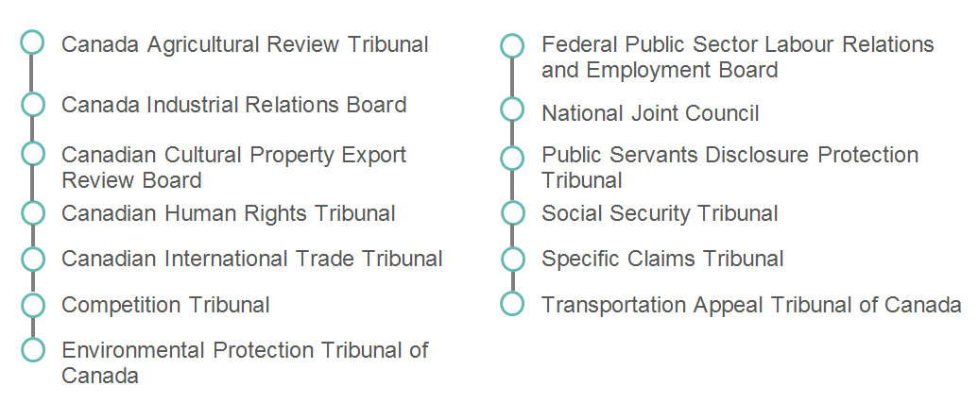
Who We Serve
Notes:
The ATSSC serves 12 federal administrative tribunals which represents a portion of the nearly 30 federal administrative tribunals.
The 12 tribunals are generally small organizations that vary in size from approximately 3 to 100 tribunal members (full-time and part-time members).
Their mandates are varied, spanning a vast array of specialization, from commerce and international trade to the administration of monetary penalties, to human rights and indigenous rights, social programs, labour relations, the protection of public servants who are whistleblowers and the protection of cultural assets.
The ATSSC also supports the National Joint Council (NJC) – a forum for co-development, consultation and information sharing between the Treasury Board of Canada as employer and public service bargaining agents.

Slide 6
ATSSC At-a-Glance
$111.5 million budget in 2020-21
Approximately 660 employees
Approximately 200 Governor-in-Council appointees are members of the 12 administrative tribunals
Four locations in the National Capital Region
Four regional offices
Notes:
The ATSSC’s budget consists of funding that was allocated to each tribunal prior to November 2014. No additional funds were provided for the creation of the ATSSC itself, however some additional funding has been acquired over the years, typically following an expansion of a tribunal’s mandate.
The ATSSC’s workforce consists of approximately 660 employees, the majority of whom are located in the National Capital Region. The organization also has employees in four regional offices (Dartmouth, Montreal, Toronto, Vancouver) who support the Canada Industrial Relations Board.
Governor-in-Council appointees serve as chairpersons, vice-chairpersons or as members of the tribunals.

Slide 7
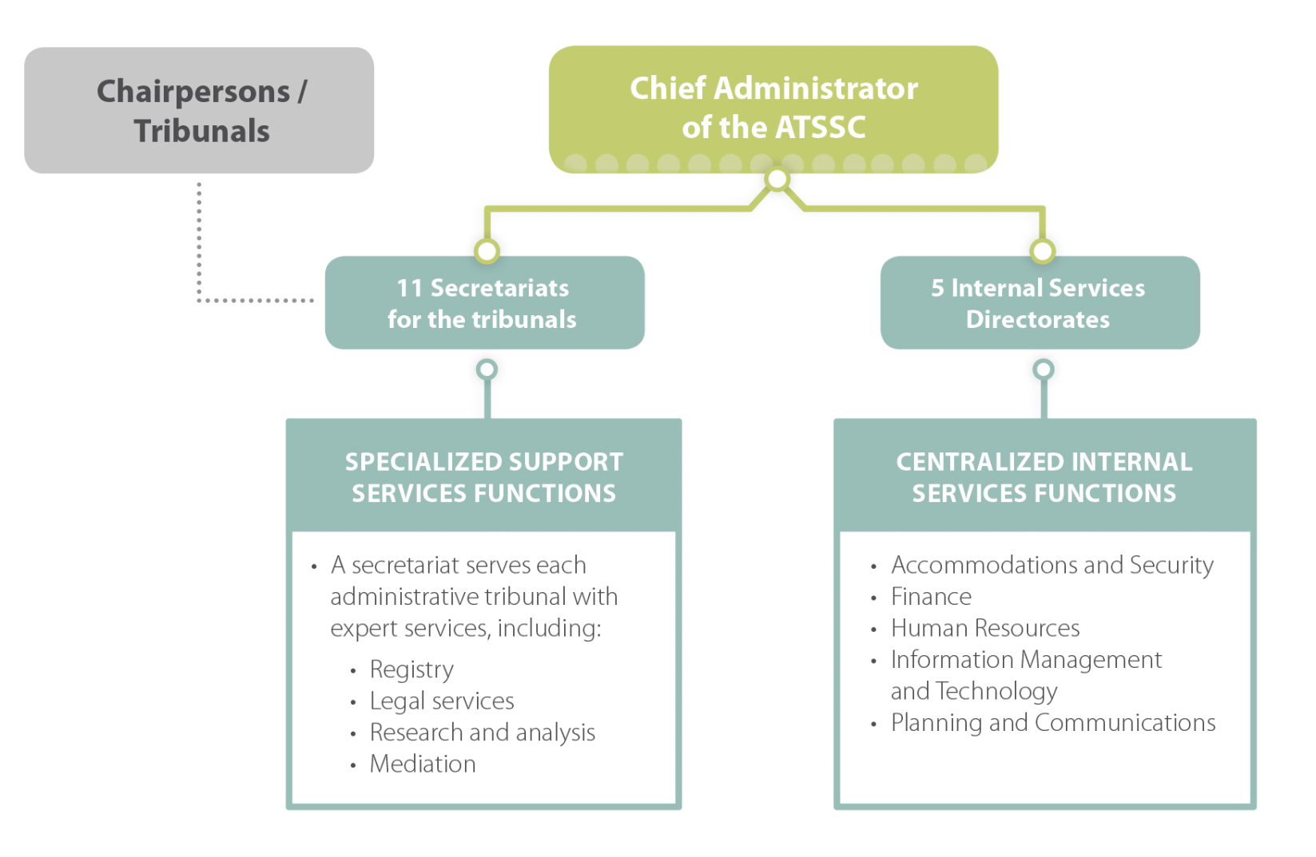
Organizational Structure
12
Notes:
The ATSSC is headed by a Chief Administrator, who is appointed by the Governor-in-Council to hold office of a term of up to five years. The Chief Administrator has the rank and status of a deputy head of a department.
In accordance with the ATSSC Act, the Chief Administrator is responsible for administering the financial and human resources required to support the tribunals.
In order to deliver the support services required by the tribunals, the ATSSC is structured with two streams of services: Secretariats who work directly with each tribunal to deliver the specialized services in the tribunal’s area of expertise; and Directorates who deliver centralized internal services across the organization.
On a day-to-day basis, tribunal members work with ATSSC employees who assist them with case files, editing decisions, making travel arrangements for hearings and any number of tasks required by the tribunal members in the course of their work.
Tribunal Chairpersons of the 12 tribunals served by the ATSSC continue to have supervision over, and direction of the work of their respective tribunals. They are able to accomplish their mandates with the assistance of the ATSSC, however the ATSSC cannot exercise a tribunal’s mandate in its place.

Slide 8
Organizational Structure
Chairpersons / Tribunals
Chief Administrator of the ATSSC
Deputy Chief Administrator
Executive Directors to Tribunal Secretariats
Chief Financial Officer and Director General Corporate Services
Chief Information Officer
Notes:
The ATSSC is headed by a Chief Administrator, who is appointed by the Governor-in-Council to hold office of a term of up to five years. The Chief Administrator has the rank and status of a deputy head of a department.
In accordance with the ATSSC Act, the Chief Administrator is responsible for administering the financial and human resources required to support the tribunals.
In order to deliver the support services required by the tribunals, the ATSSC is structured with two streams of services: Secretariats who work directly with each tribunal to deliver the specialized services in the tribunal’s area of expertise; and Directorates who deliver centralized internal services across the organization.
On a day-to-day basis, tribunal members work with ATSSC employees who assist them with case files, editing decisions, making travel arrangements for hearings and any number of tasks required by the tribunal members in the course of their work.
Tribunal Chairpersons of the 12 tribunals served by the ATSSC continue to have supervision over, and direction of the work of their respective tribunals. They are able to accomplish their mandates with the assistance of the ATSSC, however the ATSSC cannot exercise a tribunal’s mandate in its place.

Slide 9
Chairpersons’ Role
The Chairpersons’ role is more akin to a Chief Justice than a CEO. The Chief Administrator is the CEO of the ATSSC.
The Chairperson of an administrative tribunal has supervision over and direction of the work the tribunal (members, caseload and procedures), and operates within the resources that have been allocated to its tribunal. As a member, the Chairperson may also adjudicate cases.
Independence for the administrative tribunals’ adjudicative and substantive functions (including investigation and mediation) is preserved:
Tribunals control their rules and procedures
Chairpersons and members work directly with expert staff supporting mandate-related casework
Notes:
Each year, the ATSSC must account for its activities and the results it expects to achieve with the funding it receives from Parliament.
Copies of the ATSSC’s Departmental Plan, Departmental Results Report, Corporate Risks and other information are available on the ATSSC’s website.

Slide 10
Role of the Chief Administrator
The Chief Administrator is appointed by the Governor In Council.
The Chief Administrator acts as Deputy Head and CEO of the ATSSC.
The Chief Administrator allocates resources to secretariats and internal services to allow them to function effectively. In doing so, the Chief Administrator is responsible for the provision of the support services (including Human Resources and Finance) and the facilities that are needed by each of the administrative tribunals to exercise its powers and perform its duties and functions in accordance with the rules that apply to its work.
Notes:
Each year, the ATSSC must account for its activities and the results it expects to achieve with the funding it receives from Parliament.
Copies of the ATSSC’s Departmental Plan, Departmental Results Report, Corporate Risks and other information are available on the ATSSC’s website.

Slide 11
Role of the Executive Directors
Through authority delegated by the Chief Administrator, Executive Directors supervise secretariat staff and apportion work.
Executive Directors manage the secretariat work and operations that fall under the ATSSC’s purview (e.g. human resources, financial matters, information management and technology) in collaboration with ATSSC Corporate Services.
Executive Directors are the Chairperson’s advisor on any matter.
Executive Directors are supervised by the Deputy Chief Administrator to ensure they are serving the needs of Tribunals effectively and cohesively.
Notes:
Each year, the ATSSC must account for its activities and the results it expects to achieve with the funding it receives from Parliament.
Copies of the ATSSC’s Departmental Plan, Departmental Results Report, Corporate Risks and other information are available on the ATSSC’s website.

Slide 12
Governance
Chairs’ Forum
Chief Administrator
Tier 1
Responsible for horizontal decision-making, direction setting and oversight of the organization’s substantive and corporate responsibiliies.
Senior Management Committee
Transformation Subcommittee
Resources Subcommittee
Tier 2
Operational matters of common interest
Business innovation
Digital strategies and plans
Priority-setting
Financial Management Control
Management Accountability
Integrated Planning and Reporting
Reviewing and monitoring investment plan progress
Support the Executive Committee by providing leadership and direction on specific areas of focus.
Chaired at DCA and CFO/DGCS level.
Membership and quorum to be set in individual terms of reference.

