Slide 1
COVID-19
Developing web content as one government
For discussion
Theme Management Committee
March 26, 2020

Slide 2
Approach objectives
For users:
Clear and easy to understand information and services
Single trusted source
Consistent user experience
For organizations:
Avoid duplication of efforts
Clear roles and responsibilities
Better positioned for future changes

Slide 3
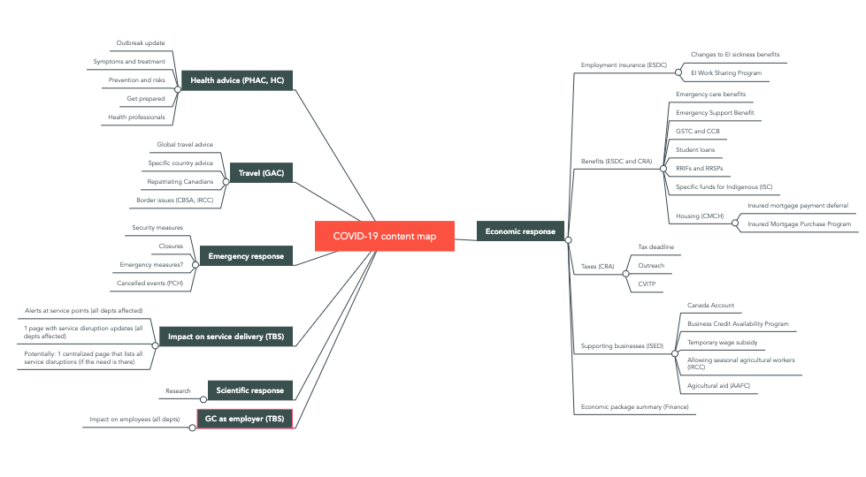
A bird’s-eye view
While there should be a single authoritative source, COVID-19 content sprawls over multiple themes and topics.
Content structure map
Content inventory
Notes:
Can we turn “Economic response” around to be from the perspective of individuals and businesses? Something like “Financial Support for Canadians and Businesses”
Proposal: Culture, history and sport could be added to the Economic response area for the time being because of the olympics and other issues in the culture and sport sectors
Proposal: another big bucket about emergency measures (or something to be really clear about social distancing, store closures, that may lead to less voluntary measures like shelter in place etc? The concept of social distancing is peculiar and it seems like that aspect of the government’s response probably needs more clear instructions, especially if we are headed where the UK just went
Proposal: a big bucket on supporting industries that are making industrial equipment/testing/masks/vaccine research etc?

Slide 4
COVID-19 affects the majority of Canada.ca themes
Health
Travel
Jobs
Immigration
Business
Benefits
Taxes
National security
Policing, Justice and Emergencies
Science
Public service
Canada and the world
Culture, history, sport
Money and Finance
Transport
Legend
Has Covid-19 content now
Anticipate Covid-19 content soon
Notes:
Likely areas for additional content in the near future: Policing Justice and Emergencies - Especially as social restrictions become more strict Science - research funding for vaccines, manufacturing etc. Canada and the world: info for students; emergency contact information for Canadians abroad Culture, history and sport - the Olympics/special messages to the arts community (Canada Council is VERY active on Covid19) Public service and military - information about pay/benefits, working from home etc Transport - what goods are still shipping/what’s an essential business/limits on shipments inside or in/out of Canada

Slide 5
All-of-Government approach
Coordinate centrally through canada.ca/coronavirus and pages underneath
Announcements and content should not be duplicated across departments

Slide 6
At the department level
Focus on:
Changes to programs and services
Service disruptions
Guidance for your employees, in coordination with TBS
Identifying and connecting with partners re upcoming collaborative content

Slide 7
Example: Changes to Canada Child Benefit
Announced by: Finance Canada
Affects: Benefits theme (ESDC)
Changes: CCB delivery (CRA)

Slide 8
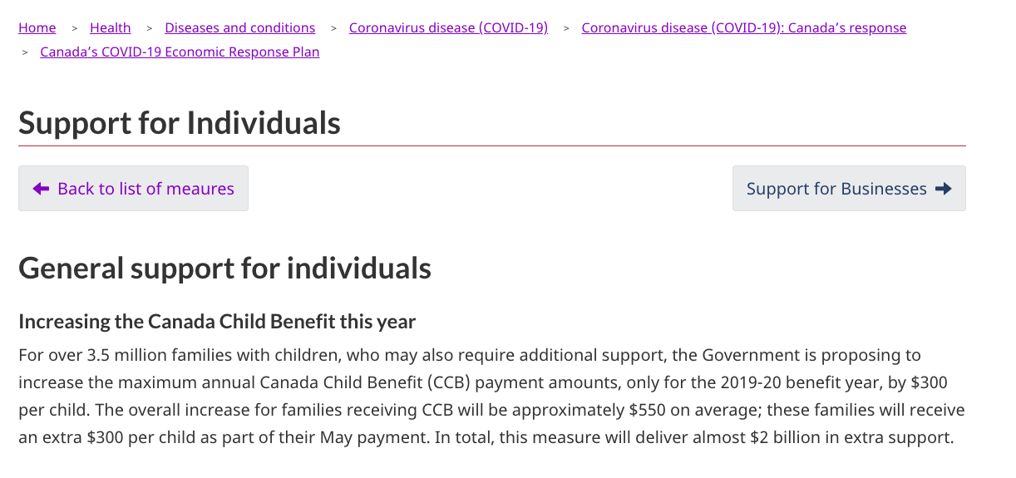
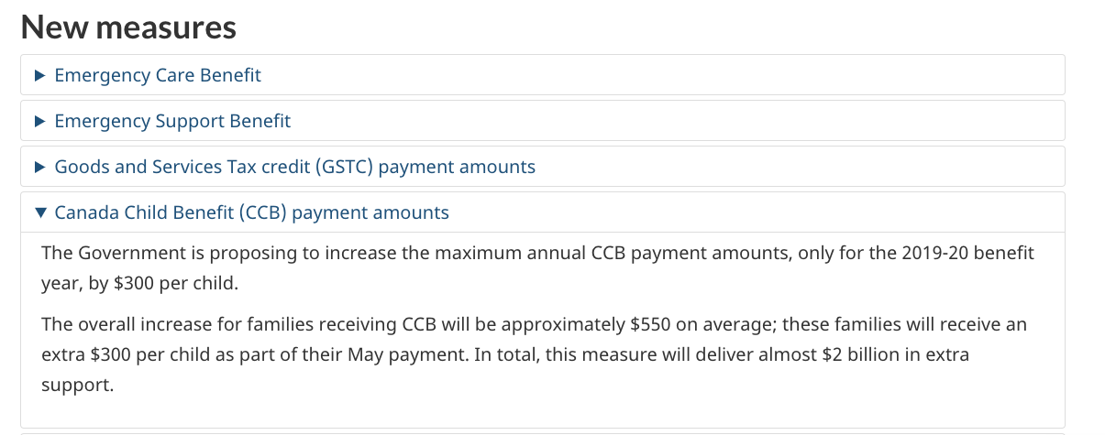
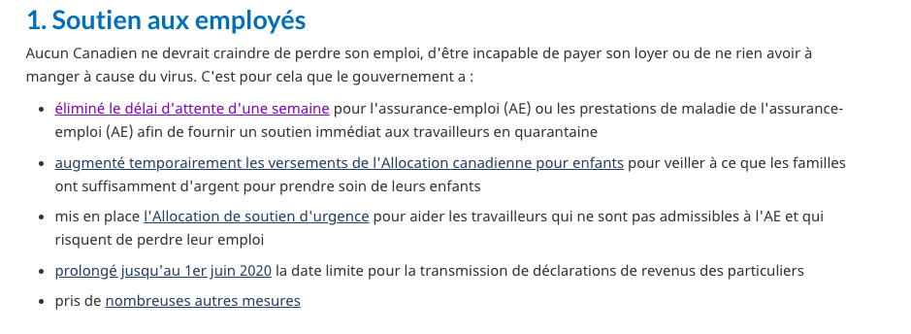
Current situation: Duplication of general info
Finance
CRA
ISED
ESDC

Slide 9
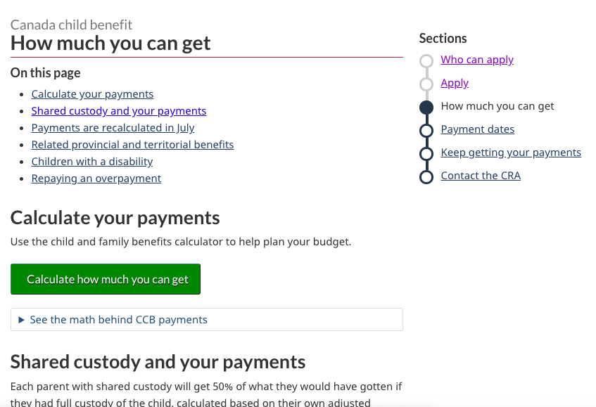
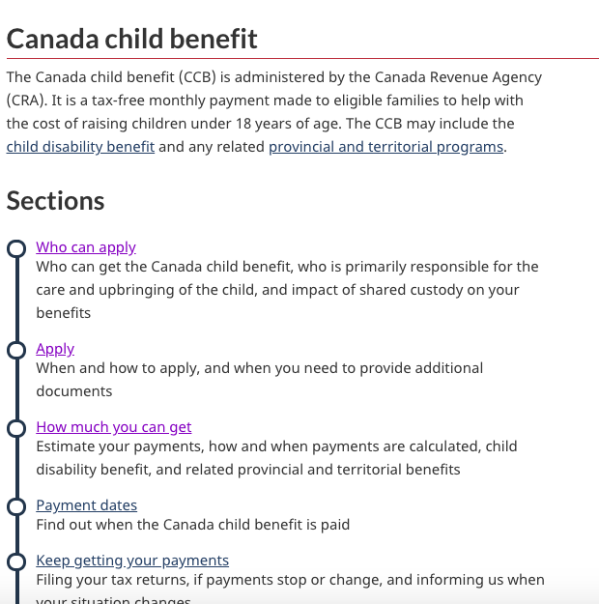
Current situation: No info at the service level yet

Slide 10
Proposed approach: navigation and content layers
Main COVID-19 response pages
Theme area (navigation layer)
Canada.ca/coronavirus
Theme A
COVID-19 sub-section
Topic B
Departmental pages (task content layer)
Program or service
Details of proposed changes

Slide 11
Example: Canada Child Benefit
Main COVID-19 response pages
Theme area (navigation layer)
Benefits
Taxes
Canada.ca/coronavirus
Economic Response Plan
Family benefits
Support for individuals
Departmental pages (task content layer)
Canada Child Benefit
Details of proposed changes

Slide 12
A phased approach for department and theme content

Slide 13
Phase 1 - Now

Slide 14
Identify impacted programs and services
If you haven’t already done so, update every program and service affected by COVID-19 ASAP.
As a first step, add a contextual alert linking to the relevant page in the main COVID-19 response group.
Guidance on alerts: https://design.canada.ca/crisis/alerts.html

Slide 15
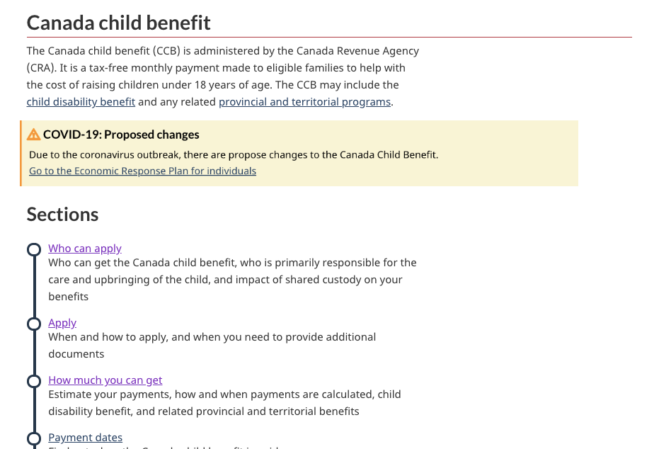
Example - CCB

Slide 16
Phase 2 - As soon as possible

Slide 17
Review all your COVID-19 content
Review your COVID-19 pages
If your content is already covered in the main COVID-19 response pages, link to it there instead
If some government-wide content is missing from the main COVID-19 response pages, either:
work with partners to integrate missing content in the main pages
work with partners to create a subpage within the main response suite of pages

Slide 18
Theme review
Review topics that fall under your theme
Review carousels and features for tone
Focus should be on COVID-19 updates and impacts
Consider removing carousels so they don’t compete with alerts

Slide 19
Service disruptions and impact on employees
Create or review pages about service disruptions for your institution (if applicable)
Impact on your employees: if you have content, connect it to the main TBS page for employees

Slide 20
Phase 3

Slide 21
Integrate changes in service or program content
As the details become available, integrate the changes and improvements in the task-level content.
Remove alerts, or have them point to the new task content.

Slide 22
Questions?

