Slide 1
JSON-LD component in AEM
Theme Management Committee
September 16, 2020
Principal Publisher

Slide 2
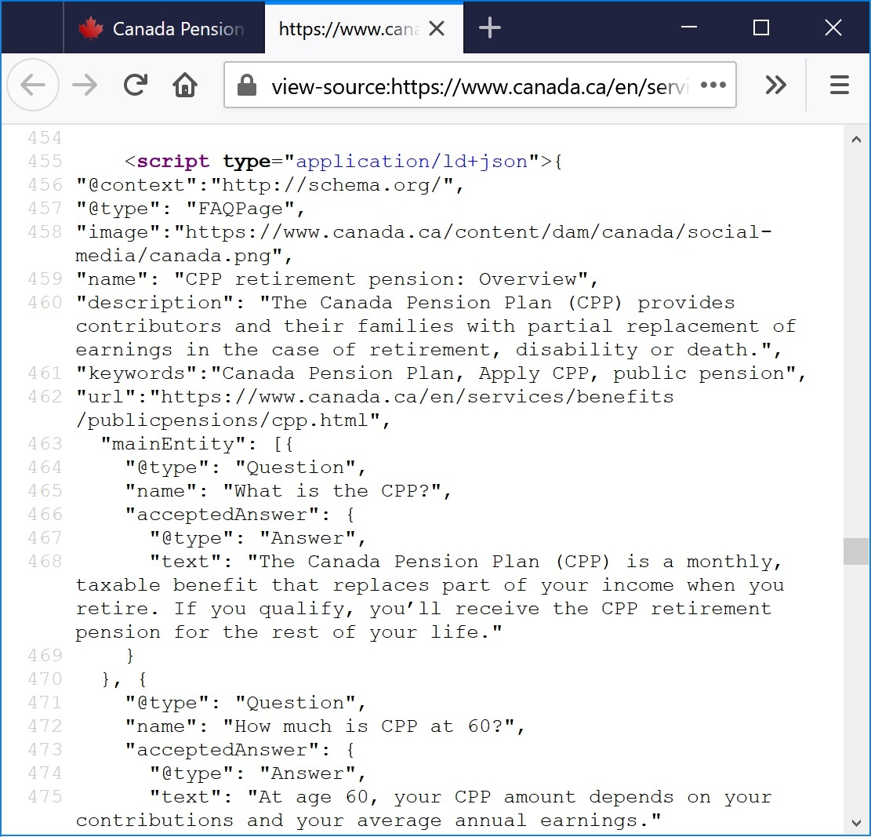
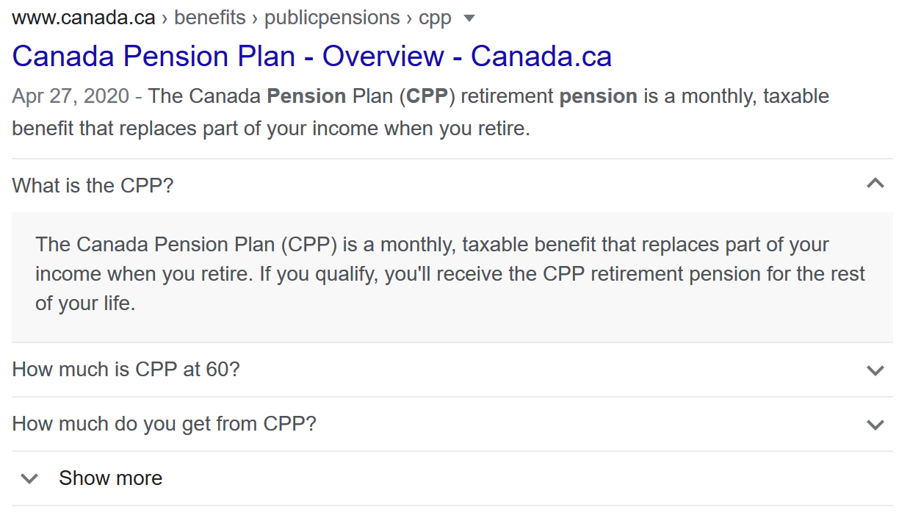
What is JSON-LD?
JSON-LD is a notation language used to add structured data to web pages. It is used by search engines to “understand” what the content is about and to build search results.
2

Slide 3
Why a new component?
AEM does not allow the <script> tag in components (required to add JSON-LD)
Replaces the hacks used as temporary solutions
Makes it easier for institutions to explore with JSON-LD and learn more on how structured data can improve search results
3

Slide 4
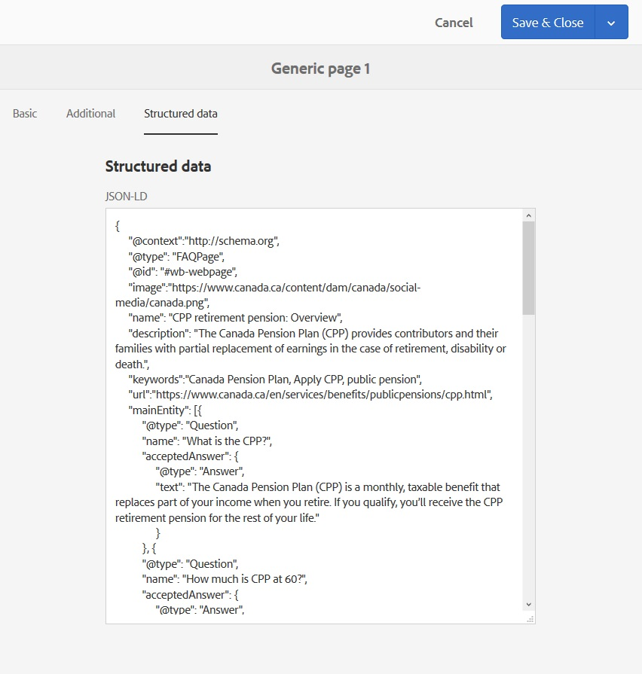
Component location
Available on all pages (except Newsroom)
Page properties
Structured data new tab

Slide 5
How it works
Paste the JSON-LD code to the input field
Automated validation
JSON-LD is added to the <head> section of the page
Note: Values could be replaced to ensure data integrity
Limitation: one instance of @context is allowed; must be http://schema.org

Slide 6
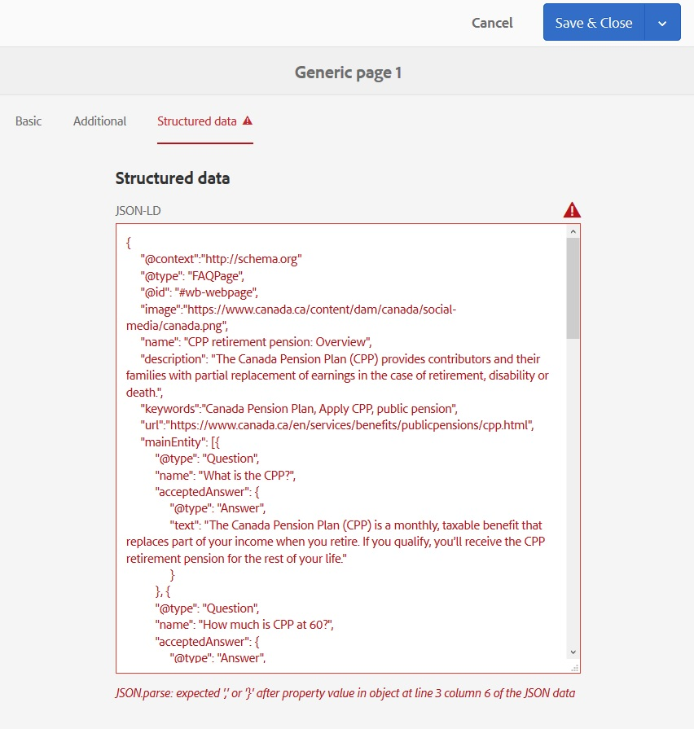
Validation
JSON-LD formatted correctly (no missing commas, brackets)
Contains mandatory elements
@context
@type
@id

Slide 7
Data integrity
On Canada.ca, structured data is also added via WET templates using another notation language called RDFa, with the schema.org vocabulary.
To ensure the integrity of the data, it is important that values assigned using RDFa and JSON-LD do not contradict each other but are written to be complementary.

Slide 8
Value replacement
The values assigned to the following properties will be overwritten with the values from the system (also used to populate the RDFa)
schema.org property | value
publisher
name | Government of Canada Gouvernement du Canada
url | https://www.canada.ca/en.html https://www.canada.ca/fr.html
logo | https://www.canada.ca/etc/designs/canada/wet-boew/assets/sig-blk-en.svg https://www.canada.ca/etc/designs/canada/wet-boew/assets/sig-blk-fr.svg
dateModified | Same as dcterms.modified
datePublished | Same as dcterms.issued

Slide 9
@id replacement
By default, use “#wb-main” to refer to the main section of the page (as specified in the RDFa).
If you use a @type listed below, the @id will need to be set to “#wb-webpage” (will be overwritten by the system if it is not):
AboutPage CheckoutPage CollectionPage ContactPage FAQPage | ItemPage MedicalWebPage ProfilePage QAPage SearchResultsPage | MediaGallery ImageGallery VideoGallery

Slide 10
Next steps
Update your pages where structured data was added using the hacks.
Note: The list of live pages can be found in the Google Search Console
Explore with JSON-LD!
Consult the AEM Training Unit:
5.1 – Adding structured data using JSON-LD https://www.gcpedia.gc.ca/wiki/AEM_GC-specific_Documentation_6.5

Slide 11
Structured data resources
Schema.org
https://schema.org
JSON-LD 1.1
https://www.w3.org/TR/json-ld11/
Resource Description Framework (RDF) 1.1 Primer
https://www.w3.org/TR/rdf11-primer/

Slide 12
Questions and comments
Submit a request via the Principal Publisher Service Desk
http://requestform.portal.gc.ca/tickets.html

