Slide 1
Learning Hub
Short Presentation – 152
Protecting Digital Privacy

Slide 2
Presentation Outline
Part 1 – Digital Identities and Online Compromise
Part 2 – Digital Profiles, Fingerprints and Tech Giants
Part 3 – Best Practices
Part 4 – Case studies

Slide 3
Part 1 – Digital Identities and Online Compromise
What is a digital identity?
Impact of compromised email account
Indirect targeting and opportunistic hackers

Slide 4
Digital Identity
Email accounts and cell phone numbers are routinely used to:
Represent our identity (account creation, communication)
Confirm our identity (email confirmation, password reset)
Communicate with us (alerts, ads)
Engage in private communications (family, friends, coworkers)
Perform transactions

Slide 5
Impact of compromised account
In the hands of malicious actors, our digital identity can be used to:
Create new accounts online
Reset passwords of existing accounts
Scam/hack our contacts
Expose our habits, location, behaviours
Disclose personal and private data
Lock us out of our recovery tools

Slide 6
Account Compromise
Online service providers are breached almost daily and can affect up to billions of accounts at once
Accounts are not targeted but mass-compromised and breaches can propagate to other accounts
A forgotten account might expose critical information, and every account is a potential point of entry
Security mechanisms are often very poor and password weakness (simple/common/reused) is a vulnerability
Compromises can expose security questions or password hints, or even the plaintext passwords

Slide 7
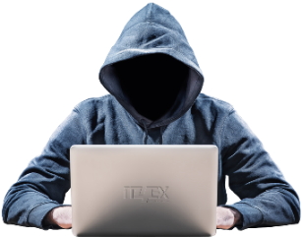
Online Service Compromise
Server A
Email
Password
Security questions
IP Addresses
Financial data
Private data
Server B

Slide 8
Part 2 – Digital Profiles, Fingerprints and Tech Giants
Digital profiles and digital fingerprints
Large scale data gathering and user tracking
Monetization of private information
Privacy legislation

Slide 9
Definitions and Context
Digital profile – A distinct set of characteristics associated with an individual user of an online service
Accumulated data is linked to the profile, tailored, packaged and sold over and over
Digital fingerprint – Even when not logged in to an account, a fingerprint can be generated and tracked from browsing and online activity
The fingerprint is linked to information including IP address, browser and operating system information, time zone and languages among others
Information is collected via cookies and tracking scripts among others
“You are not the client, you are the product”

Slide 10
What is in a Digital Profile or Fingerprint?
Profiles and fingerprints assemble valuable personal information including your:
appearance: voice, race, appearance, all biometrics
health: dietary restrictions, fitness level or goals, health concerns
financial situation: career goals, wealth, investment goals
current concerns: pregnancy, travel, home ownership
interests: hobbies, products owned or desired, topics
social connections: family, friends, gatherings, upcoming plans, appointments

Slide 11
Data Gathering and Aggregation
Running App
Wearable Data
Recipe Sites
Fitness Level / Goals
GPS
Calendar
Text/ Email
Relations
Books
Shopping
Likes
Interests

Slide 12
Filter Bubble
Browsing is filtered: websites tailor content
search results, ads, discussions, headlines, political messages
Based on the user’s digital profile or fingerprint
Creates a state of intellectual isolation in one’s cultural or ideological bubbles (echo chamber)
Prime examples:
Google Personalized Search results
Facebook personalized news-stream
Discount variation based on profile
Debatable impact on social discourse

Slide 13
Utility vs Privacy
Online service offerings are robust, with the payment for services often being our personal data
The relationship is entered by agreeing to “Terms of service” and “Privacy policy”
The clients for the providers are: advertisers, marketing firms, …
Service providers have access to private data:
What are the terms of service?
Which third-party will have access to this data?
Is the data anonymized?
How long is it kept for?

Slide 14
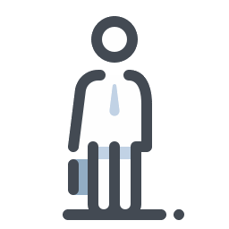
Google Ad Exchange
8.4M websites
Bidding
Online profile
Age
Income
Hobbies
Political inclination
Health issues
Religion
IP address
Coordinates
Advertising ID
…
Advertisers
Ad
Source: Google Ad Exchange in data privacy probe. Naked Security by SOPHOS. May 24, 2019.
Source: Brave uncovers Google's GDPR workaround. Brave. September 4, 2019.

Slide 15
Risks Involving Personal Information Online
Digital profile and digital fingerprint information is gathered from:
what you post and what others post about you on social media, photo sharing sites, forums, blogs, and news sites
your online account activity and shopping data
your browsing habits
This personal information is very valuable to:
companies (tech giants) that create and use profiles to sell ad space
advertisers who are targeting potential customers
threat actors who want to use the information to craft targeted social engineering attacks or use the platform to launch attacks, manipulate people and spread misinformation

Slide 16
Privacy Legislation
Personal Information Protection and Electronic Documents Act (PIPEDA)
Canadian federal private-sector privacy law
Uses principles such as consent, limiting collection, safeguards and access
Amended in 2018 to impose data breach notifications
New legislation tabled in Parliament includes new fines and controls
Some provinces have private sector privacy legislation and governments (federal, provincial, and municipal) are also subject to their own privacy laws
Source: Bill C-11. Canada's System of Justice. December 2, 2020.
Reference: Office of the Privacy Commissioner of Canada. August 16, 2022.

Slide 17
Part 3 – Best Practices
Online account best practices
Social media best practices
Online browsing best practices
Privacy enhancing technologies

Slide 18
Online Account Best Practices
Delete unused accounts (when possible)
Use the “assumed compromise” approach
Use strong, unpredictable and unique passwords for each account
Treat security questions/password hints as if they were passwords
In the event of a compromise, modify password immediately

Slide 19
Social Media Best Practices
Review and apply security and privacy options on your account
Use a unique password for every account
Be careful when accessing unknown website links or attachments
Be wary of potential misinformation, social engineering, and fraud
Reference: Use of personal social media in the workplace (ITSAP.00.066), Canadian Centre for Cyber Security, March 2019.

Slide 20
Social Media Best Practices (continued)
Be careful about what you share online; minimize your social media presence
Think before you link; know who you are connecting with
Personal information is valuable; it shouldn’t be given out freely
Many apps and websites track a user's internet use and location
Information that is posted online can be around for a long time and can be copied and seen by anyone
Prior to posting, ask yourself:
Is this how I want people to see me?
Could somebody use this to hurt me if they wanted to?
What’s the worst thing that could happen if I shared this?
Reference: Digital Citizenship - Guide for Parents. Media Smarts. 2017.
Reference: US DoD Identity Awareness, Protection and Management Guide. U.S. Department Of Defense. March 2021.

Slide 21
Online Browsing Best Practices
Keep your browser up-to-date
Find a tutorial on adjusting the permissions, privacy settings and security settings of your browser, apps and online services
Turn off the ‘Remember Me’ feature on websites and disable autofill
Delete unused accounts (when possible)
Reference: Securing Your Web Browser. Cybersecurity & Infrastructure Security Agency. September 8, 2015.
Reference: Just delete me. Background Checks.

Slide 22
Privacy Enhancing Technologies
Privacy Enhancing Technologies (PETs) can help users minimize the data collected about them, understand how their information is used and where it goes, increase their anonymity and better control their personal information
Some examples include:
ad blockers and tracker blockers which can analyze and block cookies and scripts that may collect information about your browsing
privacy-focused browsers and search engines that may limit tracking and provide more security and privacy features
“privacy” mode and “do-not-track” features in a browser that may limit how much information it collects and stores
Virtual Private Networks (VPNs) which encrypt data you send and receive online

Slide 23
CIRA Canadian Shield
CIRA Canadian Shield is a public DNS resolver
When resolving, it checks to see if the site is malicious based on threat intelligence
It blocks known online scam sites in addition to malware and phishing, and sites with a high likelihood of being fraudulent
Available as a router configuration, device configuration, mobile app and browser extensions
Reference: CIRA Canadian Shield

Slide 24
Part 4 – Case Studies
Facial Recognition
Cell Phone Tracking
Location Tracking

Slide 25
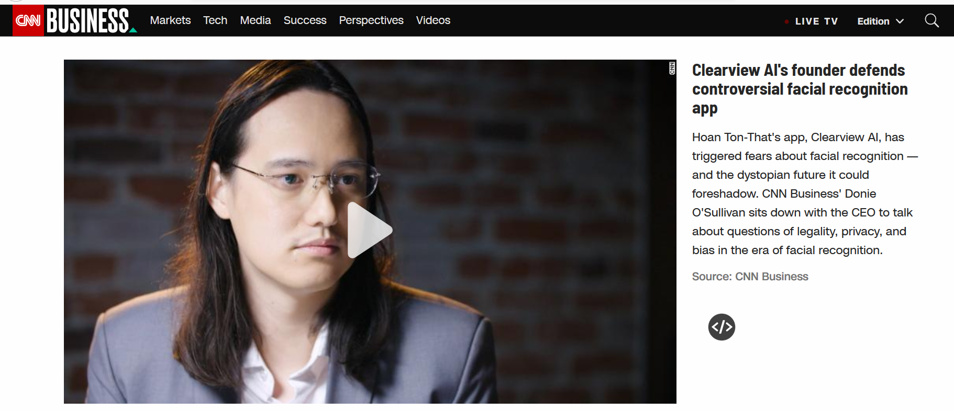
Case Study: Facial Recognition
Source: https://www.cnn.com/videos/business/2020/02/10/clearview-ai-facial-recognition-orig.cnn-business

Slide 26
Case Study: Tech-Enabled Surveillance
Dozens of schools in the US are monitoring students electronically
Bluetooth beacons track attendance in classrooms
Wi-Fi tracks students across campus
Multiple behavior indicators are tracked:
Time in dorm room
Sleeping and eating patterns
Physical activities
Social interactions
Students that do not opt-in are penalized
Source: https://www.washingtonpost.com/technology/2019/12/24/colleges-are-turning-students-phones-into-surveillance-machines-tracking-locations-hundreds-thousands/

Slide 27
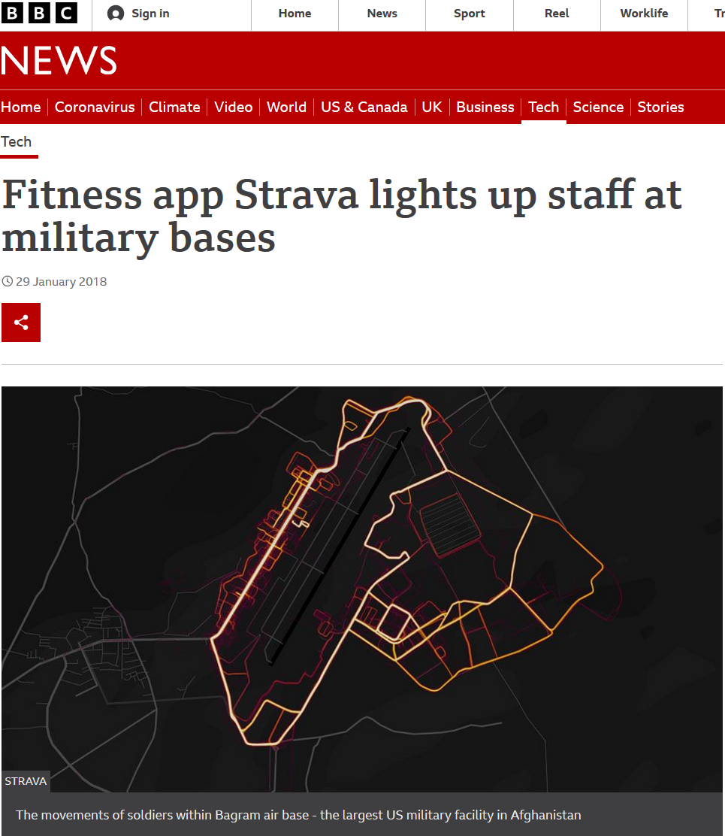
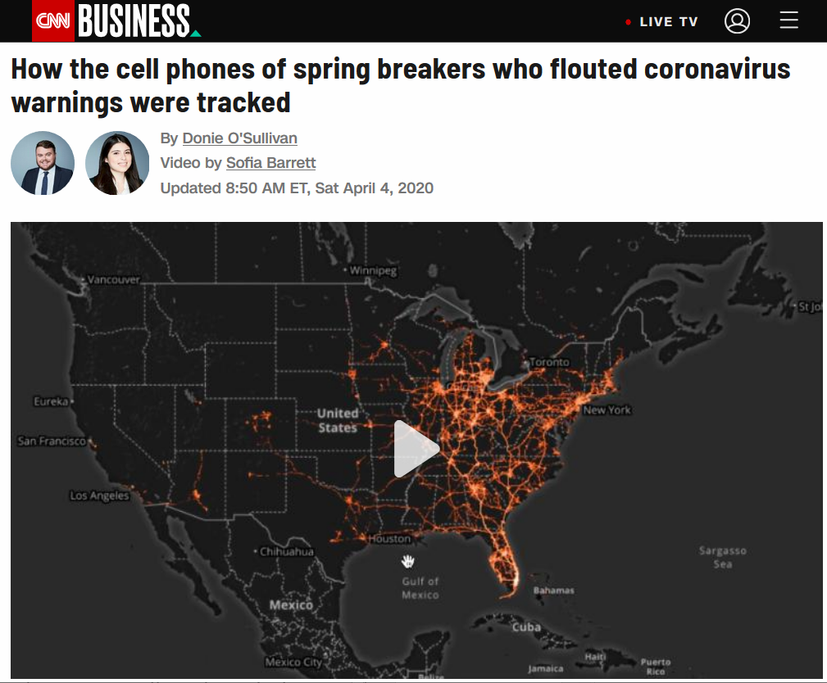
Case Studies: Location Tracking
Source: https://www.bbc.com/news/technology-42853072
Source: https://www.cnn.com/2020/04/04/tech/location-tracking-florida-coronavirus/index.html

Slide 28
Conclusion
Summary:
Digital Identities and Online Compromise
Digital Profiles, Fingerprints and Tech Giants
Best Practices
Case studies

Slide 29
Questions

Slide 30
What’s Next?
Expand your knowledge:
Course calendar
Cyber Centre publications
Look to the “What’s new” section of our website to keep informed on up-and-coming training activities

Slide 31
CONNECT WITH US
833-645-3276
education@cyber.gc.ca
https://cyber.gc.ca/en/learning-hub

