Slide 1
Reform
Investment Funding Approach Considerations
Overview and Themes for Breakout Sessions

Slide 2
Agenda and Objectives
Agenda
Provide high level overview of the investment funding approach
Present five key themes for breakout session discussions
Return to plenary and share outcomes from the breakout sessions
Objective
Understand key considerations for an Investment Funding Approach to support the development of rights-holders engagement materials, return to cabinet, and implementation

Slide 3
Drivers for Change
Support progress towards self-determination and transfer of services
ISC is prescriptive in project prioritization, timing, approach
Reduce administrative burden
Significant reporting exists, project oversight, planning, addressing deficiencies
Improve efficiencies
Challenges to align projects, lack of accountability, rigid LoSS, project timing (delays)
Support implementation of best practices in asset management
Funding for capital investments are limited to project approvals, based on targeted funding in a fiscal year and are aligned with departmental priorities
To fully implement asset management planning revenue streams cannot be ad-hoc, predictable capital funding will support communities to budget and plan around their priorities to meet their community’s needs
Notes:
LoSS – ISC’s Level of Service Standards

Slide 4
Proposed approach
Provide long term sufficient and predictable funding
Investment Funding Approach
Increased flexibility
Type of infrastructure
LoSS
Timing
Reduced reporting and oversight
Focus on portfolio management

Slide 5
Overview: Investment Funding Approach
With an investment funding approach, ISC would provide recipients, who express interest, with the opportunity to receive minor and major capital funding in addition to their O&M as an annualized/preestablished (predictable) allocation with long-term commitments, to plan for and manage the lifecycle needs of their existing assets
Through engagement with rights-holders ISC will seek input on methodologies to consider in how to best support First Nations in managing their infrastructure needs
Considerations include providing long-term regularized cashflow with the flexibility to spend, save and borrow with the transfer payments received

Slide 6
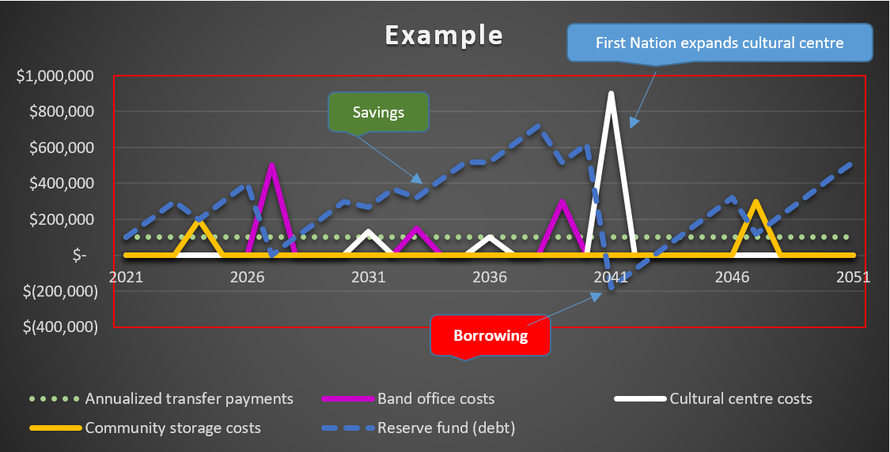

Slide 7
Cashflow Considerations:
Advance payments through multi-year funding agreements
Provide sufficient & predictable funding stream based on lifecycle costing
Ability to carry-forward surpluses to invest/save for future year expenditures/plans/priorities
Ability to monetize transfer payments and access loan programs
Provide the flexibility to spend, save and borrow with transfer payments
A funding approach that is supported by and meets the needs of First Nations as evidenced/informed through engagement

Slide 8
Financial Tools Required:
Flexibility for First Nations to save/carry over surplus funding indefinitely
To be saved/invested in a reserve fund to meet future capital investment needs (asset replacement at end of the life, roof replacements every 15 years, etc.) for their existing infrastructure
Ability for First Nations to access advanced funding (loans) such as
Borrowing through external lenders
May require Ministerial Loan Guarantee or other ISC supports
Advance funding through ISC
External lending is significantly more expensive
Consider and ISC loan or similar program such as a revolving fund
Authority for Monetization
Program authority allow for repayment of principal and interest on loans
First Nation have ability to leverage transfer payments for loans

Slide 9
Intended Results
Enables long term planning
Autonomy to plan for and deliver on their community’s infrastructure needs by advancing projects without going through ISC processes, not dependent on ISC project approvals and ISC funding decisions that may can cause delays and may contribute cost overruns
Provide flexibility
First Nations can combine projects leading to efficiencies
First Nation can deviate from LoSS to align with community needs
Not subject to PCF
Reduced reporting to and oversight from ISC
Can complete projects when it makes sense e.g., more preventative repairs, replace assets when necessary

Slide 10
Breakout Sessions
5 themes related to the Investment Funding Approach identified
Prereading material (individual decks) on each of theme was provided to participants in advance of this workshop
Participants identified preferred sessions; some rebalancing may have been needed
The five themes for breakout room discussions are:
Eligibility and Reporting
Funding methodologies
Major Capital Project Oversight
Agreement Management
Exceptional circumstances / emergencies
Notes:
Next slides provide a high-level overview of each theme for the breakout rooms

Slide 11
Breakout Session 1 Eligibility and Reporting
In the development of consideration, the approach taken was to require no more than is needed to meet departmental controls, transparency and accountability and to leverage recipient information already available to the department.
Eligibility Criteria:
ISC’s General Assessment Results
Financial Ratios on Audited Financial Statements
FNFMB certification
Implementation of a FN Financial Administrative Law (FAL)
NFR Grant eligibility criteria – includes financial ratios and FAL
Reporting:
Audit Financial Statement with schedules
Asset Management Plans/Community Plans
EACRS Inspections every three years
Core elements for discussion in this session:
Eligibility Criteria &
Reporting
Notes:
More detail on how the existing information could be leveraged for eligibility considerations and to reporting accountabilities is included in the breakout session deck to be discussed in small groups.

Slide 12
Breakout Session 2 Funding Methodology
In the development of consideration, explored multiple data sources available to the department to leverage for determining each asset’s needs over their lifecycle including demolition and replacement at end of life.
Data Sources:
Collier costing tool, support approve budgets for O&M
E-ACRS Inspections – robust assessment includes 35-year forecast
INSTAT population data and growth forecasts
FN developed Asset Management Plans – funded by ISC
NFR Grant eligibility criteria – includes financial ratios and FAL
Methodologies:
Community Assets based on long term lifecycle costs – O&M and Capital
Cashflow based on annualized amount of total cost (dollars over 35-years)
Housing may require other considerations – based on population
Annual Escalator – consider inflation and growth
Key Considerations:
An Asset’s Life Expectancy
Lifecycle Needs of each Asset
Provide predictable, sufficient and sustained funding streams for existing infrastructure
Notes:
More detail on the key considerations is included in the breakout session deck to be discussed in small group.

Slide 13
Breakout Session 3 Oversight Major Capital Projects
In the development of considerations, explored ISC’s existing controls, LoSS requirements, regional support to recipients for delivery of projects and how/if these would continue for the Investment Funding Approach.
Elements:
The various tools and controls that govern major capital project funding approvals, tendering, project tracking, gating process, etc.
Level of autonomy on major capital investments
Project oversight and supports provided by regional offices
Level of Service Standard to ISC’s expectations or the community
Managing projects funded directly from the Investment Funding already flowing to a recipient under proposed new approach
New assets, to close the gap – that don’t currently exist in a community
Key Considerations:
ISC tools that support approvals and delivery
Project types – new vs. replacement
ISC Level of Service Standard
Notes:
More detail on the key considerations is included in the breakout session deck to be discussed in small groups.

Slide 14
Breakout Session 4 Funding Agreement Management
In the development of considerations, explored opportunity to leverage the current Comprehensive Funding Agreement with the addition of terms and conditions that align with the proposed funding approach and the redesign/new ISC infrastructure program.
Elements:
How long should the term of the funding agreement be – is there a maximum limit of 10-years – per ISC or per TB
Timing for updating the funding agreements when a recipients opts-in the Investment Funding Approach
Require a commitment of 10-years when opting-in or provide an opportunity for opting out
Reserve fund and outstanding loans using the new financial tools – how is that managed if a recipient opts-out
Rebasing- adding funding to support new assets or reducing funding for decommissions assets
Key Considerations:
Term of the Funding Agreement
Opting-in
Request to opt-out
Rebasing for new or decommissioned assets
Notes:
More detail on the key considerations is included in the breakout session deck to be discussed in small groups.

Slide 15
Breakout Session 5 Extraordinary Circumstances
Extraordinary circumstances may result in situations that can not be planned for – the unexpected, external to the recipient, beyond a recipient's control. Situations where due diligence would not have avoided the impact of the event.
Elements:
How will ISC support First Nations communities if/when unforeseen circumstances arise?
Otherwise, the risk of cost overruns is borne by First Nations communities. How can the design of the investment funding approach be improved to enable success?
Factors:
Natural Disasters
Fires
Political instability
Global event
Supply chain
Notes:
More detail on the key considerations is included in the breakout session deck to be discussed in small groups.

Slide 16
Thank you for your time!
Next, breakout sessions.

