Slide 1
Environment and Climate Change Canada
Departmental Showcase
July 19, 2022

Slide 2
Moderators
Julia McClay (she/her/elle)
Junior Policy Analyst &
NYN Co-lead
Innovation and Youth Engagement Division
Public Affairs and Communication Branch
Julia is a Co-op student at ECCC in the innovation and youth engagement division as a junior policy analyst and is the co-lead of the department’s National Youth Network. She is a first-year university student pursuing a B.A. with Honors in Sociology at Concordia University.
Sara Hélène Dubé (she/her/elle)
Researcher Analyst &
Executive Member of the NYN
Positive Space Ambassador
Strategic Policy Branch
Sara works in the Sustainable Development Office of the Strategic Policy Branch at ECCC. She is a positive person who always wants to help and be involved in the Department. She is a member of the National Youth Network Executive Committee at ECCC, and a Positive Space Ambassador who has contributed to the LGBTQ2+ Network, and ECCC's Mentorship Program. Outside of work, you can often find her exploring outside, or singing and dancing like her life is a musical. Feel free to talk to her in English, French or Italian!
Notes:
Moderators introduce themselves, and share a little about their role at ECCC and in the NYNEC

Slide 3
Meet our panel

Slide 4
Holly Palen
Holly Palen is the Director of the Innovation and Youth Engagement Division, Public Affairs and Communications Branch at Environment and Climate Change Canada. Her experience includes working with the Meteorological Service of Canada as senior advisor to the Assistant Deputy Minister, serving as Reverse Mentor to the Deputy Minister on the DM Committee on Policy Innovation, and as a senior policy analyst at the Treasury Board of Canada Secretariat and at Natural Resources Canada. Holly holds a Bachelor of Science in Environmental Sciences from the University of Guelph and a Masters in Environmental Studies from Dalhousie University.
Director, Innovation and Youth Engagement Division
Public Affairs and Communications Branch

Slide 5
Iga Kurzydlo
Iga recently joined ECCC's Innovation and Youth Engagement Division as Manager, Policy Analysis and Youth. She was previously Senior Advisor to the ADM in ECCC's Public Affairs and Communications Branch. Iga has a BA in Political Science (Brock University) and an MA in European and Russian Studies (Carleton University). She completed the Government's Advanced Policy Analyst Program (APAP) and has worked at all three central agencies (Privy Council Office, Finance Canada, Treasury Board Secretariat). She has two kids under four and loves running, travel and perogies (as required by her Polish heritage).
Manager, Policy Analysis and Youth,
Innovation and Youth Engagement Division
Public Affairs and Communications Branch

Slide 6
Tina Cobb
Tina is the Manager of Stakeholder Relations in Environment and Climate Change Canada’s Sustainability Directorate. Prior to this role, Tina led the Partnerships team at the Sustainable Development Goals Unit at Employment and Social Development Canada where she managed the SDG Funding Program. Tina brings 14 years of Government experience in strategic partnership work and international climate change communications and policy. She is passionate about social impact, the environment, and breaking down organizational silos to make collaboration happen.
Manager, Sustainability Directorate
Strategic Policy Branch

Slide 7
Santana Ochoa briggs
Santana is a research analyst on the Stakeholder Relations team. She is currently finishing her Master’s in Public Policy and Administration at Concordia University. Her background is mainly development studies and she has previously worked in peace education in the non-profit sector.
Research Analyst, Sustainability Directorate
Strategic Policy Branch

Slide 8
Portfolio & ECCC overview
The Environment Portfolio consists of:
Environment and Climate Change Canada (ECCC), working to protect and conserve Canada’s natural heritage, and ensure a clean, safe and sustainable environment for present and future generations;
Parks Canada Agency, responsible for national parks, historic sites, and national marine conservation areas; and
Impact Assessment Agency of Canada, responsible for impact assessments and coordinating Crown Indigenous consultation for potential major projects
Raison D’être
ECCC is the lead federal department for strategic action on a wide range of environmental matters including:
Taking action on clean growth and climate change
Preventing and managing pollution
Conserving nature
Predicting weather and environmental conditions
Notes:
Environment and Climate Change Canada is the lead federal department for a wide range of environmental issues. The department addresses these issues through various actions including the implementation of the Pan-Canadian Framework on Clean Growth and Climate Change; engaging with our strategic partners including provinces, territories and Indigenous peoples; monitoring; science-based research; policy and regulatory development; and, through the enforcement of environmental laws. The department's programs focus on minimizing threats to Canadians and their environment from pollution; equipping Canadians to make informed decisions on weather, water and climate conditions; and conserving and restoring Canada's natural environment.
Environnement et Changement climatique Canada est le ministère fédéral responsable d’un vaste éventail d’enjeux liés à l’environnement. Le Ministère aborde ces enjeux par l’entremise de diverses mesures, comme la mise en œuvre du Cadre pancanadien sur la croissance propre et les changements climatiques, la collaboration avec nos partenaires stratégiques, notamment les provinces, les territoires et les peuples autochtones, la surveillance, la recherche scientifique, l’élaboration de politiques et de règlements, ainsi que par l’application des lois environnementales. Les programmes du Ministère visent à minimiser les menaces que représente la pollution pour les Canadiens et pour leur environnement, à doter les Canadiens des outils nécessaires afin de prendre des décisions éclairées quant aux conditions changeantes du temps, de l’eau et du climat, et à préserver et à restaurer l’environnement naturel du Canada.
Under the Department of the Environment Act, the powers, duties and functions of the Minister of Environment and Climate Change extend to matters such as:
the preservation and enhancement of the quality of the natural environment, including water, air and soil quality, and the coordination of the relevant policies and programs of the Government of Canada
renewable resources, including migratory birds and other non-domestic flora and fauna
meteorology; and
the enforcement of rules and regulations
Aux termes de la Loi sur le ministère de l’Environnement, les pouvoirs, les tâches et les fonctions du ministre de l’Environnement et du Changement climatique s’étendent aux domaines suivants :
la conservation et l’amélioration de la qualité de l’environnement naturel, notamment celle de l’eau, de l’air et du sol, et la coordination des politiques et programmes pertinents du gouvernement du Canada;
les ressources naturelles renouvelables, notamment les oiseaux migrateurs et la flore et la faune;
la météorologie;
la mise en application des règles et des règlements.

Slide 9
KEY PROGRAMMING
Taking Action on Clean Growth and Climate Change
Clean Growth and Climate Change Mitigation, including regulating emissions
International Climate Change Action
Climate Change Adaptation
Science, Monitoring and Reporting
Preventing & Managing Pollution
Air Quality
Water Quality and Ecosystem Partnerships
Substances and Waste Management
Compliance Promotion and Enforcement - Pollution
ECCC is one of the federal government’s most active regulators, addressing toxic chemicals, air pollutants, greenhouse gas emissions, effluent, migratory birds, and species at risk among others
Predicting Weather and Environmental Conditions Air Quality
Weather and Environmental Observations, Forecasts and Warning
Hydrological Services
Conserving Nature
Species at Risk
Biodiversity Policy and Partnerships
Migratory Birds and Other Wildlife
Environmental Assessment
Habitat Conservation and Protection
Compliance Promotion and Enforcement - Wildlife
Notes:
Environment and Climate Change Canada is the lead federal department for a wide range of environmental issues. The department addresses these issues through various actions including the implementation of the Pan-Canadian Framework on Clean Growth and Climate Change; engaging with our strategic partners including provinces, territories and Indigenous peoples; monitoring; science-based research; policy and regulatory development; and, through the enforcement of environmental laws. The department's programs focus on minimizing threats to Canadians and their environment from pollution; equipping Canadians to make informed decisions on weather, water and climate conditions; and conserving and restoring Canada's natural environment.
Environnement et Changement climatique Canada est le ministère fédéral responsable d’un vaste éventail d’enjeux liés à l’environnement. Le Ministère aborde ces enjeux par l’entremise de diverses mesures, comme la mise en œuvre du Cadre pancanadien sur la croissance propre et les changements climatiques, la collaboration avec nos partenaires stratégiques, notamment les provinces, les territoires et les peuples autochtones, la surveillance, la recherche scientifique, l’élaboration de politiques et de règlements, ainsi que par l’application des lois environnementales. Les programmes du Ministère visent à minimiser les menaces que représente la pollution pour les Canadiens et pour leur environnement, à doter les Canadiens des outils nécessaires afin de prendre des décisions éclairées quant aux conditions changeantes du temps, de l’eau et du climat, et à préserver et à restaurer l’environnement naturel du Canada.
Under the Department of the Environment Act, the powers, duties and functions of the Minister of Environment and Climate Change extend to matters such as:
the preservation and enhancement of the quality of the natural environment, including water, air and soil quality, and the coordination of the relevant policies and programs of the Government of Canada
renewable resources, including migratory birds and other non-domestic flora and fauna
meteorology; and
the enforcement of rules and regulations
Aux termes de la Loi sur le ministère de l’Environnement, les pouvoirs, les tâches et les fonctions du ministre de l’Environnement et du Changement climatique s’étendent aux domaines suivants :
la conservation et l’amélioration de la qualité de l’environnement naturel, notamment celle de l’eau, de l’air et du sol, et la coordination des politiques et programmes pertinents du gouvernement du Canada;
les ressources naturelles renouvelables, notamment les oiseaux migrateurs et la flore et la faune;
la météorologie;
la mise en application des règles et des règlements.

Slide 10
ECCC Branches
Audit and Evaluation
Canadian Wildlife Service
Climate Change Branch
Corporate Services and Finance Branch
Enforcement
Environmental Protection
Human Resources
International Affairs
Legal Services
Meteorological Service of Canada
Public Affairs and Communications Branch
Science and Technology
Strategic Policy and Regional Directors General Offices

Slide 11
Networks & Initiatives
Women in Science and Technology
Managers Network
Persons with Disabilities Network
National Youth Network
Respectful Workplace Committee
Indigenous Employees Network
Green Team
Government of Canada Workplace Charitable Campaign
Environment Protection Branch Youth
LGBTQ2+ Network
Black Employees Network
Official Languages Network
Visible Minorities Network
Canadian Wildlife Service Youth Network
Mentorship Program
Micro-Assignments
Diversity, Inclusion, and Employment, Equity Action Plan
Mental Health Strategy
Accessibility Strategy
Indigenous Recruitment and Retention Strategy
Notes:
ECCC strives to be inclusive with fair, equitable, supportive, welcoming and respectful. We build a culture of care to help remove barriers and retain employees. We also seek to provide opportunity for employees to connect to their peers and build their expertise and knowledge so that they can achieve their goals in public service. This is done through various initiatives, such as our Mentorship programs, strategies, networks, communities of practice, events, micro-assignments and more.
Diversity, Inclusion and Employment Equity Strategy
The strategy has two primary pillars (diversity and inclusion) and four sub-pillars (recruitment, employee development, education and awareness, and government support)
Micro-Assignments
Hands-on experience in different areas, allowing employees to learn, develop and expand their skill set
Mentorship Program
Provide employees with greater awareness of career options; Exposure to new ideas, fresh perspective, and thinking; Opportunity to develop new skills, and attain new working relationships; Personal goals and practices; Professional development and networking
Diversité, inclusion, et équité en matière d'emploi
La stratégie comporte deux piliers principaux (diversité et inclusion) et quatre piliers secondaires (recrutement, développement des employés, éducation et sensibilisation, et soutien à la gouvernance)
Micro affectations
Les employés bénéficient d’une expérience pratique dans différents domaines, ce qui leur permet de développer leurs compétences.
Programme de mentorat
Meilleur connaissance des possibilités de carrière; Découverte de Nouvelles idées, perspectives et manières de penser; Occasion d’acquérir de nouvelles compétences et connaissances; objectifs et pratiques personnelles; Réseautage et perfectionnement

Slide 12
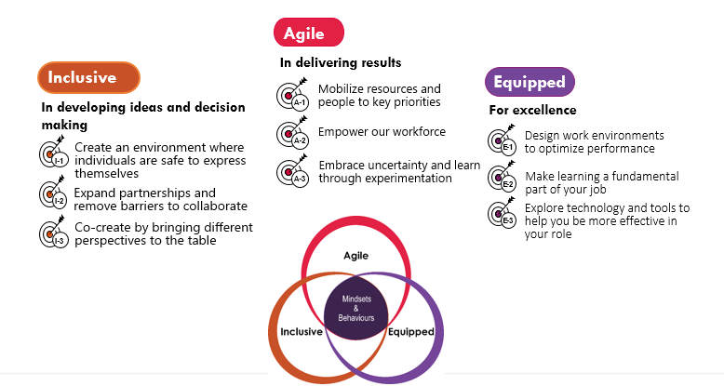
Beyond 2020: The Three Pillars
Beyond2020 is an initiative that strives to work on mindsets and behaviors that build a more agile, better equipped and fundamentally more inclusive public service; to equip public servants with modern tools and structures, improve mental health and well-being, attract and retain top talent and be a diverse and inclusive workforce. Beyond 2020 is led by the Public Service Renewal Secretariat at PCO.
Notes:
ECCC’s created an action plan including 15 initiatives centred on fostering innovation and excellence, to build a more agile, inclusive and equipped workplace that fosters innovation and excellence . Although we cannot go over them all, we highlight a few in the next slide.

Slide 13
ECCC’s Beyond2020 Action Plan 2019-20 to 2021-22 outlined 15 initiatives to build a more agile, inclusive and equipped workplace that fosters innovation and excellence
AGILE | INCLUSIVE | EQUIPPED
Micro-Assignments PACB | Mentorship Program PACB | ECCC101 Department-wide Orientation PACB
ECCCIntrapreneurs PACB | Indigenous Recruitment and Retention Strategy HRB | A Digital Plan for ECCC CSFB
Experimentation in Grants and Contributions CSFB (with PACB) | Accessibility Strategy HRB | Data and Analytics Strategy SPB
 | Diversity, Inclusion and Employment Equity Action Plan HRB | Flexible Work Arrangements, Training and Teleworking HRB
 | Mental Health Strategy HRB | Greening Government Operations CSFB
 |  | Laboratories Canada STB

Slide 14
Innovation and Youth Engagement Division (IYED)
Beyond 2020 & Innovation
IYED coordinates across ECCC to develop our Beyond2020 Action Plan; builds capacity and provides expertise in areas such as behavioural insights and user-centred design; and supports innovation through prize-based challenges, experimentation and events/learning opportunities.
ECCC Youth Champion
Michael Zinck, ADM, Public Affairs and Communications is ECCC’s Youth Champion. Michael amplifies youth voices at ECCC, and supports ECCC’s National Youth Network as well as other relevant events and initiatives across the Department. IYED provides strategic and Secretariat support to the Youth Champion.
Onboarding and ECCC101 Orientation
IYED runs a week-long orientation program, called ECCC101, on a quarterly basis, to welcome and properly equip new employees as they join the department. IYED also leads other activities to welcome students and new employees to ECCC and contribute to a culture of inclusiveness.
Centre of Expertise on Youth
IYED supports youth engagement at ECCC and facilitates engagement with youth organizations, universities, and Indigenous youth
ECCC National Youth Network
IYED leads the ECCC National Youth Network (NYN), which facilitates communications, professional development initiatives, and networking opportunities by connecting and supporting over 1000 students and young employees across the country
Environment and Climate Change Youth Council (ECCYC)
The Minister’s ECCYC will soon be announced, and will include 10 Canadians between the ages of 18-25 who will have meaningful opportunities to engage with government and provide input on the defining environmental issues of our time.
IYED implements Canada’s Youth Policy, leads ECCC’s Youth Engagement Framework, reports to PCO’s Youth Secretariat on youth engagement activities related to our mandate, and provides support to the DG Committee on Youth, led by Canadian Heritage

Slide 15
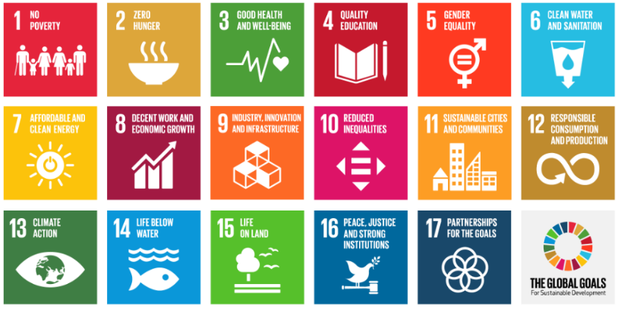
The Draft 2022 to 2026 FSDS
First under a strengthened Federal Sustainable Development Act
Supports the 17 SDGs, with a focus on environmental dimensions
Complements the 2030 Agenda National Strategy and Federal Implementation Plan
Brings together in one place major GOC environmental and sustainable development initiatives such as net zero, adaptation and greening government
Incorporates lessons learned from four previous strategies
Notes:
The FSDS brings together in one place major Government of Canada environmental and sustainable development initiatives such as net zero, adaptation and greening government.
It drives sustainability across government by gathering and highlighting the most prominent targets and actions, and by consulting and mobilizing Canadians on sustainability issues.
The strategy takes a whole-of-government approach to sustainable development, with mandatory contributions from 99 federal organizations.
It also supports Canada’s implementation of the 17 SDGs of the United Nations 2030 Agenda for Sustainable Development, with a focus on their environmental dimensions.
We have also designed the next FSDS to complement work being done by Employment and Social Development Canada, who is responsible for the National Strategy on the 2030 Agenda and its Federal Implementation Plan, to achieve all 17 SDGs.
The frame was informed by past consultation feedback as well as engagement with sustainable development experts, who identified the environmental aspect of sustainable development as a critical aspect of sustainable development in Canada.

Slide 16
Consultations approach
Social Media
Photo contest
Webinars
Targeted outreach
Indigenous organisations
Youth
PlaceSpeak
E-strategy
Promote
Listen
Engage
Notes:
As a part of the Stakeholder Relations, one of the most important parts of our job is to run the public consultations on the FSDS
This means
Informing Canadians about how the Government of Canada is taking action on sustainable development at the federal level;
Generating feedback from internal and external stakeholders to inform the development of the final FSDS;
Improving and broadening the reach of consultations with the Canadian public, including Francophone communities, youth/young adults, Indigenous and Northern peoples, rural populations, women, gender diverse people, and visible minorities; and,
Supporting an ongoing dialogue between the Government of Canada and Canadians to advance progress on sustainable development in Canada.
For the consultation period on the draft 2022-2026 FSDS which ran from March 11 to July 9 2022, we used a handful of methods to reach Canadians, including:
Our social media channels, including Facebook, Twitter, LinkedIn, and Instagram
PlaceSpeak, an online engagement platform to stimulate discussion on sustainable development issues found throughout the strategy; (we will demonstrate PlaceSpeak a little later)
The FSDS E-strategy, where stakeholders can sift and sort through content and directly submit their comments via an online template; (we will also demonstrate that in more detail in a moment)
Hosting thematic public webinars; and,
Hosting a number of bilateral meetings and targeted outreach with key stakeholders.
In addition, we will be hosting a photo contest this year, inviting Canadians from across the country to show us what a sustainable Canada looks like to them.

Slide 17
consultation results
What we heard during the consultations:
Engaging more young people in consultations and decision-making
A clearer definition of equity
Setting longer-term targets
Recognition of Indigenous self-governance and support for Indigenous ownership and leadership
Consider history and culture as a way to integrate Indigenous perspectives
Notes:
Throughout the consultations, we heard from hundreds of Canadians and received numerous submissions.
Some of the key takeaways were:
Highlighting the importance of having youth actively engaged throughout consultations and the decision-making process
We also heard how important it is to define the term “equity”
Setting longer-term targets was identified as essential
As was the recognition for Indigenous self-governance and support for Indigenous ownership and leadership
Finally, people stressed the importance of considering history and culture as a way to integrate Indigenous perspectives.
Working with stakeholders and members of the public is important to the policy process. It helps us ensure the policies we create are reflecting the priorities of Canadians and helps us address the most pressing issues faced by the public.

Slide 18
Thank you for taking the time to join us today.
Our panelists are happy to answer any questions you may have.
Q&A
Notes:
We will now open the floor for a questions, please feel free ask questions in the language of your choice!

