Slide 1


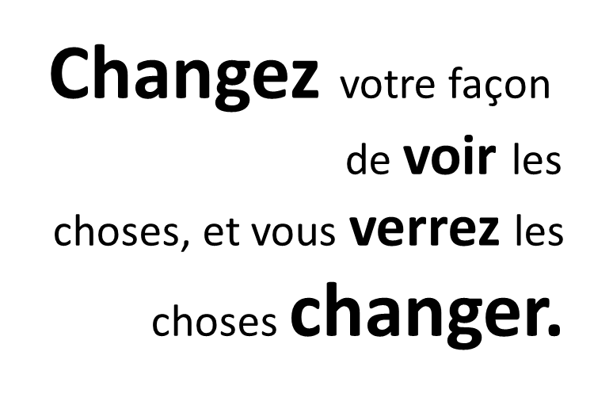
Cover slide

Slide 2

IOCN Blogging workshop
Atelier de blogging RICO
31.05.2021

Slide 3

Agenda Ordre du jour
Leadership kick-off
Mindfulness
Introductions
Celebration
Let’s write
Supports
Our network
Questions and next steps
Coup d'envoi du leadership
Pleine conscience
Introductions
Célébration
Écrivons
Supports
Notre réseau
Questions et prochaines étapes
Notes:
Image source: Sofyabolotinaphotos via CanvaPro.
Why we’re hosting this workshop
What is this network? What’s it designed to do?

Slide 4

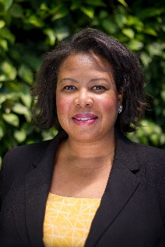
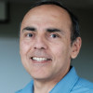
Community of Practice and Interest
  GCconnex: Change Management and Change Leadership
  GCConnex: Mindful Change Leadership
  Gccollab: Government of Canada Organizational Culture and Change (IOCN-RICO CM CoP)
Leadership Team
Alejandro Gonzalez
Stacey Ileleji
Notes:
Before we start, I’d like to introduce you to the Change Management Community of Practice which is managed by the Interdepartmental Organizational Change Network (IOCN). The IOCN Change Management Community of Practice is responsible for today’s session.
While I tell you about the IOCN, why don’t you tell me a bit about yourselves through a quick poll.
WebEx Person: Open poll 1
IOCN has been around for over 20 years. It was started by a handful of employees working in the Organization Development and Change Management and Change Leadership domain.
The IOCN has grown into a thriving community of practice and interest that is open to all public servants.
We have grown more formal over the years and have a seat at the Human Resources Council Communities of Practice Hub. The Human Resources Council is the functional lead for the human resources community.
The IOCN could be considered an enabler for individuals as they journey from knowing about managing change to leading change.
Remember to say “next slide.”
Note to WebEx Person
Watch the attendee response count. When you see no new response after about 20 seconds, and there is time on the time limit, select “Close Poll.” Otherwise, simply wait for the 5 minutes to run out. Once you select “Close Poll,” give it a minute to process and then select “Poll Results.” By selecting “Poll Results,” all participants will be able to see the results. In the chatbox, enter “Thank you for sharing your profiles with us.”

Slide 5

Mindfulness. Pleine conscience.
Notes:
You can use your computer speakers and microphone; OR,
If using your telephone, enter your Conference ID
Please, if you don’t mind, in the chat box…. introduce yourself, put in your:
Department or Agency
Where you’re located
Your expectations for this session
You don’t wait for people to do this, you just ask them and carry on with the session. You may mention the national participation and the multiple departments if you notice diversity coming in.

Slide 6
Introductions. Présentations.
Hello!
Bonjour !
Name and pronouns
Nom et pronoms
Current town.
A town close to your heart.
Ville actuelle.
Une ville proche de votre cœur.
Notes:
Name
Current town + name of any other place where your heart has ties (integrate land acknowledgement)
A question about “change” that inspires you
Did you bring a favourite post? Add it to the chat and I’ll compile a summary

Slide 7
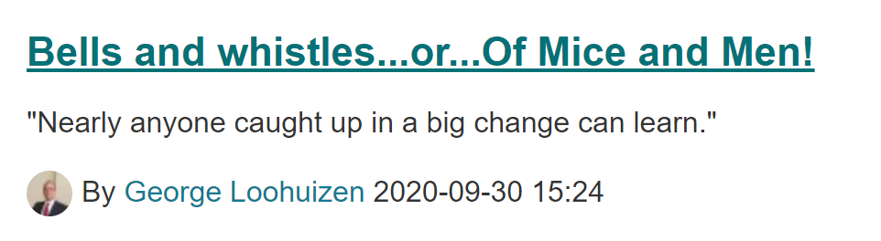
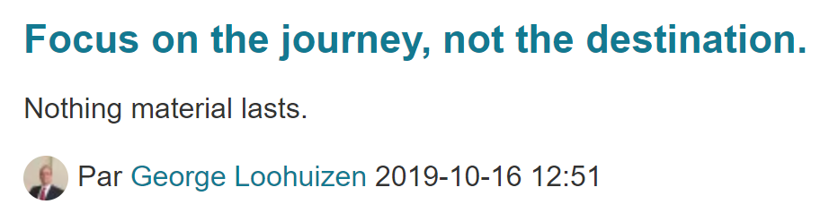
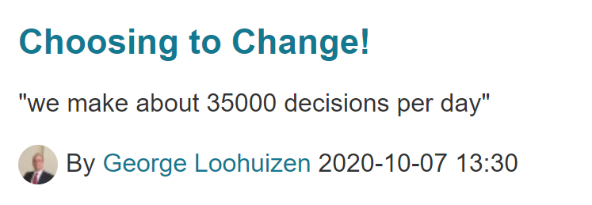
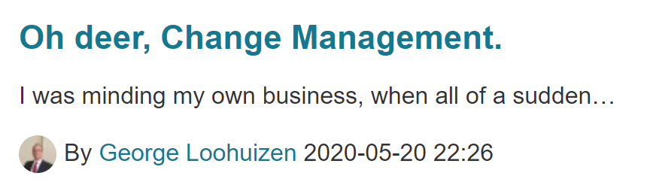
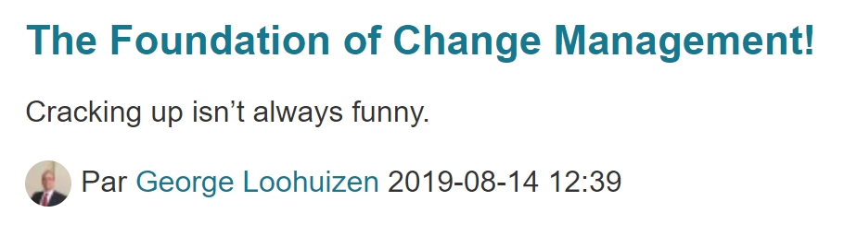
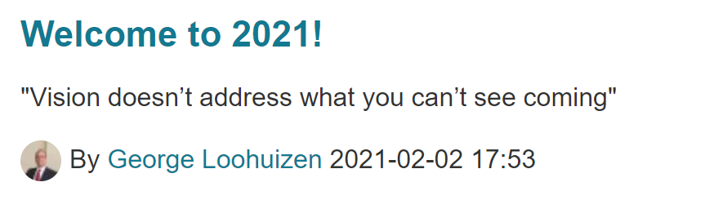
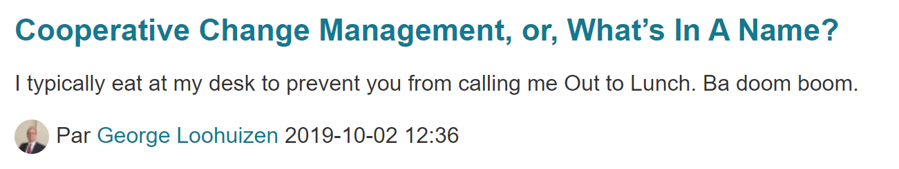
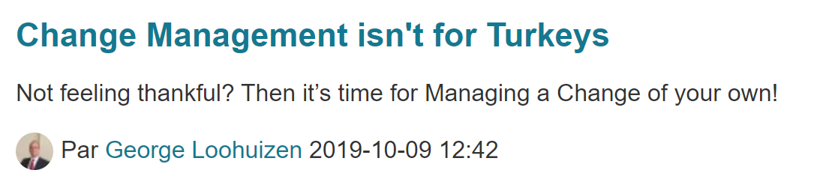
Celebrate George! Célébration de George !
Notes:
Things we learned from George (waterfall chat)

Slide 8
Blogue:
un enregistrement régulier de vos pensées, opinions ou expériences que vous mettez sur Internet pour que d'autres personnes puissent le lire.
Blog:
a regular record of your thoughts,
opinions, or experiences that you put on the internet for other people to read
https://dictionary.cambridge.org/fr/dictionnaire/anglais/blog

Slide 9
Let’s write! Écrivons !
Idea bank
Banque d'idées
Interview or profile a colleague
Tell us about a time when….
  You changed your thinking
  You had a profound experience
  You bounced back after something difficult
  You tried something new
Interview ou profil d'un collègue
Racontez-nous un moment où....
  Vous avez changé votre façon de penser
  Vous avez vécu une expérience profonde
  Vous avez rebondi après un événement difficile
  Vous avez essayé quelque chose de nouveau
Notes:
Let’s create some prompts to help spark ideas. I will collect and share.
Waterfall chat.

Slide 10
Hints and tips
Our colleagues shared some advice…
“Keep learning. Stay sharp and focused.”
“Write about what you know/do.”
“Always right from the heart and check facts.”
“Personal poignant story with positive ending.”
Other ideas?
Trucs et conseils
Nos collègues ont partagé quelques conseils…
« Continuez à apprendre. Restez attentif et concentré. »
« Écrivez sur ce que vous savez ou faites. »
« Toujours dire ce qui vient du cœur et vérifier les faits. »
« Une histoire personnelle poignante avec une fin positive. »
D'autres idées ?
Notes:
Six word stories

Slide 11

Hints and tips…continued
Short posts are good.
How might your post help others?
What action can people take?
Trucs et conseils…suite
Les messages courts sont bons.
Comment votre message pourrait-il aider d'autres personnes ?
Quelle action les gens peuvent-ils entreprendre ?
Notes:
Image: pexels.com – Andrea Piacquadio - https://www.pexels.com/photo/scared-young-ethnic-man-looking-through-hands-on-blue-background-in-studio-3928259/

Slide 12
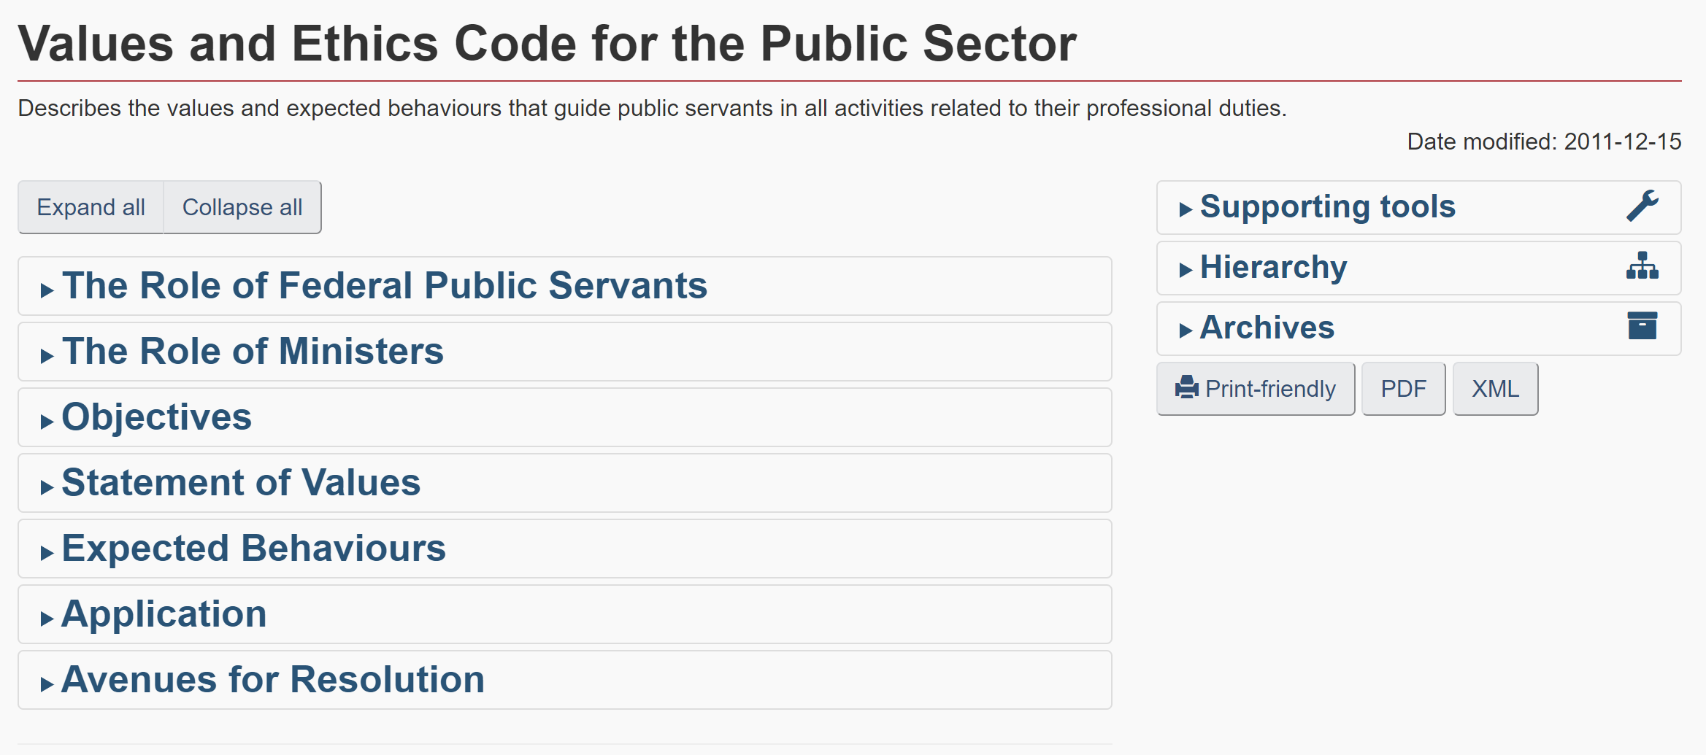
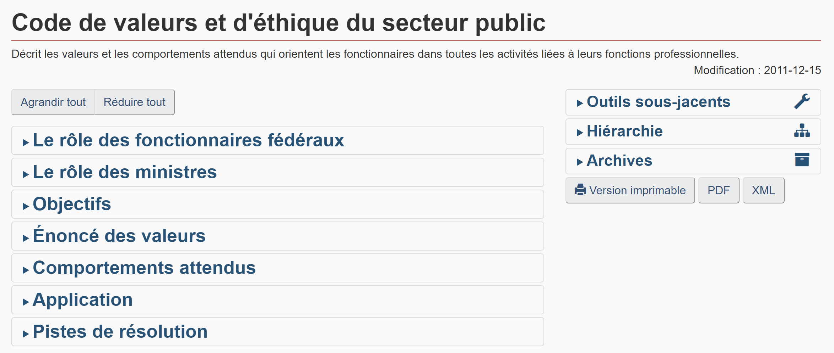
Rules? Regles ?
Notes:
Values and ethics (and we can always reach out proactively)
“Working in the open”

Slide 13
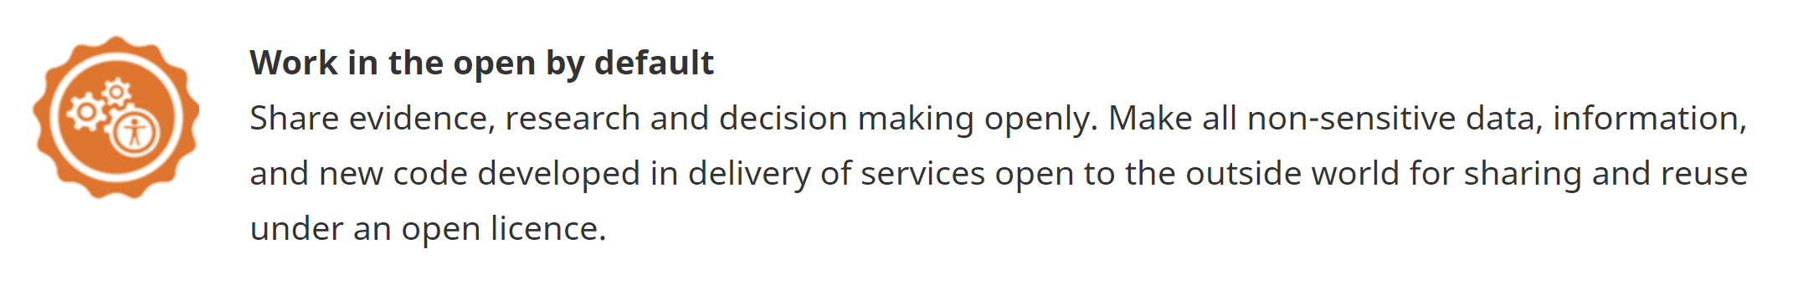
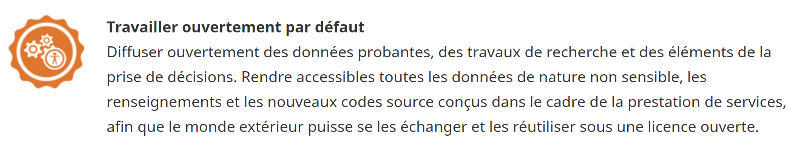

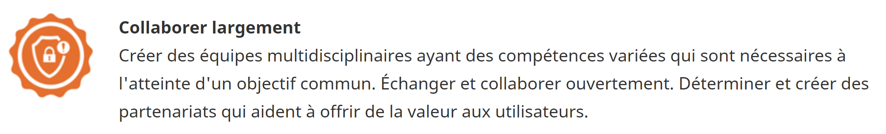
GC Digital Standards Normes numériques

Slide 14
Discussion
Quels types de soutien vous aideraient ?
« Une évaluation par les pairs pour la lisibilité, la fluidité, etc. »
« Échange d'idées »
« Des compliments ! »
« Apprendre des autres en termes de style, d'histoires racontées, d'informations glanées. »
« Le fait même de partager »
« TBC ; je suis nouveau ici. »
...et d'autres supports dont nous n'avons pas encore parlé !
Discussion
What kinds of support would help you?
“Peer review for readability, flow, etc.”
“Exchanging ideas”
“Compliments!”
“Learning from others in terms of style, the stories told, information gleaned.”
“The very fact of sharing”
“TBC; I am new here.”
…and other supports we haven’t discussed yet!
Notes:
I asked previous bloggers for some initial ideas. What else might be helpful?
(Waterfall chat).
My commitment is to take our outcomes and write – drumroll please – a blog with the details.

Slide 15




Our network. Notre reseau.
I’ll share
updates
(monthly)
Notes de
soutien
(mensuelles)
(facultatif)
examen
par les pairs
(Optional)
peer review
44 Wednesdays 2021-22
44 mercredis 2021-22
Recommend:
Hemmingway
App.com
Rédacteur
grammatical
en ligne ???
Notes:
In the chat: Name, and first month where you’d like to write (email me this week)
Goal: 52 Wednesdays + guest posts + some related conversations
How I can help: (a) whole group can help (b) extra set of eyes, (c) translation
Want Team help: a week before. Want SJ help? 3 Business days before.
https://hemingwayapp.com/
Option: Fall writing workshop

Slide 16

Questions?
Des questions ?
Notes:
Questions and next steps

Slide 17

Susan.Johnston@tbs-sct.gc.ca
@JoyCuriosity https://gcconnex.gc.ca/profile/Susan.Johnston1?language=en
Notes:
You can use your computer speakers and microphone; OR,
If using your telephone, enter your Conference ID
Please, if you don’t mind, in the chat box…. introduce yourself, put in your:
Department or Agency
Where you’re located
Your expectations for this session
You don’t wait for people to do this, you just ask them and carry on with the session. You may mention the national participation and the multiple departments if you notice diversity coming in.

Slide 18
Click on the image to learn more on GCconnex. / Cliquez sur l’image pour en savoir plus sur GCconnex.

