Slide 1



DRAFT
Digital Comptrollership Program
Release 2 Discovery Workshops
March 3rd, 2021

Slide 2
Overview
DRAFT
Background
DCP Support Approach
Planning Approach, Scope and Deliverables
Next Steps
Annex

Slide 3
Background

Slide 4
Background
DRAFT
Policy decision was made in 2012 regarding Standard on ERP where SAP became the system of choice for Financial & Materiel Management.
Currently, the GC operates 54 financial systems supported by 5 different platforms: SAP*, Oracle, FreeBalance, CDFS and G/X. Number above includes 18 SAP (ECC) instances or clusters, representing 55 departments and 85% of transactions process every year at the GC level.
SAP clients were notified that the current version of SAP (ECC) maintenance would cease by the end of 2027 with an extension to 2030.
Over the last 12 months, the Financial Management Transformation (FMT) strategy, in partnership with OGDs, was refreshed to better position GC toward its migration to S/4 HANA. The revised strategy was endorsed by the Government of Canada Enterprise Architecture Review Board (GCEARB) in April 2020.

Slide 5
GC Challenges of Migration to S/4HANA
DRAFT
Preliminary assessment indicates that there will not be enough resources (public servants and/or consultants) to deliver 18 projects by 2027, should GC maintain status quo.
Although GC established a centralized group at PSPC, the Integrated Financial Management Systems (IFMS), to manage the SAP (ECC) evolution of a common footprint, the reality is that the 18 instances had been “highly customized” over the last 23 years, which will make the migration to S/4 HANA costly and inefficient.
GC will miss an opportunity to implement common data structure and implement standardized processes (when applicable), should we collectively decide not to implement GCEARB decision.
In addition to migrating to S/4 HANA, OGDs will also be potentially involved in other significant initiatives such as Next-Gen HR to Pay, Electronic Procurement Solution (EPS), Travel modernization, which will integrate with departmental financial systems.

Slide 6





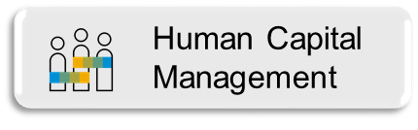


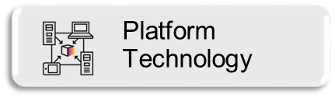
DCP Background and Approach
DRAFT
In 2019 to support the DCP roadmap, the Program conducted a series of collaborative workshops to engage the GC departments over eight key focus areas
The key activities of the engagement were as follows:
Understand GC departments’ pain points, priorities and pre-requisites
Create a heatmap of current state capabilities
Identify gaps and potential opportunities to support the DCP vision
Prioritize the gaps to identify early wins and benefits for the departments
Develop an instance strategy and deployment roadmap
Develop an optimal target solution architecture and development roadmap for the GC Digital Core
Identify program risks, recommend an operational model to position the program for success
Primary focus of GCfm *
Extended areas of focus
To support the DCP Strategy and target architecture, the Program and SAP conducted additional workshops and meetings with key line of business stakeholders.

Slide 7
Coordinated Model and GC Digital Core
DRAFT
On April 9th, 2020, the GC Coordinated model & GC Digital Core template strategy was endorsed by GC Enterprise Architecture Review Board (GCEARB)which included the following components:
Implementation of a “GC Coordinated Model” to enable the GC-wide transition to S/4 HANA and to deliver financial management transformation, utilizing a new operating and governance model.
Implementation of a “GC Digital Core” to support the transformation, which would have functionality built once, and used everywhere. This will accelerate implementations, avoid duplicative costs, and reduce the risk in transition to S/4 HANA.
Maximize technical architecture.
Maximize deployment options / clustering by reducing the number of SAP instances within the GC. This approach should significantly reduce the investments and the on-going operating costs, moving forward.
In summary and in practical terms, the proposed strategy suggests that we:
In partnership with OGDs, standardize approximately 70% of our financial processes (paying a bill is paying a bill…) across the GC and let Departments “localize” 30% to meet their specific needs.
Encourage / enable the “clustering” concept across GC; preliminary assessments suggest going from 18 instances to 11.

Slide 8
DCP System Landscape
DRAFT
It is expected that the existing DFMS landscape will eventually reduce from 54 systems across multiple system platforms to 11 S/4HANA host departments.
Workshop participants will be predominantly from host departments.
TBS/GCfm
DFO
PSPC/SSC
GAC
HC
AAFC
Heritage
DND
CRA/CBSA
ESDC
RCMP
2021-2023
2021
2023
2024
2024
2025
2025
2025
2025
2025
2024
Multi-Tenant DFMS, as service
Single-Tenant DFMS

Slide 9
Digital Comptrollership Program
DRAFT
GC Digital Core Expansion
The Digital Comptrollership Program is planning the second major release of the GC Digital Core so that there is greater functionality available for all onboarding departments.
The second major release will build on top of the SAP Model Company previously delivered, as well as, the GCfm/DFO major release 1. This will provide approximately 733 additional business processes into the GC Digital Core solution.
Release 2 will be a fully configured system that other host clusters can deploy to kick-start their own S/4HANA transitions.

Slide 10
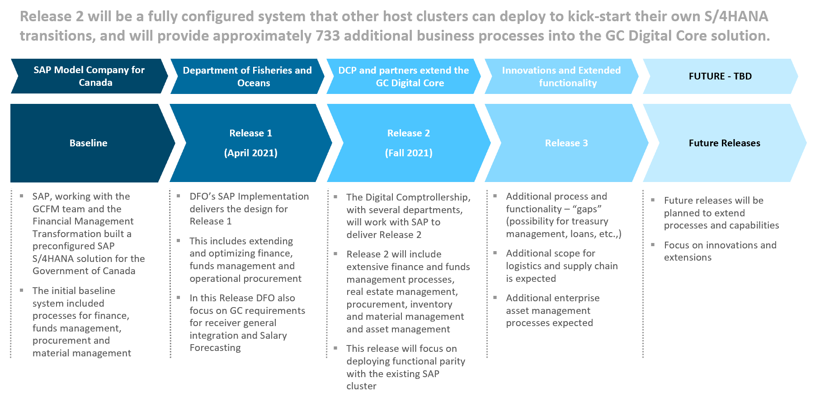
Program Expansion
DRAFT

Slide 11
DCP Support Approach

Slide 12
Business Streams Today
Finance and Budget
DCP BPO SME -Jocelyne Bédard
Procurement
DCP BPO SME - Karina Wieser
DCP BPO SME – Syed Abidi
Human Resources
Analytics
DCP BPO – To be Determined
Real Property
Non-tax Revenue
Asset Management
DCP BPO – Louise Richer
DCP BPO SME– Robin Giggey
DCP BPO – Jacky Fong
SAP BPO Lead
Pablo Sebastian
Supported by SAP counterparts during Program establishment

Slide 13
Business
Process Owner Team
DRAFT
In Release 2 Scope
Streams | Co-Lead​ | DCP SME Lead
Finance and Budget | Monique Arnold, PSPC Sophie Bainbridge, GAC ​ | Jocelyne Bédard Martial Bilodeau Jean Destin
Financial Planning and Analysis​ | Michelle Baron, ISED​ Annie Boyer, GAC
Project and Portfolio Management​ | Johanne Diotte, NRC Dwayne Ross, RCMP​​
Travel and Expense Management​ | Todd Mitton, HC​ Nathalie Proulx, IRCC​
Real Estate Management ​ | Richard Dagenais, PSPC​ Elizabeth Tough, GAC​ | Robin Giggey
Procurement, Materials Management | Karine Paré, ISED Jimmy Fecteau, CBSA ​​ | Karina Wieser Nicole Ross Chloe Hagarty
Non-tax Revenue | Johanne Diotte, NRC​ Pamela Rudiger-Prybylski, DoJ​ | Jacky Fong
Asset Management​ | Davina Brown, PC | Louise Richer
Human Resources | ​ | Syed Abidi
Future Releases - TBD
Grants Management​ | Paula Hadden-Jokiel, ISC ​ | Chantal Périard
Receiver General​ | Jeffrey Lay, PSPC RG Treasury​

Slide 14
Planning Approach, Scope and Deliverables

Slide 15
Background of SAP Approach
DRAFT
The SAP team has been engaged in various capacities with the GC for several years. This has provided a solid background to understand the GC requirements. The SAP team is using the previous engagements/outputs outlined below as input into their work packages to ensure reuse of previous work.
GC wide roadmap exercise completed in 2019
MaxAttention Service outputs from many GoC customers
Design participation and review of Rel 1 (DFO) design

Slide 16
Scope
DRAFT
Functional Scope (to be validated by participants in Discovery Workshops)
Finance and Budget:
  Extension of Release 1 (DFO) where applicable: DFSA, Accounts Receivable, Accounts Payable, Asset Accounting, Financial Close, RG Interface Configuration (as per design, no testing of interface included), Intercompany reconciliation, CO-PA
  Real Estate Management (Master Data, Lease In, Lease Out Accounting, Service Contracts)
  Project Systems (Master Data, Project Templates, Accounting Integration, Define Project, Task, Phases, Decision Flow Management, Financial Planning)
  Public Sector Management (Funds Management)
Procurement:
  Extension of Release 1 (DFO) where applicable
  Requisitioning, Operational Procurement, Core Inventory Management, Basic Warehousing, Direct Materials
Asset Management:
  Corrective, Preventative, Emergency Maintenance and integration to PS, Procurement and RP
Non-Taxable Revenue (Sales):
  Sales and Distribution, Credit Management, Service Sales
Human Resources:
  Extension of Release 1 (DFO) where applicable

Slide 17
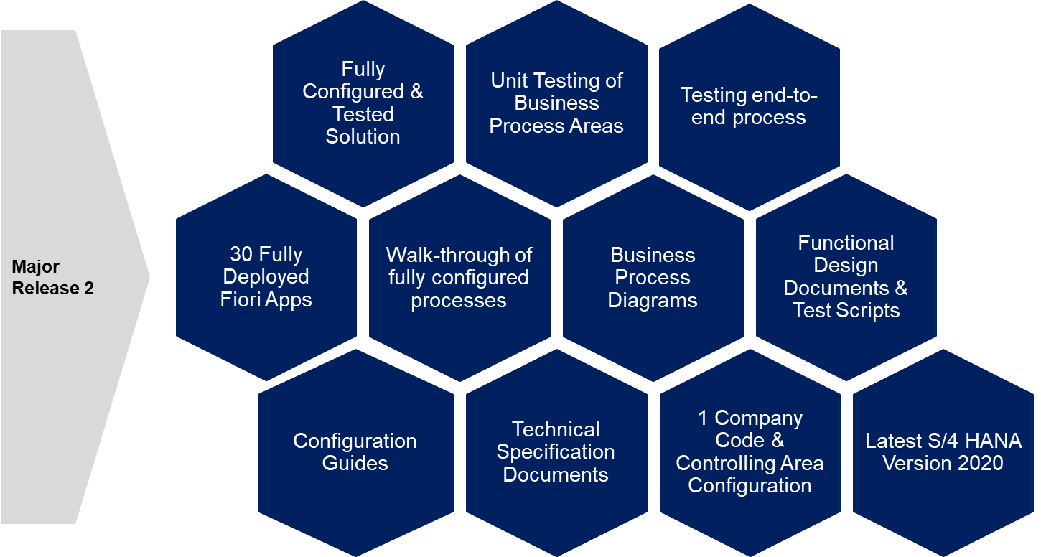
Deliverables
DRAFT

Slide 18
Project Approach and Methodology
DRAFT
Upgrade
Discover
Prepare
Explore
Realize
SAP S/4HANA
Upgrade S/4 1809 FPS 03 to S/4 2020 FPS 01
Current process and Master data Discovery
Template Instance
Fit-to-Standard Workshops
(Future state and best business practice)
Fit/Gap Validation
Review results
Document Deltas
Prioritize and Plan
Design
System Preparation
Configure
Test
Walkthrough

Slide 19
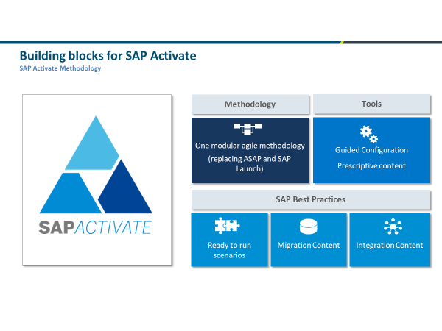
Project Approach and Methodology
DRAFT

Slide 20



DCP Release 2 High Level Approach
DRAFT
Process
SAP – Build and Configure First Iteration
Second Round of Workshops
Fit - Gap
Discovery Analysis
First Round of Workshops
Final SAP Configuration
Demos and Walkthrough
March
April
April - June
July - September
Sept - Dec
January 2022
Expect some follow ups and preparing you for the next round of workshops
Upgrade to S/4 2020
FPS 01
Participating in workshops
2nd round of workshops Fit -Gap
Validation and Approval for business fit
Participate in Demo Workshops
Business Engagement

Slide 21
Workshop Plan
DRAFT
Fiscal year end
P
P
P
P
P
P
Release 2
December 2021
We are here
P
Completed

Slide 22
Pre-Workshop
Questionnaire
DRAFT
Purpose
The questionnaire is required to confirm Release 2 scope
One questionnaire per stream if needed
  Finance and Budget
  Procurement
  Asset Management (no Questionnaire)
  Non-Tax Revenue (Sales)
  Human Resources (no Questionnaire)
  Real Estate
It is the responsibility of each host department subject matter expert/leads to complete, coordinate & submit
Must be completed within three weeks
Once completed and scope confirmed, detailed Discovery Workshop Agenda will be created

Slide 23
High Level Approach:
Step 1
DRAFT
Complete Questionnaire
SAP will provide questionnaires to fill in per line of business as required.
Questionnaires will help the SAP team understand the scope of requirements.
Additional calls can be arranged if needed

Slide 24
High Level Approach:
Step 2
DRAFT
Attend Discovery Workshops
SAP will conduct a series of workshops with the designated Business Subject Matter Experts across each line of business.
As part of the assessment, the SAP team will explore your high-level current processes, discuss the requirements, Master Data and Enterprise Structure

Slide 25
Focus Areas for Discovery Workshop
DRAFT
Focus Areas
Finance and Budget
Real Estate
Not Tax Revenue
Asset Management (no questionnaire)
Human Resources (no questionnaire)
Procurement
Detailed process scope and business process model
Discovery Workshops

Slide 26
Next Steps

Slide 27
Next Steps
DRAFT
Questionnaires will be sent out from the Digital Comptrollership Program no later than March 8th .
Completed questionnaires are due by March 26th.
Updated Discovery Workshop invites will be sent out to block calendars.
Detailed hour by hour agenda’s will be sent out closer to the workshop sessions.

Slide 28
Annex

Slide 29
FM Business Capability Model (BCM)
DRAFT
Finance and Budget
Procurement
Non Taxable Revenue
Human Resources
Asset Management
Materials Management
Supply Chain Management
Analytics and Reporting
Accounting and Financial Close
Supplier Data Management
Customer Data Management
Organisational Management
Asset Master Record
Material Master Record
Business Planning
Business Intelligence
Accounts Payable
Operational Procurement
Revenue Management
Personnel Administration
Asset Operations and Maintenance
Core Inventory Management
Warehouse Management
Planning and Analysis
Accounts Receivable
Sourcing
Order Management
Payroll
Asset Insights
Transportation Management
Operational Reporting
Asset Accounting
Catalog Management
Billing
Talent Management
Environment, Health, and Safety
Yard Logistics
Predictive Analytics
Financial Planning and Analysis
Contract Management
Credit Management
Time and Attendance
Defense Maintenance & Configuration
Defense Supply & Replenishment
Machine Learning Services
Funds Management
Invoice Management
Application Platform
Enterprise Data Warehouse
People Analytics
Defence Operational Readiness
Portfolio and Project Management
Application Platform
Spend Analysis
Delegated Signatories
Manufacturing
Robotic Process Automation
Treasury Management
Bill of Materials
Content, Collaboration and Output Management
Collaborative Networking
Defence Organizational Management
IT Management
Database and Data Management
Travel Expense Management
Production Planning
Interface Management
Application Lifecycle Management
Information Governance
Grants Management
Production Execution
Process Management and Integration
IT Infrastructure Management
Data Quality
Real Estate Management
Quality Management
User Experience
Master Data Management
Salary Forecasting
Security
Access and Identity Management
Data Migration and Replication
Enterprise Risk and Compliance
Note: Some working groups mapped to Level 1, some to Level 2 BCM
Legend
Level 1
Level 2

