Slide 1
Amendments to privacy policies
30-day response or written explanation guarantee
Update to the ATIP Community
June 19, 2018
GCDocs 31465815

Slide 2
Government commitment
Context
Budget 2016: “should a [personal information] request take longer than 30 days to fulfill, the Government will provide a written explanation for the delay to the requester and to the Privacy Commissioner”
Proposed approach informed by consultations with the top 20 request-receiving institutions and with the Office of the Privacy Commissioner.
Would meet the Government’s commitment while balancing the resource concerns of institutions and the Office of the Privacy Commissioner.
Alignment with Priorities
Improving service for Canadians
Increasing transparency
Open Government Action Plan Commitment (deadline June 30, 2018)

Slide 3
Extensions: current practice
Section 15 of the Privacy Act:
Initial 30-day timeline for personal information requests
Further 30-day extension permitted on certain grounds
Must notify requester of the extension and right to complain
65,713
personal information requests closed by federal institutions in 2016-17
18,189
requests exceeded the initial 30-day timeline
5,248
extensions claimed.* 86% cited “unreasonable interference with operations” (15(a)(i))
* Institutions failed to give notice of an extension in 12,941 cases.

Slide 4
Approach
Directive on Personal Information Requests and Correction of Personal Information
4.2 Heads of government institutions or their delegates are responsible for:
…
4.2.7 Providing a written explanation to the requester when a request for access to personal information takes more than 30 days to fulfil;
4.2.8 Reporting on the number of, and reasons for, extensions in the institution’s annual report to Parliament.
4

Slide 5
New reporting requirements
Reasons for extensions
Number of Requests Where an Extension Was Taken | 15a)(i) Unreasonable Interference with Operations |  |  |  | 15a)(ii) Consultations |  |  | 15b) Translation or conversion
 | Further review required | Large volume of pages | Large volume of requests | Documents are difficult to obtain | Cabinet Confidence (Section 70) | External | Internal
Total | 0 | 0 | 0 | 0 | 0 | 0 | 0 | 0

Slide 6
Model written explanations
Provided as a resource
May be adapted as required
Intended to provide requesters with a plain-language explanation for the delay
Does not change legislative requirements
Example:
We will require additional time beyond the initial 30 days specified in the Privacy Act to respond to your request because we need to consult with external organizations such as provincial or territorial governments.

Slide 7
Next Steps
Implementation
Effective date
GCPedia for departments/agencies
GCWiki for Crown corporations and others
Email: ippd-dpiprp@tbs-sct.gc.ca
Proposed to take effect October 1, 2018
Institutions are encouraged to change their business process to begin providing a written explanation for extensions to the requester in advance of October 1, 2018

Slide 8
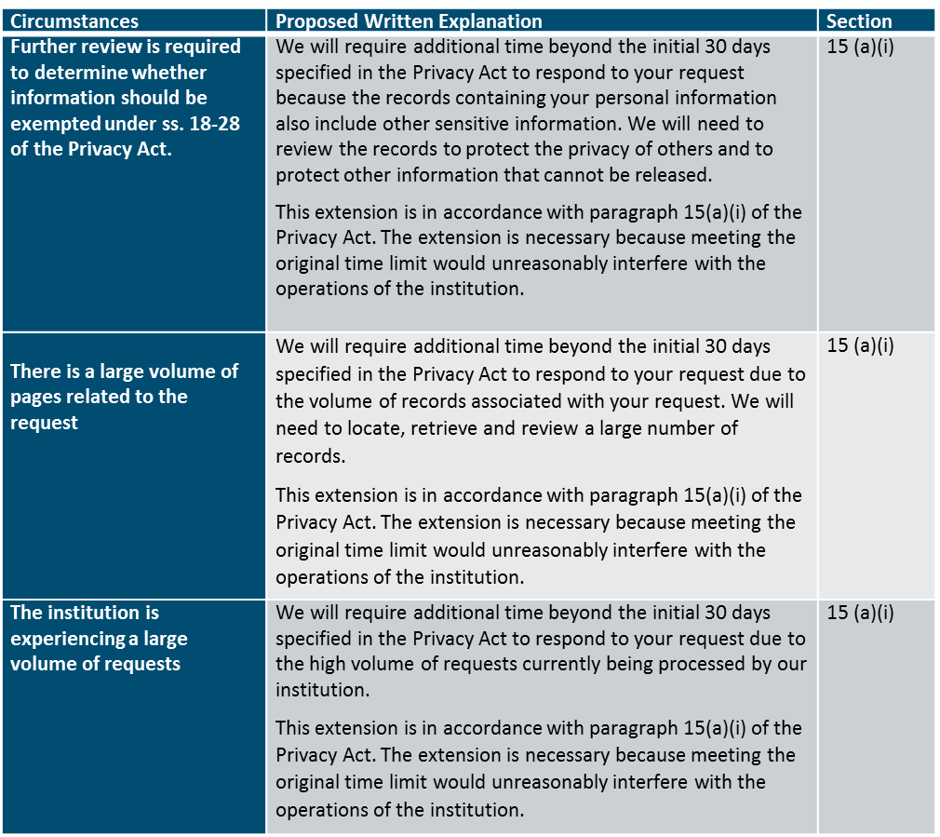
Annex: Model Written Explanations

Slide 9
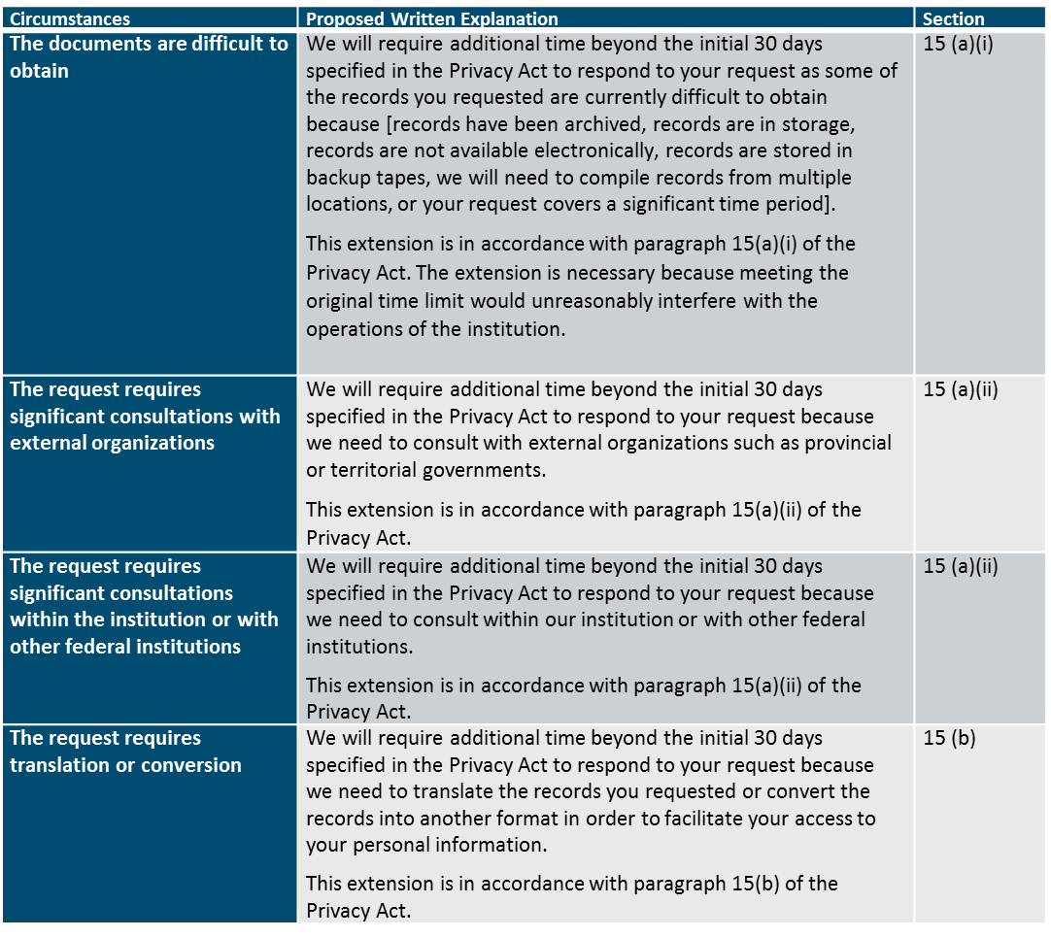
Annex: Model Written Explanations (continued)

