Slide 1
HR Talent Bank: Skill Finder Tool
A proof-of-concept on automating the detection of skills​
Collaboration between Data Science Division and Equity, Talent Development and Workforce Strategy Division

Slide 2
Talent Bank Overview
A Career Mobility Tool designed for StatCan employees to communicate their skills and learning interests for career growth opportunities like mentorship, assignments, micro-missions and growth-gigs. ​
Hiring managers looking to staff a position with interested candidates that meet their search criteria can use the Talent Bank inventory.

Slide 3
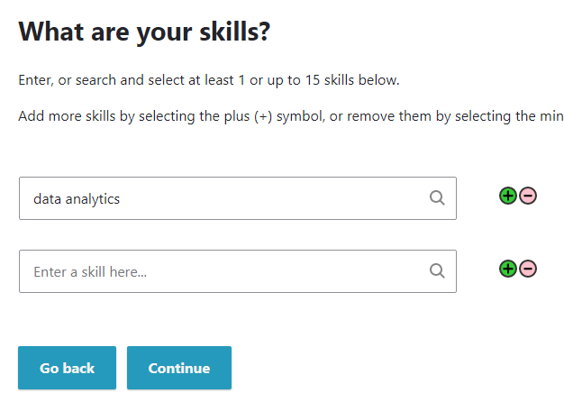
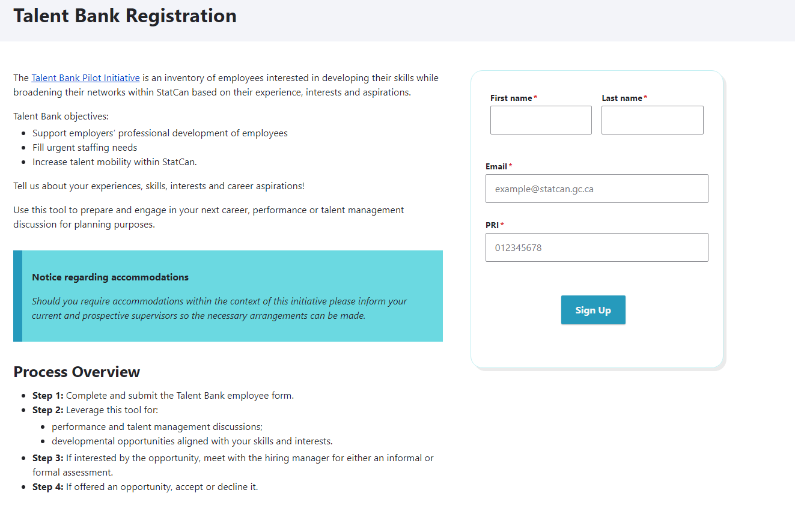
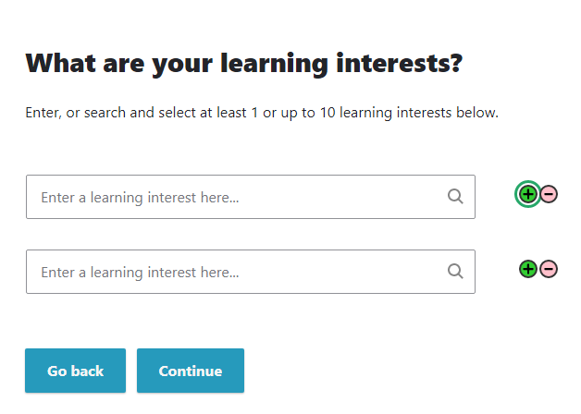
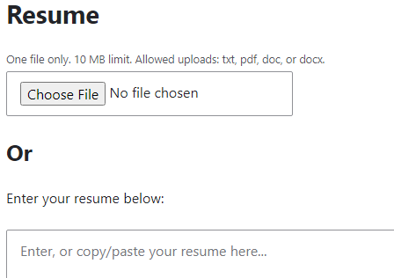
Talent Bank Form

Slide 4
Skill Finder Tool
The Skill Finder Tool enables the search for candidates with a simple keyword and dropdown menu search that filters candidates on their self-reported skills in the Talent Bank, and unstructured information in their CVs.

Slide 5
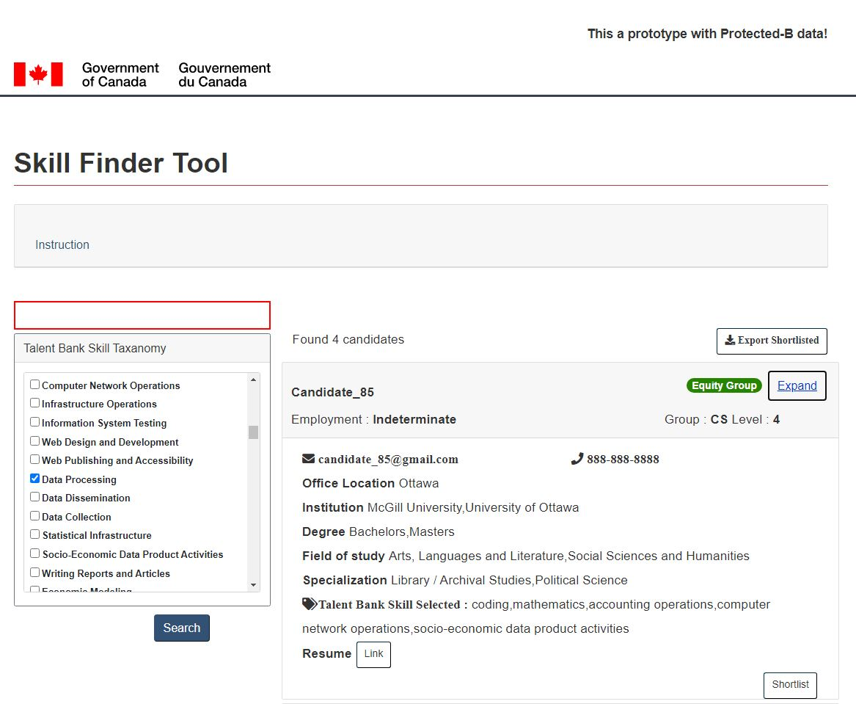
Current Skills Finder Tool Prototype
1. Search box to type in single or multiple keywords
6. Export shortlisted candidates
3. Search Results showcasing details captured in Talent Bank
2. Checkboxes to use skill taxonomy from the Talent Bank as search a filter
4. Link to view full resume where they reside
5. Shortlist matched candidates

Slide 6
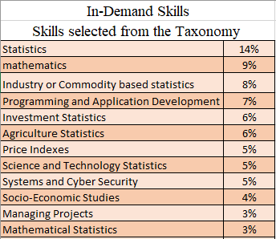
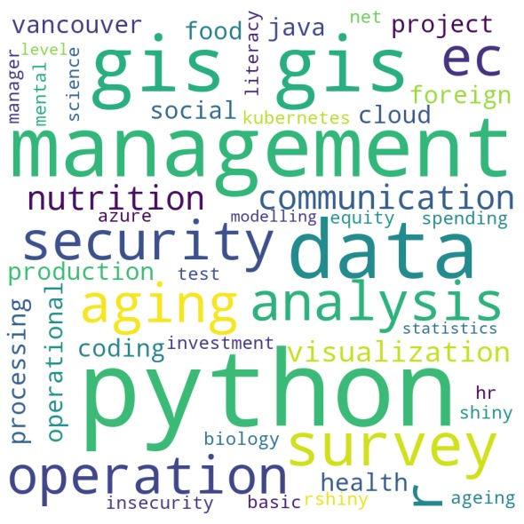
Quest for the Skills Gap
The Talent Bank Form captures in-supply skills. The more participation by employees, the clearer the picture of the workforce skills and learning interests.
The Skills Finder Tool logs what managers "search", capturing in-demand skills.
This allows an organization to measure the operational needs, align planning and activities and share with employees to support career development.
* Data captured during testing with managers

Slide 7
Questions and Comments
Equity, Talent Development and Workforce Strategy Division - ETDWSD
Imagery Analytics and Applied AI - DScD
Jean Le Moullec: jean.lemoullec@statcan.gc.ca
Ekramul Hoque: ekram.hoque@statcan.gc.ca
Michaël Bélanger-Duchesne:
michael.belanger-duchesne@statcan.gc.ca
Olivia Lamarre: Olivia.Lamarre3@statcan.gc.ca
Yousef Ali Linares: YousefAli.Linares@statcan.gc.ca
Alexandria Sacca: alexandria.sacca@statcan.gc.ca

