Slide 1
Building Modern Digital Services

Slide 2
CIO vs. CDO
CIO = IM, IT, Data, Cyber Security
CDO = IM, IT, Data, Cyber Security
+ Digital Service!

Slide 3
This is the Digital way…
The thing lives here!
Manage the thing!
Requires
Requires
Requires
Requires
Requires
Requires
Requires
Outcomes
Based Investments
Milestone Governance
Product Management
User Centric
Design
Agile Development
DevSecOps
Continuous Integration / Deployment
Cloud Automation
Enables
Enables
Enables
Enables
Enables
Enables
Enables
Do the thing!

Slide 4
Outcomes Based Investments

Slide 5
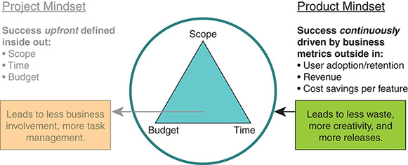
Project vs Product Mindset

Slide 6
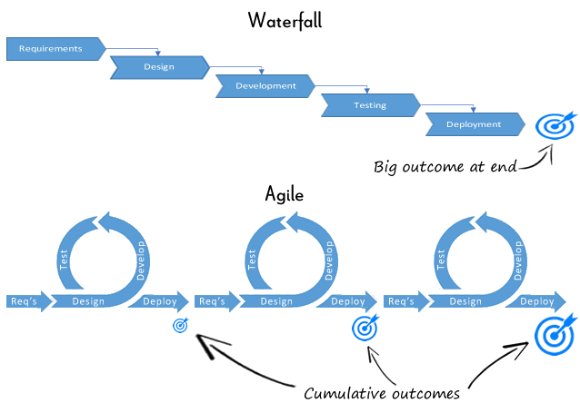
Agile vs. Waterfall

Slide 7
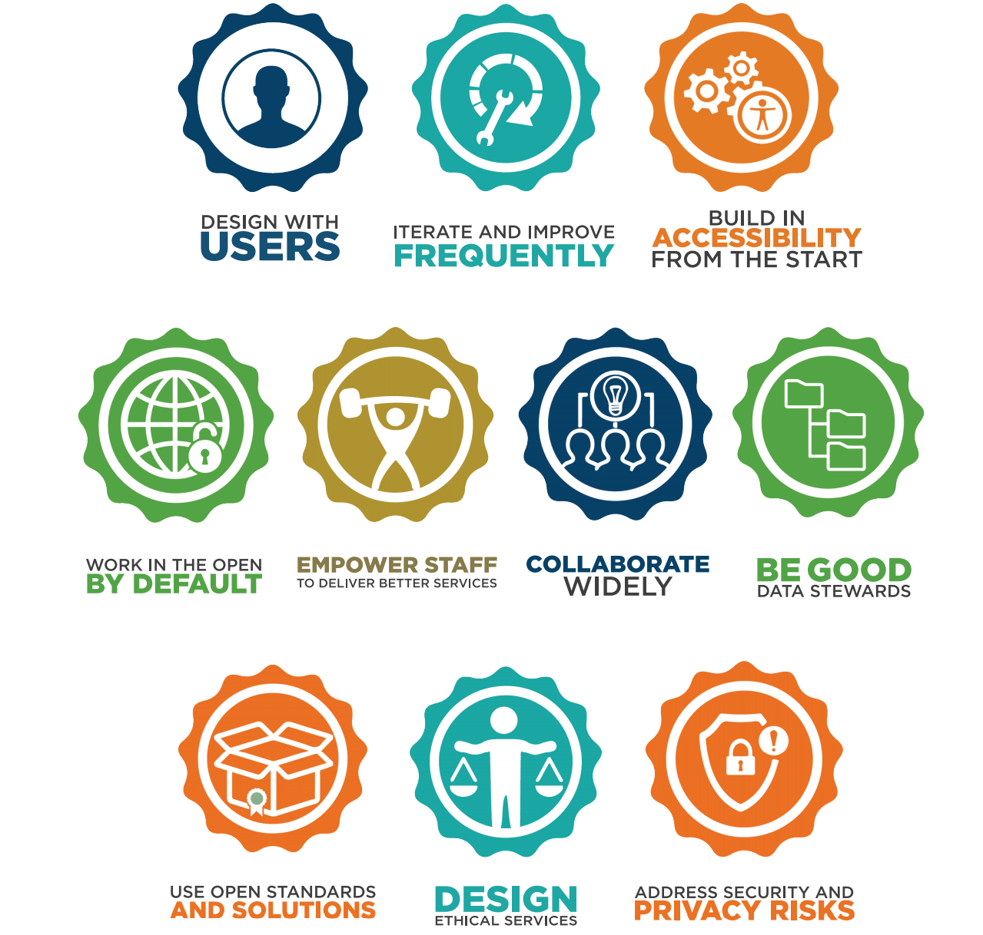
The Government of Canada Digital Standards
Notes:
These form the foundation of the government's shift to becoming more agile, open, and user-focused.

Slide 8
The Ultimate User Experience…
You knock on the door, they open the door, they let you in. Great. That’s not a big deal. You’re not going to tell every friend about it. You might say, ‘I used Airbnb. It worked.’
A 10-star check in would be The Beatles check in. In 1964. I’d get off the plane and there’d be 5,000 high school kids cheering my name with cars welcoming me to the country. I’d get to the front yard of your house and there’d be a press conference for me, and it would be just an unbelievable experience.
You knock on the door. The host opens. Get in. ‘Welcome. Here’s my full kitchen. I know you like surfing. There’s a surfboard waiting for you. I’ve booked lessons for you. It’s going to be an amazing experience. By the way here’s my car. You can use my car. And I also want to surprise you. There’s this best restaurant in the city of San Francisco. I got you a table there.’ And you’re like, ‘Whoa. This is way beyond.’
I would show up at the airport and you’d be there with Elon Musk and you’re saying: ‘You’re going to space!’
You knock on the door, the host opens and shows you around. On the table would be a welcome gift. It would be a bottle of wine, maybe some candy. You’d open the fridge. There’s water. You go to the bathroom, there’s toiletries. The whole thing is great. That’s a 6-star experience. You’d say, ‘Wow I love this more than a hotel. I’m definitely going to use Airbnb again. It worked. Better than I expected.’

Slide 9
Lessons from the 11-star experience
Lesson #1 – Pay passionate attention to your user
Lesson #2 – Design an 11-star experience
Lesson #3 – Create a magical experience… and then figure out what part of that magical experience can scale
Lesson #4 – Take advantage of the time before you scale
Notes:
Lesson #1 – Pay passionate attention to your user
The roadmap often exists in the minds of the users you’re designing things for.
Lesson #2 – Design an 11-star experience
Ask: “What can we do to surprise you? What can we do, not to make this better, but to make you tell everyone about it?:
There’s some sweet spot between “They showed up and they opened the door” and “I went to space.” That’s the sweet spot. You have to design the extreme to come backwards.
Lesson #3 – Create a magical experience… and then figure out what part of that magical experience can scale
“We are are confident on an unscalable basis that we know how to create a trip that deeply moved somebody – that was better than anything they’ve ever experience. The question is: Can we develop a technology that scales and do it 100 million times?”
Lesson #4 – Take advantage of the time before you scale
Your product changes less the bigger you get because there’s more customers, more blowback, more systems, more legacy.
The most innovative leaps you’ll ever make are going to be when you’re really, really small.

Slide 10
What this means for us?
Key Client Interactions push us to think about service design from the client experience lens, pushing us out of our comfort zones of how best towards our activity based delivering services today.
Sign-in Canada
MyGC Service Centre
1. Account Registration / Enrollment
2. Authentication / Entitlement
3. Application / Form
4. Decision
5. Issuance
(Final Output)
3. Application / Form
3. Application / Form
3. Application / Form
3. Application / Form
6. Issue Resolution and Feedback
3. Application / Form
3. Application / Form
3. Application / Form
7. API Integration

Slide 11
Calls to action
Do things differently
Add outcomes as the primary focus of investments
Take a Product Management approach
Use Agile development
Put the User at the centre of everything
Pay passionate attention to your Users
Design an 11-star experience
Figure out what can scale
Take risks while you’re still small
Think outside the box
Develop systems that are interoperable
Hide complexity from your users

Slide 12
Thank You!
Marc Brouillard
Chief Digital Officer, DFO
Marc.Brouillard@dfo-mpo.gc.ca
@MarcBrouillard

