Slide 1
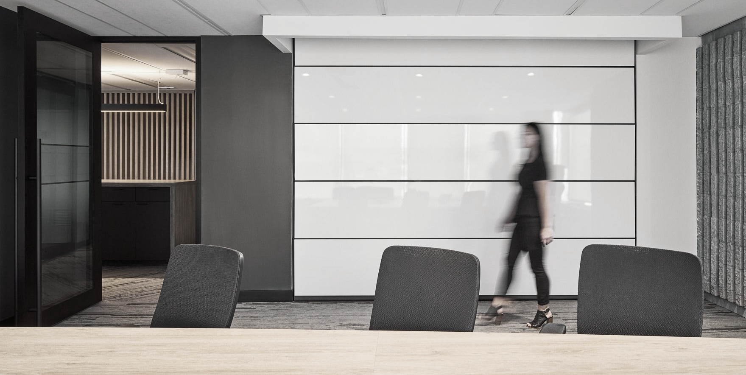
FEDERAL WORKPLACE MODERNIZATION
Flexibility for a Hybrid Future
May 2022

Slide 2
Current Context For Most Employees…
Workplace Transformation Program
MARCH
2020
… 2020
2022…
Work = Workplace
Static & Standard
Individual
Social facetime
Work = Home
Work/Life Balance
Virtual & Digital
Efficient
Work = Hybrid*
Best of both!
Empowering
Flexible & Mobile
:
FOR MANY
EMPLOYEES
Although the sudden pivot from the ‘office-first’ model to working from home almost excluvively has proven benficial for most in many ways, it hasn’t been without its challenges. Allowing for flexibility in work location going forward will empower employees and teams to retain the benefits of what each work setting has to offer, while allowing for varying personal needs and preferences.
*HYBRID WORK: Each organization defines their own hybrid model that will allow employees to work from various locations and work settings in support of flexibility.
GCworkplace and GCcoworking provides workplace solutions to support all hybrid work models.

Slide 3
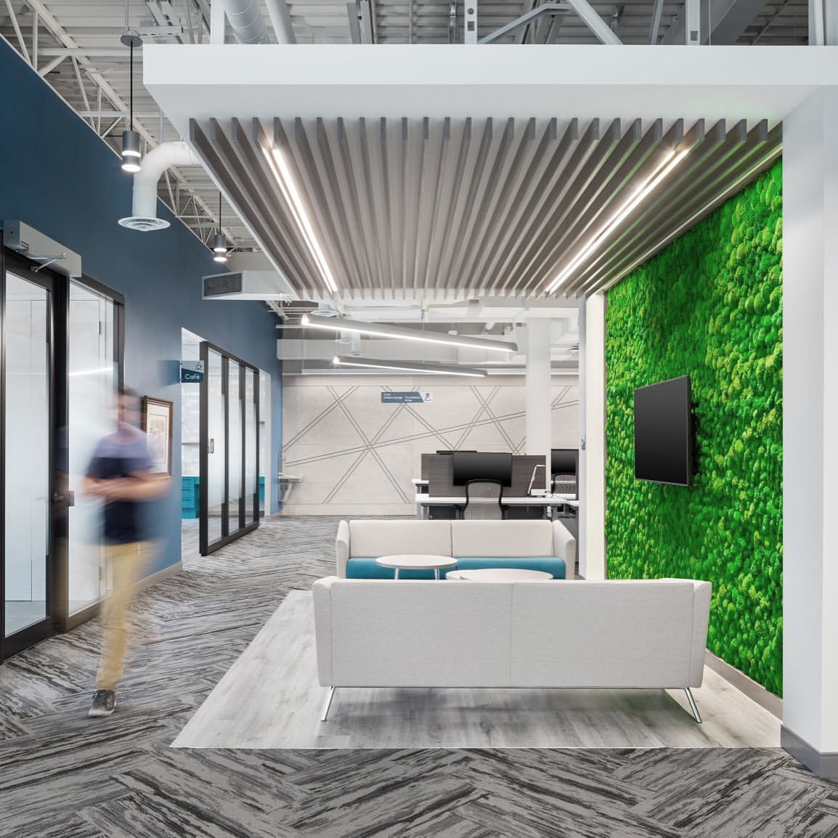
Defining Your Return to the Workplace Strategy
What do our employees want?
What will be supported in terms of flexibility going forward?
How does the return strategy support the long-term vision for our workplace?
How can we best support employees NOW in with what we CURRENTLY have?

Slide 4
Current Context Return to the Workplace
MODERN, FLEXIBLE
“The Treasury Board of Canada Secretariat continues to support deputies in their transition to hybrid work models, where applicable and operationally feasible.”
THE FUTURE IS FLEXIBLE!
TELEWORK NOT SUPPORTED
FULL FLEXIBILITY & HYBRID WORK*
- The Honourable Mona Fortier, February 28, 2022 LINK TO FULL STATEMENT
HOW IT’S ALWAYS BEEN
YOU ARE HERE
TRADITIONAL, STATIC OFFICE SPACE
*HYBRID WORK is a flexible work model that provides a spectrum of work locations and arrangements, typically a balance between home and the office, or any other location such as a GCcoworking site. GCworkplace and the Workplace Transformation Program provide an accelerated workplace solution to support various hybrid work models.

Slide 5
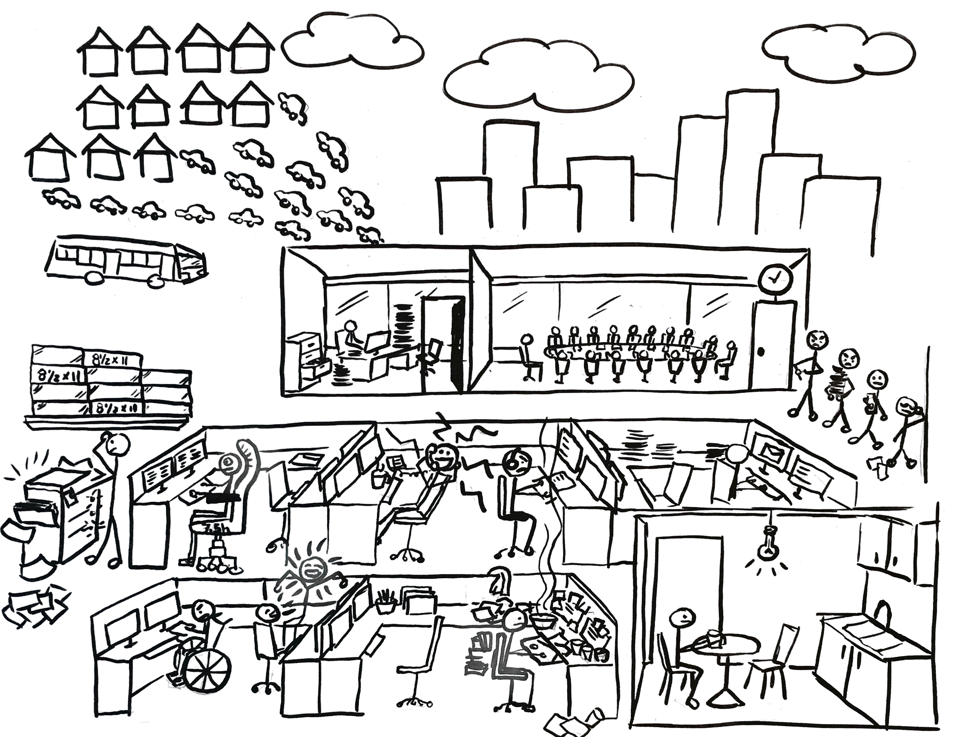
PREVIOUS WORKPLACE STANDARDS
INDIVIDUAL ● STANDARDIZED ● HIERARCHICAL ● STATIC

Slide 6
Traditional Office Space Utilization
INDIVIDUAL
COLLABORATIVE
:
Average
40% vacancy
Results of studies done at
various times with
various methodologies are surprisingly consistent
(for both private and public sectors)
on any given day,
at any given time

Slide 7
GCWORKPLACE
FLEXIBLE ● INCLUSIVE ● MOBILE ● EMPOWERING

Slide 8
GCworkplace Utilization
INDIVIDUAL
COLLABORATIVE
Unassigned utilization OPTIMIZES the workplace by regaining underutilized space to offer more meaningful amenities to employees
(eliminates the “swiss cheese effect” of traditional assigned office space)

Slide 9
What Matters to Employees
45%
of employees have expressed the desire to
work from home full time post-pandemic.
are hoping to come in 1-3 days a week.
prefer to return to the office full time.*
“The Treasury Board of Canada Secretariat continues to support deputies in their transition to hybrid work models, where applicable and operationally feasible.”
44%
8%
- The Honourable Mona Fortier
February 28, 2022
LINK TO FULL STATEMENT
*Results from PSPC IWA (4% no response). Similar results have emerged from Gartner, PricewaterhouseCoopers, Deloitte, and OGDs

Slide 10
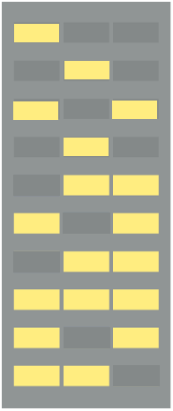
The Space Conundrum
EXAMPLE:
10 floors @ 1400m2 each
Traditional, Assigned Office
1000 employees served
Modernized, Unassigned Office
1000 employees served
10
10
10
9
9
9
45%
of employees have expressed the desire to work from home full time post-pandemic
44%
hoping to come in part-time;
8%
want to work full time in the office and 3% are undecided.**
8
8
8
7
7
7
6
6
6
5
5
5
4
4
40% underutilization in any given federal workplace, at any given time, on any given day. (vacation, sick days, off-site work/meetings, etc.)*
4
3
3
3
2
2
2
1
1
1
* Consistent results: 2017 PSPC study; 2020 Urban Logic Study on cell phone pings from 2019; and 2020 study by DND , Departmental Pulse Surveys
** Tableaux de bord des clients en date du 30 septembre 2021 – Clientèle cible
Notes:
Varies by region

Slide 11
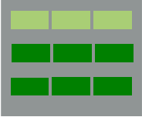
The Swiss Cheese Effect
Traditional
Assigned
Pre-Pandemic
Modernized
Unassigned
Post-Pandemic
GCcoworking
GCworkplace
Vacant/surplus
Available to clients to consolidate from elsewhere
Building A
Building B
Building C
Building A
Building B
Building C
Opportunity for mixed use and Affordable housing

Slide 12
Impacts of Mobility
``
INDIVIDUAL
COLLABORATIVE
Assigned seating
Traditional Workplace (1200m2):
85 FTEs ACCOMMODATED (85 WORKSTATIONS/OFFICES)
- remote work further increases workplace vacancy rates -
INDIVIDUAL
COLLABORATIVE
AUTONOMOUS PROFILE
INDIVIDUAL
COLLABORATIVE
Shared seating
BALANCED
PROFILE
GCworkplace (1200m2)
100 FTEs ACCOMMODATED (no remote work factor)
or
120 FTEs ACCOMMODATED with LOW remote work
150 FTEs ACCOMMODATED with MED. remote work
180 FTEs ACCOMMODATED with HIGH remote work
INDIVIDUAL
COLLABORATIVE
INTERACTIVE
PROFILE
Notes:
GCworkplace & ACTIVITY BASED WORKING
This workplace solution is about allowing occupants to untether from a fixed point and choose the optimal setting for their work activities throughout the day. It provides far greater flexibility in where and how an employee chooses to work – and in doing so, promotes collaboration, productivity and efficiency. A flexible workplace provides the infrastructure to allow occupants to move fluidly from one activity to another
The GCworkplace Activity Profiles provide three models for workpoint distributions based on different interaction profiles between employees: The Autonomous, Balanced and Interactive Profile. These profiles demonstrate how the GCworkplace design concept can be adapted to different work environment based on the types of activities, typical duration and frequency, patterns of interaction within and among teams, workstyles and overall functional and technical requirements. The GCworkplace Activity Profiles also take into account varying levels of mobility, both internally and externally.
Workpoint Distribution
Workpoint type quantities can be adjusted – within pre-determined limits to preserve the overall workplace functionality – to reflect each organization’s needs

Slide 13
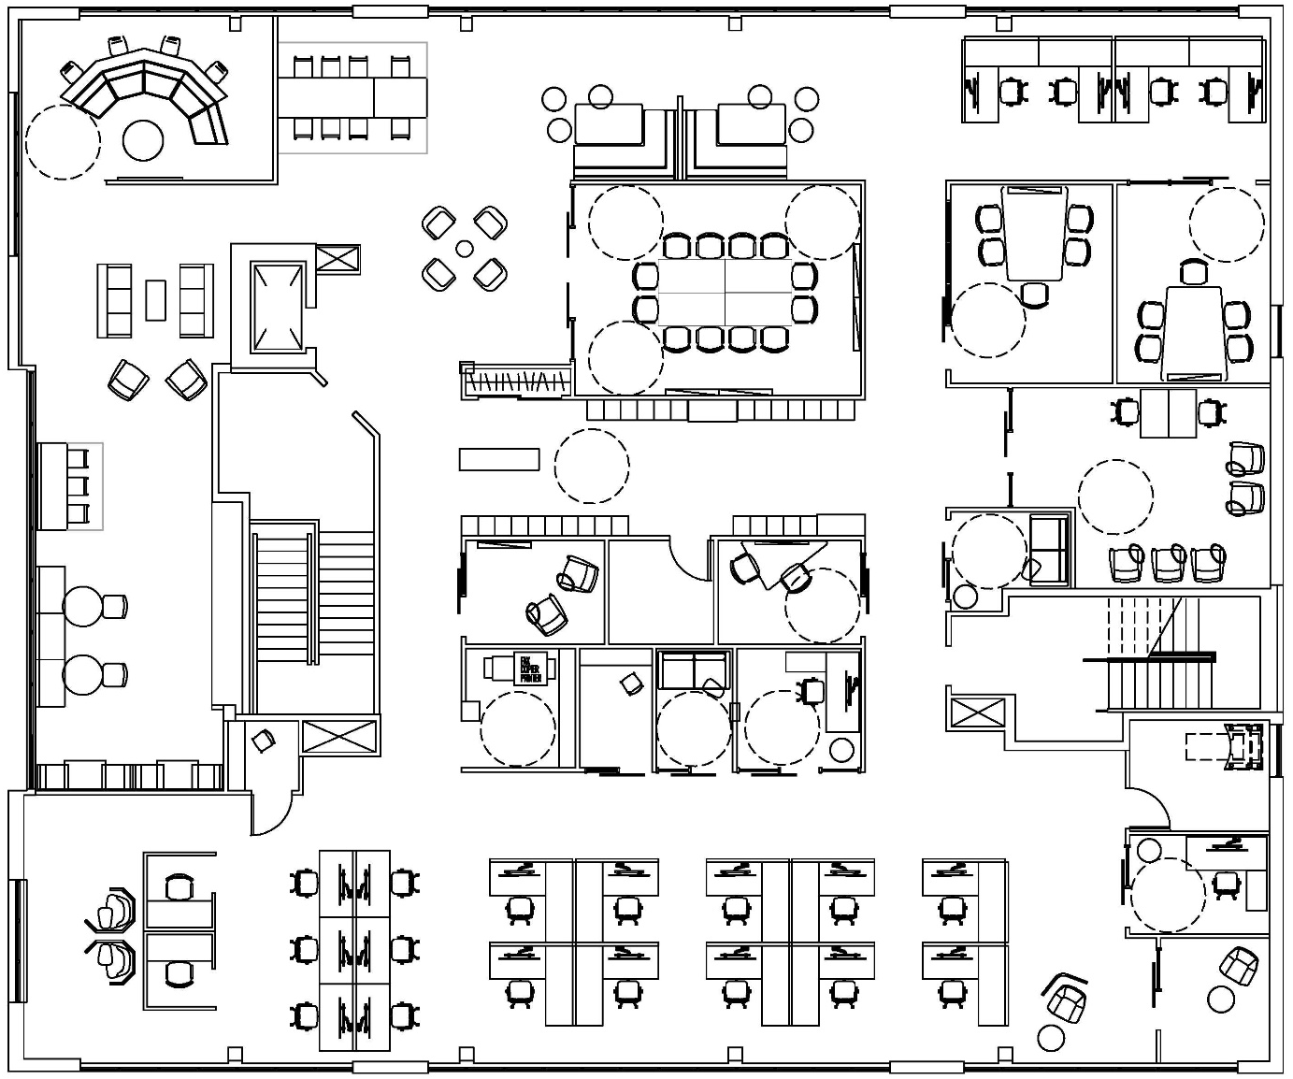
The Workplace in Relation to Hybrid Working
WORKSTATION
WORKPOINT
OCCUPANTS
POPULATION

Slide 14
Modernization & Hybrid Working in the Public Sector
Optimizing use of facilities
Assessing hybrid's impact on local community services and commuting infrastructure
Consolidating and optimizing government’s estate: In FY18/19 30% reduction compared to 2010
Supporting productivity through people-centred workplace services
Embracing data and evidence-based decision-making, technology and flexible workforce models
Facilitating flexible and remote working and increasing mobility and agility
HAVE ANNOUNCED THE DECISION TO ADOPT A HYBRID WORKING MODEL:
City of Ottawa Government of Manitoba Gouvernement du Québec Government of British Columbia
Notes:
USA:
Optimizing use of facilities
Assessing hybrid's impact on local community services and commuting infrastructure throughout the work week
Scheduling organizational use of the space
GB:
Consolidating and optimizing government’s estate: In FY18/19 30% reduction compared to 2010
Supporting productivity through people-centred workplace services
Contributing to net-zero CO₂ through retrofit and space reduction
Value for money to taxpayers
Australia:
Embracing data and evidence-based decision-making, technology and flexible workforce models
Facilitating flexible and remote working and increasing mobility and agility
Canada:
Federal Public Service has not taken a formal position on future working arrangements
People-centric federal workplace ecosystem
Contributing to net-zero CO₂
Fit-for-purpose office portfolio

Slide 15
Modernization & Hybrid Working in the Private Sector
70%
of companies plan to implement a hybrid work solution, blending on-site and remote work.
Major employers are adopting remote working first or hybrid working across multiple economic sectors.
Source: HOK RTO Survey, June 2021 of 37 companies in various industries across NAM.
Notes:
USA:
Optimizing use of facilities
Assessing hybrid's impact on local community services and commuting infrastructure throughout the work week
Scheduling organizational use of the space
GB:
Consolidating and optimizing government’s estate: In FY18/19 30% reduction compared to 2010
Supporting productivity through people-centred workplace services
Contributing to net-zero CO₂ through retrofit and space reduction
Value for money to taxpayers
Australia:
Embracing data and evidence-based decision-making, technology and flexible workforce models
Facilitating flexible and remote working and increasing mobility and agility
Canada:
Federal Public Service has not taken a formal position on future working arrangements
People-centric federal workplace ecosystem
Contributing to net-zero CO₂
Fit-for-purpose office portfolio

Slide 16
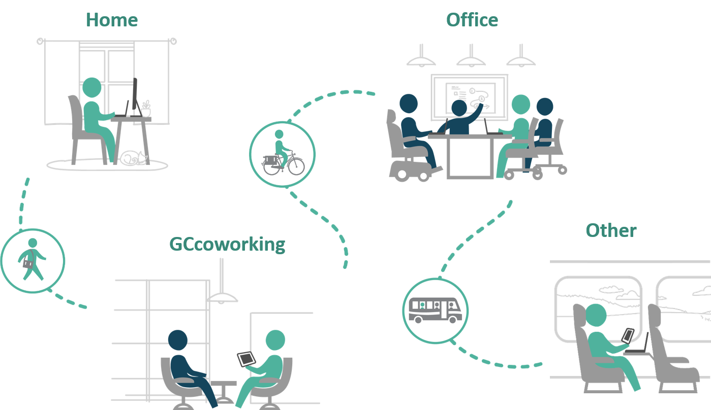
Hybrid Working: An Ecosystem of Workspaces
Notes:
Hybrid working reflects the principle that both organizations and employees have options that include remote working from any location as well as working from a physical workplace environment.

Slide 17
shared workspace accessed by employees from multiple departments
alternative to WFH or primary workplace
Supports GCworkplace
Vision
Supports mobility & flexibility
Supports work-life balance
Provides access to tech enabled space
Supports collaboration & co-creation
Reduces commute times & GHG emissions
Notes:
Shared workplace where GC employees from multiple departments may work as an alternative to their homes or to their usual central workplace locations, or as a touchdown point between meetings.
Accessible workplaces that meet the security, workplace safety, ergonomic and connectivity needs of GC employees.
Leveraging the OneGC model to go beyond shared space and act as a driver for shared ideas, reducing silos and supporting the flexible workplace of the future.
*under a budget ask

Slide 18
Hybrid Working: An Ecosystem of Workspaces
Notes:
Hybrid working reflects the principle that both organizations and employees have options that include remote working from any location as well as working from a physical workplace environment.

Slide 19
USER-CENTRIC DESIGN
PROMOTES EQUAL ACCESS
DESIGNED FOR ACTIVITIES
ZONED BY FUNCTION
SUPPORTS FLEXIBILITY

Slide 20
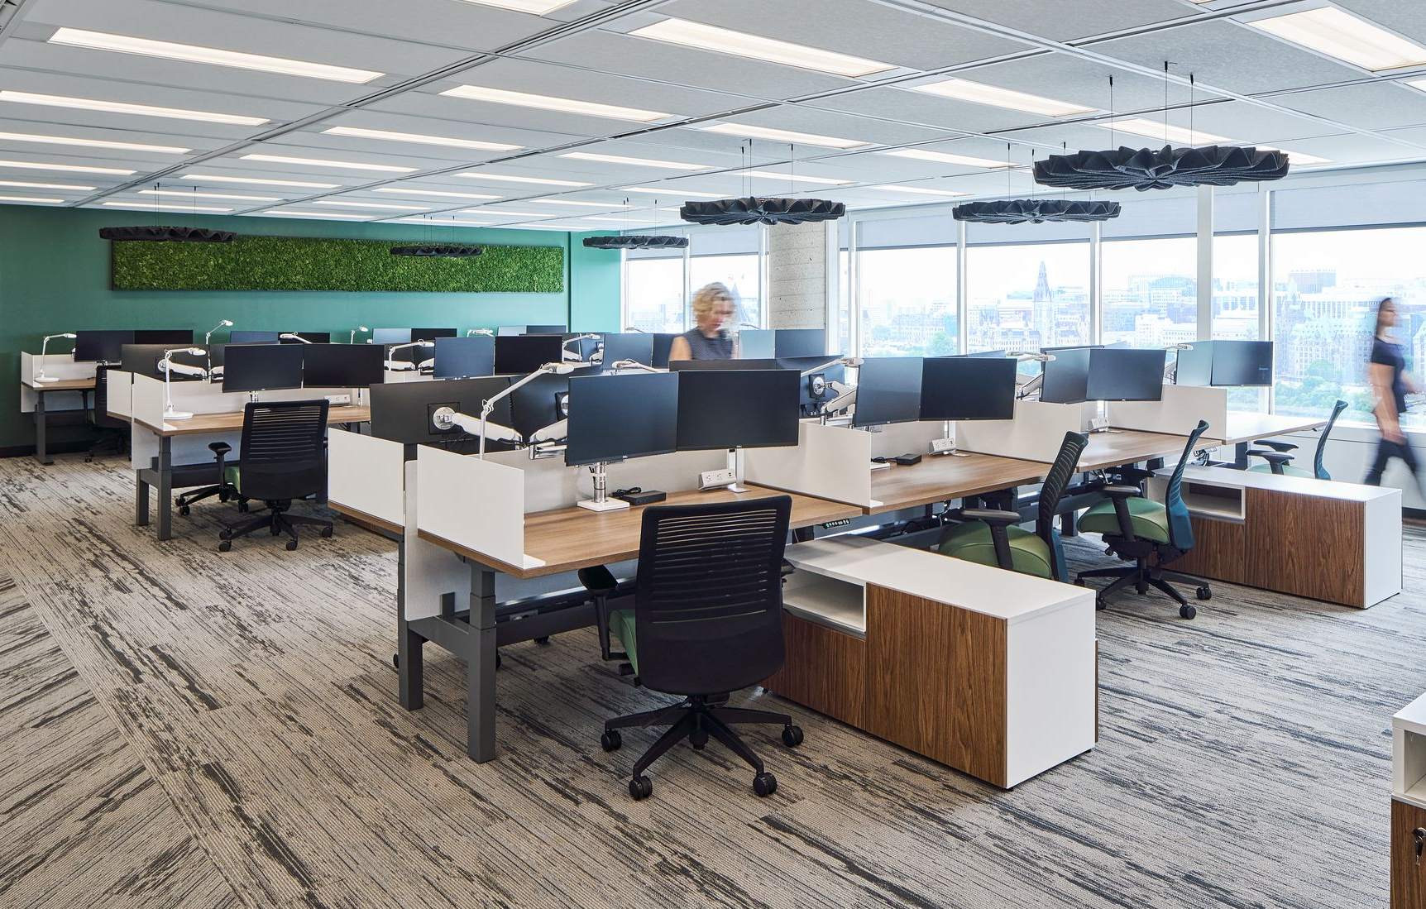
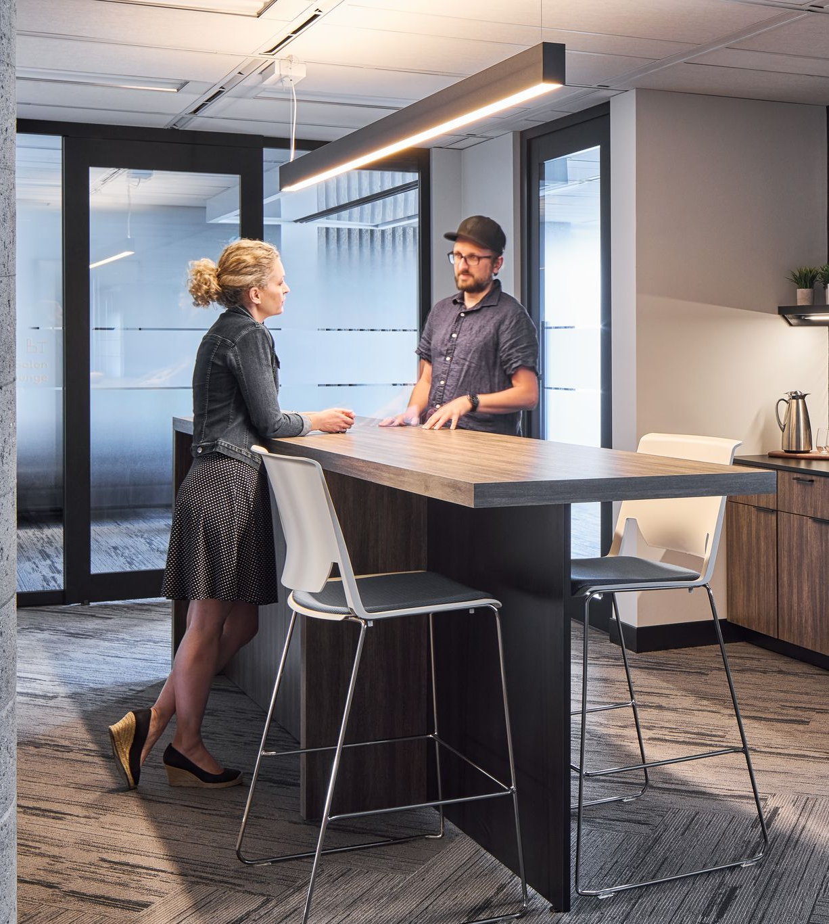
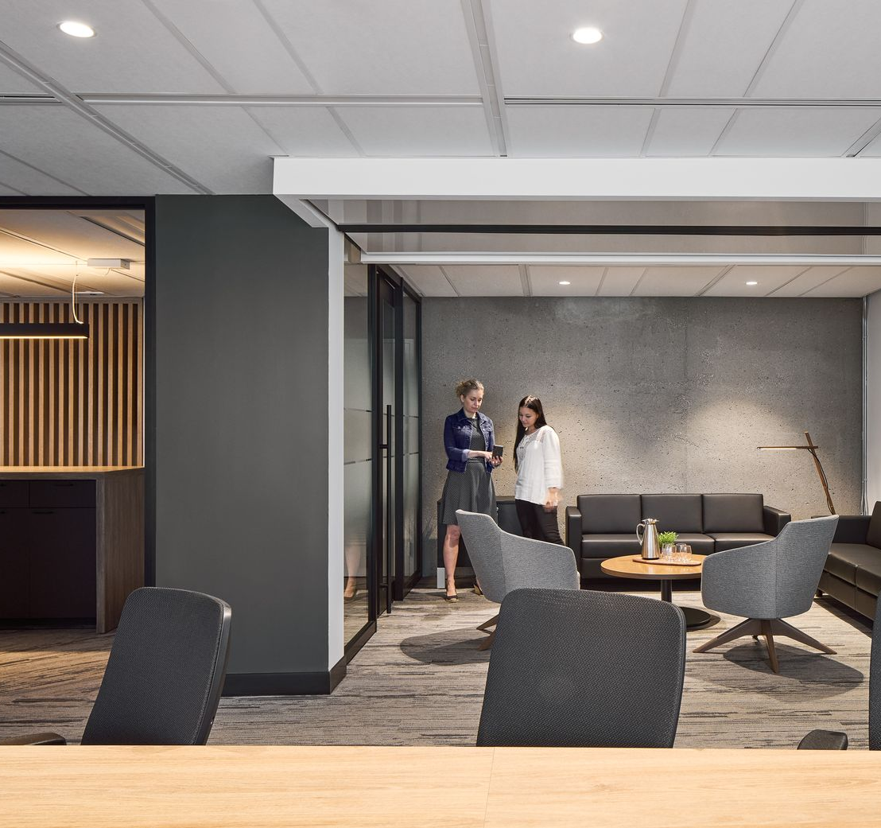
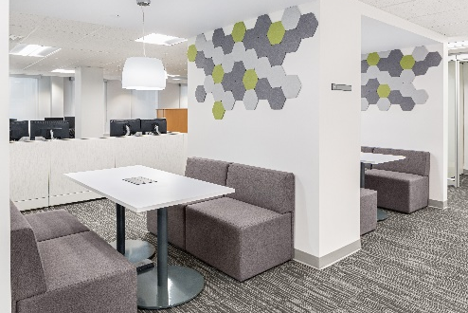
GCworkplace Design
Activity Based Working
Allows occupants to untether from a fixed point and choose the optimal setting for their work activities

Slide 21
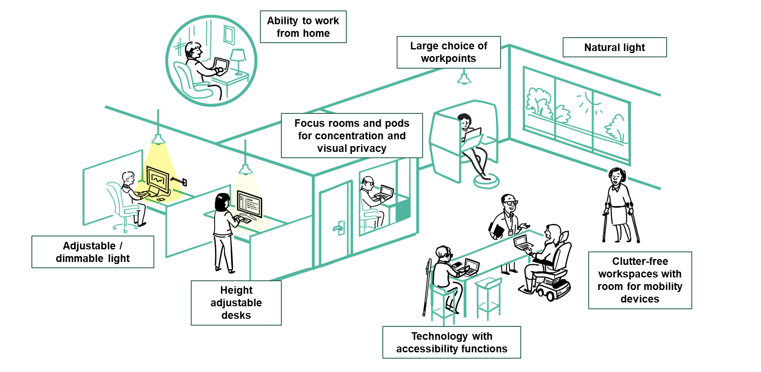
An Accessible and Inclusive Workplace by Design
To promote inclusivity and support all levels of physical and cognitive abilities, a workplace must offer variety & choice to allow for user autonomy.
All-Access Washroom
Notes:
GCworkplace Design is inherintly Accessible and inclusive as it provides users the choice to self-select from a wide variety of fucntional settings, many with user adjustability, based on each person’s activites, abilities and preferences.
Just because the workplace is now more accessible and inclusive, DTA is still applicable when the workplace does not support an employee’s specific needs

Slide 22
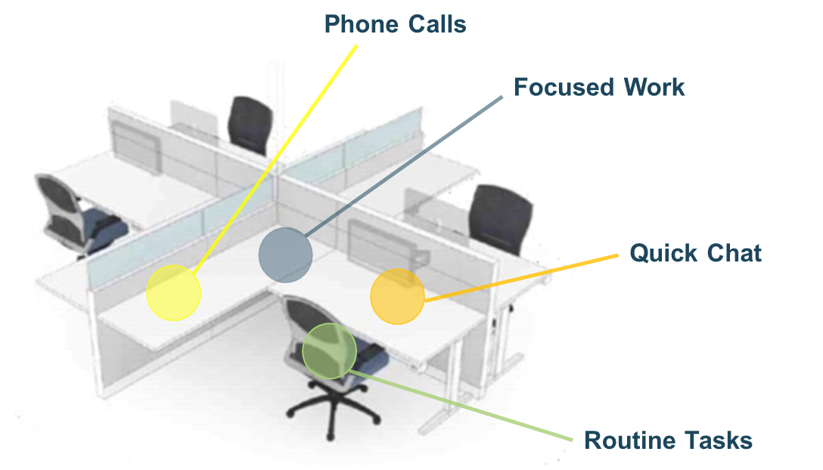
Designed for Activities

Slide 23
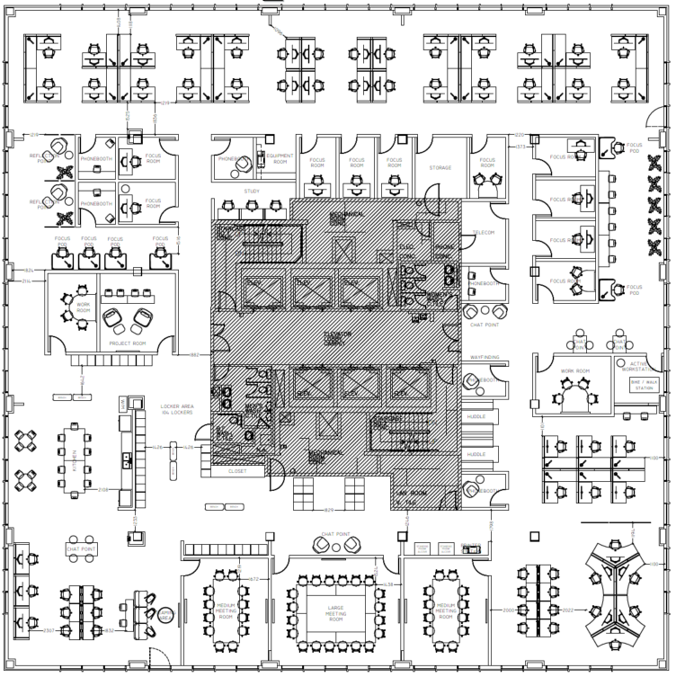
Designed for Activities
Phone Calls
Focus Work
Quick Chat
Routine Tasks

Slide 24
Zoned by Function
QUIET ZONE
TRANSITIONAL ZONE
INTERACTIVE ZONE

Slide 25
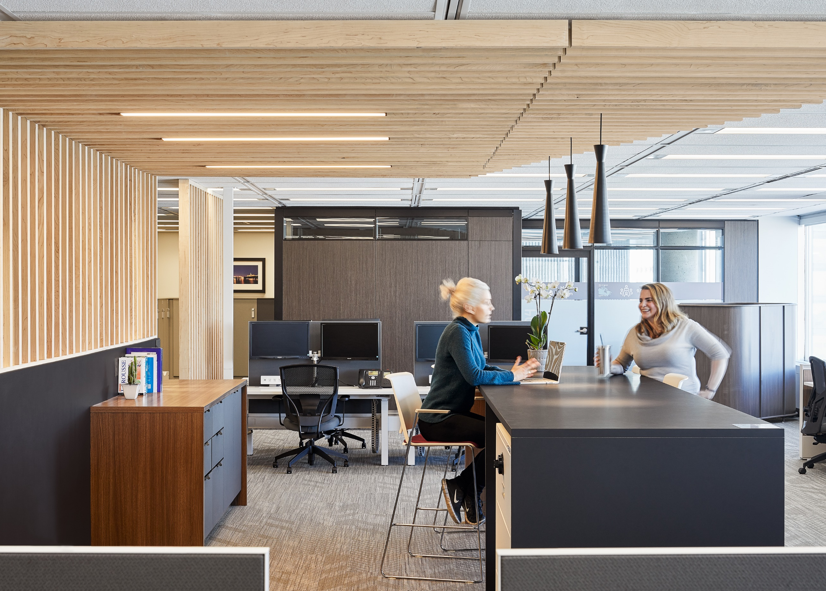
Promoting Collaboration
BETTER TOGETHER
OFTEN APART
Understanding
The
Value
Of
Facetime

Slide 26
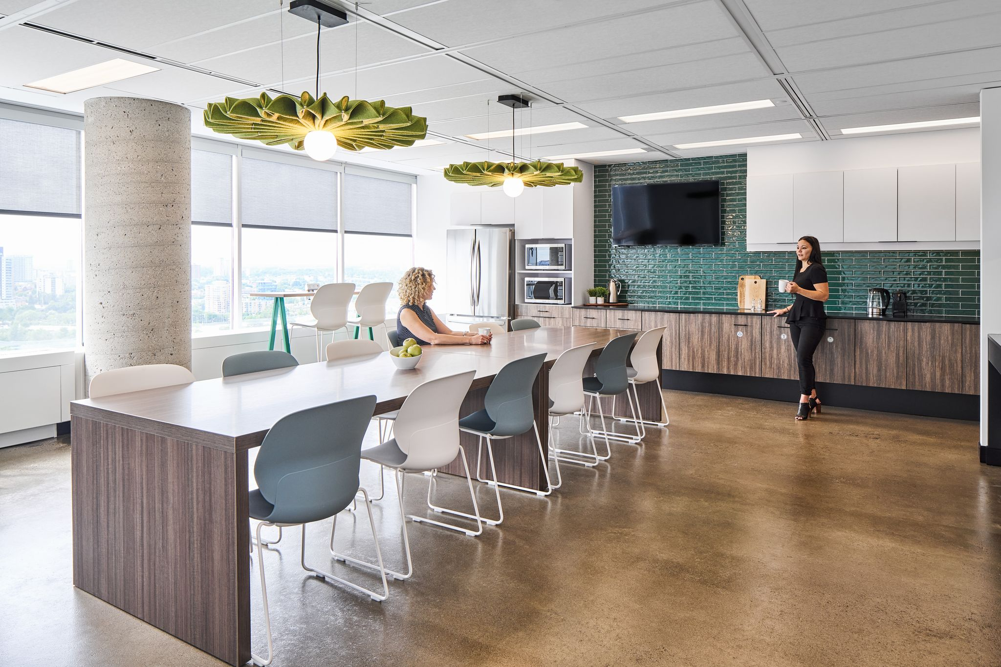
Flexibility in Utilization
Advantages for the User:
Choice and flexibility of where & how to work
Adaptable to personal needs & preferences
Access to a wide range of workpoints - open and enclosed - and amenities
Accessible and inclusive
Advantages in Asset Management:
Flexibility to suit varying requirements within the design standard
Eliminates many common tenant service requests by allowing user autonomy

Slide 27
Shared Space by Default
Shared
by
Default…
DEDICATED
for Function X
…Narrow
by
Necessity
DEDICATED
to group Y
PRIORITY ACCESS
for Z
MORE SHARED = MORE FLEX.

Slide 28
Interdepartmental Space Sharing
Shared
by
Default…
…Narrow
by
Necessity
DEDICATED DEP. A
only
DEDICATED Group Y of
Dep. B only
DEDICATED
Function X,
all departments
MORE SHARED = MORE FLEX.

Slide 29
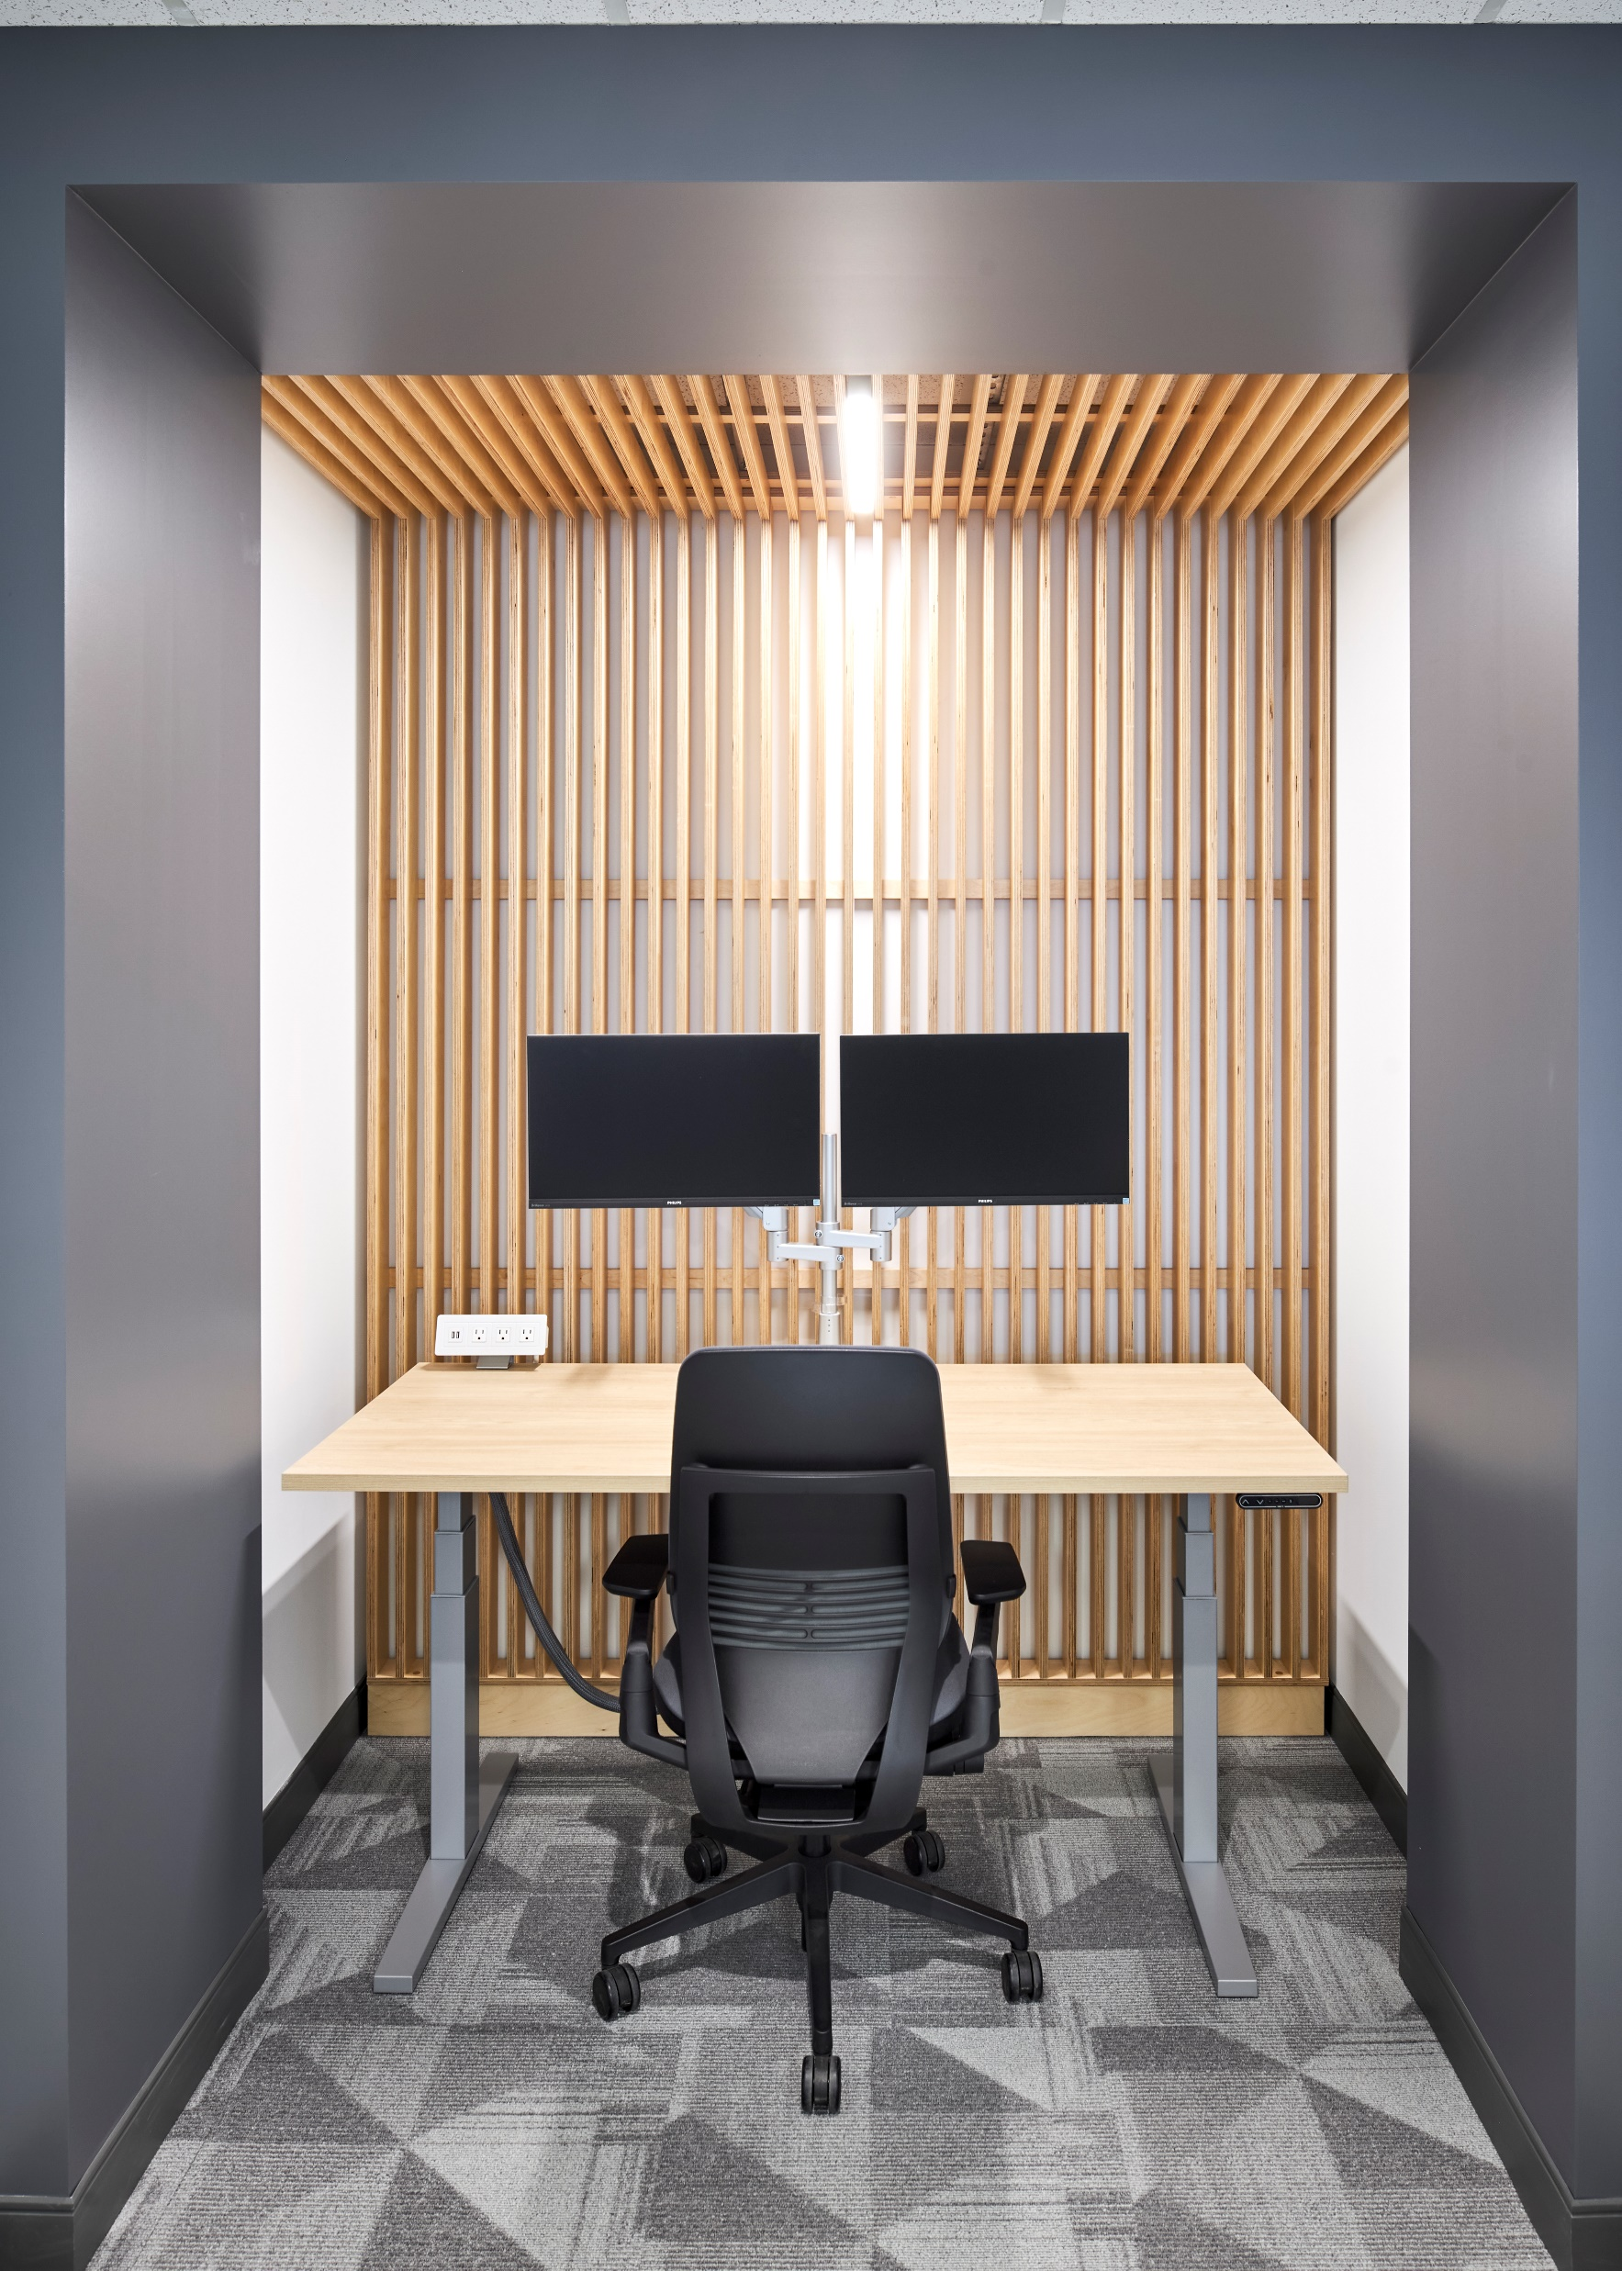
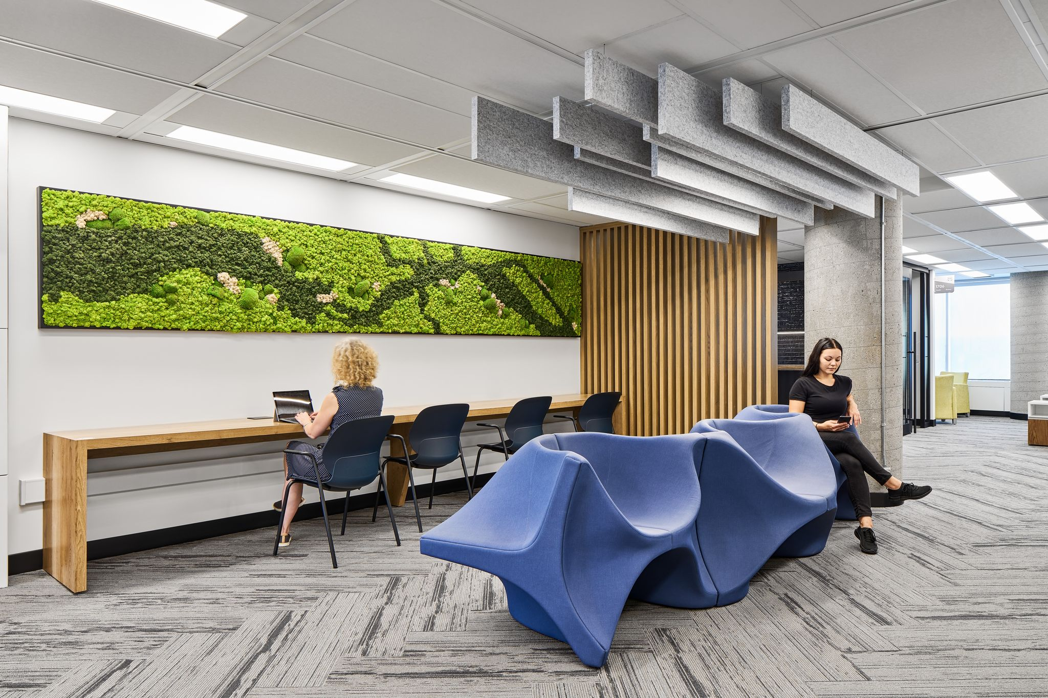
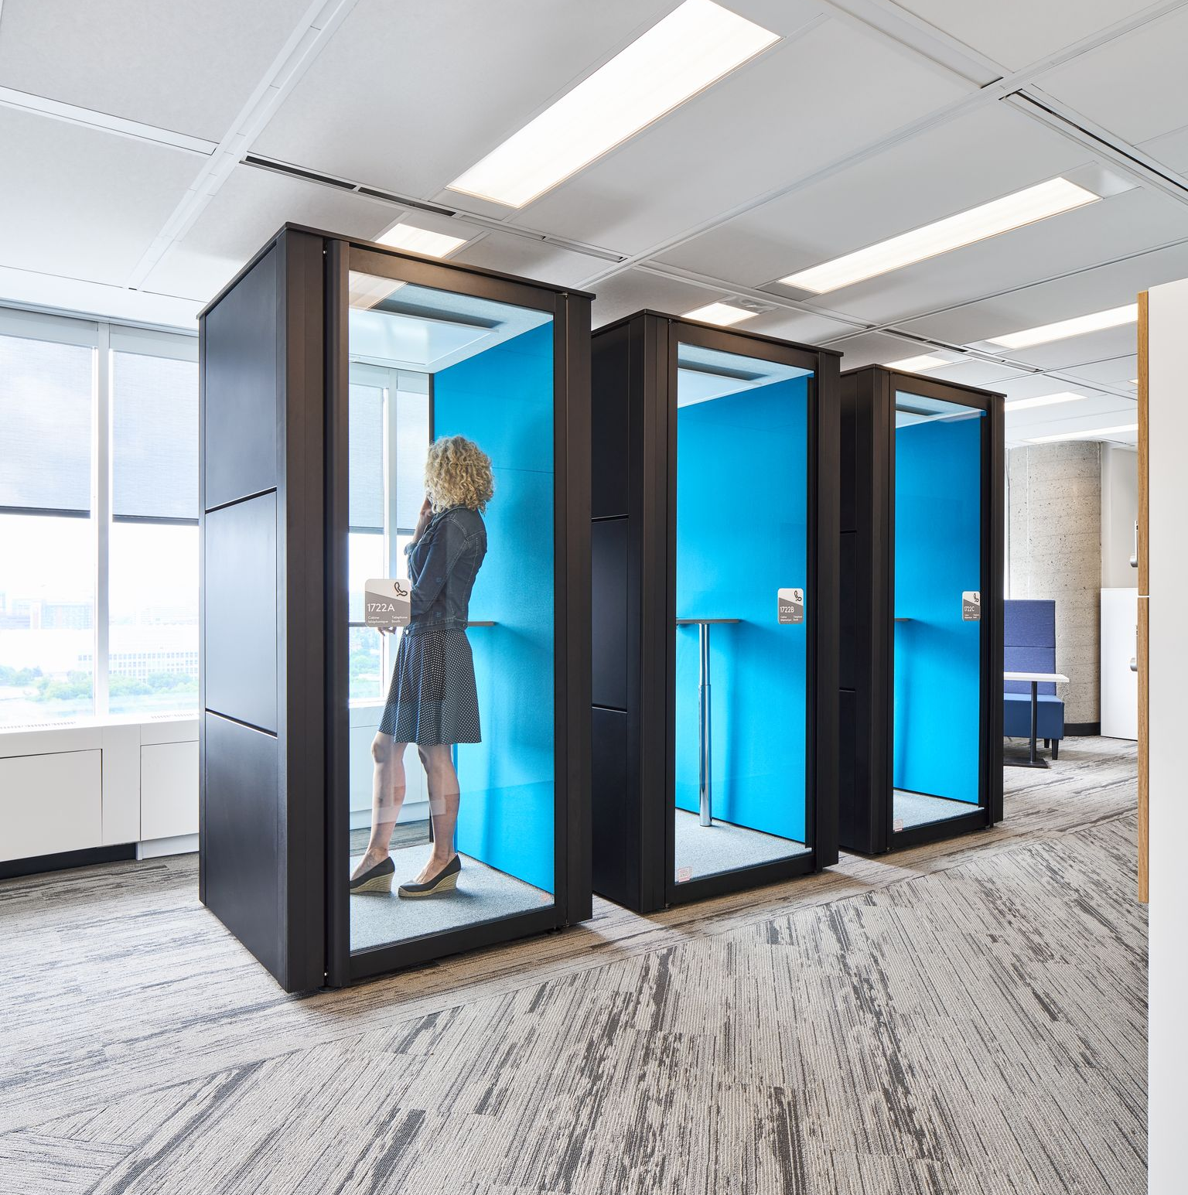
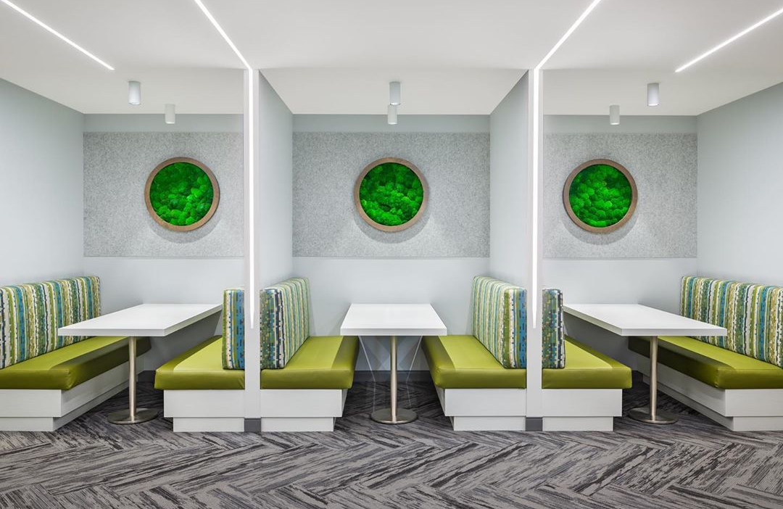
Commonly Shareable Interdepartmental Space
Shared
by
Default…
Reception Area
Locker/Closet Area
Lounge & Kitchenette
Individual Focus Rooms
Phone Booths
Wellness Room
Meeting Rooms

Slide 30
WHAT NOW? Top Success Factors for Workplace Change
Active and visible leadership
Employee engagement
Governance
Empowered managers
Clear vision
Experience
Notes:
Demonstrating active and visible leadership (champions and ambassadors) supporting the vision throughout the life of the change initiative.
Establishing leadership and governance to develop and manage your workplace strategy.
Clearly articulating a vision for the workplace that is aligned to the GCworkplace vision.
Engaging employees of all levels by way of activities, meaningful consultations and discussions on the issues that matter most.
Empowering and equipping managers and supervisors to support their employees through the change.
Creating opportunities to experience the change through pilots and demonstration spaces: seeing is believing, experiencing is knowing.

Slide 31
What is Change Management?
1
Change Management DOES NOT DEFINE change, but rather manages any change that results from a defined workplace modernization VISION.
CHANGE
IS
DEFINED
2
CHANGE
IS
MANAGED
THIS is Change Management
3
CHANGE
IS
ADOPTED
Notes:
Change management starts when a change has been defined (in order to MANAGE a change, there needs to BE a change)
Here’s a quick view of the approach proposed by the PSPC Workplace Change Management National Centre of Expertise:
Change needs to be defined, typically a decision made by senior management. By adopting GCworkplace, your organization has decided to change the way it works and uses its workspace. But what does that mean specifically for your organization? What other changes will this bring about? These become your “inputs”.
These changes require employees to adopt new behaviours -> this is where you need a change management approach (pictured in the center) that our Workplace Change Management National Centre of Expertise can provide assistance and support with. This approach, along with tools, templates and best practices in workplace change management can be found in their Workplace Change Management Playbook – available on GCpedia.
Finally, you know you’ve been successful at managing change when employees adopt the change, realize the solution and become proficient with new processes and tools. These are the change management “outputs”.
Now, has your organization defined the change?
No – its not too early to think about finding a change management resource [click to next side]
Yes – Do you have a dedicated change management resource?
Yes – Great! I will arrange for a presentation with our change management experts. [no need to show next slide]
No – Let’s look at how we can help [click to next side]

Slide 32
Change Management
BEFORE
CM can begin…
Change must be defined
Change
is managed
Change
is
adopted
based on clear VISION of the future of work
“Inputs”
process to prepare, support, and help individuals, teams, and organizations in making organizational change
Successful transition to envisioned FoW
“Outputs”
Notes:
Change management starts when a change has been defined (in order to MANAGE a change, there needs to BE a change)
Here’s a quick view of the approach proposed by the PSPC Workplace Change Management National Centre of Expertise:
Change needs to be defined, typically a decision made by senior management. By adopting GCworkplace, your organization has decided to change the way it works and uses its workspace. But what does that mean specifically for your organization? What other changes will this bring about? These become your “inputs”.
These changes require employees to adopt new behaviours -> this is where you need a change management approach (pictured in the center) that our Workplace Change Management National Centre of Expertise can provide assistance and support with. This approach, along with tools, templates and best practices in workplace change management can be found in their Workplace Change Management Playbook – available on GCpedia.
Finally, you know you’ve been successful at managing change when employees adopt the change, realize the solution and become proficient with new processes and tools. These are the change management “outputs”.
Now, has your organization defined the change?
No – its not too early to think about finding a change management resource [click to next side]
Yes – Do you have a dedicated change management resource?
Yes – Great! I will arrange for a presentation with our change management experts. [no need to show next slide]
No – Let’s look at how we can help [click to next side]

Slide 33
Adopting the change: from current to future state
pre-pandemic
Poorly managed change
Very well managed change
Current
Transition
Future
Current
Transition
Future
VS.
The ultimate objective is that all employees move from the current state to the future state.

Slide 34
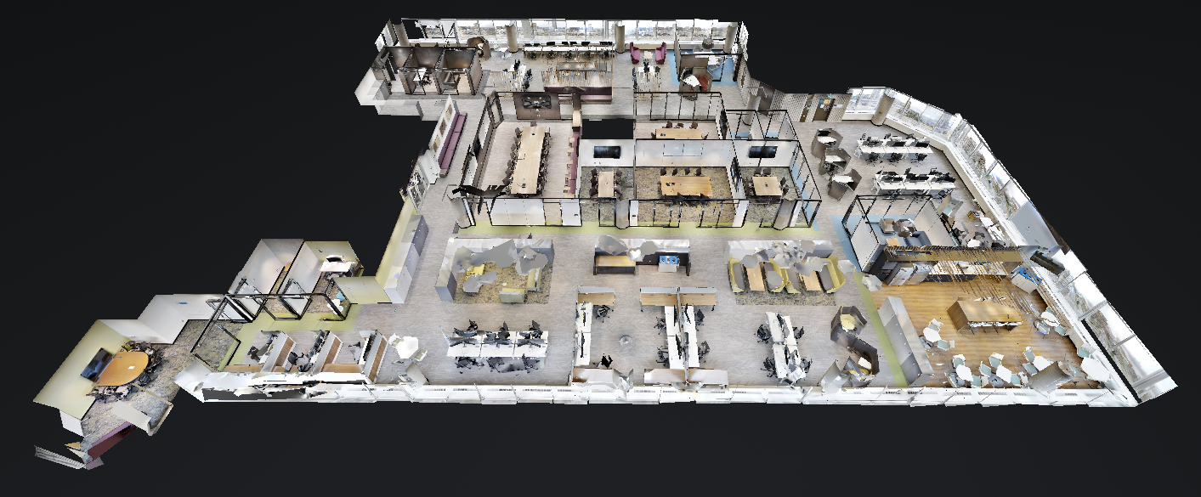
GCworkplace 3D Tour
CLICK TO ACCESS

Slide 35
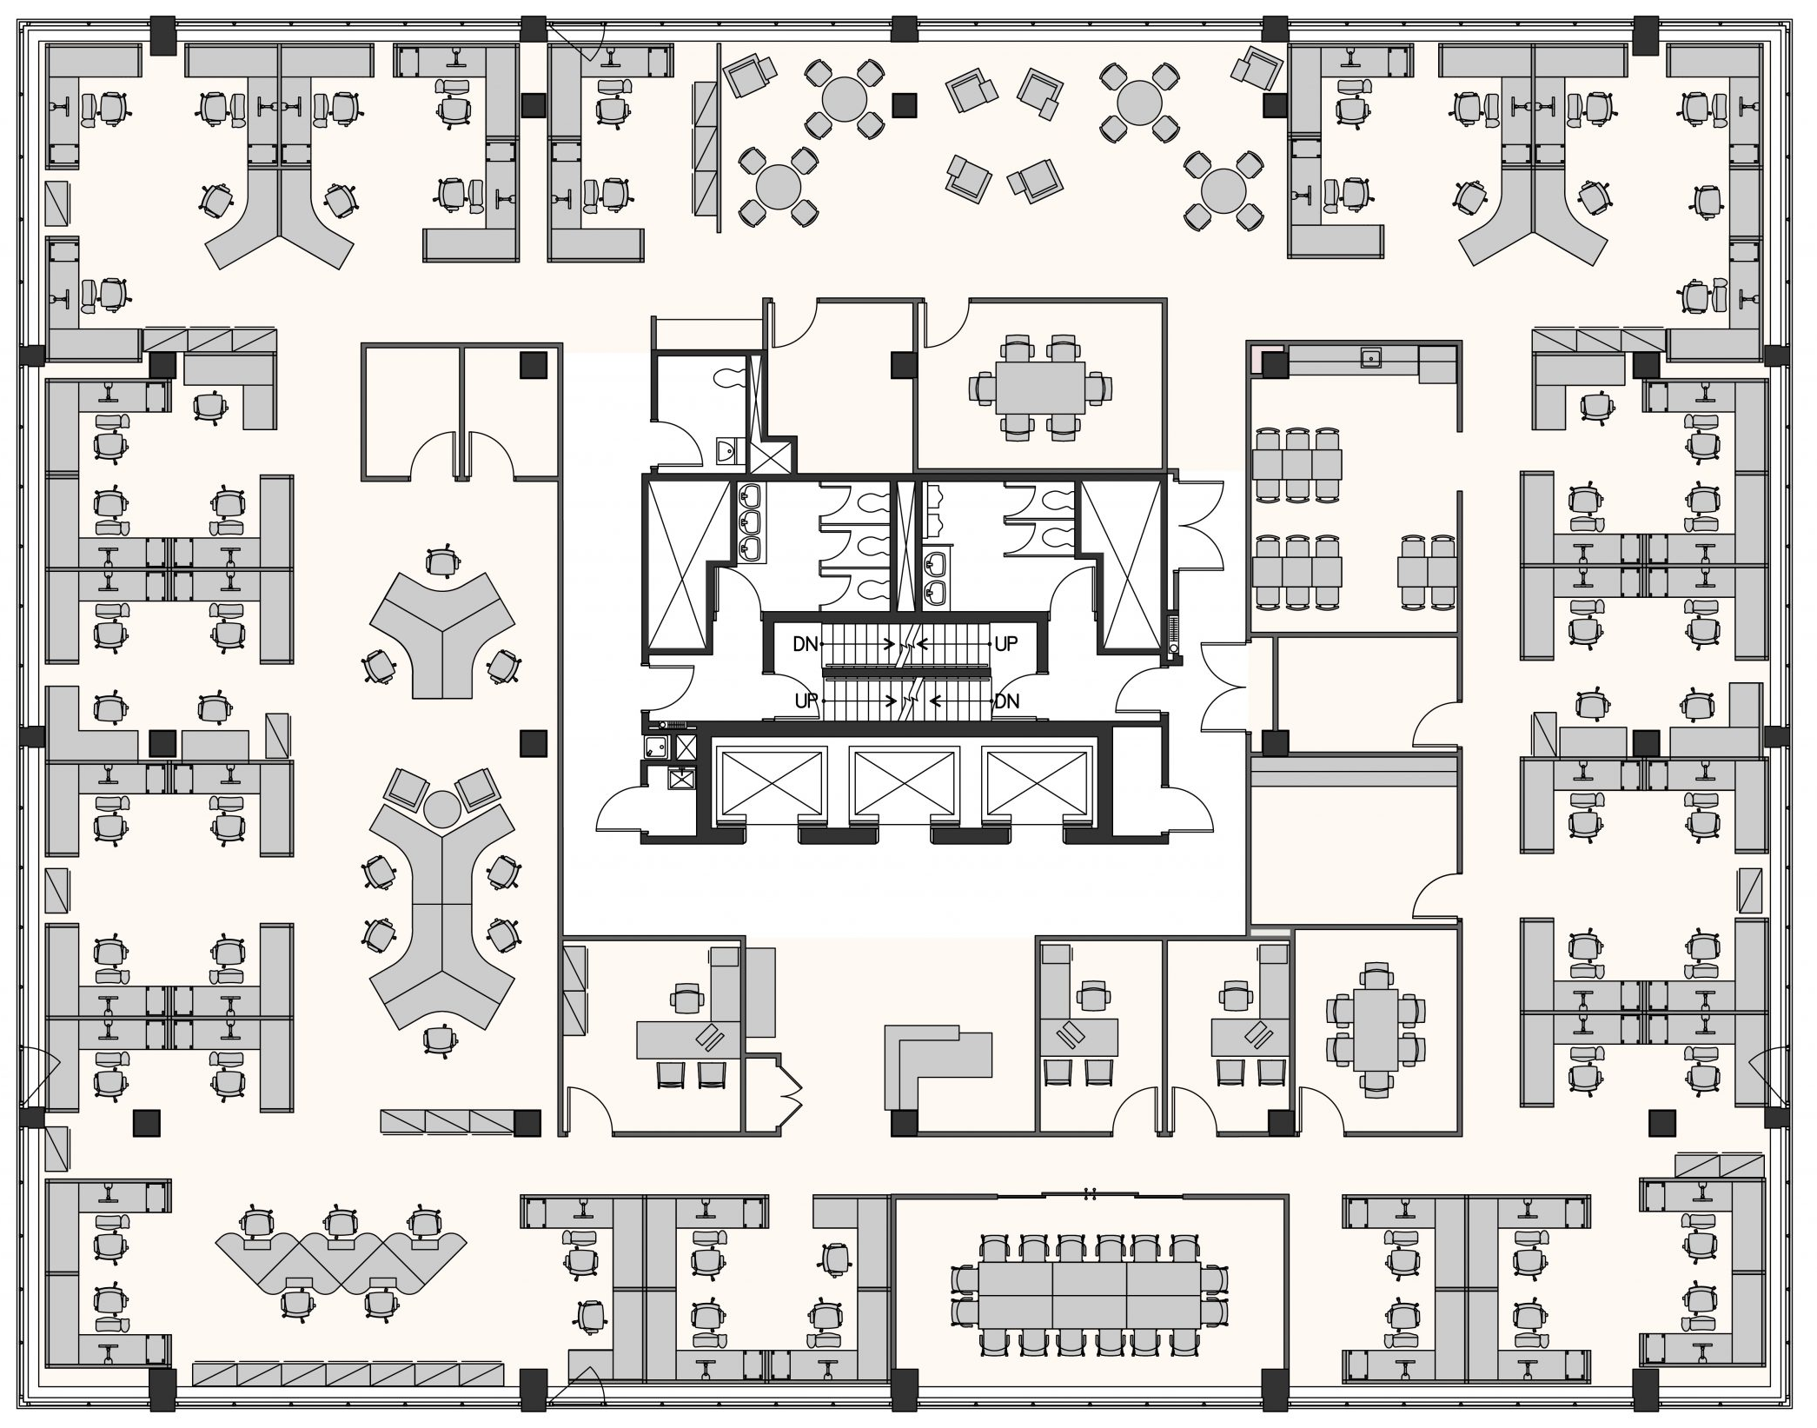
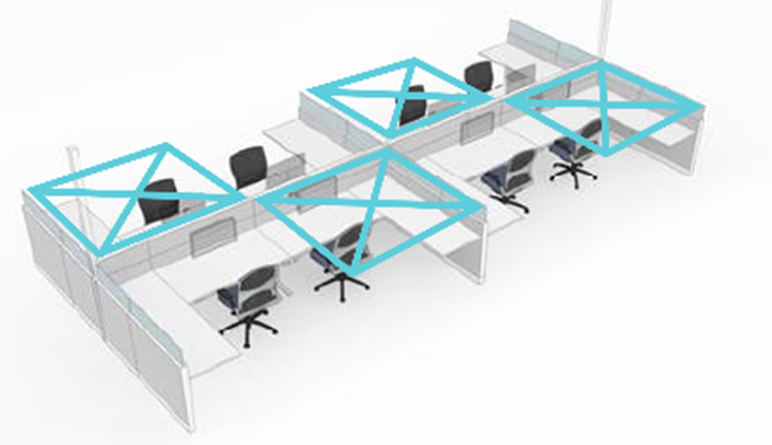
Health & Safety in the Workplace
BENEFITS of GCworkplace
(flexible/unassigned seating)
‘clean desk’ policy allows for easier, more frequent cleaning
autonomy in choosing the work setting that best meets needs, preferences and level of psychological comfort
easily adaptable to
temporary changes
in use (ex: 2m distancing)
shared work environment promotes better overall vigilance from all occupants
hand sanitizer stations and sanitizing wipes readily available
Shared space in traditional, assigned workplaces:
Risk in providing a false sense of security to occupants
Notes:
Even in traditional, assigned workplaces, most spaces are shared, which can provide a false sense of security.

