Slide 1
Minimum Viable Enterprise and Business Architecture
For discussion purpose
Last update: April 2022

Slide 2
Outline
Purpose
Context
Vision for EA and EBA
MVEA practice elements
Implications for Business Architecture
DISCUSSION!

Slide 3
1. Purpose
Purpose of this presentation is to set the table and evaluate interest to co-develop a Minimum Viable Enterprise and Business Architecture Practice across the GC, which would:
Support smaller departments and agencies in establishing a viable and sustainable EA practice
Serve as a formal baseline / lowest common denominator for a GC EA practice
From there, departments could add whatever suits their specific architecture needs, as long as we would share common foundations:
A common vision of EA with a minimal value proposition
Minimal Stakeholders and Roles
Minimal Services with Key Activities
Minimal Metamodel and Knowledgebase (EA Repository)
Notes:
« What can you do that is EA; doesn’t cost a fortune but still helps deliver the projects as well as ensure those projects are strategically aligned? »
Key questions:
WHY? A common vision of EA and its value proposition
By WHO? For WHO?Minimal Stakeholders and Roles
WHAT? HOW? Minimal Services with Key Activities
Minimal Metamodel and Knowledgebase (EA Repository)
Also:
What would be a desirable evolution/growth path from there?
What does this mean for Business Architecture?
MVEA should be based on what WORKED, not on what COULD work, what should work or what we want EA to be

Slide 4
2. Context - EA in HC/PHAC
WHO
EA was re-established in HC-PHAC 5 years ago. At first, having its own Directorate within Corporate Services Branch, then joined the IT Directorate in 2021, which upgraded to a Digital Transformation Branch in 2022
3 FTE at the moment, sometimes partnering with consultants hired by business areas
Part of an Architecture and Innovation Division, which includes Application and Technology Portfolio Management and Digital Innovation Enablement
Challenges
Small dedicated architecture team
No formal solution architecture practice
Lacking capacity to follow through with some of the more strategic initiatives
WHAT and WHY
Initial focus was about developing & « enforcing » an EA framework
Mandate has evolved to be more flexible and “organic” – mixing strategic & tactical guidance; approached as an “internal management consultancy” service
Been taking a more active role as a catalyst to some enterprise-level initiatives such as: ICAM service; Data and interoperability standards; Low-Code platforms
Challenges
No documented EA Program
Diversified business making it more difficult to promote an “enterprise culture”
No formal engagement model for enterprise projects and other potential opportunities
HOW
A high-level EA Framework and a limited set of enterprise reference models
Few formal architecture artefacts & deliverable templates
HC/PHAC Architecture Review Board soon to celebrate its 2nd anniversary, has created traction and interest but is still IT-centric
Challenges
Limited documented EA practice and blueprint
Small set of Reference Models - not consistently leveraged nor maintained
Need to reposition EA to better support agile practices, experimentation and product management

Slide 5
2. Context – GC EA and EBA
EA practice and value proposition across the GC have improved in the last few years but are still inconsistent
Some departments continue to struggle to establish EA as a valuable partner and service – instead of just another compliance mechanism
This in turns reflects on business architecture, which inherits those challenges
GC EARB template is being reviewed which provides opportunities for enterprise and business architecture
GC BCM is being reviewed which provides opportunities for business architecture
“Enterprise Architecture: Big Ideas for Small Departments and Agencies” presented by Gary Doucet in 2019 and based on his previous work as Chief Architect for the GC, as a lot of the ingredients
Participants in the newly (re-)established GC Business Architecture WG led by PSPC are showing interest in defining a common, « minimum viable » enterprise and business architecture practice
Notes:
And:
Shouldn’t have to “sell” EA or BA
Pretty much all Depts have an EARB now.. But are they getting value from it??

Slide 6
3. Vision for EA and EBA

Slide 7
Let’s first agree on an EA vision… (1 of 3)
What is EA? “Enterprise Architecture is the design, improvement and optimisation of information-intensive business systems” – Graham Berrisford
“Architects are largely on the wrong track. They are focused on how to create a well-structured enterprise architecture instead of how to create a well-architected organization.“
Enterprise Architects are the urban planners of digital organizations. They provide a “framework to digital transformation”
“The urban planner looks at how all the individual buildings fit together, considers how the structure and layout of a city affect the lives of its inhabitants, and helps to realize the overall vision of the city”
“Urban planners not only set building codes and plans common services such as roads and water, they actively participate in making those plans a reality.”
Notes:
Source: Kevin Brennan https://www.cutter.com/article/urban-planner-metaphor-ea-490976, cited in a RCMP deck
“The urban planner is somewhat analogous to the enterprise architect and enterprise architecture team in that the urban planning team needs to understand what the building architect (solution architect) does, but also need to understand a wide range of topics that the building architect doesn’t need to deal with”
- Doug McDavid https://www.linkedin.com/pulse/architecture-sandwich-doug-mcdavid
What is our mission, our goal? It isn’t to build a blueprint of the organization and it isn’t to describe our organization’s operating model in terms of capabilities and technologies. Our mission, if we choose to accept it, is to architect our organization for long term success and sustainability.”

Slide 8
Let’s first agree on an EA vision… (2 of 3)
What is EA’s purpose? “The primary purpose of Enterprise Architecture is to inform, guide and constrain the decisions made by an enterprise, especially those related to investments.” - DNDAF
Minimal Value Items:
Brings a broad view to investment decisions; maximizes investment returns, aligning short-term & local needs with long-term & strategic direction
Guide investments to reusable solutions, solution components and solution designs
Ensures that decisions are deliberate in cases where a program will not use an enterprise solution
Additional Value Items (not an exhaustive list):
Enables the Department/Agency to develop more strategic Investment plans
Reduces overall complexity and improves operational sustainability; foster longer-term operating model transformation
Enables employees at all levels to embrace a culture of continuous innovation and adopt a horizontal approach in furthering government business
Notes:
Guide investments to reusable solution, solution components and solution designs
Provide a conceptual framework (a “mental model” of the business problem and solution, with proper context) to help guide/prioritize activities and decision-making
Clarify/show the business, information, data, application and technology implications - for better/more informed designs
Help identify any gaps in the requirements. Identify reuse opportunities from/for the enterprise. Ensure enterprise integration and sustainability, post-project.
Making sure that the right enterprise infrastructure is created along the way
Identify and mitigate risks to the enterprise
Identify and expand opportunities for the enterprise
An EA Program to “align and manage the development of capabilities with established business priorities.”

Slide 9
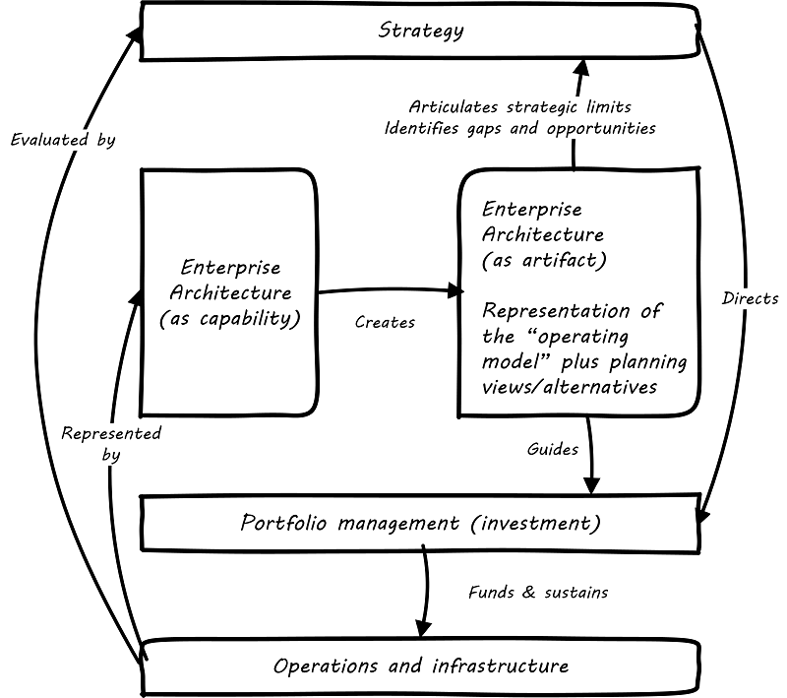
Let’s first agree on an EA vision… (3 of 3)
How does EA work? “An enterprise architecture is a corporate asset that is both a practice and a tool.”
An EA program as “the means to deliver and maintain the enterprise information required for enterprise decision-making”
An EA Program to “align and manage the development of capabilities with established business priorities”
An EA Program that is…
Business outcome-driven:
EA supporting the delivery of business value and business priorities; EA can’t simply be a “compliance stick” in this fast-evolving digital era
Actionable and Just-Enough, Just-in-Time:
providing actionable guidance to initiatives and services through “signature-ready recommendations”;
As per Gary Doucet: “Think global, Act local”
https://pubs.opengroup.org/dpbok/standard/chap-arch-portfolio.html#defining-ea
Notes:
An architecture is both descriptive and prescriptive

Slide 10
4. MVEA practice elements

Slide 11
EA Operating Model Patterns
Three “iterations” of EA Operating Models based on capacity more than maturity:
Minimum Viable EA:
Strategic EA:
Embedded EA:
An EA “Light”
Mostly tactical
Mostly reactive
Often, but not necessarily, IT-driven
Focused on engaging with and advising major initiatives
No knowledgebase; highly dependant on the knowledge of individual architects
A fully established EA
Mostly Strategic
Mix of Reactive and Pre-emptive / Anticipative
Business-driven but still mostly IT-centric
Includes some enterprise knowledgebase used to store & generate artefacts
Strategic – overseeing tactical alignment
Mostly Pre-emptive / Anticipative
Business-driven and both business & IT-centric
Includes an enterprise knowledgebase accessed and leveraged by non-architects to produce insight
Notes:
Those different Op Models would be based on the environment, the EA Unit capacity, the organizational needs & priorities, etc.

Slide 12
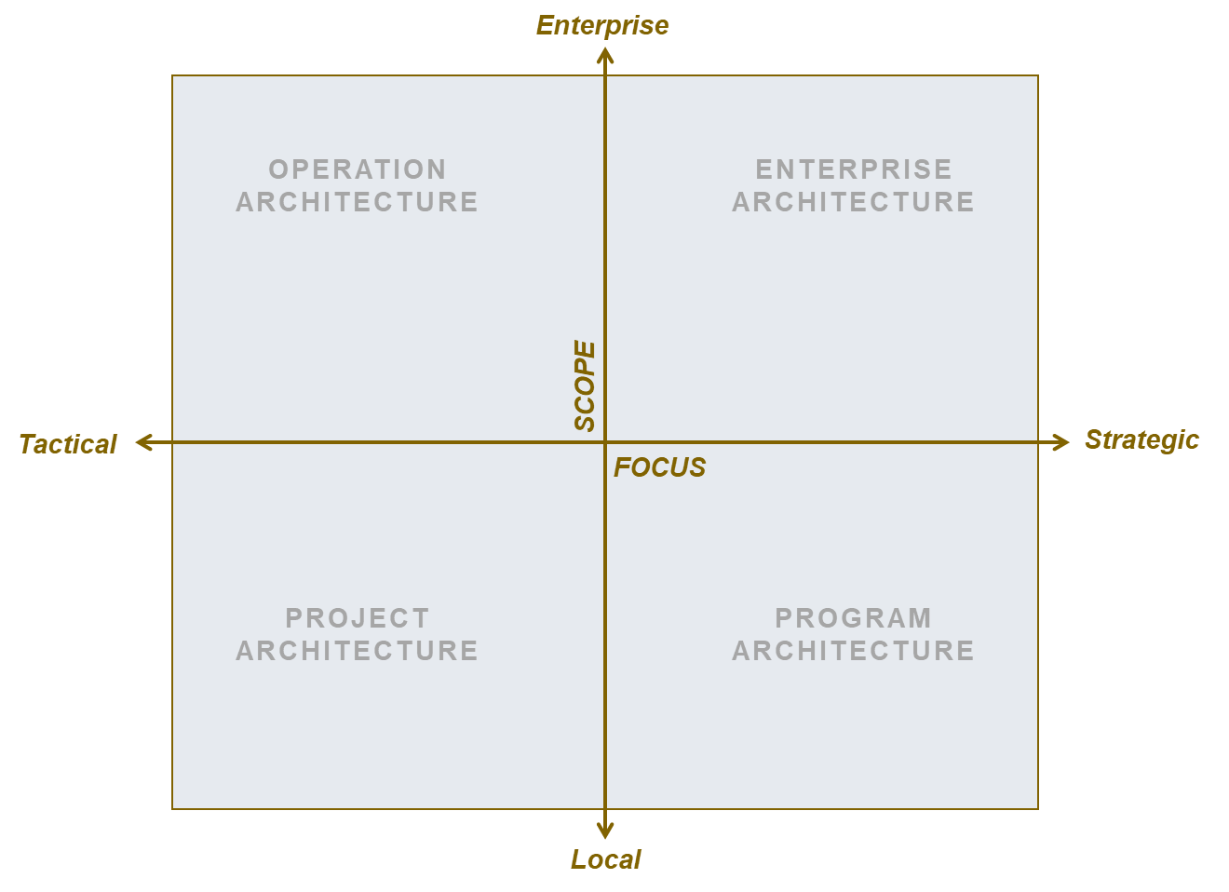
Scope
Minimum Viable EA:
Strategic EA:
Embedded EA:

Slide 13
Key Stakeholders
Minimum Viable EA:
Strategic EA:
Embedded EA:
Practitioners:
Enterprise Architects
Some Domain Architects (might not be under EA functional authority)
Some Solution Architects (might not be under EA functional authority)
Practitioners:
Enterprise Architects
Segment / Portfolio Architects (for larger organizations)
Domain Architects (framed by EA)
Solution Architects (framed by EA)
Practitioners:
Enterprise Architects
Segment / Portfolio Architects (for larger organizations)
Domain Architects (contributing to EA)
Solution Architects (contributing to EA)
Technical Architects?
Core EA Clients & Partners
IT Business Relationship Managers
Project and Programme Managers
Business & Data Analysts
Solution Architects & Engineers
Business Owners / Executives
IT Service Managers and Centers of Expertise
Core EA Clients & Partners
IT Business Relationship Managers
Application and Technology Portfolio Management Office
Enterprise Project Management Office
Chief Data Office
Business Owners / Executives
Business & IT Planners
Core EA Clients & Partners
Business, Vendor and IT Relationship Managers
Application and Technology Portfolio Management Office
Chief Digital Office
Senior Governance Bodies
Business & IT Planners
Notes:
Context to MVEA:
« Enterprise Solution Architecture »
No enterprise-coordinated solution Architecture practice
No (or low-maturity) organizational-level PPM
Enterprise architecture might focus on one or more business domains and not cover the whole enterprise
Context to Strategic EA:
Established organizational-level transformation leadership
Architecture-domain representation allows for ar hitgecture roadmapping
Context to Embedded EA:
« Self-Service EA / EA as an organizational culture »

Slide 14
Key Services and Activities
Minimum Viable EA:
Strategic EA:
Embedded EA:
Advisory Service – Major Initiatives & Projects
Establish standards, principles and guidelines and actively promote and align transformation efforts to those standards
Architecture Development and “Evangelization” service: strengthen and spread the enterprise perspective
Advisory Service – Major Initiatives & Projects
Maintain standards, principles and guidelines and actively promote and align transformation efforts to those standards
Advisory Service - Investment Portfolio & Plans
Collaborate with business lines to identify opportunities for improved business value through digital enablement.
Develop IM/IT Strategies to realize the capabilities required by the Organization
Advise innovative proof of concepts to drive HC-PHAC architecture
Maintain standards, principles and guidelines and oversee alignment to those standards
Advisory Service - Investment Portfolio & Plans
Collaborate with business lines to identify opportunities for improved business value through digital enablement.
Develop IM/IT Strategies to realize the capabilities required by the Organization
Oversee innovative proof of concepts to drive HC-PHAC architecture
Actively participate in the delivery of digital change within the organization to achieve its digital transformation, especially through the introduction of key capabilities and innovative technology.
Notes:
Architecture Assurance & Guidance service
Education & Evangelization service
Strategic Consulting / Roadmapping service
Blueprinting service
Research & Innovation service
Highlight opportunities to maximize enterprise value from transformation and/or reduce enterprise risks
Ensure alignment of tactical design decisions with enterprise/strategic decisions & policies
Oversee adherence to enterprise design decisions & policies
Champion & oversee the implementation of enterprise capabilities
Enable Business solutions planners & designers to align with strategic direction and leverage existing assets
Allow more open collaboration between IT and business units; promoting enterprise-thinking
Mature the enterprise capacity to innovate and adapt as a whole

Slide 15
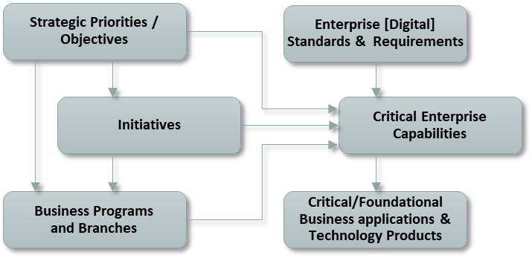
Knowledgebase + Key Artefacts/Deliverables
Minimum Viable EA:
Strategic EA:
Embedded EA:
Knowledgebase:
Single window to EA with a centralized information store for architecture artefacts and deliverables
Basic/Foundational Enterprise [Architecture] Repository, used by architects only, with the following core concepts
Knowledgebase:
Extended Enterprise [Architecture] Repository offered as a service to partners
Knowledgebase:
Extended Enterprise [Architecture] Repository offered as a service to clients
Additional enterprise objects to support Strategic and Embedded EA could include:
Business Services
Information Concepts / Business Data Entities
Business Processes
Strategic Outcomes
Application Services / Microservices
[…]

Slide 16
5. Implications for Business Architecture

Slide 17
Business Architecture
“Let’s work the problem, people.
Let’s not make things worse by guessing.”
Gene Kranz, Flight Director Apollo 13
About:
Business focus
Business problems and opportunities focus
Explore and Refine the Business Problem

Ensure a clear understanding of the business problem before discussing solutions.
Early engagement with TBS to ensure alignment prior to proceeding with the investment planning process.
Ensure that investments are conceived in a manner that aligns with the Government of Canada’s Digital Standards.
Don’t Jump Directly to Solutions

Slide 18
Different Levels of BA Practice
Minimum Viable EA:
Strategic EA:
Embedded EA:
Minimal Business Architecture:
Business Architecture is embedded within the EA practice through some of the EA deliverables and activities
Strategic Business Architecture: Business Architecture is formalized as an EA domain with a Business Architect role (full-time or not) included in the overall Organization architecture framework & practice
Enterprise Business Architecture:
Business Architecture is elevated to an enterprise practice, lives outside EA and serves business purposes
Notes:
/

Slide 19
6. Discussion

Slide 20
Appendix

Slide 21
Architecture Guidance & Assurance across HC-PHAC investment lifecycle
Investment Lifecycle
Strategic Planning
Portfolio Planning and Management
Initiative Definition and Planning
Solution Design to Deployment
Delivery Benefit Realization
Strategic requirements
Enterprise Architecture
Clarify enterprise strategy (official, emerging and shadow) and describe the resulting enterprise future state
Help define or reframe transformation and innovation opportunities aligned to business outcomes
Establish more transparent, evidence- based decision-making on investment portfolio that reflects and leverages the enterprise needs and plans
Help clearly articulate business impacts, benefits, constraints and integration potential of proposed change
Solution Architecture
Policy requirements
Embed value / enterprise design requirements into conceptual solution design to maximize enterprise alignment and outcomes
Identify major projects’ interdependencies and re-use opportunities
Legend:
Minimum Viable EA
Architecture objectives
Strategic EA

Slide 22
Architecture Guidance & Assurance across HC-PHAC investment lifecycle
Investment Lifecycle
Strategic Planning
Portfolio Planning and Management
Initiative Definition and Planning
Solution Design to Deployment
Delivery Benefit Realization
Strategic requirements
Enterprise Architecture
EARB: Conceptual design endorsement
Enterprise Frameworks, Reference Models and Standards
Enterprise Capabilities Portfolio Management
Enterprise Architecture Capability-based Guidance
Concept Case Review
Solution Architecture
Policy requirements
Solution Architecture QA and Guidance
Business Analysis QA
Option Analysis QA
Procurement Guidance
Technical Architecture Guidance
Digital Transformation Enablement (Project Portfolio Management
Application & Technology Portfolio Management
IT Business Relationship Management
Strategic Objectives
Business Programs and Branches
Initiatives
Enterprise Capabilities
Enterprise Requirements
Applications
Legend:
Application Portfolio
Project Portfolio
EA Repository
Minimum Viable EA
Architecture Delivery
Strategic EA

Slide 23
What Value is Needed and Expected From EA?
Enable Digital Business
Use ecosystem modeling to identify new business models
Explore how disruptive technologies will impact current business model
Evolve business capabilities to accommodate right blend of agility, reliability, security and scalability
Address Emerging Technologies
Identify and proactively address risks and business opportunities resulting from cloud, social media, big data, mobility, internet of things, and so on.
Plan how business capabilities need to evolve to address those risks and opportunities.
Increase Speed and Agility
Reduce time to market of new products/services.
Enable new functionality needed.
Enable interoperability and agility in response to changing needs.
EXAMPLES
Reduce Risk
Improve alignment of IT initiatives with strategic business needs.
Reduce chance of "dead-end" technology investments.
Improve Operational Efficiency
Increase economies of scale through standards.
Eliminate unused solutions, applications and technologies.
Deliver a manageable IT environment.
Improve Effectiveness
Focus investment where it produces the most business value.
Improve user experience by reducing complexity.
Notes:
Do not expect that all stakeholders will automatically support an enterprise architecture effort that will be all things to all people. At specific points in time, the usage pattern of enterprise architecture will shift, depending on people and other environmental demands of the EA effort. Use stakeholder analysis and an enterprise architecture maturity assessment to understand what is the possible value that EA can deliver, realistically, today.

Slide 24
How much of EA is best?
Notes:
« BA + EA = BFF »
Mike Rosen, Chief Scientist, Wilton Consulting Group

Slide 25
How can we leverage opportunities to rebalance EA?
Enterprise Scope
Operations Architecture:
Enterprise Architecture:
Identify enterprise infrastructure services that can be shared or upgraded?
Identify cost savings?
Implement enterprisewide strategic capabilities such as collaboration, app integration or mobility?
Address risks & opportunities from disruptive technologies?
Improve investment management?
Support budget cuts?
Identify services that can be shared?
Help M&A or divestitures?
Tactical Focus
Strategic Focus
Project Architecture:
Program Architecture:
Reduce project risk?
Support reuse of existing enterprise services?
Ensure development of new services that other solutions can leverage?
Support major business unit planning?
Ensure that major systems upgrades build new holistic and integrated capabilities?
Enable pace layering?
Local Scope
Graphic from Gartner

Slide 26
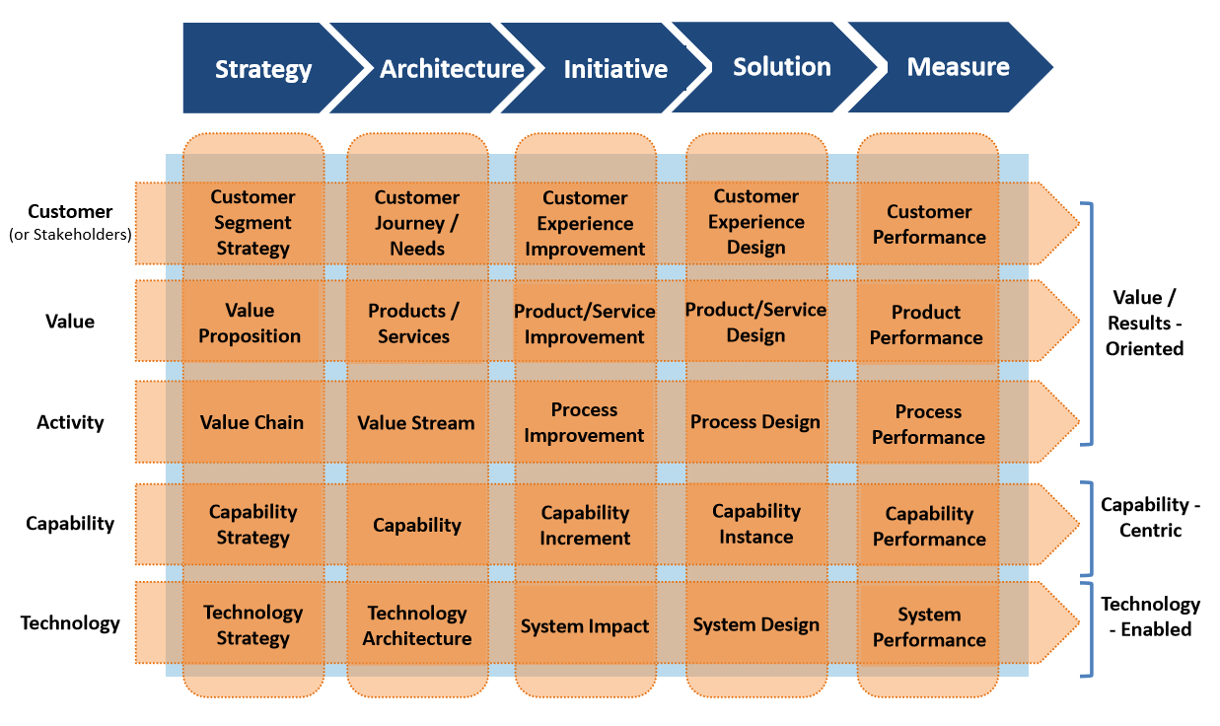
BMO EBA Lifecycle
‘Architecture’ stage:
Future state architecture and standards
Alignment with IT Strategy?
Support and enable strategy development and strategic planning
Core BA focus
Guide and direct initiative planning and solution design
Provide alignment and traceability between strategy and execution; and between business and technology

Slide 27
Business Architecture enabling Strategy Execution

Slide 28
Business Architecture enabling Solution Design & Deployment
Source: A Guide to the Business Architecture Body of Knowledge® (BIZBOK ® Guide)

