Slide 1
SAS GRID 9.4
http://www.gcpedia.gc.ca/wiki/SAS_9.4

Slide 2
Content
SAS GRID 9.4 – Content
SAS GRID Replacement Project
Migration Planning
Review Paths, Partitions, Storage
Drive Mapping (SAMBA) Replacement
Upgrading PC SAS Users
Data Management
Improvements
DAIS/DEXA
Post Migration Plans
Planned Grid Maintenance
Function/Code enhancements
EG improvements

Slide 3
Content
SAS GRID 9.4 – Content
SAS GRID Replacement Project
Migration Planning
Review Paths, Partitions, Storage
Drive Mapping (SAMBA) Replacement
Upgrading PC SAS Users
Data Management
Improvements
DAIS/DEXA
Post Migration Plans
Planned Grid Maintenance
Function/Code enhancements
EG improvements

Slide 4
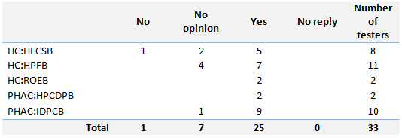
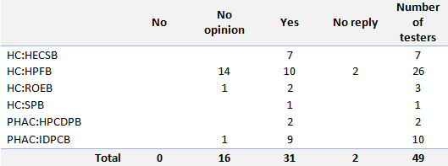
User Acceptance Testing - Results
SAS GRID Replacement Project
Two User Acceptance Testing Cycles were conducted: one in the Development environment and the second in the Production environment.
At the end of each cycle, the testers were asked whether the Grid 9.4 performed as well as or better than the Grid 9.3 environment
The first cycle, on the Development environment, took place July – August:
The second cycle, on the Production environment, took place January – March:
(PC SAS 9.4 and SAS EG 7.1 were tested with Windows 10 and MS Office 2016)

Slide 5
Risks Accepted by SAS Steering Committee (April 2019)
SAS GRID Replacement Project
A solution to replace the full functionality offered by the Drive Mappings available in the Grid 9.3 environment has not been identified
The FileZilla (sftp utility) software which will be pushed to Grid users covers the functionality to upload files to and download files from the new Grid, but it does not allow for direct load and access to SAS data.
Loss of SAS Consultant
SSC does not have a dedicated SAS Administrator and lacks the capability of strong troubleshooting skills (heavy reliance on SAS consultant to resolve issues).
Update:
ExpanDrive will be tested (July) to replace full functionality offered for mapped drives. Timeline of availability procurement dependant.
SAS Consultant returned since May

Slide 6
Content
SAS GRID 9.4 – Content
SAS GRID Replacement Project
Migration Planning
Review Paths, Partitions, Storage
Drive Mapping (SAMBA) Replacement
Upgrading PC SAS Users
Data Management
Improvements
DAIS/DEXA
Post Migration Plans
Planned Grid Maintenance
Function/Code enhancements
EG improvements

Slide 7
Information Collection
SAS GRID 9.4 – Migration Planning: Information Collection
This information, along with the shared folder groups, is key to helping us plan with whom you should be migrated.

Slide 8
Information Session
SAS GRID 9.4 – Migration Planning: Information Session
Main delay in migration process is user engagement. All SAS Grid users need to engage in the migration process when called upon.
Explain what the migration process entails…
Phase 1 Tasks for users (week one) :
Complete installation of the SAS Enterprise Guide 7.1 - IMSD may push this in advanced as there are delays being experienced in this step
Configure and test connection to the Grid 9.3 environment
Run some code in the Grid 9.3 environment
Respond to phase 1 sign-off email (granting IMSD permission to proceed with the creation of your Grid 9.4 account and the migration of the home folder)
Phase 3 Tasks for users (week two):
Configure and test connection the Grid 9.4 environment
Verify and validate that your home folder files have been copied successfully
Run some code in the Grid 9.4 environment
Respond to phase 3 sign-off email (granting IMSD permission to proceed with disabling your Grid 9.3 account)
In phase 1, users are invited to attend one of two FileZilla Demos
In phase 3, users are invited to attend one of two Q & A sessions
Explain some changes you should expect (new software SAS EG 7.1 & FileZilla, paths, code changes, connection profile configuration, partitioning.)

Slide 9
Content
SAS GRID 9.4 – Content
SAS GRID Replacement Project
Migration Planning
Review Paths, Partitions, Storage
Drive Mapping (SAMBA) Replacement
Upgrading PC SAS Users
Data Management
Improvements
DAIS/DEXA
Post Migration Plans
Planned Grid Maintenance
Function/Code enhancements
EG improvements

Slide 10
Path References
SAS GRID 9.4 – Review Paths, Partitions, Storage
Home folder:
Shared folders:

Slide 11
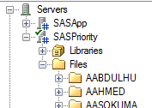
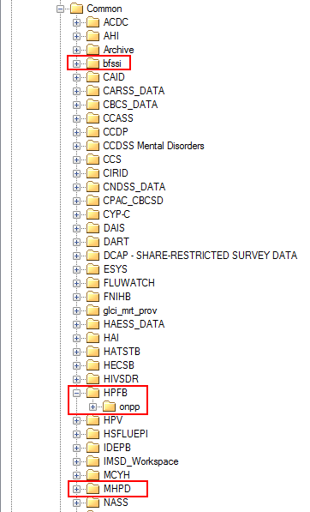
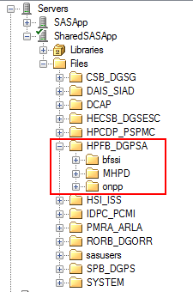
SAS GRID 9.4 – Review Paths, Partitions, Storage
Grid SAS 9.3
Grid SAS 9.4

Slide 12
Partitions and Storage Space
SAS GRID 9.4 – Review Paths, Partitions, Storage
The shared drives in the Grid 9.3 environments have been setup as partitions in the new Grid 9.4 environment.
Each partition was allocated 40% more space than the shared folder used on the Grid 9.3.
Partitioning was introduced to support data management/governance efforts (best practices). Custodians and users will be expected to manage their allotted space.
IMSD is devising processes to monitor partition space usage.
Pre-migration, the Grid 9.4 environment had 16TB storage space available as compared with 6TB on the current 9.3 environment.
An additional 50TB has been ordered. Procuring additional storage takes approximately 6 months.
Custodians will be able to draw down from the available storage space where they can show that they have implemented data governance practices.

Slide 13
Review Paths, Partitions, Storage
SAS GRID 9.4 – Review Paths, Partitions, Storage
Storage can grow
IMSD investigation implementation of:
Methods to track available space in group partitions
Notifying custodians when a certain % of storage use is reached for their partition
Custodian access to view partition consumption

Slide 14
Content
SAS GRID 9.4 – Content
SAS GRID Replacement Project
Migration Planning
Review Paths, Partitions, Storage
Drive Mapping (SAMBA) Replacement
Upgrading PC SAS Users
Data Management
Improvements
DAIS/DEXA
Post Migration Plans
Planned Grid Maintenance
Function/Code enhancements
EG improvements

Slide 15
Drive Mapping (SAMBA) Replacement
SAS GRID 9.4 – Drive Mapping (SAMBA) Replacement
SAMBA is not an acceptable solution to transfer files from mapped drives directly to SAS Grid (SAMBA, as it is now, is a security risk)
Investigation into alternate acceptable applications has led to planned testing of ExpanDrive as a desktop solution (July)
Current Workaround:
Use of Filezilla to SFTP the files from mapped drive to users’ workstation (to potentially code protected external drive) and then onto SAS Grid.
You need to consider, given your own data agreements, if the work around is suitable or if it blocks you from migrating?
Requirement to transfer/receive data directly impacts batch selection/timing
If you are impacted by the absence of the direct data transfer solution, it is important to identify yourself as such in the initial migration meeting.

Slide 16
Content
SAS GRID 9.4 – Content
SAS GRID Replacement Project
Migration Planning
Review Paths, Partitions, Storage
Drive Mapping (SAMBA) Replacement
Upgrading PC SAS Users
Data Management
Improvements
DAIS/DEXA
Post Migration Plans
Planned Grid Maintenance
Function/Code enhancements
EG improvements

Slide 17
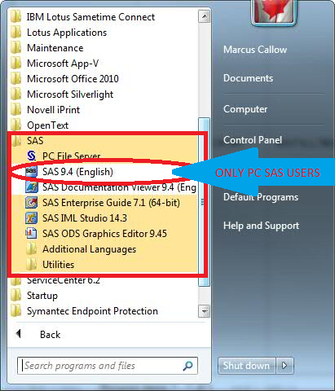
Upgrading PC SAS Users
SAS GRID 9.4 – Upgrading PC SAS Users
Grid users use Enterprise Guide (EG) vs PC SAS users which are local to their workstation
EG users connect to the SAS Grid to do their work. Intranet connection required!
PC SAS users need to acquire a license
PC SAS users see: “SAS 9.<version>” under their SAS folder. (see image)
PC SAS users can’t easily share their data sets
PC SAS users aren’t required to be online to perform their work.

Slide 18
Upgrading PC SAS Users With SAS EG
SAS GRID 9.4 – Upgrading PC SAS Users
PC SAS users must not proceed with the EG 7.1 installation until after PC SAS 9.3 & EG 5.1 have been uninstalled.
The EG 7.1 software will still be pushed via the IBM Big Fix Support Center
Uninstallation/Installation of EG and PC SAS software will be performed by Desktop Support in the Regions, our HC SAS team in the NCR
Order of uninstall / install: PC SAS, EG <reboot> EG,PC SAS
“PC SAS only” users are outside the scope of SAS Grid Migration. IMSD *may* upgrade you prior based on resource avail.- all pc sas

Slide 19
Content
SAS GRID 9.4 – Content
SAS GRID Replacement Project
Migration Planning
Review Paths, Partitions, Storage
Drive Mapping (SAMBA) Replacement
Upgrading PC SAS Users
Data Management
Improvements
DAIS/DEXA
Post Migration Plans
Planned Grid Maintenance
Function/Code enhancements
EG improvements

Slide 20
Data Management
SAS GRID 9.4 – Data Management
With the new SAS 9.4 Grid, implementation of data management best practices
Directory structures
Reduction in duplication of data
User access to data
IMSD has brought in a resource to work with business lines to introduce and implement common best practices.
~50 business lines, lengthy process to properly communicate and assist in implementation. Ongoing, evolving process.

Slide 21
Content
SAS GRID 9.4 – Content
SAS GRID Replacement Project
Migration Planning
Review Paths, Partitions, Storage
Drive Mapping (SAMBA) Replacement
Upgrading PC SAS Users
Data Management
Improvements
DAIS/DEXA
Post Migration Plans
Planned Grid Maintenance
Function/Code enhancements
EG improvements

Slide 22
Improvements
SAS GRID 9.4 –Improvements
With the SAS 9.3 Grid, performance was reduced to increase stability – especially impacting long running jobs with high I/O
With SAS 9.4, IMSD is implementing proactive monitoring to adjust and optimize as environment use evolves.
We will be providing users a best practice information which will describe how to configure SAS EG7.1 to optimize execution time for longer jobs as encountered in prod UAT testing.
Partitions by business line will limit all groups being impacted by low disk space
Expectation is that each business line will manage their own partition space
SAS users workarounds with respect to storage constraints should be eliminated with growth process negotiated with SSC.

Slide 23
Content
SAS GRID 9.4 – Content
SAS GRID Replacement Project
Migration Planning
Review Paths, Partitions, Storage
Drive Mapping (SAMBA) Replacement
Upgrading PC SAS Users
Data Management
Improvements
DAIS/DEXA
Post Migration Plans
Planned Grid Maintenance
Function/Code enhancements
EG improvements

Slide 24
DAIS/DEXA
SAS GRID 9.4 – WHAT HAS CHANGED – DAIS/DEXA
Data from legacy platforms (DAIS/DEXA) will be brought onto the 9.4 SAS Grid after 9.3 migration is complete.
Timelines are still being determined
DEXA business owner has been engaged to plan transition
When DEXA is on the SAS Grid, users will no longer need to copy information, rather access the data directly in the Grid.
Inline with the improved data management practices, users should be documenting how to handle the new approach.
DAIS approach is an iterative migration over this fiscal year (dependent on resolution of direct data transfer [SAMBA] replacement)

Slide 25
Content
SAS GRID 9.4 – Content
SAS GRID Replacement Project
Migration Planning
Review Paths, Partitions, Storage
Drive Mapping (SAMBA) Replacement
Upgrading PC SAS Users
Data Management
Improvements
DAIS/DEXA
Post Migration Plans
Planned Grid Maintenance
Function/Code enhancements
EG improvements

Slide 26
Post Migration Plans
SAS GRID 9.4 – Post Migration Plans
Hot Fix – Target before end of calendar year
Addresses issue with PROC IMPORT dropping the time portion of a date time value
M6 Upgrade – Target next fiscal year
M6 Upgrade needs to happen to apply a fix for transition from flash (discontinued support) to HTML5
Working to get rights from SSC for: Scheduler, custodian visibility of data access, batch execution

Slide 27
Post Migration Plans
SAS GRID 9.4 – Post Migration Plans
Visual Analytics (VA)
PoC planning post migration
VA on SAS 9.4 works with Flash only
VA on VIYA works with HTML5
Constraints:
Protected B (SSC) vs non-classified (Cloud)

Slide 28
Post Migration Plans
SAS GRID 9.4 – Post Migration Plans
DMS: DQ/DI
DMS software only installed for those with identified need.
DI is an ETL tool installed on Grid
DQ does fuzzy matching for different data – knowledge base and desktop license required in addition to what is on Grid. Currently we hold licenses for 5 users - who has interest?
DQ build local and promote to Grid
IMSD is investigating bringing in a SAS SME to help with introduction of feature
DQ Cost recovered model. The more licenses, the cheaper per seat
Data Management
Resource for best practices

Slide 29
Content
SAS GRID 9.4 – Content
SAS GRID Replacement Project
Migration Planning
Review Paths, Partitions, Storage
Drive Mapping (SAMBA) Replacement
Upgrading PC SAS Users
Data Management
Improvements
DAIS/DEXA
Post Migration Plans
Planned Grid Maintenance
Function/Code enhancements
EG improvements

Slide 30
Planned Grid Maintenance
SAS GRID 9.4 – Planned Grid Maintenance
Due to instabilities, the SAS 9.3 Grid didn’t have planned maintenance windows as no changes could be made.
With a new SAS 9.4 Grid, the expectation is to have patching performed at the OS level and at the application level
This will lead to planned and advertised service outages
Frequency of application & OS patching to be determined
SSC current maintenance schedule (August, November, February and May). IMSD plans to align to this schedule.
Objective is to have maintenance window not more than twice per quarter
Security patches are not included in the targeted frequency as they usually require quicker action
Intent to publish dates in advance so users can plan their jobs.

Slide 31
Content
SAS GRID 9.4 – Content
SAS GRID Replacement Project
Migration Planning
Review Paths, Partitions, Storage
Drive Mapping (SAMBA) Replacement
Upgrading PC SAS Users
Data Management
Improvements
DAIS/DEXA
Post Migration Plans
Planned Grid Maintenance
Function/Code enhancements
EG improvements

Slide 32
Function/Code enhancements
SAS GRID 9.4 – Function/Code enhancements
Given this is the first upgrade/change to the SAS Grid in quite some time, there are numerous code enhancements and changes.
Pertinent details of what is new up to SAS 9.4M5 can be found here (The grid is not on M6 yet and any changes related to M6 can be ignored for now):
What's New in SAS 9.4
SAS® 9.4 Functions and CALL Routines: Reference, Fifth Edition
SAS 9.3 M2

Slide 33
Content
SAS GRID 9.4 – Content
SAS GRID Replacement Project
Migration Planning
Review Paths, Partitions, Storage
Drive Mapping (SAMBA) Replacement
Upgrading PC SAS Users
Data Management
Improvements
DAIS/DEXA
Post Migration Plans
Planned Grid Maintenance
Function/Code enhancements
EG improvements

Slide 34
Enterprise Guide Improvements
SAS GRID 9.4 – EG Improvements
Summary of Changes
5.1 → 7.15

Slide 35
EG Improvements
SAS GRID 9.4 – EG Improvements
Process flow annotation "Sticky note" style
Navigate warnings and errors in Log Summary view
Analyze programs for internationalization
Copy and paste process flows
Filter list of tasks by predefined categories or by SAS procedure
Track changes made to programs with the new program history feature
Quickly access any tasks that you recently opened or that you marked as favorites
Smart highlighting -all occurrences of a word when you select/search for it in the Program Editor
Project Log Summary window includes an aggregated list of all messages generated in the project log

Slide 36
EG Improvements
SAS GRID 9.4 – EG Improvements
View all SAS macro variables defined in your current SAS session with the SAS Macro Variable Viewer
View all the SAS system options defined for your current SAS session with SAS System Options Viewer
Search your project for text that you specify or search for a task by name, SAS procedure, or keyword.
Open the Query Builder with multiple tables selected.
Access the data in SAS Visual Analytics with the Upload to LASR task that lets you upload data to SAS LASR Analytic Server
Quickly filter data by using a WHERE expression
Create case-insensitive filters in the Query Builder or when you filter and sort your data by using the Filter and Sort task
Enable SAS Enterprise Guide to automatically check for software updates

Slide 37
EG Improvemets
SAS GRID 9.4 – EG Improvements
Copy and paste prompts within the same project or into another SAS Enterprise Guide project.
Add data and reports to your list of favorites
Export a SAS Visual Analytics report to PDF
Process flow action if error
Copy files task
New graph format
Data step debugger
Create accessible PDF files.
Open script files in the text editor.
New Catalog and Formats Explorer
Support for project log operations (such as clear, export, and send via email) using automation.
Integration with SAS Viya. SAS Enterprise Guide enables you to run Viya tasks from SAS Studio. You can also submit Cloud Analytic Services (CAS) code

Slide 38
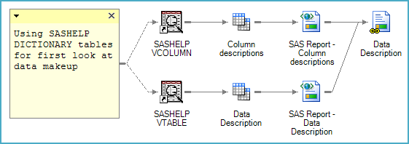
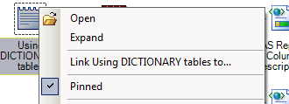
EG Improvements
SAS GRID 9.4 – EG Improvements
Process flow annotation "Sticky note" style
Notes:
All releases have included note project items.
-One limitation in earlier releases is that note contents can be viewed only by opening the note.
-SAS Enterprise Guide 6.1 has added the ability to keep notes in an open state, providing a simple way to annotate complex process flows, as shown in the image

Slide 39
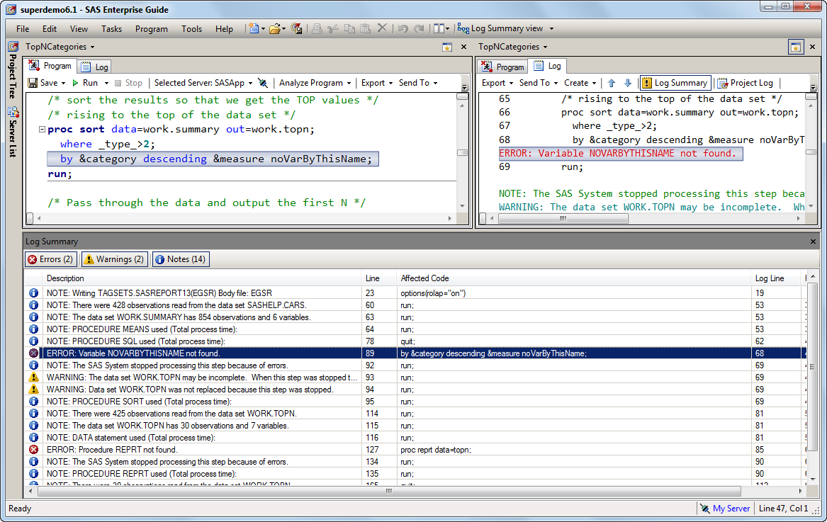
EG Improvements
SAS GRID 9.4 – EG Improvements
Navigate warnings and errors in Log Summary view

Slide 40
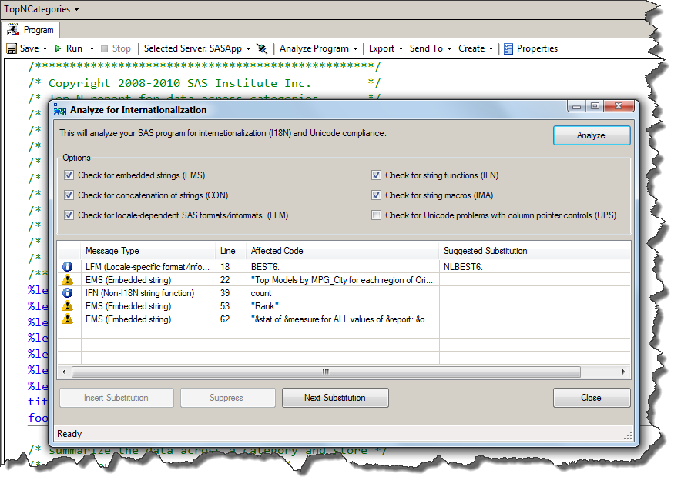
EG Improvements
SAS GRID 9.4 – EG Improvements
Analyze programs for internationalization
The ability to analyze a SAS program to determine whether there are any possible internationalization issues.
SAS Enterprise Guide lists the lines of code that might be affected and suggests substitutions when possible
http://blogs.sas.com/content/sasdummy/i18n-and-l10n-lazy-terms-for-important-work/

Slide 41
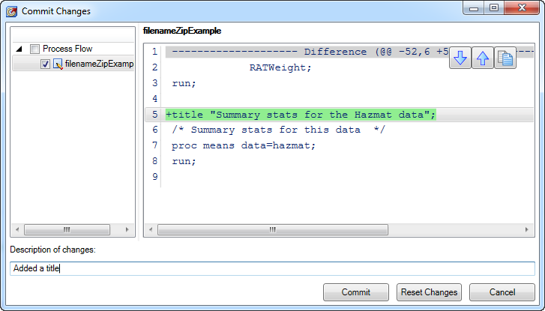
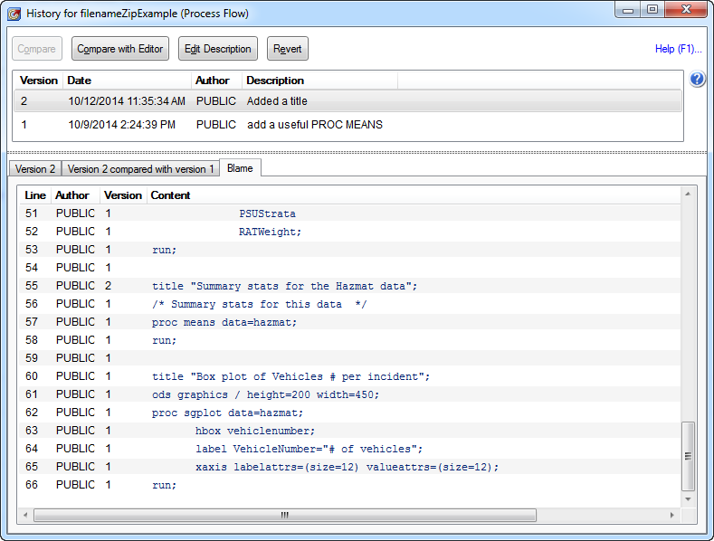
EG Improvements
SAS GRID 9.4 – EG Improvements
Track program history-source control integration
You can "commit", view history, revert changes, compare versions, and even see an annotated "blame" view that shows exactly when you introduced a change that broke your program.
.
Notes:
This is one of the biggies. If you have SAS programs in your SAS Enterprise Guide project, you can now track your changes in those programs using standard source control management methods.
GIT The program history feature relies on a "hyperlocal" Git repository within your EGP file, so you can't use this to track changes to SAS programs that you store outside of the project
But SAS Enterprise Guide 7.1 also supports integration with a file-system-based Git repository if you set one up using other tools. The SAS integrated menus/tools will still help you to see your program's heritage.

Slide 42
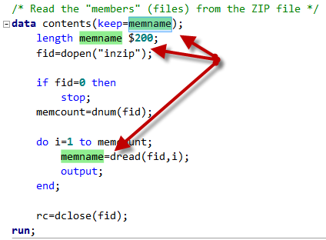
EG Improvements
SAS GRID 9.4 – EG Improvements
Double-click on a word in the editor to highlight it, and instantly see all other occurrences of that word highlighted in your program view.
Smart highlighting in the program editor
Notes:
By default, when you select or search for a word in the Program Editor, all other occurrences of that word are also highlighted
Useful for finding all occurrences of a variable name, data set name, or an embarrassing misspelling.

Slide 43
EG Improvements
SAS GRID 9.4 – EG Improvements
The Project Log shows you a complete aggregated view of your SAS logs within your project
Project log summary window
Notes:
Displayed with the Project Log window and includes an aggregated list of all the messages that have been generated in the project log.
Simplifying your journey through the log content.

Slide 44
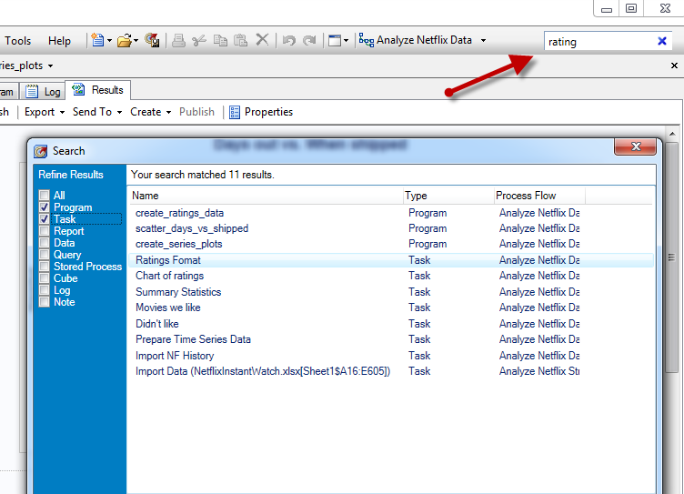
EG Improvements
SAS GRID 9.4 – EG Improvements
Project level search
New built-in search feature that allows you to search the current project for text in any project element, including tasks, programs, and results.
Notes:
Displayed with the Project Log window and includes an aggregated list of all the messages that have been generated in the project log.
Simplifying your journey through the log content.

Slide 45
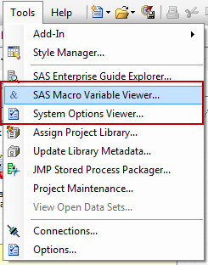
EG Improvements
SAS GRID 9.4 – EG Improvements
SAS Macro Variable viewer and SAS System Options viewer
The macro variable viewer shows all of the current SAS macro variables and their values, plus allows a quick method to evaluate macro expressions.
The system options viewer shows all of the SAS options, with their values and meanings.
Notes:
View all SAS macro variables defined in your current SAS session. Use this window to see changes to the macro variables while you work in SAS Enterprise Guide and to quickly evaluate a macro expression.
View all SAS system options defined for your current SAS session.

Slide 46
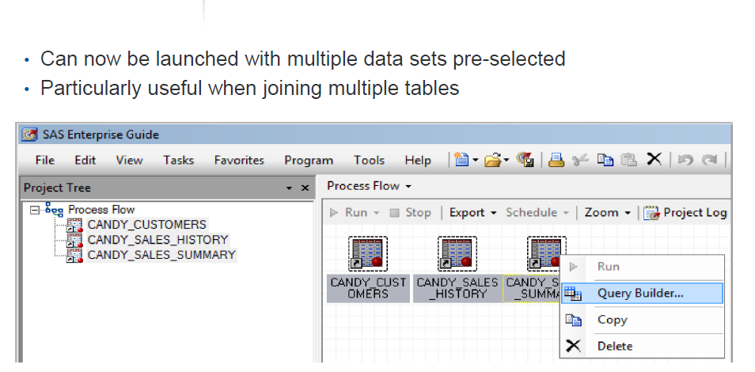
EG Improvements
SAS GRID 9.4 – EG Improvements
Query Builder can launch multiple data sets

Slide 47
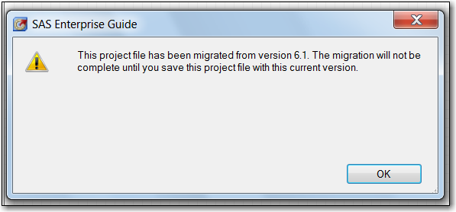
EG Improvements
SAS GRID 9.4 – EG Improvements
Migrating from older versions
Recommended Steps:
Copy / backup first
Version difference will be altered
Test!
Save a new copy as v7.x

Slide 48
EG Improvements
SAS GRID 9.4 – EG Improvements
Copy data
Select the data that you want within the SAS Enterprise Guide data grid. You don't need to select all columns or all cells within the data set. With the selection active, right-click and select Copy with headers

Slide 49
EG Improvements
SAS GRID 9.4 – EG Improvements
Copy An Entire Project Flow
Right-click on the flow name within the Project Tree, then select Copy. In your destination project, right-click on an empty spot within the Project Tree and you'll see that Paste is enabled. When you paste, you'll see the entire flow transfer over, including the links and layout

Slide 50
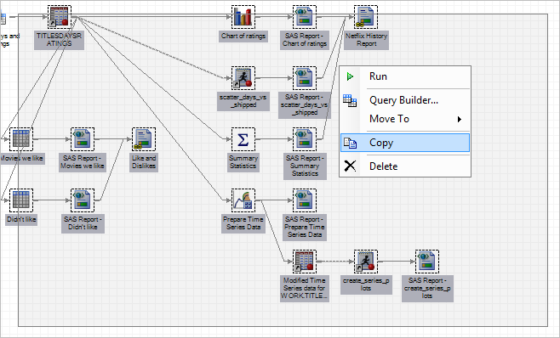
EG Improvements
SAS GRID 9.4 – EG Improvements
Copy portion of process flow (“Rubberband”)
To copy just a portion of the process flow, click-drag the cursor to "rubberband" a selection of connected items.

Slide 51
EG Improvements
SAS GRID 9.4 – EG Improvements
Subset data WHERE clause
With the latest update, you can now subset your data in the data grid by typing a WHERE clause filter. The new Where button appears at the top of the data grid.
Simply click the button, and type a filter expression into the text field. Hit the Enter key to apply the filter:

Slide 52
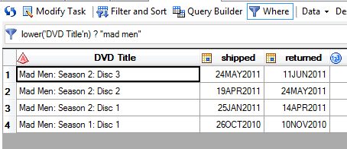
EG Improvements
SAS GRID 9.4 – EG Improvements
Build case-insensitive filters
Build more complex expressions too just like you can expect with SAS. For example, transforming the variable being compared to lower case so that case-insensitive filters are easier to build:
Notes:
Lower & upper functions new in sas 9.3

Slide 53
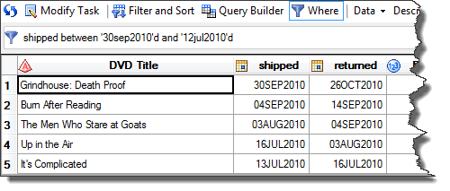
EG Improvements
SAS GRID 9.4 – EG Improvements
Flexibility with operators
If you have continuous variables e.g. a date variable, you can subset by using BETWEEN to specify the boundaries you want to see:

Slide 54
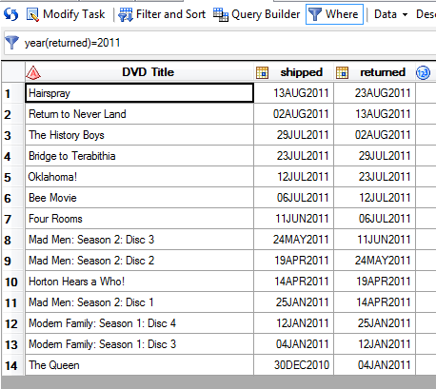
EG Improvements
SAS GRID 9.4 – EG Improvements
Other functions…
Or transform that continuous range to a category (such as a YEAR) with a SAS function, on the fly:

Slide 55
EG Improvements
SAS GRID 9.4 – EG Improvements
Overview
Generate results in Microsoft Excel and Microsoft PowerPoint formats and specify options for those formats.
New Save All option. The default behavior of the save option now saves the active item in the project.
Zoom the contents of items in the workspace, such as programs, data, HTML results, and process flows.
Open externally referenced files in their default associated applications.

Slide 56
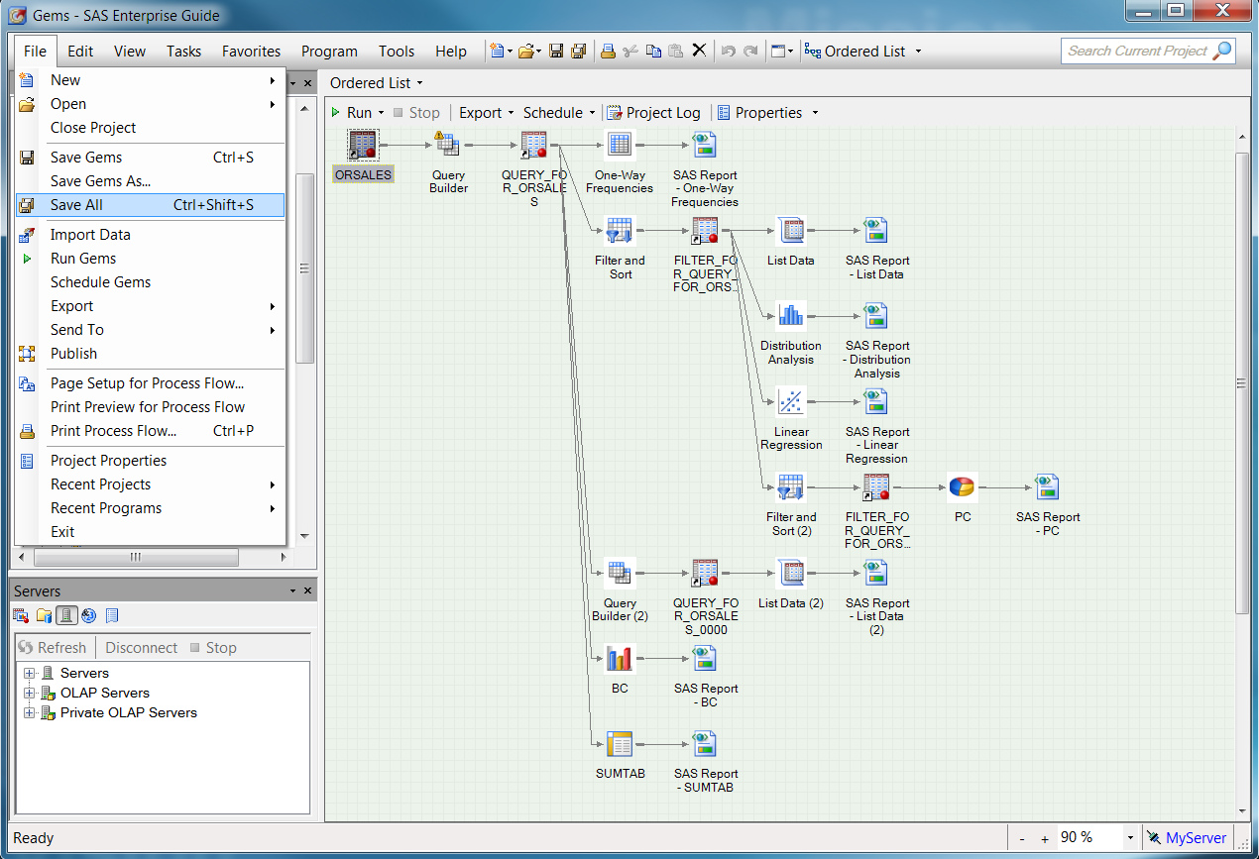
EG Improvements
SAS GRID 9.4 – EG Improvements
Save All
Notes:
-SAS Enterprise Guide 7.12 added a Save All feature and changed the behavior of the default Save operation to be a more intuitive contextual save.
-Prior to this change, the standard Save operation (Ctrl+S) always saved the SAS Enterprise Guide project.
-This was particularly confusing when editing an external SAS program.
-For example, Ctrl+S is a standard keyboard shortcut for saving a document you are editing. However, if you were editing a .sas file and pressed Ctrl+S, SAS Enterprise Guide did not save the .sas file. Rather, it saved the SAS Enterprise Guide project. Then, realizing the user probably actually expected the .sas file to be saved, Enterprise Guide would prompt the user if they also wanted to save the program. This was not a very good experience.
-The expected behavior is that pressing Ctrl+S automatically saves the document you are editing, without prompting. This is how SAS Enterprise Guide now behaves. The default save (Ctrl+S) is now contextual. If you are working on an embedded program, the default save saves the project, since embedded programs are stored in the project. If you are working on an external file, the default save saves the external file. The default save behavior for all other items that are not independently savable is to save the project

Slide 57
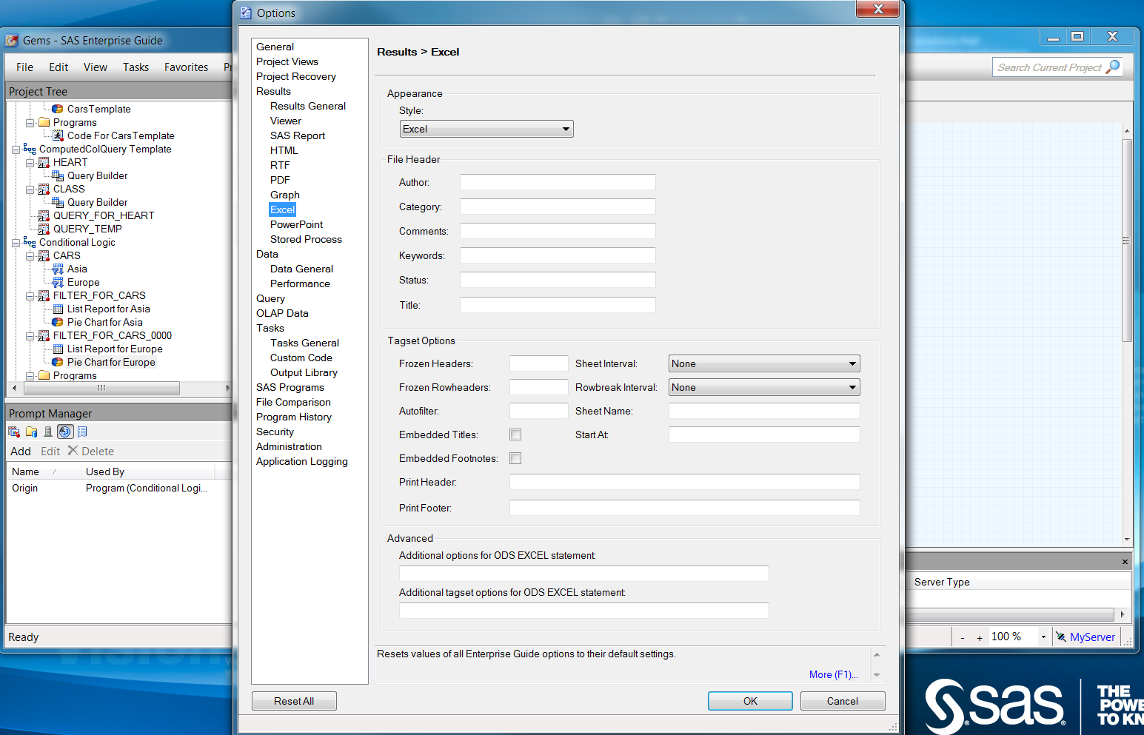
EG Improvements
SAS GRID 9.4 – EG Improvements
New destinations Excel and PowerPoint

Slide 58
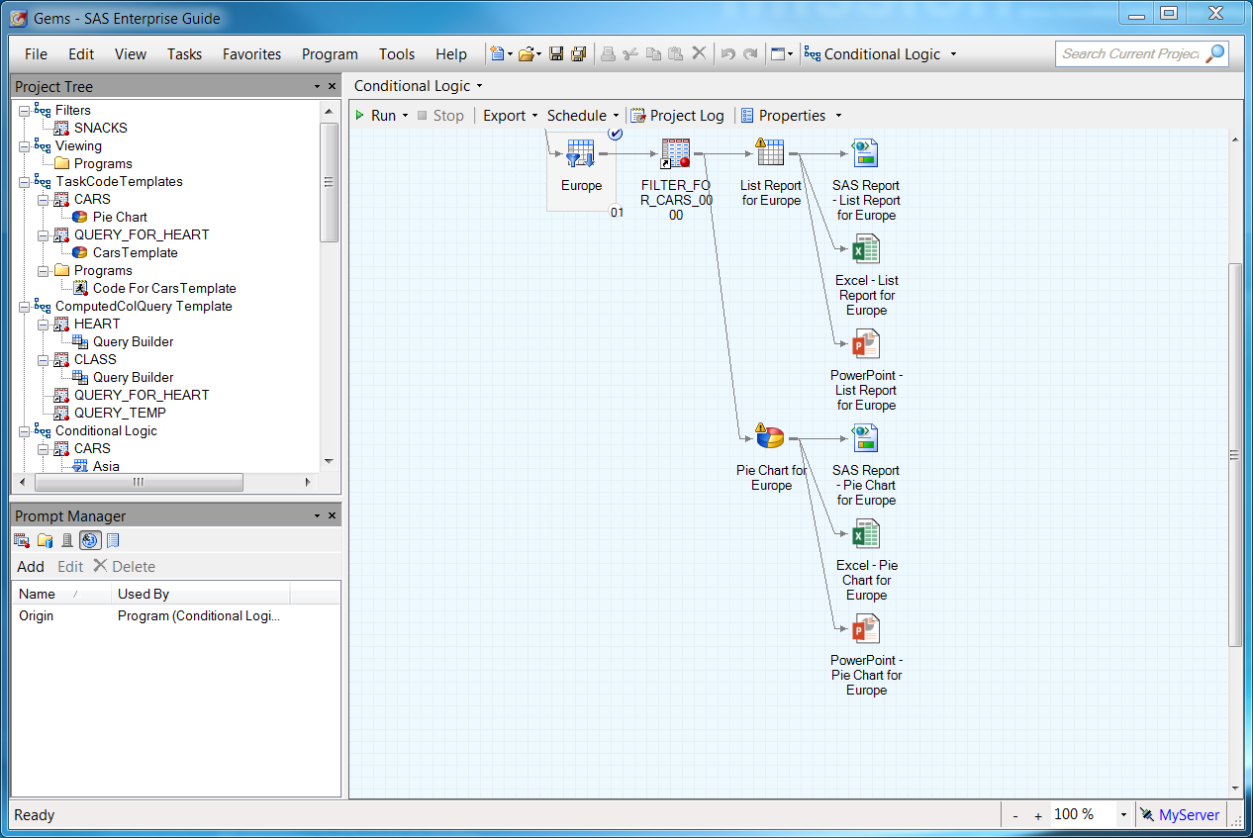
EG Improvements
SAS GRID 9.4 – EG Improvements
New destinations Excel and PowerPoint

Slide 59
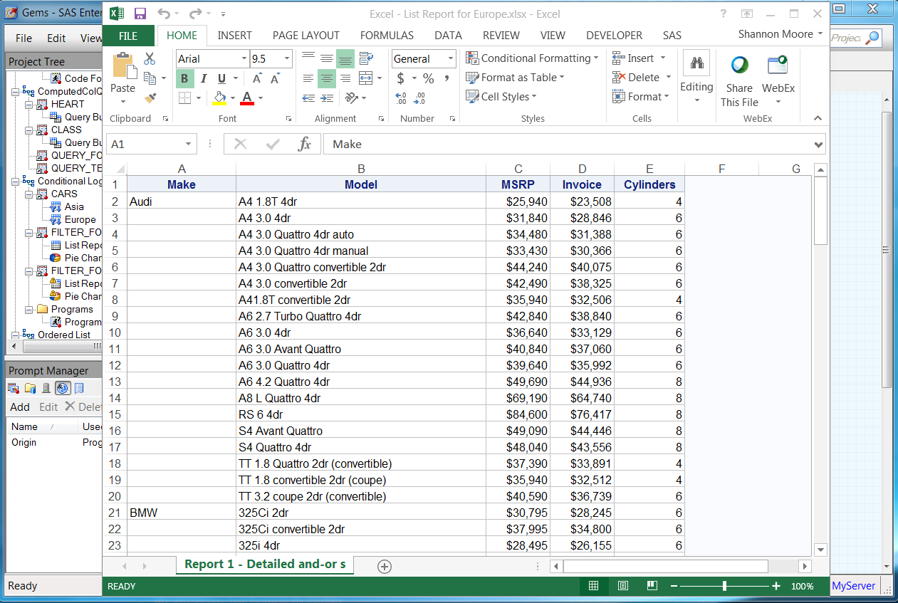
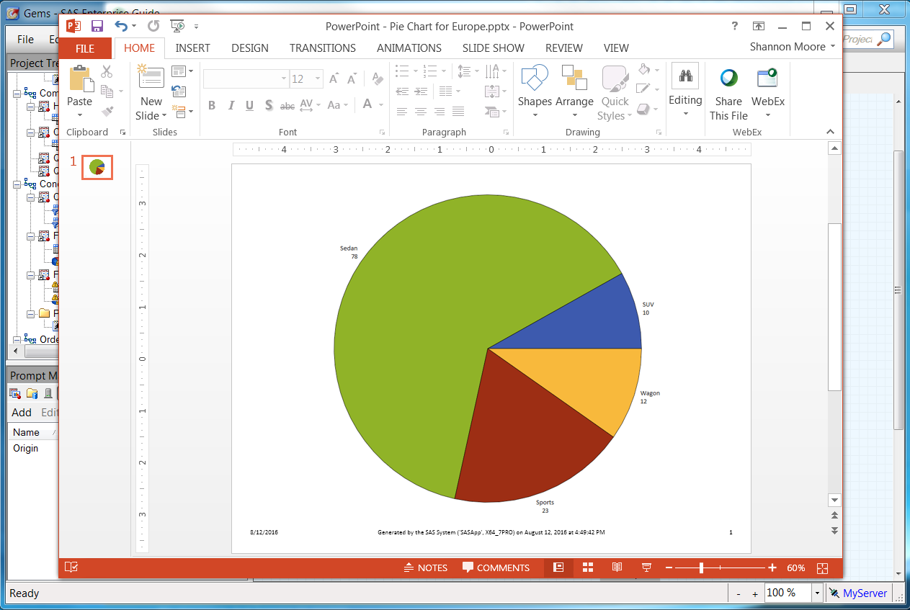
EG Improvements
SAS GRID 9.4 – EG Improvements
New destinations Excel and PowerPoint

Slide 60
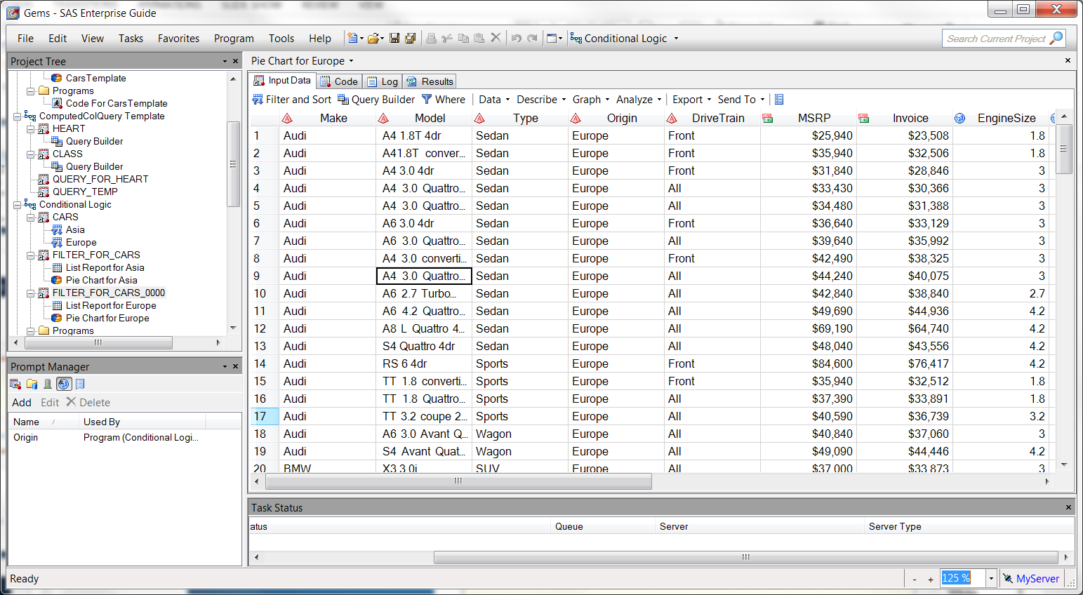
EG Improvements
SAS GRID 9.4 – EG Improvements
Zoom for process flow, data grid, log and code

Slide 61
EG Improvements
SAS GRID 9.4 – EG Improvements
Data step debugger
A tool that enables you to find logic errors in a DATA step program.
With the DATA Step Debugger, you can watch the variable values in a program change as the program runs.
You can execute the program line by line, and you can also set specific breakpoints in the program

Slide 62
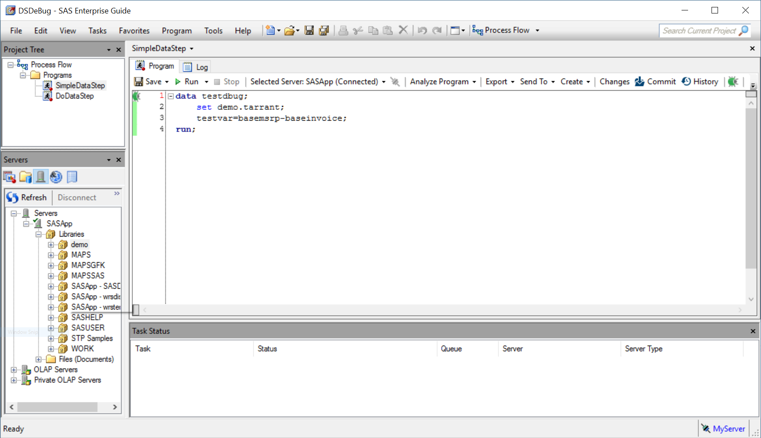
EG Improvements
SAS GRID 9.4 – EG Improvements
Data step debugger

Slide 63
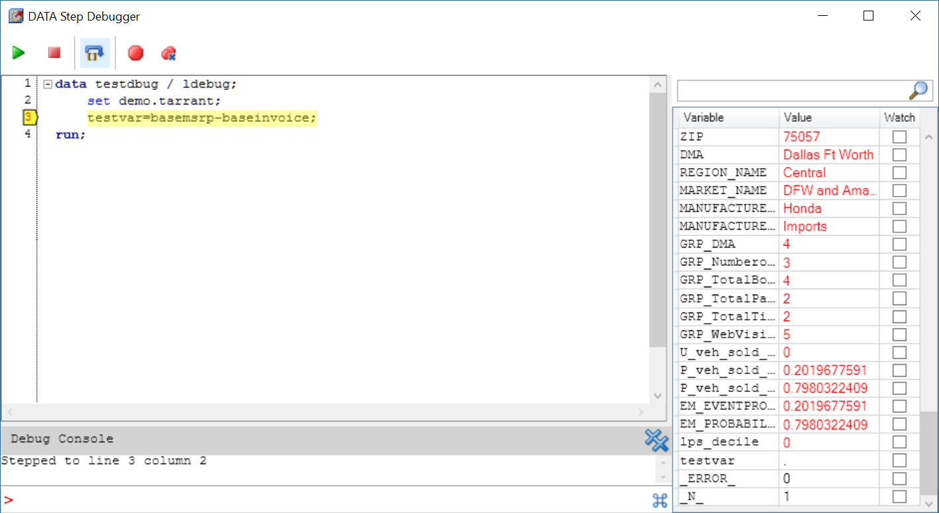
EG Improvements
SAS GRID 9.4 – EG Improvements
Data step debugger

Slide 64
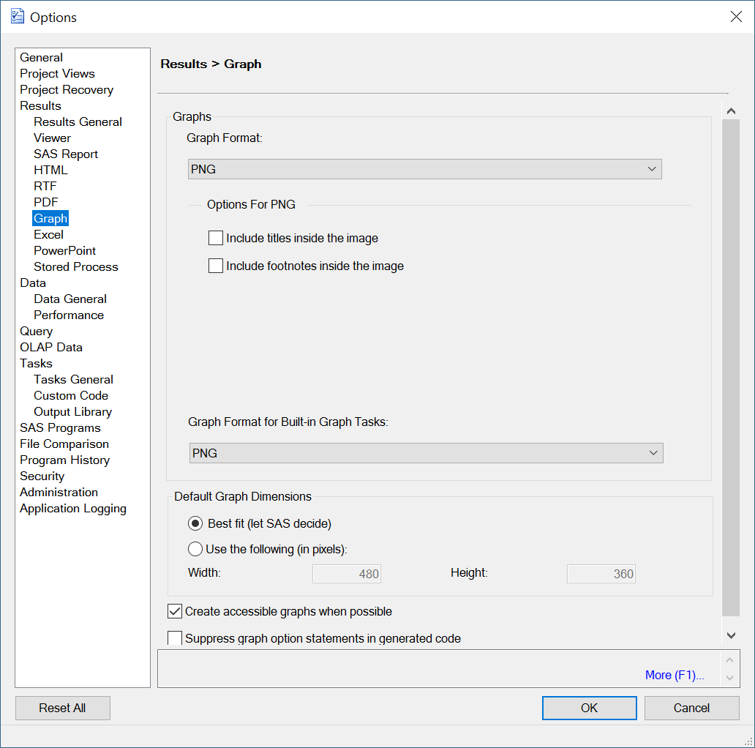
EG Improvements
SAS GRID 9.4 – EG Improvements
New graph format
New graph format
Starting with this release, the default graph format is PNG. Use the new Graph Format for Built-in Graph Tasks option to set the default format for the graph tasks, such as Bar Chart, Line Chart, and Pie Chart

Slide 65
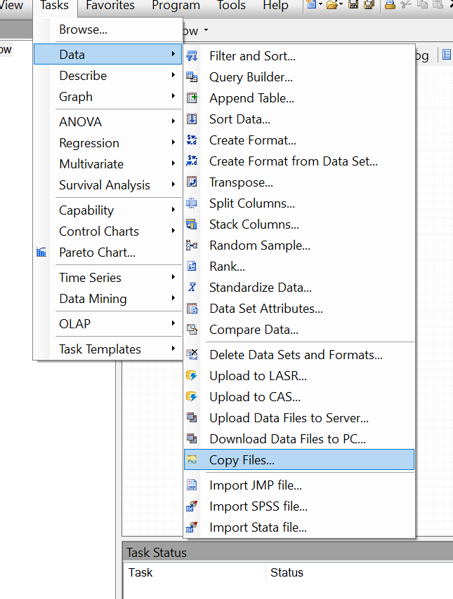
EG Improvements
SAS GRID 9.4 – EG Improvements
Copy files task
Transfer files from local computer to a SAS server, or from a SAS server to local computer by using the Copy Files task.
The Copy Files task works in a similar way to an FTP application. However, this task relies on the SAS protocols to complete the file transfers and does not require an FTP server.
New graph format

Slide 66
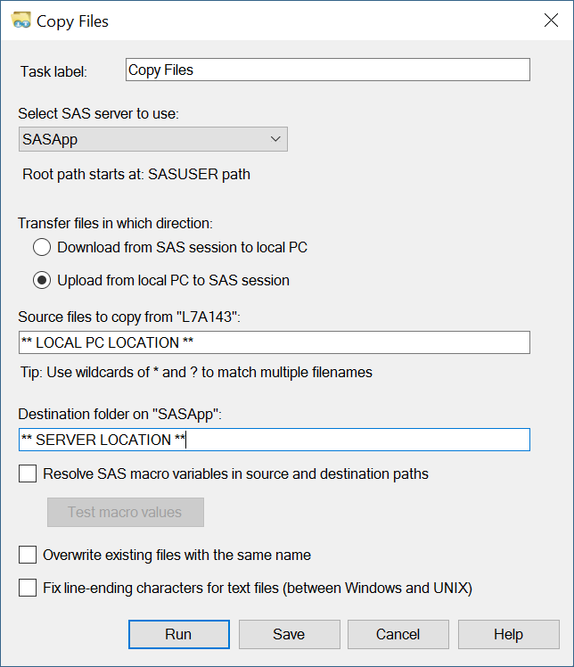
EG Improvements
SAS GRID 9.4 – EG Improvements
Copy files task
New graph format

Slide 67
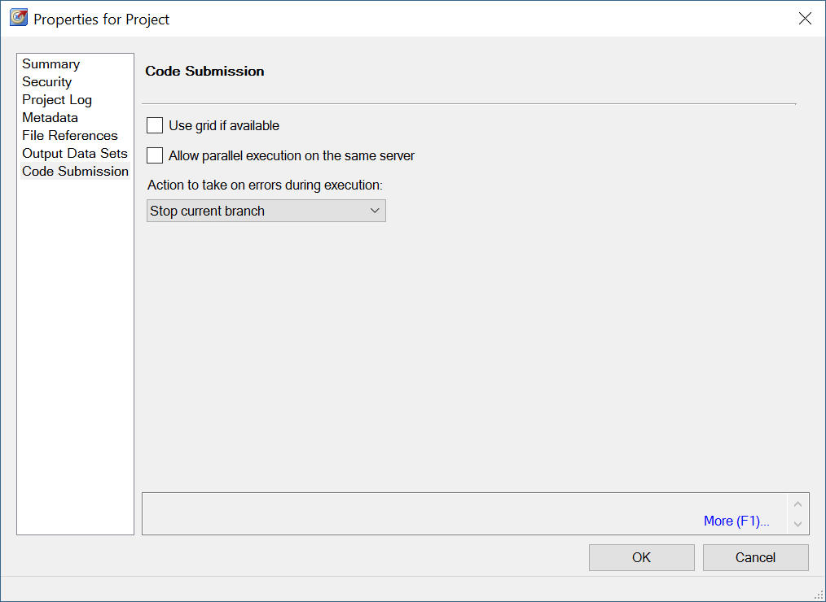
EG Improvements
SAS GRID 9.4 – EG Improvements
Process flow action if error
New graph format
You can specify whether to continue executing a process flow if an error is encountered
Notes:
Use grid option forced/used automatically job slots per user

Slide 68
EG Improvements
SAS GRID 9.4 – EG Improvements
Catalogue and Formats Explorer
Explore SAS libraries and the catalogs in those libraries with the Catalog and Formats Explorer.
View the metadata (name, description, created and modified dates) for every catalog entry, view contents of some entry types, such as SOURCE entries and format entries, and delete entries.
Notes:
Catalog and Formats Explorer
Starting in SAS Enterprise Guide 7.15, the Catalog and Formats Explorer is available. (In previous releases, this functionality was available as a downloadable custom task.)
With the Catalog and Formats Explorer, you can explore SAS libraries and the catalogs in those libraries. You can view the metadata (name, description, created and modified dates) for every catalog entry. You can view the contents of some entry types, such as SOURCE entries and format entries. You can also delete entries

Slide 69
EG Improvements
SAS GRID 9.4 – EG Improvements
Create Accessible PDF
Accessible output is generated in a way that it can be read by a screen reader to someone with low or no vision, visualized by someone with low vision or color blindness, or navigated by someone with limited mobility
Notes:
Prior to SAS 9.4M4, using a screen reader with PDF files created by ODS did not work because the PDF files created by ODS are not “tagged.”
Tags in a PDF file are not visible in Adobe Reader when the file is opened. But, when a PDF file is tagged, the file contains underlying metadata to facilitate screen readers verbalizing the results. Here’s an example of the same PROC PRINT step above written to two different PDF files using SAS 9.4M4. I created the tagged.pdf file using the ACCESSIBLE preproduction destination option, so the file includes tags, making it accessible using assistive technology.

Slide 70
EG Improvements
SAS GRID 9.4 – EG Improvements
Create Accessible PDF
ods pdf file="c:\temp\untagged_default.pdf";
ods pdf (id=a) file="c:\temp\tagged.pdf" accessible;
proc print data=sashelp.cars(obs=5);
var type origin;
run;
ods _all_ close;

Slide 71
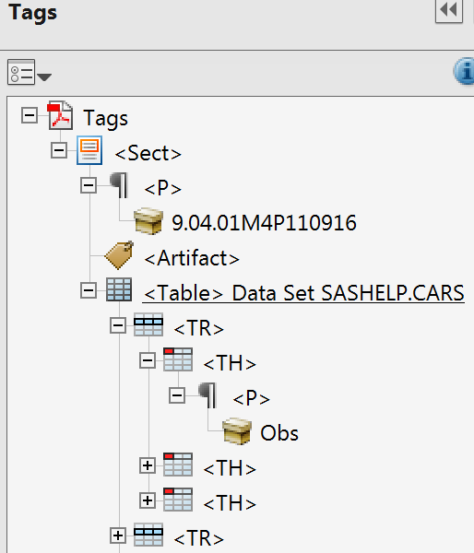
EG Improvements
SAS GRID 9.4 – EG Improvements
Create Accessible PDF
A screen reader uses the HTML-like markup shown above to verbalize the file to someone with low or no vision.

Slide 72
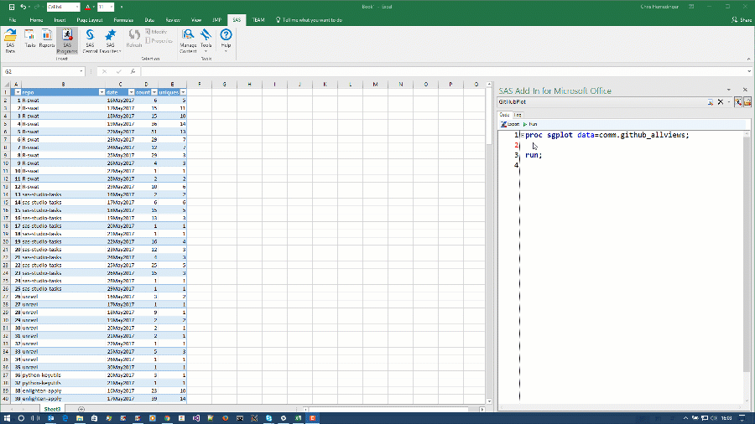
EG Improvements
SAS GRID 9.4 – EG Improvements
What’s New – SAS Office Analytics-AMO
Write & Run your SAS program directly in Microsoft Excel/Word/ PowerPoint
Notes:
When SAS Add-In for Microsoft Office was first created over a decade ago, SAS programmers were told to check their skills at the door. This new product was for non-programmers only. SAS programmers were invited to contribute to the experience by packaging their code in SAS stored processes, which end users would then run using point-and-click menus. But there was no way to write and run your SAS programs directly in Microsoft Excel or Word or PowerPoint.
This was a comfort to many SAS administrators, who wanted to provide SAS analytics to their end users but didn't want them to have to learn to program. Or perhaps to even allow them to program. But, times have changed. Citizen data scientists have been practicing their coding skills, and now they want to mix it up in Microsoft Office. In response to this demand, SAS R&D has added the SAS programming environment -- the parts that make sense, anyway -- into SAS Add-In for Microsoft Office. You can write programs, run them, and drop the results into any part of your Microsoft Office document.
Here's a short screencast of how it works in Microsoft Excel:

Slide 73
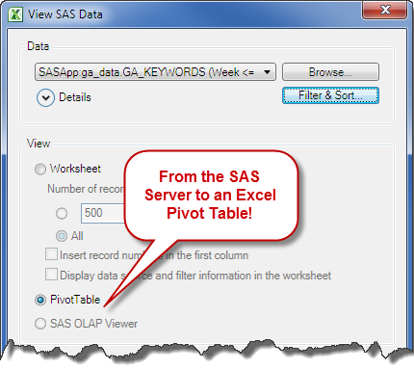
EG Improvements
SAS GRID 9.4 – EG Improvements
What’s New – SAS Office Analytics-AMO
Opening SAS data sources into a Microsoft Excel Pivot table
Notes:
When opening data into a Microsoft Excel PivotTable, you can also select OLAP data as a data source by selecting the OLAP Servers node in the Open Data Source dialog box.
After selecting a data source, the Modify Data Source dialog box displays. Depending on the data source, you might be able to limit variables or filter the data.
You cannot sort data that is opened into a Microsoft Excel PivotTable.
After you click OK in the Modify Data Source dialog box, the variables are displayed in the field list in the Microsoft Excel PivotTable.

Slide 74
EG Improvements
SAS GRID 9.4 – EG Improvements
What’s New – SAS Office Analytics-AMO
Refreshing Your MS Office Report with SAS Data
In the past, you would have had to cut-and-paste or type the data!. With the SAS connection, you can create the report once and then each month/week/day simply click the Refresh icon to have your new data
Tip! Notice that you can export the data directly to a Excel pivot table.
Notes:
When opening data into a Microsoft Excel PivotTable, you can also select OLAP data as a data source by selecting the OLAP Servers node in the Open Data Source dialog box.
After selecting a data source, the Modify Data Source dialog box displays. Depending on the data source, you might be able to limit variables or filter the data.
You cannot sort data that is opened into a Microsoft Excel PivotTable.
After you click OK in the Modify Data Source dialog box, the variables are displayed in the field list in the Microsoft Excel PivotTable.

