Slide 1
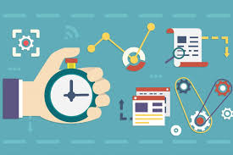
How To Be More Productive: Strategies for managing your workload in non-traditional settings
Todd Scanlan
Jodi LeBlanc
Ericka Stephens-Rennie
Notes:
Introduction to Todd and Ericka
Jodi:
I have worked from home for five years, and at the time I really had to find strategies that would help me work smarter, not harder. The job I was doing at the time used to be done by four people, so every moment counted. I ready tons of articles and talked to coworkers about their productivity hacks, and listened to podcasts to trial and error what worked for me and my work preferences. This presentation will cover some of my favourite tips and tricks.

Slide 2
Schedule a Life Repair Day
Notes:
Starting off, we have a tip for you about how to get things under control when you’re starting to feel like they’re going off the rails.
A Life Repair day is about going slow to move faster. What do I mean?
I mean making the space to deal with all the things that are piling up. It starts with attaining “Inbox zero”…and then goes much further. Jodi find it takes her about two-six hours to complete everything on this list:
Every email answered (yes, every email – for all your email addresses).
Every piece of paper, envelope, and post-it filed or thrown away, including digital clutter.
Your system of physical/electronic files is up-to-date.
Every text on your smartphone is answered.
Your physical desktop is clear, and your computer desktop is free of stray files.
Your in-box (literal and virtual) is empty.
Everything is backed up.
It is such a freeing feeling, getting caught up on all the little things – it really makes a difference to have that clean slate and to take away that feeling of overwhelm.
I find this is also a useful way to delete my transitory email – something that’s so important to reduce the volume you need to sort through in case there’s an ATIP request.
Todd, any comments?
Resources:
This is something that I do once or twice a year and wrote about it 7 years ago in Canadian Government Executive magazine.
https://canadiangovernmentexecutive.ca/2013/09/11/the-full-potential-of-a-day/
The Full Potential of a Day

Slide 3
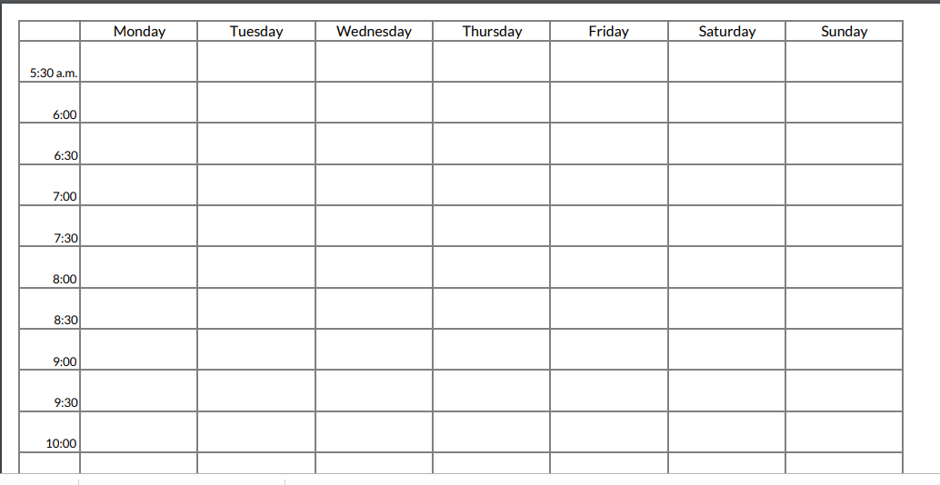
Everyday, you get 24 gold coins… how will you spend them?
Notes:
If you’re feeling like you’re not sure where the time is going, then tracking how you spend it for a week or two is helpful. There may be some tweaks you can do to your schedule to make it work better for you. Or if you find you are spending hours on auto-pilot activities, you can be more mindful of how you are using your time.
Tracking your time takes less time and attention than you might think. It takes just a few seconds to jot down what you worked on during each half-hour chunk of time, and once you settle into the practice, you can update your time tracking sheet every hour or two, recalling what you just did.
Todd, anything to add?
Resources:
How Timeboxing Works and Why It Will Make You More Productive- https://alifeofproductivity.com/how-to-track-your-time/

Slide 4
Don’t Live Life in an Email jail
Notes:
Email can be overwhelming, some days you may reflect on what you did at the end of the day and you may say “all I did today is write and respond to emails”. When you reply to emails you are fulfilling other people’s to do list, and yes you need to do that however if you have three things on your plate for the day and every time you get an email notification you drop everything, open it and then start responding, you are putting that ahead of all of your other priorities.
First turn your notifications off, it can take up to 20 minutes to get back on track with your productivity every time you are interrupted by an email. Communicate with your team that you will be checking email X number of times a day (and if they need to reach you urgently to pick up the phone and call. Otherwise you will be working on your priorities for the day.
Put the email in jail, lock it up so you are not tempted to check it every second. When you do check it here is a great process to follow:
Respond to it, if you can in two minutes or less.
Acknowledge it, and Schedule a time to deal with it. A good response “I am on it” or I will have that for you by XX date so the recipient knows you received it.
Todd, any comments?
~~~~~~~~~~~~If asked via questions for more details on this technique:~~~~~~~~~~~
This is what you do when an email is really a trigger for a task that’s too long to complete during your email session. If it’s an hour-long task, it goes in the calendar; if it’s just three minutes, then it goes on your to-do list (which I’ve written a separate article on). But simply telling the other person that you’ve got it is much more important than it looks. It’s pretty irritating to wonder, five days after emailing someone, whether they got your message or not. What impresses you is when the recipient (a) confirms they got your message, (b) tells you what they’re going to do about it, and (c) promises to deliver by a deadline. You can get the same kudos, when the boot is on the other foot and you’re the respondent, by simply remembering that the AS is a two-step: acknowledge and schedule, and making sure that your acknowledgement contains those ingredients.

Slide 5
Notes:
The Pomodoro Technique (additional info in references)
Airplane mode
It won’t feel comfortable…be dedicated
Todd, any comments?
This is great for the type of work that requires single-tasking or full focus. Developing a strategy, writing a report, evaluating findings from an initiative etc
In order to be successful it is good to block time in your calendar, and let your team know that you are doing deep work and won’t be checking emails until after the allotted time. (Read the slide to walk through 3 steps)
When you’re ready to start, set a timer for 25 minutes, you can either get a kitchen timer (a pomodoro – Italian word for tomato). I did have a pomodoro timer but it broke so I now just ask Alexa to start timer for me. Set your cell phone to airplane mode, turn off your email, and silence all other distractions. Then start on the timer.
During the 25 minutes, you must focus on that task without interruption. And unless the building burns down, do nothing but work on that task until the timer goes off. You may hit the wall, but keep going. The vast majority of people find they can work on that task “in the zone” until the timer goes off.
After 25 minutes, you have a choice: keep working or take a break. If you keep working, reset the timer to 25 minutes and go through the process again, without interruption until the next 25 minutes are up. If you decide to take a break, it can be short (such as refilling your coffee cup), medium (returning a phone call) or long (going into a meeting, or working out).
This technique will save you so much time – in three hours I was able to develop two presentations from scratch and write an article. This would have taken me a full day if I hadn’t used this strategy; having zero interruptions kept me concentrated on the task at hand.
Todd, any comments?

Slide 6
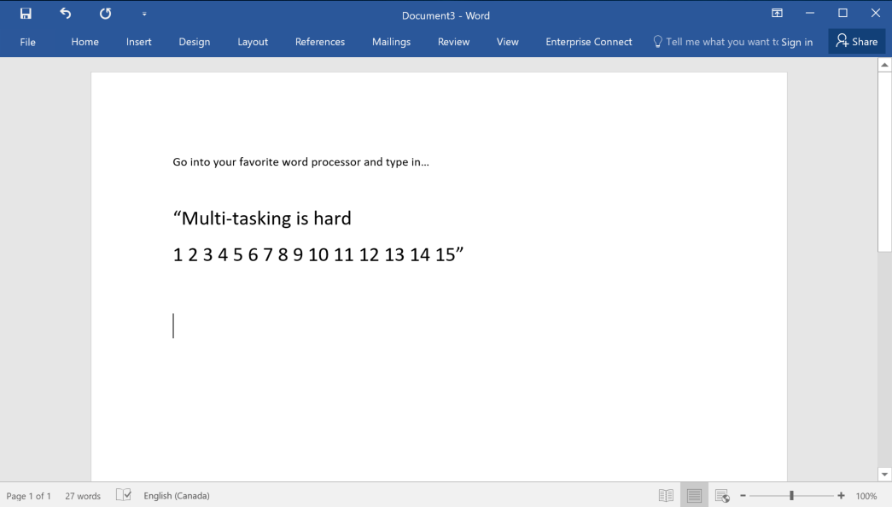
Multitasking is Hard
Notes:
TODD
Multitasking game
Write
“Multitasking is hard” and 12345678910111213141516171819120
NOW do both at the same time
Multi
1234

Slide 7
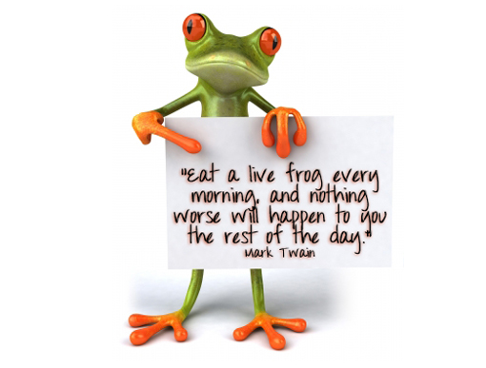
Eat your Frogs First
Notes:
Eat The Frogs First Thing in The Morning (And Other Better Work Habits)
Get that uncomfortable frog out of the way!
“If it’s your job to eat a frog, it’s best to do it First Thing in the Morning. And if it’s your job to eat two frogs, it’s best to eat the BIGGEST one first.” — Mark Twain
You might know about Brian Tracy’s famous“eat-a-frog”-technique from his classic time-management book, Eat That Frog!: 21 Great Ways to Stop Procrastinating and Get More Done in Less Time.
In the morning, right after getting up, you complete the most unwanted task you can think of for that day (= the frog). Focus on the things you don’t want to do, but actually need to do. The biggest, ugly, distasteful things that need to be done, but tend not to.
If more time or during questions>
How do I spot the famous frog?
To get a better overview of your tasks, divide your to-do list in these four categories:
— Things you don’t want to do, but actually need to do. — Things you want to do and actually need to do. — Things you want to do, but actually don’t need to do. — Things you don’t want to do, and actually don’t need to do.
Todd, any comments?

Slide 8
How to Eat an elephant? How to eat a potato field (for vegetarians)?
Notes:
The Only Way to Eat an Elephant
https://www.psychologytoday.com/ca/blog/mindfully-present-fully-alive/201804/the-only-way-eat-elephant
Desmond Tutu once wisely said that “there is only one way to eat an elephant: a bite at a time.” What he meant by this is that everything in life that seems daunting, overwhelming, and even impossible can be accomplished gradually by taking on just a little at a time.
If you’ve ever wanted to accomplish something major, you know that getting started can be a bit of a challenge. Maybe you have some vague idea about what you want but no clue how to get it. Or perhaps you sit down to think about everything you have to do and get completely intimidated, freezing up and feeling incapable of taking the first step.
If you can just commit to even five minutes of 1 item related to the large task, you will get that done. And then the next, and then the next. Soon you will have ¼ of the work completed and so on. Getting started is the key – breaking things up into manageable bit size chunks.
The more elephants you eat, the more you will want to eat an elephant tmo.
Todd, any comments?

Slide 9
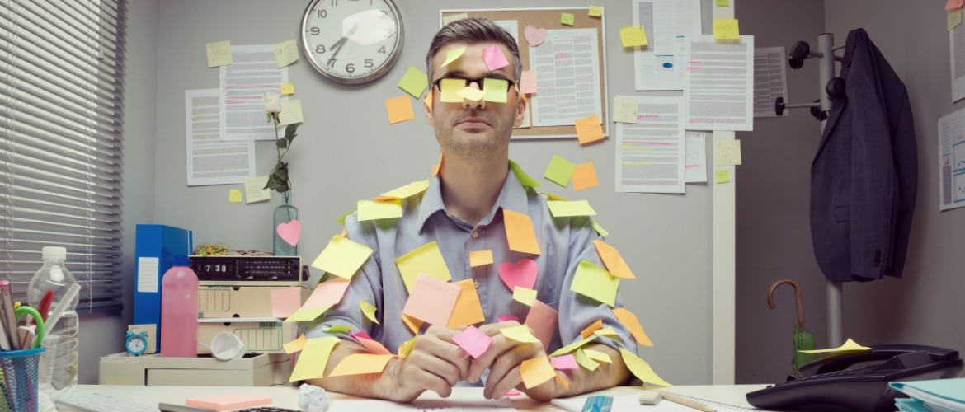
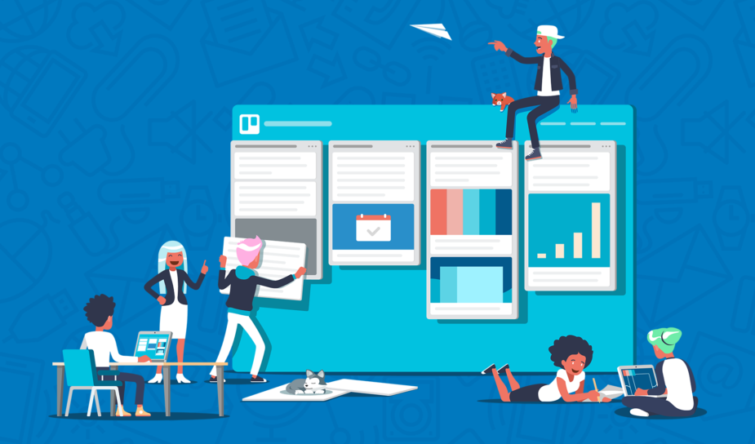
Tool Tip #1: Trello (or any Kanban board)
Trello is an easy, free, flexible, and visual way to digitally manage your projects and organize anything
Notes:
https://canadiangovernmentexecutive.ca/2015/02/05/a-blank-page/
How Trello cured my writer’s block (article above)
I use Trello for every aspect of my life, it has been a game changer in keeping me paperless, but being able to track everything I work on individually and as a team, both personally and professionally.

Slide 10
How Kanban Helps
Notes:
TODD

Slide 11
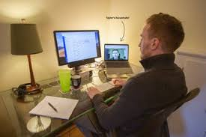
Tool Tip #2: Focusmate
Notes:
One way to improve productivity in a short burst, is to schedule a coworking session. You can do this by asking a colleague on your team, or any other worker you like. The key is to pick someone who won’t do a lot of talking. Then, call or video call each other, state what you’re going to work on, and when you’ll check in next, and get to work.
Focusmate is a platform that will match you up with a virtuall accountability partner somewhere else in the world.
1. Decide when to work Select the times when you want to be productive. We’ll send an email to confirm your sessions.
2 Launch your video session Start each 50-minute session by greeting your partner and declaring your goal. Then get to work.
3 Get your work done Work quietly in tandem with your Focusmate and experience the power of human accountability.
Three free sessions a week - $5 a month for unlimited
I have done over 60 sessions and find it particularly useful for things I may be procrastinating on. Highly recommend it!
It is not for networking or collaborating, it is two people getting things done knowing someone is there virtually to keep you accountable. It may sound creepy but it really works!

Slide 12
Resources
Notes:
Lots of resources out there, blogs, podcasts, book summaries and of course books.

Slide 13
Find what works best for you
Notes:
There is no one size fits all approach. You need to find out what works best for you. What works for me, may not work for you, but the only way to know is trying things out, one at a time, to see how they feel and not just implement everything at once, it is too much change and you will not stick with it.

