Slide 1
Architecture in an Agile Enterprise
How Architects integrate with Agile, DevOps, and other modern delivery practices

Slide 2
Industry Perspective
John Zachman has always said that we need to document everything in ‘excruciating detail.’ Yet in the real world – even in aircraft-engineering, as I know from much first-hand experience – much of the detail won’t stay the same for long enough to make that ‘excruciating detail’ requirement achievable in practice.
Tom Graves
Enterprise Architect, Business Anarchist, Confusionist
Info-Tech Research Group Contributor

Slide 3
Enterprise Architects need to find a new balance
Working
software
isn’t
valuable
We are uncovering better ways of developing software by doing it and helping others do it. Through this work we have come to value:
Automated Processes
Being DevOps
Being Agile
Doing DevOps
Individuals and Interactions
Customer Value & Quality
Working Software
Customer Collaboration
Processes and Tools
Responding to Change
Comprehensive Documentation
OVER
Contract Negotiation
Customer Value & Quality
Following a Plan
That is, while there is value in the items on the right, we value the items on the left more.
Source: “The Agile Manifesto”
Notes:
First you need to change your mindset about what matters.
Scope and cost are usually considered fixed in the Iron Triangle.
Share the key bullets.
Avoid the misconception of considering the cost of delivery as the value provided.
Within an Agile release/MVP – we roadmap scope and cost to provide stakeholders some clarity while under-committing to leave flexibility to adapt to change.
Review the balance.
Comment that if you find yourself on the right as opposed to the left you might be doing Agile, but you won’t see the benefits of being Agile.
“The Agile Manifesto” does not suggest that you don’t value the things on the right. If you focus on the right, it means you are doing Agile and not truly being Agile. Instead, we value the things on the left over the things on the right to increase productivity and improve customer value.

Slide 4
Enterprise Architects need to find a new balance
We are uncovering better ways of developing software by doing it and helping others do it. Through this work we have come to value:
Automated Processes
Being DevOps
Being Agile
Doing DevOps
Individuals and Interactions
Customer Value & Quality
Working Software
Customer Collaboration
Processes and Tools
Responding to Change
Comprehensive Documentation
OVER
Contract Negotiation
Customer Value & Quality
Following a Plan
That is, while there is value in the items on the right, we value the items on the left more.
Source: “The Agile Manifesto”
Notes:
First you need to change your mindset about what matters.
Scope and cost are usually considered fixed in the Iron Triangle.
Share the key bullets.
Avoid the misconception of considering the cost of delivery as the value provided.
Within an Agile release/MVP – we roadmap scope and cost to provide stakeholders some clarity while under-committing to leave flexibility to adapt to change.
Review the balance.
Comment that if you find yourself on the right as opposed to the left you might be doing Agile, but you won’t see the benefits of being Agile.
“The Agile Manifesto” does not suggest that you don’t value the things on the right. If you focus on the right, it means you are doing Agile and not truly being Agile. Instead, we value the things on the left over the things on the right to increase productivity and improve customer value.

Slide 5
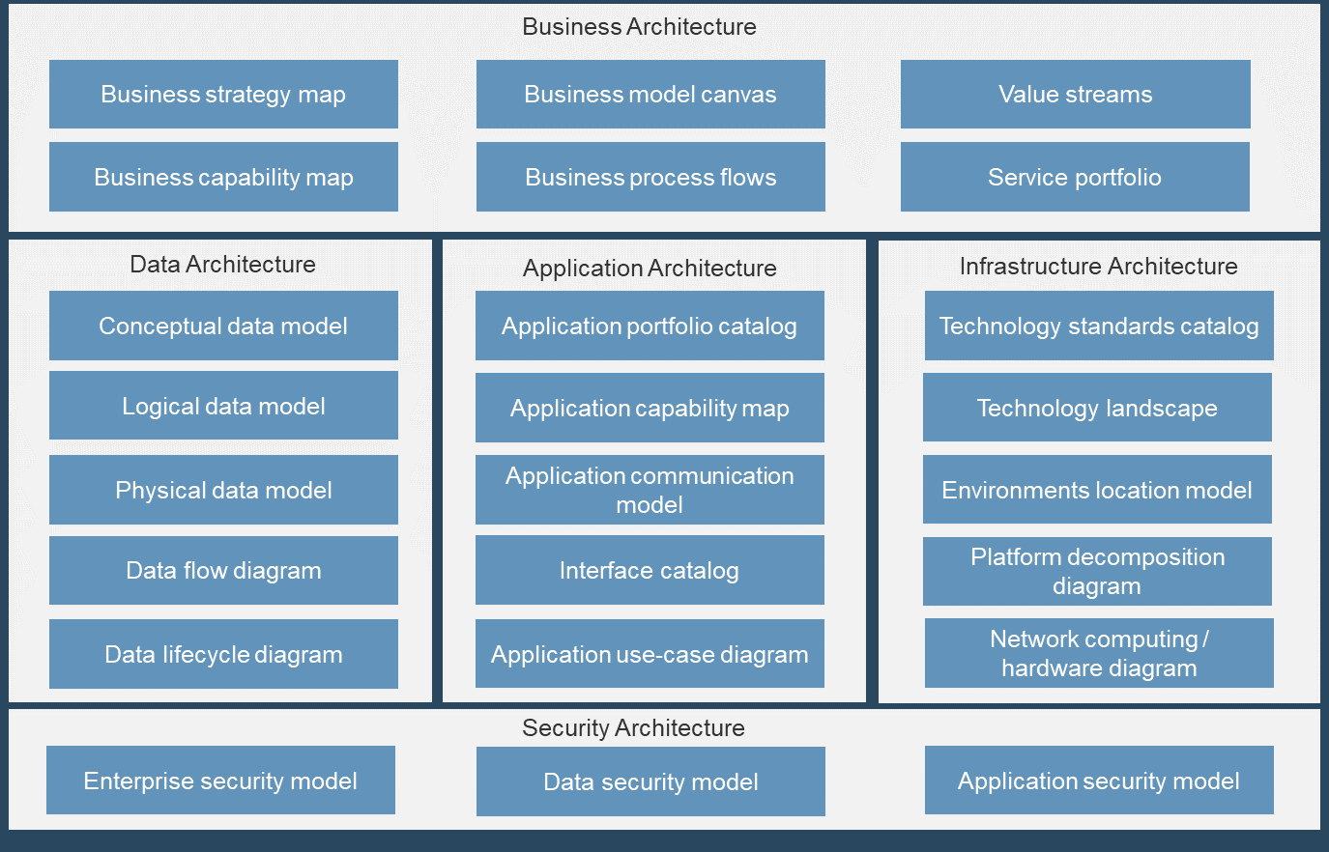
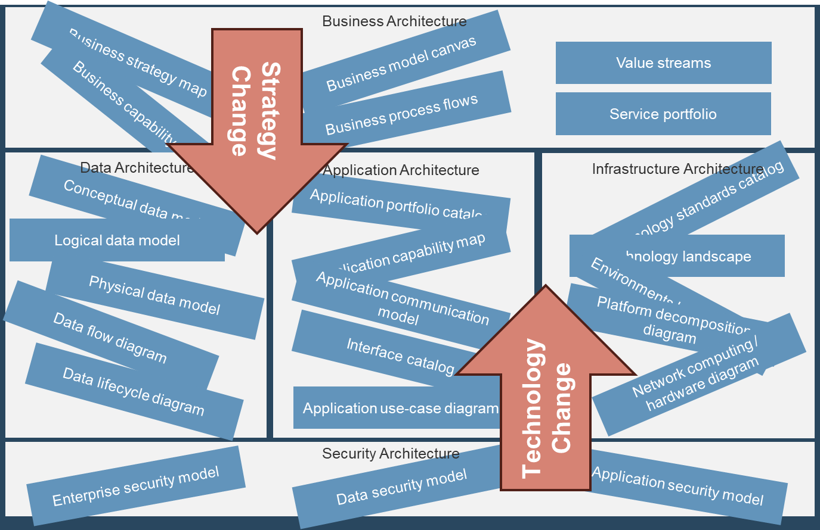
Architects need to shift their values left because change happens.
In an ideal scenario your architecture illustrates detailed, committed target state.
In reality, things change. Your strategic intentions are subject to volatility, especially those planned within a further timeline. The more costs you incur in planning, the more you leave yourself exposed to inefficiency and waste if those plans change.
In reality, things change, and too much architecture is waste.
Notes:
Link in my personal Zachman Story
In an ideal scenario your architecture illustrates detailed, committed target state that can be immensely valuable, allowing you to align your teams and stakeholders and to increase your ability to implement the architecture.
In reality, things change. Your strategic intentions are subject to volatility, especially those within a window when you’ve already made commitments and plans. The more costs you incur architecture in planning, the more you leave yourself exposed to inefficiency and waste if those plans change.

Slide 6
Analyst Perspective
Traditional enterprise architecture in the public sector is dead. In order to thrive in the digital government space, enterprise architects must drop the verbose language and put an end to the endless academic debates. We need to turn our attention toward the needs of the stakeholders and spend our energy on solving complex business problems. The conversation needs to shift dramatically from vetting IT solutions to delivering exceptional value.
Cole Cioran
Recovering Enterprise Architect, Senior Research Director
Info-Tech Research Group

Slide 7
Rethinking Architectural Governance in an Agile Enterprise
Architectural Strategy and Roadmap
Architectural Guidance and Support
Business
Value
Deliver the right things
Deliver things right
Deliver Value

Slide 8
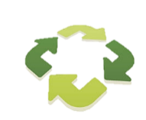
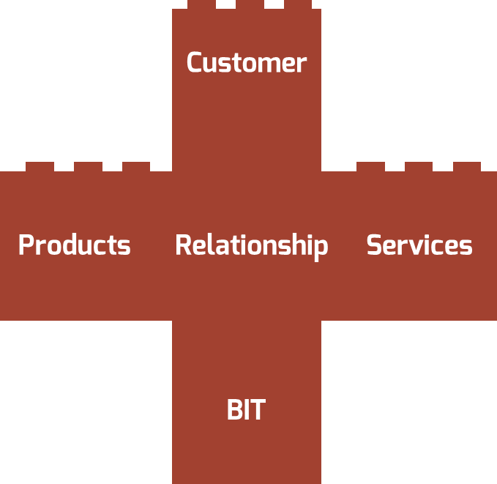
Agile and DevOps are just steps on a journey that integrates business and IT to deliver exceptional value
Architects and architecture are key in navigating the complex interface between humans and technology so that we focus not on software but on delivering digital products and services that create exceptional value for the taxpayers and users
Integration
Integrated Product and Service Value Stream
Continuous
Delivery
Lean/DevOps
Agile
Throughput
Efficiency
Iterative
ROI
Stakeholder Value
Waterfall
Predictability
Discipline
Value Source: Ambysoft, “2018 Project Success Survey Results”

Slide 9
Architecture defines the relationship between products and services.
As a products and services grow and mature, increasing complexity and size may slowdown and complicate decision making. Breaking down your product and services into its various elements will provide owners and managers a visual representation of the relationship among these elements and a clear understanding of what the product requires. Gradually decompose your product + services to reveal its various parts as it matures.
Are built from
Common Components, Features, and Data
Product
e.g. Microservices, APIs, Dapps
A Product + Service Family
Is structured by
Service
Which share
Data, Application, and Infrastructure Architecture
Product
Is satisfied by
Business Architecture
(esp. Capability focussed)
Is organized by
Increasing Product + Service Maturity
Notes:
What are Common components and features
As a products and services grow and mature, increasing complexity and size may slowdown and complicate decision making. Breaking down your product and services into its various elements will provide owners and managers a visual representation of the relationship among these elements and a clear understanding of what the product requires. Gradually decompose your product + services to reveal its various parts as it matures.

Slide 10
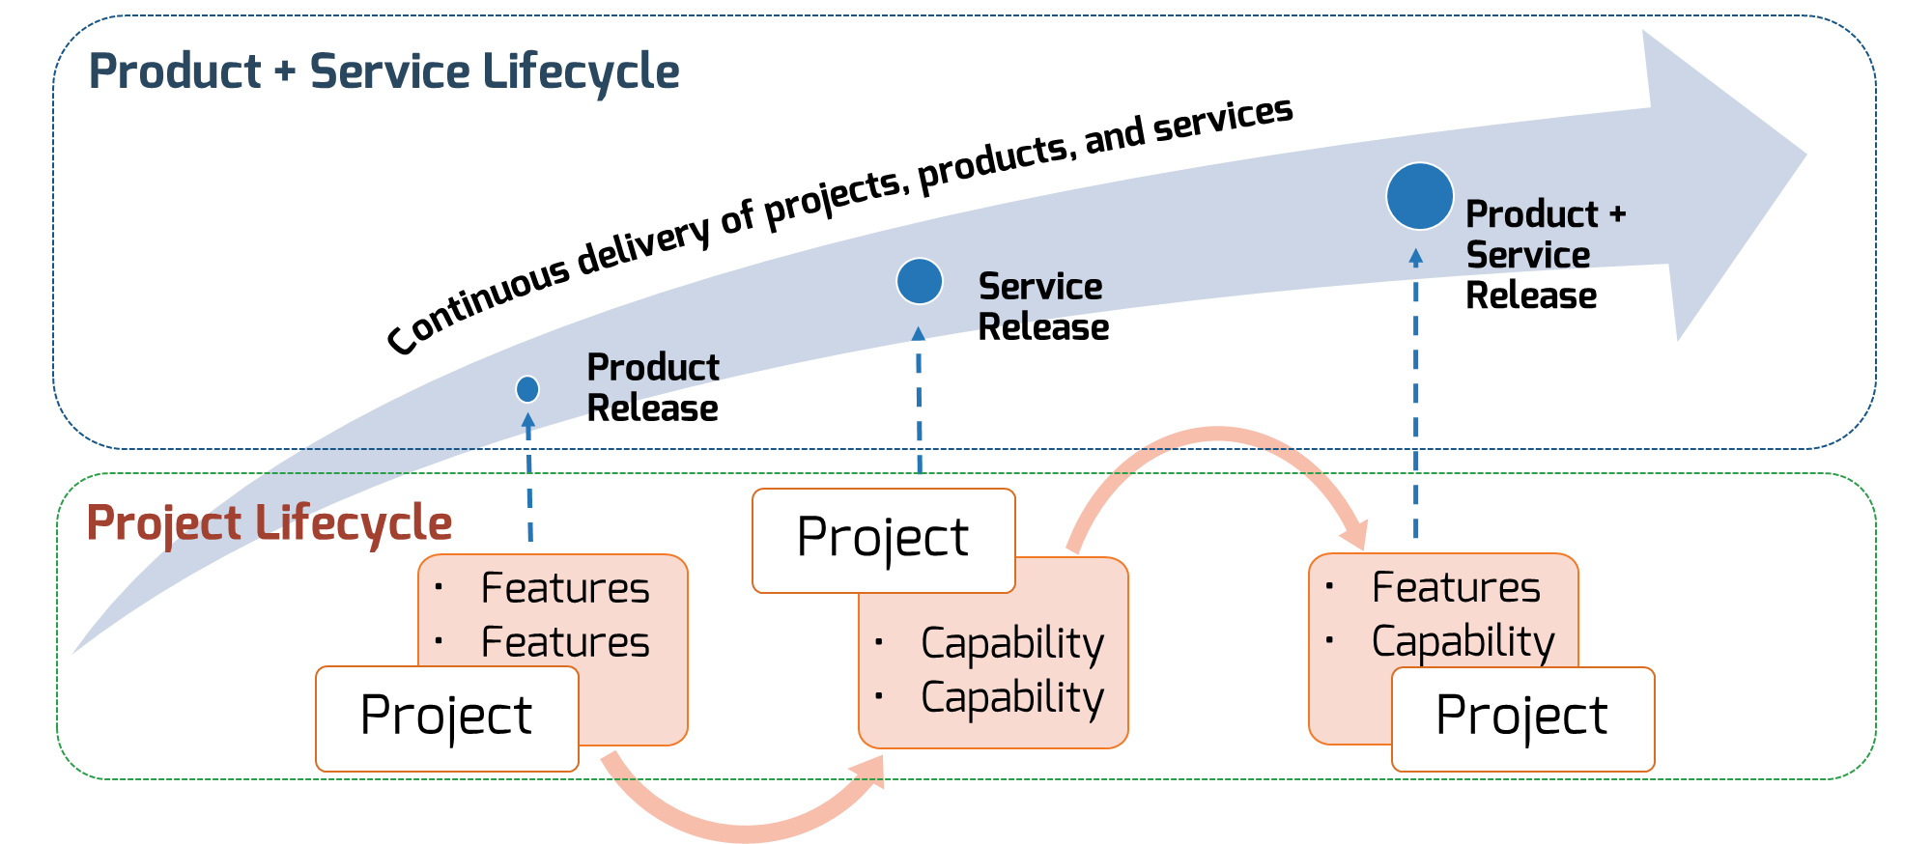
Architects need to focus on the entire lifecycle of the organization’s products and services, not just the next project
Notes:
The Projects Within the Products and Services
Regardless of whether you recognize yourself as a product-based or project-based shop, the same basic principles should apply.
You go through a period or periods of project-like development to build a version of an application or a product.
You also have parallel services along with your project development that encompass a more product-based view. These may range from basic support and maintenance to full-fledged strategy teams or services like sales and marketing.
Product and architecture roadmaps should also include maintenance and enhancements conducted outside of the project lifecycle.

Slide 11
Architects need to shift their focus left to the overall organization and technology roadmaps
Communicate a strategy
Enterprise Architecture Focus
Solution Architecture Focus
Portfolio Roadmaps
Business and IT leaders
Show the evolution of architecture to drive business value
Technology Roadmaps
Delivery teams
Coordinate
delivery teams around implementation of technology standards
Product Roadmaps
Business stakeholders and customers
Visualize
product strategy and
plan delivery
Product or Sprint Backlogs
Development teams
Prioritize and deliver
technology
change
Audience
Objective

Slide 12
Now What?
Focus!
GCARB on ensuring departmental roadmaps integrate with the overarching architectural roadmap.
Departments on defining architectural roadmaps for products and services enable their capabilities.
Architects on supporting teams in architecting common components and features.
Cole Cioran
Recovering Enterprise Architect, Senior Research Director
Info-Tech Research Group

