Slide 1
KNOWING YOUR SKILLS AND INTERESTS
FITTING IN OR FINDING FIT
JANUARY 2022

Slide 2
Fit
Skills
Passions
Interests
Attributes
TRYING TO FIT IN REQUIRES A LOT OF ENERGY AND EVENTUALLY YOU LOSE YOURSELF. THERE IS NO SOULMATE OF JOBS, THERE ARE MANY THAT FIT YOUR SKILLS AND INTERESTS.

Slide 3
FITTING IN OR FINDING FIT
EMSI
Adobe Creative Types
PLUM AI Tool
Deloitte Business Chemistry
Apolitical
Canva
FYN CAREER BOOT CAMP
KEY PLACES TO LOOK

Slide 4
Go through the steps of the Resume Builder, even if you have a resume. Put in the title of the job you have and it will give you an option to look at the work tasks and skills typically associated with this job.
Then in Resume Optimizer, you can choose the type of work you want to do. It will populate the skills that you should include on your resume that are needed in the desired role
OR
Copy and paste from your own resume and it will pull out skills from work tasks, position titles and education
FREE TOOL
EMSI
RESOURCES
SKILLS.EMSIDATA.COM

Slide 5
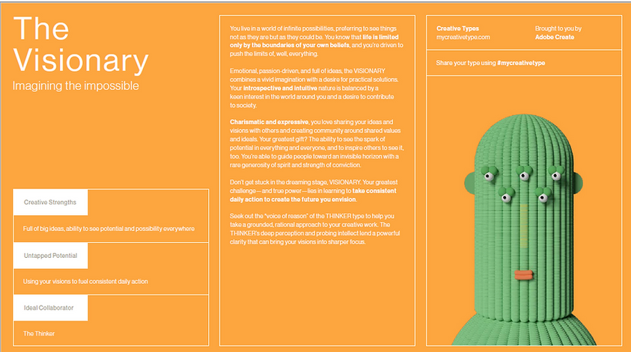
FREE TOOL
ADOBE CREATIVE TYPES
I LOVE THIS BECAUSE IT IS NOT NECESSARILY WORK RELATED BUT WHO I AM AND WHO I WORK WELL WITH. PART OF THIS MODERNIZATION OF HOW WE LOOK FOR FIT IS BRINGING TOGETHER WHO WE ARE WITH WHAT WE DO FOR A LIVING
WHAT IS OUR CREATIVE STYLE
MYCREATIVETYPE.COM

Slide 6
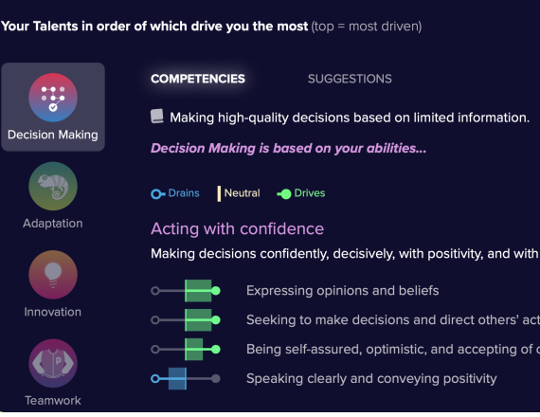
PLUM
'YOU ARE MORE THAN JUST YOUR RESUME' IS THEIR TAGLINE BUT THIS CAN HELP IN YOUR RESUME TOOLBOX
CREATE A FREE PROFILE PLUM.IO/JOB-SEEKERS

Slide 7
DELOITTE BUSINESS CHEMISTRY
HOW WE COMMUNICATE AND WORK TOGETHER
There is a paid version but for the free tools:
20 Questions Tool, input qualities about yourself or someone else to see how to work with them : bc20questions.deloitte.com/#/
Interactive 'find your work style' video: bcfyws.com

Slide 8
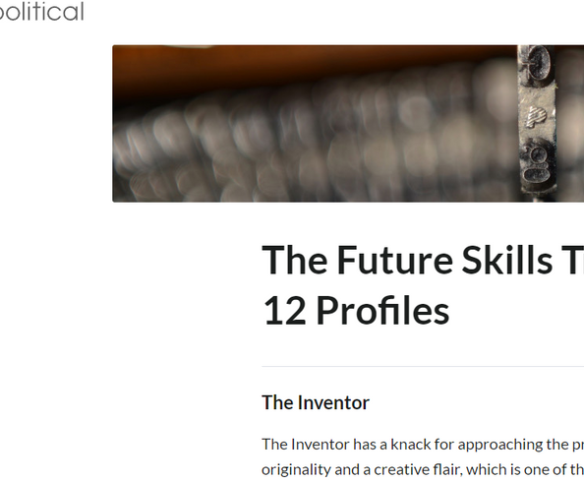
APOLITICAL.CO
Good for Public Servants, can gain insight into yourself and those you work with or will potentially work with
APOLITICAL
FUTURE SKILLS TRACKER QUIZ

Slide 9
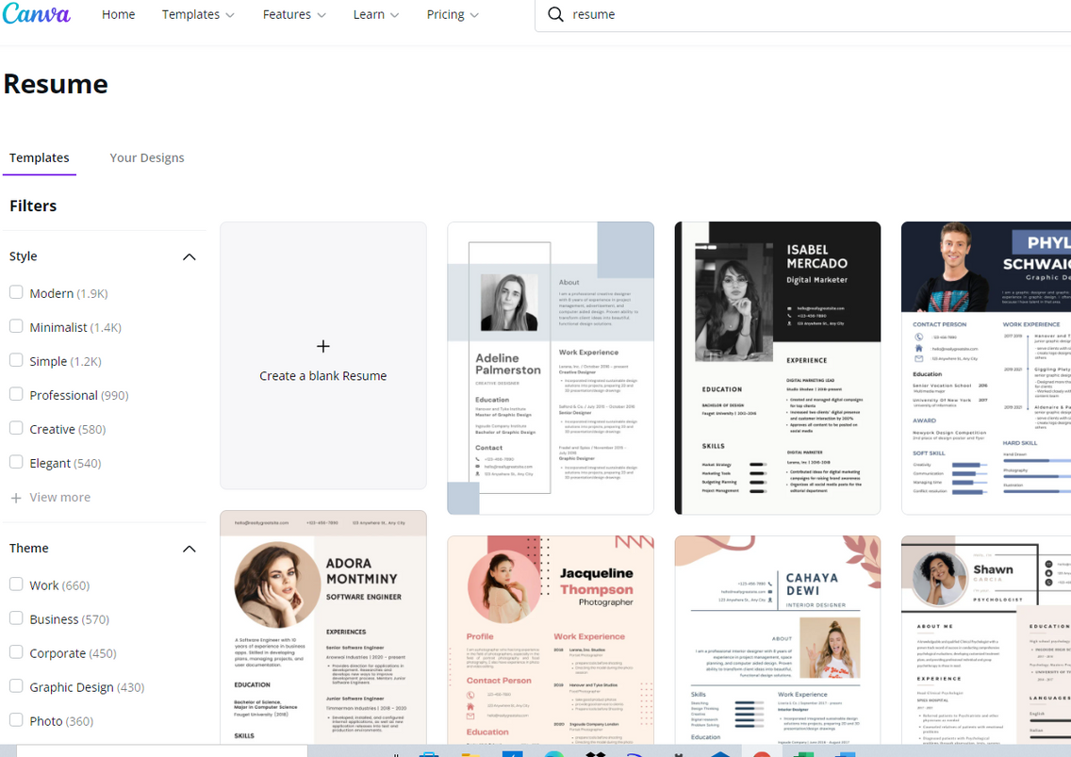
CANVA
FOR SNAPSHOTS
Free Version available
Include your assessments, skills, areas you thrive, what drives you, what interests you, social media profiles, links to more information

Slide 10
SHAPING YOUR STORY WITH YOUR SUPER SKILLS
YOUR BRANDING PACKAGE
CONVEYING SKILLS AND INTERESTS EFFECTIVELY
BUILDING YOUR TOOLBOX
FINDING WHERE YOU WANT TO EXPLORE

Slide 11
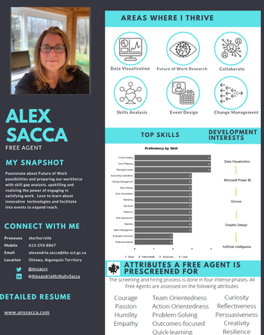
YOUR SKILLS AND INTERESTS
USING YOUR TOOLBOX
To find your best fit and not fit the mold
SNAPSHOT
Highlighting skills and interests, areas you thrive, with a link to more information
You lose the impact of communicating yourself if you give everything at once
YOUR SOCIAL MEDIA PROFILES
LinkedIn, Twitter, etc - how best to convey your skills and interests.
YOUR FULL CV
Cramming every skill, education, experience into a long form CV. Not a bad thing, you can use this as your foundation to draw depending on needs. Making it more palatable by giving the option of expanding for more info.

