Slide 1
Policy experimentation at the Innovation Growth Lab
Experimentation Works Kick-Off Event
Ottawa, March 2, 2020
Notes:
Part 1: High Level introduction of policy experimentation and the work of IGL
(Marieke, 10 minutes)
What do we do at Nesta?
What is some of the work that we do with governments to help them become more experimental?
What do we mean by “continuum of experimentation”?
What’s the work that we do at IGL?
Part 2: Practical advice on policy experimentation
(Teo, 10 minutes)
What are some of the main findings from our work with governments and academics?
Initial considerations
Opportunities and pitfalls
RCTs vs other methodologies
Examples of trials we have supported
Practical advice for participants

Slide 2
Notes:
Nesta was set up by the UK government supported by a financial endowment from UK lottery
Now independent UK foundation but work all over the world
Nesta combines knowledge (i.e. research), networks, funding and skills to grow ideas that can change the world for the better.
We operate across the globe and across sectors, working with others to turn these good ideas into reality
Almost 300 people, 20 years

Slide 3
Innovation policy is one of Nesta’s five priority fields of work
Health
Education
Government innovation
The creative economy, arts & culture
Innovation policy

Slide 4
Innovation policies that deliver more, for more people, and shape the future we want to see
Innovation policies aren’t effective enough
Innovation is far too exclusive
PROBLEM
Innovation policies aren’t innovative

Slide 5
Innovation policies that deliver more, for more people, and shape the future we want to see
Innovation policies aren’t effective enough
Evidence
Experimentation
Measurement
Smarter
Innovation is far too exclusive
Transform who benefits, who participates, who decides
More inclusive
PROBLEM
SOLUTION
RESULT
Innovation policies aren’t innovative
New trends
New methods
Fit for the future

Slide 6
Becoming more experimental
Traditional approach
Launch a large programme without prior small-scale testing, with one design and the hope that it will work
Experimental policy
Start small, trial different designs systematically, learn what works to increase impact and scale it up

Slide 7
What do we mean by experiments?
“A test done in order to learn something or to discover whether something works or is true”
Definition of the Cambridge English Dictionary
Source: https://www.diocesecpa.org

Slide 8
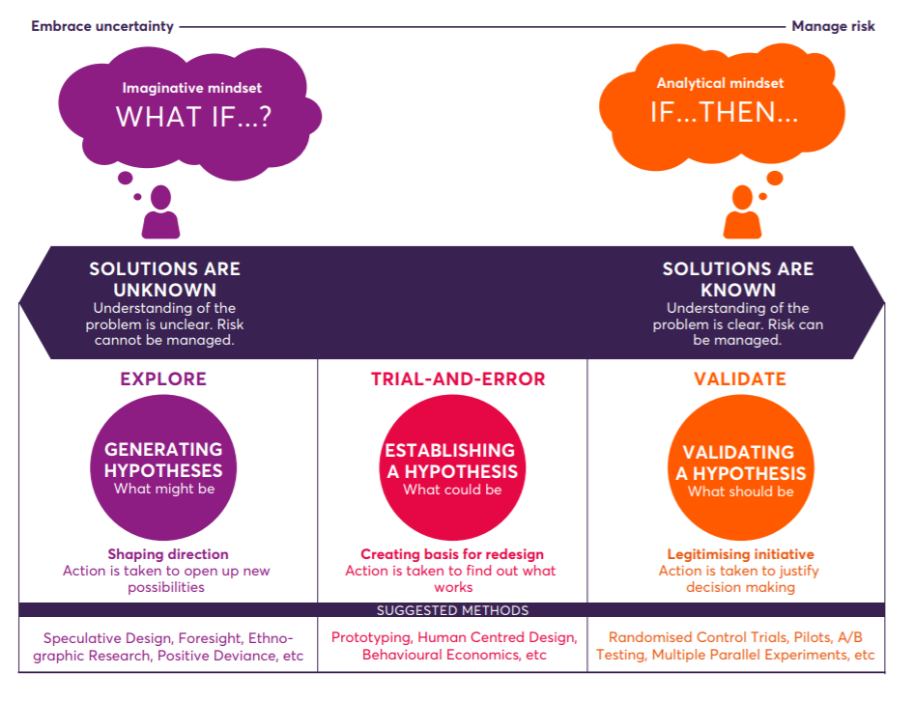
How do we learn what works?
There is a range of experimental methods that can help us understand what works...
Source: Playbook for innovation learning, Nesta, April 2018.
Notes:
At Nesta we see experimentation as a continuum, which comprises a number of possible evaluation methodologies and fosters a dynamic process to find, develop and test new ideas. The choice of the right methodology should be aligned with the characteristics of the programme as well as the circumstances under which it is implemented.
The latter would take into account elements such as the level of uncertainty, the understanding of the underlying problem and the knowledge of solutions that can potentially help tackle them.

Slide 9
"Innovation amateurs talk good ideas; innovation experts talk testable hypotheses."
Michael Schrage, MIT Center for Digital Business

Slide 10
IGL is a...
…global partnership bringing together governments, foundations and researchers to scope, develop and test different approaches to increase innovation, support high-growth entrepreneurship and accelerate business growth.

Slide 11
The IGL Community
IGL Partners
IGL Research Network
Over 85 researchers from around the world:
IGL Scientific Committee
Nick Bloom Stanford Graduate School of Business | Dietmar Harhoff Max Planck Institute for Innovation and Competition | Karim Lakhani Harvard Business School | Josh Lerner Harvard Business School | Fiona Murray MIT Sloan | Mark Schankerman LSE | Scott Stern MIT Sloan | John Van Reenen MIT Sloan
Other organisations we’ve worked with:

Slide 12
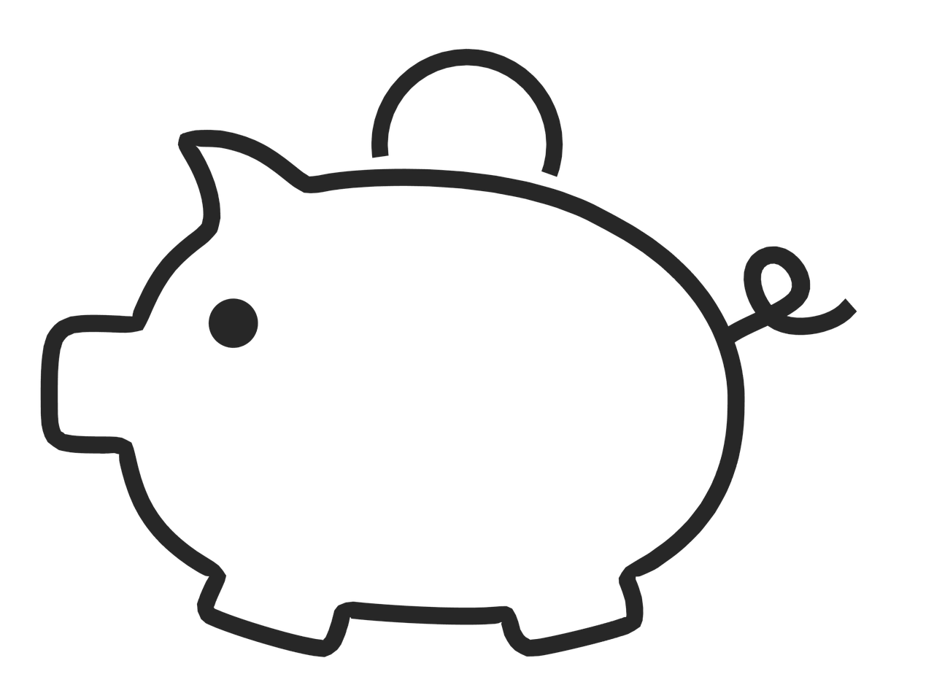
Why experiment
Novel solutions to policy challenges | De-risk new programmes | Continuous improvement
Time-limited unless demonstrated impact | Better evidence & decisions | Save money
More impactful policies & better value-for-money
Notes:
Stopping ineffective schemes easier

Slide 13
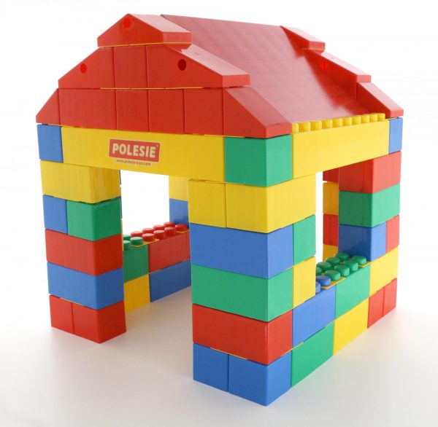
Experimentation in public policy
1. Experiment
2. Evaluate
3. Scaling up
Control group
Notes:
Diseñadores de política:
Enfrentan retos sin soluciones obvias
Trabajamos con gob’s para identificar opciones y testearlas
Area prioritaria, ej colaboración universidad-empresa
Eventos de networking
Campañas de información
Incentivos financieros
costo-beneficio
Distintos tipos de experimentos, grado de incertidumbre
Prueba controlada aleatoria (tienen suerte…)
Más evidencia, mejores programas
Premio Nobel

Slide 14
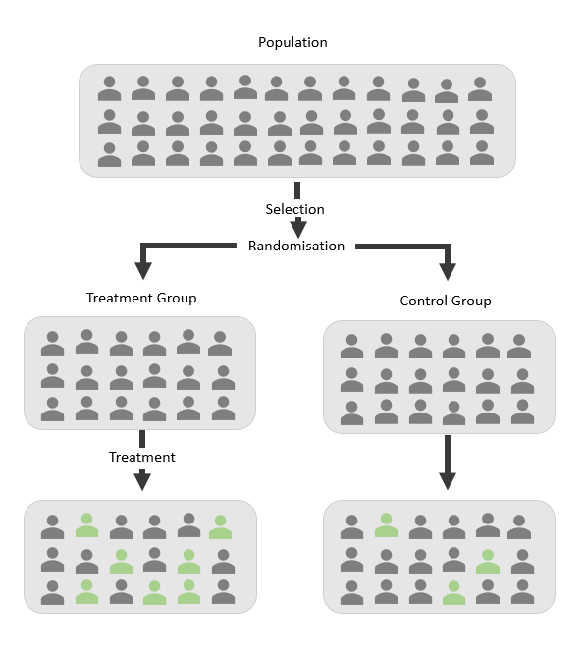
What is a randomised controlled trial (RCT)?
An RCT is an experiment where participants are randomly allocated to receiving an intervention. The randomisation enables you to compare the effectiveness of the new intervention against what would have happened if you had changed nothing
Notes:
RCTs have been widely adopted in areas such as health, education and development, but are particularly underutilised in the domain of innovation and growth policy.
The idea behind randomised trials is simple. Participants are randomly placed in a ‘treatment’ group and a ‘control’ group, and the impact of the programme is estimated comparing the behaviour and outcomes of the two.
Through this exercise, RCTs provide robust evidence which is key for informing policy design and influencing those in charge of making decisions.

Slide 15
Behavioural biases in public funding decisions
Do biases impact R&D and innovation grants funding decisions, and how to prevent it?
Design stage

Slide 16
Increasing business-science links and technology transfer
Can innovation vouchers “nudge” SMEs to build successful collaborations with knowledge providers, and help SMEs grow?
Max Planck Institute for Innovation and Competition
Notes:
Also other tech transfer trials that we are doing.

Slide 17
Incentivising employees to contribute new ideas
Can subtle non-monetary nudges be used to influence intrapreneurial behaviour in a large corporation?
Radboud University Nijmegen and Utrecht University

Slide 18
Imagine your objective is to raise SME productivity, but can your trial prove this?
Inputs
Activity
Output
Immediate Outcome
Intermediate Impact
Ultimate Impact
£ and People
What you will do
What gets delivered
Change in business behaviour
Change in business activity
Productivity growth
You want to measure impacts on productivity
But lots of other factors affect this. Even though independent of treatment the ‘noise’ will likely hide impacts. Even if they don’t, will take time
Notes:
TF
Developing a logic model can be very helpful when thinking about the outcomes.
So imagine that are delivering an activity that you want to increase the growth of businesses. There is a significant gap between the intervention you deliver and its impact of the business’s growth.
When you run your power calculations you may find that detecting impacts this far out will be difficult given all the other factors that create ‘noise’ around business turnover and employment growth. Or you may find that you can be confident of detecting the scale of impacts seen as a success for the programme but realise will take 3 years before draw conclusions.

Slide 19
Better look for proximate impacts!
Inputs
Activity
Output
Immediate Outcome
Intermediate Impact
Ultimate Impact
£ and People
What you will do
What gets delivered
Change in business behaviour
Change in business activity
Productivity growth
So in short term at least, identify the more immediate outcomes especially if vital to success
Ideally, choosing outcomes that evidence from outside you trial can connect to productivity
Notes:
TF
If so can use your logic model to look for more immediate impacts where the impact of you intervention could be more concentrated and immediate
For example, if running a programme to connect businesses to Universities. Your ultimately want to know if it leads to additional business growth… but in the short term could measure whether the programme creates new collaborations - a crucial factor in whether it does generate greater growth.

Slide 20
The IGL2020 Global Conference
London 2-4 June 2020
Early bird tickets are on sale now!

Slide 21
Interested?
Get in touch with us to find out more innovationgrowthlab@nesta.org.uk
Sign up to our newsletter here to learn about new policy ideas and the latest evidence
Visit our website to see some of our work www.innovationgrowthlab.org

Slide 22
Background (for ourselves)
No need to translate the following slides

Slide 23
Overall objective of the event
Build a foundation for learning about the value and practice of experimentation.
Educate and generate enthusiasm about experimental government trends internationally
Show how starting small with a single experiment is connected to a larger world of research, experimentation and evidence synthesis in the aim of finding what works.
Provide concrete examples.
Give concrete, actionable advice to: public servants, executives/departments, and centralized authorities within the federal government.

Slide 24
Panel questions
POSSIBLE QUESTIONS FOR PANEL
Top Recommended Questions to kickoff chat
(To IGL and P-O) What’s some of the advice you give to governments or departments when they first come to you with an interest in becoming more experimental? Where to start?
(To Trina and P-O) What can non-science-based departments learn from the work that is happening in science-based departments and apply in their own contexts?
(To All) Advice for individual public servants embarking on this journey, advice for executives and departments supporting this direction, advice for central agencies in government.
Additional question options if needed
(To Trina and P-O) How do we go from what we are right now in government - e.g. laying the foundation for single, primary studies -- to being able to effectively synthesize a whole body of evidence
(To IGL) What are some of the main objections/criticisms that you hear when it comes to policy experimentation and in particular RCTs vs other methods, and how do you respond?
Or: What are some of the most common mistakes when it comes to designing and implementing RCTs?
(To IGL) How does IGL work with the UK government and how does our work fit into the broader UK ecosystem of experimental government and evidence-based approaches?

