Slide 1
Community Lands Development
Overview of Lands & Law-making
Whitehorse, Yukon - June 2019

Slide 2
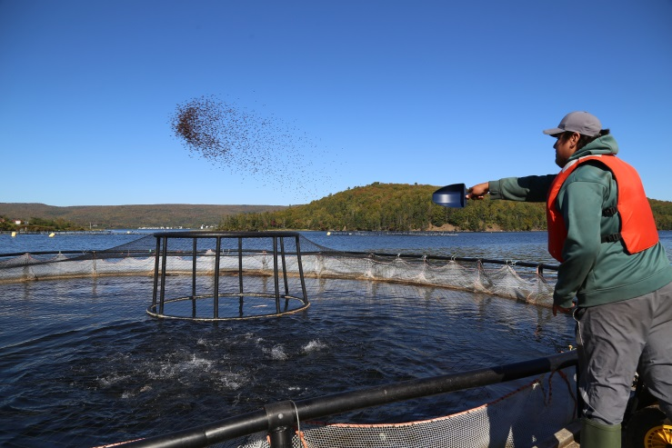
Community Lands Development
Community Lands Development supports First Nations in building capacity to effectively exercise authority, as well as autonomy, over their laws, lands and environment.

Slide 3
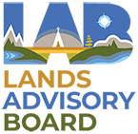
CLD Functions & National Indigenous Partners
First Nations Land Management | Land Use Planning | Reserve Land and Environment Management Program (RLEMP) | Matrimonial Real Property (MRP)
CLD Functions – ISC and CIRNAC HQ and Regions
Notes:
Discuss the important connections between CLD files and Indigenous organizations.

Slide 4
Contextualizing CLD
Increasing level
of Responsibility and Authority
Self-government
(27)
FNLM
Operational
(79)
53/60
(10)
FNLM
Developmental
(55)
Indian Act Land Management
(~400)
RLEMP
Operational
(102)
T&D
(15)
Addressing
MRP
on-reserve
Notes:
Land and environmental management in RLEMP is land management under the Indian Act . This diagram is to visually differentiate between RLEMP, FNLM and self-government.
This is ‘a model’ to represent increased self-determination to illustrate increasing levels of authority being taken on by First Nations. This is not the panacea and in no way should indicate First Nations should move to self-government. Self-determination is defined by each First Nation and it is a goal at CLD to support the goals of a given First Nation.
Also mention:
The Indian Act is silent on the issue of matrimonial real property on-reserve. Through FHRIMIRA, the Provisional Federal Rules apply to all First Nations until they have created their own MRP laws, with some exceptions.
Through FHRIMIRA, the Provisional Federal Rules apply to all First Nations until they have created their own MRP laws. First Nations under the Indian Act can create their own MRP laws pursuant to FHRMIRA, while First Nations with a land code in force can create their own MRP laws through the FNLM law-making provisions. Self-governing First Nations can request that the Provisional Federal Rules apply to their reserve lands, if they have any.

Slide 5
What is RLEMP?
RLEMP is a capacity building program that provides First Nation land managers with the resources, tools, skills and knowledge required to perform land management functions under the Indian Act.
First Nation land managers become certified through the National Aboriginal Land Managers Association (NALMA) to assume greater responsibility in managing land activities under the Indian Act.
NALMA administers the Professional Land Management Certification Program (PLMCP), which provides general training through the University of Saskatchewan and Algoma University (Level 1) and more hands-on training through NALMA (Level 2).
Canada retains liability when First Nations operate within the boundaries of RLEMP authority.
Training and Development
(80% of funding)
Certified/Operational
(100% of funding)
Training to develop land management capacity
ISC Regions continue to provide land management services
Once certified, a First Nation is operational
First Nation assumes primary responsibilities and Regions shift to support role
Notes:
Prior to RLEMP the Department supported land and resource management through the 53/60 Delegated Authority Program beginning in the 1980s, and later, in the 1990’s, the Regional Land Administration Program (RLAP).
RLEMP, which started in 2005, is a sub-program of the Lands and Economic Development Services Program (LEDSP), that supports First Nations to take on additional responsibility over their reserve lands, resources and environment by undertaking Indian Act land management activities on behalf of the Minister. It improved upon RLAP by including integrated training and more funding.
It is a capacity building program to provide First Nation land managers with the tools, skills and knowledge required to perform land management functions under the Indian Act.
Canada retains liability when First Nations operate within the boundaries of RLEMP authority.
Training and Development Level (80% of funding)
First Nations develop their land management capacity by attending RLEMP Training while ISC Regions continue to provide land management services to the First Nation.
Operational Level (100% of funding)
Once the land manager is certified, First Nation progress to the operational level and now assume primary responsibility for land management on reserve. The role of Regions now shifts to one of support as well as audits and approves all FN land management activities.
Delegated Authority Level (100% +15% of funding)
This level is currently closed to new First Nations (as of 2011), but was established to provide a mechanism to obtain delegated authority under Sections 53 and 60 of the Indian Act.
First Nations with Delegated Authority perform all of the operational level activities in addition to approving land transactions on behalf of INAC that the First Nation has delegated authority to manage.
Funding is based on land management activity – number of and complexity of land instruments, population and land area. Funding to attend training is also provided – includes tuition costs, meals, accommodations etc

Slide 6
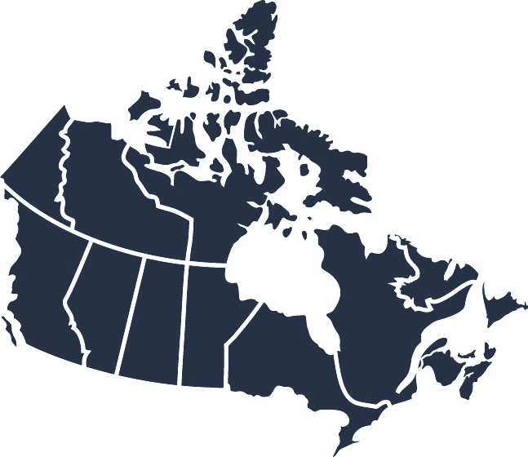
RLEMP – A National Picture
Communities who are operational or training a lands manager are considered “active” in RLEMP. There are currently 127 active participants:
15 Training & Development First Nations
102 operational First Nations
10 Delegated Authority First Nations
Training & Development FNs by province
Operational FNs by Province
Delegated Authority FNs by Province
1/25/1
6/29/3
4/22/4
1/8/1
2/6/1
1/8/0
0/4/0
BC
AB
SK
MB
ON
QC
ATL
Status as of: June. 2019
Notes:
Note that the largest number of RLEMP operational First Nations are found in Saskatchewan, BC and Ontario. As a result, NALMA and Canada have focused on establishing partnerships with educational institutions in these areas, but also want to expand to Eastern Canada.

Slide 7
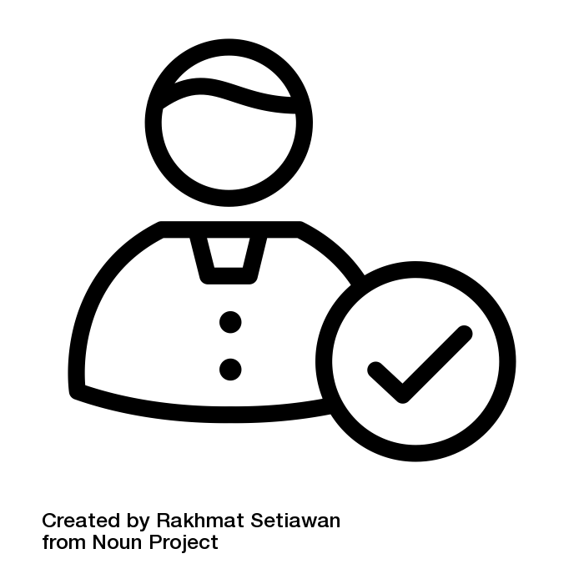
How to apply
Entry
First Nations express interest to ISC First Nation completes that Entry Request and Capacity Self-Assessment Regions assess First Nation eligibility and provides recommendation Headquarters reviews regional assessment and makes final decision If approved, First Nation begins Training & Development stage: train a land manager through the PLMCP (2 year process)
Eligibility
First Nation has reserve lands Person identified to become land manager Economic development and medium level of activity Good financial management Subject to available funding
Notes:
Entry
- First Nations express interest in RLEMP to ISC
- ISC Headquarters assesses First Nation for Land Management capacity
- If approved, First Nation passes BCR to enter program
- Training & Development stage: train a land manager through the PLMCP (2 year process)
First Nation is fully operational once land manager has been certified by NALMA
RLEMP budget is roughly $15 million; without additional funding more First Nations can move into RLEMP as long as others transition to FNLM or self-government, or leave RLEMP completely.

Slide 8
Available Funding for RLEMP First Nations
Developmental Funding
Operational Funding
Tuition
$23K
Meals / Accommodations
Travel
Complexity of land instruments
Population
80% of funding
Calculator based
Land area
Complexity of land instruments
Population
Land area
100% of funding
Calculator based

Slide 9
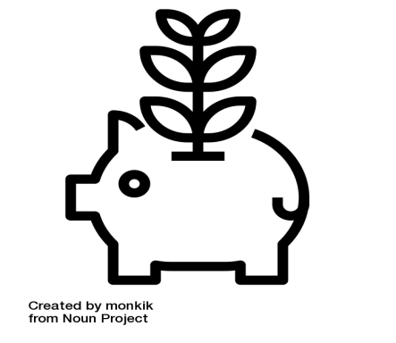
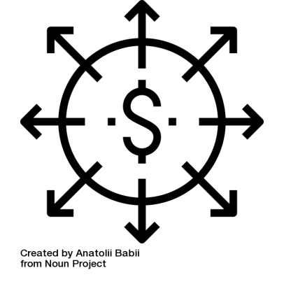
RLEMP Engagement: What We Heard
Base funding $ for Env. Management $ to train land managers $ for various LM activities
Closer to home In-person/Online Prior Learning Professional Development
Ease of Entry
Greater decision making
Notes:
CIRNA partnered with the National Aboriginal Land Managers Association to engage with First Nation leaders and land managers to seek input on how to make RLEMP more responsive to First Nation needs.
May 2-4, 2017
Wendake, QC
May 9-11, 2017
Toronto, ON
May 16-18, 2017
Winnipeg, MB
May 30- June 1, 2017
Saskatoon, SK
June 6-8, 2017
Edmonton, AB
June 13-15, 2017
Kelowna, BC
June 27-29, 2017
Moncton, NB
September 13, 2017
Whitehorse, YK
351 participants from 224 First Nations, including Chiefs, Councillors, Land Managers, Environmental Officers, and other First Nation Officials.
Funding
New funding formula with base funding for a lands and environment office
Consideration required for activities outside of those identified through registered transactions (e.g. enforcement, community engagement, or responding to activities on traditional territories) / Additional funding for environmental management
Funding to train more than one land manager per First Nation
Training
Partnerships with schools closer to home (and more training offered in French)
Ongoing professional development is important
Both in-person and on-line training for land managers
Regional training with curriculum that incorporates traditional knowledge
Prior learning assessments and recognition required
Focus on environmental and natural resource management
Eligibility: More flexible entry criteria and training supports before entry
Authority: Greater independent decision-making ability

Slide 10
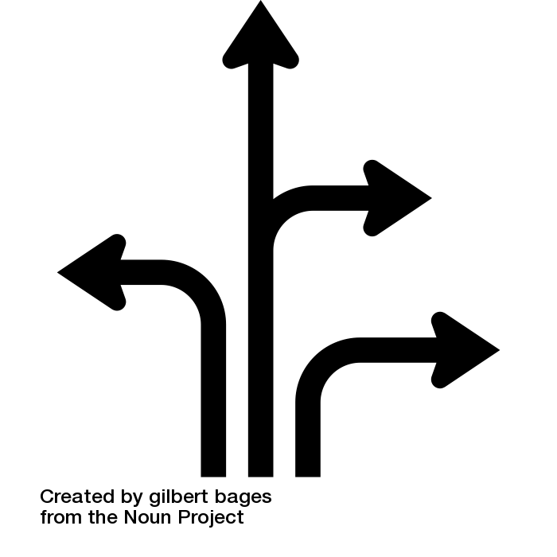
RLEMP Updates
Plans
Working with NALMA and other partners to ensure that feedback from engagement is incorporated into program, policy and service enhancements. Continuing to pursue funding and policy improvements to enhance RLEMP
Possibilities
Continued growth of PLMCP and continued support for sharing of best practices
Notes:
Feedback from the national engagement clearly identified the need to improve certain areas such as broadening eligibility, amending the funding formula, and increasing the funding and flexibility of the Professional Land Management Certification Program (PLMCP).
Although the Departments did not receive new funding through Budget 2019 to support capacity development in lands and environmental management, Canada remains committed to working in collaboration with the National Aboriginal Lands Managers Association (NALMA), First Nation communities and other partners to ensure that feedback from the engagement is incorporated into land and environmental management program, policy and service enhancements.
Canada has supported NALMA in partnering with Algoma University as the Eastern Canada site for delivery of the PLMCP Level 1, with the first course that launched a few weeks ago (May 2019). NALMA is also engaging with the Vancouver Island University on developing PLMCP Level 1 training scheduled to be offered starting May 2020. We are continuing to pursue funding and policy improvements to enhance the current RLEMP program, and the delivery of land and environment management services to better meet the needs of existing and future community participants and partners.
Speak to challenges around expectations that come with a national engagement.

Slide 11
What is MRP? What is it designed to correct?
Matrimonial Real Property (MRP) refers to the family or matrimonial home and other structures or land that a couple owns or occupies while they are married or in a common-law relationship.
It all started when a legislative gap was identified by the Supreme Court of Canada in 1986. It took decades of studies, reports, and consultation to come up with two legislative responses:
Amendments to the Framework Agreement on First Nations Land Management and the First Nation Land Management Act
First Nations without reserve lands can create MRP
laws through their land code / FNLM law-making authority
The Family Homes on Reserves and Matrimonial Interests or Rights Act (FHRMIRA) (2013)
FHRMIRA
First Nation
Law-Making
Provisional Federal Rules
Notes:
The Family Homes on Reserves and Matrimonial Interests or Rights Act (FHRMIRA), received Royal Assent in 2013 to respond to an on-reserve legislative gap after extensive studies and consultation.
MRP Implementation Program provides funding to the Centre of Excellence for Matrimonial Real Property as well as for First Nation law development
Support for new and more targeted training and awareness activities
Ie. When a couple divorce, breaks up or a spouse dies the province has laws in place to guide the division of property.
The requirement for the Minister to maintain and publish a list of First Nations with Matrimonial Real Property laws remains, even when the implementation program sunsets.
Department employees at Headquarters and in the Regions will continue to implement aspects of the Act.
Concerns may arise as stakeholders and First Nations communities come to understand that the Implementation program will sunset at the end of fiscal year 2019-2020.

Slide 12
FHRMIRA – A National Picture
# of First Nations communities who have taken the COEMRP toolkit training
Communities with their own MRP law
# of First Nations participating in the pilot project (funding/support for MRP law-making)
0/0/1
62/4/2
YK
46/0/1
23/7/4
BC
AB
SK
MB
ON
QC
ATL
75/1/2
29/1/1
32/0/1
35/0/0
Status as of: March 2019

Slide 13
Who is part of the MRP Implementation Program?
National Aboriginal Lands Managers Association - Centre of Excellence | Provides training sessions and technical support related to the FHRMIRA. Develops, distributes and makes available online Matrimonial Real Property toolkit and bilingual materials.
CIRNA and ISC | Develops policies and provides strategic direction. Maintains the published list of First Nations with laws made pursuant to the FHRMIRA. Adapts federal policies (e.g. MRP forms). Collaborates with partners and raises awareness.
Public Safety Canada & Royal Canadian Mounted Police | Develops and provides training to law enforcement and peace officers on the FHRMIRA. Public Safety Canada has developed online training for non-RCMP police officers. The RCMP developed online training for its members.
First Nations Chiefs of Police Association | CIRNA will partner with the FNCPA to develop and deliver scenario-based training to law enforcement officers.
Notes:
Registry (Loretta), Estates (Lynn and Melinda), Housing (Elena and Luke) and Legal (Andrew) folks.
Centre of Excellence hosted NALMA: Toolkit sessions
CIRNA funding pilot project.
role of the Centre later this morning.
The RCMP and Public Safety Canada.
Online training and, as of October 2017, 312 officers.
Upcoming work:
First Nation Chiefs of Police Association
CIRNA funded law societies
Presenting at various legal continuous learning conferences
National mailout

Slide 14
Addressing the Gap
CIRNA’s sense of the
breakdown of MRP laws in
First Nation communities
First Nation matrimonial real property laws enacted pursuant to the Act (14)
Matrimonial real property is addressed under the First Nations Land Management Regime (39)
Subject to the Provisional Federal Rules (approx. 566)
Notes:
The Minister is also required by the Act to maintain a list of self-governing First Nations that retain reserve land who ask that the Minister declare that the provisional federal rules apply to them via a ministerial order. Currently, no self-governing First Nations that retain reserve land have asked the Minister to declare that the provisional federal rules apply to them.

Slide 15
Main MRP 2019-2020 Activities
MRP Regional Training
Completed 7 Regional Training Sessions for Departmental Employees: Manitoba, Atlantic, Saskatchewan, Alberta, British Columbia, Ontario
Training for Legal Practitioners
Saskatchewan Bar Association completed in May 2019
Enforcement
Establish a working group to look at broad enforcement issues
Future Direction of the Program
More trainings scheduled for 2019-2020 including the Yukon
On-going outreach to other Associations and organizations
Determining on-going needs and how to address them once the implementation program sunsets in 2020
Indigenous Bar Association – tentative October 2019
Notes:
MRP Regional Training
Refer to training schedule.
Training for Legal Practitioners
Planning to reach out to other law societies and the Indigenous court workers program.
Enforcement
We have reached out to RCMP and Public Safety; planning to reach out to DOJ, NRCan, First Nations Chief of Police, ECCC, Fisheries and Oceans, Public Prosecution Service of Canada, By-law within ISC.
Future Direction of the Program
The implementation program formally sunsets in April 2020; however, work will continue but transform as workload shifts from the Centre of Excellence to Crown-Indigenous Relations and Northern Affairs. The Department and NALMA will have ongoing discussions throughout Summer 2019 to plan for a smooth transition and inform First Nations of the closing of the CoE, as well as how they can contact for support going forward.

Slide 16
MRP Updates
Plans
Budget 2018 committed $5.5 million over two years to continue the implementation of the Act. Budget 2019 committed $2.8 million for 2020-2021 to support First Nations in developing their own community-specific laws, and to provide targeted training.
Possibilities
Although funding should still be available, The Centre of Excellence is expected to close April 2020. CIRNA will work with NALMA and other Indigenous partners to develop transition plans and communications materials.

Slide 17
What is FNLM?
First Nation Land Management (FNLM) is a government-to-government relationship through which First Nations can opt-out of the 44 sections of the Indian Act related to land and environmental management.
FNLM was established through the Framework Agreement on First Nation Land Management (Framework Agreement) signed in 1996, and then brought into law through the First Nations Land Management Act (FNLMA) in 1999.
FNLM is neither a program nor a delegated authority. It is viewed by Canada as First Nation-led sectoral self-government.
Once operational, a First Nation gains more autonomy but also liability is transferred to the First Nation for activity going forward after a successful vote.
Interested
First Nation
Developmental
First Nation
Operational
First Nation
Notes:
First Nations interested in FNLM must submit a Land Governance Community Profile Form to express their interest. These are then prioritized according to land and environmental capacity, and funding availability. Once selected, First Nations must adhere to the Framework Agreement on First Nation Land Management and be added to the Schedule of the Act by the Minister. They become a Developmental First Nation under FNLM.
Developmental First Nations receive milestone-based funding over two years to develop an Individual Agreement with Canada, their Land Code, and hold a Community-Approval Process to ratify their Land Code.
Once a Land Code is in force, the First Nation is Operational under FNLM
Operational First Nations receive on-going funding determined by funding formula re-negotiated every five years.
To help with the transition from Developmental to Operational, newly Operational First Nations receive two years of Transitional Funding.
Once a First Nation’s land code comes into force, they gain more autonomy and the liability, within the scope of land/environmental management on reserve, is transferred to the First Nation for activity going forward after a successful vote.

Slide 18
FNLM – A National Picture
Communities who are operational or working towards becoming operational are considered “active” in FNLM. There are currently 134 active participants:
55 Developmental communities
79 Operational communities
45/16
Operational FNLM FNs by province
0/1
Developmental FNLM FNs by province
NWT
15/16
0/5
9/7
7/4
1/3
2/3
BC
AB
SK
MB
ON
QC
ATL
Status as of: June. 2019

Slide 19
How to apply
Entry
First Nation expresses interest First Nation completes Land Governance Community Profile Form and provides BCR ISC Regional Office and LABRC provide recommendations Entrants discussed by LABRC, NRCan and CIRNA/ISC Senior management Review Recommended new entrants proposed to Assistant Deputy Minister
Eligibility
First Nation has reserve lands or lands set aside First Nation formally expressess interest in joining FNLM by completing the Land Governance Community Profile Form (self assessment of capacity) and providing a BCR
Notes:
Entry
- First Nations express interest in RLEMP to ISC
- ISC Headquarters assesses First Nation for Land Management capacity
- If approved, First Nation passes BCR to enter program
- Training & Development stage: train a land manager through the PLMCP (2 year process)
First Nation is fully operational once land manager has been certified by NALMA
RLEMP budget is roughly $15 million; without additional funding more First Nations can move into RLEMP as long as others transition to FNLM or self-government, or leave RLEMP completely.

Slide 20
At-A-Glance Progression Through FNLM
Expression of Interest and Pre-Entry Stage
Developmental Stage
Entry Stage
Operational Stage
Develomental Stage (Ratification)
Notes:
Expression of Interest and Pre-Entry Stage
- FN expresses interest
- FN Completes Land Governance Community Profile Form and provides BCR
- ISC Regional Office and LABRC provide recommendations
- Entrants discussed by LABRC, NRCan and CIRNA/ISC
- DG-Level Committee Review
- Recommended new entrants proposed to ADM
Entry Stage
- ADM approves new entrants
- Welcome letter from CIRNA/LABRC
- Signing of documents for the Adhesion to the FA
- Ministerial Order to add First Nation to Schedule 1 of the FNLMA
- ID signed
Developmental Stage
- Individual Agreement (includes Land Description Report and Phase 1 ESA)
- Land Code
- Community Consultation
- Compliance review by Verifier
- Revision of Land Code based on Community Consultation and Compliance Review
- Land Code complies with FA
Develomental Stage (Ratification)
- Community Ratification process document developed and finalised
- FN notifies Verifier/Ratification officer of eligible voters
- Final mail out of pre-vote procedure
- Ratification Vote
- Certification of the ratification process and validity of vote. Parties advise on post-vote results.
- Successful vote: IA is signed
- Failed vote: Community can elect to hold another ratification vote. They remain under the Indian Act.
Operational Stage
- RDG and ADM signs IA
- Community Land Code is in effect
- First Nation is operational under the FNLM regime
- Phase 2 ESA conducted (if required)
- Ministerial Order to add First Nation to Schedule 2 of the FNLMA.

Slide 21
Key FNLM Partners
Lands Advisory Board (LAB) is a political body comprised of representatives from operational First Nations.
First Nations Land Management Resource Centre (RC) is a co-facilitator of FNLM and the technical arm of the LAB.
CIRNAC Headquarters is responsible for national policy coordination, financial management, and operational support for Regional offices and external partners (LAB/RC, NRCan, DoJ).
ISC Regional Offices are co-facilitators of FNLM and the point of contact for many First Nations.
Natural Resources Canada provides technical expertise in the areas of surveys/survey instructions, research reports, and Land Description Reports.
Typical Levels of Interaction
LAB/RC | ISC/CIRNAC
Chair of the Board | Minister
Chair of RC | Director General
Executive Director | Director
Assistant Executive Director | Managers, Ops & Policy
Technicians | Regional Staff
Notes:
Lands Advisory Board (LAB) is a political body comprised of representatives from operational First Nations.
First Nations Land Management Resource Centre (RC) is a co-facilitator of FNLM and the technical arm of the LAB, providing services such as:
assisting interested First Nations with the entry process;
strengthening capacity through models, templates, course curricula, and training programs; and
coordinating the First Nation component of the FNLM developmental process (e.g., development of land codes, community ratification plans, ratification votes).
CIRNAC Headquarters is responsible for national policy coordination, financial management, and operational support for Regional offices and external partners (LAB/RC, NRCan, DoJ).
ISC Regional Offices are co-facilitators of FNLM and the point of contact for many First Nations, providing services such as:
promoting FNLM, assisting First Nations with the entry process and assessing readiness for entry;
strengthening the capacity of interested First Nations (pre-readiness); and
coordinating the federal component of the FNLM developmental process (e.g., ESA, IA, LDR).
negotiating/advising on legacy land issues exposed through research reports and Land Description Reports
Natural Resources Canada provides technical expertise in the areas of surveys/survey instructions, research reports, and Land Description Reports.

Slide 22
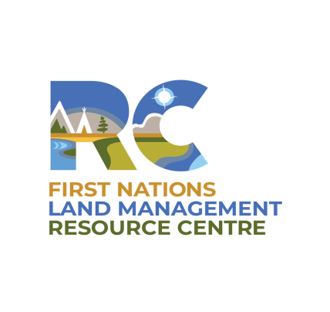
Available Funding for FNLM First Nations (to March 31, 2023)
Developmental Funding
Operational Funding
Transitional Funding
$150K
2 years
Developing Land Code
Community Approval Process
Individual Agreements
Category | Funding (2019-2020)
1 | $274,981
2 | $352,186
3 | $461,856
4 | $495,915
Grant authority
MOU / 5 years
+1% annual inflation
$150K
2 years
Training
Environment management
Residual law-making (MRP)
Notes:
Developmental Funding
Managed by the LAB/RC through a contribution agreement.
$150,000 is provided over two years to each entrant for a variety of activities (e.g., Land Codes, Individual Agreements, Community Approval Process).
Operational Funding
Flows through its own Grant Authority.
Managed by Canada in accordance with a joint MOU negotiated between Canada and the LAB. The current MOU is for five years and was voted and approved by LAB membership.
Operational funding is determined at the ‘pre-entry’ stage. It is a transaction-based formula resulting in four funding categories (plus an annual 1% inflationary adjuster):
Category 1: $272,259
Category 2: $348,699
Category 3: $457,283
Category 4: $491,005
Transitional Funding
Managed by the LAB/RC through a contribution agreement.
$150,000 is provided over the first two years for transitional funding – a new feature in the MOU. It is provided to support environmental management, training and residual law-making activities (e.g., matrimonial real property).

Slide 23
FNLM - Legislative Amendments
Phase 1 (1-2 years)
Phase 2 (3-5 years)
Notes:
Phase 1 (1-2 years):
focused on non-controversial, straightforward, but meaningful improvements in the short term to the Framework Agreement and the Act;
addressed recommendations from the Lands Advisory Board in its proposal to the Working Group of Ministers on the Review of Laws and Policies.
Phase 2 (3-5 years) involves engagement on broader land reform and extensive work with LAB-RC and consultation with other federal departments, Indigenous organizations and provincial/territorial governments

Slide 24
FNLM Updates
Plans
Accepting new entrants Implement Operational Funding Formula Implement Phase 1 legislative amendments Begin Phase 2 legislative amendments
Possibilities
Process of co-development with LAB Repealing and/or replacing FNLMA with a shorter piece of legislation that refers to the Framework Agreement’s primacy Expansion of First Nation Land Management jurisdiction
Notes:
Mention that Phase 2 amendments are “Very exploratory”

Slide 25
Discussion Questions
From what you’ve heard from this presentation, what is the most relevant information for you and your community?
How do you think Lands and Economic Management programming could better support your community needs?
If we relayed one message to our colleagues on your behalf, what could that be?
How do you think today’s presentation could be improved?

Slide 26
Contact information
Manager of Operations
Bernice Draper-Hickey
bernice.draper-hickey@canada.ca
819-639-5079

Slide 27
Additional Information

Slide 28
MRP – 2019 - Training and Engagement Calendar
Event | Location | Date | Complete
MRP Regional Training – Atlantic | Amherst, NS | January 16, 2019 | X
MRP Workshop – Estates National Meeting | Ottawa, ON | February 2019 | X
MRP Regional Training – Saskatchewan | Regina, SK | February 12, 2019 | X
MRP Regional Training – British Columbia | Vancouver, BC | March 19, 2019 | X
MRP Regional Training – Alberta | Edmonton, AB | March 20, 2019 | X
MRP Regional Training – Ontario | Toronto, ON | April 24, 2019 | X
MRP – Saskatchewan Bar Association Workshop and Prince Albert Office | Saskatoon, SK | May 1-2, 2019 | X
MRP Update – Lands Managers Face-to-Face | Ottawa | June 6, 2019
MRP Regional Training & First Nations Managers Open House | Yukon | June 11-13, 2019
MRP – Indigenous Bar Association Presentation | Ottawa | October 2019
Evergreen

Slide 29
Framework Agreement/FNLMA Amendments: Phase 1
Theme | From | To
UNDRIP | FNLMA silent on UNDRIP. | Acknowledge Canada’s endorsement of UNDRIP.
Lands Eligible for Management Under FNLM | Only reserve lands can be managed under the FNLM. | Include federal land categorized as “lands set aside” (in Yukon).
Ratification | Voting threshold combines minimum participation and majority of voters. | Simple majority or a higher voting threshold as decided by the Nation.
Verifier | Role of Verifier (independent third party) is mandatory throughout developmental and voting process. | Role of the verifier optional after the development of the Land Code, voting may be managed by a Ratification Officer.
Monies | Only revenue monies are part of the jurisdictional transfer. | Include both revenue and capital monies as part of the transfer.
Additions to Reserve | Additions to Reserve language procedural in nature and focus on making new lands subject to Land Code. | Strengthen language to: Eliminate pre-reserve designation requirement. Manage third party interests. Ensure added lands are brought under Land Code authority automatically.

Slide 30
Framework Agreement/FNLMA Amendments: Phase 1
Theme | From | To
Expansion | FNLM is silent. | Acknowledge ability of First Nations to manage jointly held reserves and provide guidelines to that effect.
Enforcement Powers | Enforcement language is general. | Enable cooperative enforcement and valid collection remedies.
First Nations Land Registry | Canada must manage land registry. | Create legislative frame to enable 3rd party management of the registry.
Protection for Band Officials | FNLM is silent on protections. | Similar protections to those employed by other local governments.
Administrative | Certain provisions in FNLM are no longer relevant, lack clarity, or administratively onerous. | Update, modernize and clarify language. For example: Scheduling by Ministerial Order rather than Order in Council Clarify that prior Indian Act designations no longer apply under FNLM Update to align with other Federal Acts.

Slide 31
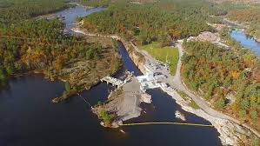
Dokis First Nation’s Okikendawt Project
The Dokis First Nation’s Okikendawt Project is a run of the river hydro project that was completed through the creation of its own land code under the First Nations Land Management Act. The Okikendawt Project will create economic opportunities for the community now, and for generations to come.
http://www.aadnc-aandc.gc.ca/eng/1459449220161/1459449341752

Slide 32
Image credits
Adrien Coquet
Lakshisha
Creative Mahira
Mikhail Bazilevsky
Arthur Shlain
Jimmy
Vectors Market
Binpodo
Priyanka
Graphic Tigers
art shop
andi
Monkik
Atif Arshad
MRK
Saifurrijial100
Gregor Cresnar
Becris
Shashank Singh
Ismael Ruiz
Gilbert Bages
Priyanka
Faisalovers
Mark Aventura
BornSymbols

