Slide 1
BLACK HISTORY MONTH Diversity

Slide 2
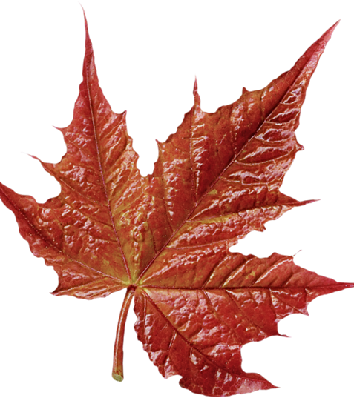
Diversity is more than just race!
Please join us as we explore the great diversity in Canada’s African Diaspora

Slide 3
dictionary.com
Diversity ^{[ dih-vur-si-tee]}
noun, plural di·ver·si·ties.
the state or fact of being diverse; difference; unlikeness :diversity of opinion.
variety; multiformity.
the inclusion of individuals representing more than one national origin, color, religion, socioeconomic stratum, sexual orientation, etc. :diversity in the workplace.
a point of difference.
Diaspora ^{[ dahy-as-per-uh ]}
noun, plural di·as·por·as.
any group migration or flight from a country or region.
any group that has been dispersed outside its traditional homeland, especially involuntarily, as Africans during the trans-Atlantic slave trade.

Slide 4
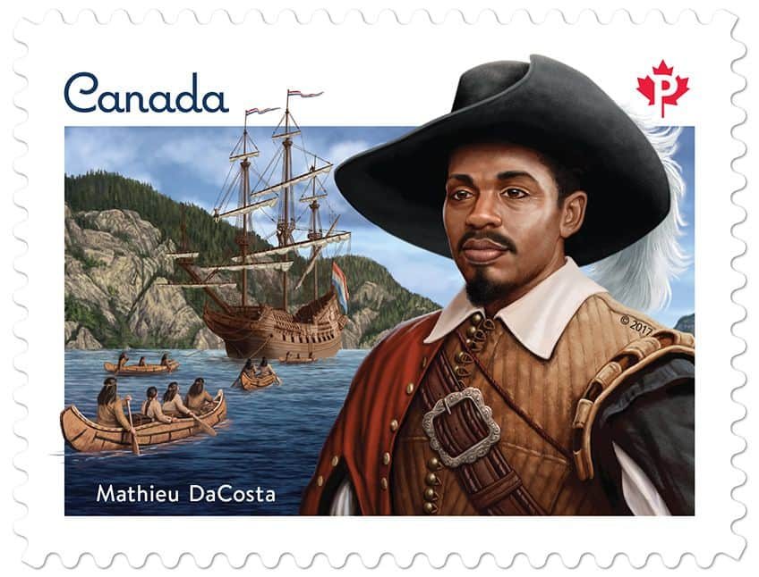
Where are we from?
Please do not: Make the mistake of assuming that because we are black, we are new to Canada!
Mathieu Da Costa is remembered and celebrated as a skilled interpreter and the first man of African heritage to visit and live in Canada. Some accounts say that he was a polyglot, able to speak several languages including French, Dutch and Portuguese. Mathieu's language skills were very valuable and sought after by early explorers.
He assisted well-known explorers such as Samuel de Champlain and Pierre Dugua de Mons on many expeditions in the early 17th century. He also spoke a language used by fishermen on the Atlantic coast that was a mix of a French-Spanish dialect and First Nations languages including Mi' kmaq.
A school in Toronto, and a street in Montreal and Quebec City have been named after him.
https://www.cbc.ca/kidscbc2/the-feed/the-first-person-of-african-heritage-to-arrive-in-canada

Slide 5
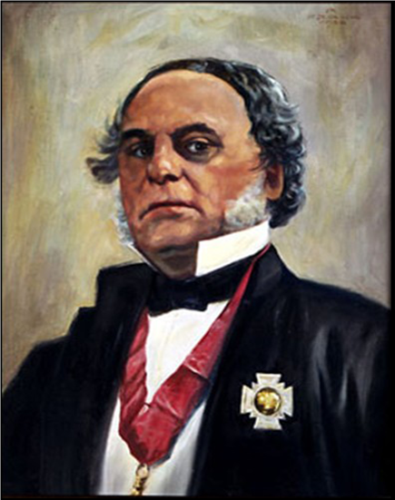
Where are we from?
Sir James Douglas, Governor of Vancouver Island and of BC
Born in August 15, 1803 in Guyana to a biracial or black mother and a well-to-do Scottish merchant father, James Douglas was educated in Scotland before moving to Canada to take on the prestigious position with the Hudson’s Bay Company that led to his governorship of Vancouver Island, and later, the province of British Columbia. Although his history of land treaties with coastal First Nations is credibly tainted with bad-faith negotiation, he is known as “the Father of British Columbia” for securing British rule west of the Rockies and blocking the annexation and Manifest Destiny threat posed by the USA. Part of his strategy on this front was inviting free black men from California to BC with the promise of becoming British subjects which was enticing, after the 1857 Supreme Court decision that denied citizenship to enslaved or free African Americans.
https://curious.royalbcmuseum.bc.ca/our-colonial-ancestry/
https://www.theafronews.com/the-bridge/sir-james-douglas/
https://www.thecanadianencyclopedia.ca/en/article/sir-james-douglas

Slide 6
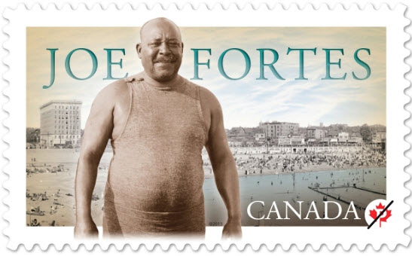
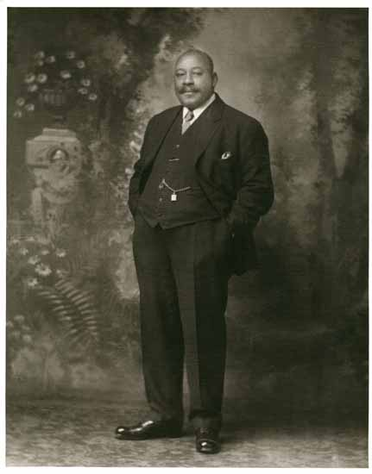
Where are we from?
Joseph Seraphim Fortes was the first lifeguard in English Bay, Vancouver.
He was most likely born in Port-of Spain, Trinidad, on February 9, 1863. When a teenager, he shipped out on the Brigantine, Robert Kerr, to England about 1880. He lived a few years in Liverpool, where he showed his swimming skill by crossing a 1,200 metre span of the Mersey River, among other swimming and diving feats. In 1885, Joe was again a crew member on the Robert Kerr, which sailed via Cape Horn to Panama and then on to Vancouver, arriving here in September 1885.
Joe Fortes died of pneumonia on February 4, 1922. His funeral, on February 7, was conducted at Holy Rosary Cathedral to an overflow crowd, and an estimated 10,000 persons lined Dunsmuir, Granville, Hastings and Main streets. Schools all over Vancouver observed a 5-minute silence, as his funeral procession made its way to Mountain View Cemetery.
https://bcblackhistory.ca/seraphim-joseph-fortes/

Slide 7
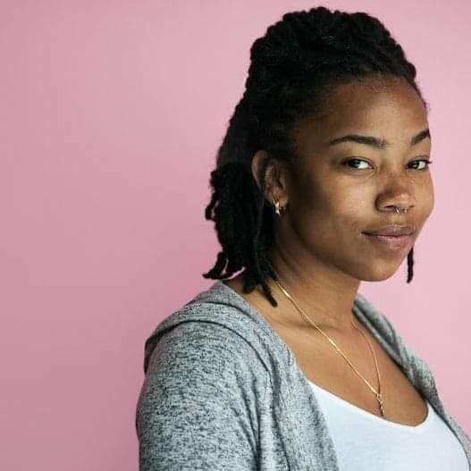
Where are we from?
VICE: What’s your background? Jade Brooks: I’m Nova Scotian. This is kind of a loaded question because everyone is always like, 'But where are you really from?' but my family has been in Nova Scotia for almost 10 generations.
I identify just as Scotian.
https://www.vice.com/en/article/gyajj4/who-is-a-settler-according-to-indigenous-and-black-scholars

Slide 8
Where are we from?
Transatlantic Slave Trade
Africans had been enslaved in Canada since the early 17th century. Both France and England participated. We will examine slavery in Canada more closely in an upcoming slideshow.
Black people have lived free in Canada, specifically Nova Scotia, since the mid 18th century, prior to Commonwealth emancipation. https://humanrights.ca/story/the-story-of-africville
The final stops for the Underground Railroad that delivered enslaved Americans to lands where they could be free of slavery, though not of discrimination and oppression, were in Upper and Lower Canada, southern Ontario and Québec. https://www.thecanadianencyclopedia.ca/en/article/underground-railroad
Please do: Remember that Africa is now full of bustling metropolises, with world class universities, modern sky scrapers and public transportation systems that compare or exceed many in North America!

Slide 9
Where are we from?
Please do not: Assume that all black immigration is motivated by a desire to escape oppression…
Many black Canadians arrived in Canada as economic immigrants, for the exact same reasons most white and Asian immigrants come to Canada. This covers most Caribbean immigration and also a significant number of European immigrants. Statistics for European immigration includes black individuals and families from Great Britain, France, and Spain, to name but a few actual countries of origin.
“People from the Caribbean region began to settle in Canada in the late 18th century. In the 2016 census, 749,155 Canadians reported that they originated from the Caribbean, and most have immigrated to Canada since the 1970s.” https://www.thecanadianencyclopedia.ca/en/article/caribbean-canadians
Many anglophone Caribbean immigrants in the 1950s and ‘60s were already British Commonwealth subjects when they arrived directly, or via Great Britain.
Transatlantic Slave Trade
Caribbean Immigration
Please do: Try Trinidadian or Guyanese curry and roti at your earliest convenience - it is very different than Indian or Thai curry, but just as delicious!

Slide 10
Where are we from?
Please do: Remember that Africa is a massive continent, not a single country, and that its own diversity is vast!
Transatlantic Slave Trade
Caribbean Immigration
African Immigrants and Refugees
According to Statistics Canada, African-born individuals comprised 13.4% of recent immigrants to Canada as of 2016, a four-fold increase from the number of African-born immigrants in 1971 (3.2%). The only larger immigrant group is European. To this point, it’s important to remember the note from the previous slide that a segment of black immigration also originates in Europe!
Persons with ancestry from Africa were the youngest residents as of 2016, with the largest proportion aged between 0-14 years old (~12%).
The number of Nigerians issued permanent resident permits has tripled since 2015, outpacing India, China and Philippines, among Canada’s traditional immigrant nations.
Although political unrest has vastly increased the number of African refugees, Africans join our tapestry as entrepreneurs, artists, and graduate students.
https://www.thecanadianencyclopedia.ca/en/article/africans

Slide 11
Where are we from?
Please do: Consider that for many of us and our parents, the first time we experience discrimination and racism in our lives is when we move to Canada….
https://www.youtube.com/watch?v=D9Ihs241zeg&ab_channel=TED
“Africans are not black,” she said. “They are Igbo and Yoruba, Ewe, Akan, Ndebele. They are not black. They are just themselves. They are humans on the land. That is how they see themselves, and that is who they are.” I felt slapped into a realization and slowly started to perceive a huge misconception that I had been unaware of till now. Perhaps reading the confusion on my face she continued. “They don’t become black until they go to America or come to Europe. They become black when they first land into the Western world that chooses to see them that way.”
://medium.com/an-injustice/there-are-no-black-people-in-africa-84fbeabb39c6

Slide 12
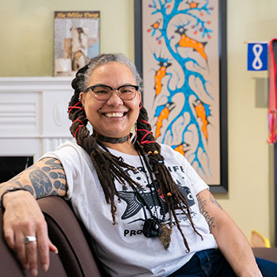
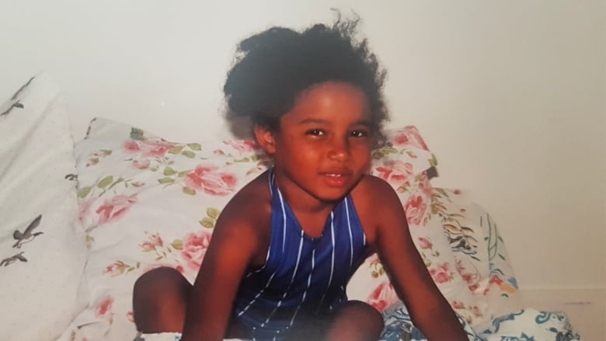
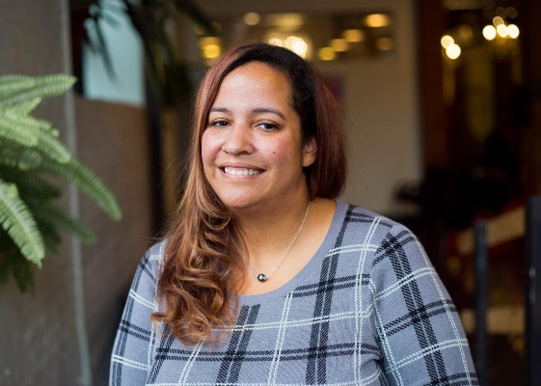
Cultural Diversity
Of course, by now you’re aware that we have been Canadian for centuries, that we are South American, Caribbean, European, and African, and enjoy a myriad of cultural and historical backgrounds a result, but are you aware that we are also Indigenous?
Please anticipate a self-directed slide show focussed on Afro-Indigenous Canadians, January 17, 2021.

Slide 13
Religious Diversity
Black Canadians are proud and historical adherents of Islam, Judaism, and Christianity. This should not be surprising if one considers the geographic birthplace of all three Abrahamic faiths. In addition, we are atheists, Buddhists, and Baháʼí.
In fact, we are represented in most other major faith or philosophy traditions on earth, including multiple traditional African and South American religions.
https://www.cjnews.com/living-jewish/being-a-jew-of-colour-finding-acceptance-and-inclusion
https://www.haaretz.com/world-news/americas/meet-the-woman-who-wants-to-become-the-first-black-jewish-leader-of-a-canadian-party-1.8931013
https://blog.islamicreliefcanada.org/matters/black-canadian-muslims/

Slide 14
Linguistic Diversity
Please do not: Assume that French, Spanish, Portuguese, Dutch or English were not our first languages!
As we’re all aware, Europe’s colonialism left its linguistic stamps all over the world. While Spain left her footprint only in the Americas and Caribbean, France, Belgium, Portugal, England and the Netherlands left marks all over Africa and beyond, including Asia, the South Pacific, and the Americas.
We have spoken Dutch in Suriname, Spanish in Cuba, Portuguese in Brazil, and English in Jamaica for centuries. In addition, 20th and 21st century immigration means we are German, Italian, and Israeli.
We proudly bring our diverse linguistic heritages to Canada!

Slide 15
Linguistic Diversity
Join us on February 24th for a
Self-Directed Slideshow that will focus on our diverse Black Canadian Francophone Diaspora, a testament to French and Belgian colonialism.

Slide 16
Orientation and Gender Diversity
As is true in every other human population on earth, we are lesbian, gay, and bisexual.
We are transgender, non-binary and gender queer.
We are straight, allied, and supportive of our LGBTQ brothers and sisters.

Slide 17
Orientation and Gender Diversity
in·ter·sec·tion·al·i·ty /ˌin(t)ərsekSHəˈnalədē/
noun
the interconnected nature of social categorizations such as race, class, and gender as they apply to a given individual or group, regarded as creating overlapping and interdependent systems of discrimination or disadvantage.
"through an awareness of intersectionality, we can better acknowledge and ground the differences among us"
Oxford languages

Slide 18
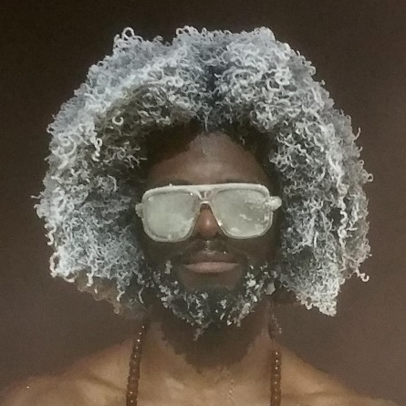
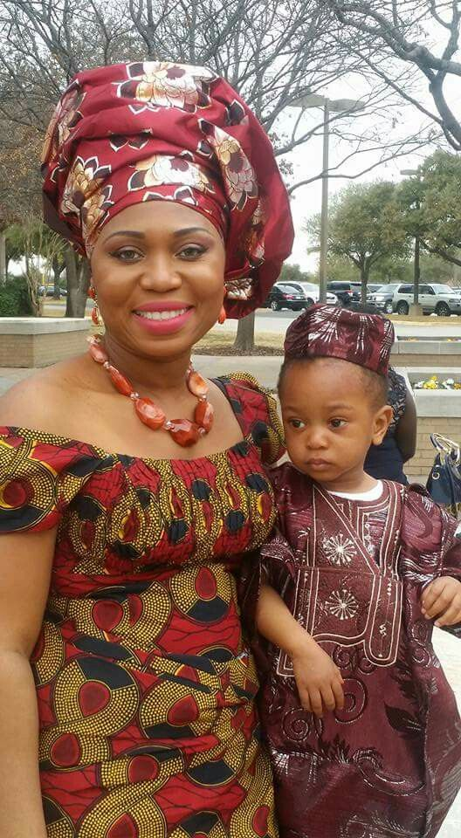
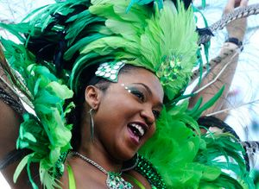
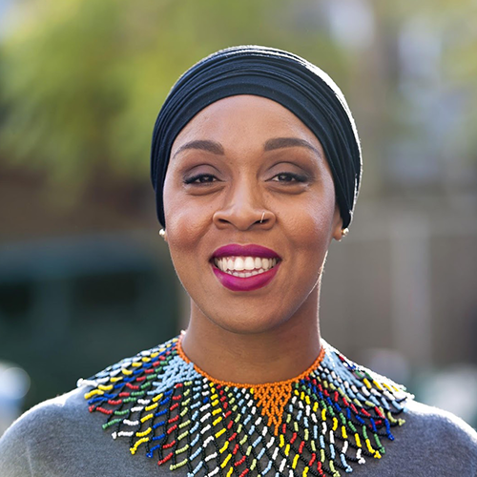
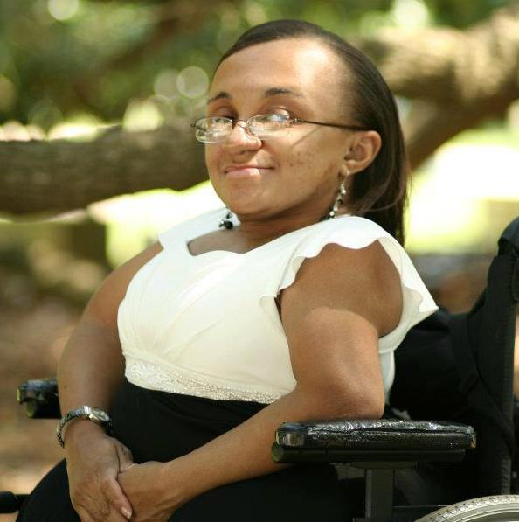
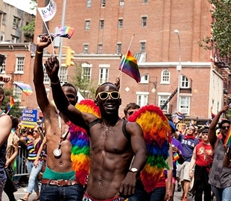
There is no single “Black Community” in Canada.
We are not a monolith.
Please do: Engage us in conversation about our various histories when it is appropriate and in an already established context. We’re generally very happy to share in two-way conversation, though we’re never obliged to take on a professor’s role!
Please do not: Ask us where we’re “really from”. This is not a polite, friendly, inquiry, it a microaggression.

Slide 19
coming soon:
Introduction
Diversity
Slavery
Afro-indigenous identity
Francophone diaspora
FBEC British Columbia
Regional Representatives: Charlene Libert-Scott and Elizabeth (Liz) Martin
fbecbc.cefncb@gmail.com
https://fbec-cefn.ca/ (national website)
Notes:
https://gccollab.ca/profile/fbecbccefncb
https://gccollab.ca/groups/profile/3051375/enfederal-black-employee-caucus-fbec-u2013-british-columbia-chapterfrcaucus-des-employu00e9s-fu00e9du00e9raux-noirs-cefn-u2013-section-de-la-colombie-britannique

