Slide 1
“Leadership is not a rank or a position, it is a choice - a choice to look after the person to the left of us & the person to the right of us.”
- S. Sinek
Notes:
Prepping:
https://www.youtube.com/watch?v=xoLQ3qkh0w0
Slido Slido https://app.sli.do/event/4u67KprDRdy8VCbhvSt23n code # imcl
https://wiki.gccollab.ca/MCLD-DLCP
Alejandro:
A quote from Simon Sinek, (read from the slide)
Strong leadership is one of the drivers of successful change, and leaders who support the people-side of change are essential to success.
This program delivers and promotes mindfulness practices to increase participants’ self-awareness and resilience, equipping leaders that can nurture mindfulness in their teams, with their colleagues and contribute to employee wellness and well-being.
This presentation will provide an overview of the program, share the highlights of the program

Slide 2
Introduction to Mindful Change Leadership @ Work
CCG Future Leaders Speaker Series
October 2023
Notes:
Alejandro:
For anonymous Q’s and level of comfort & learned something? https://app.sli.do/event/cnpYdpq5TGZMj5LC7HBHQp
_{Sli.do code: mcld}
https://wiki.gccollab.ca/MCLD-DLCP
_{FAQ, Details, Cohort}
((Right after starting the session…))
_{(( Start recording. ))}
_{Hello everyone.}
(( Land reconnaissance (may need to be updated) ))
First of all, I would like to point out that I am communicating with you from the traditional territory of the Algonquin people of the Anishinaabe, in the National Capital Region (NCR).
First of all, I would like to point out that I am communicating with you from the beautiful town of Kingsville, Ontario, on the traditional territory of the Caldwell, Anishinabewaki, Attiwonderonk, Myaamia and Mississauga peoples. I encourage you to think about the traditional territory from which you are connecting.
Some friendly reminders and housekeeping
Web cameras are welcome. Just PLEASE refrain from eating while your web camera is on.
Remember to disconnect from the VPN (or “VPN”) for better reception.
The session is recorded, by remaining in this session it is understood that we have your consent to the recording, this helps those who cannot attend.
(Please be assured that if anything of a sensitive nature is recorded, at the request of interested parties, the recording will be edited before broadcast.)
“As with other Government of Canada sessions, please feel free to use the language of your choice to ask questions or participate in the discussion. This program will be given mainly in French“
((Dites ce qui suit en français : ))
Comme pour toute séance du gouvernement du Canada, n’hésitez pas à utiliser la langue de votre choix pour poser des questions ou participer à la discussion. La séance d’aujourd’hui sera principalement dirigée en Anglais.
I welcome you to this Introduction to “Mindful Change Leadership at Work” session.

Slide 3
Agenda / Intentions
Experience a couple of quick mindful exercises
Share a definition of Mindful Change Leadership
Explore how Mindful Change Leadership supports Leadership at Work
Mindful Change Leadership Development (MCLD) program, the offering
Notes:
Alejandro:

Slide 4
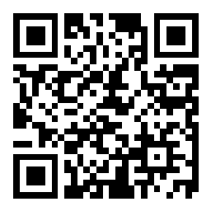
Sli.do
I would say my level of experience with mindfulness is:
How are you feeling right now?
https://www.slido.com/ # imcl https://app.sli.do/event/4u67KprDRdy8VCbhvSt23n
Notes:
There are two questions on the Sli.do
The first one is…
And the second one is…

Slide 5
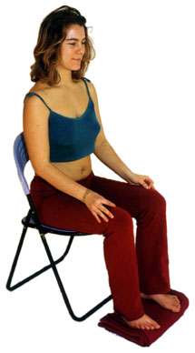
Mindfulness Exercise – Body Scan
Time required: 5 minutes
Take advantage of the opportunity to experience this exercise
Sit as comfortable as possible in a straight position
Feel free to close your eyes
Follow my voice as I lead you through the exercise
Then, we will do a short debrief of what you noticed.
Notes:
Alejandro:
To start, let's do a mindfulness exercise, this one is called body scan
If you have never done mindfulness, I invite you to take advantage of the opportunity to do so.
With your back straight, not tense, sit as comfortable as possible
You can place your feet flat on the floor; and place your hands on your lap, palms facing up or down, depending on what is most comfortable for you.
Feel free to close your eyes or semi-close them.
Follow my voice, which will guide you during the exercise.
Gently pay attention to your breathing. No need to change the way you breathe; just notice it.
breath in... breath out
Now direct your breathing and attention to:
your face, eyes, nose and mouth; your jaw, teeth, tongue;
become aware of what you notice
Inhale, now focus on your head, your scalp, your hair, your ears; and exhale;
as we continue breathing, direct your attention to your shoulders; and notice…
now…your arms, hands and fingers;
each time your attention wanders away, bring it back gently;
Inhale, back to your shoulders and neck; become aware of… exhale
…upper back, then your chest;
from your lower back, then your abdomen;
And direct your breathing towards your waist; inhale and exhale;
down your legs; inhale; up your legs; and notice how you feel; and exhale
towards your feet; inhale; notice how you feel;
towards your toes; exhale;
stay there for a few seconds;
when you feel like, open your eyes and come back
(click)
Feedback on the exercise:
There is a third question on Sli.do for you to answer
and if we can have 2 or 3 people briefly sharing how the exercise went for you... please open your microphones or raise your hand.
You can also use the chat space to describe what you noticed.

Slide 6
What’s the difference between Mindfulness and Meditation*?
~ Time of exercise, the objective, and the experience ~
5 minutes
Relax and realise
Self-awareness
20 minutes to an hour
Engage in reflection or contemplation
Could be mind shifting
*The way I see it
Notes:
Alejandro:
The core are the same, focus on your breathing. A way to compare them are:
The extent of time you typically take to do an exercise
The objective you aim for or achieve doing an exercise
The experience you perceive while doing the exercise
Mindfulness: like the body scan we just did.
Takes about 5 minutes
The objective is to relax and realise what’s going on in your mind
The experience could vary from person to person, but basically is a self-awareness experience
Meditation: having a practice of sitting and observing your breathe
May start by sitting 5 minutes for beginners
A good 20 minutes for those with an established practice, up to 8 hours a day in some days long retreats
The objective is to engage in contemplation or reflection.
The experience could be mind shifting
And keep in mind, Mindfulness is simple, not easy though
[[ Note for Translators: Not to be translated nor referenced during the presentation
La pleine conscience est une expression désignant une attitude d'attention, de présence et de conscience vigilante, qui peut être interne (sensations, pensées, émotions, actions, motivations, etc.) ou externe (au monde environnant, bruits, objets, événements, etc.).- Wikipedia
Pleine conscience — Wikipédia (wikipedia.org) – *we changed to reflect French
“Mindfulness means presence of heart” - John Kabbat Zinn https://www.youtube.com/watch?v=xoLQ3qkh0w0
“Meditation” noun the action or practice of meditating.
“Meditation” is a practice in which an individual trains the mind or induces a mode of consciousness
Forms: Buddhist meditation, Christian meditation, Daoist meditation, Jain meditation, Jewish meditation, Meditation in the Ravidasi Faith, Transcendental Meditation – Wikipedia
"Mindful meditation: Training the brain on attention and meta-attention with the purpose to develop Emotional Intelligence"
"Meta-attention: attention of the attention, being able to know that your attention has wandered away“
Tan, C (2013). Search Inside Yourself. NY; page 30.
]]

Slide 7
What is Mindfulness? - Definitions
Being attentive and aware, without judging.
“Mindfulness means presence of heart” - John Kabbat Zinn https://www.youtube.com/watch?v=xoLQ3qkh0w0
The following ideas and concepts are similar: Flow, Presence, Balance, Being, Alignment, Connectedness, Here and now (Gestalt), Wisdom, Centeredness, Slowness, and many more.
Notes:
Ginette:
Being mindful means to be present. To be in alignment with the thinking, the intention, the body. To have coherence between what you think, say, do, and also what you believe and trust
Show video: https://www.youtube.com/watch?v=xoLQ3qkh0w0

Slide 8
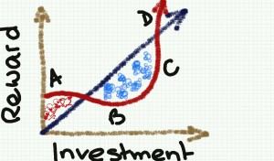
Why Mindful Matters
Resilience
Focus and concentration
Harmony
Fewer sick days
Satisfaction and well-being
Stress reduction
Creativity
Notes:
Ginette:
Let’s have some ideas around this... How do you see Mindfulness having an impact in the workplace?
Increased resilience: being mindful increases the ability to be open to new perspectives, to think creatively, to distinguish thoughts from feelings, and to respond to challenges rather than merely reacting. For a leader this helps with strategic thinking.
Focus and concentration: after an eight-week mindfulness course, participants could concentrate better, stay on task longer, more effectively, and remember what they’d done better. In a fast paced environment where leaders have to react quickly to situation this is a great capacity to have.
Workplace harmony: being mindful promotes and creates more empathy and altruism in the workplace. As a leader we are expected to foster a respectful workplace.
Fewer sick days: those who have a practice missed 76% fewer days of work.
Greater employee satisfaction and well-being: being mindful helps significantly to have less emotional exhaustion and more job satisfaction.
Stress reduction: just being mindful helps in reducing stress, anxiety, and depression. The practice helps reducing the levels of the primary stress hormone. As a leader we are put under a lot of stress and any tools that can help manage the pressure is something to be considered.
Greater creativity: Leaders with a mindfulness practice say it helps them create space for innovation and it also helps them to think strategically.
---
How mindfulness can help your employees and improve your company's bottom line – white paper, Mental workout http://www.mentalworkout.com/white-papers/how-mindfulness-can-help-your-employees-and-improve-your-companys-bottom-line/

Slide 9
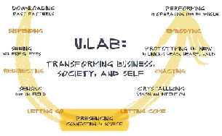
Organizations with Mindfulness Programs
RCMP / GRC
http://www.siyli.org
www.Mindfulnet.org
http://instituteformindfulleadership.org
Notes:
Ginette:
You see many different logos here. You may know some of them. All of these organizations are large companies. This is a serious reason why they implement these mindfulness programs.
I now want to draw your attention to 3 logos in particular:
RCMP / GRC
Peel Regional Police
Community Oriented Policing Services, US Department of Justice
All of them have Mindfulness related programs
You can find details in the links provided in the speaking points of these slides
- - -
Although this slide was created about 6 years ago (2017’ish), it is still very relevant. You see many different logos here, you may be familiar to more than one of them. Many of these are big companies, and there is a reason why they are implementing mindfulness programs.
Let me draw your attention to a couple of examples
((pick two that you like the most))
On the NBA, Phil Jackson, first with the Chicago Bulls and then with LA Lakers obtained 11 championships, having Michael Jordan, Koby Bryant and the alike do mindfulness exercises. They call it being in “the zone”. He asked NBA players to work on mindfulness exercises he called it being in the Zone – if you read the book 11 rings it will explain more about this.
Also, the Golden State Warriors, have a Mindful Mindset on Four Core values, in order:
1. Joy;
2. Mindfulness;
3. Compassion for team members and for the game of basketball; and
4. Competition
To me that speaks volumes
Google – who has not used google? it is big player in the booming of Mindfulness. Chad-Meng Tan started a mindfulness program in Google with great success that other silicon valley companies asked for it, they created a non for profit organization called Search Inside Yourself (SIY) book and it grew so big that now there is a SIY Leadership Institute (SIYLI).
SIYLI now delivering Mindfulness programs across the world, certifying teachers, implementing programs into organizations and also some countries like Bhutan - https://siyli.org/bhutan-government-employees/
OR
Karen May, VP People Development, executives start meetings with mindfulness time - https://youtu.be/zVlXE1UtJKY?t=421
World Economic Forum – The Forum engages the foremost political, business and other leaders of society to shape global, regional and industry agendas. Janice Marturano, ex VP General Mills and now president of the Institute for Mindful Leadership, presented at that forum - https://www.youtube.com/watch?v=v0CNZLIkIqw
U.Lab / MIT – Senior business management savvy, including mindfulness -they call it presencing- as part of the new way of doing ethical business. You will find the mindfulness theory particularly at the bottom of the circle. The U model takes us from Ego-System to Eco-System - https://www.youtube.com/watch?v=GcbB1I__BmM
Mindful Nation UK – Is co-chaired by the three main political parties in UK with the intention to apply mindfulness programs in the areas of National education, health, the workplace and the criminal justice system. - https://www.themindfulnessinitiative.org/mindful-nation-report
---
Resources in English:
Phil Jackson’s eleven Rings – with Chicago Bulls and LA Lakers obtained 11 championships - https://www.amazon.ca/Eleven-Rings-Success-Phil-Jackson/dp/0143125346
Golden State Warriors, Four Core values - http://yogadork.com/2015/12/09/the-golden-state-warriors-record-breaking-mindful-mindset/
Article – mentions some details about the Mindfulness programs at Google, Aetna, General Mills, Intel, Target & Green Mountain Coffee Roastershttps://hbr.org/2015/12/why-google-target-and-general-mills-are-investing-in-mindfulness
http://www.siyli.org
http://www.Mindfulnet.org
http://instituteformindfulleadership.org
https://www.meditationasmedicine.ca/blog/meditating-cop-peel-Ontario
https://www.rcmp-grc.gc.ca/en/gazette/mindfulness-difference
https://cops.usdoj.gov/html/dispatch/05-2021/mindfulness_training.html

Slide 10
Mindfulness & Agile Leadership
"Mindfulness helps an Agile leader to create a highly collaborative work environment, and this achievement occurs when you are aware of your emotions, thoughts, and actions. Similarly, a self-aware team capable of efficiently communicating can better support each other in times of change and stress.” - How Mindfulness Enables Agile Leadership - Leadership Tribe US
Notes:
Ginette:
For leaders trying to bring forward an Agile team, a few points of concern go a long way in creating their team’s ideal traits and characteristics.
Purpose – focusing on goals
Transparency – sharing information and brainstorming ideas
Stronger Communication – positive interaction without obstacles to behaviour – quickly resolve problems with effective interaction
Faith – trust in each other which brings cohesion and confidence in each other
Consistent Upgrade – continuous solution-finding cycle
https://leadershiptribe.com/blog/how-mindfulness-enables-agile-leadership#:~:text=Mindfulness%20helps%20an%20Agile%20leader%20to%20create%20a,each%20other%20in%20times%20of%20change%20and%20stress.

Slide 11
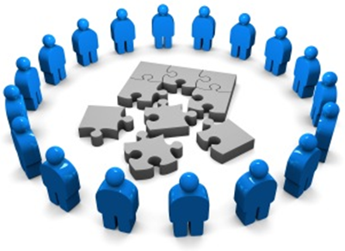
What is Mindful Change Leadership?
Refers to the person who is present, non judgmental and cultivates several aspects during his interactions. These aspects are visible and tangible in the Mindful Leader:
Focus (focus of attention)
Clarity (self awareness & emotional intelligence)
Creativity (innovation & decision making)
Compassion in the service of others (presence, deep listening)
Notes:
Alejandro:
Mindful Leaders have the following skills: and what you cultivate by a mindfulness practice*
Focus – Focus of attention: by training the mind to focus on a specific objective.
Clarity – Self awareness and Emotional Intelligence: by helping the mind to notice the body’s reactions clearer.
Creativity – Innovation and Decision making: by quieting the mind and allowing the creativity to rise and the decision to occur.
Compassion in the service of others –by being in presence and deep listening to others.
- Adapted from http://instituteformindfulleadership.org/definitions/
*Those who have a mindfulness practice have been linked with:
Increased attention
Improved emotional intelligence
Stronger resilience
Enhanced strategic decision making
Increased ethical decision making
Increased creativity
http://www.hrzone.com/perform/people/the-science-of-mindfulness-for-leaders#.VcSEic0IUYg.linkedin

Slide 12
Mindful Change Leadership Development (MCLD) Program Goal
To increase self-awareness by developing key skills:
Focus,
Clarity,
Creativity, and
Compassion in the service of others
… with a positive impact on well-being and resiliency.
“Individuals with higher mindfulness have greater resilience, thereby increasing their life satisfaction.” - ScienceDirect
Invitation page and details: https://wiki.gccollab.ca/MCLD-DLCP
Notes:
Alejandro:
Those 4 key skills are the aim of the program, which we’ll chat a bit more later… and it also has a positive impact on well-being and resiliency
(click)
There are studies showing that individuals with higher levels of mindfulness tend to be more resilient. And also note that both mindfulness and resilience are important skills for improved well-being
By partaking in the program, you will likely increase the level of honesty and trust within yourself, and therefore with others, allowing for an authentic connection with the work that we do at the Government of Canada.

Slide 13
Which Mindful Change Leadership skills support the Key Leadership Competencies?
 | Focus | Clarity | Creativity | Compassion in the service of others
Create Vision and Strategy
Mobilize People
Uphold Integrity and Respect
Collaborate with Partners and Stakeholders
Promote Innovation and Guide Change
Achieve Results
Notes:
Alejandro:
In the following table, we have the Key Leadership Competency profile from TBS on the left column, and on the top row we have the Mindful Change Leadership skills
This table indicates which competencies is supported by which skill
(click) – in the case of the “Create Vision and Strategy” competency is supported primarily by Clarity and Compassion in the service of others
(click) – “Mobilize people” competency is supported by Focus, Clarity and Compassion in the service of others
(click) and so on and so forth
Now, you may think, well, actually all of the competencies are supported by all of the skills, in a sense yes, the table indicates the skill most predominant or directly related to the competency.
Resources…
Key Leadership Competency profile and examples of effective and ineffective behaviours…
Create Vision and Strategy
Leaders define the future and chart a path forward. They are adept at understanding and communicating context, factoring in the economic, social and political environment. Intellectually agile, they leverage their deep and broad knowledge, build on diverse ideas and perspectives and create consensus around compelling visions. Leaders balance organizational and government-wide priorities and improve outcomes for Canada and Canadians.
Mobilize People
Leaders inspire and motivate the people they lead. They manage performance, provide constructive and respectful feedback to encourage and enable performance excellence. They lead by example, setting goals for themselves that are more demanding than those that they set for others.
Uphold Integrity and Respect
Leaders exemplify ethical practices, professionalism and personal integrity. They create respectful and trusting work environments where sound advice is valued. They encourage the expression of diverse opinions and perspectives, while fostering collegiality. Leaders are self-aware and seek out opportunities for personal growth.
Collaborate with Partners and Stakeholders
Leaders are deliberate and resourceful about seeking the widest possible spectrum of perspectives. They demonstrate openness and flexibility to forge consensus and improve outcomes. They bring a whole-of-government perspective to their interactions. In negotiating solutions, they are open to alternatives and skillful at managing expectations. Leaders share recognition with their teams and partners.
Promote Innovation and Guide Change
Leaders have the courage and resilience to challenge convention. They create an environment that supports bold thinking, experimentation and intelligent risk taking. They use setbacks as a valuable source of insight and learning. Leaders take change in their stride, aligning and adjusting milestones and targets to maintain forward momentum.
Achieve Results
Leaders mobilize and manage resources to deliver on the priorities of the Government, improve outcomes and add value. They consider context, risks and business intelligence to support high-quality and timely decisions. They anticipate, plan, monitor progress and adjust as needed. Leaders take personal responsibility for their actions and outcomes of their decisions.
From: https://www.canada.ca/en/treasury-board-secretariat/services/professional-development/key-leadership-competency-profile/examples-effective-ineffective-behaviours.html

Slide 14
Exercise – Noticing
Time required: 3 minutes
The trick is to shift from “doing” to “being”
We’ll do a short debrief of what you noticed
Notes:
Ginette:
Let’s start by doing the following...
Sit as comfortable as possible in a straight position
It helps if you close or semi-close your eyes
Let’s not worry about time
And take a minute, only a minute...
To breathe, just to breathe
That simple
inhale
exhale
If at any point your mind wanders, be kind to yourself, acknowledge the thought, let it be, and bring your attention back to the object of your attention, which is your breathing .
inhale
exhale
Just continue breathing
I’ll let you know when the time is over.
Feedback on the exercise: if we can have 2 or 3 people sharing how the exercise went for you... please open your microphones or raise your hand.
You can also use the chat space to describe what you noticed.
Mindful breathing https://www.youtube.com/watch?v=ZE-r-x2T4ok
This is one way of doing it, getting it depends on the practice of.
Noticing is very important in the practice of Mindfulness.
Noticing where your thinking is, that’s the first step to become more Mindful.

Slide 15
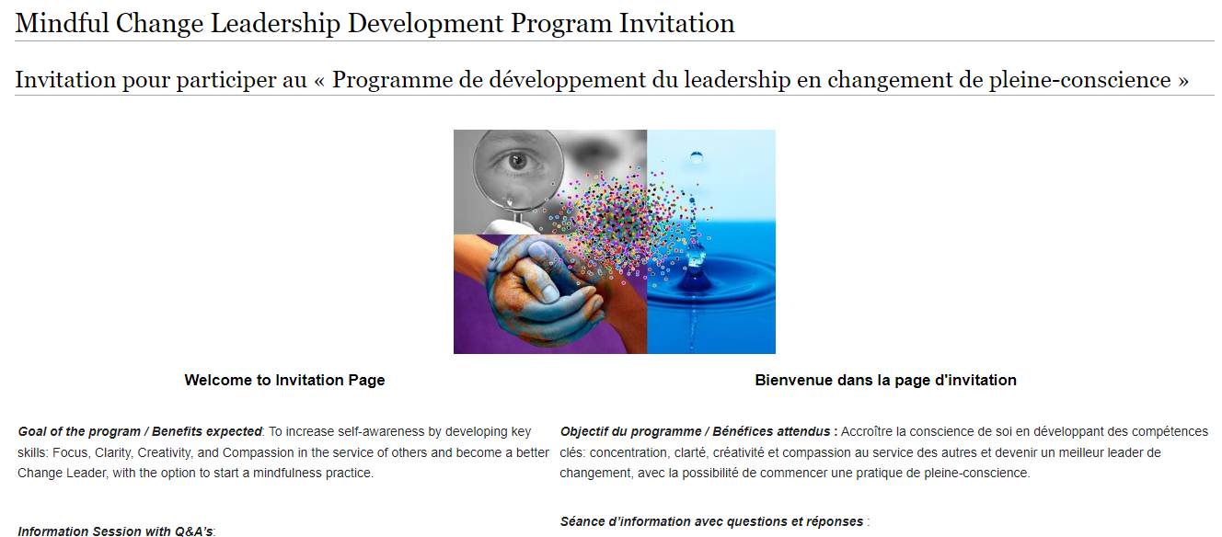
MCLD program
https://wiki.gccollab.ca/MCLD-DLCP
MCLD - 8 Week Program Details
MCLD - FAQ
Notes:
Ginette:
The Main Goal of the MCLD Program is to increase self-awareness by developing key skills:
Focus
Clarity
Creativity
Compassion in the service of others
… with a positive impact on well-being and resiliency.
Pages to open and explore:
https://wiki.gccollab.ca/MCLD-DLCP , scroll down to the commitment section
MCLD - 8 Week Program Details (https://wiki.gccollab.ca/Mindful_Change_Leadership_Development_Program_Details)
MCLD – FAQ (https://wiki.gccollab.ca/Mindful_Change_Leadership_Development_Program_-_FAQ)

Slide 16
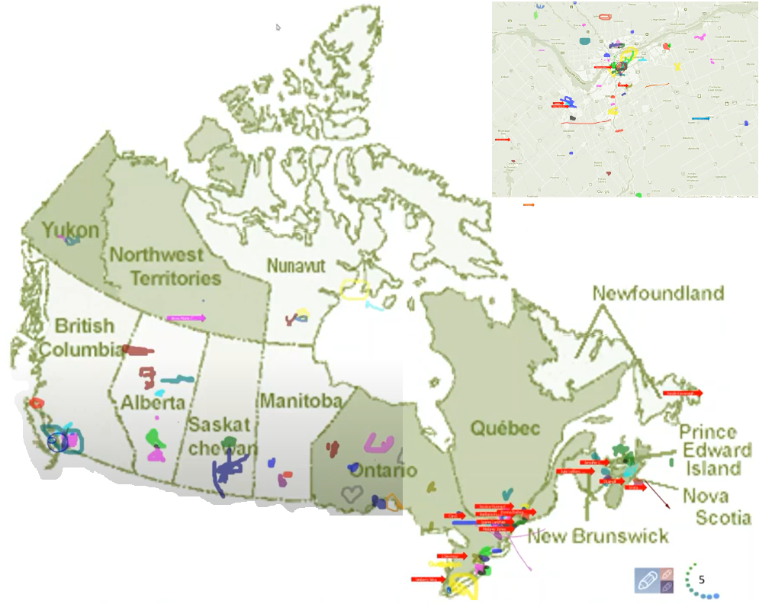
Participants MCLD 2022 English Offering
From across Canada:
From NCR:
Notes:
Ginette:
The program had participants from across Government and across Canada, as you can see per the slide, the image was co-created at the beginning of the 2022 English offering

Slide 17
Key Findings - MCLD English Program 2022
20.8%
23.0%
14.0%
20.5%
12.6%
, 3 months after
**76% success rate for self-assessments: 99 responses were received out of the 130 participants who completed the program.
* People who answered "Almost Always", "Very Frequently", and "Somewhat Frequently"
Notes:
Alejandro:
Participants completed self-assessment questionnaires at program registration and again three months after the eight-week program, and we have compiled the data to evaluate the results and impacts of the Mindful Change Leadership Development program.
(click)
The blue columns represent the results of the self-assessment questionnaires completed at registration.
(click)
The green columns represent the final assessment, and the differences between them indicate behavioural changes.
A total of 130 participants completed the program, we received 99 final assessments (76% return on self-assessments), and the key findings per category are:
(click on each bullet)
An increase of 12.6% Increase in Employee Engagement – respondents show a sense of clarity of mind.
(Q2. I have difficulty distinguishing what day it is.)
A 23.0% Increase in Promoting Sounder Decision Making - people reported taking time to optimize their productivity.
(Q7. I take time each day to optimize my personal productivity)
Slightly over 20% decrease in Behavioural Risks - participants indicated being more aware of the task at hand.
(Q13. It seems I am running on automatic, without much awareness of what I am doing.)
Close to 21% Increase in Well-Being – respondents feel they are more present while at work and at home.
(Q1. I notice that I am distracted by thoughts about work after working hours or about home related things when I'm working.)
And 14.0% Increase in Resiliency - people reported an improvement in their ability to be present.
(Q21. I find myself listening to someone with one ear, doing something else at the same time.)
What we heard from participants was that the program was a life changing experience, it helped them increased their own sense of well-being; and gave them the tools and practices to use with their teams to support employee wellness and well-being.

Slide 18
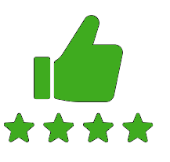
MCLD Program Testimonials
"…in a way, your investment in becoming medicine... is a very important investment…" - Elder Malcom Saulis
"I found this course to be extremely powerful and grounding... this really helps to shape how I look at my relationships with my staff… it was excellent. "
"it was very powerful, very interesting, lots of insights. I learned a lot about myself. I found the exercises appropriate in me being more productive, more present in my relationships with my colleagues and also with my family.”
“This series is life changing. I hope to participate more in the future”
"These 8 weeks have been profound… in my view I think this should be mandatory for everyone. it's that powerful"
"Thank you for this valuable opportunity to grow personally and professionally. It has been an important adjunct to the transformational work we are doing at ISC.“
I wanted to also share some specific gratitude... I found the sessions incredibly helpful, useful and well structured… it's already had a wonderful effect on my life
Notes:
Alejandro:
From this set of testimonials, I’ll allow myself to read the first one in full… from Elder Malcom Saulis: "... in a way, your investment in becoming medicine for yourself and for the rest of the world is something that I'm grateful to be witness to as an occasional participant in this program... any kind of investment like this in order to open your mind, your heart and your spirit to the presence of a larger world, which is either spiritual or physical, is a very important investment, and I applaud you for the investment that you've made." - Elder Malcom Saulis, session 8, 5456

Slide 19
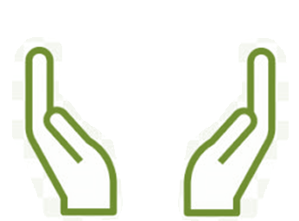
What’s Needed For Success ?
Grass Roots
Voluntary Participation
Support from Management
Notes:
Alejandro:
The sessions and take-home activities require a fairly significant investment by participants, and two components which will be key for ensuring the continued success of the program are maintaining voluntary participation and support from management.
(These 2 success factors are emphasized during the promotion of the program, and employees are encouraged to discuss with their managers to get their support)

Slide 20
Mindfulness Practice
A Mindfulness practice could make a difference
Mindful change leadership is about compassion and understanding
No Magic Pill,
No McMindfulness
Notes:
Although it is not a magic pill, a daily mindfulness practice could make a difference in the way people adopt, manage and lead change.
Remember that mindful change leadership is about balancing the need for change with compassion and understanding. It involves creating an environment where employees feel valued, heard, and motivated to adapt to new circumstances.

Slide 21
List of strategies to help you become a Better Mindful Change Leader
1. Self-awareness
2. Active listening
3. Empathy
4. Decision-making
5. Mindfulness practices
6. Communicate openly and transparently
7. Patience
8. Resilience
9. Celebrate small wins
10. Coaching and mentoring
11. Clear objectives and measurements
12. Adaptability
13. Continuous improvement
14. Conflict resolution
15. Feedback loops
16. Support mental health
3. Empathy
13. Continuous improvement
7. Patience
Notes:
Now, let’s talk abuot strategies for becoming a better change leader..
I’m not going to lie, I ask my friend ChatGPT and this is what it told me… now, I shorten the text for it to fit in one page
I’ll read #3, 7 & 13 in full, you can read all of them in full from the speaking notes
1. Self-awareness:
Start by cultivating self-awareness. Understand your own reactions, biases, and emotions in the face of change.
Reflect on your strengths and weaknesses as a leader, and how they might affect your ability to guide change effectively.
2. Active listening:
Practice active listening to truly understand the concerns and ideas of your team members.
Create an open and non-judgmental space where employees feel safe sharing their thoughts.
3. Empathy:
Developing empathy for your team members. Understanding their perspectives and emotions during the change process.
Showing genuine care and concern for their well-being.
4. Communicate openly and transparently:
Be transparent about the reasons for the change, its expected impact, and the steps involved.
Encourage open dialogue, addressing questions and concerns promptly.
5. Involve employees in decision-making:
Involve employees in the change process by seeking their input and feedback.
They have a stake in the changes and can influence the outcome.
6. Mindfulness practices:
Introduce mindfulness practices like meditation or deep breathing exercises to help employees manage stress and stay present during the change.
Lead by example by practicing mindfulness yourself.
7. Patience:
Recognizing that change takes time, and not everyone will adapt at the same pace.
Being patient and providing support to those who need more time to adjust.
8. Resilience:
Foster resilience within your team by emphasizing the learning opportunities that change brings.
Encourage a growth mindset and help employees bounce back from setbacks.
9. Celebrate small wins:
Acknowledge and celebrate small milestones and achievements during the change process.
This boosts morale and helps maintain motivation.
10. Coaching and mentoring:
Offer coaching and mentoring support to employees who may be struggling with the change.
Help them build the skills and confidence needed for the new situation.
11. Clear objectives and measurements:
Establish clear, measurable objectives for the change initiative.
Regularly assess progress and make adjustments as necessary.
12. Adaptability:
Be open to adjusting the change strategy if needed based on feedback and emerging insights.
Stay flexible and responsive to changing circumstances.
13. Continuous improvement:
Encouraging a culture of continuous improvement and learning, within your team and organization.
Promoting the idea that change is an ongoing process.
14. Conflict resolution:
Address conflicts and disagreements within the team promptly and constructively.
Use mediation and conflict resolution techniques to find common ground.
15. Feedback loops:
Create feedback loops that allow employees to provide ongoing input on the change initiative.
Use this feedback to make informed decisions.
16. Support mental health:
Recognize the emotional toll that change can take on individuals and offer mental health resources and support.

Slide 22
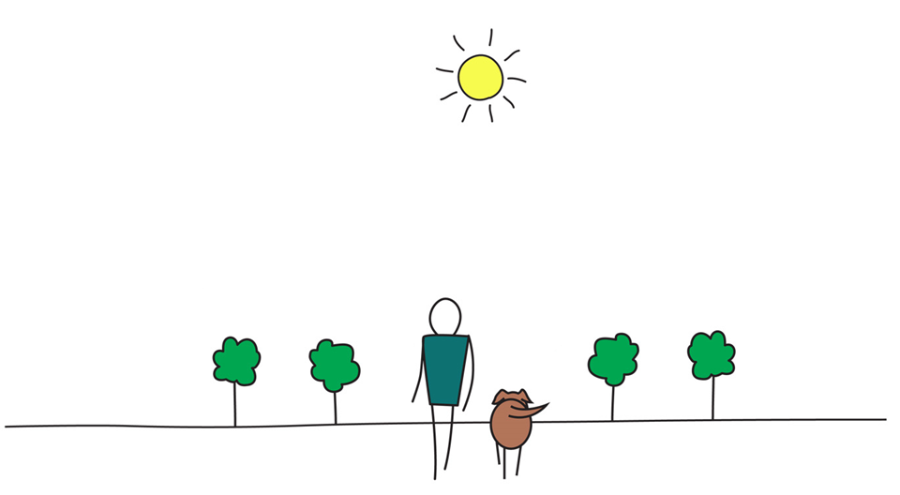
Be Mindful, Be Happy /
Prenez conscience, soyez heureux
Notes:
Alejandro: Open floor for questions
Please use the “raise hand” functionality
Observe:
One question, per participant, per turn
Alternating with the chat and with anonymous

Slide 23
Mindfulness & Change
“Reducing resistance to change: … Particularly when change is poorly managed, it tends to bring negative emotions of loss and threat, fear and anger, anxiety and insecurity. Under these conditions, employees protect themselves from this stressful situation and resist as much as they can the possibility to change.” – Now Unlimited, Mindfulness & Change Management
“The “Dealing with Change Mindfulness Meditation Study” showed 100% of participants were able to create a better experience of their change through guidance by a change management mindfulness meditation.” – ACMP Global events 2019 – Mindfulness for CM
Notes:
How Mindfulness practice relates to CM, CL & Transformation?
https://kipdf.com/mindfulness-change-management_5ad40bfa7f8b9a5e228b45aa.html
https://www.acmpglobal.org/events/EventDetails.aspx?id=1243972
https://www.bcg.com/en-ca/publications/2018/unleashing-power-of-mindfulness-in-corporations

Slide 24
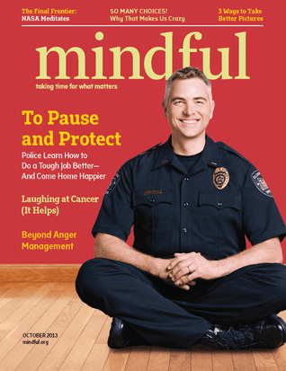
Mindfulness & Change Leadership
We can no longer afford to make decisions with distracted minds, reacting instead of responding
The Two Qualities of a Great Leader:
Ability of a leader to connect
to self, to our values and our ethics
to others, in an organizational environment that values inclusion
to the larger community, the bigger picture, the wider connection is how great organizations give meaning to their existence and inspire their employees
Ability of a leader to skillfully initiate or guide change. Leading by collaborating and listening with open curiosity… …take a courageous stand, lead the organization into new arenas, and accept failures as experiments from which to learn” - Transforming Leaders into Mindful Leaders
Notes:
https://www.mindful.org/finding-the-space-to-lead-3

Slide 25
Mindfulness & Transformational Change
“The benefits of mindfulness are both clear and proven. Mindfulness programs help leaders and employees reflect effectively, focus sharply on the task at hand, master peak levels of stress, and recharge quickly. On an organizational level, mindfulness reduces sick days, increases trust in leadership, and boosts employee engagement. What’s more, mindfulness helps to unlock the full potential of digital and agile transformations. New processes and structures are just the starting points for these transformations.” - Boston Consulting Group
Notes:
BCG: https://www.bcg.com/en-ca/publications/2018/unleashing-power-of-mindfulness-in-corporations

Slide 26
Mindfulness & the Future of Work
“…he has made the mindfulness practice program an important part of his future of work agenda and an element of the company’s Global Health, Safety & Well-Being team…” - Christian Schmeichel, chief future of work officer at SAP
“Mindfulness isn’t some social nonsense; it’s a prerequisite for authentic, powerful human interaction. We want to change our culture toward more creativity, better focus, greater resiliency, better leadership qualities, and well-being at all levels of the company. ” - Peter Bostelmann is chief mindfulness officer and head of SAP Global Mindfulness Practice
Notes:
SAP:
now offers mindfulness programs... https://www.sap.com/canada/about/customer-involvement/global-mindfulness-practice.html
https://news.sap.com/2022/09/mindfulness-day-2022-new-superpower/
Video – a minute to arrive: https://www.sap.com/canada/assetdetail/2019/04/da2202a2-4a7d-0010-87a3-c30de2ffd8ff.html

Slide 27
Which Mindful Change Leadership skills support the Core Competencies?
 | Focus | Clarity | Creativity | Compassion in the service of others
Demonstrating integrity and respect
Thinking things through
Working effectively with others
Showing initiative and being action oriented
Notes:
http://myssc-monspc.ssc-spc.gc.ca/en/theacademy/my-faculties/faculty-behavioral-competencies
In this table, showing the Treasury Board of Canada’s Core Competencies, developed within the context of the Performance Management Program:
We can see how Clarity and Compassion in the Service of others supports Demonstrating integrity and respect
How Focus, Clarity and Compassion in the service of others supports Thinking things through
That Working effectively with others is supported by Focus, Creativity and Compassion, and that
Showing initiative and being action oriented is supported by the same Focus, Creativity and Compassion,

