Slide 1
Designing guidance
Simple and user-friendly
without sacrificing accuracy
Draft for discussion

Slide 2
Why this deck
Guidance that is not clear can lead to confusion and frustration and risks not being understood or acted on appropriately
This deck will provide recommendations and examples on how to create clear, understandable and useable GC COVID-related guidance

Slide 3
Key messages
Involve colleagues from the beginning – multidisciplinary teams working in close collaboration develop better products
Keep the user in mind – guidance content needs to be understandable and useable. Use proven methods such as plain language, pyramid style, clear and simple headings, etc. for all content design
Consider the communications channels – guidance content is consumed on different channels in different formats. Keep in mind where and how you’re going to publish and promote the guidance content as you’re creating it
Know your audience – not all guidance should be written the same way. Speak to your audience in a way that they will understand, e.g., medical doctor versus daycare owner

Slide 4
People just want instructions and answers
Excerpts from usability study undertaken May 26, 2020. See findings

Slide 5
Useful templates and patterns — visual and interactive
As content is drafted, consider applying:
Navigation design patterns (e.g. subway, on this page)
Document summaries
Checklists
Expand/collapse (e.g. provide main summary points, expand for details)
Tables and charts
Wizards: guided answers [add visual examples]

Slide 6
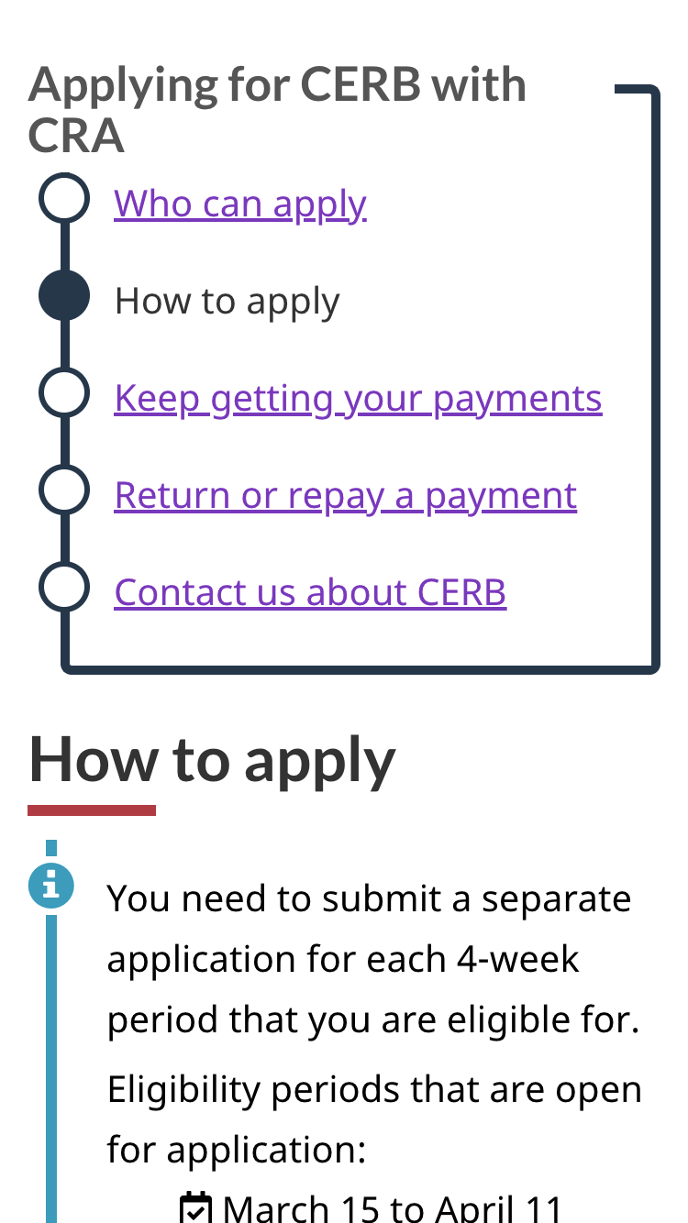
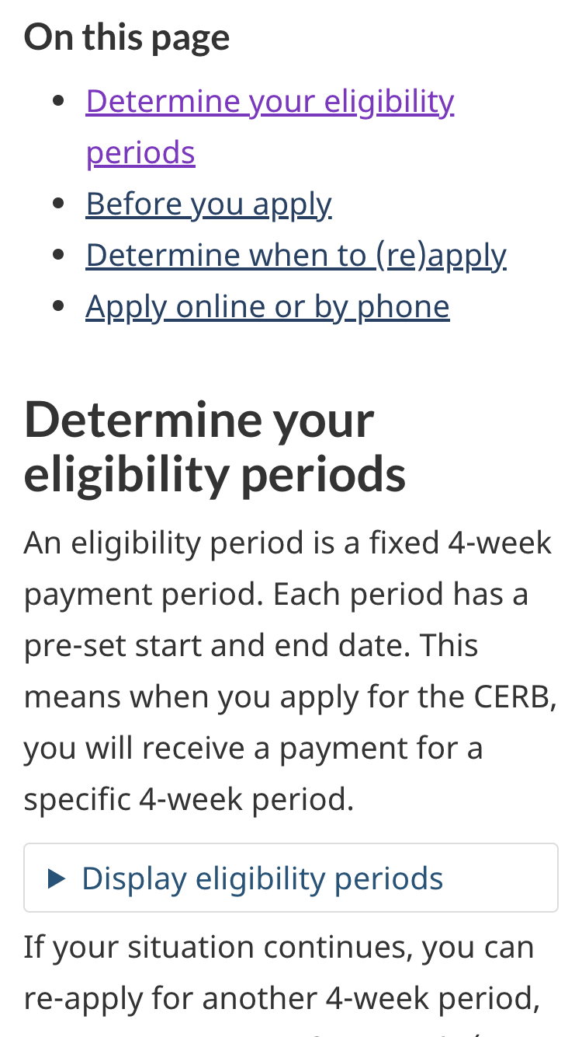
Navigation: help people find what they need
People hunt links online. Good navigation helps them use links to find what they need. Breaking content into chunks makes it easier for people to:
Follow along step by step (“subway” pattern)
Decide which part of a page they want to use (“On this page” links)

Slide 7
Document summaries: is this content for me?
[insert example]

Slide 8
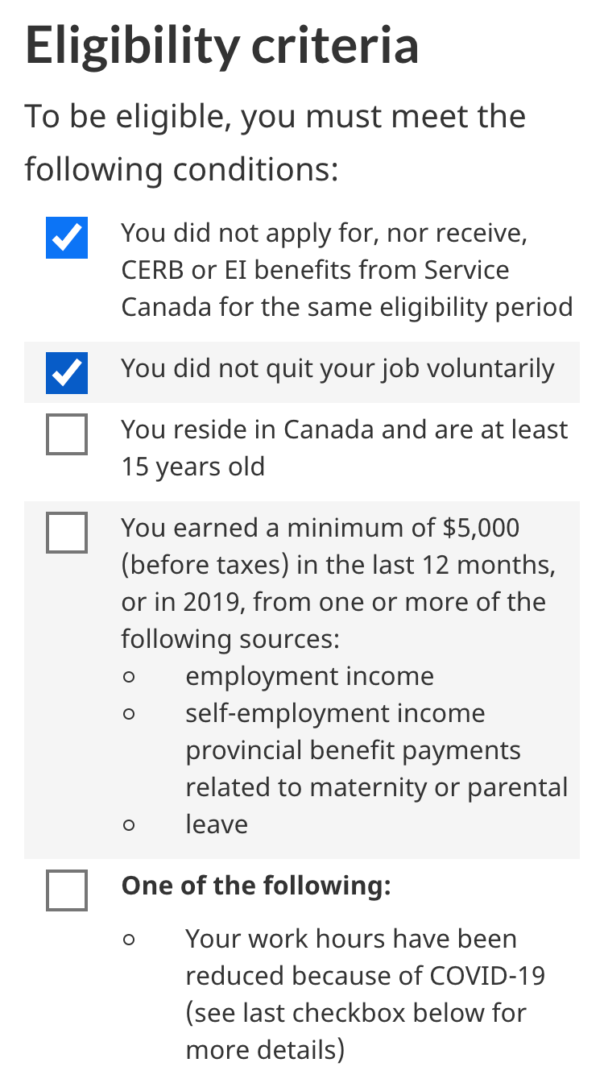
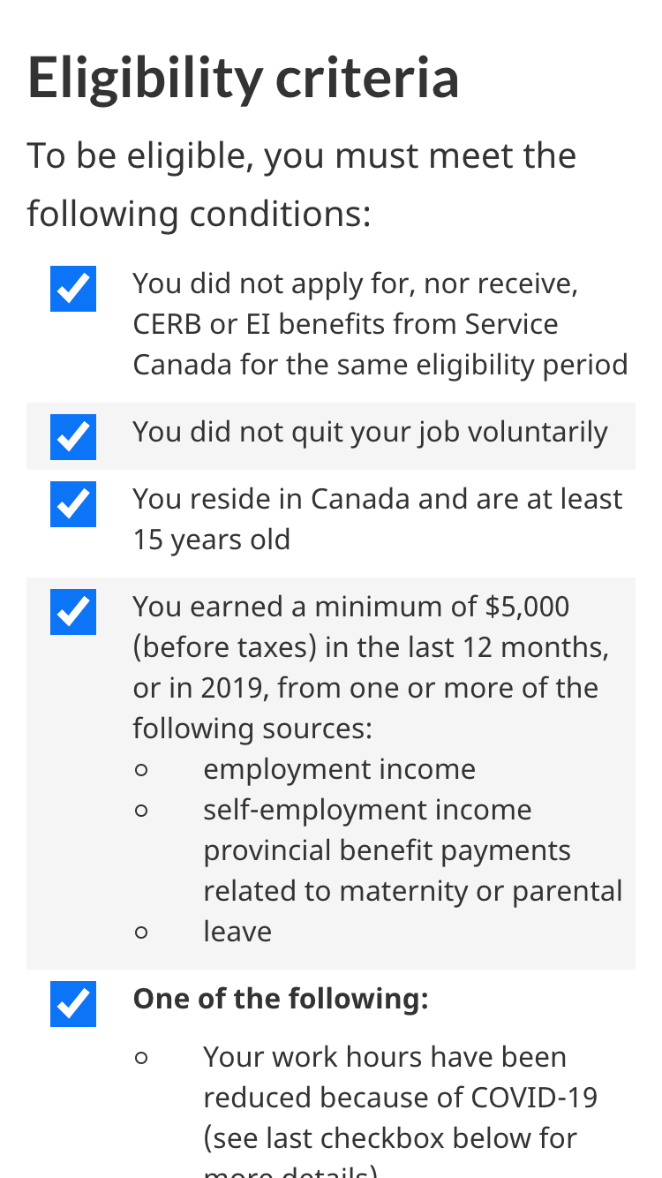
Checklists: instructions you can use
Providing interaction on a list of instructions focuses people’s attention & facilitates greater understanding
Confirming success reinforces and reassures

Slide 9
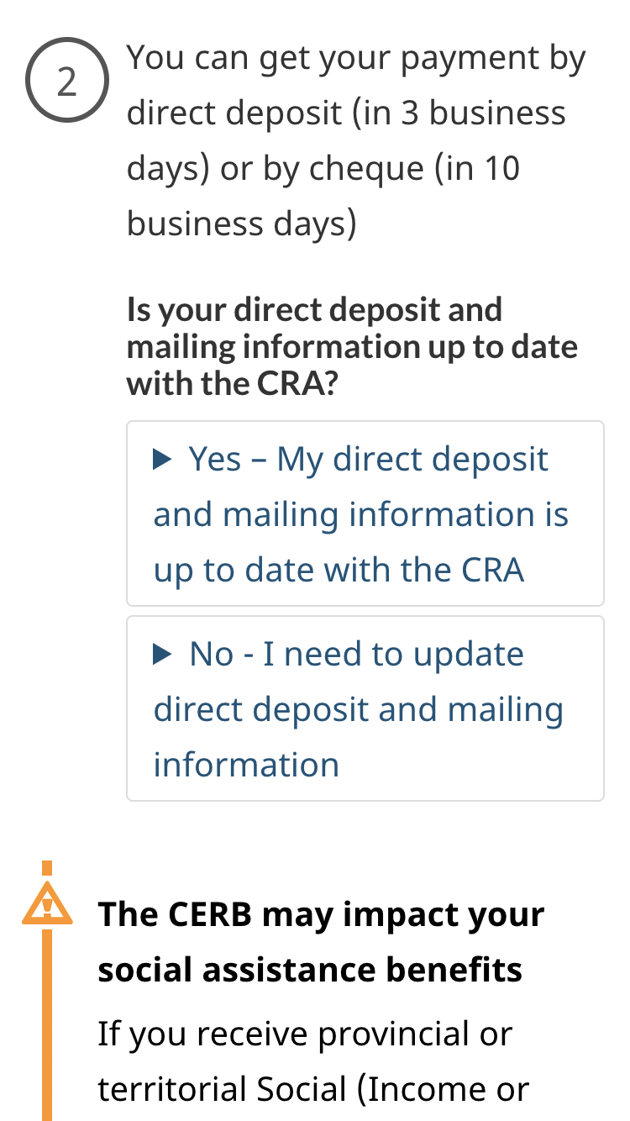
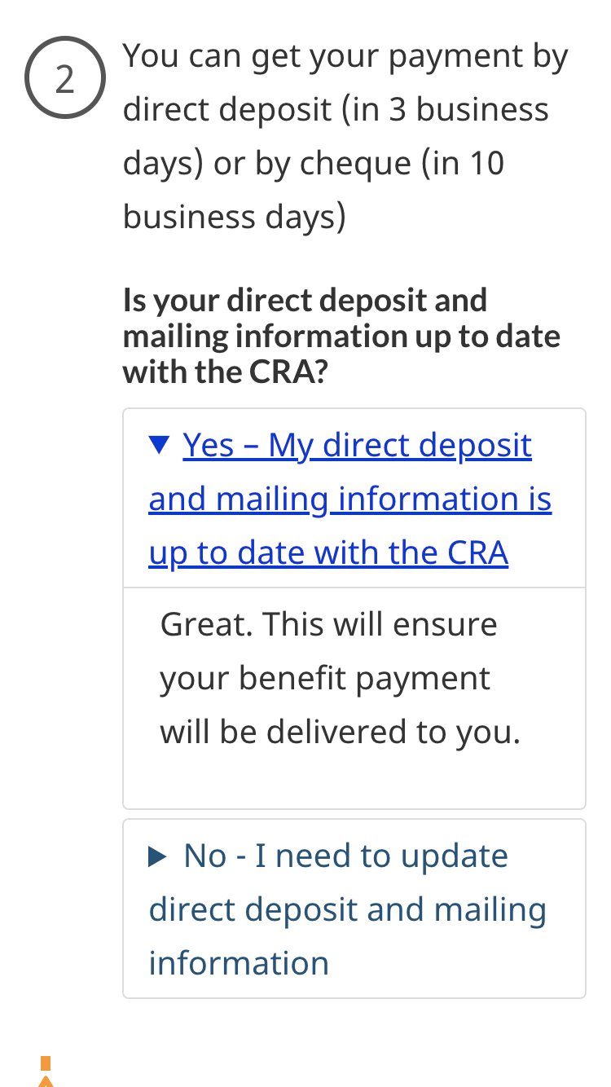
Expand/collapse: making choices
Expand/collapse interaction is excellent for when people need to make mutually exclusive choices
Improves people’s confidence that they have made the correct choice

Slide 10
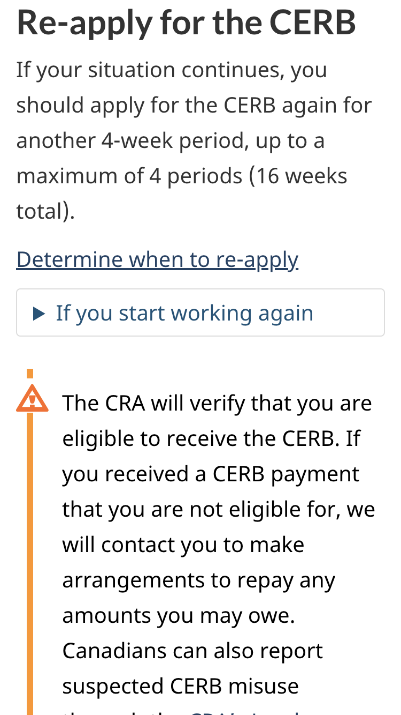
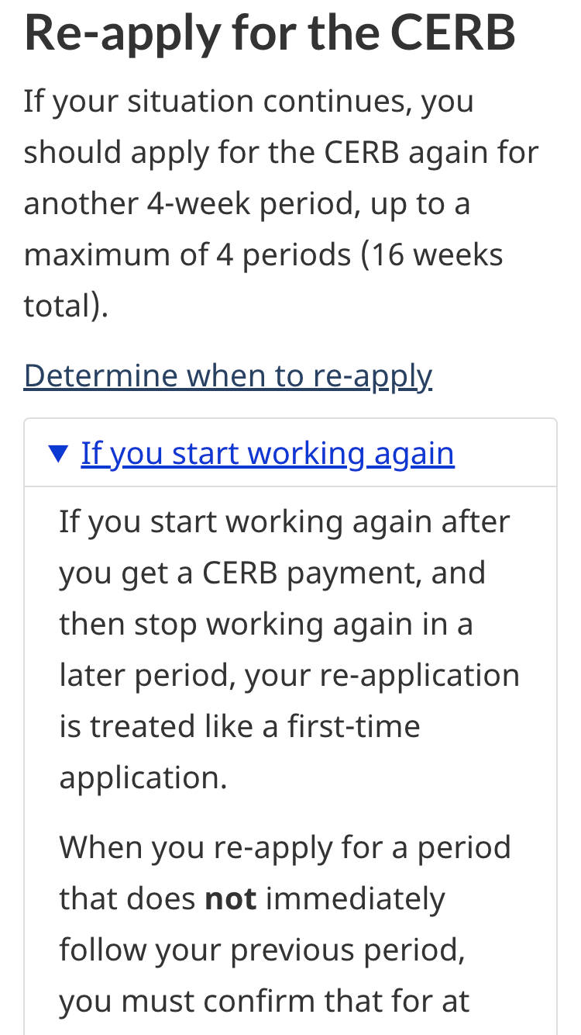
Expand/collapse: presenting secondary info
Use to prevent secondary content from interfering with the main task.
Excellent for content that applies only to a minority of people or a rare situation

Slide 11
Wizards: guided answers
Structuring your content as answers to questions helps personalize it to people's situations

Slide 12
Content style: Answers not information
Inverted pyramid - most actionable or important first
Use plain language — Even experts can benefit as they are extremely busy people
Clear and simple headings — Avoid words like “tool” “resources” ...
Don’t use third person (they/them) — Speak directly to the user (you)
Drop the intro/background info — Get to the substantive content which provides answers
Pull links out of paragraphs — They should sit on their own
Avoid footnotes — If it’s worth mentioning, mention in main text
Follow the Canada.ca Style guide! It covers these and other points, gained from experience researching, designing and testing effective content [add examples]

Slide 13
Involve your colleagues from the beginning
Multidisciplinary teams in close collaboration = leads to better products
This is more than sending a draft for feedback
Don’t just write your content — design it
So:
Embed your web/design colleagues in your team from the beginning
Practice pair writing
This is a big change. Start with specific projects!

Slide 14
User-friendly content: A shared responsibility
Program/Policy:
accuracy, completeness
Web/Digital design:
plain language,
layout,
dissemination,
promotion
Notes:
Co-writing. Ownership can be shared!
Policy owns factual accuracy
Web/digital content team owns how the content is organized and appears on the page

Slide 15
If push comes to shove….
If you meet resistance to improving usability of guidance because of reasons X, Y, Z...
Create a summary page with plain language, checklists, etc. that can be used to fulfill the user need
Place this summary more prominently in the IA than the detailed guidance itself
Link the summary to detailed guidance for those who want the full details
Make a plan for iterating content
Notes:
In a pandemic situation we can’t afford to wait for web/digital and policy/program to work through their differences. People need the answers buried in guidance now.
Related deck: Have a plan for iterating content (such as found in this guide on how to move from announcements to web content…) https://docs.google.com/presentation/d/1uO3FKJN8YsFl5a3FWA0H1ae8c6BkB0bCj0c3Ble-UJQ/edit#slide=id.p

