Slide 1
mobilitéGCmobility Initiative Iteration 42: Erso December 5th – December 15th 2 Week Service Build: Release 0.8 December 14, 2022
UNCLASSIFIED
Notes:
Welcome to Gcmobility, an initiative to help make it easier to manage a mobile workforce in the Government of Canada
My name is Dave Sampson, and I am part of the Free Agent program.
While my home department is Natural Resources Canada, I get the opportunity to work with many departments like Employment and Social Development Canada

Slide 2
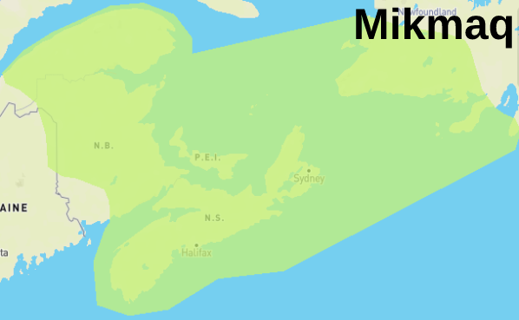
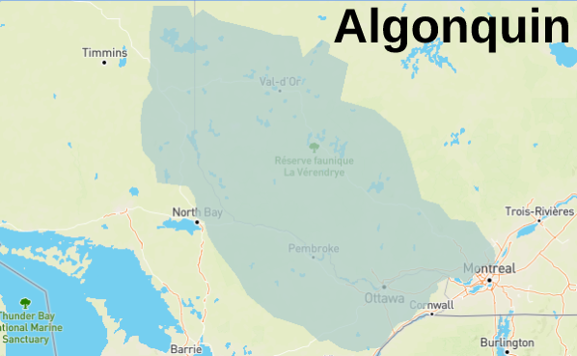
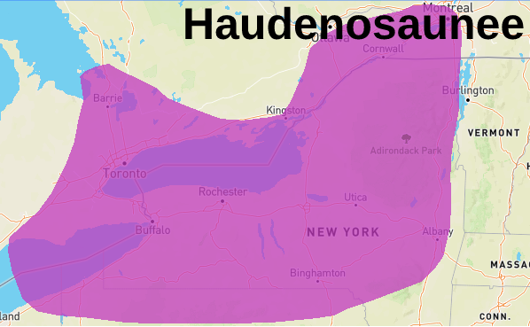
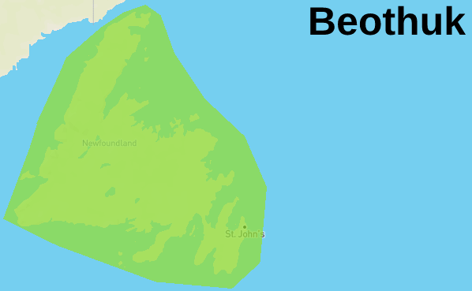
Land Acknowledgement
The GCmobility team recognizes the traditional unceded territories of:
Algonquin
Anishinabewaki (Anish-inabi-walk-ee)
Haudenosaunee (Hoh-de-noh-show-nee)
Mi’kma’ki (meeg-maw-key)
Beothuk (BEE-oth-uck)
Updated: #583: Inclusion of traditional land acknowledgement information in iteration demos
https://native-land.ca/
Notes:
Respectfully, we begin by acknowledging that we are in the ancestral and unceded Traditional Territory of the Algonquin People, the Anishinabewaki Nation, the Haudenosaunee Confedederacy, the Mi’kma’ki Nation, and the Beothuk. We recognize them as the stewards of these lands and resources – in the past, in the present and in the future.

Slide 4
We Believe
Managing Effective Mobility
Is Not Only Possible
But Required
For a Modern Public Service
Mobility
Iterate
Experiment
Mobile
Workforce
Autonomy
Cross Boarding
Collaborate
Measure
Value
Notes:
The Gcmobility initiative believes that managing effective mobility is not only possible but required for a modern public service
To achieve mobility we apply experimental methods, measure the results and collaborate with stakeholders to continualy iterate to discover potential solutions.
We will know that we have achieved our goals when we can
measure an increase of overall workforce mobility
while decreasing the time it takes to crossboard between departments.
We anticipate an increased value proposition for hiring managers to choose mobile workers for their teams
which in turn will put more autonomy in the hands of employees, managers and executives to find the best fit for everyone.

Slide 5
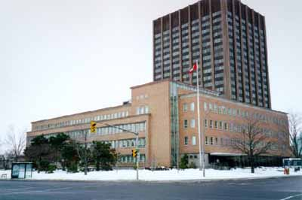
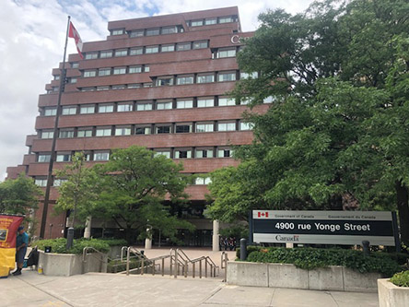
Goal: Cross-boarding Employees In 2 Weeks Or Less
Cross boarding
Source Department
Mobile Employee
Hiring Manager
Destination Department

Slide 6
How Will We Accomplish This Goal?
Build
Measure
Learn

Slide 7
Team GCmobility
Dave Sampson
Kerry Roberts
Adriana Melendez
Jonathan Moore

Slide 8
Design
Generic Service Model
Generic Service
(System Design)
Input
Output
Business Process

Slide 9
Release “0.8” Goals 1/2
Planning
Release 0.8
Backlog Grooming
Cards updated to further sort and clarify release elements
#680: User Intake Service: Flow2 0.8
#682: User Intake Service: Email Template(s) Update 0.8
Flow
Flow updates SharePoint list with Opt-in status if user chooses to Opt-in from initial email received.

Slide 10
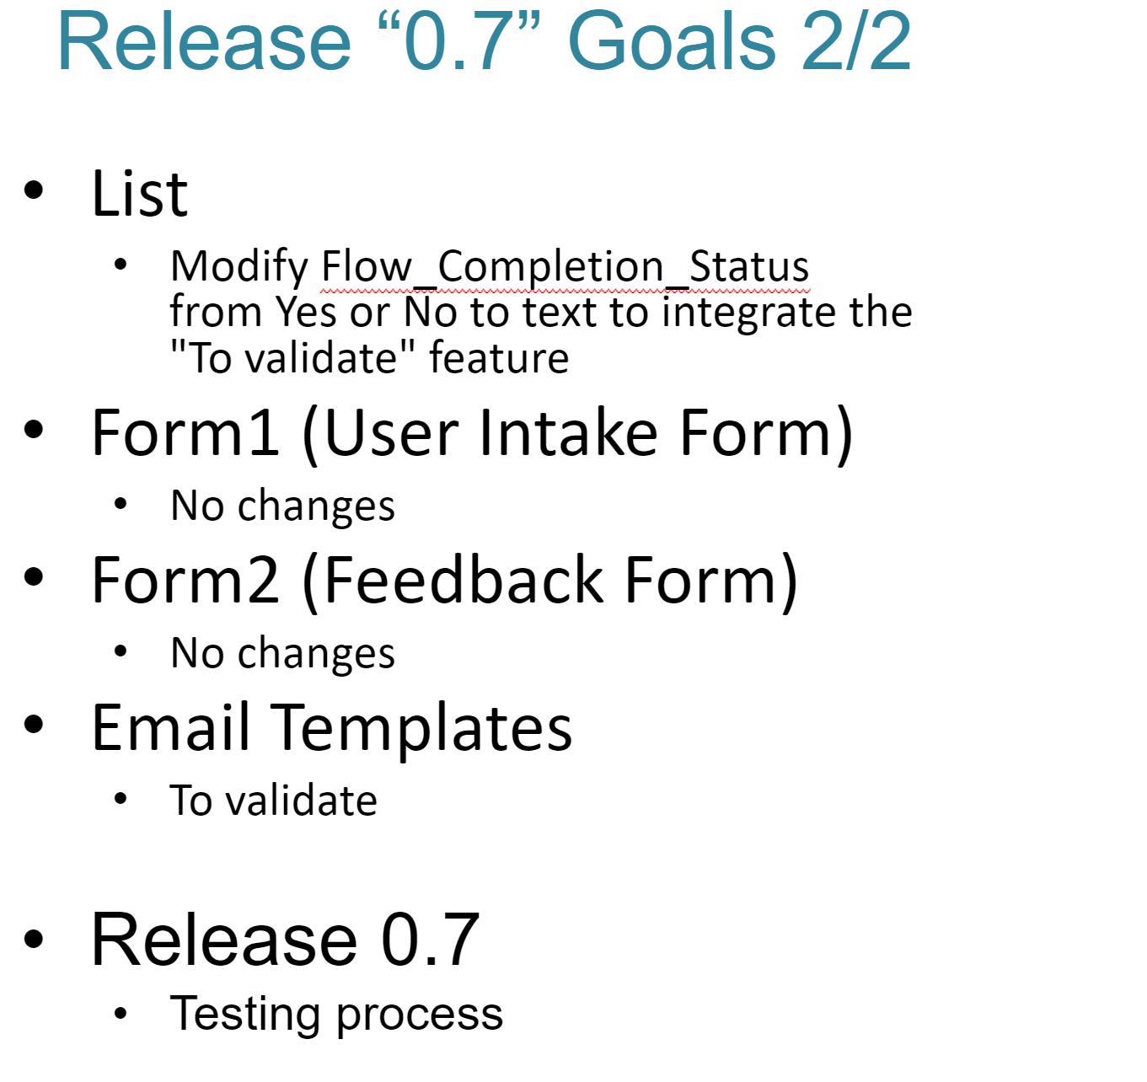
Release “0.8” Goals 2/2
Planning
List
Format Flow_Completion_Status column to highlight the"To validate" and "Rejected" features
Format Opt_In_Opt_Out Column to highlight Opt-out selection
Dashboard
Automated / Refreshed data
Form1 (User Intake Form)
No changes
Form2 (Feedback Form)
No changes
Release 0.8
Testing process
Email Templates
To validateSwap around "Send Email" and "Fill out Form" paragraphs on Email Template 1​
Remove capital letter from Form in Template 1​
Add a field for "Type" of Corp Service Provider​
Signature block and banner.​
Add Opt-out to all communications

Slide 11
Communications
Release Features
Release Package
Release Notes
0.1.1, 0.1.2, 0.2.1. 0.3.1, 0.3.2, 0.4, 0.5, 0.6.1, 0.7
0.8 (Pending)
YouTube
2 Week Service Video List
Release 0.2.1, 0.3.1, 0.3.2, 0.4 0.5, 0.6.1, 0.7
0.8 (Pending)

Slide 12
Design
User Intake Service Model and Test Suite
User Intake
Test Suite
Intake Form
E-Mail
Business Process
Sharepoint
List

Slide 13
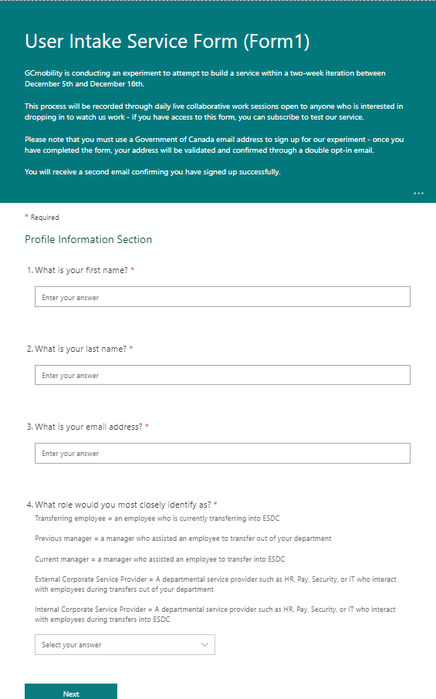
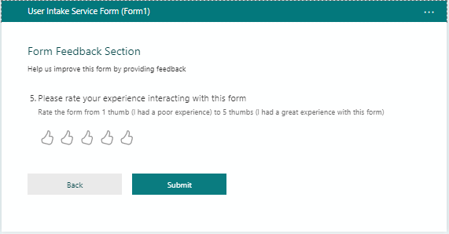
User Experience
User Intake Service Form (Form1)
No Updates

Slide 14
Prototyping
Demo Test: Test ID: 9 – ServiceProvider-Int-HR-Rate (Invalid GC E-Mail)
Section | Test Field | Test Input
Section 1 | First Name | Gcm-Test
Section 1 | Last Name | Test-009
Section 1 | E-mail | GCM-TEST-009@gcminvalid.gc.ca
Section 1 | Role | Internal Service Provider
Section 1 | Sub Type | External
Section 2 | Service Type | IT
Section 3 | Rate | 3 [or below]
Feature Tests
Invalid GC e-mail
Role Type: internal Service provider
Service Type: IT
Rating: Negative [1-3]
Response:
Receive E-mail
Link to confirm opt-in
Link to Feedback Form
Link to prepopulate email to ask a question, raise a concern, or to request changing the information we have for them on file

Slide 15
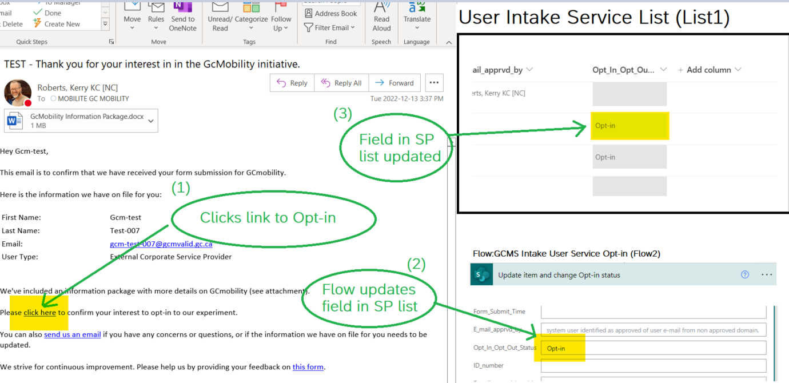
Flow Updates: GCMS Intake User Service Flow (Flow1). Presenter: Kerry
Automation
- Modified flow to update field Opt_In_Opt_Out_Status in SharePoint List
Completed Updates to Power Automate Flow
Click here to open the Flow card #668 01-GCmobility Plan - Planner (office.com)
Click here to open the GCMS Intake user service (Flow1)

Slide 16
Automation
Email Templates
Presented By: Jonathan
Template1 Modified:
Swap around "Send Email" and "Fill out Form" paragraphs
Remove capital letter from Form in Template 1
Opt-in reqs subject Template 1
Send Us req subject and body for choices

Slide 17
Prototyping
Demo Test: Test ID: 9 - ServiceProvider-Int-IT-Rate
Section | Test Field | Validate Output
Field 1 | First Name | Gcm-Test
Field 2 | Last Name | Test-009
Field 3 | E-Mail | GCM-TEST-009@gcminvalid.gc.ca
Field 4 | User Type | Internal Service Provider
Action 1 | Opt-In | E-mail Opens
Action 2 | Feedback: Email | E-mail Opens
Action 3 | Feedback Form | Feedback Form Opens
Response 1 | GCmobility Inbox | Opt-In E-mail
Response 2 | GCmobility Inbox | Feedback E-mail
Opt-In E-Mail Response
Verify Returned Data
Actions
Op-In
Send E-Mail
Open Feedback Form
Response
GCmobility GD Mailbox

Slide 18
Prototyping
Demo Test: Test ID: 8 – GCmobility Feedback Form (Negative)
Feedback Form
Submit Form
Section | Test Field | Test Input
Section 1 | What asset | Feedback (Form 2)
Section 1 | Rate Overall | 3
Section 1 | Rate Length | 3
Section 1 | Rate Ease of Use | 3
Section 1 | Rate Language | 3
Section 1 | Comments | You can do better
Section 1 | Rate Current Form | 3

Slide 19
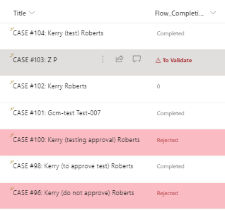
Data / Info Management
List Updates: User Intake Service List (List1)
Presented By: Adriana
Column "Flow_Completion_Status" was formatted to highlight "Rejected" & "To Validate" entries.
Column "Opt_In_Opt_Out" was formatted to highlight Opt-out

Slide 20
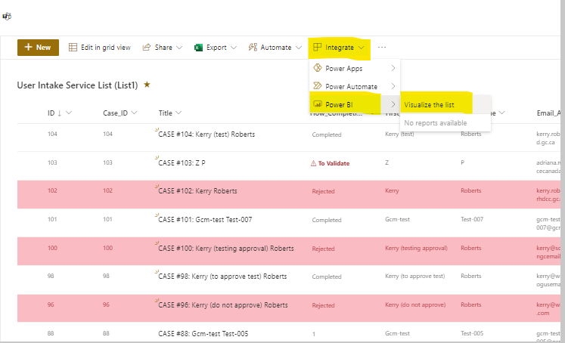
Data / Info Management
Dashboard PowerBI
Presented By: Adriana

Slide 21
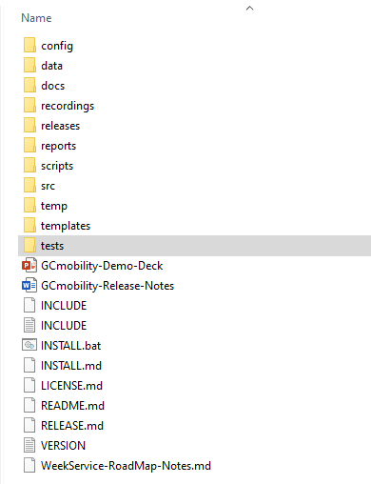
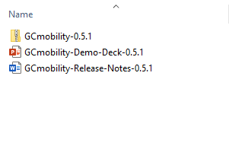
Data / Info Management
Service Repository
Structure
Document Re-org
Canonical Docs

Slide 22
Data / Info Management
Release Management
Automated Release Packaging
./scripts/release.bat
./build
./temp
./release
LOCAL Build Directory
Tape Archive using Tar
Tarball
GCmobility-VERSION.tar.gz
tar -a -C PathToArchive -czf ArchiveName DirToArchive

Slide 23
Planning
Next Steps
List
Features closed until 1.0
Email Templates
Features closed until 1.0
Dashboard
Confirm all Admin can run the automation.
Releases
Iteration 42 Demo: 2022-12-15
9:00am to 11:00am (Eastern)
Forms
Intake
Features closed until 1.0
Feedback
Features closed until 1.0
Flow
Intake (Flow1)
Features closed until 1.0
Opt-In (Flow2)
No outstanding issues
Feedback Flow (Flow3)
To Be Created for 1.0

Slide 24
Tooling / Connectors
OneDrive
Visio
PowerBi
Plain Text
Twitter
Mastodon
Command Prompt
Chirr

Slide 25
Communications
Collaboration
Engagement
Follow GCmobility
Mastodon
mstdn.ca/@GCmobility mstdn.ca/@jondotgov
If you’re @ ESDC:
Join the GCmobility Teams channels here
Check Out GCmobility SharePoint
Review Previous Demos
If you’re in another department, join us on GCExchange
Join the GCmobility Teams channels here
Reach out to Jon for a chat!
Teams,
Email,
Meeting request
Twitter
@GCmobility
@jondotgov
E-Mail
mobiliteGCmobility@hrsdc-rhdcc.gc.ca
Jonathan.Moore@servicecanada.gc.ca
GCExchange

Slide 26
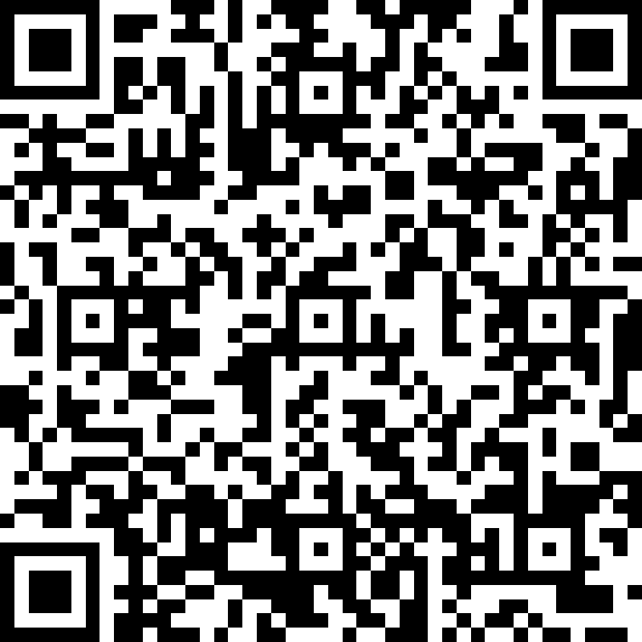
Managing Mobility Using A Partnership Approach
Thanks for participating in today’s demo
We’d appreciate hearing your feedback,
Please fill out the form located here
Notes:
When an executive champion for Gcmobility was identified at ESDC. Gcmobility found a new home.
With Gcmobility also comes a network of engaged stakeholders including over 100 of Canada’s Free Agents from four different home departments and deployed across the whole of government.
Lets get moving and start experimenting.

Slide 27
PARKING
LOT

Slide 28
Iteration Resource Slide
(Contains assets and information to be used in all future decks, such as color swatches etc – not to go live – unless we’re demoing it!)

Slide 29
Management
Reporting
Governance
Collaboration
Data / Info Management
Capacity Building
Design
Prototyping
Risk
Automation
Other (non GCm)

Slide 30
Project
Product
Planning
Team
Training / Learning
Communications
Research
User Experience
Requirement
Funding
Engagement

