Slide 1
Healthcare
Excellence Canada
AGE-WELL
Centre for
Aging & Brain Health
Innovation
Understand
the WHY
It Starts
With the Story
Understand
the
Challenges
Altumview
Sentinare 2
wetraQ
GuardIO
Silverts
Adaptive Apparel
ImaginAble
Solutions
Guided Hands™
Innovations in Aging (and Living) in Place
A Caregiver's Experience
Ron Beleno
E-mail: ron@rb33.com
Web: www.rb33.com
Twitter: @rb33Canada
LinkedIn: ronbeleno
January 12, 2022
Canada School of Public Service
Understanding Aging in Place:
Improving Quality of Life Through Innovation

Slide 2
Innovations in Aging (and Living) in Place
A Caregiver's Experience
Ron Beleno
E-mail: ron@rb33.com
Web: www.rb33.com
Twitter: @rb33Canada
LinkedIn: ronbeleno
January 12, 2022
Canada School of Public Service
Understanding Aging in Place:
Improving Quality of Life Through Innovation

Slide 3
It Starts with the Story

Slide 5
Understand the WHY

Slide 6
It Starts with the Story
Understand the WHY

Slide 7
Understand the
Challenges
Brief Summary
Dad was diagnosed with Alzheimer's in 2007
Parents live in an apartment 20 minutes away (Toronto)
Dad passed away peacefully at home January 2018
A few CHALLENGES over the years:
Memory Loss
Verbal Communication
Mobility / Falls / Frailty
Incontinence
Walking and Wandering
Social Activities

Slide 8
Canada’s Technology and Aging Network

Slide 10
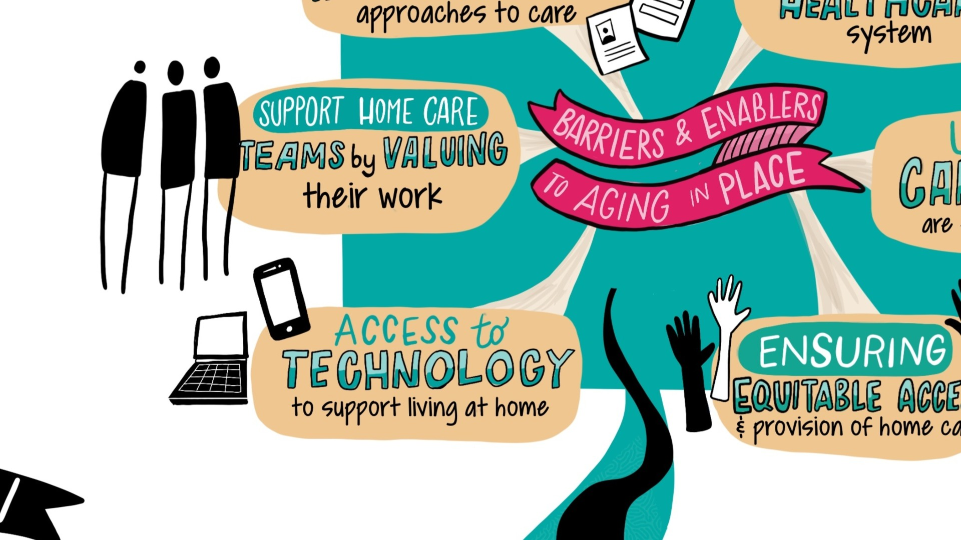

Slide 12
Canada’s Technology and Aging Network

Slide 14
Canada’s Technology and Aging Network

Slide 18
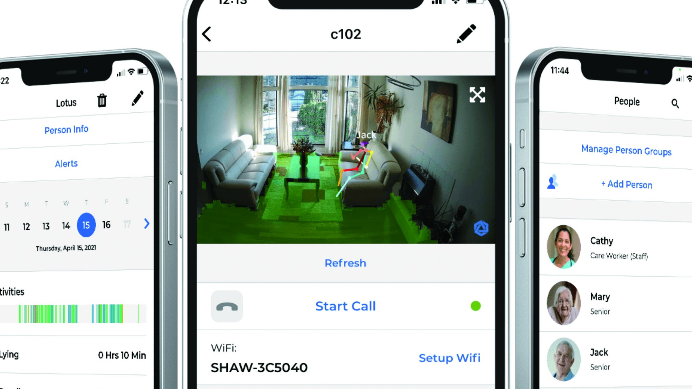

Slide 22
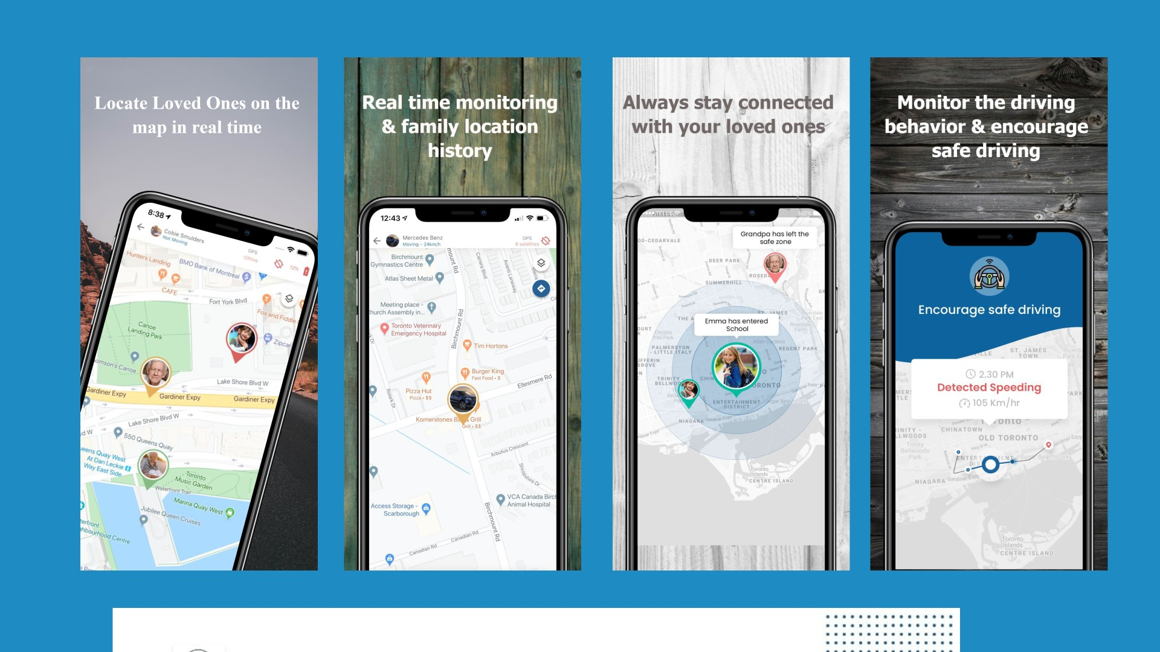

Slide 27
Healthcare
Excellence Canada
AGE-WELL
Centre for
Aging & Brain Health
Innovation
Understand
the WHY
It Starts
With the Story
Understand
the
Challenges
Altumview
Sentinare 2
wetraQ
GuardIO
Silverts
Adaptive Apparel
ImaginAble
Solutions
Guided Hands™
Innovations in Aging (and Living) in Place
A Caregiver's Experience
Ron Beleno
E-mail: ron@rb33.com
Web: www.rb33.com
Twitter: @rb33Canada
LinkedIn: ronbeleno
January 12, 2022
Canada School of Public Service
Understanding Aging in Place:
Improving Quality of Life Through Innovation

