Slide 1
Government of Canada
Enterprise Architecture Review Board (GC EARB)
Presenter Template
Department – Initiative Name
(Date)
Presentation for:
EARB Appearance:
Contact Information:
Endorsement
Information
Initial
Follow-up
Final Architecture
Presenter(s):
Name /Email / Phone #
Name /Email / Phone #
Last Updated December 15, 2020
GC Docs #XXXXXXX0

Slide 2
Purpose of GC EARB Session
The purpose of this presentation is to seek GC EARB endorsement of …
“OR”
The purpose of this presentation is to provide GC EARB information related to …
…..as an Enterprise Solution.

Slide 3
Request - Background
Describe which departmental policies, programs and business services the presentation is addressing.

Slide 4

Business Capabilities Addressed
List the business capabilities addressed with this architecture.
Business Capability Model 2.0 reference material, https://gcconnex.gc.ca/file/download/50303103
Business Capabilities | List the Business capabilities addressed, 2 examples below
1. Legislation, Regulation and Policy Management
2. Enterprise Planning
3. Outcomes Management | 3.2 Performance Management
4. Relationship Management | 4.3 Stakeholder Interaction Management
5. Compliance Management
6. Program and Service Delivery
7. Information Management
8. Government Resources Management
9. Corporate Management

Slide 5
Current State Architecture – Problem Summary
Describe the problems with the current architecture.
Summary of the business problem as described in the Concept Case
Describe the problem in each of the layers of EA Framework: Business, Information, Application, Technology and Security

Slide 6
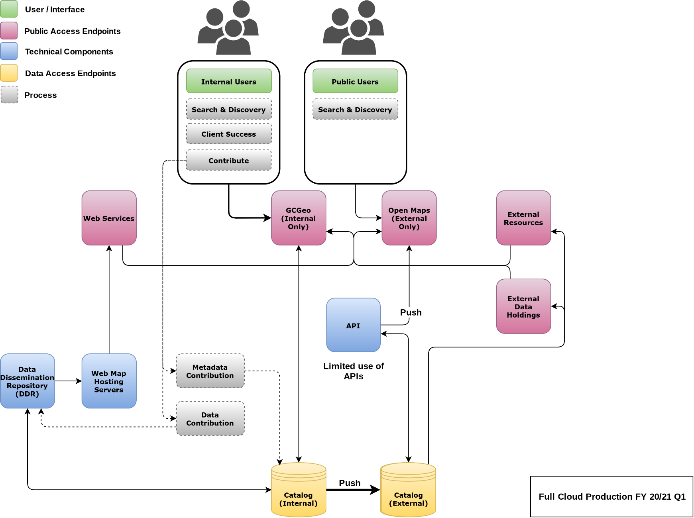
Current State Architecture Diagram
EXAMPLE

Slide 7
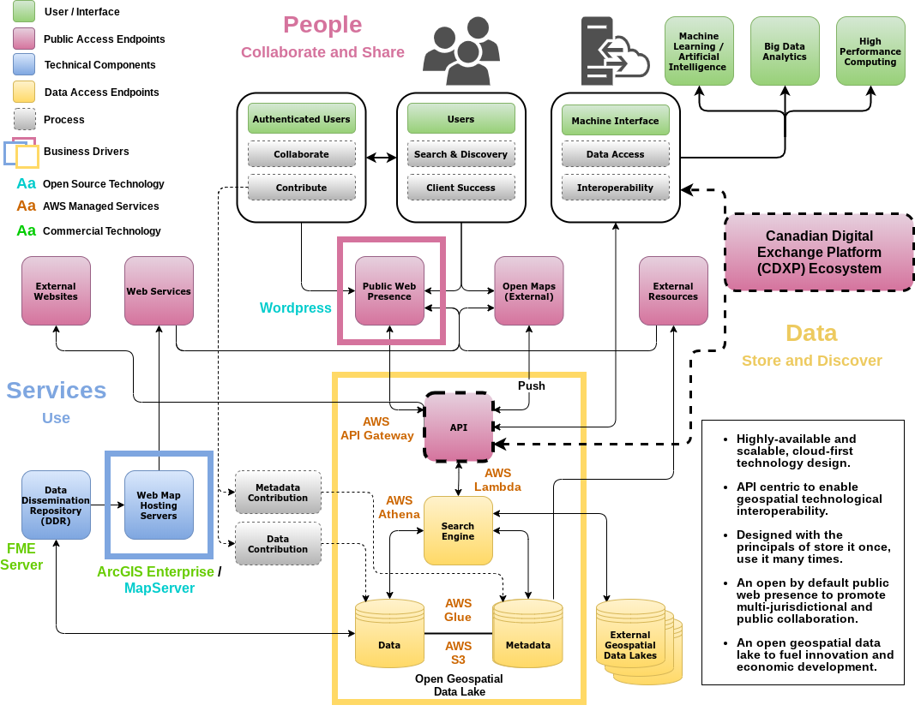
Target State Architecture Diagram
EXAMPLE
NEW
Identify the old component(s) in GREY and the new component(s) in BRIGHT COLOURS, show zoning and legend.

Slide 8
Target State Architecture – Solution Summary
Describe the Target State Architecture.
Describe how the target state architecture addresses the business problem stated in the Concept Case…
Describe the solution in each layer of the EA Framework: Business, Information, Application, Technology and Security

Slide 9
Environmental Scan and Analysis
Which crown institutions have you been discussing your problem with to identify potential reusable solution / component?
What other solution(s) available in the GC have you taken into consideration?
Summary of options analysis – (fill out full analysis on Appendix 3)
Summary of assessment against the Enterprise Solution(s) – (fill out full analysis on Appendix 4)

Slide 10
GC EA Summary
To be completed by TBS EA Team.
This is the second last slide during EARB presentation
 Endorsement  Information | PCRA: OPMCA: | One time: $ On going: $ | Overall:
Type of Cloud |  SaaS |  PaaS |  IaaS |  Not Applicable
Data Classification |  Unclassified |  Protected A |  Protected B |  Other
Summary of Proposal
Business
Information
Application
Technology
Security
GC EA Recommendation
Proposed Conditions
Architectural Alignment:
TBS Assessor:
Fully
Partially
Not

Slide 11
Enterprise Solution – EA Recommendation
To be completed by TBS EA Team.
This is the last slide during EARB presentation
Facet | Summary (Please identify what is ready – what is no
Governance | (Please identify what is ready – what is not)
Culture
Solution
GC EA Recommendation

Slide 12
ANNEX, reference material, not for presentation
Appendix 1
GC Digital Standards
Required for GC EA Assessment
NOT to be part of Presentation
Appendix 2
GC EA Framework
Required for GC EA Assessment
NOT to be part of Presentation
Appendix 3
Service & Digital Target
Enterprise Architecture
Reference Material
NOT to be part of Presentation
Appendix 4
Additional Project Details
Required for GC EA Assessment
NOT to be part of Presentation
Appendix 5
Option Analysis
Required for GC EA Assessment
NOT to be part of Presentation
Appendix 6
Enterprise Solution Assessment
Required for GC EA Assessment
NOT to be part of Presentation
Appendix 7
SSC Involvement
Complete as required
NOT to be part of Presentation
Appendix 8
List of Acronyms
Complete as required
NOT to be part of Presentation

Slide 13
Appendix 1:
GC Digital Standards Alignment
https://www.canada.ca/en/government/system/digital-government/government-canada-digital-standards.html
 | ◆ | Design with users Research with users to understand their needs and the problems we want to solve. Conduct ongoing testing with users to guide design and development.
 | ❖ | Iterate and improve frequently Develop services using agile, iterative and user-centred methods. Continuously improve in response to user needs. Try new things, start small and scale up.
 | ⬥ | Work in the open by default Share evidence, research and decision making openly. Make all non-sensitive data, information, and new code developed in delivery of services open to the outside world for sharing and reuse under an open license.
 |  | Use open standards and solutions Leverage open standards and embrace leading practices, including the use of open source software where appropriate. Design for services and platforms that are seamless for Canadians to use no matter what device or channel they are using.
 |  | Address security and privacy risks Take a balanced approach to managing risk by implementing appropriate privacy and security measures. Make security measures frictionless so that they do not place a burden on users.
 |  | Build in accessibility from the start Services should meet or exceed accessibility standards. Users with distinct needs should be engaged from the outset to ensure what is delivered will work for everyone.
 |  | Empower staff to deliver better services Make sure that staff have access to the tools, training and technologies they need. Empower the team to make decisions throughout the design, build and operation of the service.
 |  | Be good data stewards Collect data from users only once and reuse wherever possible. Ensure that data is collected and held in a secure way so that it can easily be reused by others to provide services.
 |  | Design ethical services Make sure that everyone receives fair treatment. Comply with ethical guidelines in the design and use of systems which automate decision making (such as the use of artificial intelligence).
 |  | Collaborate widely Create multidisciplinary teams with the range of skills needed to deliver a common goal. Share and collaborate in the open. Identify and create partnerships which help deliver value to users.
Architectural Alignment:
Fully
Partially
Not

Slide 14
Appendix 2: GC EA Framework
Business Architecture
Business architecture is a critical aspect for the successful implementation of the GC Enterprise Ecosystem Target Architecture. The architectural strategy advocates whole of government approach where IT is aligned to business services and solutions are based on re useable components implementing business capabilities in order to deliver a cohesive user experience. As such, it is essential that business services, stakeholder needs, opportunities to improve cohesion and opportunities for reuse across government be clearly understood. In the past these elements have not been a priority. It is expected that the IT culture and practices will have to change to make business architecture, in general, and these elements a primary focus.
Design services digitally from end to end to meet the Government of Canada users and other stakeholders’ needs | HOW will this be achieved?
Clearly identify internal and external users and other stakeholders and their needs for each policy, program and business service
Include policy requirement applying to specific users and other stakeholder groups, such as accessibility, gender-based plus analysis, and official languages in the creation of the service
Perform Algorithmic Impact Assessment (AIA) to support risk mitigation activities when deploying an automated decision system as per Directive on Automated Decision-Making
Model end to end business service delivery to provide quality, maximize effectiveness and optimize efficiencies across all channels (for example, lean process)

Slide 15
Appendix 2: GC EA Framework
Business Architecture - continued
Architect to be outcome driven and strategically aligned to the department and to the Government of Canada | HOW will this be achieved?
Identify which departmental/GC business services, outcomes and strategies will be addressed
Establish metrics for identified business outcomes throughout the life cycle of an investment
Translate business outcomes and strategy into business capability implications in the GC Business Capability Model to establish a common vocabulary between business, development, and operation
Promote horizontal enablement of the enterprise | HOW will this be achieved?
Identify opportunities to enable business services horizontally across the GC enterprise and to provide cohesive experience to users and other stakeholders
Reuse common business capabilities, processes and enterprise solutions from across government and private sector
Publish in the open all reusable common business capabilities, processes and enterprise solutions for others to develop and leverage cohesive horizontal enterprise services

Slide 16
Appendix 2: GC EA Framework
Information Architecture
Information architecture includes both structured and unstructured data. The best practices and principles aim to support the needs of a business service and business capability orientation. To facilitate effective sharing of data and information across government, information architectures should be designed to reflect a consistent approach to data, such as the adoption of federal and international standards. Information architecture should also reflect responsible data management, information management and governance practices, including the source, quality, interoperability, and associated legal and policy obligations related to the data assets. Information architectures should also distinguish between personal and non personal data and information as the collection, use, sharing (disclosure), and management of personal information must respect the requirements of the Privacy Act and its related policies.
Collect data to address the needs of the users and other stakeholders | HOW will this be achieved?
Assess data requirements based program objectives, as well users, business and stakeholder needs
Collect only the minimum set of data needed to support a policy, program, or service
Reuse existing data assets where permissible and only acquire new data if required
Ensure data collected, including from third-party sources, are of high quality

Slide 17
Appendix 2: GC EA Framework
Information Architecture – continued 1
Manage and reuse data strategically and responsibly | HOW will this be achieved?
Define and establish clear roles, responsibilities, and accountabilities for data management
Identify and document the lineage of data assets
Define retention and disposition schedules in accordance with business value as well as applicable privacy and security policy and legislation
Define retention and disposition schedules in accordance with business value as well as applicable privacy and security policy and legislation
Ensure data are managed to enable interoperability, reuse and sharing to the greatest extent possible within and across departments in government to avoid duplication and maximize utility, while respecting security and privacy requirements
Contribute to and align with enterprise and international data taxonomy and classification structures to manage, store, search and retrieve data
Use and share data openly in an ethical and secure manner | HOW will this be achieved?
Share data openly by default as per the Directive on Open Government and Digital Standards, while respecting security and privacy requirements; data shared should adhere to existing enterprise and international standards, including on data quality and ethics
Ensure data formatting aligns to existing enterprise and international standards on interoperability; where none exist, develop data standards in the open with key subject matter experts
Ensure that combined data does not risk identification or re identification of sensitive or personal information

Slide 18
Appendix 2: GC EA Framework
Information Architecture – continued 2
Design with privacy in mind for the collection, use and management of personal Information | HOW will this be achieved?
Ensure alignment with guidance from appropriate institutional ATIP Office with respect to interpretation and application of the Privacy Act and related policy instruments
Assess initiatives to determine if personal information will be collected, used, disclosed, retained, shared, and disposed
Only collect personal information if it directly relates to the operation of the programs or activities
Notify individuals of the purpose for collection at the point of collection by including a privacy notice
Personal information should be, wherever possible, collected directly from individuals but can be from other sources where permitted by the Privacy Act
Personal information must be available to facilitate Canadians’ right of access to and correction of government records
Design access controls into all processes and across all architectural layers from the earliest stages of design to limit the use and disclosure of personal information
Design processes so personal information remains accurate, up-to-date and as complete as possible, and can be corrected if required
De-identification techniques should be considered prior to sharing personal information
In collaboration with appropriate institutional ATIP Office, determine if a Privacy Impact Assessment (PIA) is required to identify and mitigate privacy risks for new or substantially modified programs that impact the privacy of individuals
Establish procedures to identify and address privacy breaches so they can be reported quickly and responded to efficiently to appropriate institutional ATIP Office

Slide 19
Appendix 2: GC EA Framework
Application Architecture
Application architecture practices must evolve significantly for the successful implementation of the GC Enterprise Ecosystem Target Architecture. Transitioning from legacy systems based on monolithic architectures to architectures that oriented around business services and based on re useable components implementing business capabilities, is a major shift. Interoperability becomes a key element, and the number of stakeholders that must be considered increases.
Use open source solutions hosted in public cloud | HOW will this be achieved?
Select existing solutions that can be reused over custom built
Contribute all improvements back to the communities
Register open source software to the Open Resource Exchange
Use software as a service (SaaS) hosted in public cloud | HOW will this be achieved?
Choose SaaS that best fit for purpose based on alignment with SaaS capabilities
Choose a SaaS solution that is extendable
Configure SaaS and if customization is necessary extend as open source modules
Design for Interoperability | HOW will this be achieved?
Design systems as highly modular and loosely coupled services
Expose services, including existing ones, through APIs
Make the APIs discoverable to the appropriate stakeholders

Slide 20
Appendix 2: GC EA Framework
Technology Architecture
Technology architecture is an important enabler of highly available and adaptable solutions that must be aligned with the chosen application architecture. Cloud adoption provides many potential advantages by mitigating the logistical constraints that often negatively impacted legacy solutions hosted “on premises.” However, the application architecture must be able to enable these advantages.
Use cloud first | HOW will this be achieved?
Adopt the use of the GC Accelerators to ensure proper security and access controls
Enforce this order of preference: software as a service (SaaS) first, then platform as a service (PaaS), and lastly infrastructure as a service (IaaS)
Fulfill cloud services through SSC Cloud Brokering Services
Enforce this order of preference: public cloud first, then hybrid cloud, then private cloud, and lastly non cloud (on-premises) solutions
Design for cloud mobility and develop an exit strategy to avoid vendor lock-in

Slide 21
Appendix 2: GC EA Framework
Technology Architecture - continued
Design for performance, availability and scalability | HOW will this be achieved?
Ensure response times meet user needs, and critical services are highly available
Support zero-downtime deployments for planned and unplanned maintenance
Use distributed architectures, assume failure will happen, handle errors gracefully, and monitor performance and behaviour actively
Establish architectures that supports new technology insertion with minimal disruption to existing programs and services
Control technical diversity; design systems based on modern technologies and platforms already in use
Follow DevSecOps principles | HOW will this be achieved?
Use continuous integration and continuous deployments
Ensure automated testing occurs for security and functionality
Include your users and other stakeholders as part of the DevSecOps process, which refers to the concept of making software security a core part of the overall software delivery process

Slide 22
Appendix 2: GC EA Framework
Security Architecture
The GC Enterprise Security Architecture program is a government wide initiative to provide a standardized approach to developing IT security architecture, ensuring that basic security blocks are implemented across the enterprise as the infrastructure is being renewed.
Build security into the system life cycle across all architectural layers | HOW will this be achieved?
Identify and categorize information based on the degree of injury that could be expected to result from a compromise of its confidentiality, integrity and availability
Implement a continuous security approach, in alignment with Centre for Cyber Security’s IT Security Risk Management Framework; perform threat modelling to minimize the attack surface by limiting services
Apply proportionate security measures that address business and user needs while adequately protecting data at rest and data in transit
Design systems to be resilient and available in order to support service continuity

Slide 23
Appendix 2: GC EA Framework
Security Architecture - continued
Ensure secure access to systems and services | HOW will this be achieved?
Identify and authenticate individuals, processes or devices to an appropriate level of assurance, based on clearly defined roles, before granting access to information and services; leverage enterprise services such as Government of Canada trusted digital identity solutions that are supported by the Pan-Canadian Trust Framework
Constrain service interfaces to authorized entities (users and devices), with clearly defined roles; segment and separate information based on sensitivity of information, in alignment with ITSG-22 and ITSG-38. Management interfaces may require increased levels of protection
Implement HTTPS for secure web connections and Domain-based Message Authentication, Reporting and Conformance (DMARC) for enhanced email security
Establish secure interconnections between systems through secure APIs or leveraging centrally managed hybrid IT connectivity services
Maintain secure operations | HOW will this be achieved?
Establish processes to maintain visibility of assets and ensure the prompt application of security related patches and updates in order to reduce exposure to vulnerabilities, in accordance with GC Patch Management Guidance
Enable event logging, in accordance with GC Event Logging Guidance, and perform monitoring of systems and services in order to detect, prevent, and respond to attacks
Establish an incident management plan in alignment with the GC Cyber Security Event Management Plan (GC CSEMP) and report incidents to the Canadian Centre for Cyber Security (CCCS)

Slide 24
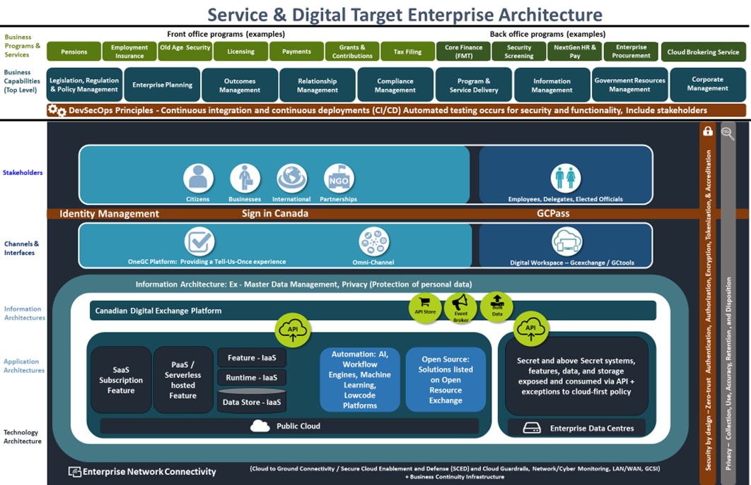
Appendix 3:
Service & Digital Target Enterprise Architecture
The Service & Digital Target Enterprise Architecture defines a model for the digital enablement of Government of Canada services that addresses many of the key challenges with the current GC enterprise ecosystem.
1
It seeks to reduce the silos within the current GC ecosystem by having departments adopt a perspective centred on users and service delivery when considering new IT solutions or modernizing older solutions.
2
It advocates a whole-of-government approach where IT is aligned to business services and solutions are based on re-useable components implementing business capabilities optimized to reduce unnecessary redundancy. This re-use is enabled through the use of published APIs shared across government..
3
It will be realized through new digital investments that are assessed against the criteria of the revised GC Enterprise Architecture Framework (BIATS) reflecting the detailed elements of the target architecture. This approach allows GC to focus on improving its service delivery to Canadians while addressing the challenges with legacy systems.
The Service & Digital Target Enterprise Architecture and Whitepaper were endorsed by the GC EARB on December 3rd, 2020.

Slide 25
Appendix 4:
Additional Project Details
Request Summary Information
TBS Project/Activity ID (from IT PLAN)
Concept Case (ENDORSED ?) | YES  DATE: ___________ | NO    REASON:
Timeline | Planned Start Date: MM – YYYY | Planned End Date: MM - YYYY
Cost Summary | One Time project cost: $ | On-going (annual) costs: $
Funding Source | A-Base  B-Base  | Other: Please specify
Current Gate
On schedule? | YES  NO    | IF not… why not?
(TB Sub)
Departmental Architecture
Do you have a Departmental Architecture Review Board (ARB)? | YES  NO 
Who is the Chief Architect? | Name Email / Phone #
When did the Departmental EA and Architecture Review Board sanctioned the preferred Solution Architecture option? | Date:
Name of Business owner:
Name of Technical owner:

Slide 26
Appendix 5:
Options Analysis
Summary of architecture options reviewed, analysis criteria and rating
Analysis Criteria | Option 1 | Option 2 | Option n
1.
2.
3.
4.
n

Slide 27
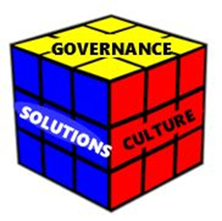
Enterprise Solution Framework
Enterprise solutions definition
Enterprise solutions are internal and external Government of Canada assets that can be re-used in and across multiple parts of the organization.
Additional info: GC Enterprise Architecture/Enterprise Solutions - wiki (gccollab.ca)
Governance | HOW will the questions for this facet be addressed?
What are the roles and responsibilities and who decides who fills them?
What is the financial and funding model for an enterprise solution?
Which business capabilities should be addressed first?
How will user expectations be addressed?
What is the path to enterprise-wide adoption?

Slide 28
Enterprise Solution Framework…continued
Culture | HOW will the questions for this facet be addressed?
Is everyone ready to buy-in to enterprise solutions?
How do we ensure participation?
How will open and transparent input be gathered?
What are the mind-set and skills needed to foster an enterprise solution culture?
Solutions | HOW will the questions for this facet be addressed?
Which business problem are we solving?
Who can access the Enterprise Solution?
What data and technology standards are required?
Is the implementation secure enough?
Will it always be reliably online?

Slide 29
Appendix 6:
Assessment against the Enterprise Solution(s)
Is the endorsed enterprise solution sufficient?
Select the applicable impact level for each of the assessment criteria below and describe your rationale for choosing that impact level.
Assessment Criteria | Impact (choose applicable items & provide rationale)
 | Zero Impact | Low Impact | Medium Impact | High Impact
1. Timing Urgency >>How well does the estimated implementation schedule using the endorsed enterprise solution align to required deadlines? | No impact to benefit realization timelines | Minor impact to benefits realization timelines (e.g. 3 to 6 month extension) | Moderate impact to benefits realization timelines. (e.g. 6 to 12 month extension) | Significant impact to benefits realization timelines (e.g. 12+ months)
2. Functional Requirements >>How well does the endorsed enterprise solution support the departmental CIOs requirements? | Requires no workaround to support business requirements | Requires minor manual workarounds to support business requirements | Requires customizations to support business requirements | Requires significant customizations “OR” functional requirements not on the product roadmap
3. Non-functional Requirement (NFR) >> How well does the endorsed enterprise solution meet non-functional requirements including compatibility, maintainability, usability, availability, performance, and/or scalability. | Requires no compromise to NFRs | Requires slight compromise on NFRs. (e.g. response time, availability, etc.) | Requires compromise on NFRs. (e.g. response time, availability, etc.) | Cannot meet critical NFRs.

Slide 30
Appendix 6:
Decision Making Framework for Assessment against the Enterprise Solution(s)
G
A
B
C
D
E
F
End: Endorse use of existing instance
Is there an enterprise solution*?
Is enterprise solution aligned with objectives?
Can an existing instance be used?
Yes
Start: Departmental CIO submits request to TBS EA unit.
Assess option of enterprise solution.*
Evaluate use of an existing instance
Yes
Yes
H
End: Endorse use of new instance
No
No
No
Is there a Pathfinder or reuse opportunity available?
L
I
K
End: Endorse Selection
No
Present options analysis of alternative solutions
N2
Yes
N1
J
Explore Pathfinder/ reuse opportunity
* = endorsed by TBS GC EARB
30

Slide 31
Appendix 7:
Shared Services Canada (SSC) Involvement
SSC Scope
What is the scope of work required by Shared Services Canada?
When/How has SSC been involved in this project?
What SSC Services are to be impacted or consumed? | https://service.ssc-spc.gc.ca/en/services Include due dates for SSC deliverables.
What are the dependencies and assumptions? | (ex: authentication, cloud connectivity. If legacy Data Centre, which one and has capacity has been confirmed.)
SSC Internal Governance
Presentation title: Please include Presentation title, committee and date of presentation (or rational for not going through governance) | Governance Committees: Committee DD/MM/YY Committee DD/MM/YY
For help in completing this slide feel free to contact your Client Executive
https://service.ssc-spc.gc.ca/en/contact/partclisupport/client-execs
SSC Contact
SSC BR number (if available) | BR Number
SSC Client Executive contact | Name/Title
SSC project contact | Name/Title
SSC architecture contact | Name/Title (if available)

Slide 32
Appendix 7:
Summary of Cloud Access Scenarios and Usage Profiles
Use Case | Details
B4 | GC users connecting over internet to System X sitting in Y cloud service provider departmental Protected B tenant. This will also connect back to on-premises application Z in EDC
C1 | Non-CG users will connect to System Z, but there is now connection back to legacy data centre.
Details of the Cloud Connection Patterns can be found in the presentation https://gcconnex.gc.ca/file/view/58109995/gc-earb-2019-12-19-02-gc-cloud-enablement-cloud-connection-patterns-pptx?language=en

Slide 33
Appendix 7:
Additional Technical Details required by Shared Services Canada (SSC)
Solution’s Security Profile (e.g. PBMM, PBHM, etc.)
Maximum Allowable Downtime (Unplanned) / Year (in hours)
Availability Requirements: Med (95%), High (>=99 %)
Disaster Recovery Requirements: (None, Cold Site, Warm Site, Hot Site)
Authentication Method (DCAM, ICE/ECM, Sign-in Canada, Other)
Sensitivity to Network Latency: Very High, High, Medium, Low
Workload migrating off legacy?
Network Name(s) (e.g. Science Network, GCNet, GCSI, etc.)
Minimum bandwidth needed:
Expected Network Traffic: (Video, Audio, Data, Interactive)
Approximate number of users:
Network Geographical Distribution: (Low, Moderate, Regional, National, Global spread)
Hosting Solution(s): (Legacy DC, EDC, Cloud – list all applicable)
Complete the information below by selecting values from the available options, or providing an additional value where applicable
For help in completing this slide refer to the guidance on: https://wiki.gccollab.ca/GC_EARB_Presenter_Template_%E2%80%93_SSC_Appendix_3_Guidelines

Slide 34
Appendix 8:
List of Acronyms used in this presentation
Acronym | Definition

