Slide 1
Government of Canada
Enterprise Architecture Review Board (GC EARB)
Tri-Agency Grants Management Solution (TGMS)
April 21, 2022
Presentation for:
EARB Appearance:
Contact Information:
Endorsement
Information
Initial
Follow-up
Final Architecture
Presenter(s):
Norman Marcotte / Norman.Marcotte@nserc-crsng.gc.ca
Adam Eikenberry / adam.eikenberry@cihr-irsc.gc.ca 343-548-3268
Dan Chow /dan.chow@cihr-irsc.gc.ca / 613-808-2359

Slide 2
Purpose of GC EARB Session
The purpose of this presentation is to provide an update on the conceptual architecture presented in November 2019 and to seek GC EARB endorsement of the target state conceptual architecture for the Tri-agency grants management solution (TGMS).

Slide 3
Request - Background
Canada’s three federal research granting agencies, the Canadian Institutes of Health Research (CIHR), the Natural Sciences and Engineering Research Council of Canada (NSERC), and the Social Sciences and Humanities Research Council of Canada (SSHRC), have the common mandate to promote and support post-secondary-based research and training in their respective disciplines.
Combined, the Agencies manage over $3 billion annually in grant funding for research and training to address social, health and innovation challenges facing Canadians.
Funds are administered through both direct payments to recipients or through hospitals, research institutes, post-secondary institutions, and non-profit organizations, with whom the Agencies have a Memorandum of Understanding (MOU), as defined in the Agreement on the Administration of Agency Grants and Awards by Research Institutions.
The Agencies currently share the delivery of several tri-agency horizontal transfer payment programs, which amount to over $1B in grant funding annually. Some of these programs are administered using the software of a single agency, thereby restricting the sharing of information and adding an additional administrative burden with regards to program reporting.
The Agencies are jointly responsible for the management of the Canadian Common CV (CCV), a web-based application intended to provide a single, common approach to the collection of professional skills and experience data (curriculum vitae (CV) information) to support the submission and review of funding applications.
Despite differences in funding models, program architecture and delivery, and governance across the Agencies, there are significant similarities in their core business processes (e.g., application, assessment, funding decision and dissemination).

Slide 4
Request – Background (continued)
In April 2017, Canada’s Fundamental Science Review was launched by the Minister of Science and its final report recommended that the Agencies define a streamlined process for submitting grants, starting with a rapid and major improvement to the ease-of-use and agency harmonization of the Canadian Common CV.
In January 2018, the Agencies’ Presidents signed an intent-to-partner to explore the feasibility of creating one integrated grants management solution. This led to a signed memorandum of understanding for the agencies to partner on the TGMS initiative.
In November, 2019, the Government of Canada Enterprise Architecture Review Board (GC EARB) endorsed the TGMS conceptual application architecture, business architecture and proposed agile procurement approach
In November, 2021, Treasury Board (TB) granted project approval and expenditure authority to NSERC, as the lead agency, to proceed with the definition phase activities to develop a common Tri-agency grants management solution.

Slide 5
Request – Background (continued)
Procurement Path
  2019 Industry Engagement
    NPP, Industry Day, One on One vendor meetings were held to assess landscape of potential solutions.
  2020 Proof of Concept (PoC) Exercise (Nov 2020-Jan 2021 )
    Conducted through SSC’s Cloud Brokering Service (CBS), small purchases were made from Microsoft & Salesforce to have Tri-Agency users provide feedback on the potential of off the shelf-SaaS solutions to address agency needs. Based on this process, feasibility was confirmed that there were multiple potential solutions that could potentially meet agency needs.
  2021/2022
    Procurement: Requirements Confirmation Request (RCR – competitive process) through SSC’s CBS vehicle to select a SaaS solution (Dec 2021-Feb 2022), followed by an RFP to select a systems integrator to assist the agencies with configuration of the solution (and to bring grants management accelerators for the selected solution).

Slide 6
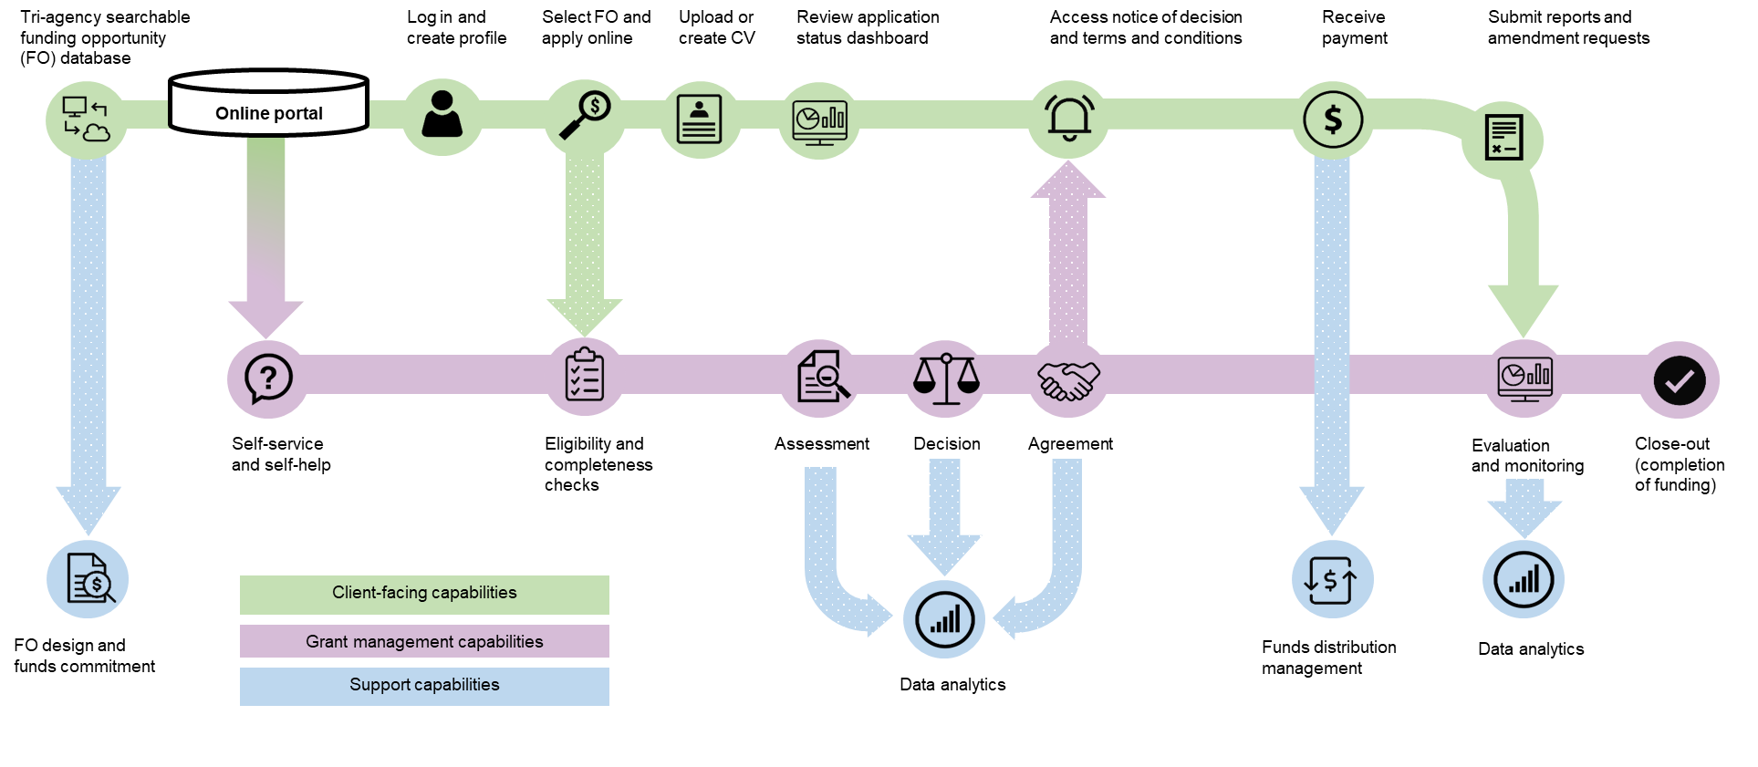
Business Capabilities Map
Notes:
Focus on the description of the client-facing capabilities (applicants, research administrators, reviewers):
Search for funding opportunities
Complete and submit applications and CVs
Review and approval of application by institutions
Assessment of applications
Access to decisions
Receive payment
Submission of amendments, financial report, end of grant reports
Support capabilities: self-service/help, status dashboards, data analytics
The agencies aspire to select a grants management solution that will enable them to offer capabilities to the research community and agency staff . Through ongoing industry and stakeholder engagement, the TGMS team is acquiring knowledge to guide the agencies in the selection of a solution that will best align with this vision.

Slide 7
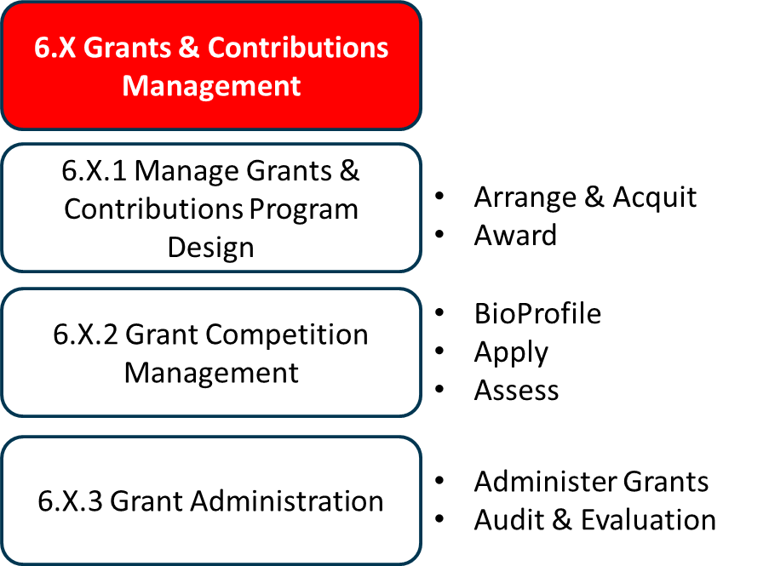
Business Capabilities Addressed
Business Capabilities | List the Business capabilities addressed
1. Legislation, Regulation and Policy Management | 1.1 Policy Management
2. Enterprise Planning | 2.1 Financial Planning 2.3 Program and Service Planning
3. Outcomes Management | 3.2 Performance Management 3.3 Reporting Framework Management
4. Relationship Management | 4.1 Stakeholder Awareness Management 4.2 Stakeholder Information Management 4.3 Stakeholder Interaction Management
5. Compliance Management | 5.1 Compliance and Investigation Management
6. Program and Service Delivery | 6.1 Agreements Management 6.8 Payment Management 6.X Grants and Contributions Management (NEW)
7. Information Management | 7.1 Information Lifecycle Management 7.2 Registry Management 7.3 Research and Knowledge Management
8. Government Resources Management | 8.2 Financial Management 8.6 Work Management
9. Corporate Management | 9.2 Communications Management 9.6 Audit Management
Notes:
The bulk of the new capabilities are related to the client facing and grants management capabilities from the previous slide.

Slide 8
Current State Architecture – Problem Summary
The current state architecture impacts the Agencies’ mandates to effectively and efficiently deliver grants management services on behalf of the Government of Canada.
Business
Current systems are unresponsive to rapidly changing business needs and do not support all of the required business capabilities and provide a poor user experience.
Information
Inconsistent data architecture impedes data sharing and data analysis. This siloed approach makes it difficult to conduct analysis of funded research and to understand the impact it has on the lives of Canadians.
Application
Presently, the Agencies support the grants management life cycle over 10 application portal sites and 18 databases very few of which are integrated.
Technology
These legacy systems are hosted at on premise data centers, built on outdated technology, some over 20 years old that is complex, at end of life, and no longer supported by the software companies.
Security
In addition to security concerns with using unsupported technology, current grants management systems do not use Government of Canada trusted digital identity solutions.

Slide 9

Current State Architecture Diagram
Client Facing Portals
Internal Agency Administrator
Internal Agency Analyst
Researcher
Research Administrator
Peer Reviewer
Grant Management Systems
Financial Systems
NSERC Online
(SAP ASE 16, PowerBuilder, JSP)
SSHRC Online
(SAP ASE 16, PowerBuilder, Java, JSP)
Convergence
(MS Dynamics 365)
RP1 Portal
(.NET)
CRIS
(Oracle PL/SQL)
Reporting Systems
Users
ResearchNet
(J2EE)
ResearchNet Reviewer Portal
(ADX + .NET)
CCV
(J2EE)
Reviewer Extranet (SharePoint)
FDD
(J2EE, SOLR)
Internal Agency Administrator
Internal Agency Analyst
Internal Agency Administrator
EIS
(Oracle Forms/ Reports)
CRM
(MS Dynamics CRM 2016)
RP1 / Convergence
(MS Dynamics 365)
AMIS
(SAP ASE 16, PowerBuilder)
BI
(SAP Business Objects)
EIS reports
(Oracle Reports)
SSRE
(Oracle Discoverer / Power BI / SSRS)
NAMIS
(SAP ASE 16, PowerBuilder)
Matrix
(MS SQL Server)
InfoNet
(OpenText Content Server)
Enterprise
(OpenText Content Server)
Internal Agency Analyst
R Studio
WBFR
(Oracle Discoverer / Power BI / Excel)
VOXCO
Excel
FDSR
(web-enabled interface)
GSAP
FreeBalance
(Oracle / MS SQL Server)
Internal Agency Administrator
Internal Agency Analyst
Research Administrator

Slide 10
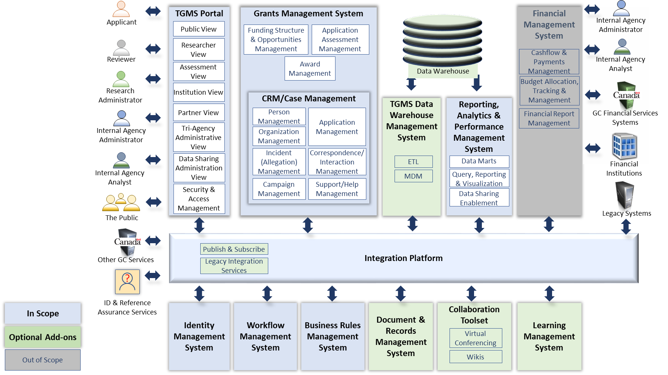
Target State Conceptual Architecture Diagram

Slide 11
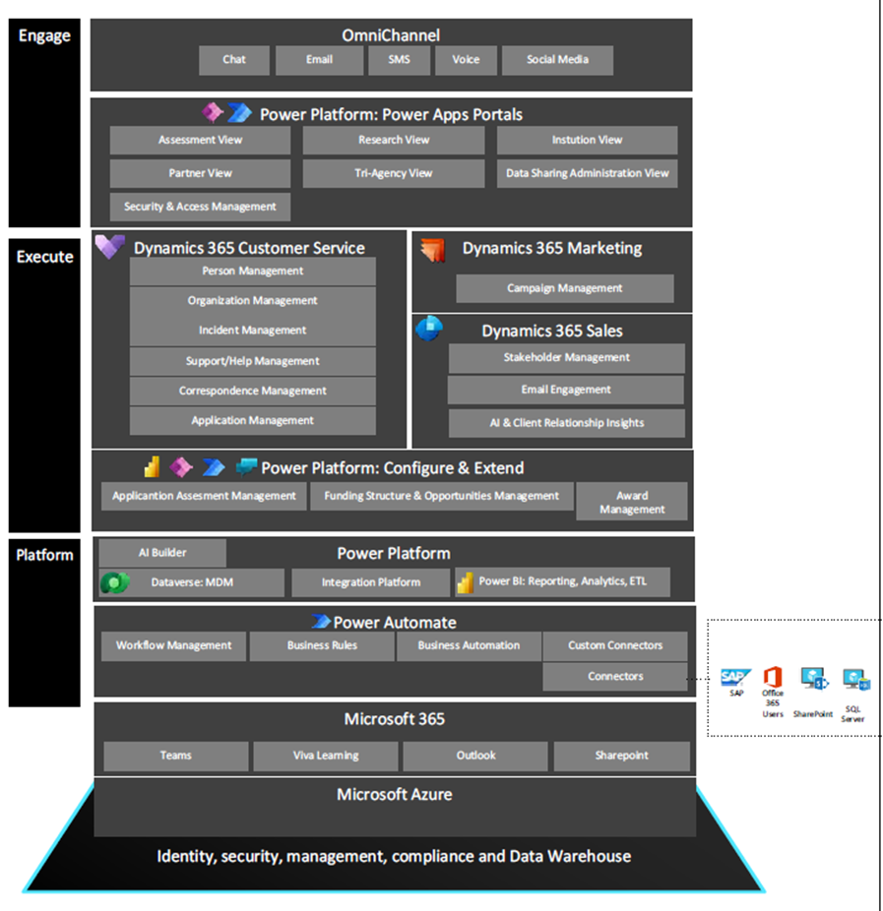
Target State Architecture – Vendor Components

Slide 12
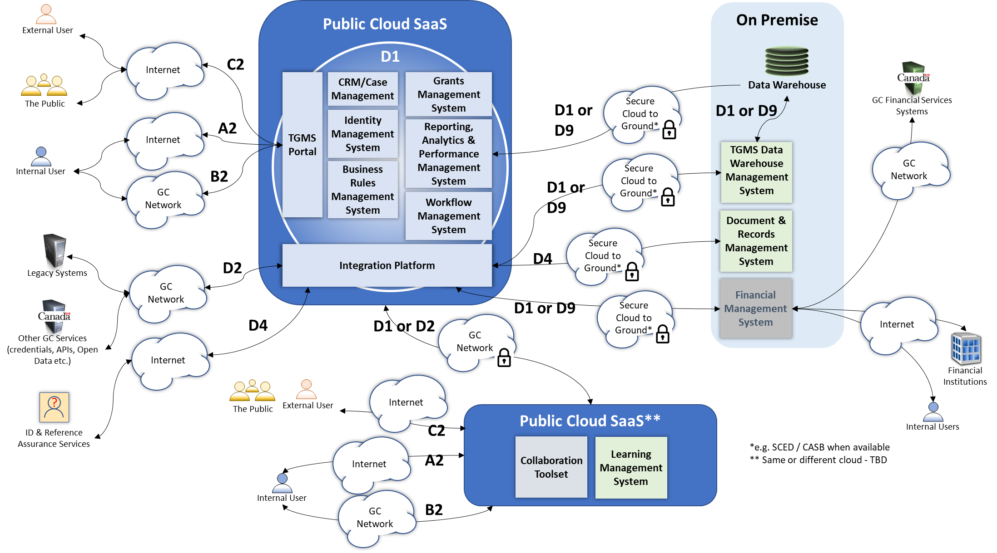
Target State Cloud Access Patterns

Slide 13
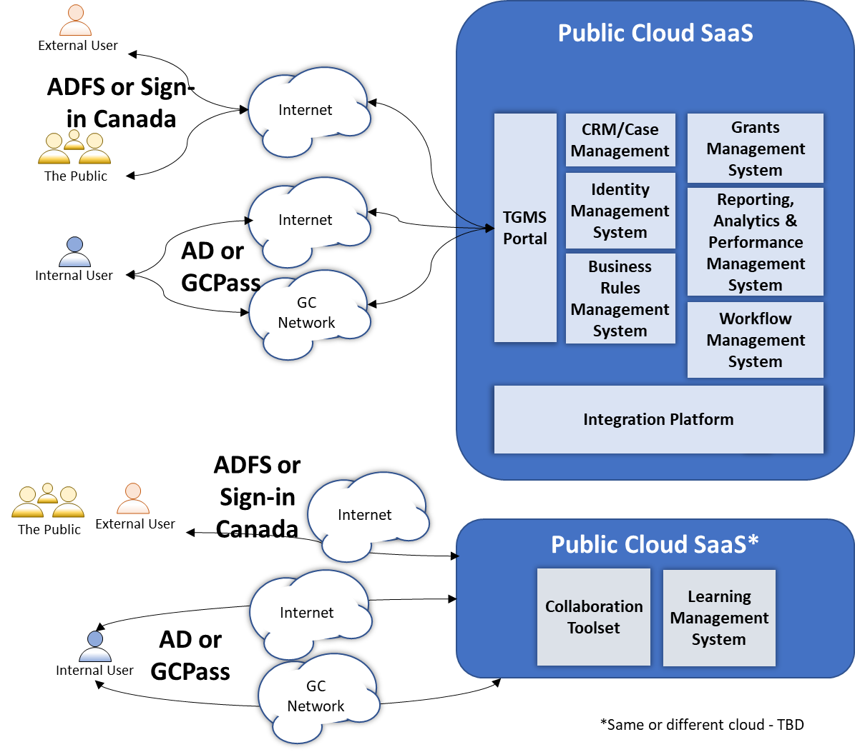
Target State Authentication Patterns

Slide 14
Target State Architecture – Solution Summary
The target state architecture will include a user-centric solution that supports the full grants management lifecycle, providing:
an online and end-to-end solution which provides a single-window platform for all three agencies while respecting privacy;
intuitive and easy to use tools integrated within the platform;
simplified, harmonized, streamlined and automated processes;
a modern look/feel that meets the standards of excellence expected by researchers, institutional administrators and Agency staff;
a more efficient, interoperable, accessible, secure and usable solution capable of supporting the requirements of the Policy on Service and Digital

Slide 15
Target State Architecture – Solution Summary - continued
The target state architecture is presented using the layers of the EA Framework:
Business
The target state business architecture will support simplified, harmonized, streamlined and automated processes for the end-to-end grants management lifecycle, from program design, application intake, CV management, assessment, awarding, award monitoring, reporting, post-award management and financial management. Service design and delivery will be client-centric by design in alignment with the Policy on Service and Digital.
Information
The target data architecture will allow more reliable, accurate and timely data sharing and data analysis as well as improved data management and reporting. It will be supported through data warehouse, reporting and analytics tools integrated with the grants management platform.
Application
Microsoft Power Platform was selected as the base platform for the solution and procured as a public cloud service (SaaS) through the Cloud Brokering Service following the GC Cloud Strategy. An integration platform will enable integration with the data warehouse management system, reporting, analytics & performance management system, financial management system, document & records management system and legacy applications (during the transition period).

Slide 16
Target State Architecture – Solution Summary - continued
Technology
The solution is based on the Microsoft Power Platform as a public cloud service procured through SSC’s Cloud Brokering Service (CBS). The nature of the service provides for resiliency, and elasticity. Service level agreements will be defined to ensure that response times meet user needs for availability even during peak periods. Since the solution is a service, the technology layer will be managed by the vendor.
Security
The statement of sensitivity classified the information needs as Protected B, Medium Integrity, Medium Availability. The base platform is being procured through the CBS and has been certified for PBMM use. As part of the SA&A process, TGMS will implement all required GC Cloud Guardrails and Baseline controls for SaaS Solutions for PBMM solutions.
Government of Canada trusted digital identity solutions will be used for authentication.
Data at rest will be encrypted via the Cloud Services Provider. Data in transit will be encrypted via SSL.

Slide 17
Environmental Scan and Analysis
GMS Consultations
Canada Council for the Arts
Global Affairs Canada (GAC)
Heritage Canada
NRCan
Innovation, Science and Economic Development Canada (ISED)
International Development Research Centre (IRDC)
Cloud Consultations
Public Services and Procurement Canada (PSPC)
Shared Services Canada
Office of the Privacy Commissioner of Canada (OPC)
Canadian Digital Service
Office of the Comptroller General (OCG)
EA Consultations
EA CoP
OCIO
OCG - Enterprise Grants & Contributions System (EGCS) Information Model
GC Solutions Considered
GC Case

Slide 18
GC EA Summary
 Endorsement  Information | PCRA: 1 OPMCA: 2 | One time: $52.4M On going: $ 6M | Overall:
Type of Cloud |  SaaS |  PaaS |  IaaS |  Not Applicable
Data Classification |  Unclassified |  Protected A |  Protected B |  Other
Summary of Proposal
Tri-Agency Grant & Management Solution requested GC EARB endorsement on conceptual Target State Architecture as an update to the previous endorsed request from Nov 14, 2019. The previous conditions were to return to GC EARB to provide a target state architecture once confirmed. In the process, Tri-Agencies achieved more, including harmonization of their business processes, definition of a common conceptual data model and development of an information sharing strategy. Data governance will be established.
Business | Extensive research, co-design & testing with users were conducted to understand the needs of users & stakeholders. An outcomes model is developed and mapped to the business services and business capabilities. Business process harmonization for all three agencies created a more cohesive user experience.
Information | Extensive consultations with stakeholders helps define a common conceptual data model for TGMS. Data governance will be established with clear roles, responsibilities and accountabilities. An information sharing strategy has been developed and reviewed by Justice Canada.
Application | A SaaS is being sought based on a CBS qualified cloud service provider configured by a professional services provider with a grants management accelerator using a highly configurable platform. TGMS will be deployed as a set of cohesive and loosely coupled solutions. Services will be exposed through APIs.
Technology | TGMS will be procuring its cloud services through the SSC CBS in public cloud
Security | TGMS will conduct application vulnerability assessments on a periodic basis to assess new security needs and evolving threats/vulnerabilities
GC EA Recommendation
Recommend endorsing the request & recommend the agencies to work with OCG to develop a Reference Architecture for G&C.
Proposed Conditions
N/A
Architectural Alignment:
TBS Assessor: Gita Nurlaila
Fully
Partially
Not

Slide 19
ANNEX, reference material, not for presentation
Appendix 1
GC Digital Standards
Required for GC EA Assessment
NOT to be part of Presentation
Appendix 2
GC EA Framework
Required for GC EA Assessment
NOT to be part of Presentation
Appendix 3
Service & Digital Target
Enterprise Architecture
Reference Material
NOT to be part of Presentation
Appendix 4
Additional Project Details
Required for GC EA Assessment
NOT to be part of Presentation
Appendix 5
Option Analysis
Required for GC EA Assessment
NOT to be part of Presentation
Appendix 6
Enterprise Solution Assessment
Required for GC EA Assessment
NOT to be part of Presentation
Appendix 7
SSC Involvement
Complete as required
NOT to be part of Presentation
Appendix 8
List of Acronyms
Complete as required
NOT to be part of Presentation

Slide 20

Appendix 1:
GC Digital Standards Alignment
https://www.canada.ca/en/government/system/digital-government/government-canada-digital-standards.html
 | ◆ | Design with users Research with users to understand their needs and the problems we want to solve. Conduct ongoing testing with users to guide design and development.
 | ❖ | Iterate and improve frequently Develop services using agile, iterative and user-centred methods. Continuously improve in response to user needs. Try new things, start small and scale up.
 | ⬥ | Work in the open by default Share evidence, research and decision making openly. Make all non-sensitive data, information, and new code developed in delivery of services open to the outside world for sharing and reuse under an open license.
 |  | Use open standards and solutions Leverage open standards and embrace leading practices, including the use of open source software where appropriate. Design for services and platforms that are seamless for Canadians to use no matter what device or channel they are using.
 |  | Address security and privacy risks Take a balanced approach to managing risk by implementing appropriate privacy and security measures. Make security measures frictionless so that they do not place a burden on users.
 |  | Build in accessibility from the start Services should meet or exceed accessibility standards. Users with distinct needs should be engaged from the outset to ensure what is delivered will work for everyone.
 |  | Empower staff to deliver better services Make sure that staff have access to the tools, training and technologies they need. Empower the team to make decisions throughout the design, build and operation of the service.
 |  | Be good data stewards Collect data from users only once and reuse wherever possible. Ensure that data is collected and held in a secure way so that it can easily be reused by others to provide services.
 |  | Design ethical services Make sure that everyone receives fair treatment. Comply with ethical guidelines in the design and use of systems which automate decision making (such as the use of artificial intelligence).
 |  | Collaborate widely Create multidisciplinary teams with the range of skills needed to deliver a common goal. Share and collaborate in the open. Identify and create partnerships which help deliver value to users.
Architectural Alignment:
Fully
Partially
Not

Slide 21
Appendix 2: GC EA Framework
Business Architecture
Business architecture is a critical aspect for the successful implementation of the GC Enterprise Ecosystem Target Architecture. The architectural strategy advocates whole of government approach where IT is aligned to business services and solutions are based on re useable components implementing business capabilities in order to deliver a cohesive user experience. As such, it is essential that business services, stakeholder needs, opportunities to improve cohesion and opportunities for reuse across government be clearly understood. In the past these elements have not been a priority. It is expected that the IT culture and practices will have to change to make business architecture, in general, and these elements a primary focus.
Design services digitally from end to end to meet the Government of Canada users and other stakeholders’ needs | HOW will this be achieved?
Clearly identify internal and external users and other stakeholders and their needs for each policy, program and business service | TGMS has adopted client experience (CX) and user experience (UX) approaches to documenting business requirements with agencies employees and users from the research community and has conducted research, co-design and testing activities with users throughout the Discovery phase and will continue in the implementation phase. Artefacts include personas, journey maps (current/future state), usability testing, etc…
Include policy requirement applying to specific users and other stakeholder groups, such as accessibility, gender-based plus analysis, and official languages in the creation of the service | The TGMS CX/UX strategy for implementation follows the Canadian Digital Services Standard (CDS) guidelines to create accessible and inclusive services for everyone.
Perform Algorithmic Impact Assessment (AIA) to support risk mitigation activities when deploying an automated decision system as per Directive on Automated Decision-Making | No current plans for automated decision making, however an AIA will be performed if this is identified as a new requirement.
Model end to end business service delivery to provide quality, maximize effectiveness and optimize efficiencies across all channels (for example, lean process) | The business architecture includes a model for the TGMS business services to be delivered and is aligned with the TGMS business capabilities model, desired outcomes and future state journey maps of six personas.

Slide 22
Appendix 2: GC EA Framework
Business Architecture - continued
Architect to be outcome driven and strategically aligned to the department and to the Government of Canada | HOW will this be achieved?
Identify which departmental/GC business services, outcomes and strategies will be addressed | An outcomes model has been developed and mapped to the business services and business capabilities. An outcomes management plan has been developed that outlines the targeted GC business services, outcomes and strategies for TGMS.
Establish metrics for identified business outcomes throughout the life cycle of an investment | The outcomes register includes key performance indicators (KPIs) that will be used to track if the outcomes are being achieved throughout the life cycle of the grants managements solution.
Translate business outcomes and strategy into business capability implications in the GC Business Capability Model to establish a common vocabulary between business, development, and operation | Business outcomes have been mapped to the TGMS Business Capability Model. The TGMS Business Capability Model has been mapped to the GC Business Capability Model
Promote horizontal enablement of the enterprise | HOW will this be achieved?
Identify opportunities to enable business services horizontally across the GC enterprise and to provide cohesive experience to users and other stakeholders | By implementing a common grants management solution for all three agencies and through business process harmonization, a more cohesive user experience is expected to be achieved.
Reuse common business capabilities, processes and enterprise solutions from across government and private sector | The solution architecture will leverage existing services and tools wherever practical such SaaS services offered through the Cloud Brokering Service.
Publish in the open all reusable common business capabilities, processes and enterprise solutions for others to develop and leverage cohesive horizontal enterprise services | TGMS will continue to collaborate with OCG to evolve the Grants and Contributions Common Information Model and a common model for research and talent management programs. TGMS will share any reusable business capabilities, processes and solutions it can with the Grants and Contributions Modernization Interdepartmental Sharing Forum and GC EA CoP.

Slide 23
Appendix 2: GC EA Framework
Information Architecture
Information architecture includes both structured and unstructured data. The best practices and principles aim to support the needs of a business service and business capability orientation. To facilitate effective sharing of data and information across government, information architectures should be designed to reflect a consistent approach to data, such as the adoption of federal and international standards. Information architecture should also reflect responsible data management, information management and governance practices, including the source, quality, interoperability, and associated legal and policy obligations related to the data assets. Information architectures should also distinguish between personal and non personal data and information as the collection, use, sharing (disclosure), and management of personal information must respect the requirements of the Privacy Act and its related policies.
Collect data to address the needs of the users and other stakeholders | HOW will this be achieved?
Assess data requirements based program objectives, as well users, business and stakeholder needs | Extensive consultations held with internal and external stakeholders to define a common conceptual data model for TGMS to support needs and achieve expected outcomes
Collect only the minimum set of data needed to support a policy, program, or service | Only the minimum data required to support the programs will be collected as defined by the TGMS Conceptual Data Model. A Tri-Agency Information sharing agreement will be developed prior to implementation to define what information can be shared between the agencies. A PIA will assess the data to be collected.
Reuse existing data assets where permissible and only acquire new data if required | TGMS will reuse existing data assets where permissible. An information sharing agreement between the three agencies will facilitate reuse.
Ensure data collected, including from third-party sources, are of high quality | Data standards will be defined and applied to data collected or migrated. Information sharing agreements will include clauses on data quality.

Slide 24
Appendix 2: GC EA Framework
Information Architecture – continued 1
Manage and reuse data strategically and responsibly | HOW will this be achieved?
Define and establish clear roles, responsibilities, and accountabilities for data management | Tri-agency data governance will be established with clear roles, responsibilities and accountabilities for data management
Identify and document the lineage of data assets | The lineage of data assets is embedded in the SaaS
Define retention and disposition schedules in accordance with business value as well as applicable privacy and security policy and legislation | Data retention and disposition schedules will be developed in accordance with policy and legislation.
Ensure data are managed to enable interoperability, reuse and sharing to the greatest extent possible within and across departments in government to avoid duplication and maximize utility, while respecting security and privacy requirements | Data will be managed to enable and support interoperability, reuse, and sharing across departments. Governance bodies and Committees will be organized to ensure security and privacy across the system and maximize re-use of information.
Contribute to and align with enterprise and international data taxonomy and classification structures to manage, store, search and retrieve data | A common conceptual data model has been developed for the three agencies, aligned with the Enterprise Grants and Contributions Common Information Model and shared with OCG. This model will form the base for discussions with implementation vendors. The agencies have already developed a Common Research Development Classification (CRDC) scheme and published this with Statistics Canada.
Use and share data openly in an ethical and secure manner | HOW will this be achieved?
Share data openly by default as per the Directive on Open Government and Digital Standards, while respecting security and privacy requirements; data shared should adhere to existing enterprise and international standards, including on data quality and ethics | An information sharing strategy has been developed and reviewed by Justice Canada and provides guidance on methods for sharing data while respecting security and privacy such as data aggregation and depersonalization.
Ensure data formatting aligns to existing enterprise and international standards on interoperability; where none exist, develop data standards in the open with key subject matter experts | Existing data standards will be adopted where possible such as NAICS codes. The tri-agencies have also worked to developed new standards such as the CRDC.
Ensure that combined data does not risk identification or re identification of sensitive or personal information | Protocols for small data sets will be adopted to reduce the risk of identification.

Slide 25
Appendix 2: GC EA Framework
Information Architecture – continued 2
Design with privacy in mind for the collection, use and management of personal Information | HOW will this be achieved?
Ensure alignment with guidance from appropriate institutional ATIP Office with respect to interpretation and application of the Privacy Act and related policy instruments | ATIP offices of all three agencies have been engaged to develop an information sharing strategy and will collaborate further in defining an information sharing agreement and conducting a PIA prior to implementation.
Assess initiatives to determine if personal information will be collected, used, disclosed, retained, shared, and disposed | The conceptual data model will be used as a basis to document what information will be collected, how it is used, retention and disposition periods and rules for sharing.
Only collect personal information if it directly relates to the operation of the programs or activities | Only required personal information will be collected.
Notify individuals of the purpose for collection at the point of collection by including a privacy notice | Privacy notices will be used to inform individuals of the consistent uses of data on each of the agencies websites.
Personal information should be, wherever possible, collected directly from individuals but can be from other sources where permitted by the Privacy Act | Personal information will be collected from individuals where possible, but in some cases may be collected from other sources. The Privacy Act will be used to guide all information collection
Personal information must be available to facilitate Canadians’ right of access to and correction of government records | Users of the solution will be empowered to manage the accuracy of their personal data or data that they self report.
Design access controls into all processes and across all architectural layers from the earliest stages of design to limit the use and disclosure of personal information | Non-functional requirements have been documented to allow for fine grained control over the access to information. Privacy by design principles will be followed to limit the use and disclosure of personal information.
Design processes so personal information remains accurate, up-to-date and as complete as possible, and can be corrected if required | Processes will be designed to ensure that personal information remains accurate.
De-identification techniques should be considered prior to sharing personal information | The TGMS Information Sharing Strategy lists de-identification or aggregation as a potential method to consider to safely share personal information.
In collaboration with appropriate institutional ATIP Office, determine if a Privacy Impact Assessment (PIA) is required to identify and mitigate privacy risks for new or substantially modified programs that impact the privacy of individuals | ATIP offices of all three agencies have been engaged and will conduct a combined PIA.
Establish procedures to identify and address privacy breaches so they can be reported quickly and responded to efficiently to appropriate institutional ATIP Office | Procedures and privacy management frameworks will be established to identify and address privacy breaches to the appropriate ATIP office.

Slide 26
Appendix 2: GC EA Framework
Application Architecture
Application architecture practices must evolve significantly for the successful implementation of the GC Enterprise Ecosystem Target Architecture. Transitioning from legacy systems based on monolithic architectures to architectures that oriented around business services and based on re useable components implementing business capabilities, is a major shift. Interoperability becomes a key element, and the number of stakeholders that must be considered increases.
Use open source solutions hosted in public cloud | HOW will this be achieved?
Select existing solutions that can be reused over custom built | A SaaS is being sought based on a CBS qualified cloud service provider configured by a professional services provider with a grants management accelerator. The Enterprise Grants and Contributions Solution (EGCS) will be leveraged where appropriate and extended as needed.
Contribute all improvements back to the communities | TGMS will share what it can and what is useful with the communities
Register open source software to the Open Resource Exchange | If open source software is to be used, it will be registered
Use software as a service (SaaS) hosted in public cloud | HOW will this be achieved?
Choose SaaS that best fit for purpose based on alignment with SaaS capabilities | The selected solution is SaaS on public cloud at the protected B level.
Choose a SaaS solution that is extendable | Extensibility will be sought and evaluated
Configure SaaS and if customization is necessary extend as open source modules | The platform is highly configurable. Use of customization will be minimized but extended as open source where possible and useful
Design for Interoperability | HOW will this be achieved?
Design systems as highly modular and loosely coupled services | To the extent permitted by the SaaS, TGMS will be deployed as a set of cohesive and loosely coupled solutions
Expose services, including existing ones, through APIs | Where possible through the SaaS, services will be exposed through APIs
Make the APIs discoverable to the appropriate stakeholders | APIs will be made discoverable to appropriate stakeholders

Slide 27
Appendix 2: GC EA Framework
Technology Architecture
Technology architecture is an important enabler of highly available and adaptable solutions that must be aligned with the chosen application architecture. Cloud adoption provides many potential advantages by mitigating the logistical constraints that often negatively impacted legacy solutions hosted “on premises.” However, the application architecture must be able to enable these advantages.
Use cloud first | HOW will this be achieved?
Adopt the use of the GC Accelerators to ensure proper security and access controls | Government of Canada trusted digital identity solutions will be used
Enforce this order of preference: software as a service (SaaS) first, then platform as a service (PaaS), and lastly infrastructure as a service (IaaS) | A SaaS is being procured
Fulfill cloud services through SSC Cloud Brokering Services | TGMS will be procuring its cloud services through the SSC CBS
Enforce this order of preference: public cloud first, then hybrid cloud, then private cloud, and lastly non cloud (on-premises) solutions | The solution will be in the public cloud
Design for cloud mobility and develop an exit strategy to avoid vendor lock-in | With SaaS there's limited portability from one cloud service provider to another, but the TGMS implementation approach will be set-up to minimize long-term lock-in to a Systems Integrator. An exit strategy will be developed.

Slide 28
Appendix 2: GC EA Framework
Technology Architecture - continued
Design for performance, availability and scalability | HOW will this be achieved?
Ensure response times meet user needs, and critical services are highly available | Service level objectives will be defined and will inform service level agreements.
Support zero-downtime deployments for planned and unplanned maintenance | Evaluation criteria will be defined to favor this technical capability. If the selected solution does not support this, SLAs will be established to define acceptable maintenance windows.
Use distributed architectures, assume failure will happen, handle errors gracefully, and monitor performance and behaviour actively | Evaluation criteria will be defined to favor distributed architectures.
Establish architectures that supports new technology insertion with minimal disruption to existing programs and services | Not applicable to a SaaS solution
Control technical diversity; design systems based on modern technologies and platforms already in use | Not applicable to a SaaS solution
Follow DevSecOps principles | HOW will this be achieved?
Use continuous integration and continuous deployments | IT operations, security teams and application developers shall continue the process to integrate security into DevOps pipeline, making security a core component of the software development cycle.
Ensure automated testing occurs for security and functionality | A test-driven development environment will be employed and where applicable, automated testing and continuous integration shall form part of the development cycle.
Include your users and other stakeholders as part of the DevSecOps process, which refers to the concept of making software security a core part of the overall software delivery process | Security testing shall be performed in iterations maximize delivery cycles. Critical security issues are dealt with as they become apparent within each Agile Sprint.

Slide 29
Appendix 2: GC EA Framework
Security Architecture
The GC Enterprise Security Architecture program is a government wide initiative to provide a standardized approach to developing IT security architecture, ensuring that basic security blocks are implemented across the enterprise as the infrastructure is being renewed.
Build security into the system life cycle across all architectural layers | HOW will this be achieved?
Identify and categorize information based on the degree of injury that could be expected to result from a compromise of its confidentiality, integrity and availability | Statement of Sensitivity conducted in TGMS Discovery phase categorized the projected solution “high water mark” as PBMM, with degrees of injury specified in the assessment.
Implement a continuous security approach, in alignment with Centre for Cyber Security’s IT Security Risk Management Framework; perform threat modelling to minimize the attack surface by limiting services | As part of the SA&A process, TGMS will implement all required GC Cloud Guardrails and Baseline controls for SaaS Solutions for PBMM solutions prior to system implementation. TGMS will conduct application vulnerability assessments on a periodic basis to assess new security needs and evolving threats/vulnerabilities
Apply proportionate security measures that address business and user needs while adequately protecting data at rest and data in transit | Approved cryptographic algorithms and appropriate methods will be used as for data at rest and in transit using ITSG-33 guidance as part of the SA&A process.
Design systems to be resilient and available in order to support service continuity | Service Level Agreements will be established to meet availability targets for a PBMM solution both for the platform and for the systems integrator supporting the platform.

Slide 30
Appendix 2: GC EA Framework
Security Architecture - continued
Ensure secure access to systems and services | HOW will this be achieved?
Identify and authenticate individuals, processes or devices to an appropriate level of assurance, based on clearly defined roles, before granting access to information and services; leverage enterprise services such as Government of Canada trusted digital identity solutions that are supported by the Pan-Canadian Trust Framework | Vendors selection process includes requirements to leverage GC digital identity solutions.
Constrain service interfaces to authorized entities (users and devices), with clearly defined roles; segment and separate information based on sensitivity of information, in alignment with ITSG-22 and ITSG-38. Management interfaces may require increased levels of protection | Role based access permissions to be implemented. Segregation will be permission based as opposed to physical segregation to allow for information sharing where/when possible.
Implement HTTPS for secure web connections and Domain-based Message Authentication, Reporting and Conformance (DMARC) for enhanced email security | HTTPS is standard baseline for all web connections. Email security controls will be assessed if/when email processes are required for TGMS, but will leverage DMARC where feasible.
Establish secure interconnections between systems through secure APIs or leveraging centrally managed hybrid IT connectivity services | Interconnections between systems expected to be largely secure API based, but will need further confirmation during transition where integration points may exist between legacy and TGMS resources. Interconnections will leverage encryption in transit, regardless of protocol.

Slide 31
Appendix 2: GC EA Framework
Security Architecture - continued
Maintain secure operations | HOW will this be achieved?
Establish processes to maintain visibility of assets and ensure the prompt application of security related patches and updates in order to reduce exposure to vulnerabilities, in accordance with GC Patch Management Guidance | Patch management will largely be handled by Vendor in SaaS. Agency endpoints will fall under agency patch management procedures.
Enable event logging, in accordance with GC Event Logging Guidance, and perform monitoring of systems and services in order to detect, prevent, and respond to attacks | Logging will be enabled at the level possible within the SaaS to monitor for attacks. Vendor will be contractually obligated to monitor system and service performance and potential cyber attacks.
Establish an incident management plan in alignment with the GC Cyber Security Event Management Plan (GC CSEMP) and report incidents to the Canadian Centre for Cyber Security (CCCS) | An incident management plan will be created in alignment with GC CSEMP and incidents will be reported to CCCS.

Slide 32
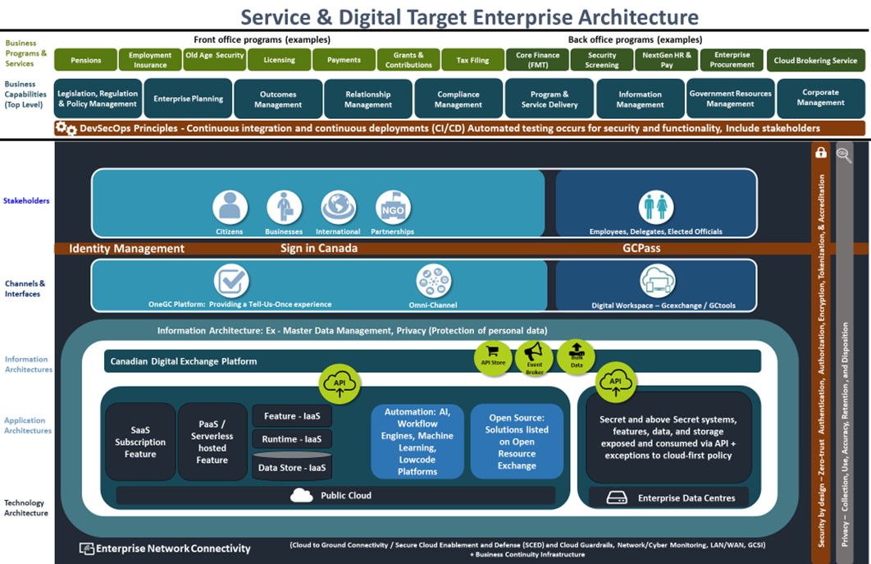
Appendix 3:
Service & Digital Target Enterprise Architecture
The Service & Digital Target Enterprise Architecture defines a model for the digital enablement of Government of Canada services that addresses many of the key challenges with the current GC enterprise ecosystem.
1
It seeks to reduce the silos within the current GC ecosystem by having departments adopt a perspective centred on users and service delivery when considering new IT solutions or modernizing older solutions.
2
It advocates a whole-of-government approach where IT is aligned to business services and solutions are based on re-useable components implementing business capabilities optimized to reduce unnecessary redundancy. This re-use is enabled through the use of published APIs shared across government..
3
It will be realized through new digital investments that are assessed against the criteria of the revised GC Enterprise Architecture Framework (BIATS) reflecting the detailed elements of the target architecture. This approach allows GC to focus on improving its service delivery to Canadians while addressing the challenges with legacy systems.
The Service & Digital Target Enterprise Architecture and Whitepaper were endorsed by the GC EARB on December 3rd, 2020.

Slide 33
Appendix 4:
Additional Project Details
Request Summary Information
TBS Project/Activity ID (from IT PLAN)
Concept Case (ENDORSED ?) | YES X DATE: Nov 15, 2019 | NO    REASON:
Timeline | Planned Start Date: 12 – 2022 | Planned End Date: 03 - 2026
Cost Summary | One Time project cost: $ 52.4M (indicative) | On-going (annual) costs: $6M/yr (indicative)
Funding Source | A-Base X B-Base  | Other: TBD
Current Gate | Gate 2 – Approve preferred option and approach
On schedule? | YES X NO    | IF not… why not?
(TB Sub)
Departmental Architecture
Do you have a Departmental Architecture Review Board (ARB)? | YES X NO 
Who is the Chief Architect? | Name Dan Chow Email / Phone # dan.chow@cihr-irsc.gc.ca
When did the Departmental EA and Architecture Review Board sanctioned the preferred Solution Architecture option? | Date: CIHR – 2022/01/25 NSERC/SSHRC -2022/02/09
Name of Business owner: Adrian Mota, TGMS Chief Executive, AVP Research Programs - CIHR
Name of Technical owner: Norman Marcotte, TGMS DG - NSERC

Slide 34
Appendix 5:
Options Analysis
A competitive process was conducted through SSC’s Cloud Brokering Service vehicle.
Multiple responses were received and Microsoft was selected as the winning bidder.

Slide 35
Appendix 6:
Assessment against the Enterprise Solution(s)
Is the endorsed enterprise solution sufficient?
Select the applicable impact level for each of the assessment criteria below and describe your rationale for choosing that impact level.
Assessment Criteria | Impact (choose applicable items & provide rationale)
 | Zero Impact | Low Impact | Medium Impact | High Impact
1. Timing Urgency >>How well does the estimated implementation schedule using the endorsed enterprise solution align to required deadlines? | No impact to benefit realization timelines | Minor impact to benefits realization timelines (e.g. 3 to 6 month extension) | Moderate impact to benefits realization timelines. (e.g. 6 to 12 month extension) | Significant impact to benefits realization timelines (e.g. 12+ months)
2. Functional Requirements >>How well does the endorsed enterprise solution support the departmental CIOs requirements? | Requires no workaround to support business requirements | Requires minor manual workarounds to support business requirements | Requires customizations to support business requirements | Requires significant customizations “OR” functional requirements not on the product roadmap
3. Non-functional Requirement (NFR) >> How well does the endorsed enterprise solution meet non-functional requirements including compatibility, maintainability, usability, availability, performance, and/or scalability. | Requires no compromise to NFRs | Requires slight compromise on NFRs. (e.g. response time, availability, etc.) | Requires compromise on NFRs. (e.g. response time, availability, etc.) | Cannot meet critical NFRs.

Slide 36
Appendix 6:
Decision Making Framework for Assessment against the Enterprise Solution(s)
G
A
B
C
D
E
F
End: Endorse use of existing instance
Is there an enterprise solution*?
Is enterprise solution aligned with objectives?
Can an existing instance be used?
Yes
Start: Departmental CIO submits request to TBS EA unit.
Assess option of enterprise solution.*
Evaluate use of an existing instance
Yes
Yes
H
End: Endorse use of new instance
No
No
No
Is there a Pathfinder or reuse opportunity available?
L
I
K
End: Endorse Selection
No
Present options analysis of alternative solutions
N2
Yes
N1
J
Explore Pathfinder/ reuse opportunity
* = endorsed by TBS GC EARB
36

Slide 37
Appendix 7:
Shared Services Canada (SSC) Involvement
SSC Scope
What is the scope of work required by Shared Services Canada? | SSC to provide cloud services via the CBS on a common tenant for TGMS
When/How has SSC been involved in this project? | SSC provided cloud services for the PoC and has been consulted on the planned procurement path.
What SSC Services are to be impacted or consumed? | Cloud and connectivity services for the Microsoft cloud solution implemented on a common tenant for TGMS.
What are the dependencies and assumptions? | TBD
SSC Internal Governance
Presentation title: NSERC/SSHRC/CIHR – Tri-Agency Grants Management Solution (TGMS) | Governance Committees: CIHR ARB 25/01/22 NSERC/SSHRC ARB 09/02/22 GC EARB 24/03/22
SSC Contact
SSC BR number (if available) | BR Number
SSC Client Executive contact | Daniel Boucher
SSC project contact | Name/Title
SSC architecture contact | Noha Beshir, Amina Hussein

Slide 38
Appendix 7:
Summary of Cloud Access Scenarios and Usage Profiles
Use Case | Details
A2 | Agency staff (GC users) access the TGMS Application from within a GC network
B2 | Agency staff (GC users) access the TGMS Application from a remote location (via the Internet)
C2 | Non-GC users such as applicants, researchers, research administrators, reviewers, partner organizations access TGMS
D1 | TGMS services access other cloud-based GC services that reside on the same CSP
D2 | TGMS services access cloud-based GC services that reside on different CSPs (e.g., CRA Business Number, ISED, Receiver General, GC trusted identity services)
D4 | Non-GC services (e.g., ORCID, PubMed) provide information to TGMS
D9 | TGMS cloud services access an on premise services (e.g. data warehouse, financial management systems, legacy systems)
Cloud access scenarios will be reconfirmed post RFP selection

Slide 39
Appendix 7:
Additional Technical Details required by Shared Services Canada (SSC)
Solution’s Security Profile (e.g. PBMM, PBHM, etc.) | PBMM
Maximum Allowable Downtime (Unplanned) / Year (in hours) | 72
Availability Requirements: Med (95%), High (>=99 %) | Med
Disaster Recovery Requirements: (None, Cold Site, Warm Site, Hot Site) | TBD
Authentication Method (DCAM, ICE/ECM, Sign-in Canada, Other) | TBD
Sensitivity to Network Latency: Very High, High, Medium, Low | Med
Workload migrating off legacy? | No
Network Name(s) (e.g. Science Network, GCNet, GCSI, etc.) | GCNet, Internet
Minimum bandwidth needed: | TBD
Expected Network Traffic: (Video, Audio, Data, Interactive) | Data, Interactive
Approximate number of users: | 1,000 internal (800/day) 250,000 external (3,000/day) + 10% /yr
Network Geographical Distribution: (Low, Moderate, Regional, National, Global spread) | Mainly national with small percentage of global users
Hosting Solution(s): (Legacy DC, EDC, Cloud – list all applicable) | Cloud

Slide 40
Appendix 8:
List of Acronyms used in this presentation
Acronym | Definition
NSERC | Natural Sciences and Engineering Research Council
SSHRC | Social Sciences and Humanities Research Council
CIHR | Canadian Institutes of Health Research
TGMS | Tri-agency grants management solution
CCV | Canadian Common CV
SSC | Shared Services Canada
CBS | Cloud Brokering Service
SA&A | Security assessment and authorization
PBMM | Protected B medium integrity medium availability
SaaS | Software as a service
SSL | Secure Sockets Layer
GMS | Grants management system

Slide 41
Appendix 8:
List of Acronyms used in this presentation
Acronym | Definition
EGCS | Enterprise grants and contributions system
OCG | Office of the Comptroller General
SCED | Secure Cloud Enablement and Defence
CASB | Cloud Access Security Broker

