Slide 1
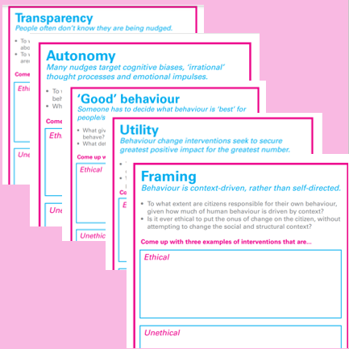
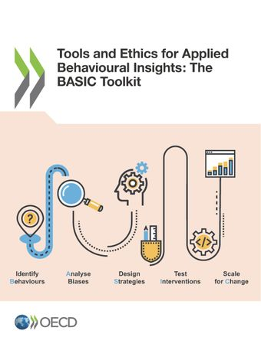
Ethics Frameworks and Toolkits
Fairness: Does the behavioural policy have undesired redistributive effects?
Openness: Is the behavioural policy open or hidden and manipulative?
Respect: Does the policy respect people’s autonomy, dignity, freedom of choice and privacy?
Goals: Does the behavioural policy serve good and legitimate goals?
Opinions: Do people accept the means and the ends of the behavioural policy?
Options: Do better policies exist and are they warranted?
Delegation: Do the policy-makers have the right and the ability to nudge using the power delegated to them?
Transparency,
Autonomy,
‘Good’
Behaviour,
Utility,
Framing
LINK: Behavioral Insights Ethical Dilemmas card deck (Pykett and Johnson 2015)
LINK: Lades and Delaney 2020 Nudge FORGOOD
The United Nations International Children’s Emergency Fund (UNICEF) Ethics Toolkit
3 General Principles:
All Behavioural Insight interventions require ethical evaluation;
Public acceptance is not the same as “ethically permissible”;
Consider consent and awareness
23 considerations in the Organization for Economic Cooperation and Development (OECD) 2019 BASIC Framework (LINK)
LINK: 10 Behavioural Goals and Interventions Questions

